Slide 1
SEARUG Alliance
Oracle Cloud EPM
September 19, 2017
Jason Little
VP BI/EPM
jason.little@sierra-cedar.com
John Behme
EPM Practice Director
john.behme@sierra-cedar.com

Slide 2
Agenda
Sierra-Cedar Overview
Oracle Planning & Budgeting Cloud Service (PBCS) Overview
Structure and data flow
Task lists
Data entry forms
Smart View & Financial Reporting Studio
Other PBCS Notes
Case Study: Chapman University
Case Study: University of Georgia
Successful Implementation Suggestions
Live Demo of PBCS

Slide 3
Sierra-Cedar
Oracle Platinum Partner
HQ Alpharetta, GA
20+ years of experience with Oracle’s ERP, HCM, EPM & BI Solutions (PeopleSoft/EBS/Fusion/Cloud ERP & HCM/Hyperion)
Oracle Cloud Applications and Technologies Consulting including ERP, HCM, EPM, and BI
Industry thought leadership – Cloud EPM and Cloud HCM
1,000+ experienced Oracle consultants with functional and technical knowledge
Over 1,000 customers
We are an Oracle PBCS Customer !

Slide 4
Oracle Planning & Budgeting Cloud Service (PBCS)

Slide 5
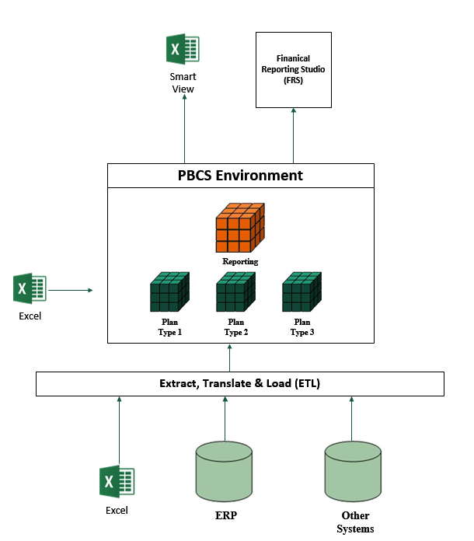
PBCS – Structure and Data Flow
Ability to “slice and dice” through large volumes of data
Standard reporting packages in HTML or PDF format
Reporting Layer:
Powerful Essbase calculation engine
Create multiple rollups of members to facilitate reporting
Design databases unique to your business model
Database Layer:

Slide 6
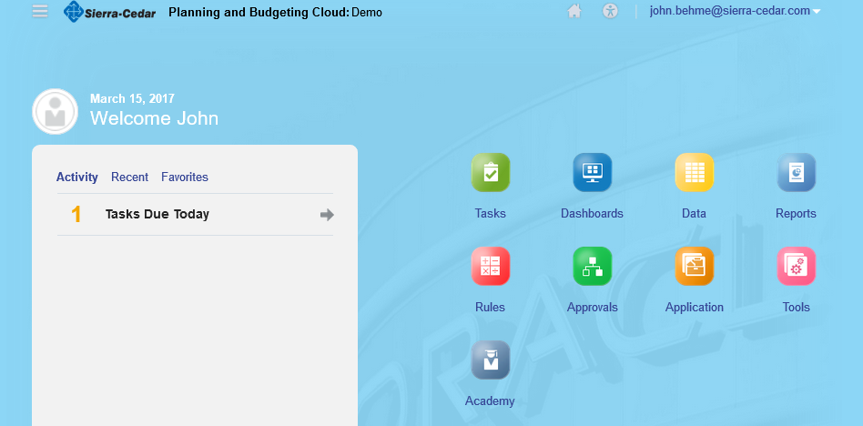
PBCS – Home Page
Clean look and feel with customizable background
Large icons for easy navigation
Announcement box for communication to the user base

Slide 7
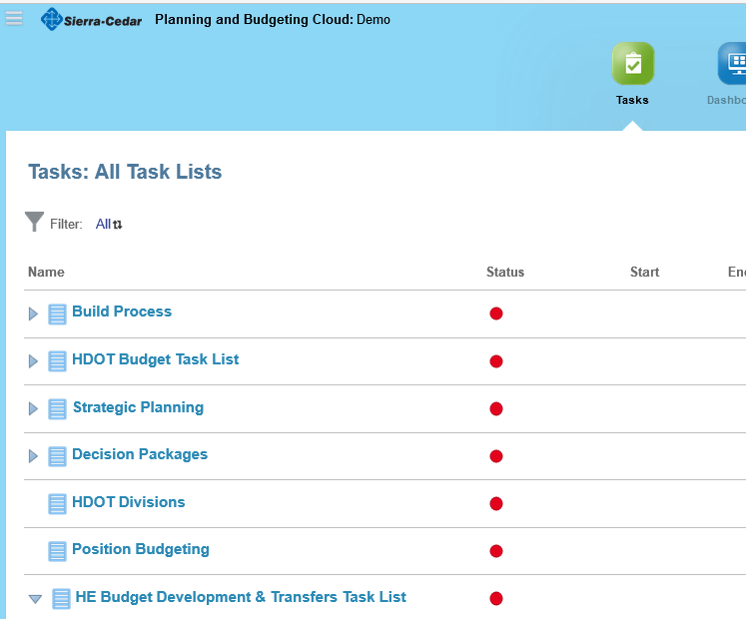
PBCS – Task Lists
Task Lists allow for organization of standard tasks
Easy to follow process for end users
Links to data entry forms, reports, websites, etc.
Configurable to fit your unique business processes

Slide 8
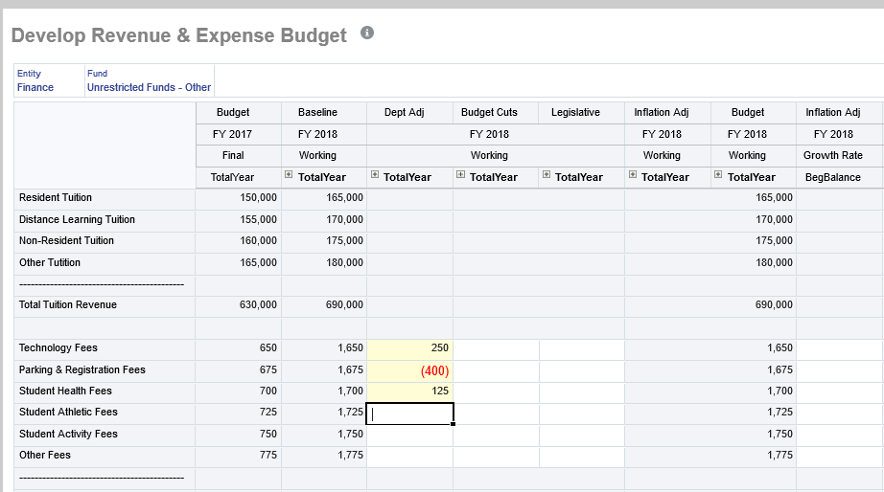
PBCS – Data Entry Forms
Data entry forms have a “look & feel” similar to Excel, and can actually be opened in the Excel Add-in, Smart View (discussed later)
Flexible design allows for users to change form members for various data entry needs

Slide 9
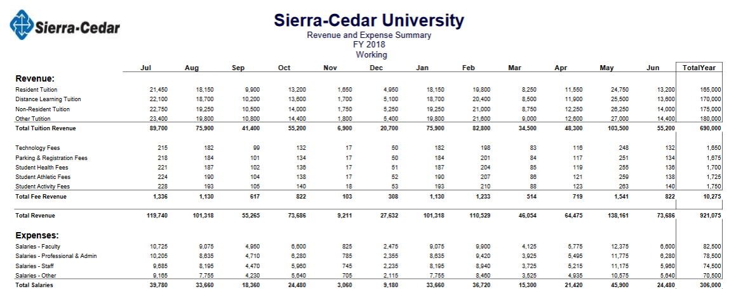
Financial Reporting Studio
Highly formatted reports for standard reporting
HTML and PDF formats
Ability to create reporting books for standard financial packages

Slide 10
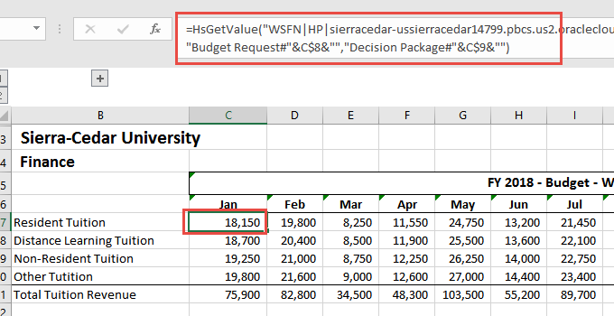
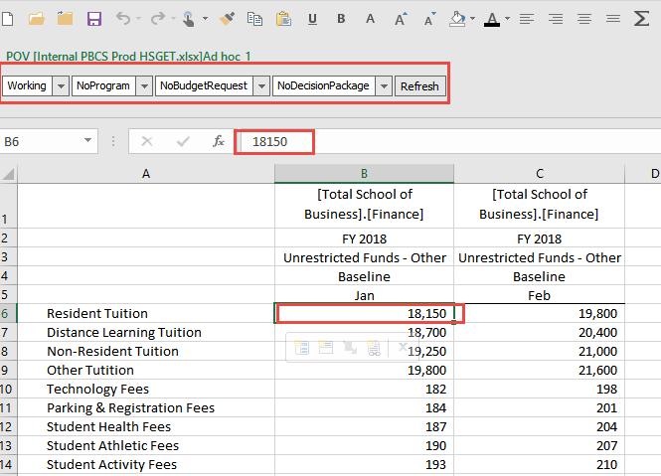
Smart View
Ability to pull data using several methodologies, such as standard functions, or ad hoc retrieval, which allow for “slice and dice” of the data across all dimensions

Slide 11
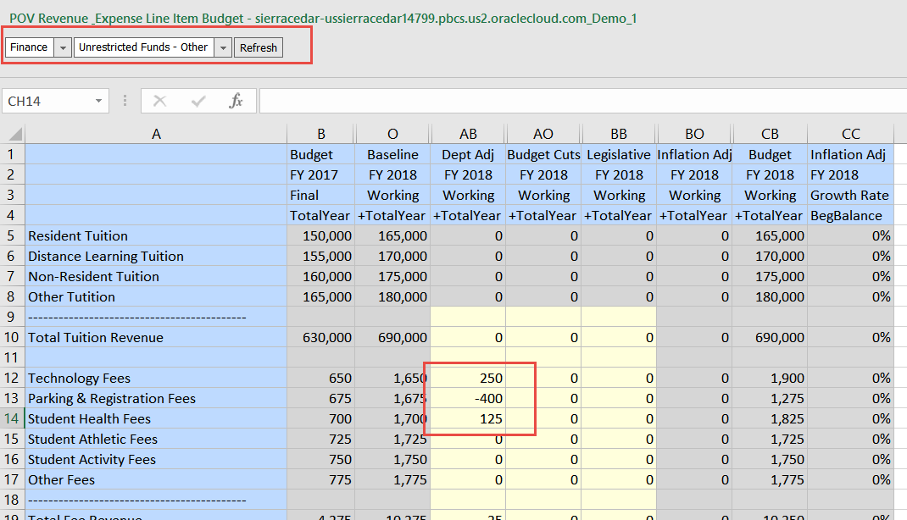
Smart View
Ability to open date entry forms in Excel. This gives the user base the option between the web and Excel.
Smart View is the tool of choice for Finance

Slide 12
Other PBCS Notes
Subscription Based
Cost is per user, per month
No need for on-premise servers, unless required for automation
Upgrades
Automatically handled by Oracle
Eliminates the cost of time-consuming, on-premise upgrade projects
Built-in data mapping tool, “Data Management” (aka FDMEE)
Built-in automation tool, EPM Automate
EPBCS – Enterprise Planning & Budgeting
Pre-built modules for Financials, Workforce, Capital & Projects
Sierra-Cedar offers free, one-week PBCS proof of concept models using your data!
(we also do this for Business Intelligence)

Slide 13
Case Study: Chapman University

Slide 14
Chapman University: Case Study
Current State
Chapman University performs thousands of budget transfers each year using a customized data entry for in PeopleSoft
The process is time consuming and technically complicated
Why Planning & Budgeting Cloud Services (PBCS)?
Chapman was looking for a tool that the Budget Office could own, with minimal need for IT support
Oracle’s cloud environment provided the stability and dependability they were looking for
Chapman required quick turnaround time for data entry, data calculation, as well as data transfer back into (and from) PeopleSoft.
Chapman needed flexibility for data entry form design. Users needed an easy-to-use interface. PBCS provided both a Web and Excel interface, thus allowing users options that fit their needs.

Slide 15
Chapman University: Case Study
Project Scope
Focus was on the Operating Fund as this is where the majority of budget transfers occur
Budget data needed to be pulled from PeopleSoft, loaded into PBCS, modified in PBCS and then loaded back into PeopleSoft. This process was to occur every two hours, or on demand by the Budget Office
Transfers would occur by program, account and Journal Class, or reason code. Transfers could also be across months. Each user’s data entry needed to be stored as unique, and identified as belonging to that user when transferred back into PeopleSoft

Slide 16
Chapman University: Case Study
Sierra-Cedar’s Solution
Sierra-Cedar configured budget extracts from PeopleSoft for loading into PBCS
Sierra-Cedar configured a post-transfer process from PBCS, containing the unique user data identification, which was posted back to PeopleSoft via a journal entry. PeopleSoft chartfield security was used for posting confirmation. PBCS also contained security so that users could only enter data into approved chartfields.
Versions were used in PBCS for approval. Only certain authorized employees could approve transfers in PBCS. If data was not approved, it would not be posted into PeopleSoft until corrections were made.
Sierra-Cedar configured a data entry and approval process “task list” which methodically steps users through the transfer entry and submission. Users are able to simply follow steps to guide them through the process.

Slide 17
Case Study: University of Georgia

Slide 18
Implementation Focus at University of Georgia
Budget Development
Ability to build a detailed annual bottom-up budget
Revenue & Expense
Position/Employee Level
Build Funding COA details
Budget Amendment process
Tasks list to identify needed amendments
Journal Import file generation back to PeopleSoft
Formatted and Ad-Hoc Reporting capabilities
Integrated Labor and Financial reporting
Budget to Actual (Spend authority)
Fund Level analysis
Detailed Actual Transaction reporting
Detailed Employee Labor reporting
What-If Analysis
Assists with annual Budget Development process
Allow version modeling and analysis

Slide 19
Successful Implementation Suggestions

Slide 20
Areas of Focus for a Successful Implementations
Get to know the products before the project starts
Essbase, Smart View, Financial Reporting Studio, etc.
Oracle training options; consultant-led training sessions
The business/finance teams need to be involved for the entire project
Finance owned tools with IT partnership
Focus on system deliverables, such as reports, dashboards, and other analytical deliverables. This will help guide design.
Data validation is crucial
Identify your system administrator(s) early
Ideally this is someone with a finance background who has an interest in financial systems
If a fast implementation is the goal, requirements need to be defined during the beginning of the project. Scope creep must be limited!
Identify a project manager from both the client and consulting sides up front
Weekly status reports hold people accountable

Slide 21
PBCS Live Demo

