Slide 1
Into (and out of) the woods
Launching CS 9.2 Fluid
Liz Kitto
Functional Analyst
Notes:
Why Into the Woods?
-Musical is a medley of fairy tales. The characters cross paths, their stories intermingle and they reach their happy ever after moment. But, that’s just half the story. What comes next is the really exciting bit…each character has to face the consequences of their previous actions and so the journey continues…
-Theme chosen to help represent the elements to our own journey, upgrading our student self service system. As our upgrade unfolded we saw that we had characters from different parts of the business (or kingdom), all in search of a solution for the student experience (or to re-establish that happily ever after moment) but not able to get there on their own. By coming together we were able to defeat our own giant (a technical and functional upgrade all-in-one) and deliver a functioning student management system, with a mobile compatible self service interface. The End. (just joking…☺ )
So, who are the characters in our story? Well, instead of a baker and his wife longing for a child, we have a Deputy Vice Chancellor and a Director of Academic Services longing for an upgraded student management system. Their challenge is not to reverse the curse of being barren but, to upgrade their existing student management system AND implement a self service option to students which (among many other qualities) is easier to use and mobile friendly.
The main characters of our upgrade do not need to gather together a cow as white as milk, a cape as red as blood, hair as yellow as corn, and a slipper as pure as gold (although at times that would possibly have proven easier), instead they require:
A project team as smart as a fox
• Server space as vast as the ocean
• Customisations far fewer in number than the student population
• New functionality as exciting as a Bledisloe Cup match
So, let us start our tale…

Slide 2
Or why can’t this work on my mobile?
Notes:
Like all good stories, we start our tale at the beginning…Chapter One (or why can’t this work on my mobile?)

Slide 3
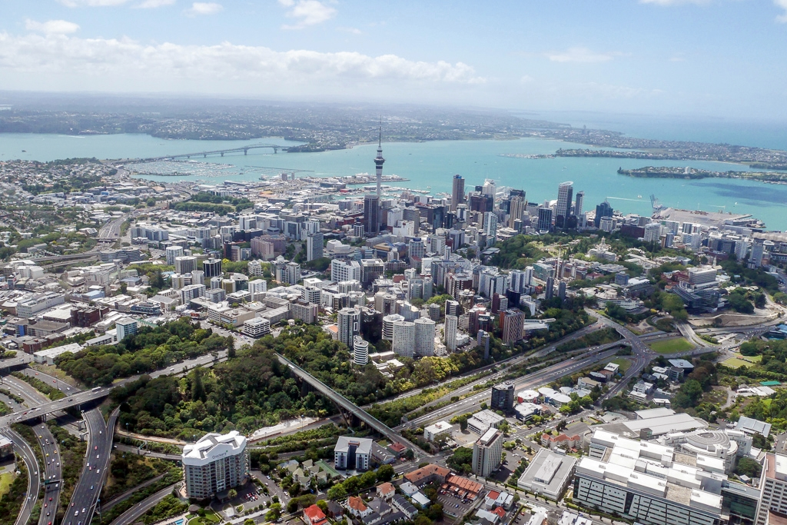
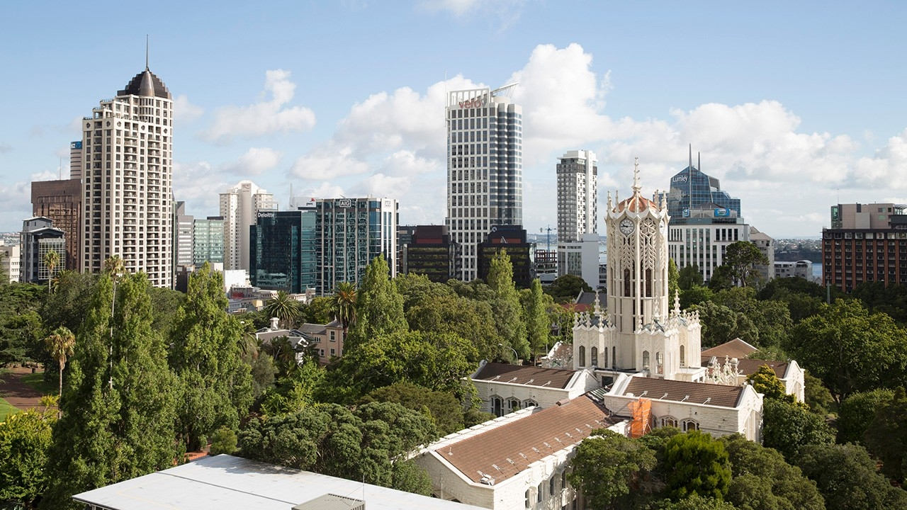
40,000+ students
5000 staff
8 faculties
Campus Solutions v9.0
Plus integrations:
Identity management system
Application/Admission system
Timetabling system
Learning Management System
Scholarships system
Notes:
Once upon a time…in the city of Auckland, at a University of the same name their worked a Deputy VC and her Director Acad Services.
They lived in an elegant stone tower on a beautiful expanse of land in the middle of a very busy city. The Deputy VC and Director AS knew they offered quality to the people who flocked to their University…but times were changing and technology was progressing fast. What had always been happy cheers when visits were made to the faculties, were now being tainted with whispers of unrest.
Let’s survey the University of Auckland kingdom and look at what they already had:
40,000 + students
5000 staff
8 faculties
SMS = CS9, plus integrations to other systems (EPR, AfA, Syllabus Plus, Exam Scheduler, Canvas, Community Force)

Slide 4
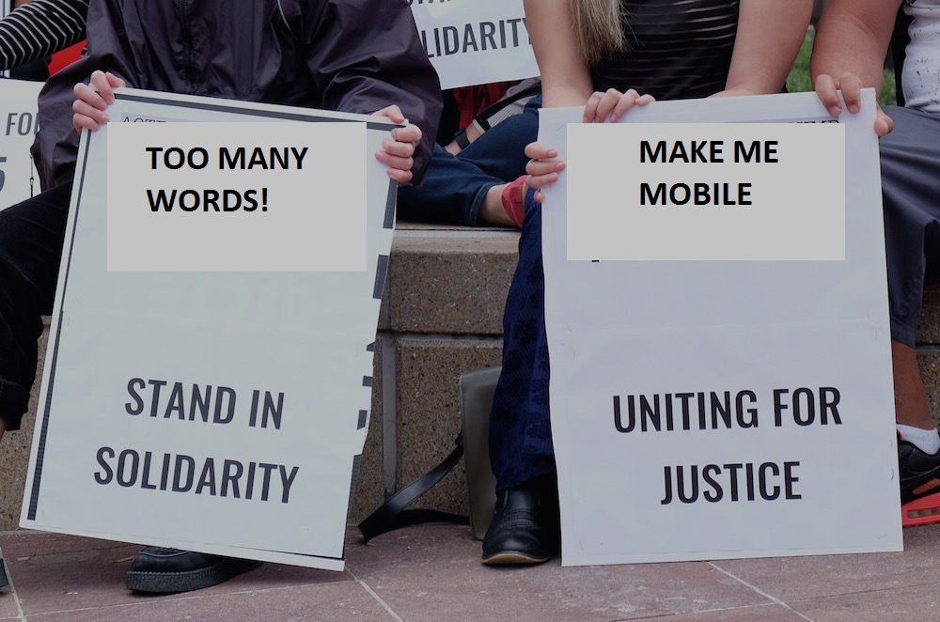
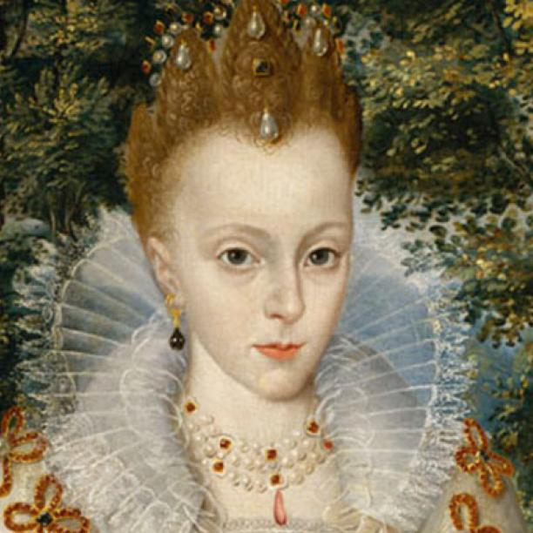
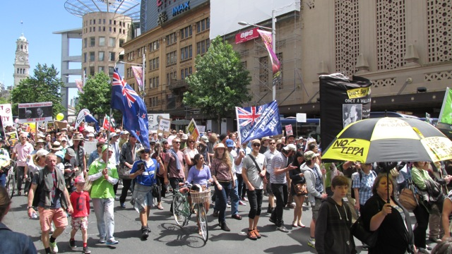
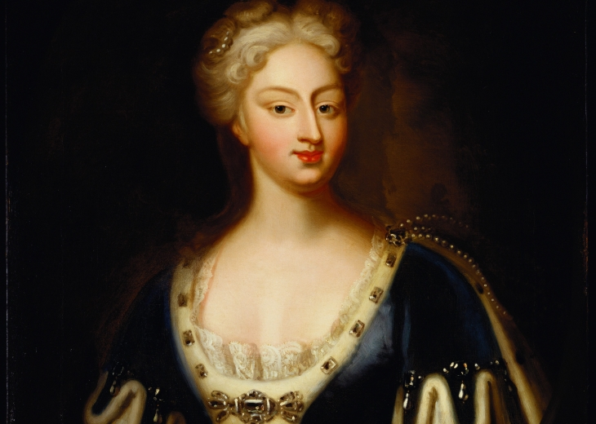
We’re going to need a project to manage all this work!
What’s fluid???
Unashamed advertising…
I quite agree!
Notes:
The Deputy Vice Chancellor and Director of Academic Services were proud of their kingdom and boasted of its success whenever they got the chance.
Clearly the people of the modern University required more. The words of discontent could no longer be ignored:
Could there be any more words on this page?
This is not my favourite site to use, but I have to!
Why won’t this work on my mobile!?!
Something had to be done! There must be a way for students to access all their records whilst strolling, I mean walking purposefully, between lectures!
There was a theme to the what wasn’t working at the University. Suddenly it all seemed so obvious. The answer was staring them right in the face! I know said the Deputy VC!! Let’s give the people what they want! Let’s give them an upgraded student management system and mobile friendly self service interface! Let’s give them CS9.2 and Fluid!

Slide 5
Update existing software
Reducing cost of future upgrades
Better user experience for students
System useable on mobile devices
Modern and intuitive experience
Notes:
Soon a decree was sent out with established reasons for upgrading:
Ensure software is up-to-date and supportable in line with the agreed application strategy (to be solved through a technical upgrade)
Lowering the cost of ownership by reducing the expense of future upgrades (aka selective adoption)
Enhanced usability for student users
Enabling of smartphone and tablet related device usability
Provide a modern and intuitive mobile and desktop user experience
There are many other reasons for this upgrade (these are the main ones which apply specifically to Fluid)

Slide 6
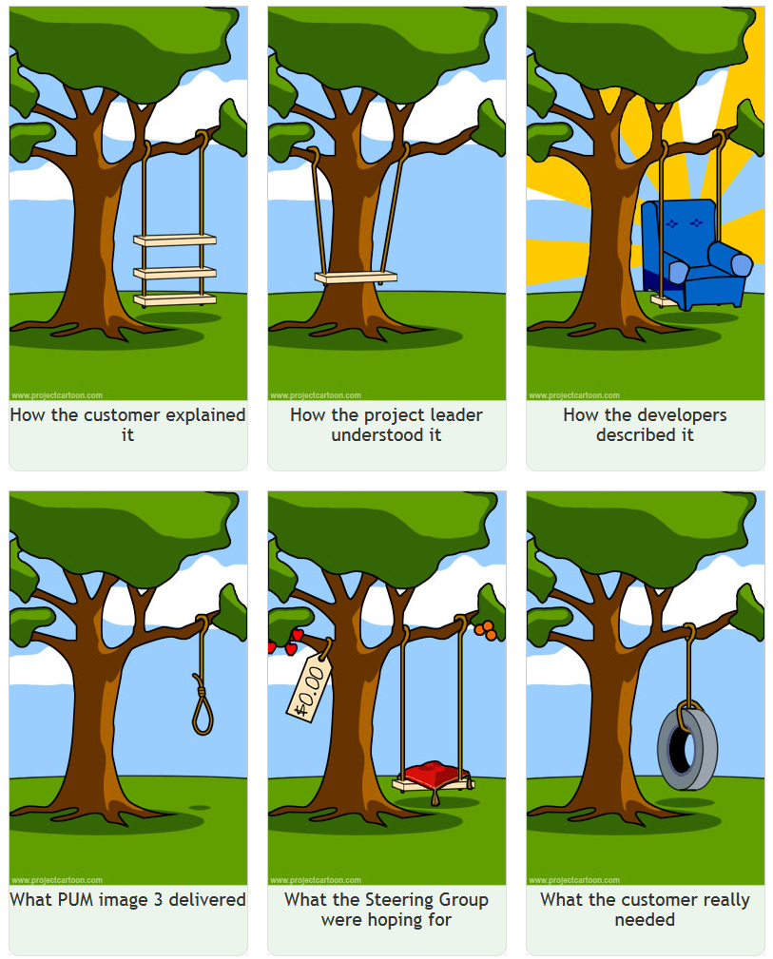
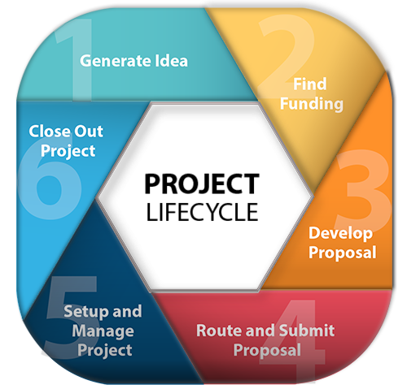
Notes:
Now, we’re all familiar with the lifecycle of a project:
An idea is generated
Funding found
Proposal is developed and submitted
Project is set up and managed
Project is completed
Or is maybe it’s a little more like this:
The customer comes up with an idea which sounds great (although slightly flawed)
The project leader interprets the idea as best they can and forms a project team
The developers start work on what they’re convinced will be the solution to end all solutions
The base functionality is provided by the vendor
The senior leaders are still demanding the deluxe version (in the same timeframe, at the same price)
What the customer realises they actually needed when the project is about to go live…
Either way, we are now wandering into the large (and in places, uncharted) densely wooded area of a significant IT project…

Slide 7
Or where it all began…
Notes:
Chapter Two (or where it all began)
Our Deputy VC and Director AS know what their ultimate goal is, but how are they going to get there?
It’s been years now since anyone has ventured into the forest that is upgrading Campus Solutions. How will we know how to get to our destination?
Old paths may now be blocked, and replacement ones formed. We will need to venture through new and uncharted territory…
…better upgrade our GPS maps!

Slide 8
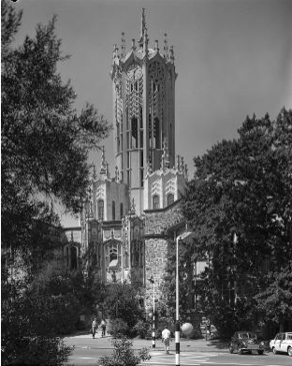
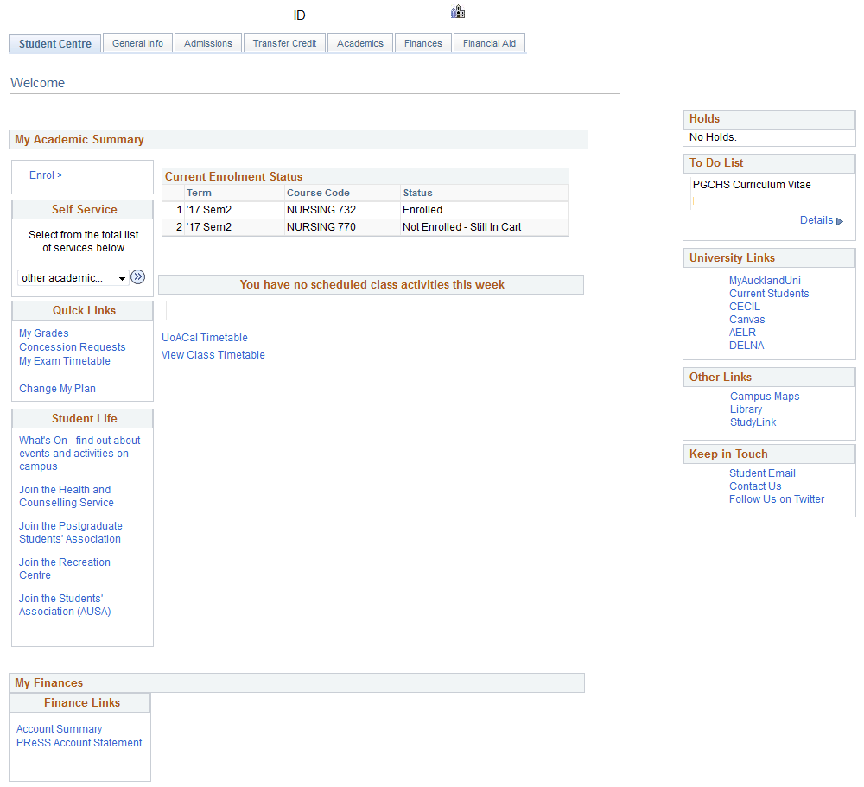
Starting point
2010 launch student self service – CS9.0 Classic
Functionality included:
Add/Swap/Drop enrolments
View class/exam timetable
View account/pay fees
View final grades
View/action checklist items
View course history
View academic advisement
Graduation application
Link to other systems/information
Notes:
So, while we wait for the GPS to be updated to guide us on our journey, let’s take at look at where we are now (our starting point).
The University of Auckland was formally opened on 23 May 1883…oops, that’s a little far in the past…
In 2010 UoA launched a student self service system using a customised version of Campus Solutions 9.0.
This self service system included enrolment, timetable, student financials, student records and advisement functionality.
UoA continued to enhance this over the next 6 years adding options such as; Change My Plan, Postgrad Research student support and enrolment concession requests.
The self service system delivered the functionality the students required for managing their records with the University. What it didn’t keep up with was the increasing usage of mobile devices.

Slide 9
CS 9.2 upgrade scope
Technical upgrade
Implement Fluid self service for students
Look to reduce number of customisations
Re-implement required customisations
Investigate and implement new delivered functionality
Update test scripts
We’re so excited!!!
Notes:
The Deputy VC and Director AS couldn’t wait to get started on their mission to give the people what they wanted. The benefits of completing this upgrade were numerous and it was obvious to them that the decision to upgrade to CS version 9.2 offered the perfect opportunity to update our self service system also and meet the need for a mobile friendly application.
In summary, the scope of the upgrade was:
Complete a technical upgrade
Provide all of the same functionality currently available through self service
Make self service mobile compatible, with a modern and intuitive experience (Generally something sexier than what we currently had)
Look for any opportunities to reduce number of customisations (16 years worth, 1700+ projects, 30,000+ objects)
Re-implement and test required customisations
Investigate and implement new delivered functionality (new to the University, that is) e.g. WorkCenters, Activity Guides
Update test scripts

Slide 10
Techy bits
CS9 Bundle 27
CS9.2 PUM image 3
PeopleTools 8.52
PeopleTools 8.55.16
Notes:
And now a short interlude while we quickly cover some technical information.
Move from CS 9.0 Bundle 27 to CS9.2 PUM image 3
PeopleTools 8.52 To 8.55
If you are a techy person and really want to know more, come see us after the presentation and we’ll put you in-touch with our PeopleSoft techy guy who’s here at HEUG also.
Now, in-case you’re wondering why on earth we apparently settled for PUM image 3, this was the current PUM image available at the time we started development and as the rest of this presentation will show moving to a later image was not as easy as first thought…

Slide 11
Where’s that super smart project team we talked about?
Or have we got a deal for you!?
Notes:
And on our story goes…
Chapter Three (or have we got a deal for you!?)
With the GPS maps all updated and the survival kits fully loaded, our fearless explorers feel ready to venture into the woods. Their only concern at this point is potentially running out of things to talk about along the way, with just the two of them. They needed more friends!

Slide 12
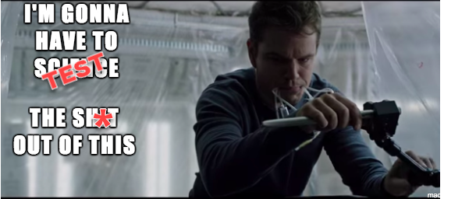
Agreed path
Go Live August 2017 (or bust!)
Everyone involved
Lots of testing!
Notes:
Before we meet the real heroes of our story, let’s take a closer look at the map we’ll be using to find our way through the woods. The Deputy VC is a precise kind of person and really into detail so this journey wasn’t going anywhere until she had information enough to feel satisfied that they wouldn’t lose their way.
The total project time would be 11 months, with a Go Live date set for August 2017
There would be no compromising over the delivery date. This date was carefully chosen to ensure minimal disruption to the business and to be in place prior to the opening of enrolment for the next academic year.
If this date was missed the Go Live would have to be held over until 2018.
Will definitely need support from all across the business to get this over the line (this means staff and student involvement)
The project team would be formed and seated together to maximise productivity
The delivered product had to work first time! We would need to test the crap out of this!
The project resource was mostly sourced from existing staff within the IT Services department, and a few independent contractors brought in also for development work.
Team consisted of:
4.5 developers (2 permanent, 3 contract)
4.5 functional analysts (all permanent)
2.5 QA Testers
1 Change and Comms (permanent)
1 Project Manager (contract)
Technical resource as required
Staff and student representatives were included in all aspects of testing.
We used focus groups to discuss ideas and test developed functionality, as it became available.
The student focus groups allowed us to hear more about existing problem areas for students and to work to resolve these.
The feedback received from the student representatives overall was really positive.
Any feedback gathered from students was then discussed with individual service divisions and faculties to ensure that this matched up with what’s important for the UoA.

Slide 13
Or build me a bomb from this stick of gum, MacGyver!
Notes:
Chapter Four (or build me a bomb from this stick of gum, MacGyver!)

Slide 14
November 2016
CS9.2 PUM image 3 Fluid | Could we use it?
Campus Community Updated Profile tile My Preferences tile | No. Custom identity management system already integrated
Admissions Activity Guide to Accept or Decline an Offer | No. Custom application system already integrated
Student Financials Make a payment Charges Due Account Balance | Yes. Customisation required
Student Records Maintain Shopping Cart View My Classes Drop Classes | Yes. Customisation required
Notes:
Where in history are we now? Let’s go back one year in time…it’s November 2016 and PUM image 3 has just been delivered.
The conversations in project land are going something along the lines of:
So, PUM image 3 gives us an okay starting point, but there’s some really core functionality we still need which hasn’t been released. How do we deal with that?
What are our options? Go with an alternative system? Nope! Too expensive! Proceed with Campus Solutions using Classic? Kind of puts us back to square one doesn’t it? And certainly doesn’t provide a mobile solution for the masses.
Do the Fluid thing with PUM 3, fill-in any gaps we find ourselves and pick from the next PUM images the bits that we need (that’s what selective adoption is all about right!?)
From PUM 3 we were able to use some bits of delivered functionality including; View Grades, Course history, Tasks, Enrolment Cart, Drop Classes
Everything else would need to be delivered by us. Gulp!

Slide 15
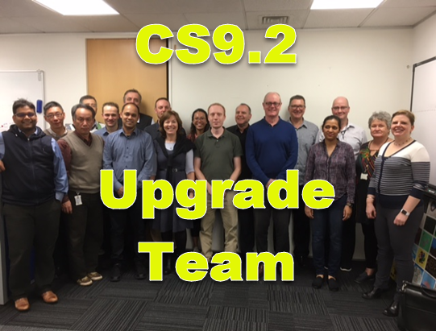
Bridging the gap
Notes:
Bet you’re thinking we’re crazy right about now? Bet you’re wondering who in their right mind would keep going, with 9 months left until Go Live and the better part of a whole self service system to re-develop?
Wonder know more! It was us! In retrospect it does seem a little nuts, and there will certainly be work to do in the future to allow us to further update what we have, but we did it!
Here’s how…with some help from…the A-Team…oops, I mean these guys…the CS 9.2 upgrade project team ☺
With full support from management and the business, our dedicated project team were able to deliver a self service system which was easily usable across any device and continued to offer all of the functionality our students had come to rely on.

Slide 16
Or ask not what your student management system can do for you…
Notes:
Chapter Five (or ask not what your student management system can do for you…)
As our expedition team headed into the woods and the project unfolded it was evident that we needed to use a blended approach to deliver the self service pages we required.

Slide 17
Functions in Fluid
Delivered | Custom (based on Classic) | UoA Customisations | Classic Page in Fluid wrapper
View Grades | Class Search | Change My Major | Swap Classes
Course History | Enrolment (Shopping) Cart | Enrolment Concessions | Edit Classes
Tasks | Course Catalogue |  | Advisement Report
 | My Class Timetable
 | My Exam Timetable
Notes:
The Fluid self service we have delivered uses a variety of different kinds of Fluid pages. Examples being:
Functions delivered in PUM 3 (View Grades, Course History, Tasks)
Custom Fluid items developed using Classic as a guide (Class Search, Enrolment (Shopping) Cart, Course Catalogue, My Class Timetable, My Exam Timetable)
Fluid items created by UoA with no Fluid equivalent. These items had custom Classic pages which we used as a guide (Change My Major, Concessions (request for enrolment where requirements aren’t met))
Lastly Classic pages which we put in a Fluid wrapper, to keep the experience consistent for our students (Swap Classes, Edit Classes, full My Programme Requirements (Advisement Report))

Slide 18
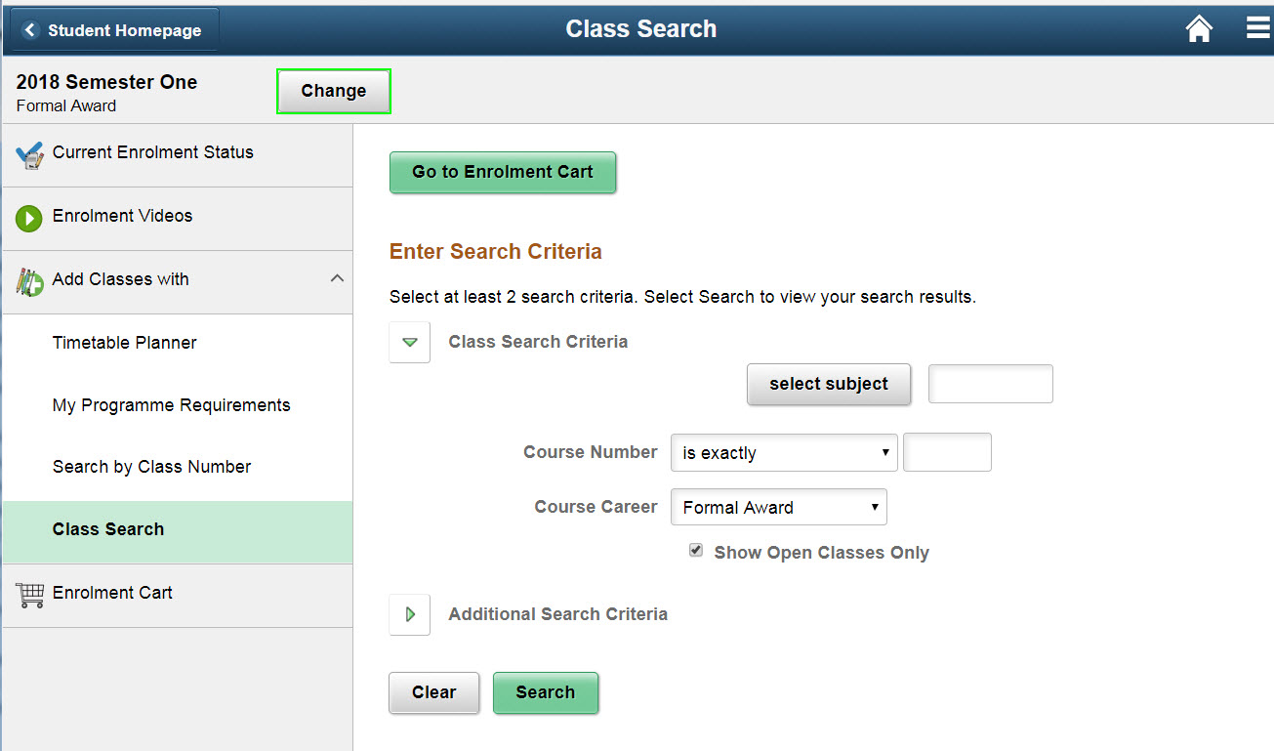
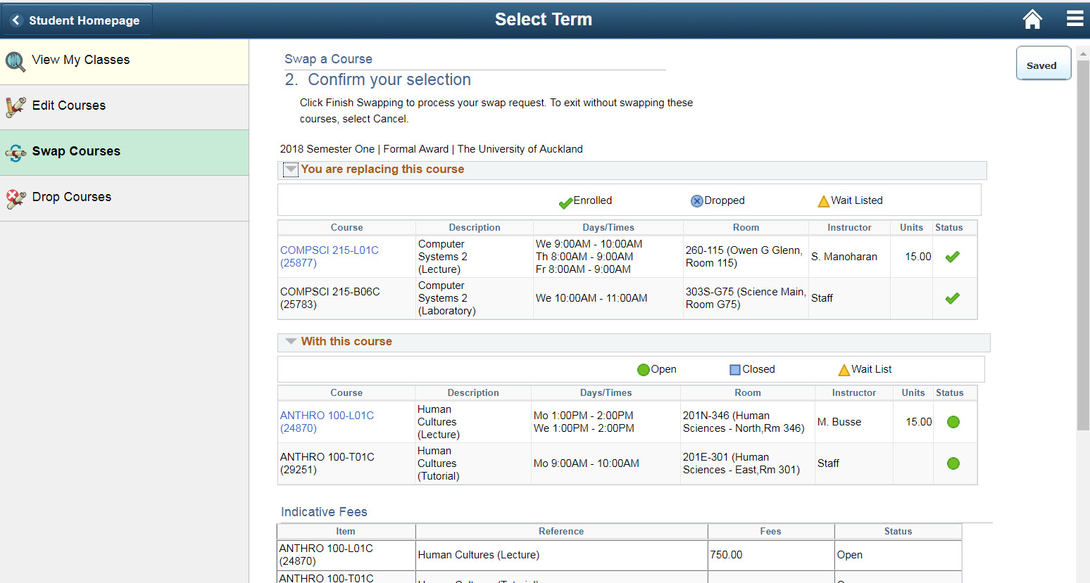
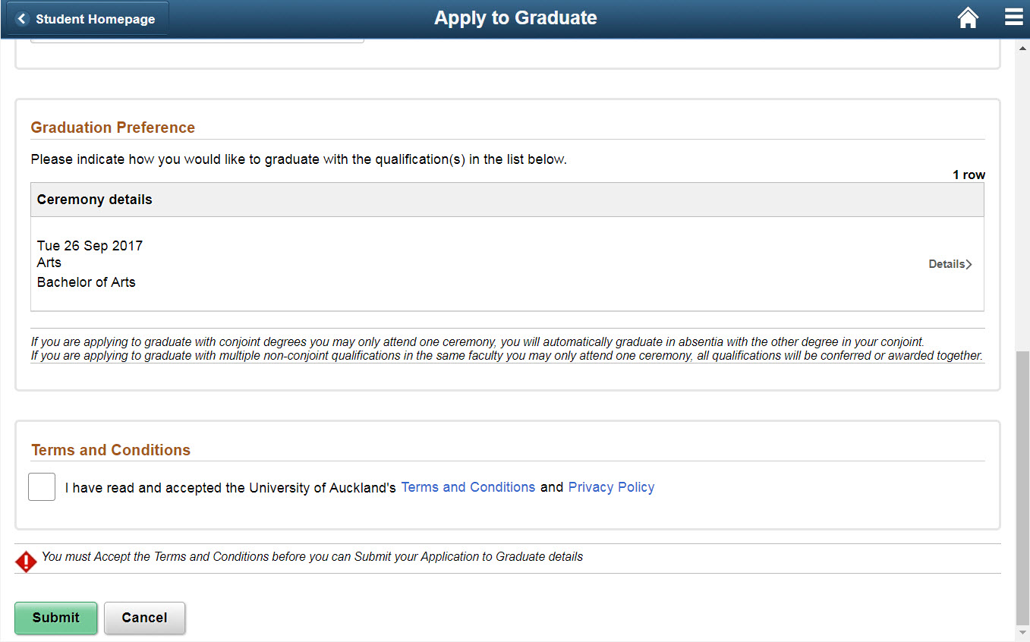
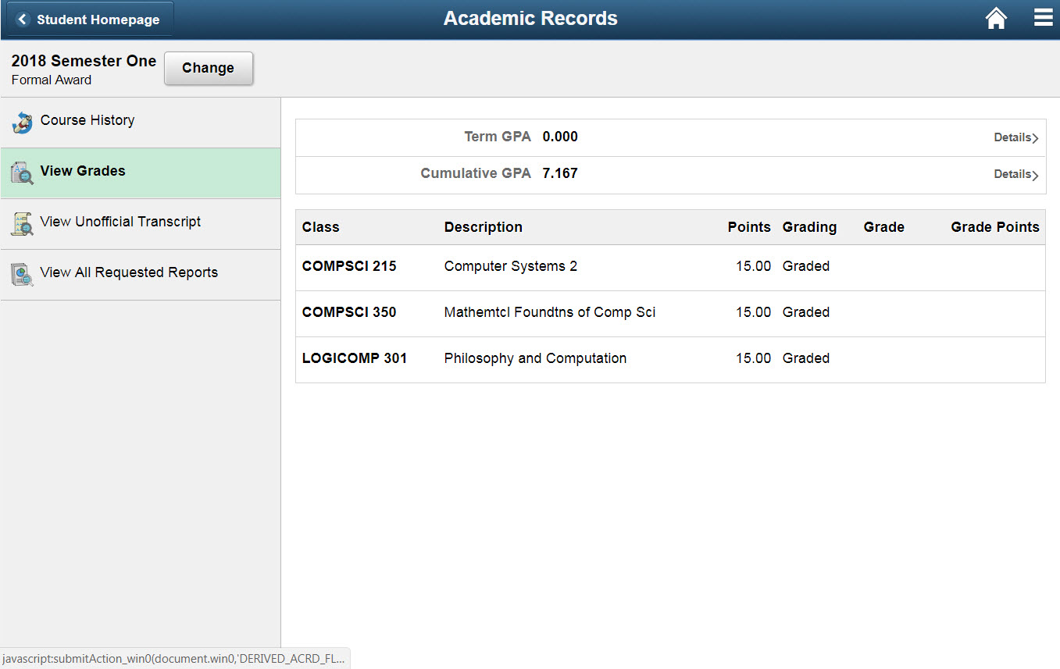
Notes:
Here’s a look at some of our pages using examples from those four groups:
What was delivered that we could use?
View Grades: This was delivered in PUM 3, and we’re using it as is with the config option of display GPAs switched on.
What did we need that PUM image 3 didn’t include?
Class Search: We used Classic as our model to develop a Fluid version.
Steep learning curve for developers
What did we re-create which doesn’t exist in delivered Classic?
Graduation Application: This is based on a custom Classic page which we had already implemented, but was significantly re-worked for Fluid and mobile devices.
Double development required for some areas to accommodate different sized devices e.g. Graduation application
iOS issues (continued…) Pop-up pages, re-bounding scrolls on some pages
What did we need to deliver but, couldn’t re-create in Fluid in time for Go Live?
Edit/Swap Courses: This is an example of a Classic page with a Fluid wrapper (one of 3 items which were delivered in this wrapped state due to time constraints). These 3 pages we have not made available on a mobile device
You may be aware that the Edit and Swap Courses functionality was delivered as part of PUM image 5 in May 2017. We were pretty excited about this but after some investigation determined that the code base had been altered sufficiently between releases which prevented us from being able to take the items we desired and add them to PUM image 3. With 3 and a bit months to go until Go Live, a decision was made to wrap these Classic pages in a Fluid wrapper.

Slide 19
Or Veni, Vidi, Vici
Notes:
Chapter Six (or Veni, Vidi, Vici)

Slide 20
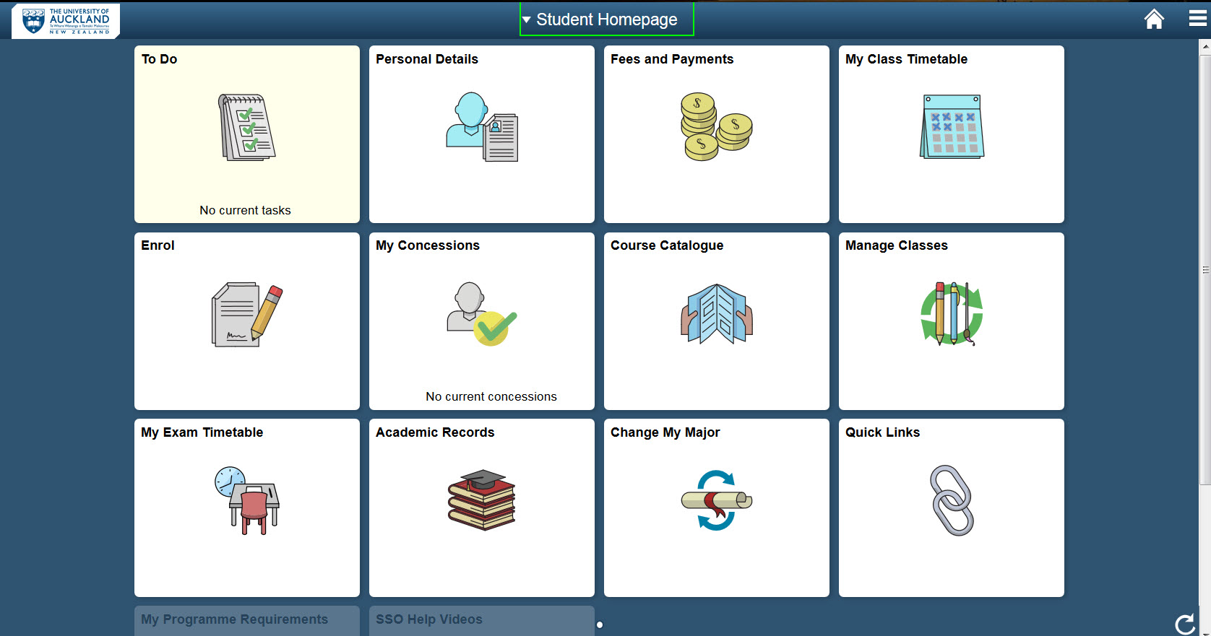
Happily ever after…
Notes:
We’ve reached our destination, the team is all intact (no-one was trampled by the giant), we’ve delivered a Fluid self service system complete with everything our students need on-time and under budget (no really!?!). And, we’re all living happily ever after. ☺

Slide 21
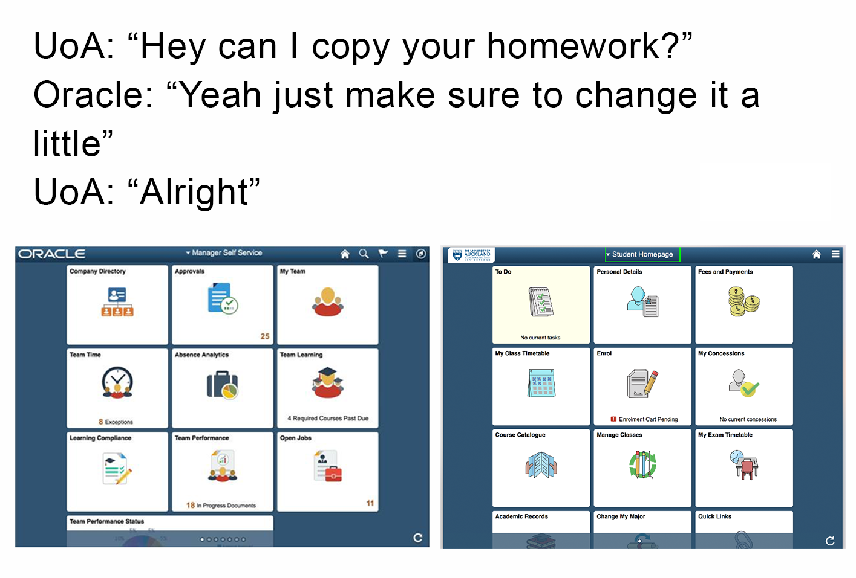
Lessons learned
Selective adoption more challenging across PUM images
Wait for a PUM image containing the majority of the delivered functionality required
Notes:
In hindsight (with perfect vision of selective adoption), we would choose to wait for a PUM image that contained the majority of the Fluid items that we wanted.
At the start of our process we had the expectation that swapping out our custom pages for those delivered in a later PUM would be a fairly straightforward process, using selective adoption. Reality proved different.
In-order for the University to move to a later PUM image there will be a requirement to complete significant re-work.
Our Fluid self service system has been well received and within a week of opening enrolments for 2018 we have seen an increase in the number of enrolments, compared with the same point in prior years. We see this as evidence that the modern intuitive Fluid interface is delivering the expected benefits.
During the week of Go Live we checked social media pages to gage reaction and it turns out that some students recognised the functionality but, missed the finer point of what is running their self service system.

Slide 22
Future plans
Move to later PUM image
Will require re-work of custom items
Notes:
The plans for our sequel journey do include:
Moving to a later PUM image > as noted this is going to require re-work of our custom items

Slide 23
Questions?
Notes:
Questions?

Slide 24
Closing credits
Starring:
Liz Kitto
Functional Analyst, University of Auckland
l.kitto@auckland.ac.nz
Support from:
Paul Farrell
Functional Analyst, University of Auckland
p.farrell@auckland.ac.nz

Slide 25
Thank you

