Slide 1
Managing academic progress with campus solutions and oracle service cloud
SESSION 36037
Thu Nov 10, 2.20pm

Slide 2
presenters
Giacinta Gazzola
Dani Hopkins
Business Analyst
University of Adelaide
giacinta.gazzola@adelaide.edu.au
Project Manager
The University of Adelaide
danielle.hopkins@adelaide.edu.au
Notes:
Dani

Slide 3
THE UNIVERSITY OF ADELAIDE
Founded in 1874
First in Australia to admit women (1881)
4 metro campuses
1 offshore campus
27k students
3,700 staff
Notes:
Dani

Slide 4
UOFA & ORACLE
Campus Solutions 9.0/8.55
HCM 9.2/8.54
Finance 9.1/8.55
RightNow CRM
Notes:
Dani

Slide 5
crm context
2014/2015 initial roll out focused on Customer Service
2016 focus on driving revenue i.e. Outreach and Recruitment and Business Development
2016 CRM Strategy focused on positioning CRM to deliver business value by:
Inviting business to come in and voice their needs in Design Labs
Fostering relationships across business areas to reduce silos and share knowledge
Continue supporting Customer Service with the Faculty Assistance Program
Academic Progress provided opportunity to introduce Case Management aspects
Notes:
Dani

Slide 6
OvervieW
1
3
POLICY CONTEXT
Background and drivers
WHAT HAPPENED?
Experiences from review period 1, 2016
2
4
SOLUTION
What did we do in CS & the CRM
LESSONS & NEXT
What did we learn and what will we do next
Notes:
Dani

Slide 7
POLICY CONTEXT
Background and drivers
Notes:
Dani

Slide 8
WHAT IS ACADEMIC PROGRESS?
The process that occurs when a student IS NOT making satisfactory academic progress;
- they have not passed more than 50% of their enrolled units, or
- fail the same course for a second or subsequent time.
3 risk categories - Risk 1, Risk 2 and Unsatisfactory
Notes:
Dani

Slide 9
POLICY BACKGROUND
Academic Progress Policy & Process already existed.
Driven by final GPA in Campus Solutions.
Did not include all teaching terms.
Centralised hardcopy process
Notes:
Dani

Slide 10
POLICY CHANGES
Meet ESOS legislation – Must have an intervention strategy for International students.
Now applies to students enrolled in all teaching periods.
Criteria changed to include subsequent failures of courses.
Focus ahs changed from a punitive to early and supportive intervention.
At risk students complete a self-reflective survey to help identify any issues
Risk 2 Students have to complete a survey and request an advisor
Notes:
Dani

Slide 11
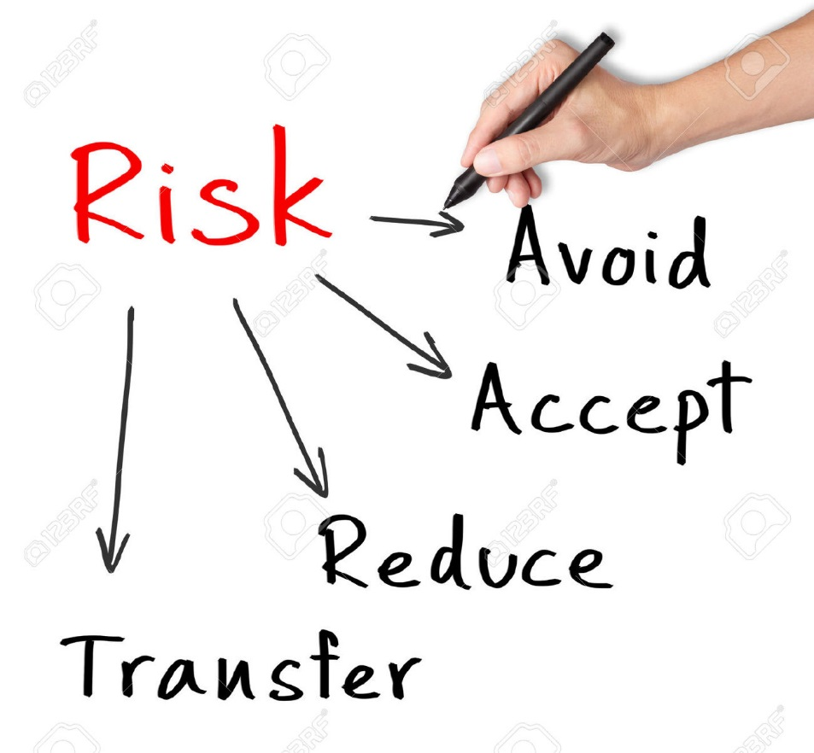
POLICY CHANGEs
And…
Remove the ability for students transferring programs to remove risk indicators through defined cognate programs
And…. last but most contentious!
Academic Progress process runs after primary & final results (ie. before replacement assessment)
Notes:
Dani

Slide 12
SOLUTION
What did we do in CS & the CRM?
Notes:
Giacinta

Slide 13
SOLUTION IN A NUTSHELL
CAMPUS SOLUTIONS
We’ve defined new cognate program relationships to avoid risk reduction by transfer
Faculty can review and update risk status’
New engine to calculate risk
Report for CRM
CRM
Import process & rules based incident creation
Standard communication templates for letters and emails
New Academic Progress Incident Type & Workspace
2 Risk surveys with response-triggered feedback
Introduction of dispositions with AP incident for process lifecycle
Introduction of relationship between contacts
Reports and dashboards for workload management and enterprise tracking
ONLINE FORM
Show cause submission (emails to inboxes)
Notes:
Giacinta

Slide 14
ASSUMPTIONS & EXPECTATIONS
SYSTEM
Campus Solutions the authoritative source for student risk levels
CRM is for tracking engagement & interactions
Introduction of case management to CRM
People centric and not fully automated
PEOPLE
Low survey engagement (~%5)
Inability to quantify existing AP workload
Increased Faculty workload across multiple policy rollouts
Handling of referrals to non-CRM users
PRIVACY
Reliance on employment policy
Record management practices
Notes:
Giacinta

Slide 15
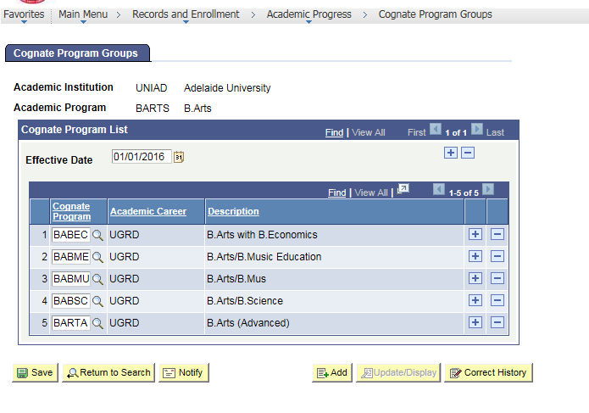
COGNATE PROGRAMS
Notes:
Giacinta
Intention is that Faculty will maintain ongoing. The first load was done centrally from spreadsheets.

Slide 16
CRM Business RULES
Academic Progress Risk Progression | CRM Incident Created? | Student notified by email? | Survey required? | Show cause submission required?
-> Risk level 1 | Yes | Yes | Yes
Risk level 1 -> Risk Level 2 | Yes | Yes | Yes
Risk Level 2 -> Unsatisfactory | Yes | Yes |  | Yes
Risk Level 1 -> Satisfactory | Yes | Yes
Risk Level 2 -> Risk Level 1 | Yes | Yes
Unsatisfactory to Risk Level 2 | Yes | *
* Communication is at discretion of Faculty Student Support Areas
Notes:
Giacinta

Slide 17
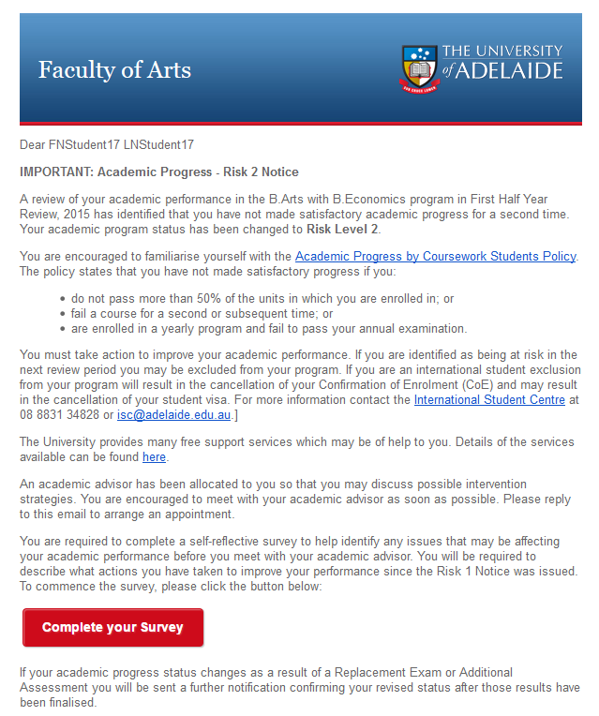
CRM NOTIFICATION
Notes:
Giacinta
Went out from Faculty mailboxes under the DVCA Executive Director’s name. This was done to avoid incidents passing through Central Student Hub.

Slide 18
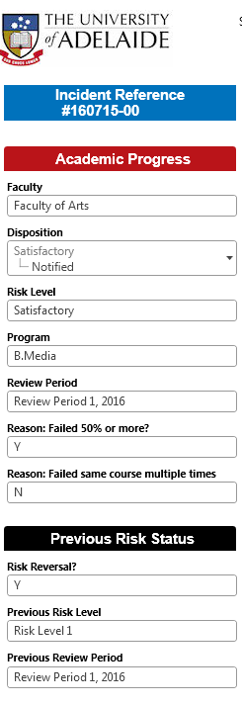
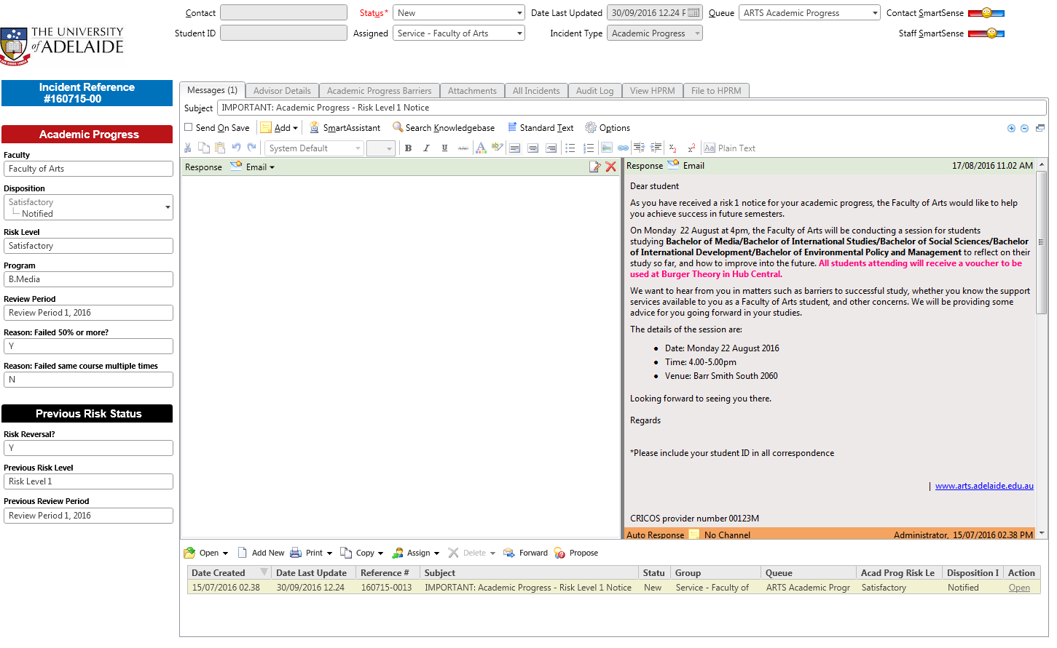
CRM WORKSPACE
Notes:
Giacinta

Slide 19
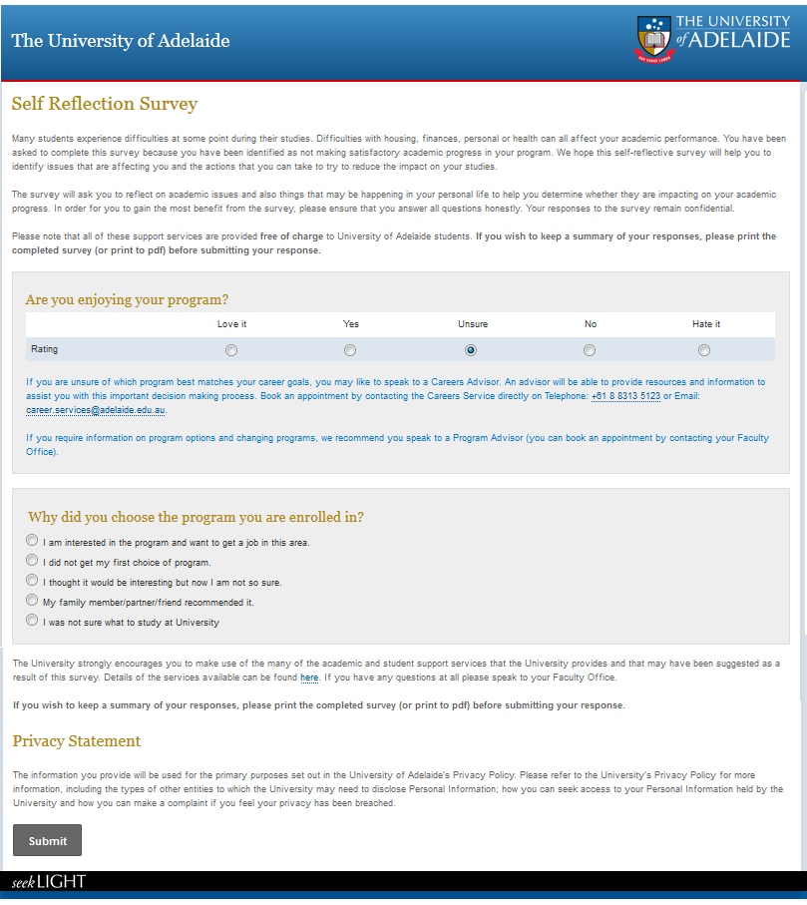
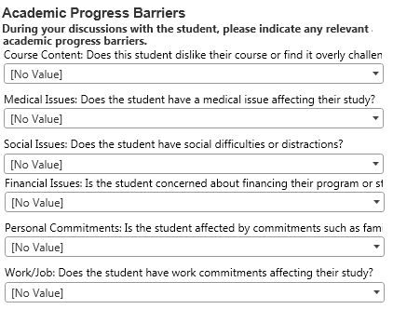
CRM SURVEY & Academic Progress Barriers
Notes:
Giacinta

Slide 20
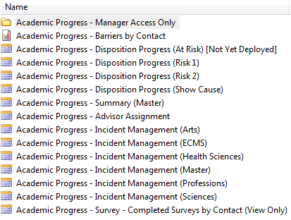
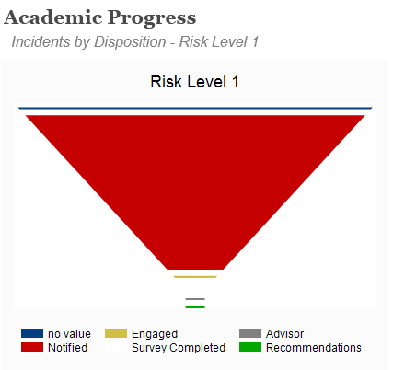
CRM DASHBOARD & REPORTS
Notes:
Giacinta

Slide 21
WHAT HAPPENED
Experiences from Review Period 1, July 2016
Notes:
Dani

Slide 22
SNAPSHOT OF REVIEW PERIOD 1, 2016
2967 AP cases created
2830 notifications sent to students
Over the coming weeks 853 survey results received
Survey results | Completed | %
Risk 1 | 674 | 35%
Risk 2 | 179 | 33%
Notes:
Dani

Slide 23
PROCESS & PEOPLE
Survey responses vastly higher than anticipated (~34%)
Enterprise and Faculty visibility to monitor and track AP
Higher volume of show cause submissions than previous years
Higher referral rate to Counselling and Disability services
Increased staff/student accountability and visibility
Supported Faculty process variation without impacting tracking
Supported upskilling of CRM users (Reporting, bulk editing of incidents)
Increased confidence in ability of CRM team to deliver a new solution
CRM dispositions, referrals, status updating was manual and cumbersome
Resourcing issues with policy focus change and increased Faculty workload
Notes:
Dani

Slide 24
TECHNICAL
Only able to import <300 records at a time (painful and manual)
HPRM integration valuable but central users did earlier (and closed off the incidents as a result – oops)
Required QA over the initial data from Campus Solutions to identify any data issues that couldn’t be found in testing
Legacy data with risk status’ not having been updated created adhoc requests for extra incidents
Unable to extract individual survey responses easily (single html page that can’t be pdf’d or exported easily)
Notes:
Dani

Slide 25
LESSONS & NEXT STEPS
What did we learn and what will we change?

Slide 26
FROM HERE
Changes for the 2nd review period;
Extra templates for consistency in communication
Reviewing dispositions to align with processes
Incorporating previous risk incidents into the AP workspace for reference
Changes for 2017
Linking survey responses to dispositions to automatically track engagement
Manual creation of AP risk incident for even earlier intervention (needs business process considered)
Extraction of individual survey responses for dissemination to other staff (referrals)
Review of the policy to remove 2 runs per review period
Notes:
Dani

Slide 27
FROM HERE
Ongoing process considerations
Importance of survey responses in supporting evidence of engagement & providing background
Distributed support model with limited users in each faculty responsible for AP – should this be centralized with different support tiers?
Tension over the role of CRM – outreach & recruitment vs retention vs service?
Review over management of confidential student records is required
Notes:
Giacinta

Slide 28
CONCLUDING
Any questions?

Slide 29
presenters
Giacinta Gazzola
Dani Hopkins
Business Analyst
University of Adelaide
giacinta.gazzola@adelaide.edu.au
Project Manager
The University of Adelaide
danielle.hopkins@adelaide.edu.au
all Alliance presentations will be available for download from the Conference Site

Slide 30
THANK YOU!

