Slide 1
One upload page to rule them alL!
SESSION 4503
October 9 2018

Slide 2
presenters
Lennaert Wilschut
Business Information Manager
Leiden University
L.wilschut@sea.leidenuniv.nl
Functional Consultant
Working with Campus Solutions since 2006
Working at Leiden University since 2010
Primary focus on digitalizing / automating Admissions processes

Slide 3
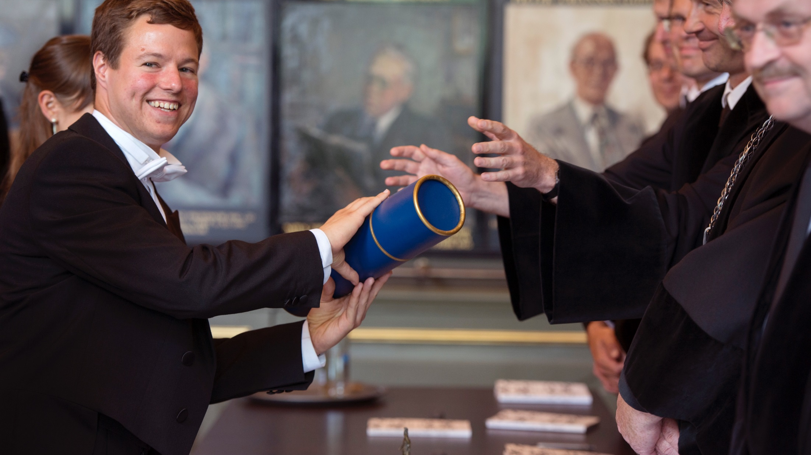
Leiden University
28.000
120
Students
Nationalities
6.700
16
Employees
Nobelprizes
83
46
Masters
Bachelors
First University in the Netherlands (1575)

Slide 4
ORGANIZATION & ORACLE
PeopleSoft
Functional employees
9.0 Bundle#43
11
PeopleTools
SaNS Expertise Centre
8.56.09
Technical Mangement
MCX
Hardware

Slide 5
OvervieW
1
3
Why do we need new upload functionality?
Demo of the product
2
4
What do we need? (design)?
How to configure it yourself?

Slide 6
Use case
Use case: Digitalizing Admissions
Trigger:
Implementation of the admission process from a different system to PSCS
Why do we need new functionality?

Slide 7
Admissions process
Apply (Studielink)
Register application
Determine conditions
Complete other requirements
Enrolled
Submit extra info
Evaluation by administration
Evaluation by faculty
Admitted

Slide 8
Challenges: Upload framework
Configure and Categorize by
Business proces, subproces, document
Statusses
Authorisation
1 Page for employees

Slide 9
Challenges: Merge file
Configurable
Authorisation
Extra information

Slide 10
Challenges: Student portal
Fluid pages
Configurable
Extra Business logic concerning statusses

Slide 11
OvervieW
1
3
Why do we need new upload functionality?
Demo of the product
2
4
What do we need? (design)?
How to configure it yourself?

Slide 12
Design
What do we need?

Slide 13
What do we need?
Datamodel Upload framework
Merge
Student portal

Slide 14
Datamodel upload framework
Authorization
Standard row level
(manual, copy , XL2CI)
Business proces
Category
Key Structure
Sub category
Items
Type / size
Status
Admission
Person
Student nb.
ID
Passport
PDF 10MB
Group 1
ID
PDF 10MB
Group 1
Res permit
Admission request
Admis. Nb. / Subplan
Appl. fee
Extra uploads
Resume
DOC 20MB
Group 1
Essay
JPG 5MB
Group 2
Motivation
PNG 3MB
Group 3
Decision
Language test
Results
DOC 20MB
Group 1
Yearly
Year
Prior edu
Edu nb.
Permit
Number

Slide 15
What do we need?
Datamodel Upload framework
Merge
Student portal

Slide 16
Merge file
Configurable per item
Authorisation
Extra information
Cover sheet
Summary

Slide 17
What do we need?
Datamodel Upload framework
Merge
Student portal

Slide 18
Student portal
Fluid pages
Configurable per page (EMS)
Extra Business logic concerning statusses

Slide 19
OvervieW
1
3
Why do we need new upload functionality?
Demo of the product
2
4
What do we need? (design)?
How to configure it yourself?

Slide 20
Demo
What does it look like?

Slide 21
Admissions process
Apply (Studielink)
Register application
Determine conditions
Complete other requirements
Enrolled
Submit extra info
Evaluation by administration
Evaluation by faculty
Admitted

Slide 22
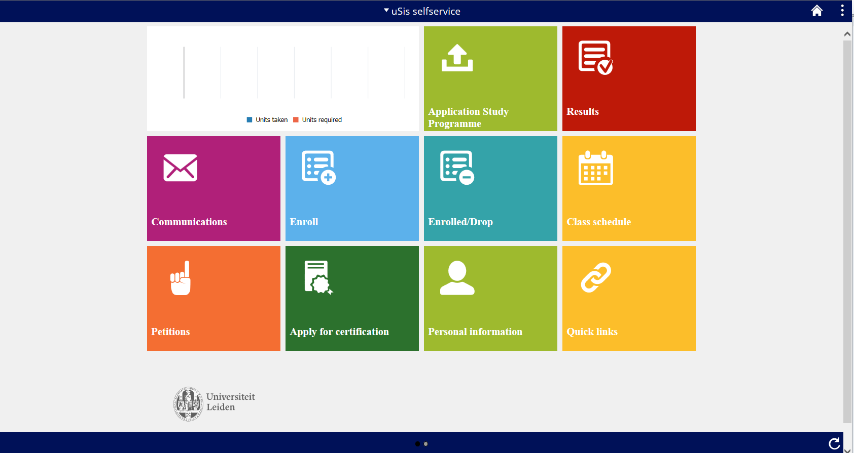
Student portal: Sumbit extra info

Slide 23
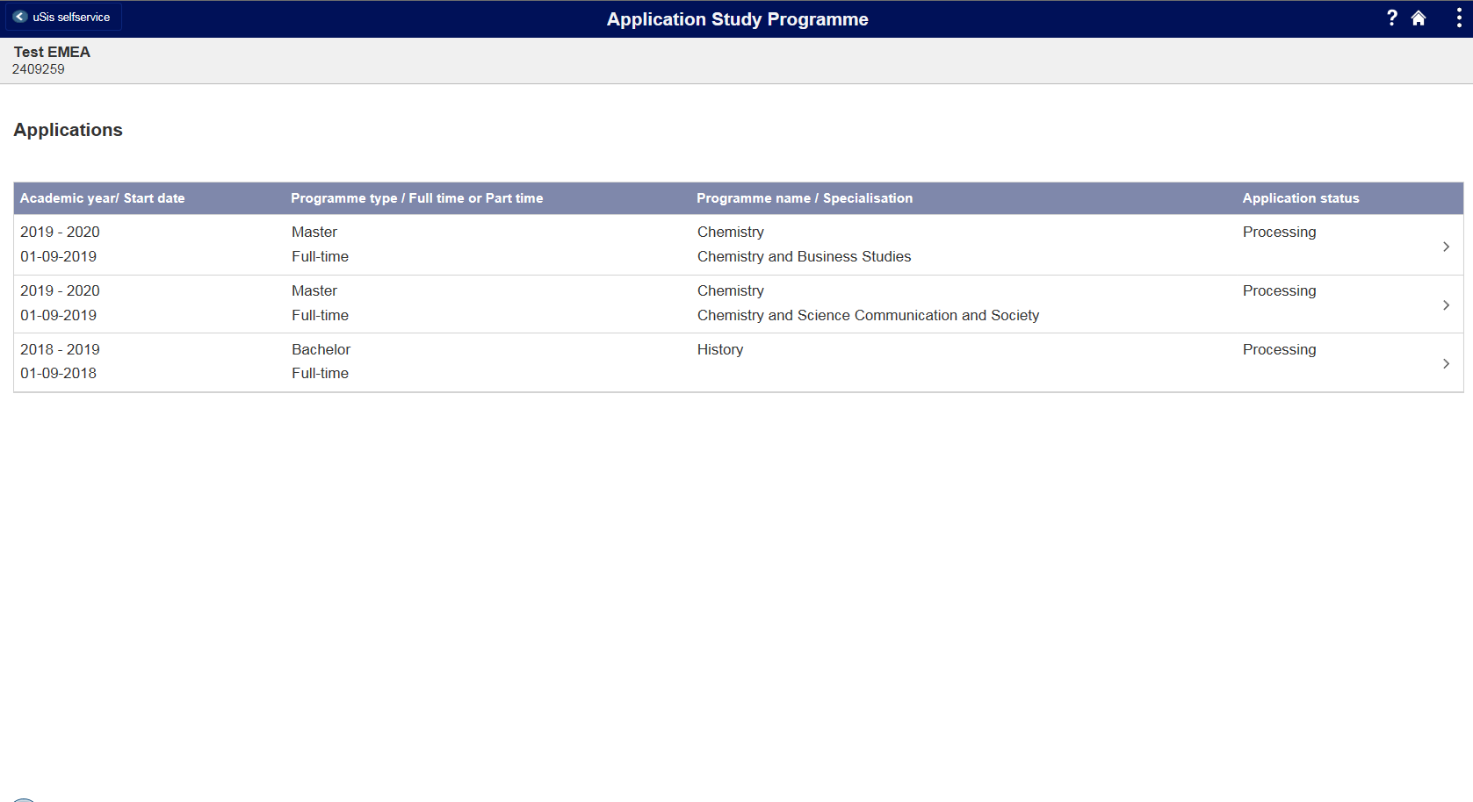

Slide 24
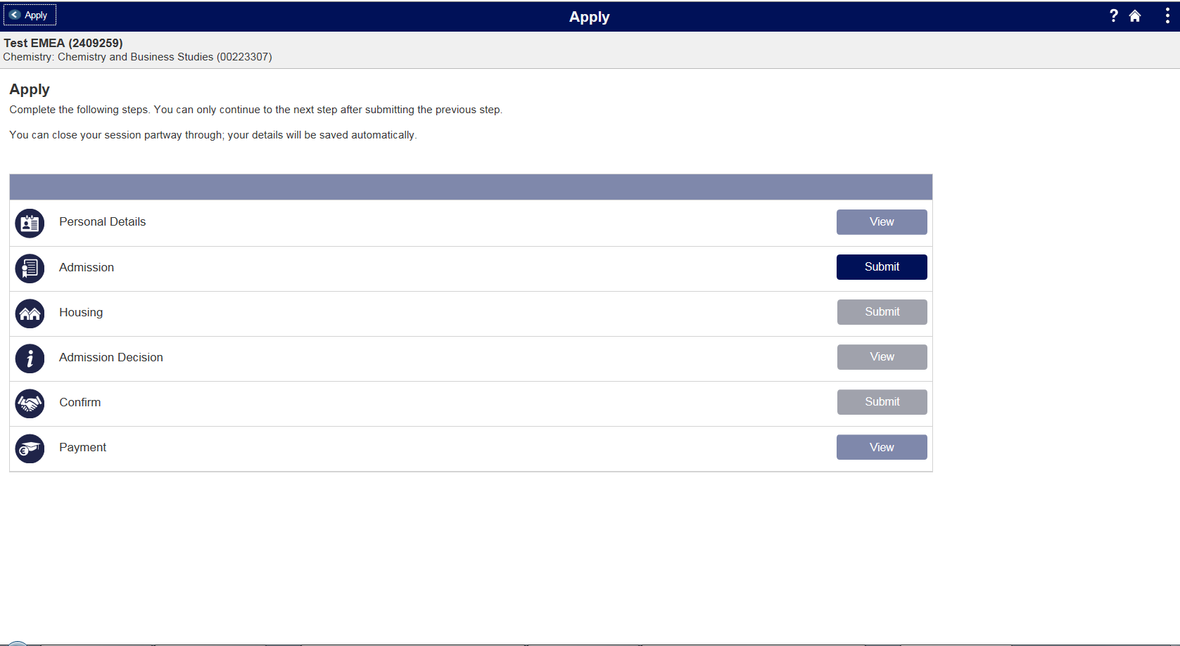

Slide 25
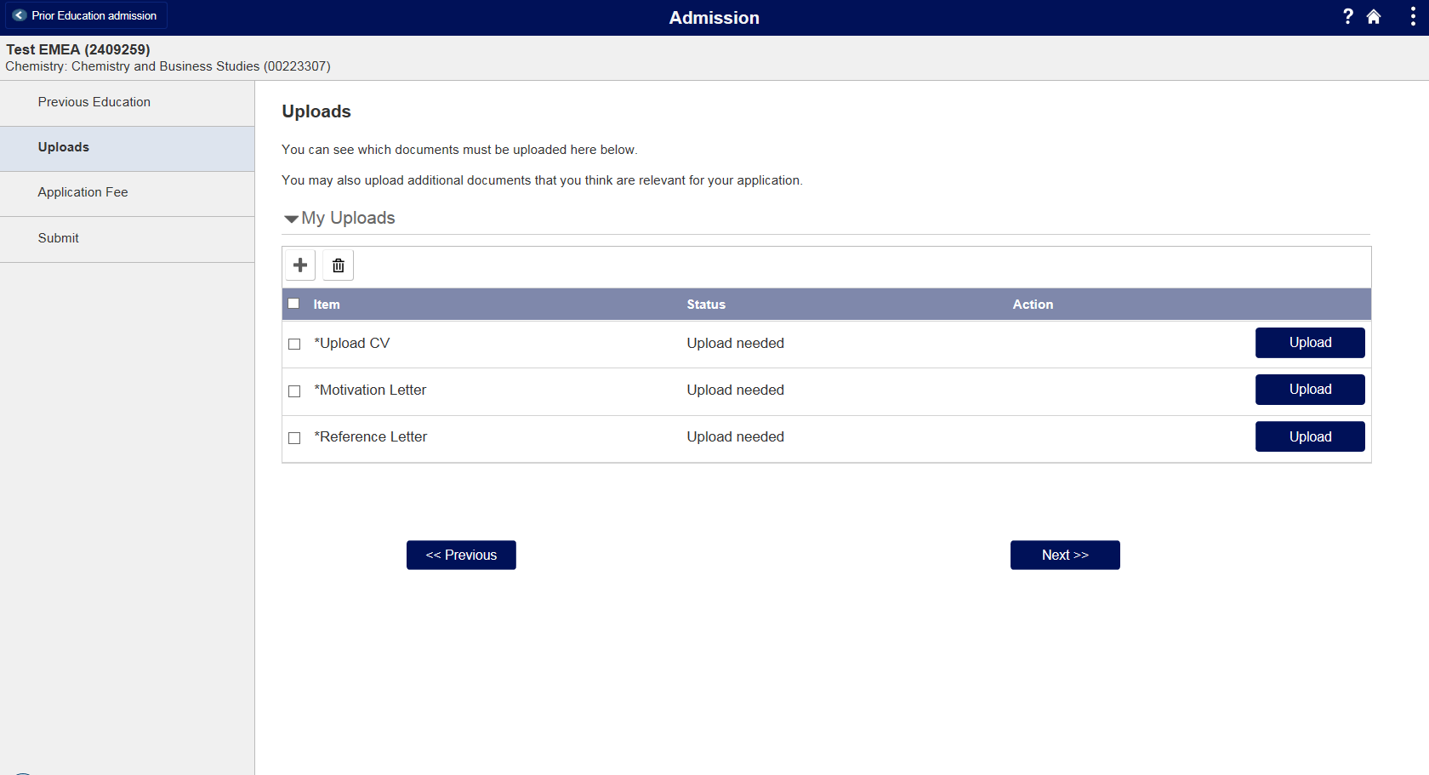

Slide 26
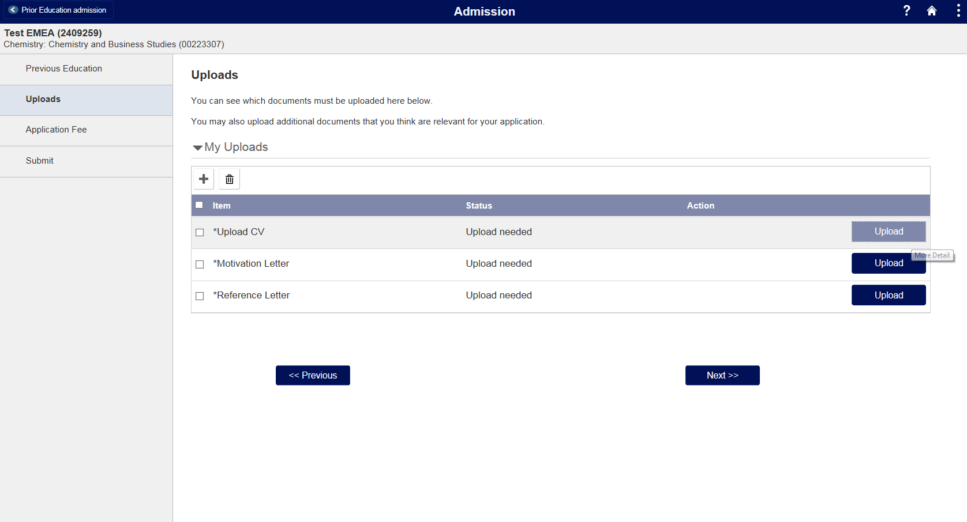

Slide 27
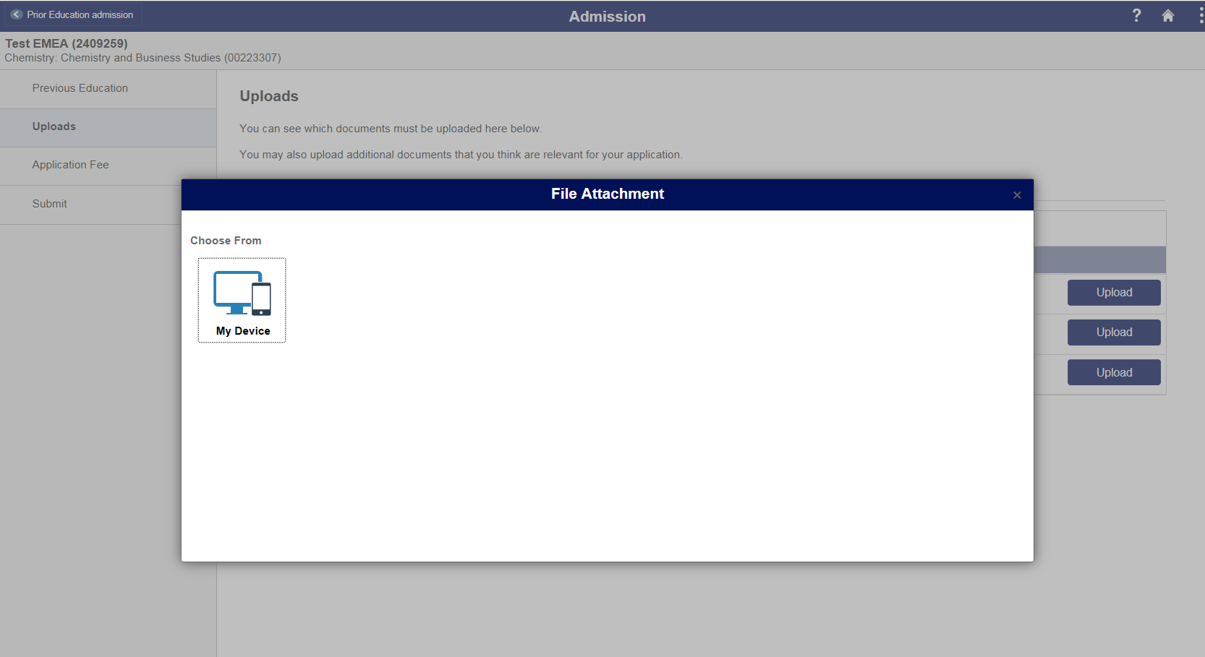

Slide 28
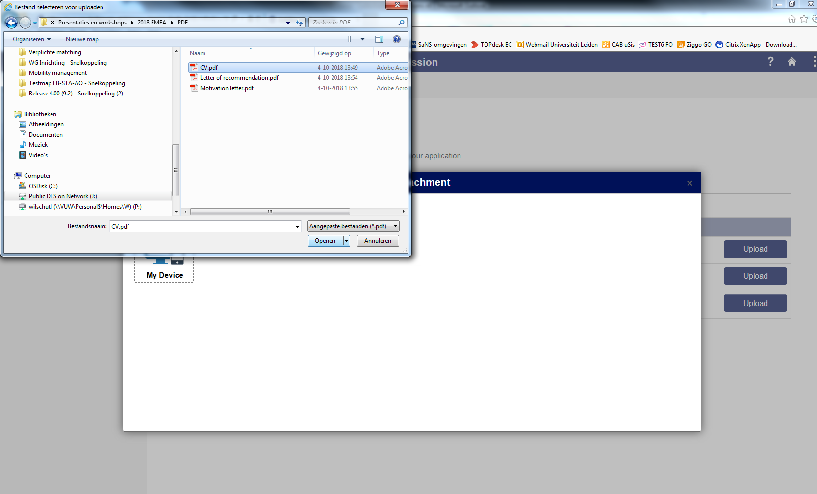

Slide 29
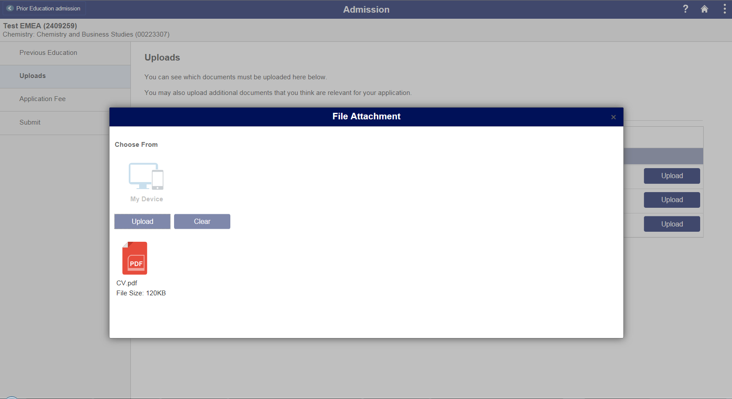

Slide 30
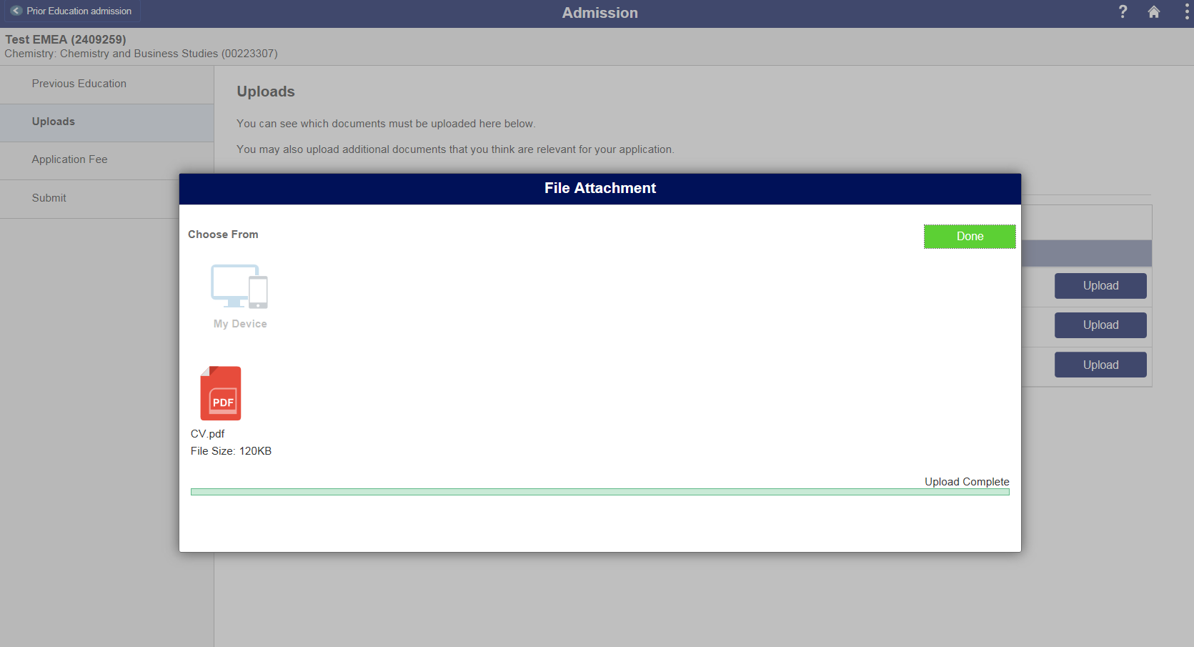

Slide 31
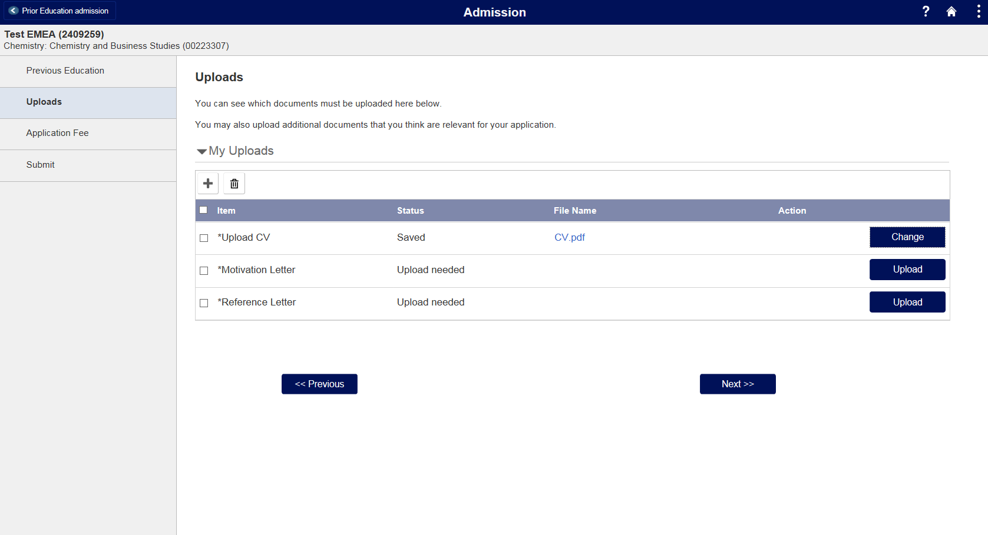

Slide 32
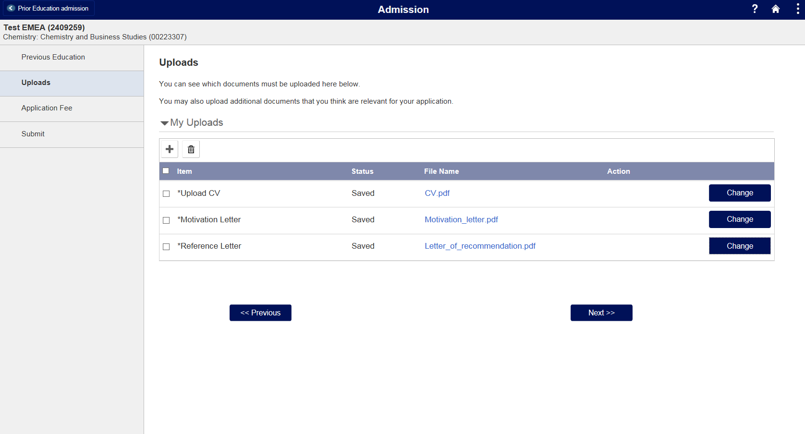

Slide 33
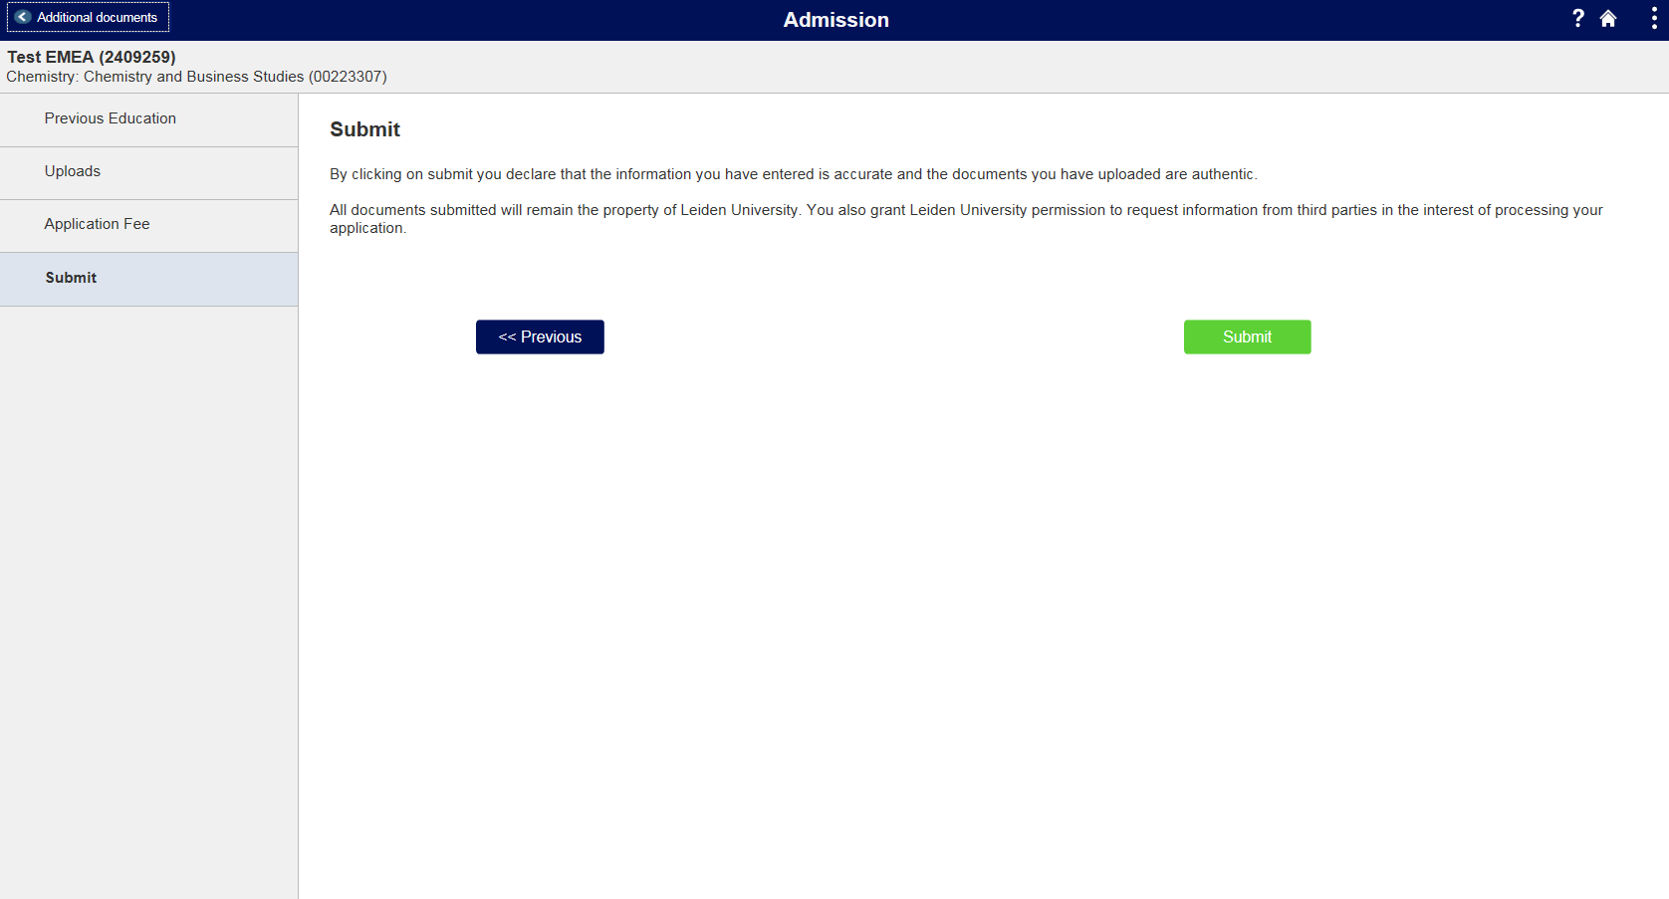

Slide 34
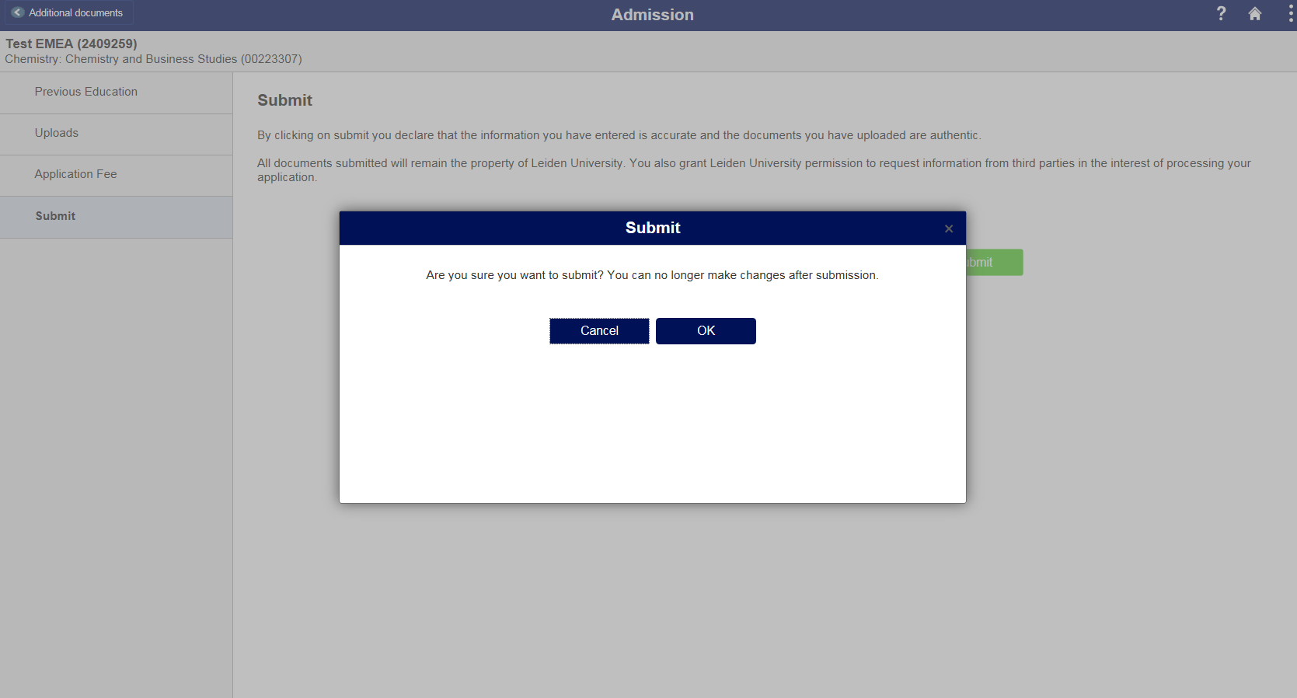

Slide 35
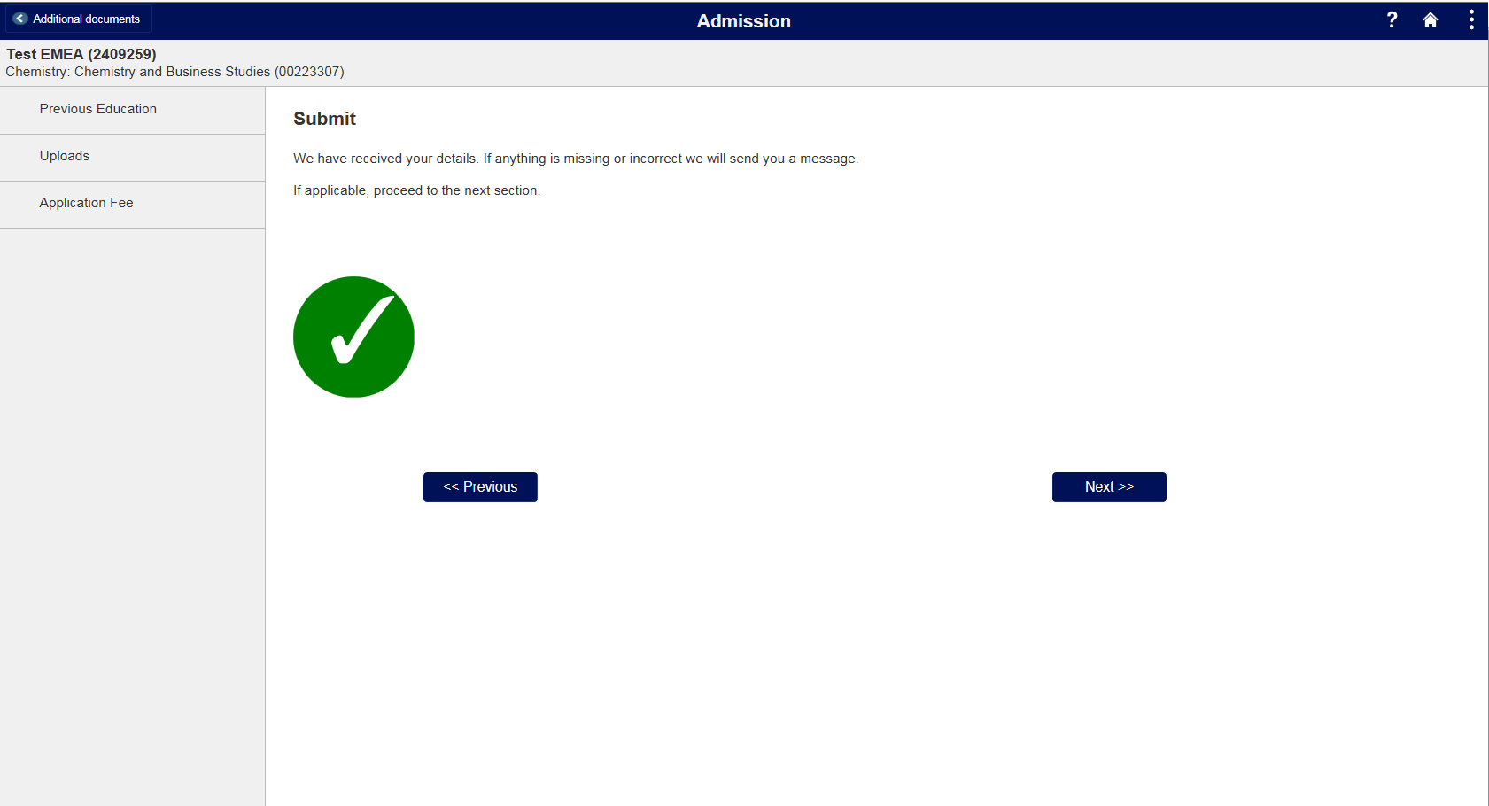

Slide 36
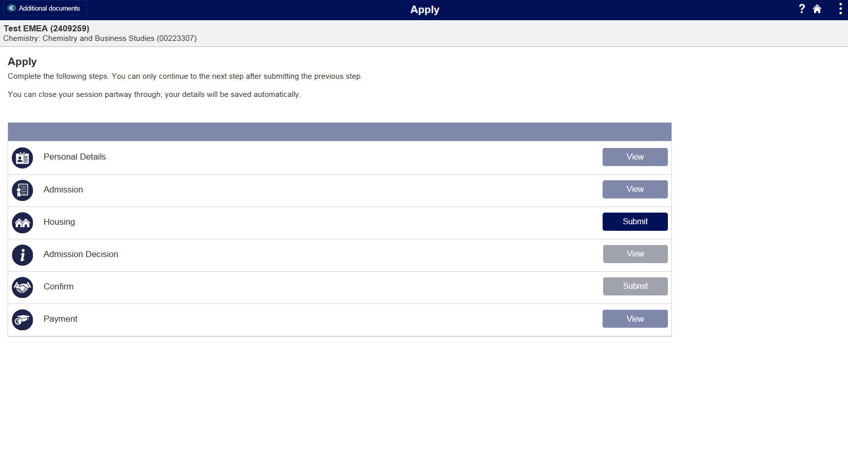

Slide 37
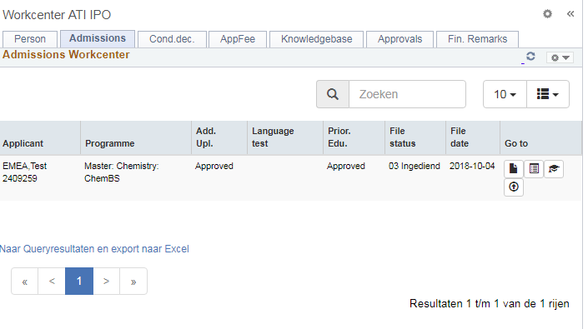
Evaluation by Adminstration

Slide 38
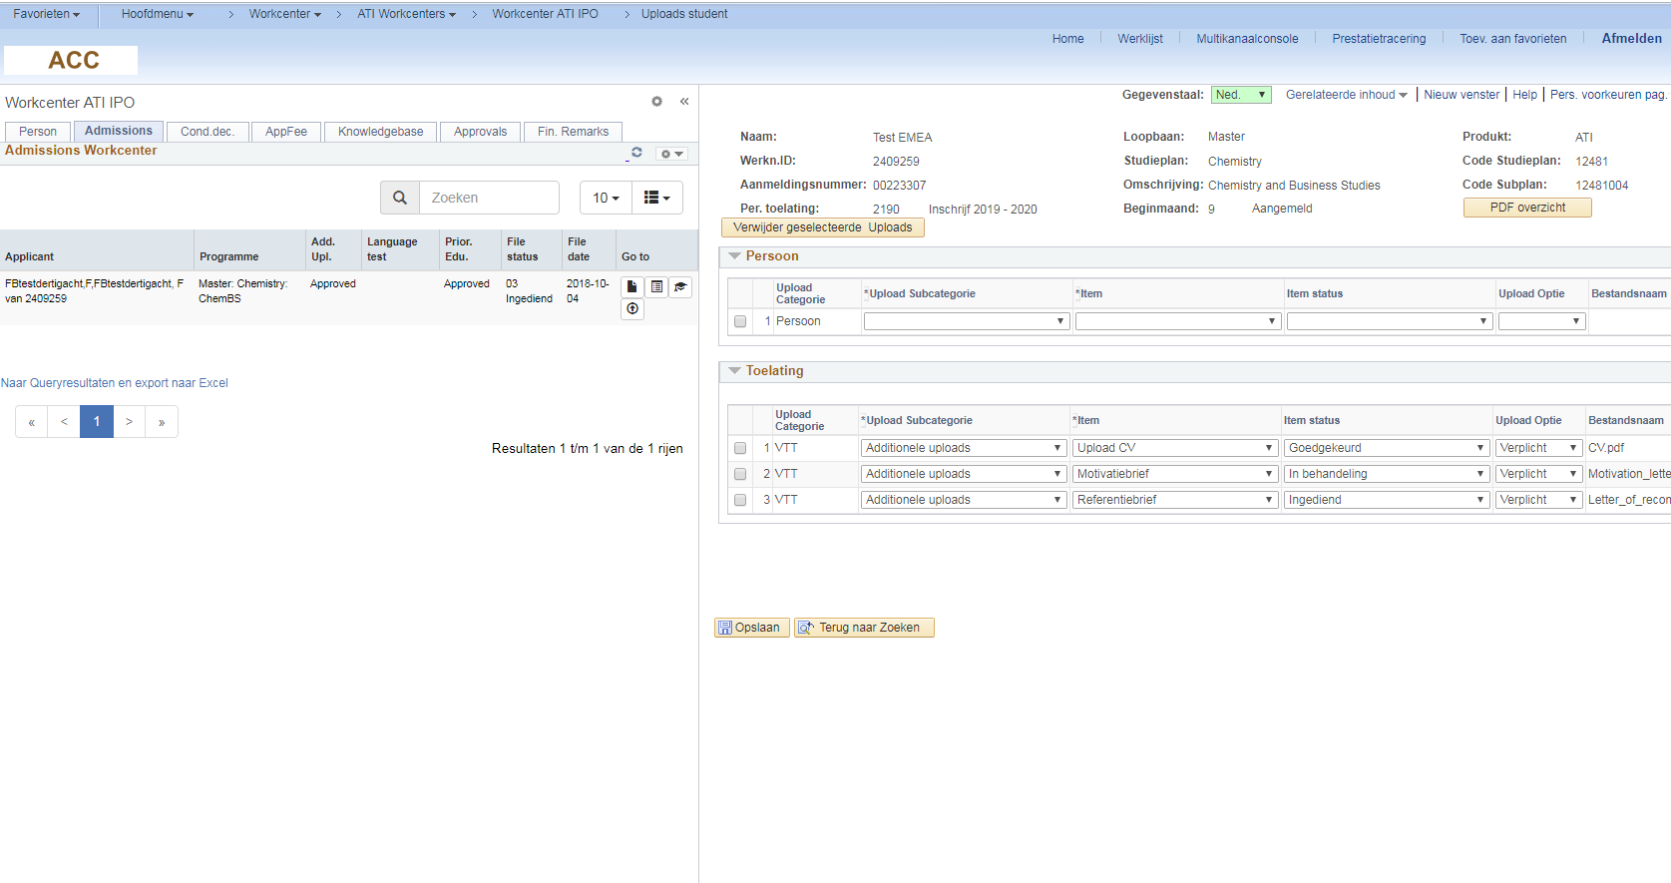

Slide 39
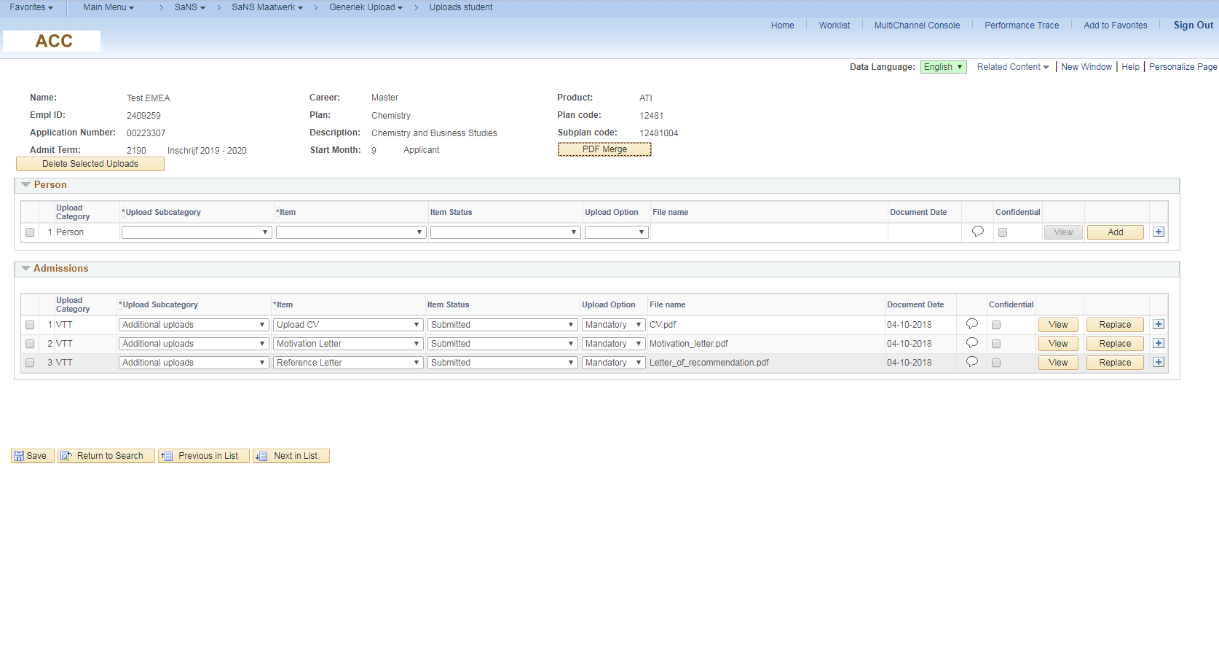
Category
Item
Mandatory
Date
Sub
Category
Status
Name
Remarks

Slide 40
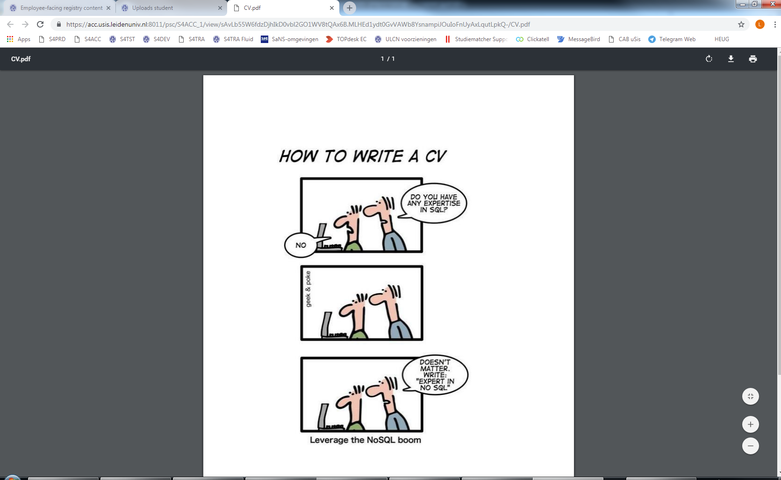
View attachment

Slide 41
Evaluate attachment: reject

Slide 42
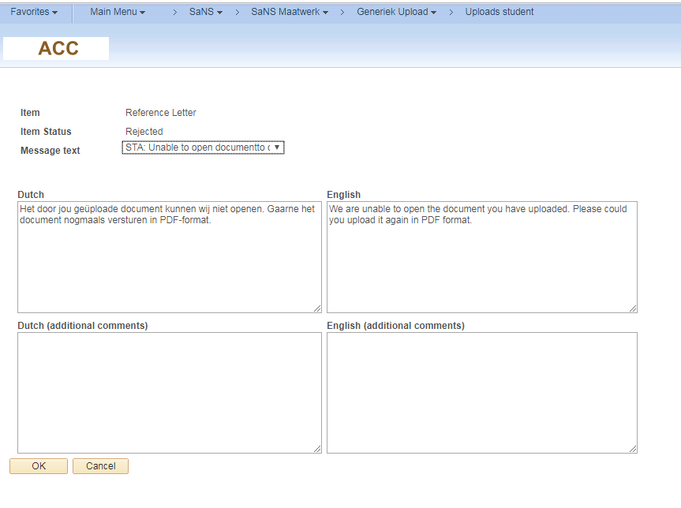
Add remark

Slide 43
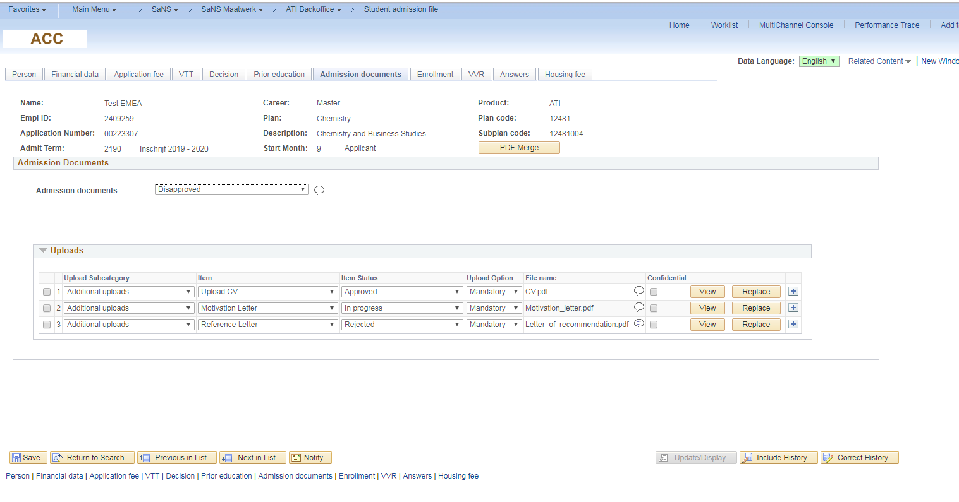
Disapprove proces: Admissions file

Slide 44
Students submits extra info

Slide 45
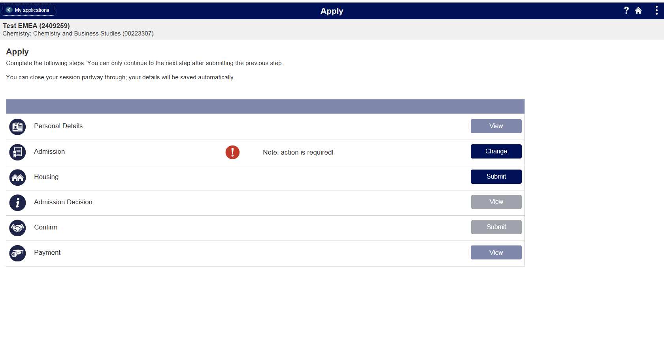

Slide 46
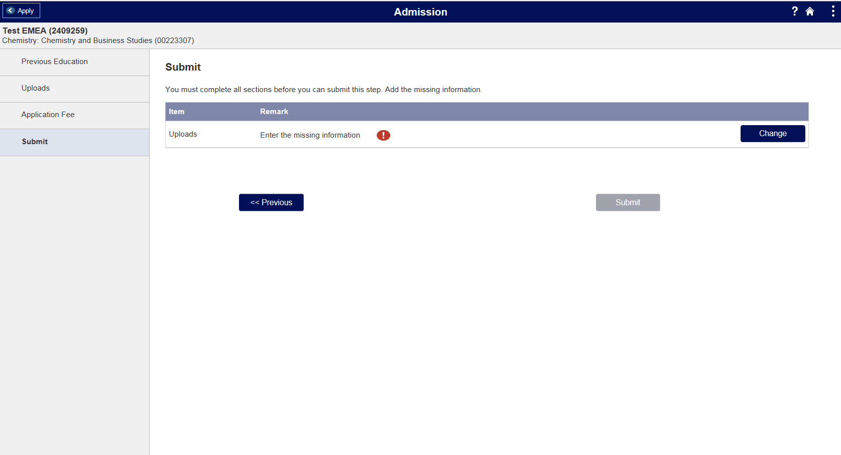

Slide 47
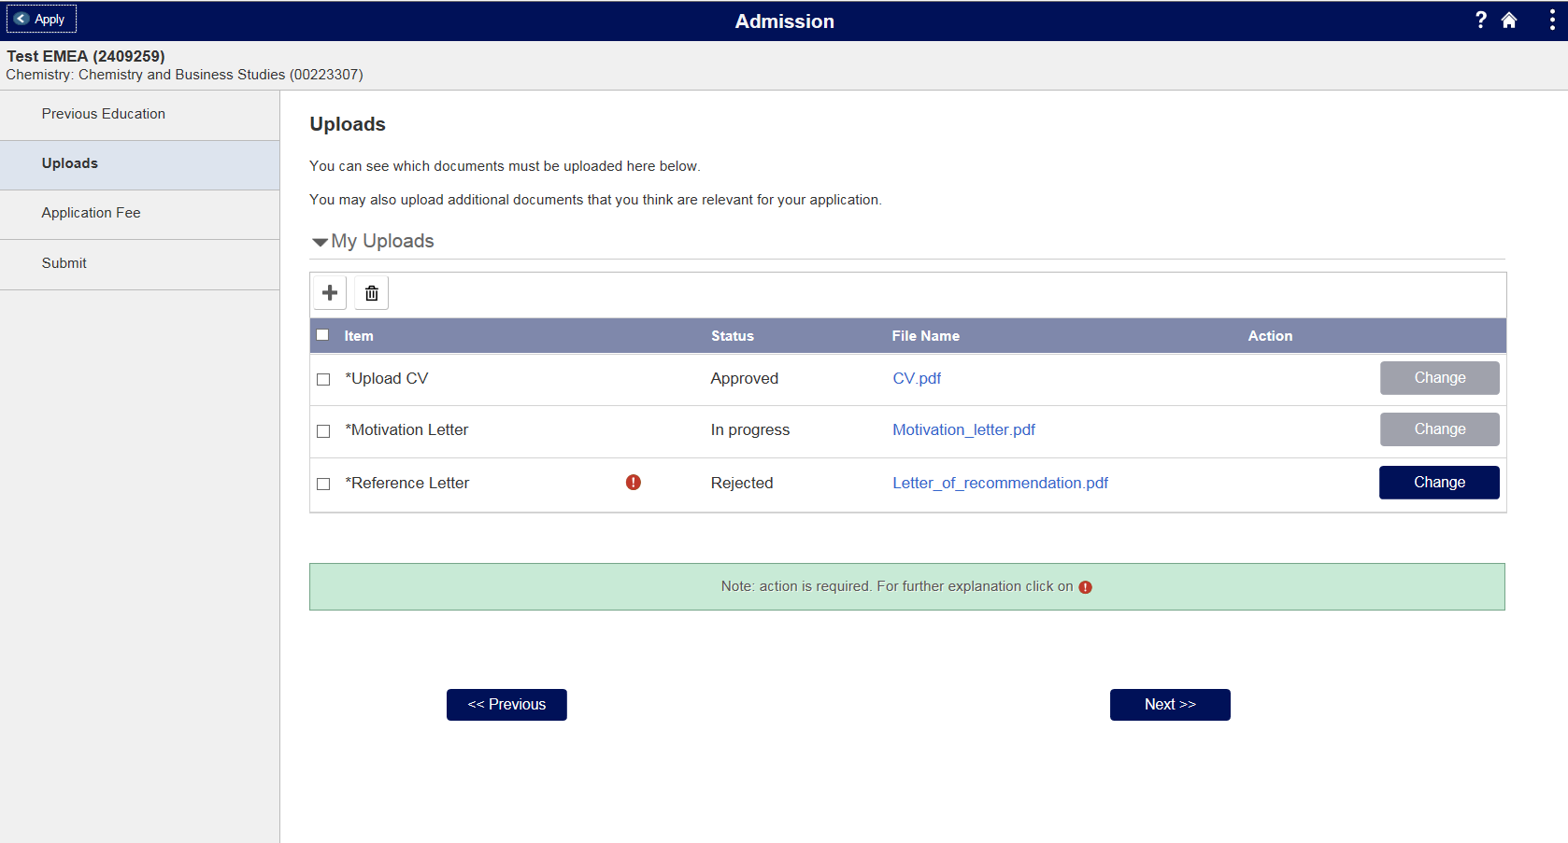

Slide 48
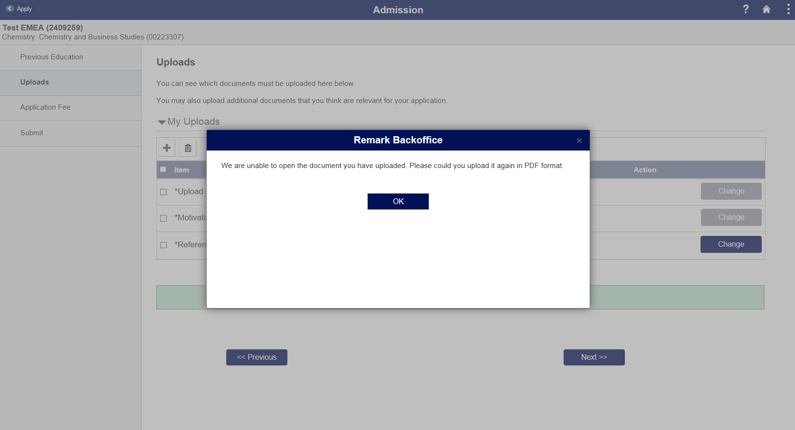

Slide 49
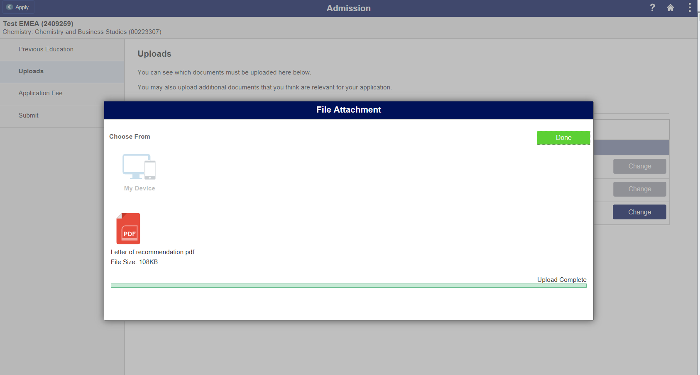

Slide 50
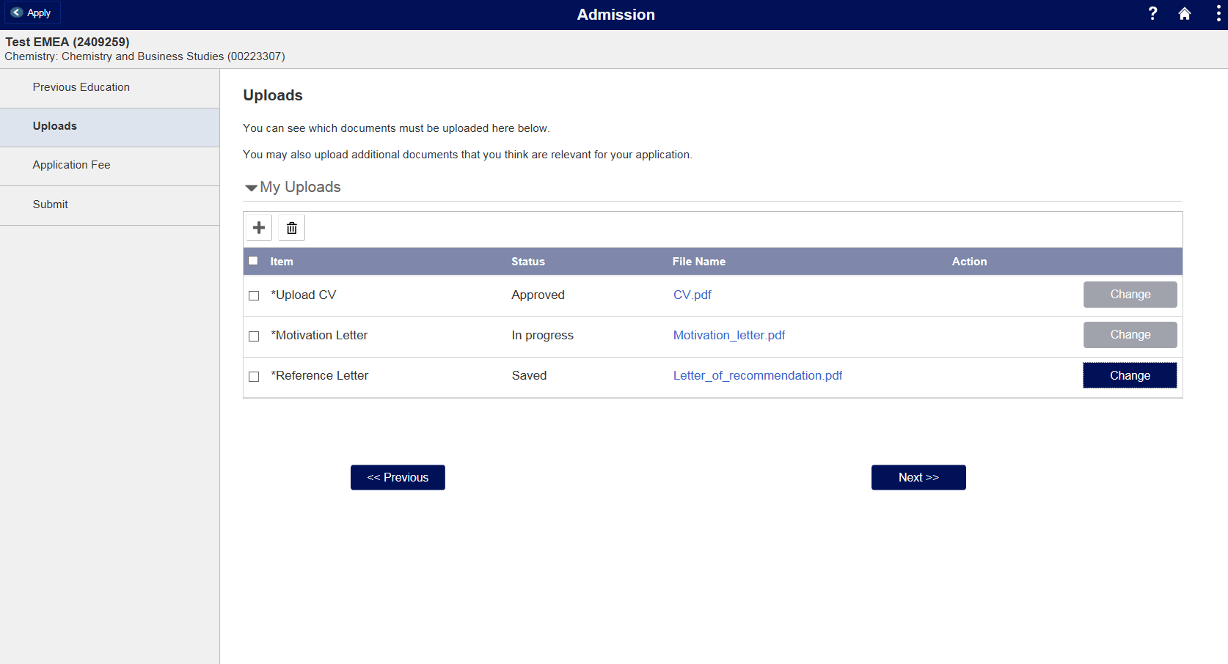

Slide 52
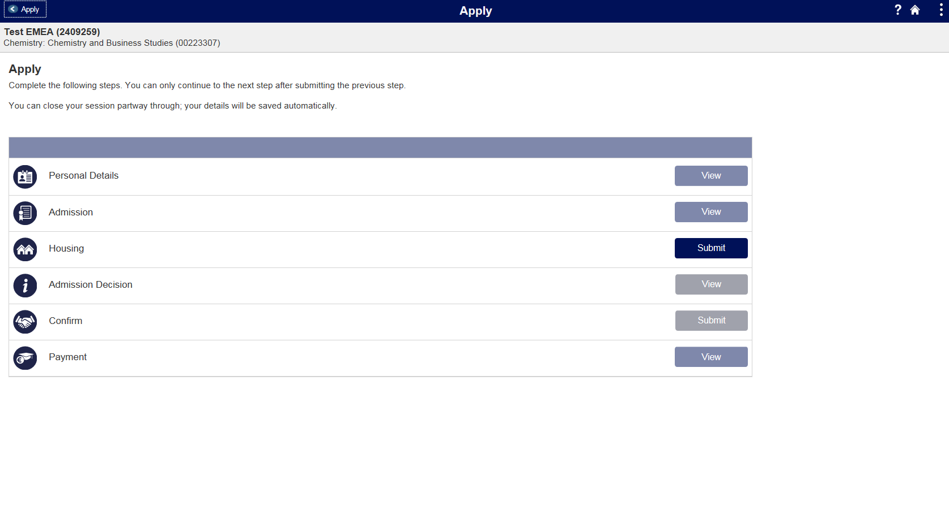

Slide 53
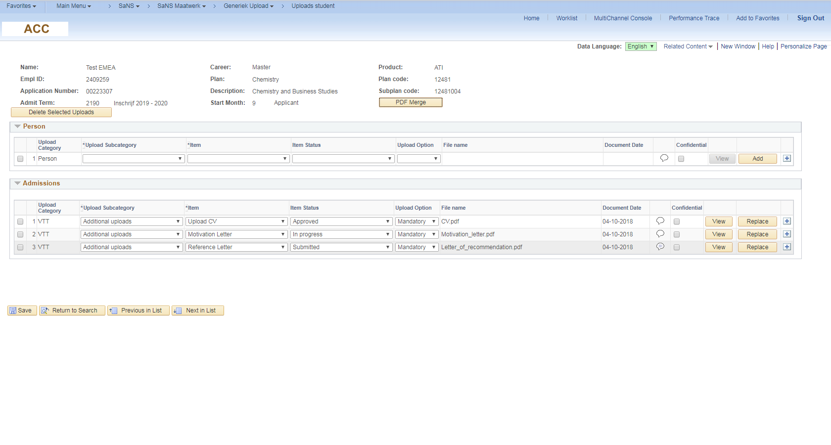
Re-Evaluation by Adminstration

Slide 54
Approve documents

Slide 55
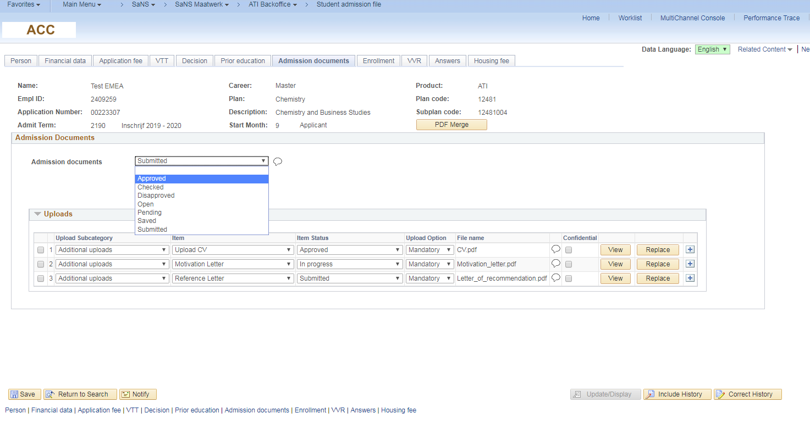
approve proces

Slide 56
Merge

Slide 57
Cover sheet

Slide 58
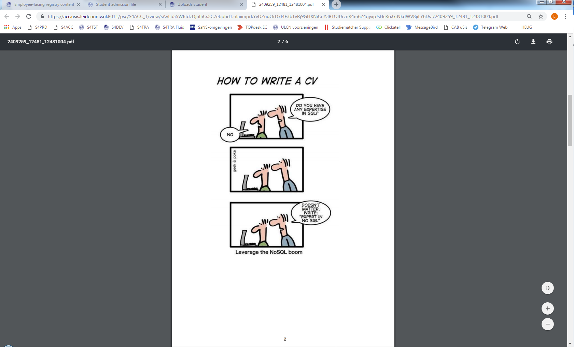
Selected Documents

Slide 59
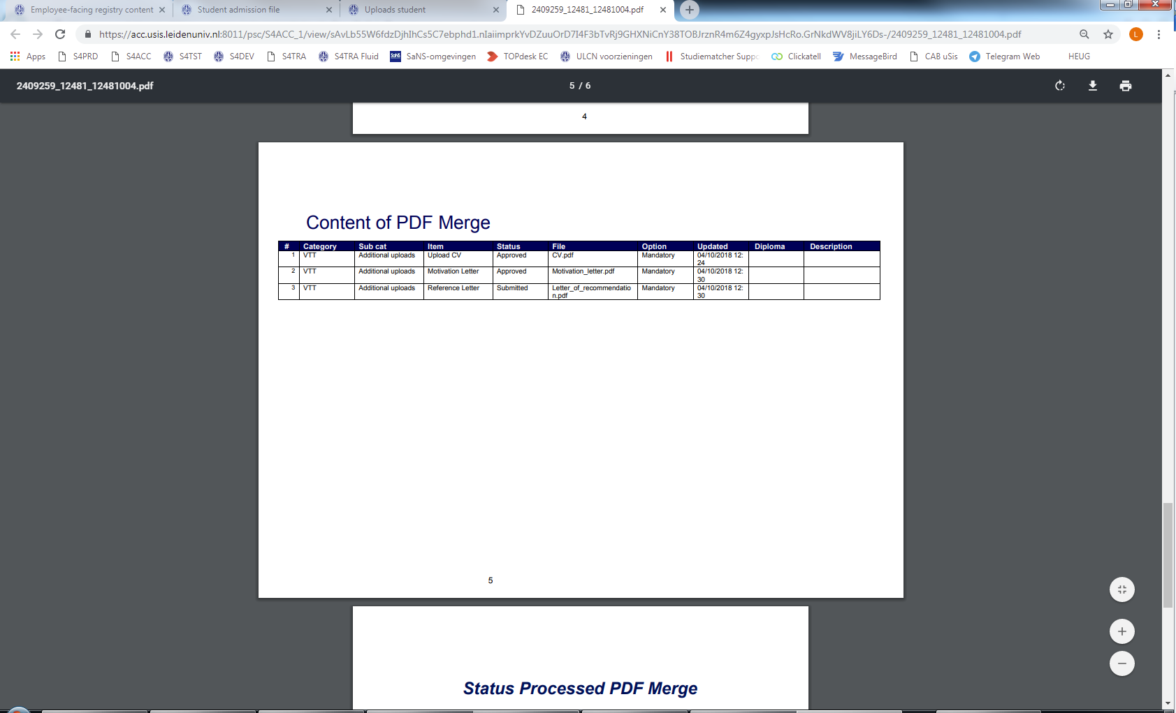
Content

Slide 60
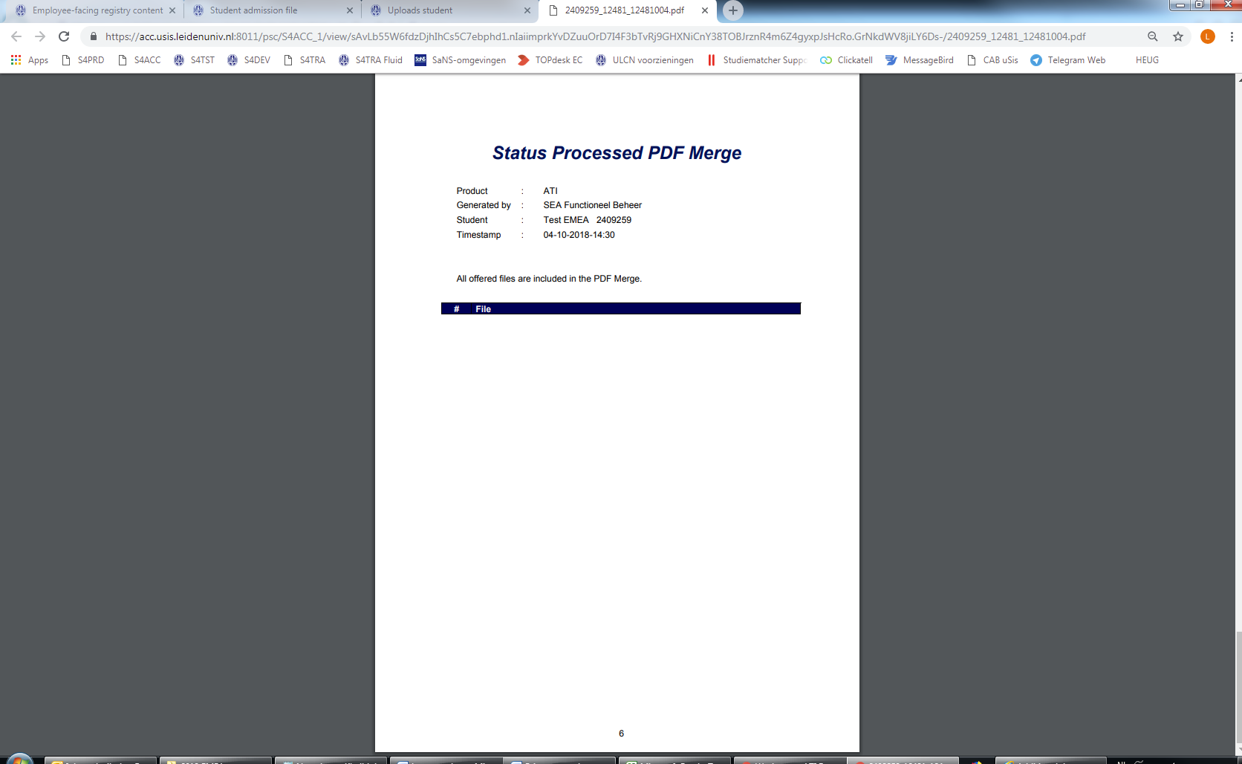
Summary

Slide 61
Admissions process
Apply (Studielink)
Register application
Determine conditions
Complete other requirements
Enrolled
Submit extra info
Evaluation by administration
Evaluation by faculty
Admitted

Slide 62
OvervieW
1
3
Why do we need new upload functionality?
Demo of the product
2
4
What do we need? (design)?
How to configure it yourself?

Slide 63
Configure it yourself

Slide 64
Configuration upload framework
Product
Category
Cross reference (PeopleCode to add new)
Page block (PeopleCode to add new)
Subcategory
Item
Status group
Authorization

Slide 65
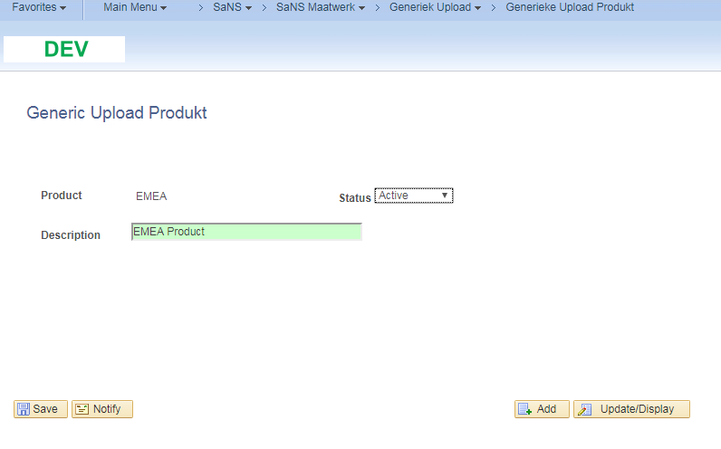
product

Slide 66
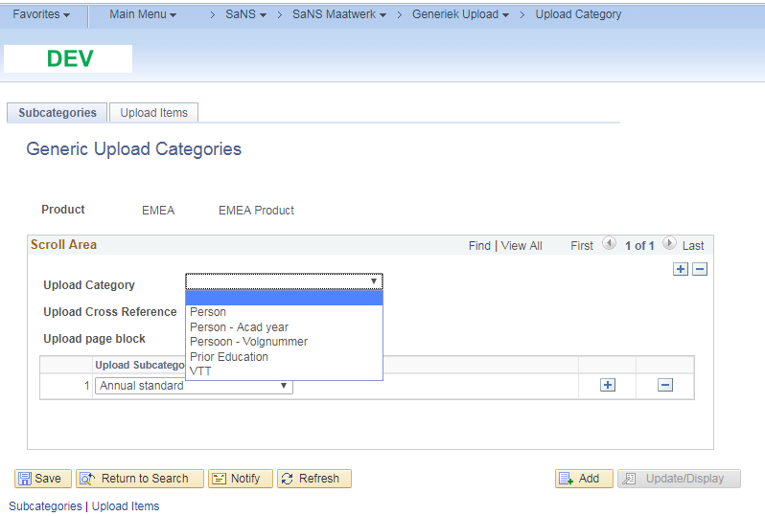
Category

Slide 67
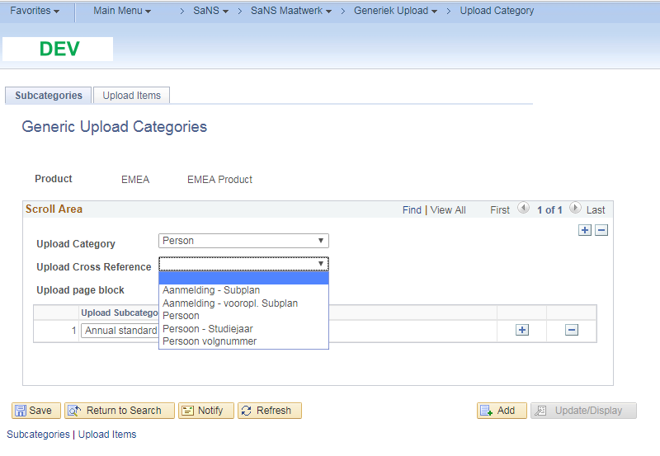
Cross reference

Slide 68
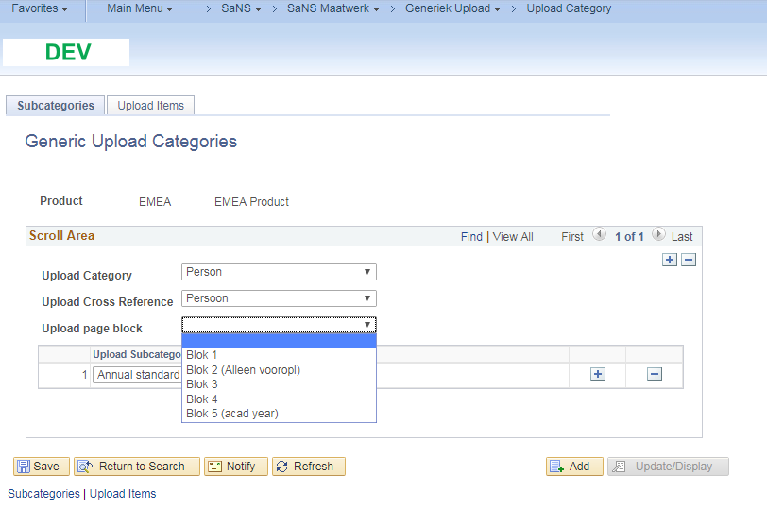
Page block

Slide 69
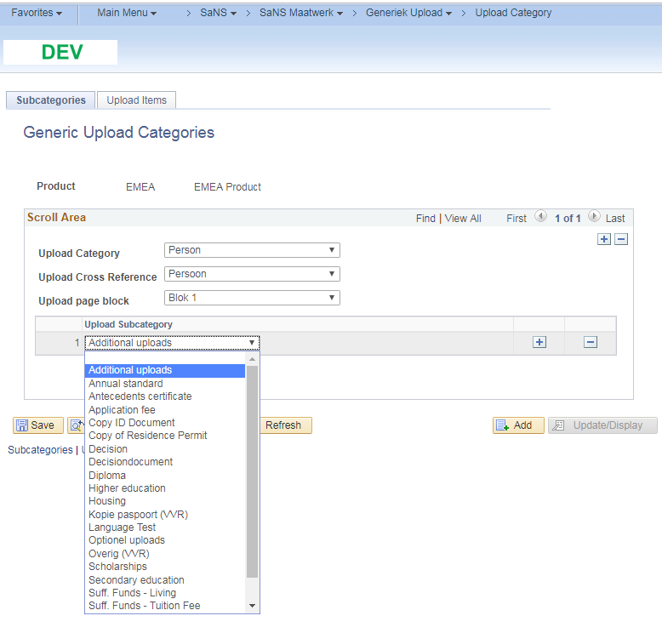
Subcategory

Slide 70
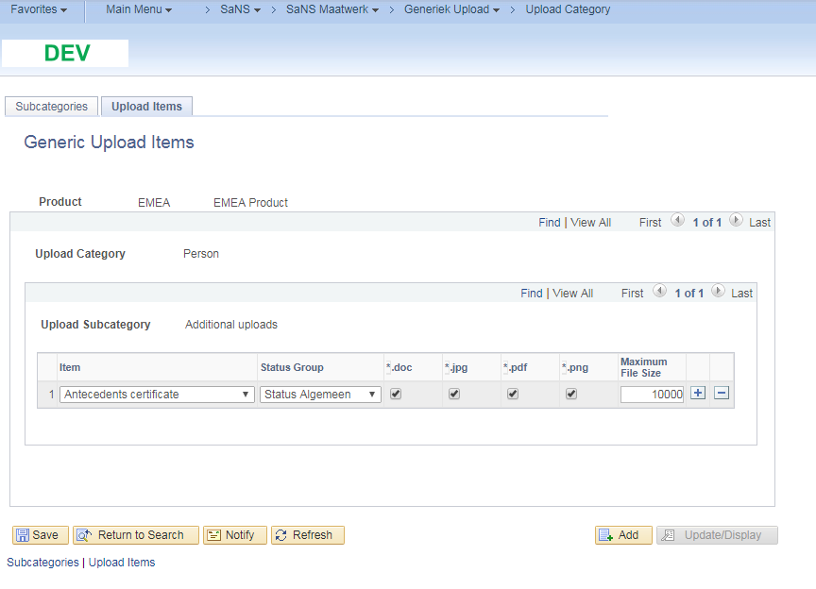
Items, status group, type, size

Slide 71
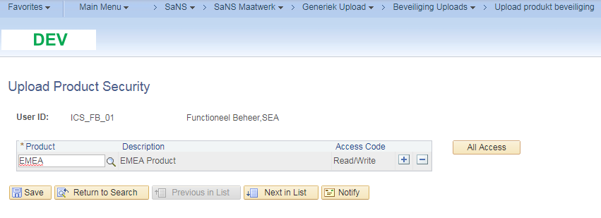
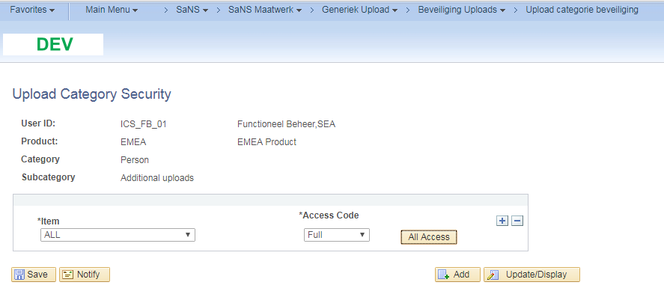
Authorize user: row level (&role)

Slide 72
Add attachments!

Slide 73
OvervieW
1
3
Why do we need new upload functionality?
Demo of the product
2
4
What do we need? (design)?
How to configure it yourself?

Slide 74
Concluding thoughts
Future:
- Improve standard Oracle upload functionality
- Roll out for different user groups / processes
ANY QUESTIONS?

Slide 75
presenters
Lennaert Wilschut
Business Information Manager
Leiden University
L.wilschut@sea.leidenuniv.nl
Functional Consultant
Working with Campus Solutions since 2006
Working at Leiden University since 2010
Primary focus on digitalizing / automating Admissions processes

Slide 76
THANK YOU!

