Slide 1
LEEP INTO THE FUTURE OF CURRICULUM MANAGEMENT!
SESSION 6046
November 13, 2018

Slide 2
PRESENTER
Pernell Blake
Functional Analyst
MacEwan University
blakep5@macewan.ca

Slide 3
MACEWAN UNIVERSITY
Founded in 1971
19, 606 students
6 Schools and Faculties
2 Campuses - City Centre and Alberta College
Alberta’s fourth-largest post secondary institution

Slide 4
ORGANIZATION & ORACLE
PeopleSoft Release 9.2
PeopleTools 8.56

Slide 5
OVERVIEW
SECTION 1: REASONS FOR THE PROJECT
SECTION 2: PROJECT OBJECTIVES
SECTION 3: THE ONLINE SYLLABUS MANAGEMENT SYSTEM
SECTION 4: THE IMPLEMENTATION OF CAT (Academic Calendar)
SECTION 5: THE IMPLEMENTATION OF CIM
SECTION 6: LESSONS LEARNED

Slide 6
REASONS FOR THE PROJECT
In 2017 MacEwan University decided that there was a need for a more robust Curriculum Management Solution (CMS).
The need arose because the current OnLine syllabus management System (OLS) was experiencing system and functional issues.
The OLS system is an Access database which was difficult to maintain.
To create an online web calendar that ties in with the university pillars of sustainability.

Slide 7
PROJECT OBJECTIVES
Replace the current OLS with an easy to use system that allows flexibility and meet the requirements of the university.
Establish an interactive and printable online academic calendar. Moving our calendar into the 21st century.
Enhance functional capabilities with the new system for example, flexible workflow process.
Enhance online services to the university community.
Improved customer service.
Meet future business needs of the university.
Improve operational efficiencies throughout the university.

Slide 8
THE ONLINE SYLLABUS MANAGEMENT SYSTEM (OLS)
Prior to 2018 MacEwan University printed academic calendars and used an access database for their online syllabus management

Slide 9
THE OLS SYSTEM
The OLS system involved a lot of manual processes.
It was non-integrative and used to create and update syllabus information and create the paper academic integration.
The data held in OLS was inconsistent because updates were done in multiple areas.
There was also functional and system issues.
There was no integration between OLS and Campus Solutions.

Slide 10
THE OLS SYSTEM

Slide 11
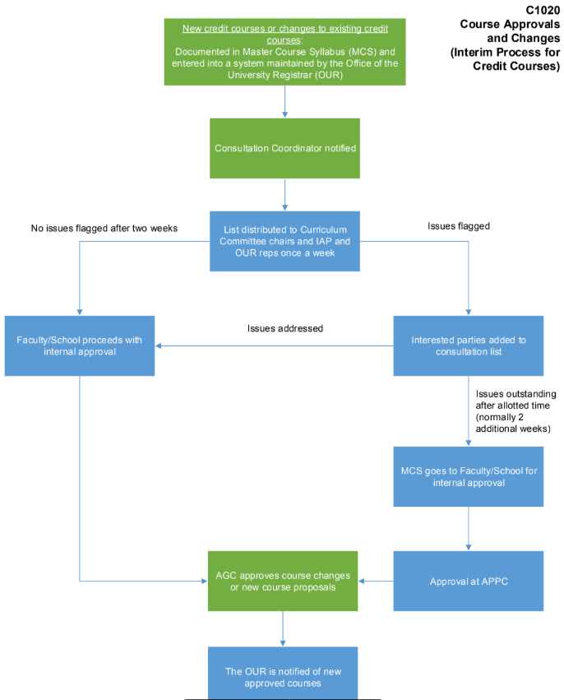
COURSE DEVELOPMENT WORKFLOW
Under the old system the workflow included departments and positions that no longer existed.
There was no easy way to remove these triggers.
The person(s) involved with building the database no longer worked at MacEwan.

Slide 12
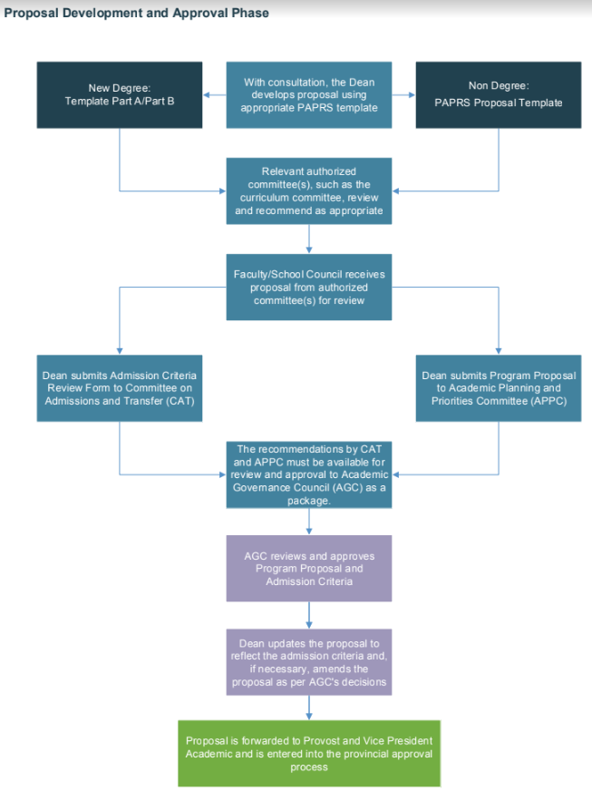
PROGRAM DEVELOPMENT WORKFLOW

Slide 13
THE IMPLEMENTATION OF CAT
CAT is CourseLeaf’s Academic Calendar that allows users to update, manage, and publish the academic calendar.

Slide 14
CAT PILOT
On February 20, 2018 MacEwan and Leepfrog had their CAT Pilot Meeting.
At this meeting Leepfrog consultants meet with the MacEwan’s team. During this meeting they:
Demonstrate sample pages in Courseleaf solution.
Calendar specifications.
To determine the primary audience for your academic calendar.
To determine the calendar structure for example, pages, navigation, formatting etc.
To determine how data will be displayed for example, course date, faculty information etc.
How to handle future business needs such as anti-requisites.
Gather feedback in order to provide the finalized product.

Slide 15
CAT MIGRATION & GO LIVE
The online calendar went live August 27, 2018.
However, prior to migration the implementation team:
.
Reviewed all calendar pages to ensure that all custom formats were indeed accurate.
The administrative team reviewed and approved the accuracy of the page content.
The IT security team reviewed and approved access control, possible vulnerabilities, and infrastructure assessment.

Slide 16
CAT GO LIVE
At Go Live:
All ERP, infrastructure/Operations and other technical resources were identified and updated.
All business resources identified and updated.
Links were tested.
Cutover plan schedule distributed.
Go live was implemented.
The Calendar was published on the Production site.

Slide 17
BENEFITS OF CAT
Easy to author
Allows administrator to easily check the accuracy of calendar information.
Allows the use of simple streamlined workflows to manage information and inform users.
Allowed for a standardised published calendar.
We are able to track changes made to courses and programs.
We now have the ability to provide reports to senior management.

Slide 18
THE IMPLEMENTATION OF CIM
CIM or Curriculum Management allows users to create, edit, manage, and approve courses and programs.

Slide 19
CIM PILOT
On August 29, 2018 MacEwan and Leepfrog had their CIM Pilot Meeting.
The Pilot took the form of a two day on site meeting with representatives from Leepfrog. At this meeting the following areas were covered:
A review of the forms developed by the Leepfrog implementation team.
Form specifications were updated in real time as decisions are made.
By the end of the meeting, requested specifications are considered final.
Workflows for course and program developments were finalised.

Slide 20
FLOW OF COURSE PROPOSALS

Slide 21
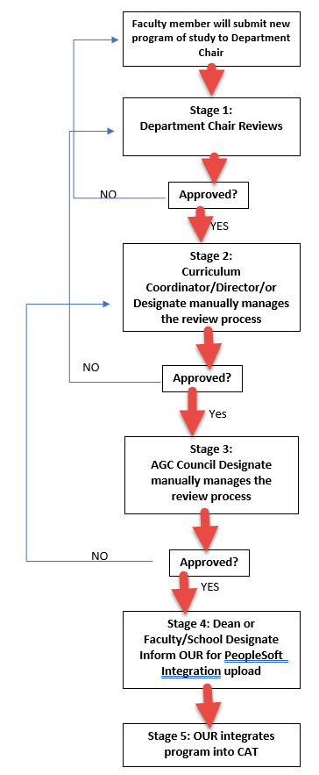
NEW MINISTRY APPROVED PROGRAMS
Faculties & Schools develop Ministry approved programs based on the process outlined in policy C1010

Slide 22
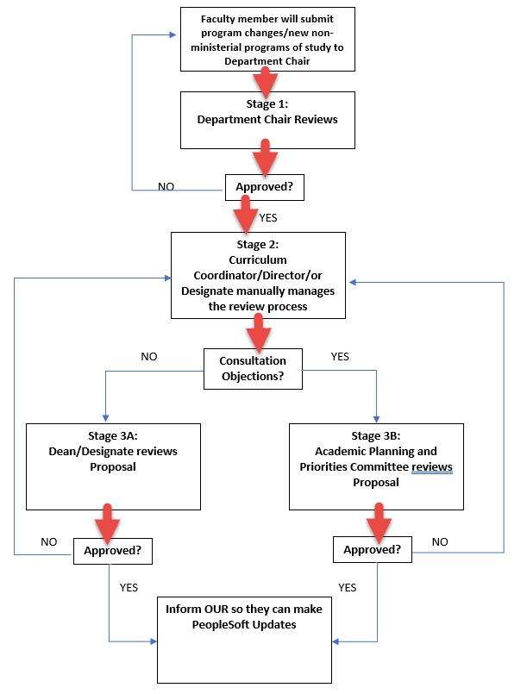
NEW NON-MINISTRY APPROVED PROGRAMS
Faculties & Schools develop Ministry approved programs based on the process outlined in policy C1010

Slide 23
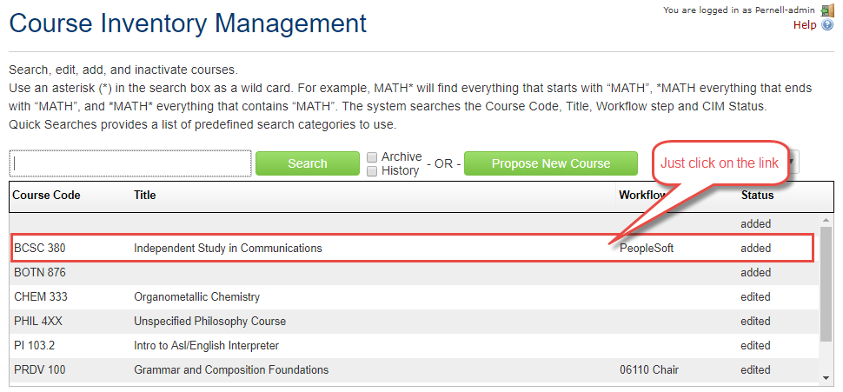
CIM Course Page

Slide 24
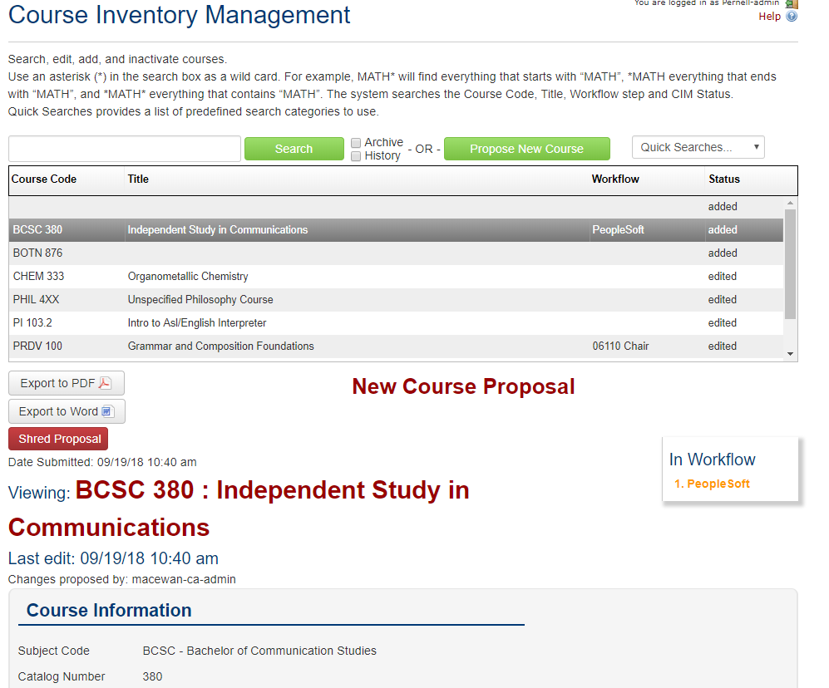

Slide 25
LESSONS LEARNED SO FAR...
Things we did or would do differently…

Slide 26
Lessons Learned
Start working on standardising the data for your calendar ahead of time. This will allow smoother data migration.
For the first calendar publication we kept the calendar content and format as close to the original as possible.
Start working on your data bridge early.
Establish a firm deadline to decommission your existing systems.

Slide 27
CONCLUDING THOUGHTS
ANY QUESTIONS?

Slide 28
PRESENTER
Pernell Blake
Functional Analyst
MacEwan University
blakep5@macewan.ca

Slide 29
THANK YOU!

