Slide 1
Online quotation system for student fees and housing
SESSION 11002
DATE OF PRESENTATION:
Thu, Jul 04, 2019

Slide 2
presenter
Dinesh Pillay
Title of Presenter: Mr
Company Name: University of the Witwatersrand
dinesh.pillay@wits.ac.za

Slide 3
University of thE Witwatersrand, jhb

Slide 4
University of the Witwatersrand (Wits)& Oracle
Oracle: 12.1.3
Oracle Data base: 12.1.0.2
PeopleSoft: 9.2
Tools 8.55.10

Slide 5
Introduction and background
* Our historical fee quotation system was a manual and paper based process * Students required a fee estimate/quotation for the costs of studying for a particular program, housing and meals * Students were required to obtain a pre-printed template from the Fees Office which was completed by the Faculties on behalf of the student * The student then had to return the template to the fees office and a manually typed estimate/quotation was done * This process was time consuming and posted restriction for the applicant and staff, i.e. must be present on campus * The manual process required the University to employ additional temporary staff for 4 -5 months during the peak registration period * The costs of paper and the employment of temporary staff was astronomical each year * We had an average of 16 000 fee quotations requested annually

Slide 6
Aspects taken into consideration for online fee quotation * Only applicants or existing student are allowed to request for a fee and housing quotation via the student self- service portal * Applicants may only apply for a fee quotation for the different study choices made on their academic application * Existing students can only request a quotation for programs they are active in or have made an application for * Each quotation must be uniquely numbered and stored for reference purposes
Additional functionality * The preferred student email address stored on the system will be a default with the option to change the email address * Nationality (residency status) will be obtained from the system, i.e. additional charges depending on nationality * Include the Residence costs if required by the student * Include the Meal plan costs if required by the student * Staff can request a quote on behalf of a student

Slide 7
Costing calculation logic * Full/part time programs * Part time students are not eligible for Residence costs * Course selection is determined by the academic program * Academic programs could be a fixed curriculum where the courses will be automatically populated by the system * Academic programs could be a flexible curriculum where there is a choice of courses from a drop down list * Current year and the next year fee quotation can be requested * Term fees will be determined by the rules

Slide 8
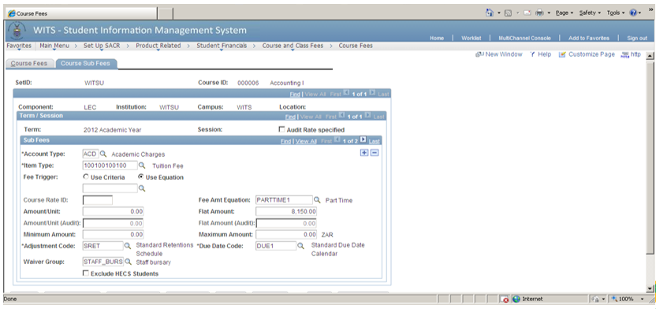
Course and Program Fees * The Fees structure is managed within People-soft in the Course Fees table. Once the Course selection on the fee estimator has been made (or determined), the Course Fees can then be accessed in this table, including any additional charges, i.e. Notes, Unit Packs & E-Learning and other miscellaneous charges * Some Programs also have charges associated with them and these too, should be retrieved for the purposes of the fees quote, i.e. a special computer fee for 3rd year engineering students

Slide 9
Costs from the Residence system in PeopleSoft (Bolt on) * The fee quotation will be based on the new Residence System and obtain the cost based on the student type and the Residency Category. The costs for the Residence will be retrieved from the new Resident system setup * The student type is system determined, i.e. if the student is new to the University, returning or Post graduate. The student type displays the different residence the student can access * The Residency category classifies the different types of residences that can be accessed, e.g. catering or self-catering residence and is based on age and gender * The residence room type allows a student to select if they require a single or double sharing room * The above rules will determine the costs for the residence section on the fee estimator

Slide 10
Student self-service portal using Fluid technology
Students and applicants can request for an online quotation via the self service portal
We have created different tiles on the student home page, this allows easy navigation around the portal
Students can click on the Fee Estimator tile to access the online fee and housing quotation

Slide 11
Fee and housing estimator
Students can request a new fee estimate or view and print previously requested quotes from the estimate history section
Each quote has a unique estimate number, this is system generated
Displayed is the Academic year, the Program, Academic level, total amount, requested date, a view and a details icon button

Slide 12
Fee and housing estimator
Before the applicant/student can continue we have to include a declaimer for the protection of the University
The student will then either accept and continue or decline and exit

Slide 13
Fee and housing estimator
This example illustrates a student who is currently active in a program, therefore the fee estimator will be generated based on this program

Slide 14
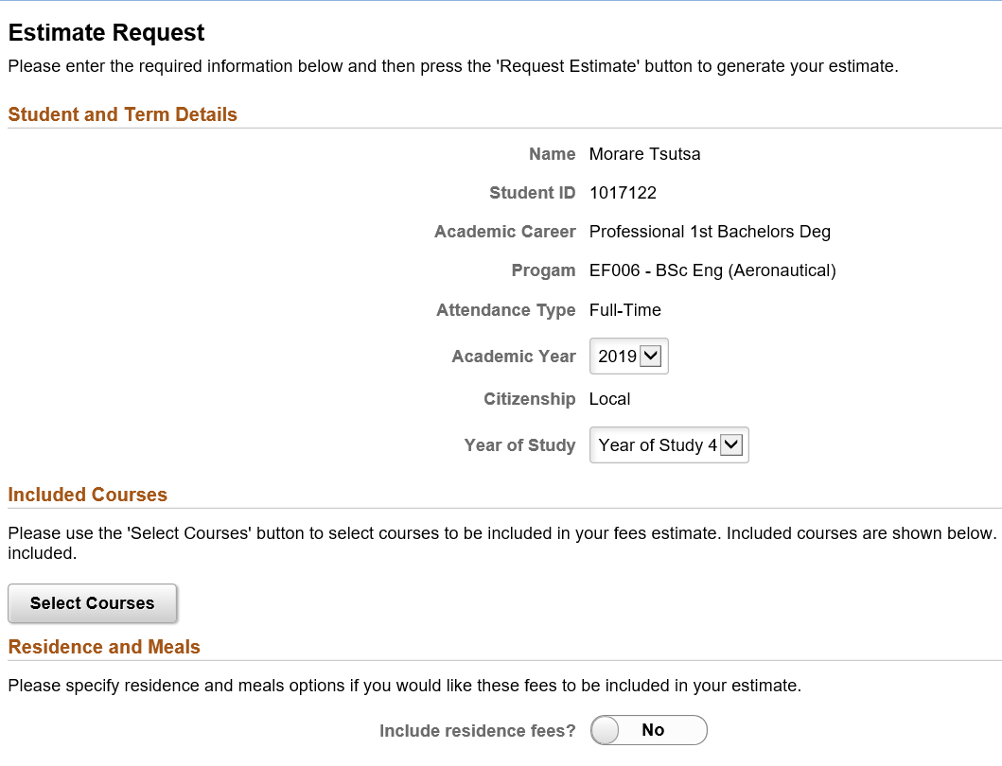
Fee and housing estimator
After selecting your program, the Student and Term Details will be displayed, one has a choice of Academic year 2019 or 2020. You can also change the Year of Study
The enquirer should then click on the selected Courses, Residence and meals if applicable
Then if you would require the fee estimator to be emailed to you, you have options for alternative email address

Slide 15
Fee and housing estimator: Select Courses
When you click on the courses selection button, the courses linked to the curriculum will be displayed and you can choose which courses you would like to have displayed on the fee estimator
The additional course sections allows the enquirer flexibility to add courses that are non-curriculum courses

Slide 16
Residence and Meals
After the courses are selected and the return key is selected, the enquirer can then select the option to include the Residence fees. One can choose from self or catering residence, the residence type, i.e. which residence would you prefer. What room type, i.e. single, double or sharing and then your meal option
Then request for the quote to be emailed

Slide 17
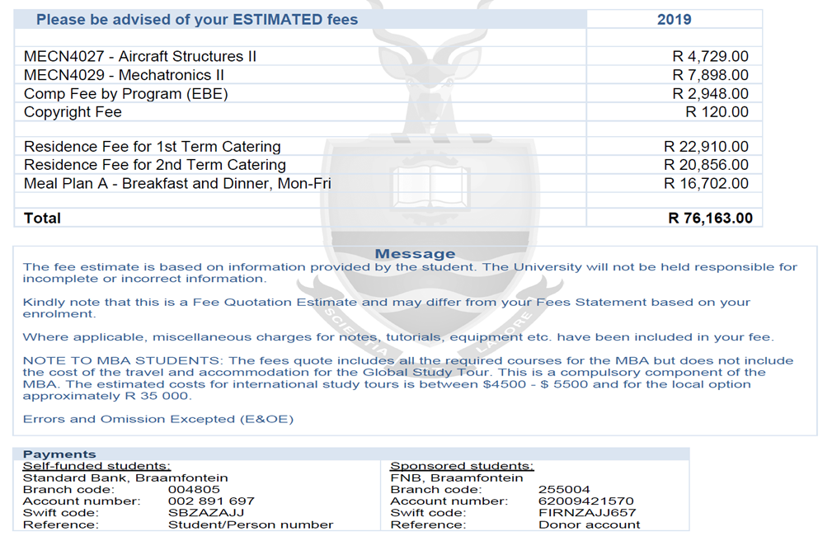
Fee and housing estimator display
The display of the Fee Estimate reflects the following, the student information, the courses selected including term fees and additional charges, The Residence and Meal charges
We have included a message block for any relevant message to students
There is a payment section displaying our student banking details and Sponsors banking details

Slide 18
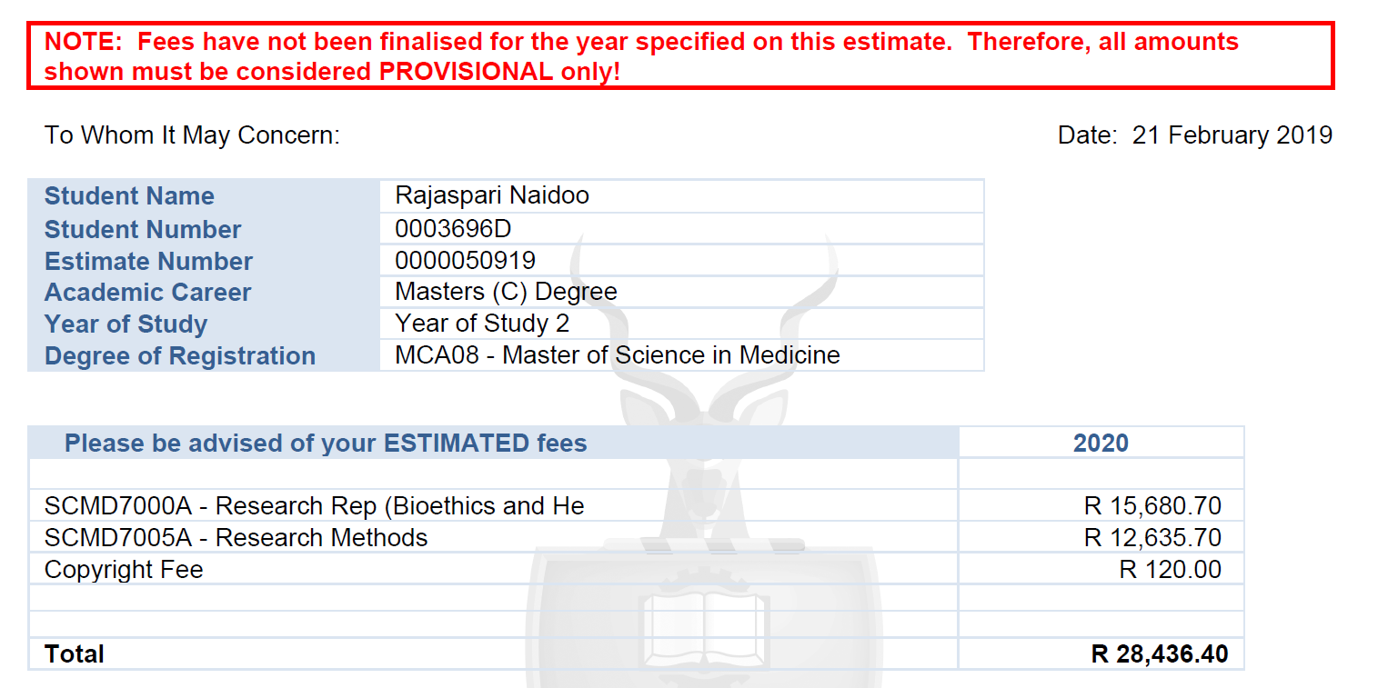
This example illustrates a fee estimator for the following year

Slide 19
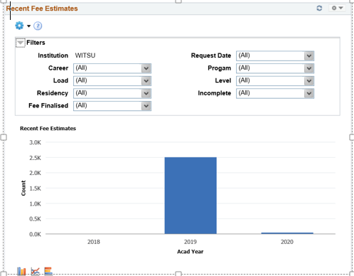
Pivot reporting using Fluid technology

Slide 20
REPORTS
Detailed information when you expand on the pivot grid, or you can run these report when required

Slide 21
Setup Page
We have the Fee Estimator setup and configuration page
The first tab is the General Configuration
Then the Year Setup
Then the Meals Plan

Slide 22
General Defaults and Setup
Tuition fee Increase percentage depending on the fee increase for the following year
Residence fee Increase percentage - depending on the increase for the following year
Part time Fee calculation
Fee Estimator disclaimer and other message
Technical Setup – option to use the custom curriculum program or not, email activation, debug file logging when we experience problems, included a archive function

Slide 23
YEAR setup page
The fee estimator academic year for the current year
The Fees Finalised tick box will determine the costing year to be calculated with actual costing
If you enquire a 2020 fee quote the costing will be based on the 2019 fees because the Fees are not yet finalised with a 5% increase on costing

Slide 24
Meals Plan setup page
The 6 Meal Plan option from where a student can select one plan
The Meal Plan is maintained yearly

Slide 25
Concluding thoughts

Slide 26
presenter
Dinesh Pillay
Title of Presente: Mr
Company Name: University of the Witwatersrand
Dinesh.pillay@wits.ac.za
all Alliance presentations will be available for download from the Conference Site

Slide 27
THANK YOU!

