Slide 1
Admissions and student financials working together in harmony
SESSION 9
18 November 2015

Slide 2
presenters
Karen Tallett
Paula McEwan
Functional Expert – Student Financials
University of Glasgow
Karen.Tallett@glasgow.ac.uk
Functional Expert – Admissions
University of Glasgow
Paula.Mcewan@glasgow.ac.uk

Slide 3
University of glasgow
Located in Glasgow, Scotland.
19,375 undergraduate students
7,233 postgraduate students (AY 2014)
Founded in 1451, the University of Glasgow is the fourth oldest university in the English-speaking world.
Top 1% of the world's universities

Slide 4
ORGANIsATION & ORACLE
Campus Solutions v9.0
Tools 8.53
Go live August 2011

Slide 5
Agenda
Application Fees Configuration
Application Fees - Online Application System (OAS)
Enrolment Deposits Configuration
Enrolment Deposits – Maintain applications

Slide 6
Application fee configuration
System Set Up and Amendments

Slide 7
Application Fees
University of Glasgow required a fee to be charged for specific plans, in order for a student to submit an application.
For this to be efficient, we identified the following requirements as essential to the business:-
Different amounts can be charged per plan
Different amounts can be charged per residency (customisation)
Automation of the process
Waiver basis criteria

Slide 8
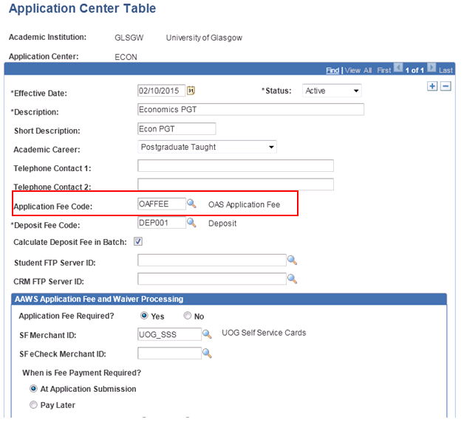
Application Center

Slide 9
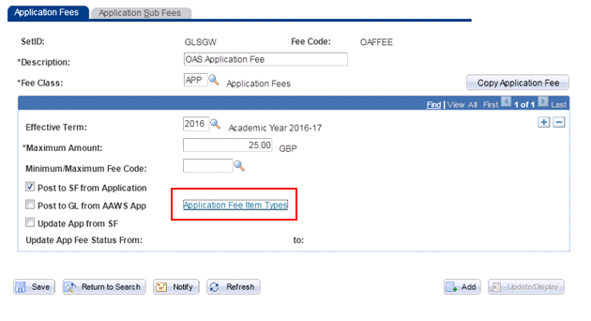
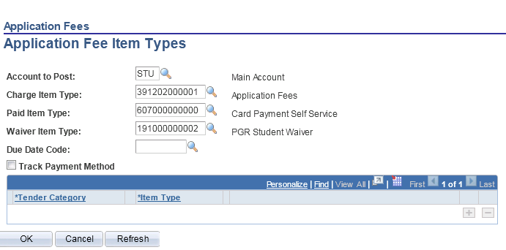
Application Fees Configuration

Slide 10
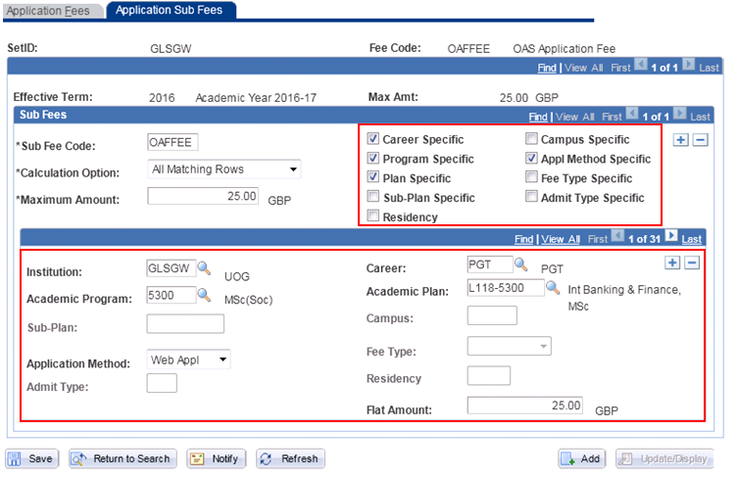

Slide 11
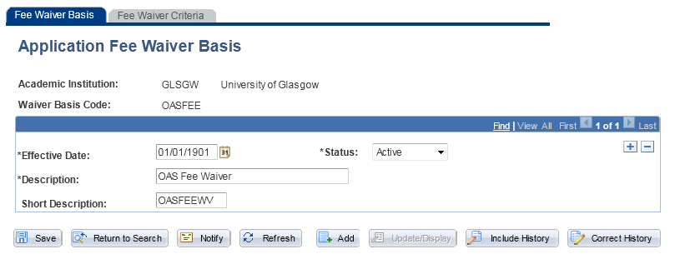
Application fee waiver

Slide 12
SECTION 2 application fees (AAWS)
Application Fees -
A View from the Online Application System - AAWS

Slide 13
Application fees via the online app
How does an applicant know when an application fee will be charged?
When does an applicant have to pay their application fee?
How can an applicant check if they have paid their application fee?
Are application fees waived at any time?

Slide 14
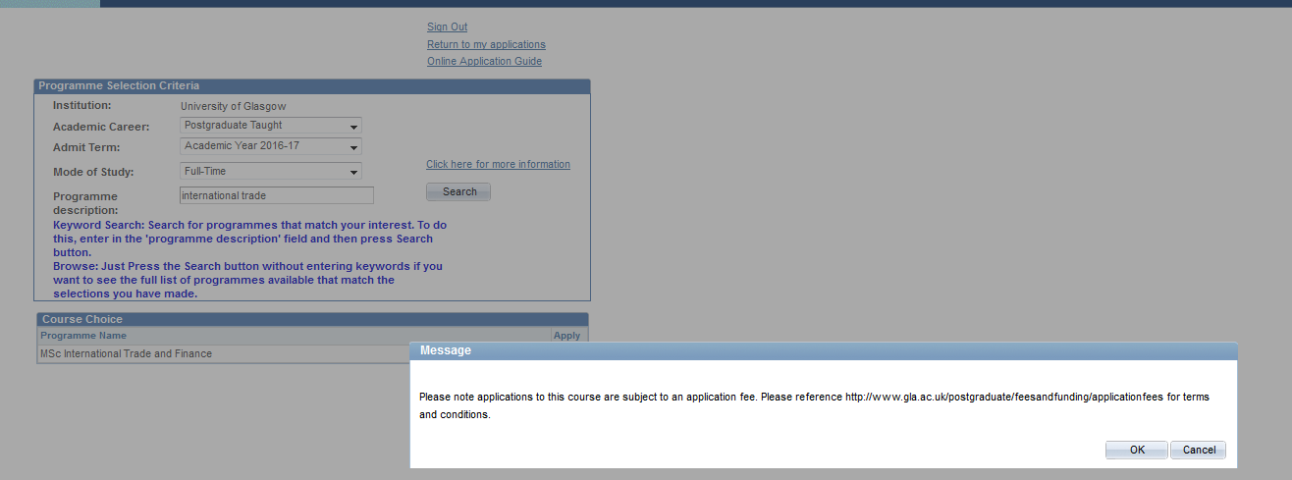
Online application

Slide 15
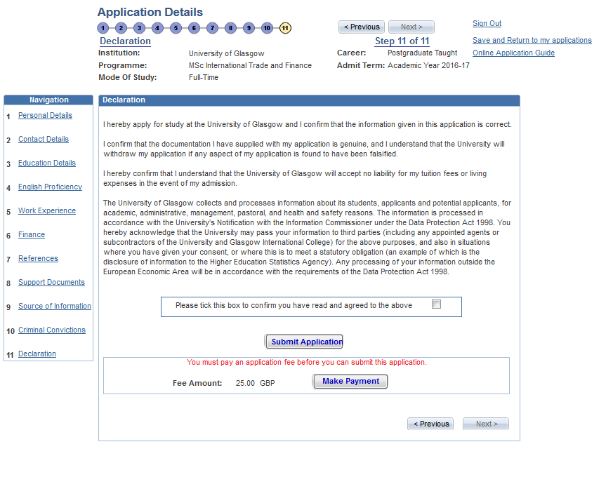
Online application

Slide 16
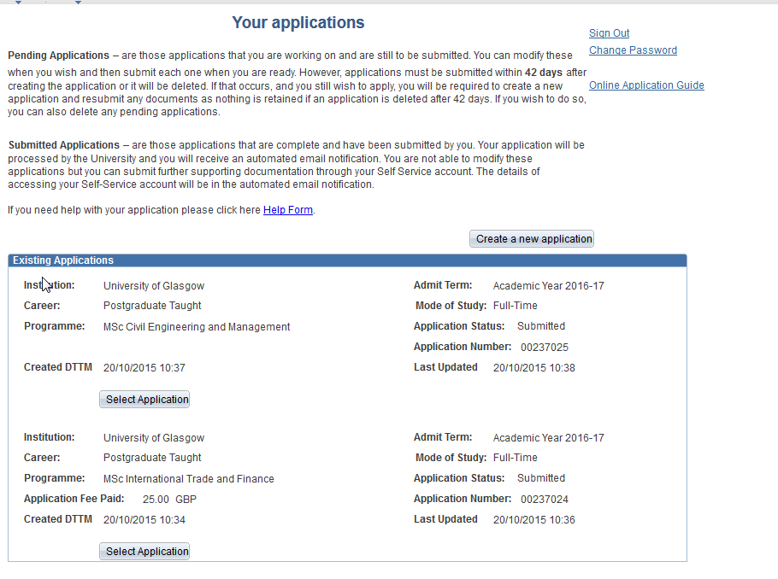
Application summary

Slide 17
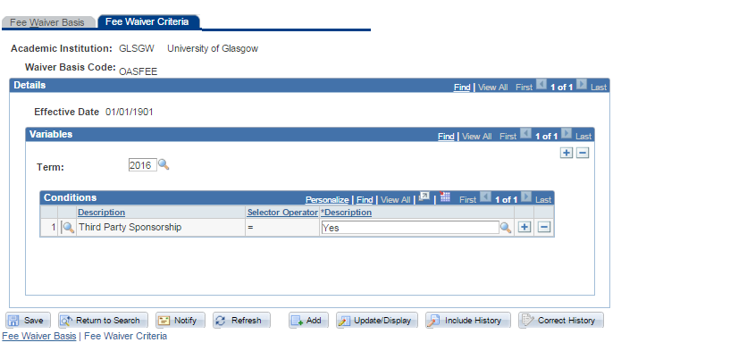
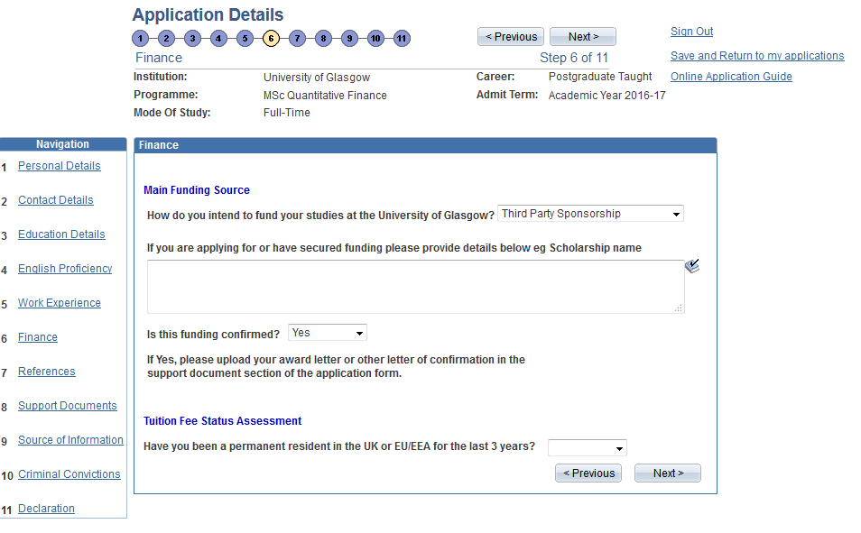
Waiver criteria configuration
Waiver criteria (OAS)

Slide 18
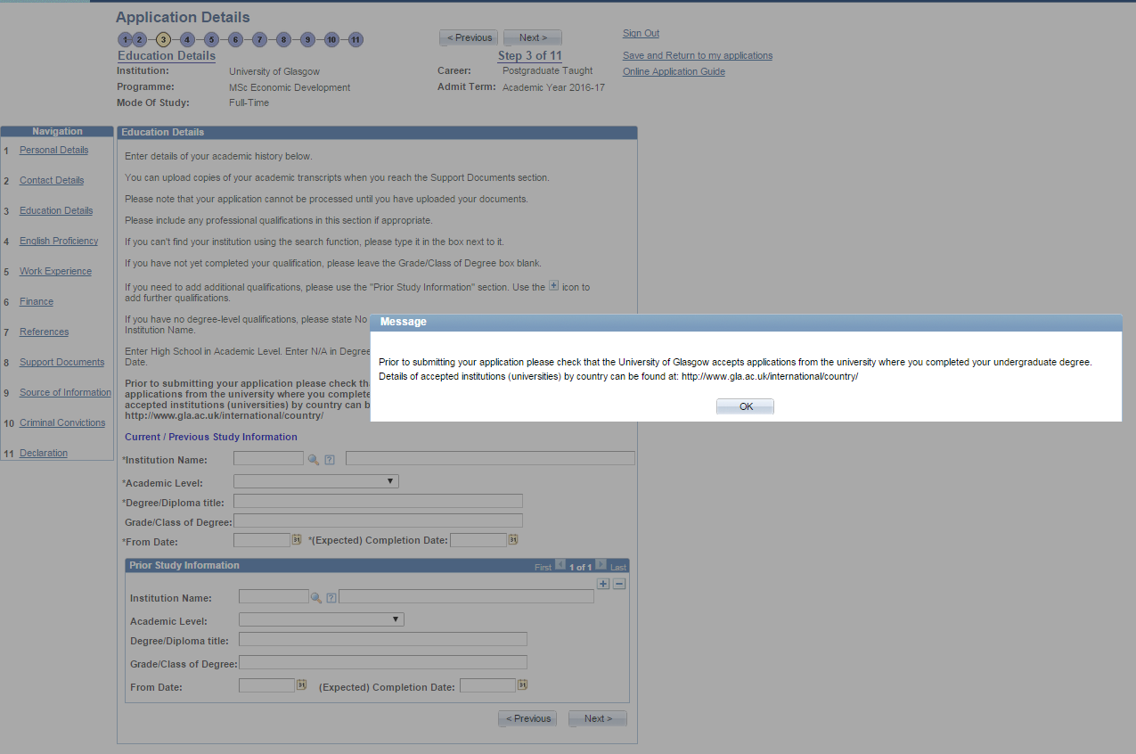
END USER REQUESTS

Slide 19
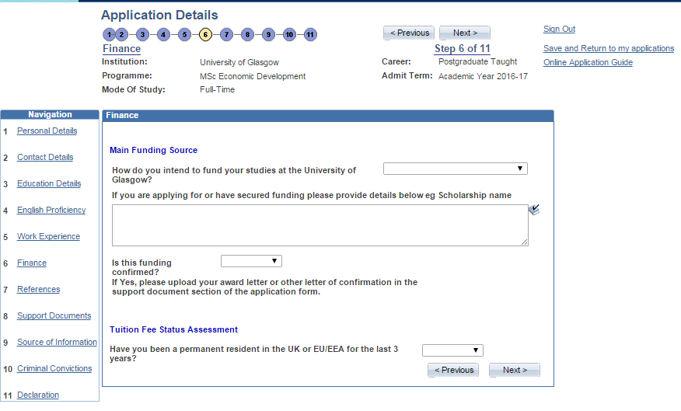
END USER REQUESTS (contd.)

Slide 20
Deposit Configuration
Set Up and Amendments

Slide 21
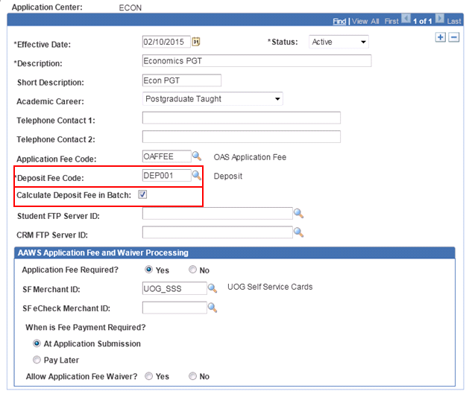
Back to the application center

Slide 22
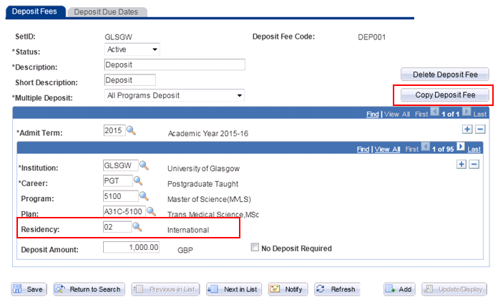
Deposit Configuration

Slide 23
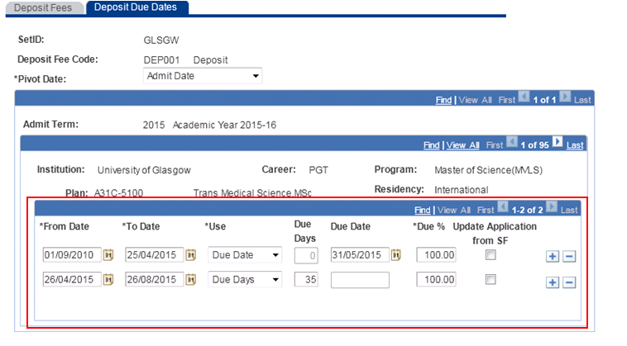
Deposit due dates

Slide 24
SECTION 4 – enrolment deposits
Enrolment Deposits – Maintain applications page

Slide 25
ENROLMENT DEPOSIT fees via the online app
When does an enrolment deposit get added?
When does an applicant have to pay their deposit?
Are enrolment deposit fees waived at any time?
How can an applicant pay their deposit fee?

Slide 26
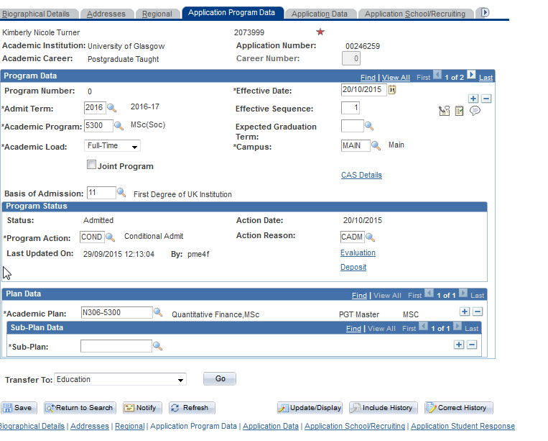
Maintain applications

Slide 27
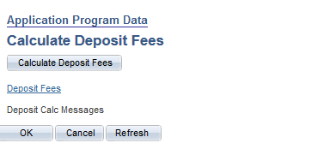
Deposit calculation

Slide 28
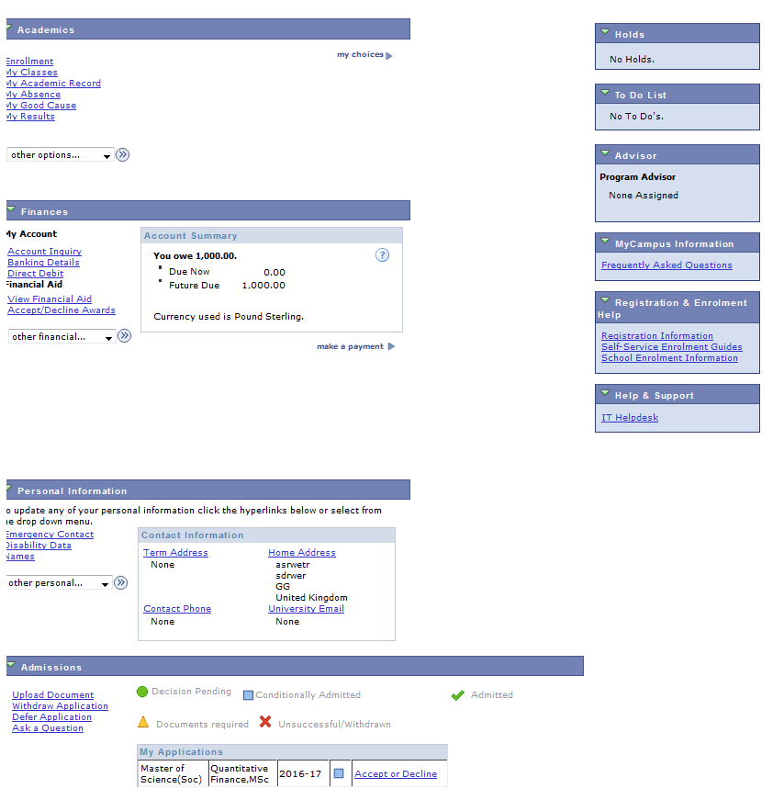
Applicant self service

Slide 29
Concluding thoughts
What have we learned?
Application Fees
By adding a new page for fee waiver criteria it has enabled us to add or amend waiver criteria at a later date
Enrolment Deposit Fees
Understand and document the process regarding when enrolment deposit fees are being charged
And most importantly …………
We have learned that Admissions and
Student Financials can work together in
harmony ☺

Slide 30
Questions?

Slide 31
SUMMARY
Enrolment deposit fees were implemented in April 2015.
Application fees were implemented at the beginning of October 2015.
Both new processes are running successfully!!!!

Slide 32
presenters
Karen Tallett
Paula McEwan
Functional Expert – Student Financials
University of Glasgow
Karen.Tallett@glasgow.ac.uk
Functional Expert - Admissions
University of Glasgow
Paula.McEwan@glasgow.ac.uk
all Alliance presentations will be available for download from the Conference Site

Slide 33
THANK YOU!

