Slide 1
Automation Walhalla: a showcase of automating complex processes
SESSION 2020
Tuesday 17 October 2017

Slide 2
presenter
Hylke Hoekstra
Functional Application Manager
Leiden University
h.r.hoekstra@sea.leidenuniv.nl

Slide 4
In figures

Slide 5
Version
PS CS 9.0 (9.2 upgrade planned 2018)
Peopletools 8.55.13 bundle 41
Live since 2010 and continuously evolving
10 FTE functional team
Collaborating Higher Ed institutions: Leiden University, University of Amsterdam, Hogeschool van Amsterdam (UoAS)
Technical partner and hosting:

Slide 6
Overview of this presentation
DEREGISTRATION IN THE NETHERLANDS A brief overview of the rules and procedures
VISUALISING THE PROCESS FLOW How we visualized the process flow (multiple times)
CALCULATIONS WITH THE HELP OF SQL VIEWS How SQL views can help in (complex) calculations

Slide 7
Deregistration in the netherlands
A brief overview of the key rules and procedures

Slide 8
(DE)REGISTRATION VIA
Studielink is a national web portal for student registration at all higher education institutions in The Netherlands
Every student gets his or her own account which can be used for registration and deregistration
Institutions control when a student can request registration
Studielink controls when a student can request deregistration

Slide 9
Criteria for requesting deregistration
Studielink uses three criteria to allow students to request deregistration:
The student needs to have a definitive registration
Deregistration is only possible per the last day of the month (31st, 30th, 28th, 29th)
A student can only request deregistration per the end of the current month or later (past dates are not allowed)

Slide 10
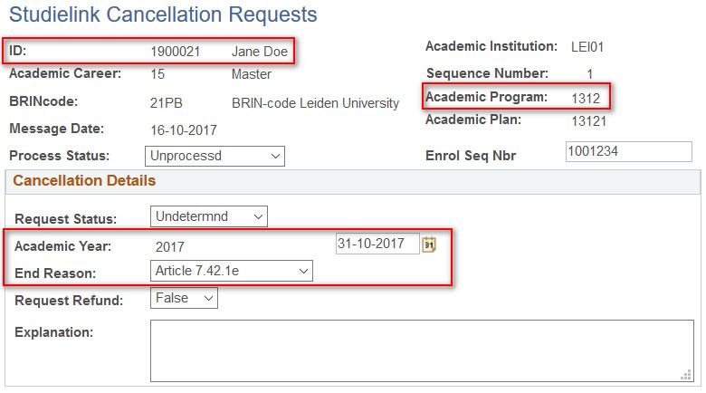
STORING THE DEREGISTRATION REQUESTS
Requests for deregistration submitted via Studielink are stored in a special deregistration table in PeopleSoft Campus Solutions (uSis).

Slide 11
Tuition fees (simplified)
Two types of tuition fees:
1. Statutory fee
2. Institutional fee
Students pay per month that they are registered (irrespective the number of registrations)
We will not discuss all exceptions

Slide 12
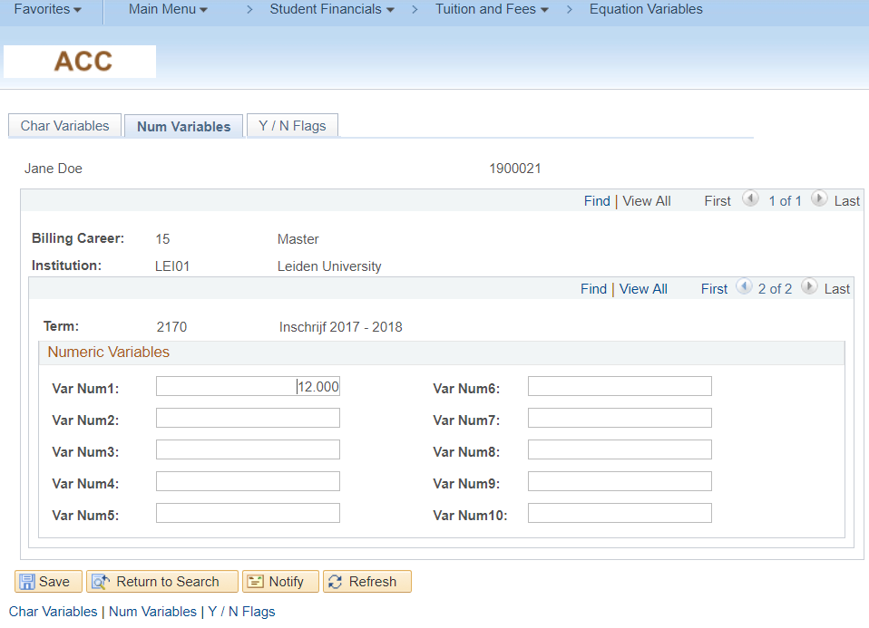
Using equation variables for tuition fee calculation

Slide 13
Manually deregistering a student
On average the manual deregistration process takes up to 5 minutes per student deregistration
There were approximately 4000 manual deregistrations per year
In January and February there are over 200 deregistration requests per week
It would take one person at least 16-20 hours per week to manually process all these requests in those months
Students can wait up to six weeks before their request is processed
Looks like a genuine business case; can we automate this process?

Slide 14
Visualising the process flow
A description of the iterations of visualizing the process

Slide 15
Inquiry at student administration
We asked the Student Administration Department to tell us about the deregistration process
They found it difficult to make a list of requirements
Basic procedure:
Check if recalculation is necessary
Add correct programme action.

Slide 16
Basic process flow (2016)

Slide 17
Functional Requirements
Calculation is necessary when
There are no other programmes currently active within the same career
There are no other programmes currently active in another career with a starting date that is earlier than the desired termination date
In case of graduation:
Only terminate registration if there is an EXAM registered
Always terminate the registration ‘after’ the EXAM date

Slide 19
Additional functional requirements
Do not terminate the registration if the desired termination date is greater than 31st of May
Do not terminate the registration if it concerns a Pre-Master’s Programme
Do not recalculate the tuition fee if the Study Form = ‘E’
Do not recalculate the tuition fee if we have received a waiver

Slide 21
More Additional functional requirements
Additional rules concerning a ‘special’ programme (1298)
Additional rules concerning tuition fee waivers

Slide 22
Technical constraints/requirements
App Engine cannot insert row on Student Program/Plan if the student has an inactive subplan
Batch tuition calculation cannot calculate if there is an inactive program within the same academic year in a career with a lower career number
Tuition fee waivers cannot be recalculated automatically

Slide 24
Result: a very Complex query for this process
28 tables
10 subqueries
Months are calculated by subtracting startdates from end dates
Two-pass process for quitting and graduating

Slide 25
Back to the drawing board
Objectives:
1. Stop using just one query and create separate (small) building blocks
2. Get the student registration status per month in one overview
Advantages:
Easier to oversee each block, and thus the complete process
Easier to test every component of the batch
Easier for troubleshooting
Easier calculations by simplifying complex student registrations

Slide 26
Simplifying the process flow (2017)
Identifying the three key elements of the process:
1. Determining provisional termination dates and determining whether the registration is eligible for automatic termination
Functional requirements
Technical requirements
2. Determining whether the tuition needs to be recalculated
3. Calculating the correct number of registered months per student

Slide 28
Unify all deregistration requests…

Slide 29
.. AND Select all eligible requests

Slide 30
The first building blocks
One SQL View containing all deregistration requests with the correct date
One query that allocates a new programme action called ‘EXIT’ which defines:
whether the registration is eligible for automatic termination
the provisional termination date
One query to monitor all exceptions that need individual attention (manual deregistration)

Slide 32
Determining whether an update of the variable is necessary.
If an update is necessary, we need to calculate the correct number of months.

Slide 33
CALCULATion with the help of sql views
How to effectively use binary logic and aggregate functions in an SQL View to calculate how many months a student is registered

Slide 34
The 2016 expression
In 2016 we calculated the number of months with the following expression:
ROUND((TO_DATE(A.SSR_SL_END_DT_NLD) - TO_DATE(D.EFFDT)) / (365/12))
This subtracts the start date from the termination date and then divides this by 365/12 and convert this to an integer using the ROUND function.

Slide 35
Disadvantages of the 2016 expression
It works for a student who is registered for one programme only
It will not work if a student is registered for more than one programme
If programmes do not have overlap it may also work (not always)
In 2016 we needed a different expression for graduating students
→ this was already fixed in 2017 by creating the SQL View with provisional termination dates

Slide 36
Creating a new SQL View using binary logic
A simple way to show student registration by using binary logic:
1 = registered / 0 = not registered
One expression for each month
Every expression checks the programme status for that month
Student ID | Year | Career | Car Nbr | M09 | M10 | M11 | M12 | M01 | M02 | M03 | M04 | M05 | M06 | M07 | M08
1234567 | 2017 | 10 | 0 | 1 | 1 | 1 | 0 | 0 | 0 | 0 | 0 | 0 | 0 | 0 | 0
1234567 | 2017 | 10 | 1 | 0 | 0 | 0 | 0 | 0 | 1 | 1 | 1 | 1 | 0 | 0 | 0

Slide 37
Creating a new SQL View using binary logic
A simple way to show student registration by using binary logic:
1 = registered / 0 = not registered
By using the Maximum (MAX) function and deleting the field ‘career number’, we get the overview per career:
Student ID | Year | Career | Car Nbr | M09 | M10 | M11 | M12 | M01 | M02 | M03 | M04 | M05 | M06 | M07 | M08
1234567 | 2017 | 10 | 0 | 1 | 1 | 1 | 0 | 0 | 0 | 0 | 0 | 0 | 0 | 0 | 0
1234567 | 2017 | 10 | 1 | 0 | 0 | 0 | 0 | 0 | 1 | 1 | 1 | 1 | 0 | 0 | 0
Student ID | Year | Career | M09 | M10 | M11 | M12 | M01 | M02 | M03 | M04 | M05 | M06 | M07 | M08
1234567 | 2017 | 10 | 1 | 1 | 1 | 0 | 0 | 1 | 1 | 1 | 1 | 0 | 0 | 0

Slide 38
Combining bachelor and master DATA
Multiple careers generate multiple rows:
Student ID | Year | Career | M09 | M10 | M11 | M12 | M01 | M02 | M03 | M04 | M05 | M06 | M07 | M08 | Tuit. Type
1234567 | 2017 | 10 | 1 | 1 | 1 | 1 | 1 | 1 | 1 | 0 | 0 | 0 | 0 | 0 | Stat. Fee
1234567 | 2017 | 15 | 0 | 0 | 0 | 0 | 0 | 1 | 1 | 1 | 1 | 1 | 1 | 1 | Stat. fee
Using a second SQL View and some expressions can combine both rows into one:
Student ID | Year | M09 | M10 | M11 | M12 | M01 | M02 | M03 | M04 | M05 | M06 | M07 | M08 | Tuit. Type | M09 | M10 | M11 | M12 | M01 | M02 | M03 | M04 | M05 | M06 | M07 | M08 | Tuit. Type
1234567 | 2017 | 1 | 1 | 1 | 1 | 1 | 0 | 0 | 0 | 0 | 0 | 0 | 0 | Stat. Fee | 0 | 0 | 0 | 0 | 0 | 1 | 1 | 1 | 1 | 1 | 1 | 1 | Stat. Fee
The first sequence of binary fields is representing the Bachelor, the second sequence is representing the Master

Slide 39
Combining bachelor and master data
Combining the Bachelor and Master data has its own process flow, but we will not discuss this in detail.
Main rule:
Bachelor and Master add up to a maximum of 12 months per academic year.

Slide 40
Combining bachelor and master DATA
Again, the second view gives the following output:
Student ID | Year | M09 | M10 | M11 | M12 | M01 | M02 | M03 | M04 | M05 | M06 | M07 | M08 | Tuit. Type | M09 | M10 | M11 | M12 | M01 | M02 | M03 | M04 | M05 | M06 | M07 | M08 | Tuit. Type
1234567 | 2017 | 1 | 1 | 1 | 1 | 1 | 0 | 0 | 0 | 0 | 0 | 0 | 0 | Stat. Fee | 0 | 0 | 0 | 0 | 0 | 1 | 1 | 1 | 1 | 1 | 1 | 1 | Stat. Fee
A third and last view counts the months per career and gives the output as follows:
Student ID | Year | Bachelor | Master
1234567 | 2017 | 5 | 7

Slide 41
Equation Engine
We use the Equation Engine to run an Update statement to update the Num. Variable #1
Equation engine performs better than the Population Update Process (SACR > System Utilities) and it needs only one RunID.
Warning: no checks from Component Interface (!)

Slide 42
Translating the 2017 process flow...

Slide 43
…to a JobSet Definition
The whole process is now easily translated in a JobSet Definition containing 7 steps
Process | Description
Custom App Engine | Add EXIT rows to HE records
Equation Engine | Set TuitCalcReq= 'N'
Equation Engine | Update Num. Variable #1
SFPBCALC | Calculate Student Tuition (Batch)
Custom App Engine | Add DISC rows to Student Program/Plan
Custom App Engine | Delete EXIT rows from HE records
Studielink Process | Send messages to Studielink

Slide 44
Evaluating the business case
Batch runtime is avg. 9 minutes every night
Waiting time for processing (for students) has drastically improved
Every step of the process is visualized, which helps in easy Change Management and troubleshooting
By dividing the process into building blocks, it is easy to troubleshoot when issues are reported
No Peoplecode adaptations are necessary, everything can be managed by our own department

Slide 45
Not the only way to go
This showcase is just an example of a possible route to follow, it is definitely not the only way
All sorts of complex processes can be divided into smaller pieces, for example by using SQL Views, or temporary data storing as a record in Student Program/Plan, in a Student Group, etc.

Slide 46
Concluding thoughts
ANY QUESTIONS?

Slide 47
presenter
Hylke Hoekstra
Functional Application Manager
Leiden University
h.r.hoekstra@sea.leidenuniv.nl

Slide 48
THANK YOU!

