Slide 1
Study Plan Advising presented by Alison dell and Tanja Oosthuysen
SA HEUG
10 July 2018
Session nr: 10018

Slide 2
Technology
PeopleSoft Campus 9.2
PeopleTools 8.55

Slide 3
University of Pretoria
110 years old
40 000 UGRD applications
9800 registered 1st years
60 000 students
9 faculties

Slide 4
Study Plan Advising
The process of advising a student on the available study options he qualifies for based on his school grades & UP’s admission requirements
1. What can I study?
Before applying
From a student’s perspective
2. What can we offer you to study?
After applying
From UP’s perspective
SA HEUG. 10.07.2018

Slide 5
Why?
Enabling students/applicants to help themselves
Less enquiries
After attending a few CAS (Central Application System) meetings, UP realised that all Universities calculate APS scores differently
Simplify it for students to identify the programmes they can apply for
Interactive way resonating with the generation we are currently recruiting. Generation Z.

Slide 6
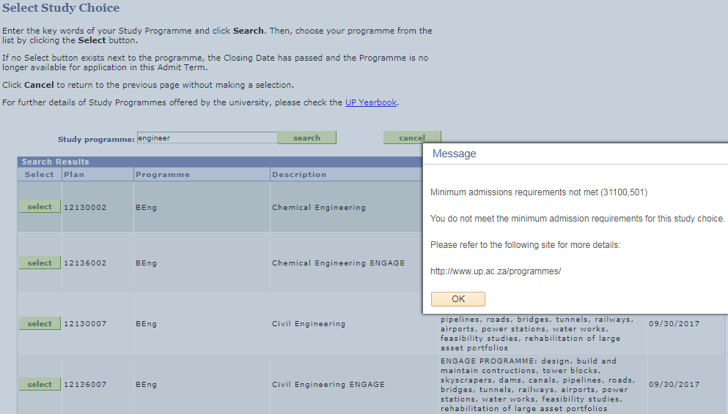
Why?
In 2017 UP introduced an Automated Application and Admissions process, where a student can only apply for a programme where he meets the minimum requirements for.

Slide 7
Background Information
Admission Requirements
APS Calculation
The calculation of an Admission Point Score (APS) is based on a candidate’s achievement in SIX recognised NSC 20-credit subjects by using the NSC seven-point rating scale. The required subjects for a specific plan will be used and then any other remaining.
Notes:
124 ugrd programmes

Slide 8
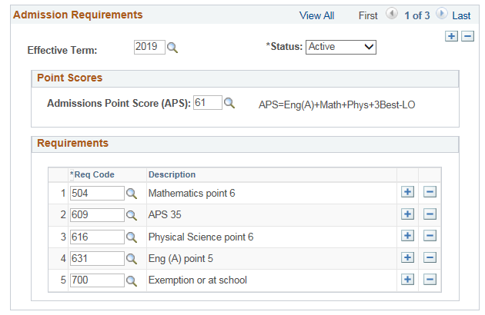
Admission Requirements

Slide 9
Study Plan Advising
1. What can I study?
Before applying
From a student’s perspective
SA HEUG. 10.07.2018

Slide 10
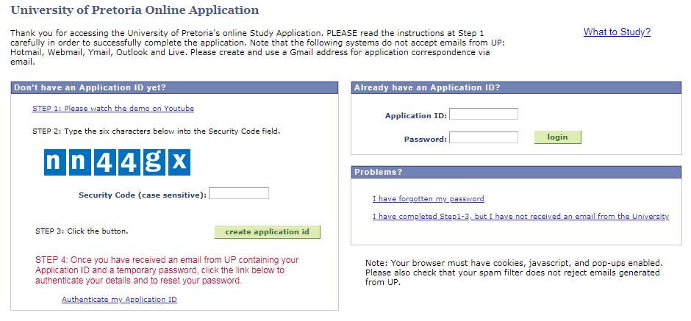
1. What can I study?
Try it yourself @ www.up.ac.za/apply

Slide 11
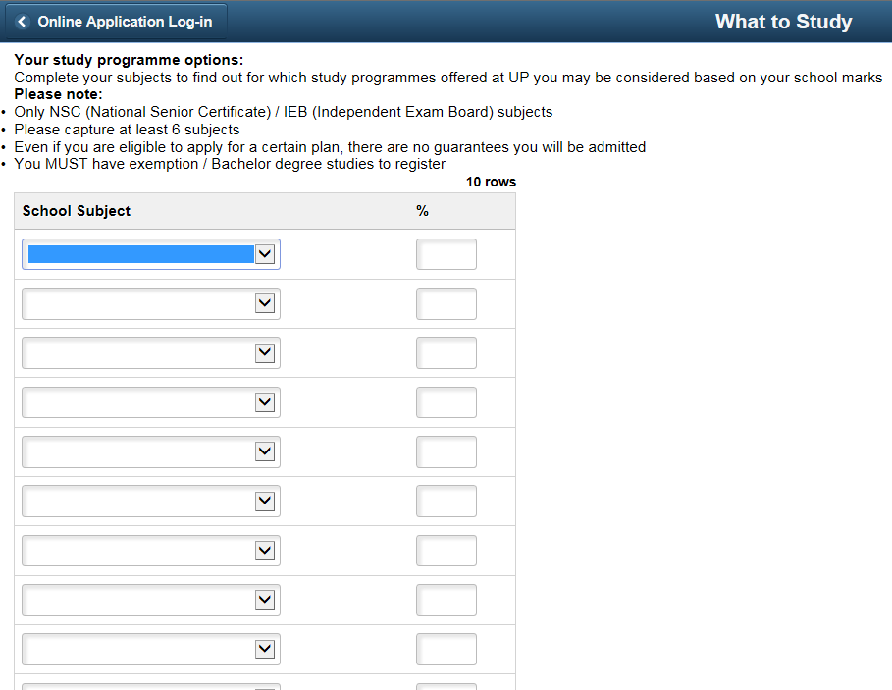
What can I study?

Slide 12
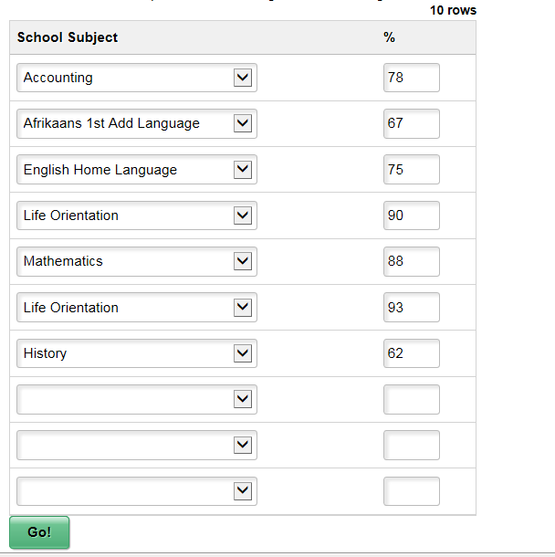

Slide 13
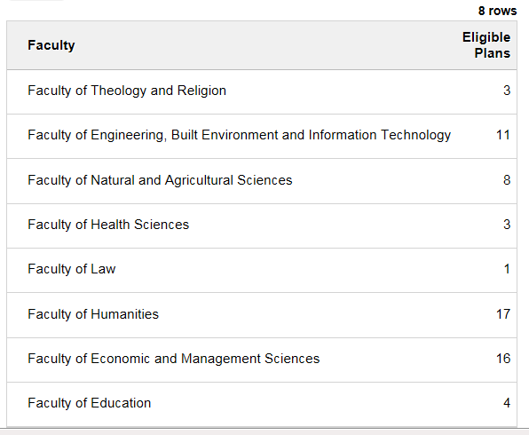

Slide 14
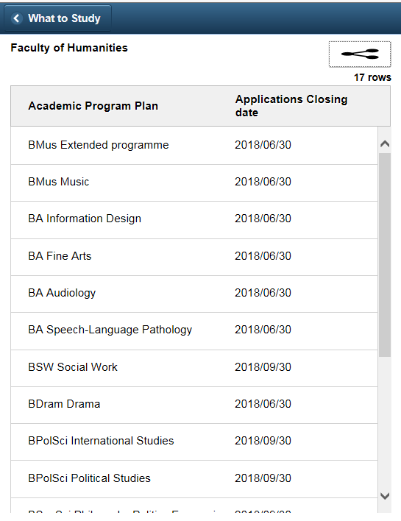
Each plan option has a link that takes you to more information on the plan
Application closing date generated from PeopleSoft

Slide 15
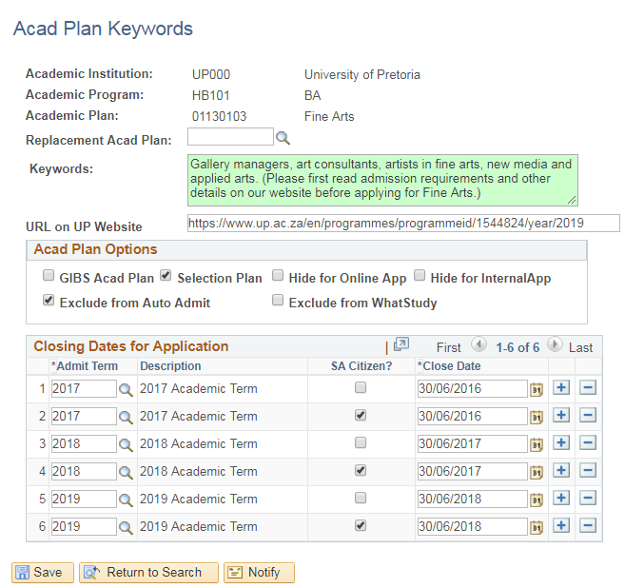
Setup

Slide 16
What to Study - Technical
What to Study is hosted in Peoplesoft Campus – we use a kiosk deployment of campus to host the gateway to our online study application, which allows access to the system without requiring Peoplesoft operator login credentials – What to Study utilises the same kiosk instance
Our admission requirements calculations all assume a valid emplid and rows on the admissions stack. So we had to artificially create all the data that the calculations were expecting, and clean up after ourselves once the calculations had finished
All academic plans available in the online study application are evaluated – admission requirements are measured against the captured marks and only eligible plans are returned as options
60% of users accessing the What to Study component are doing so using a mobile device – we gather stats on devices, browser and operating system for selected components

Slide 17
Study Plan Advising
2. What can we offer you to study?
After applying
From UP’s perspective
SA HEUG. 10.07.2018

Slide 18
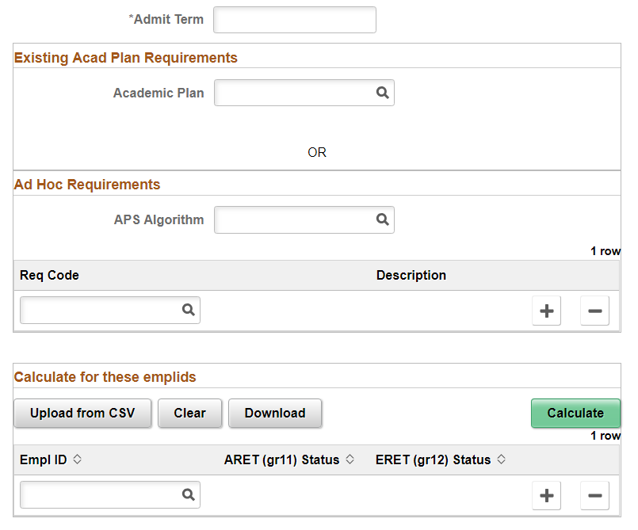
2. What can we offer you?
Test against a certain plan’s requirements
or
Test against certain requirements

Slide 19
What can we offer you?
Test against a certain plan’s requirements
Test against certain requirements

Slide 20
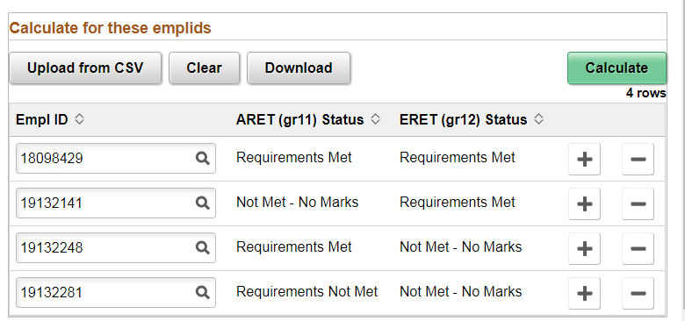
What can we offer you?
ARET Status: Admission Requirements for applicants applying with Gr.11 results for conditional admission
ERET Status: Entrance Requirements for applicants who finished Gr.12 applying for unconditional admission
Notes:
Upload, Download function

Slide 21
Study Plan Advisor- Technical
As mentioned in What to Study, our admission requirements calculations all assume a valid emplid and rows on the admissions stack. So we had to artificially create all the data that the calculations were expecting, and clean up after ourselves once the calculations had finished.
This included creating programme / plan requirements dynamically if the user selected ad hoc requirements – and deleting them after the calculations complete
Emplids are evaluated against both admissions and entrance requirements (based on whether they have grade 11 and / or grade 12 marks in the system) – admissions requirements (ARET) use grade 11 marks, entrance requirements (ERET) use grade 12
Results are downloaded into CSV for upload into a mass update program – where they can be added to the admission stack en masse

Slide 22
Advantages
In need of applications for certain plans / programmes that still have space available
Data analytics
Selection plan applicants
Bulk processing
Statistics on devices used for applying online
Plan/programme planning from a young age
Marketing of unknown programme options

Slide 23
Questions?
Alison Dell
alison.dell@up.ac.za
Tanja Oosthuysen
tanja.oosthuysen@up.ac.za
SA HEUG 10.07.2018

Slide 24
Thank you
SA HEUG 10.07.2018

