Slide 1
Research Management 9.0 Warts and All
SESSION 5026
8th November 2017

Slide 2
presenter
Jonathan Peters
Manager, Student Systems Development (Functional)
The Australian National University
Jonathan.Peters@anu.edu.au

Slide 3
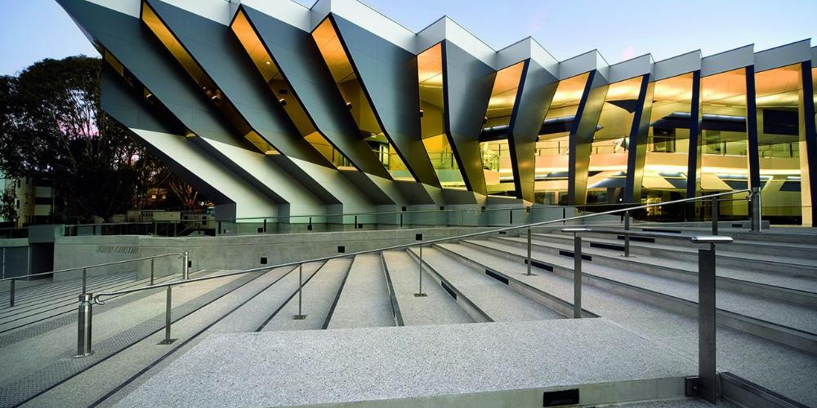
Australian National University
Total students 23k
Research 3k

Slide 4
ORGANIsATION & ORACLE
CS9.2
PUM02
Tools 8.55.09

Slide 5
Overview
Background Moving from the previous system
Project structure What the project looked like
Data migration ANZ mod to CS9.2
Page functionality Where were the gaps
Summary

Slide 6
Background
Moving from the previous system

Slide 7
Previous system
In early 2000’s a group of Australian Institutions engaged Oracle consulting to build an ANZ Research Student Module
Over last 3+ years, Oracle have been releasing delivered functionality for managing research students
Notes:
In early 2000’s a group of Australian Institutions engaged Oracle consulting to build an ANZ Research Student Module. This is what ANU have been using since 7.6 with the framework dragged through the 9.0 and 9.2 upgrades.
My notes say that at least Griffith, Newcastle, UQ, UNSW and ANU all implemented this module
Over the past 3+ years Oracle have been releasing delivered functionality for managing research students. This includes candidature and thesis submission, though no specific scholarships functionality was delivered.

Slide 8
ANZ Research module
Candidature pages (incl. application)
Customised student milestones pages
Student Advisors
Referees
IP agreements and ethical clearance
Research leave and load
Scholarship sub-module
Thesis management
A suite of reports
Notes:
A number of customisations were made to this functionality at ANU both to deliver on local requirements and to complement/simplify related business processes. Example being connections to the scholarship module for changes to program leave.

Slide 9
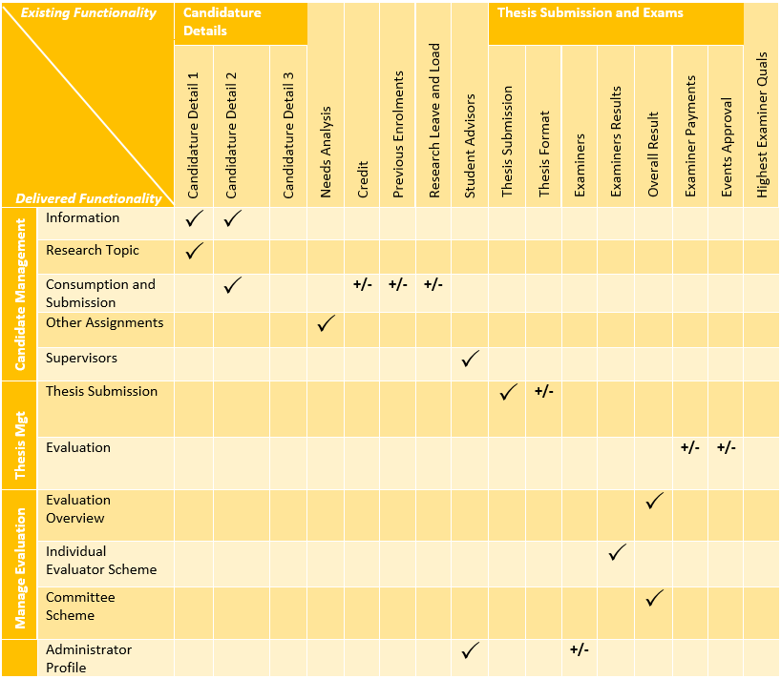
Fit gap
Notes:
Here’s a fairly high level fit-gap from an ANU perspective. There’s a few small things that were missing and a few tweaks required, but our theory going in was that it should be reasonably fit for purpose.
Milestones and scholarships functionality not changed.

Slide 10
Why change?
Remove customisations
Improve integrity of data
Access new functionality
Maintain vendor support
Notes:
Remove customisations: Not purely rhetoric, we are pushing back hard when people ask for customisations. Where it is the only way, then of course we go ahead, but all other options are investigated such as queries, related content, CAF fields, etc.
Data integrity: I’ve spent a fair bit of time as both a user and a functional analyst on the research module. I’ve regularly been frustrated (as have many others on campus) with the integrity of some of our data. Supervisors being a big one – that executive is always interested in – and I’ve always found it hard to get a straight answer from the system.
New functionality: A couple of pieces of functionality from the new module jumped out at us. Evaluation management is something we’ve only just dabbled with, but would be very interested in looking further at – we think it has a range of other applications from scholarship award committees to admissions. Also the self-service tools. We’re currently running our own self-service though with the release of fluid are looking closely at the delivered functionality. Either to borrow from it or purchase it, we haven’t decided yet.

Slide 11
Project Structure
What the project looked like

Slide 12
Project structure
Run as a BAU project
2 functional resources
2 technical resources
Approx. 6-9 months
Migrate all research data
Update all research reports/interfaces
Notes:
Run as a BAU project – initially came about as a pre-upgrade project to remove customisations
Both the functional and technical resources fluxed a little bit but 2 of each was probably a fair average for the project.
The timing was also a little vague as it had a couple of soft starts thanks to the 9.2 upgrade project and long tails, but again 6-9 months feels about right. The functional lead changed through the project which caused some disruption
Handled as a ‘migration’ and carefully avoided referring to it as an upgrade. Maintain existing functionality. Attempt to avoid interfering with business processes.
Candidature and Thesis Submission/Examination, Evaluation

Slide 13
Project timeline
[First cut]
Data migration
completed
Page changes
documented
Q2
2016
Q3
2016
Q4
2016
Q1
2017
Q2
2017
Fit gap
completed
Data migration
documented
Report changes
documented
Testing
completed
Analysis
Design
CS9.2 Upgrade
Testing
Notes:
Last 3 months were the busiest. We decided to totally split the data/pages from the reports interfaces and put senior BA’s on each to help get us over the line.
Data migration was fairly complex and needed a fair bit of massaging through the testing process and a few tweaks post go-live.
Cleansing bad data was a bit of an issue.
Setup a business reference group to provide input to the project.

Slide 14
Data migration
ANZ mod to CS9.2

Slide 15
Migrated data
Name | Description | Volume
RSH_DTL_HDR_ANZ | Research Student Career | 15561
RSH_DETAIL_ANZ | Candidature details | 50962
RSH_EX_RSLT_ANZ | Final Thesis result | 28961
RSH_EXM_PNL_ANZ | Examiners and results | 27754
RSH_LEAVE_ANZ | Research Leave | 11790
RSH_CREDIT_ANZ | Research Credit/Status | 687
RSH_NDS_HDR_ANZ | Research Student Module | 4982
RSH_NEEDS_ANZ | Needs Analysis | 7415
RSH_OFF_ADV_ANZ | Research Student Module | 4620
RSH_PRG_RPT_ANZ | Research Student Module | 7650
RSH_PRV_ERL_ANZ | Previous Enrolment data | 559
RSH_REFEREE_ANZ | Research Module | 4986
RSH_SUBMIT_ANZ | Thesis submission header | 10777
RSH_FORMAT_ANZ | Thesis format | 11287
STDNT_ADVISOR | Student Advisor | 25000
STDNT_ADVR_HIST | Supervisors Header | 88000
RSH_SUPER_ANZ | Supervisors Detail | 91165
 | Total: | 476505
Number of rows:
476,505
Number of active research students: 3,065
Number of research students (total): 15,546
Notes:
A bit redundant to say but…the first step was to understand the new functionality and new business process. The pages were different. The structures were different. In many cases the way to record particular actions was substantially different. Being candid, I’d say we didn’t spend quite enough time on this activity as we were still getting surprises well into the testing process.
Testing approach:
Front end checks
SQL compares of numbers
SQL compare of key fields
Robot to insert new rows and trigger recalc followed by more SQL data compares
At the end of the day, we had the vast majority of data migrated cleanly, though we did have perhaps a hundred students that had to be manually corrected which were identified prior to conversion due to one reason or another.

Slide 16
Challenges
Changed data structures
Supervisors
Leave
Credit
Load
Historical data
Data cleansing
Changing requirements
Unexpected data
Unexpected issues
Admissions data
Notes:
Changed Data structures:
Changed keys – supervisor data has a student career number (which is great) but matching the data where it had changed program across effdt was messy.
Significant changes to records (elimination of records) – leave, credit and load are now recorded in very different ways – all stored in the stack. This created some issues both in terms of logic and data cleansing. E.g. no rows can exist while a student is on leave which was possible in the old system.
First migrated all data from candidature across (including each max submission date) and were trying to insert the leave/credit/load change rows without breaking the submissions dates migrated across. After running round in circles with increasingly convoluted code, we then changed to only migrate the minimum rows for candidature and rebuild everything from the bottom up. As mentioned on the previous slide, we then ran many sql compares to ensure the data matched.
Historical data:
We had candidate data for non-research programs (from somewhere).
We had Thesis data without candidature.
Supervisors without consumption.
Changing requirements:
Linked to above, we formulated our rules for the conversion and then had to change them when testing the data – probably should have come up in analysis. According to business rules, a thesis status of pending indicated a grade of ‘minor amendments’. Post go-live we were advised there were a couple of hundred students who were incorrectly coded as pending with a grade of ‘revise and resubmit’.
Unexpected issues:
We stumbled a little with the connection with the Admissions module. We had staff turn-over through the middle of the project and this impacted our testing and understanding of the product – some knowledge was lost. Once we went live, we quickly realised the dependency hadn’t been thoroughly identified and this required additional data manipulation and Oracle bug fixes.

Slide 17
Page Functionality
Where were the gaps

Slide 18
Field mapping
Breakdown from 117 identified fields
Notes:
Numbers were from an early analysis and may have changed a little – but should be fairly close.
Our analysis was that the product was a good fit (as you would expect) with a few additional enhancements required.

Slide 19
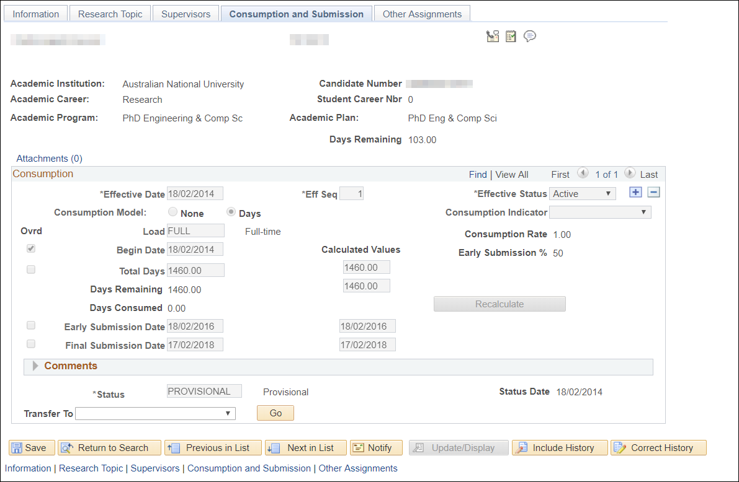
Consumption & Submission
Notes:
Enhancement:
Create new dropdown for Leave Reason when Status = LEAVE is selected
Bug:
Prevent adding of multiple effective dated rows in Consumption and Submission stack. If multiple rows are added then calculation of number of Days consumed, Remaining and Final Submission dates are derived/calculted incorrectly.
Prevent Retrospective Effective Dated Row Changes. System allows the user to add/remove/change (in correction mode) rows with effective dates less than the maximum date in Consumption and Submission stack. This will result in incorrect data in the Consumption and Submission stack and system will not calculate the Final Submission Date and Days Remaining correctly.
Changes to Final Submission Date when new Effective Date row is added and Eff Date > Calculated Maximum Submission Date of previous row. To prevent inconsistency of FSD and CFSD when adding a new row when Eff Date > Calculated Maximum Submission Date of previous row.
The minimum submission date is set based on a simple formula – depending on config but according to our rules [Max submission date] – [start date] divided by two. It sounds legit and works when things stay clean, but…when students exceed the minimum submission date and then take leave (which change the max submission date), the results are not what we would expect. I suspect this should be working off the total number of days allowed instead.

Slide 20
Consumption & Submission
Enhancement | Bug
Capture ‘Leave Code’ | Prevent adding multiple effdt rows
 | Prevent retrospective row changes
Minimum submission date calculation
Effdt row greater than max submission date
 | CAF functionality is unstable
Effdt structure on Other Assignments page
Notes:
Enhancement:
Create new dropdown for Leave Reason when Status = LEAVE is selected
Bug:
Prevent adding of multiple effective dated rows in Consumption and Submission stack. If multiple rows are added then calculation of number of Days consumed, Remaining and Final Submission dates are derived/calculted incorrectly.
Prevent Retrospective Effective Dated Row Changes. System allows the user to add/remove/change (in correction mode) rows with effective dates less than the maximum date in Consumption and Submission stack. This will result in incorrect data in the Consumption and Submission stack and system will not calculate the Final Submission Date and Days Remaining correctly.
Changes to Final Submission Date when new Effective Date row is added and Eff Date > Calculated Maximum Submission Date of previous row. To prevent inconsistency of FSD and CFSD when adding a new row when Eff Date > Calculated Maximum Submission Date of previous row.
The minimum submission date is set based on a simple formula – depending on config but according to our rules [Max submission date] – [start date] divided by two. It sounds legit and works when things stay clean, but…when students exceed the minimum submission date and then take leave (which change the max submission date), the results are not what we would expect. I suspect this should be working off the total number of days allowed instead.

Slide 21
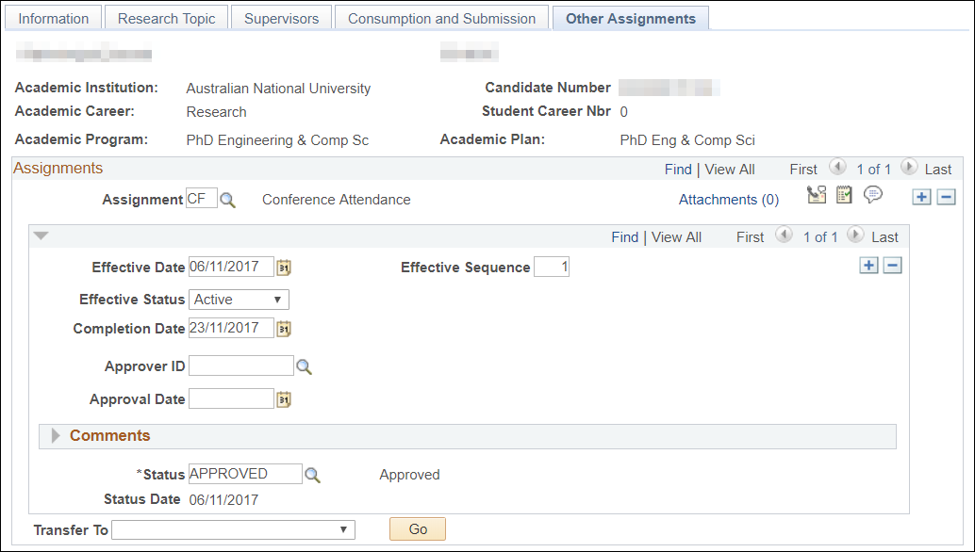
Consumption & Submission
Notes:
Enhancement:
Create new dropdown for Leave Reason when Status = LEAVE is selected
Bug:
Prevent adding of multiple effective dated rows in Consumption and Submission stack. If multiple rows are added then calculation of number of Days consumed, Remaining and Final Submission dates are derived/calculted incorrectly.
Prevent Retrospective Effective Dated Row Changes. System allows the user to add/remove/change (in correction mode) rows with effective dates less than the maximum date in Consumption and Submission stack. This will result in incorrect data in the Consumption and Submission stack and system will not calculate the Final Submission Date and Days Remaining correctly.
Changes to Final Submission Date when new Effective Date row is added and Eff Date > Calculated Maximum Submission Date of previous row. To prevent inconsistency of FSD and CFSD when adding a new row when Eff Date > Calculated Maximum Submission Date of previous row.
The minimum submission date is set based on a simple formula – depending on config but according to our rules [Max submission date] – [start date] divided by two. It sounds legit and works when things stay clean, but…when students exceed the minimum submission date and then take leave (which change the max submission date), the results are not what we would expect. I suspect this should be working off the total number of days allowed instead.

Slide 22
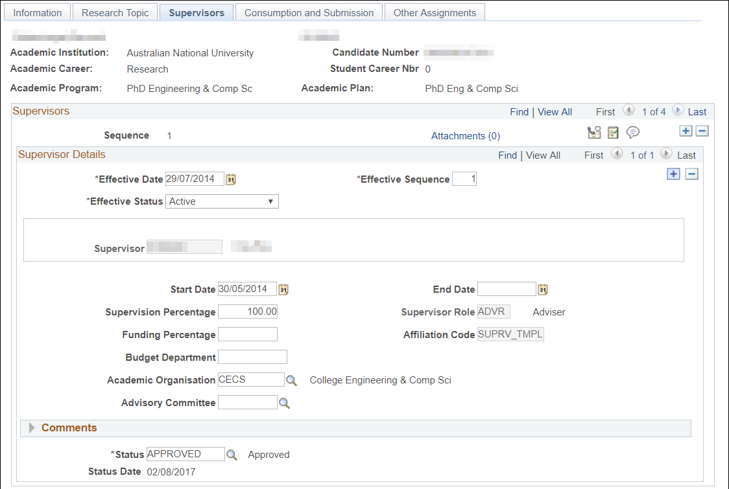
Supervisors
Enhancement | Bug
Ambiguous page function
Various page validation
Hide ‘Primary Supervisor’ field
Un-actioned but…page appears to be built upside down
Notes:
Enhancement:
Disable Supervisor Selection. The confusion arises due to the fact that system allows user to select different Supervisors at both Supervisor section level and Supervisor Details section.
Proposed Solution:
User is unable to select a new Supervisor in Supervisor Details section. This will force the user to add a new Supervisor at the top level (under Supervisor Section).
Supervisor Page Changes (Disable Supervisor and Supervisor Role Selection)
Rule 1: Prevent addition of multiple rows at "Supervisor Details" section
User must first save row at “Supervisor Details" section before a new row is added
Rule 2: Force user to select "Supervisor" and "Supervisor Role" when saving the row.
Rule 3: When adding a new row (+), copy the "Supervisor" and "Supervisor Role" from previous row and disable selection of both in all rows.
Rule 4: When Effective Status = Inactive for a row, system must prompt user to enter End Date
Rule 5: System must not allow user to add a new row on top of an Inactive Supervisor row.
Hide Primary Supervisor Label and Checkbox

Slide 23
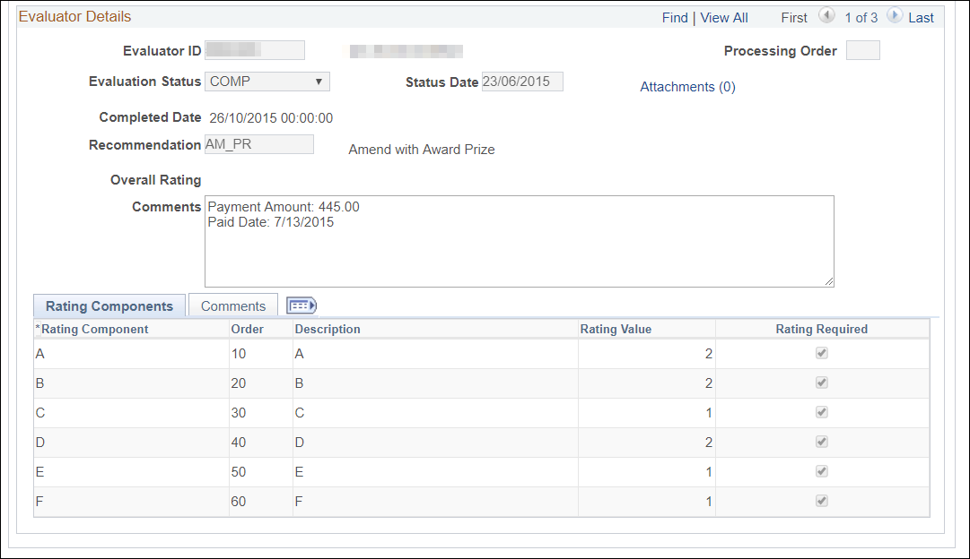
Evaluation
Enhancement | Bug
Tweaks to allow duplicates in committee evaluation | Missing name on evaluations page
Evaluation is not effdt – included audit trail
Allow multiple final evaluation status
Allow for comments to be added when evaluation is final
Notes:
Enhancements:
Tweaks to allow duplicates in committee evaluation
Audit Trail – Individual Evaluator/Committee Scheme
Remove PeopleCode Validations [Individual Evaluator Scheme Page]. The requirement is to remove the validation which prevents saving of the page only when Individual Evaluation Status is set to Withdrawn or Paid but Overall Evaluation Status at Scheme Details is set to Complete.
Make Comments Textbox Editable on Individual Evaluator Scheme Page. Comments textbox editable when Evaluation Status under Scheme Details and Evaluator Details section is set to COMP. This is to allow comments to be made regarding examiner payments after the evaluation has been finalised without need to change the evaluation status (which would disturb the audit record).
Bugs:
Missing name on the evaluations page due to poor effdt logic.

Slide 24
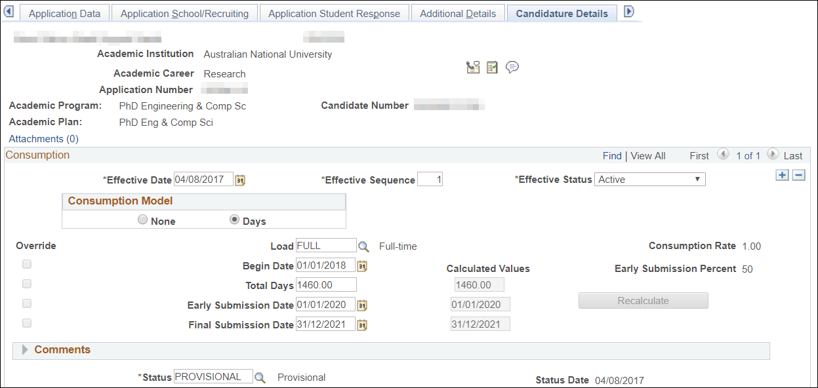
Admissions
Enhancement | Bug
Set Default Status for New Research Application (manual) | Career number changes on Matric do not update candidature
Set Default Status for New Research Application (upload)
Set Default Status for Existing Research Application
Copy candidate number to previous application rows
Notes:
Enhancements:
Do not require admissions office to complete an additional page when creating applications for RSCH applicants.
As part of migration, candidature numbers were created for all candidates, not applicants. When candidature was stored against most effdt row only for a student, removing the top row would cause a peoplecode error.
Bugs:
Career number is stored against candidature record when the application is created. This includes career number. When application is matriculated, this number may change but not update the candidature stack (fixed in PUM04).

Slide 25
Concluding thoughts
ANY QUESTIONS?

Slide 26
user acceptance
Good
Bad
Ugly
Notes:
Mixed feedback:
Good:
Supervisor data integrity
One stop shop for student information
Bad:
Some functionality lost due to removed customisations
Some pages clunky to use
Some functionality not-intuitive
Washup meeting the first request was to include gender or date of birth on the summary page which I took as a fair indication of success.

Slide 27
SUMMARY
Notes:
While on the face of it, the product seems like a good fit – it feels like it was built by someone with a good map, but no real understanding of the process – at least from an ANU (ANZ) perspective. Pages are unnecessarily clunky, concepts like consumption were delivered but with some very pointy corners.
It’s fit for purpose, but it certainly has a few warts. We have submitted perhaps 5 SR’s and have prepared a more conversational ‘feedback’ paper to share with Oracle regarding the functionality. Unfortunately true to style, many of the SR’s have been returned as operating as intended.
A big step forwards in terms of core functionality but go in with your eyes open and prepared to smooth off some of the pointy bits.

Slide 28
presenter
Jonathan Peters
Manager, Systems Development
The Australian National University
Jonathan.Peters@anu.edu.au

Slide 29
THANK YOU!

