Slide 1
Fluid Development What PeopleBooks doesn't teach you.
With Jim Villiers and William Clarke

Slide 2
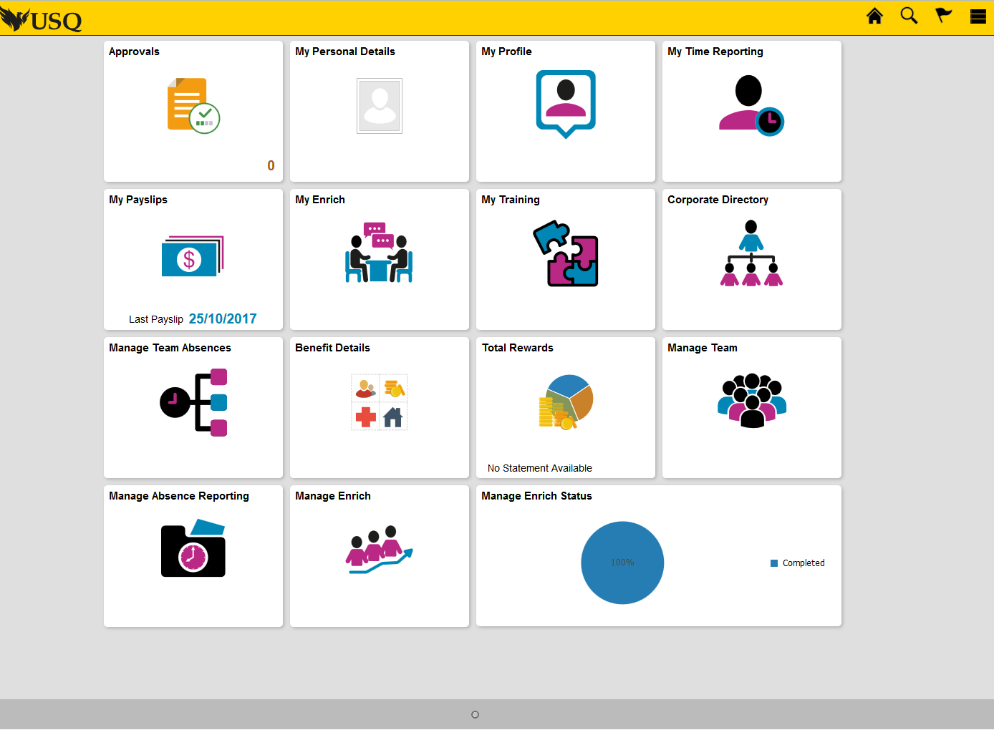
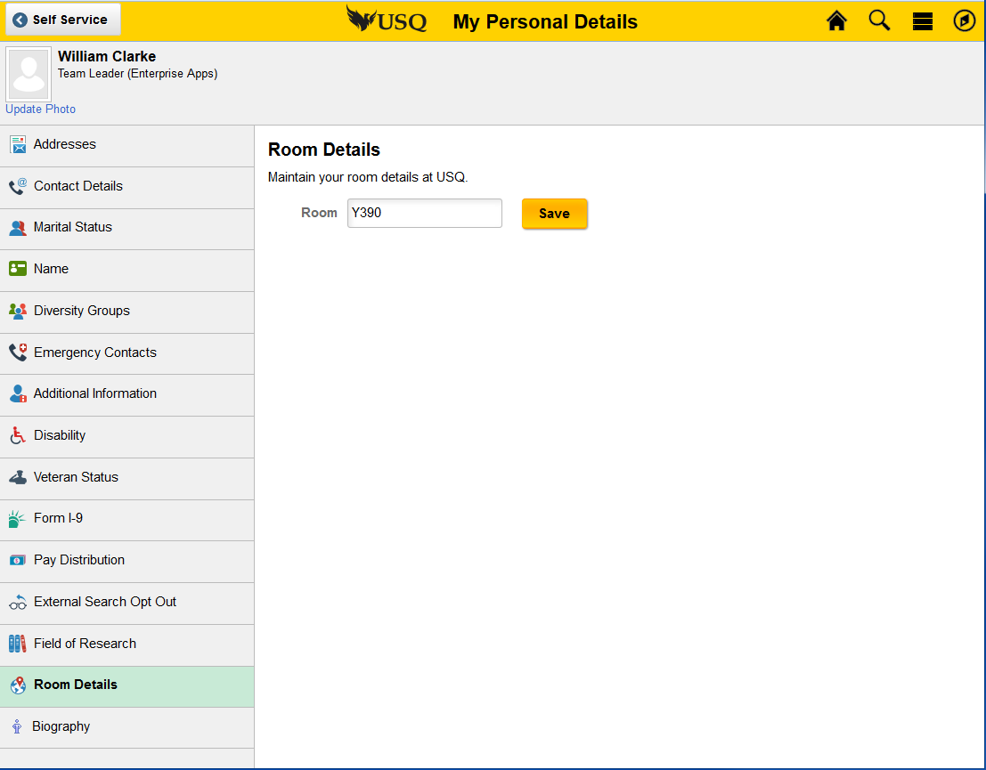
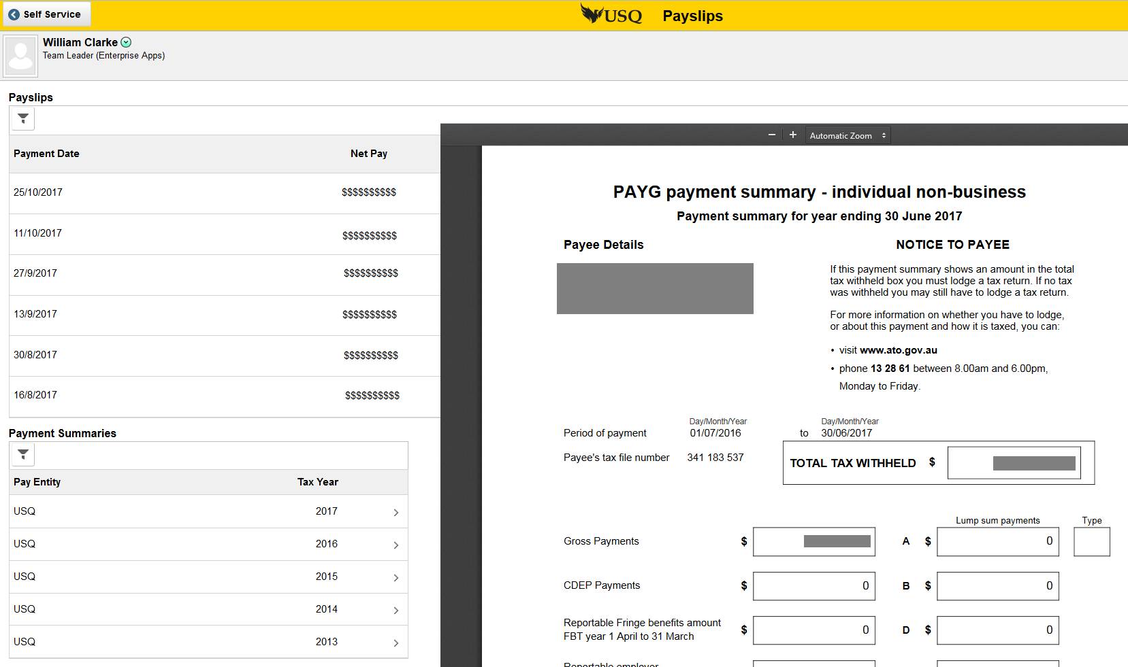
USQ HR 9.2 Staff Self Service
Released November 2015
Notes:
2015 implemented HRMS 9.2
staff “Self Service”
Single fluid homepage
Majority of pages were fluid
Fluid attachments, workflow
SES search engine
~15 custom fluid pages

Slide 3
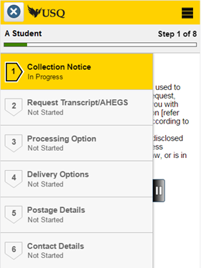
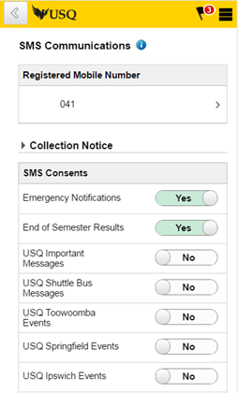
USQ CS 9.2 Student Centre
Released September 2017
Notes:
2017 implemented CS 9.2
Completely fluid “Student Centre”
Class Search, Enrolments, Student Payments
Fluid activity guides, push notifications, Elastic search
Over 180 custom fluid pages

Slide 4
We thought we knew Fluid
Forget classic when designing new pages. Asking for a "fluid page that works like this classic page“ only leads to pain.
Test on real mobile devices. Small form factor browser setting is a starting point, not a complete test.
Think end user experience and consistency. Having 50 tiles on your homepage is easy for us, but not nice for them!
Fluid pages can link back to classic pages, but this is not very nice for the end user.

Slide 5
What we NOW know
Developers need to learn CSS, HTML and Javascript
Use Component PeopleCode and Application packages – not record PeopleCode
Use work tables and views, not direct database tables
Fluid Styles
Apply styling to pages last
Less styling is better
Existing app designer controls have new uses
Use javascript to enhance page UI/UX elements
Dynamic Searches with or without Elastic
Links to external content and BI Publisher work well.

Slide 6
Developer’s Toolkit
Skills that all PeopleSoft Teams have:
PeopleSoft Classic Development
PeopleSoft OO – particularly Application Packages/Classes
New skills we had to learn:
Cascading Style Sheets
HTML
JavaScript

Slide 7
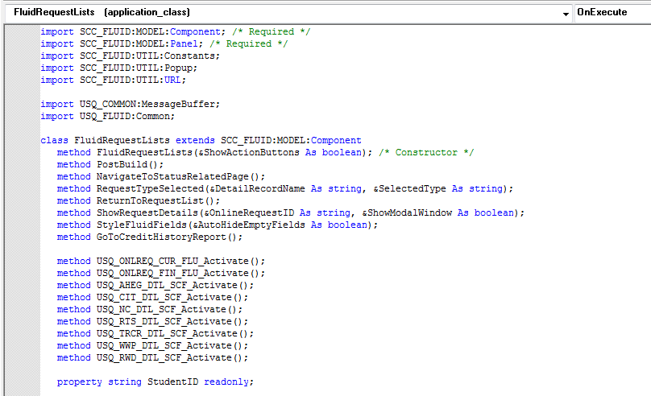
PeopleCode
Use Component PeopleCode to pass context data to app package
App Package code performs the application logic

Slide 8
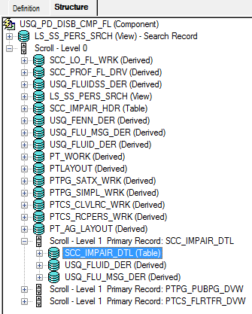
Component Processor
Fluid components still use the component processor
search rec,level 0, level 1,level 2 etc
Fluid pages shouldn’t be designed this way
Search record – don’t want a classic component search page, so set to a single row table
use work tables or views to display data on a fluid page
load data via app package code
save data via app package code

Slide 9
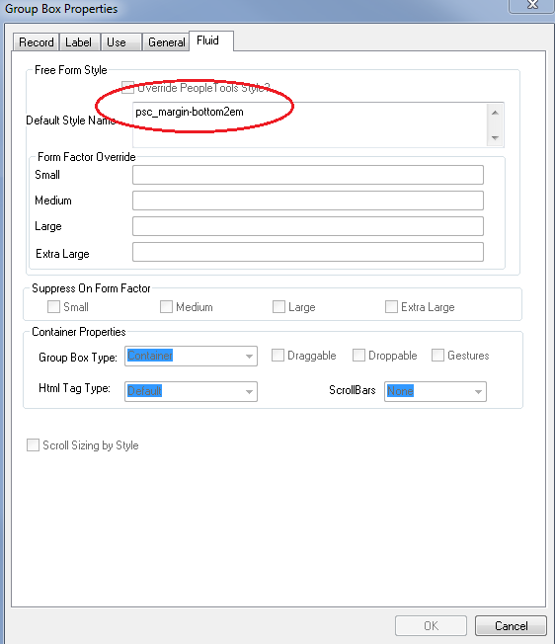
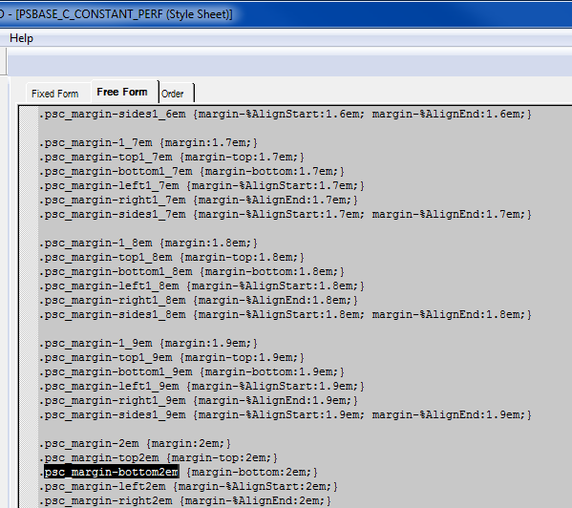
Free Form Styling
Fields are styled with PeopleSoft custom style tags added to a new fluid section of page-field properties
The CSS styles are interpreted by the user’s browser or device to draw the web page

Slide 10
More styling != Better results
Original:
Revised version – a single style applied to small (SFF):

Slide 11
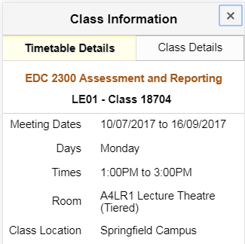
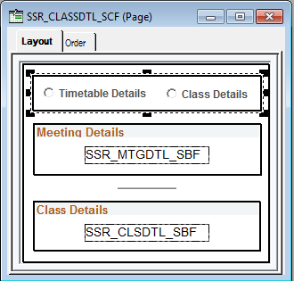
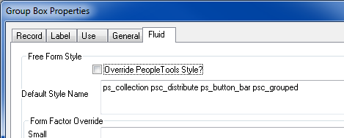
A new style, not new controls

Slide 12
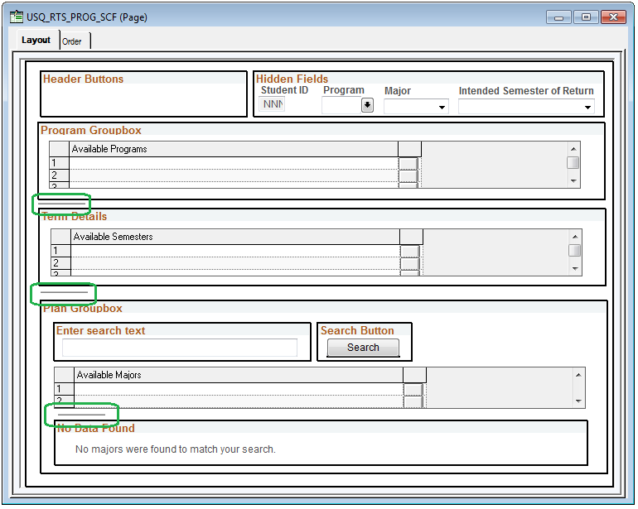
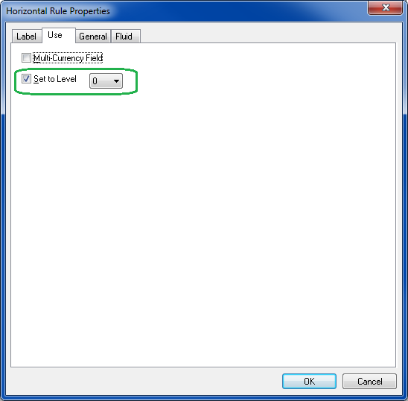
An old control has a new trick

Slide 13
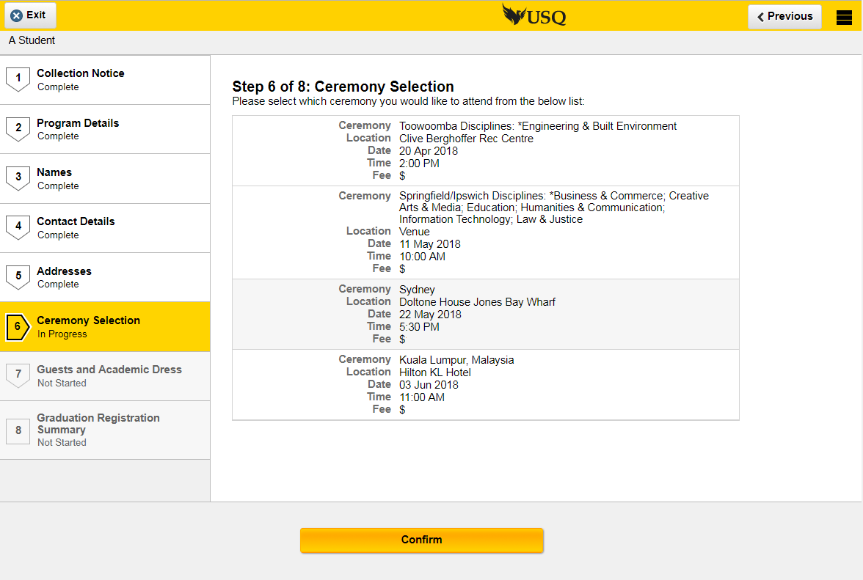
Fluid Activity Guides
Javascript controls the AG step display and action buttons

Slide 14
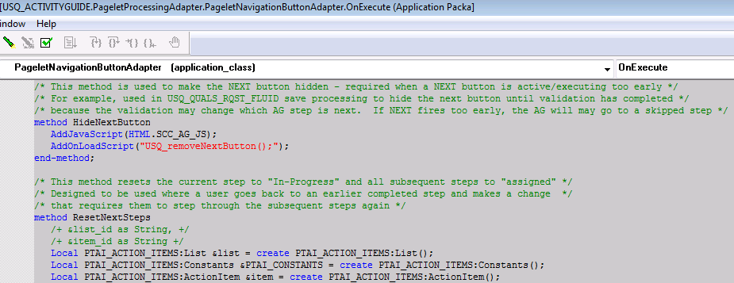
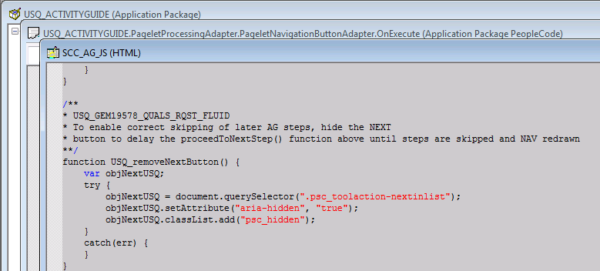
Javascript to enhance UI elements

Slide 15
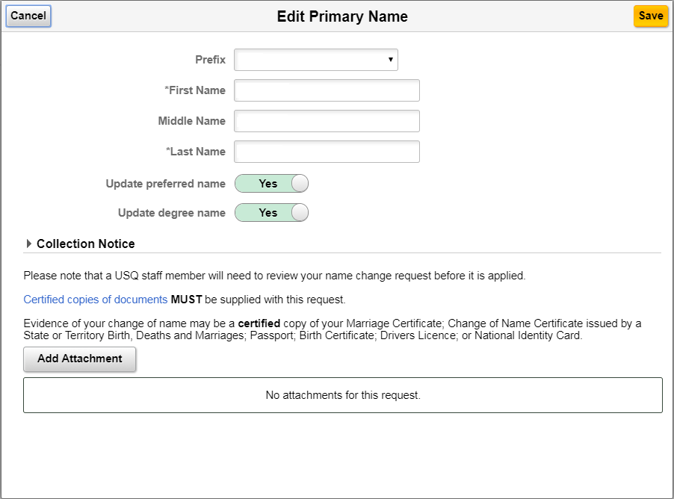
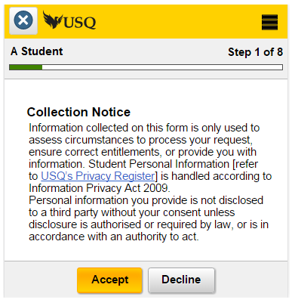
Student Agreements

Slide 16
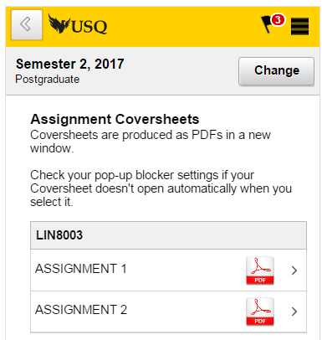
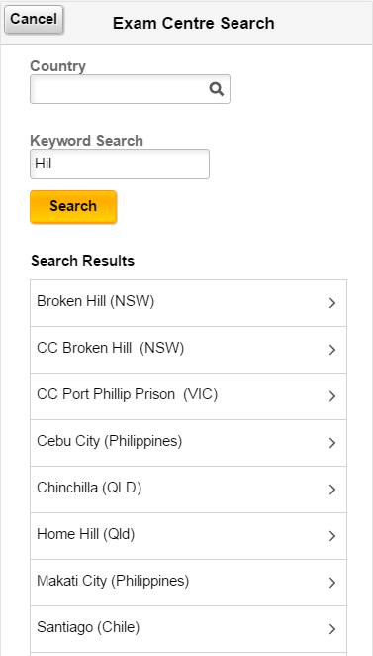
External Content and Dynamic Searches

Slide 17
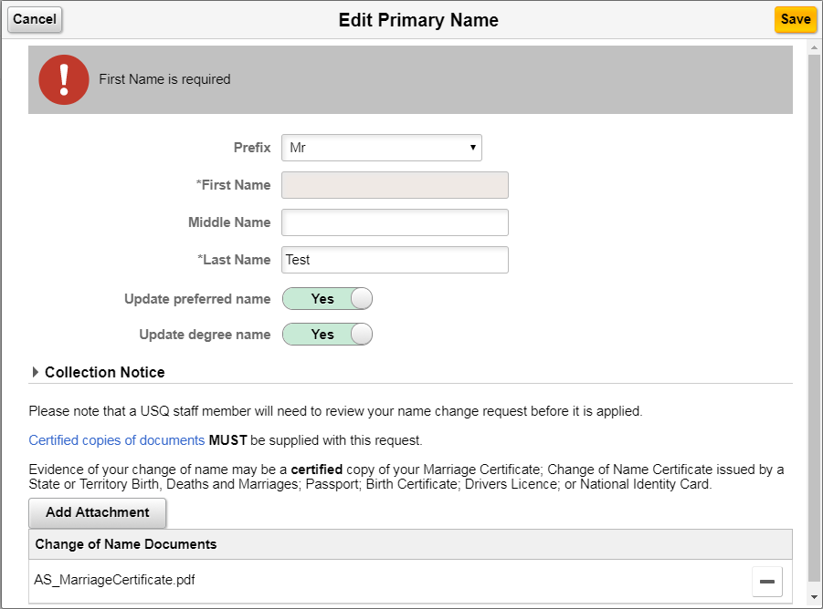
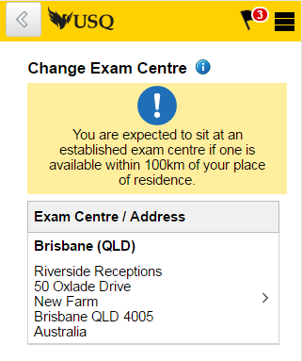
Errors and Warnings

Slide 18
Going with the flow…
PeopleSoft continues to adapt its toolset
Fluid development standards are now evident in the latest PUM code lines
Fluid development is powerful and flexible but does require new learning
Don’t be afraid

Slide 19
Useful Links:
Fluid UI CSS Guide (v0.1) (Access via Document 1909955.1)
PeopleSoft Fluid UX Standards
Contact Details:
Jim Villiers - jim.villiers@calibreconsulting.com.au
William Clarke – clarkew@usq.edu.au

