Slide 1
RAM 2 years on – the highs and lows of the journey to integrated research management
ADU 2017
Allan Tabor
Director Student and Academic Services
UniSA

Slide 2
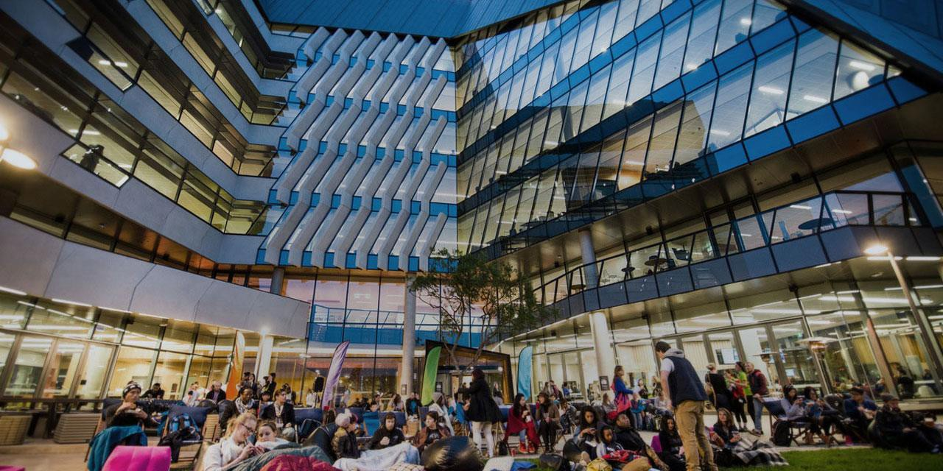
6 Campuses
4 Metropolitan, 2 Regional
31,000 + students

Slide 3
RAM (Research Administration in Medici)
This was the name of our project implemented December 2015, hence the name of this presentation
Medici is the name of our student system which is actually Campus Solutions 9.2

Slide 4
Overview of Change
1. System Configuration
4. Admissions
& Enrolment
5. Portals
6. People & Organisations
7. Scholarships
& Sponsorships
Set up Careers & Terms
Set up Programs & Courses
Set up Fees
Admit Student
Enrol Student
OSHC
Candidature Record
Classification of Research
Student Portal
Staff Portal
Supervisors
External Organisations
Examiners
Set up Scholarship Payments
Fee Relief
Scholarship Changes
Sponsorship

Slide 5
Overview of Change
8. Candidature Management
9. Consumption
10. Review of Progress
11. Thesis
12. Conferral & Graduation
•Confirmation of Candidature
•Request for change
•Change of Supervisor
•Change of Program/ School
•Withdrawal
•Readmission
•Engagement
•Leave
•Change of Mode/ Load
•Overtime
•Track RTS
•Major Review
•Submission
•Track Progress
•Arrange Examiners
•Despatch
•Receipt of Marked Thesis
•Payment to Examiners
•Change in title
•Conferral

Slide 6
Project Outcomes
Move administration of HDR students from Research Master to Research Module in Medici.
Wherever possible, use existing configuration in PeopleSoft and minimise customisation.
Move processes online – reduce reliance on manual forms and processes to increase efficiency and data integrity
Identify opportunities to utilise new PeopleSoft functionality that could be utilised by other areas in the future?

Slide 7
Project Outcomes
Enrolment to reflect if the student is active (previously we were massaging enrolment around census dates)
Fees to reflect the consumption used (didn’t previously use the consumption model for fees but enrolled in set study periods and recorded consumption outside system)
Record student leave and accurately reflect fees and any extension to candidature
Manage review of progress (milestones and evaluation), supervisor information, thesis submission and exams management, post exam corrections
Manage scholarships (stipends) within Campus Solutions using Financial Aid

Slide 8
Project Outcomes
Prepare portal views for staff and students using Fluid functionality
Implement new research study periods
Implement new Research Career
Implement Evaluation Management System

Slide 9
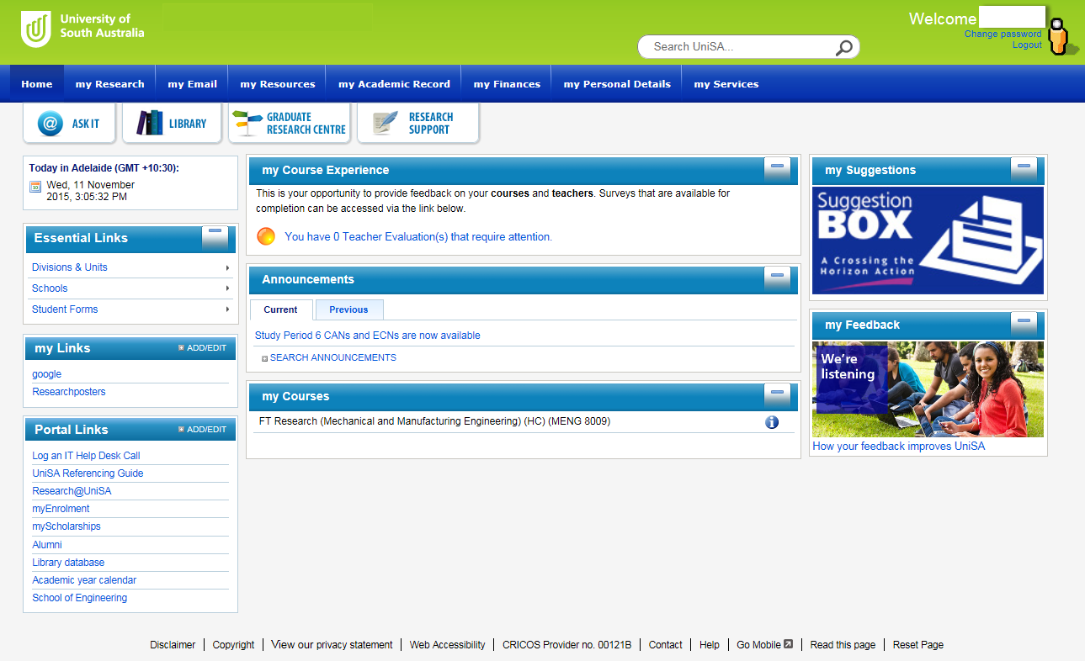
Project Outcomes – Student portal
My Research tab

Slide 10
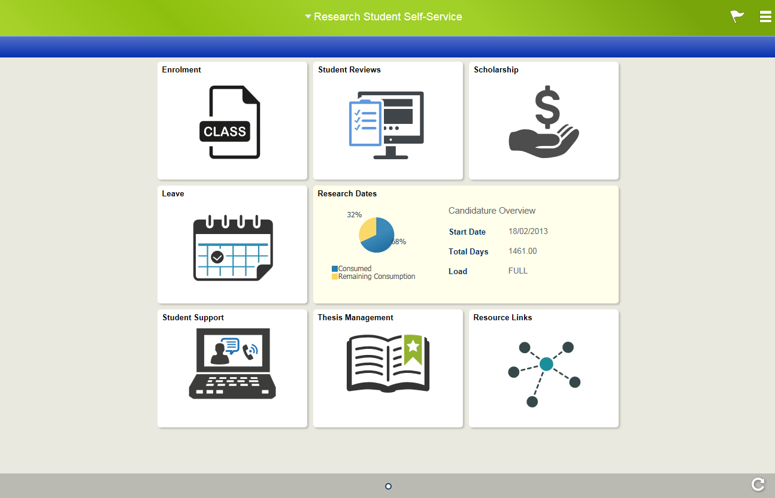
Project Outcomes – Research student view

Slide 11
Project Outcomes – Staff portal view

Slide 12
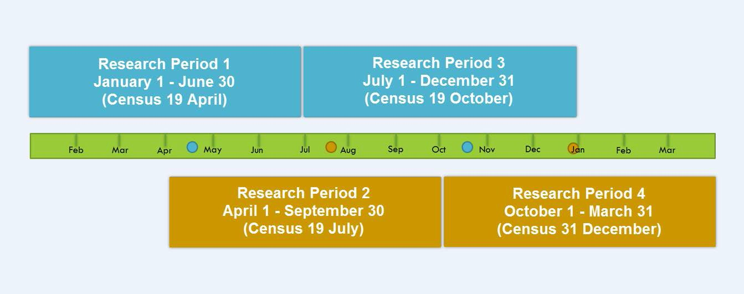
Project Outcomes - Research Study Periods

Slide 13
Project Outcomes - Review of Progress: Online
Student Portal
•Review information
•Attachments
Staff Portal
•Supervisor enters outcome
Student Portal
•Result
•Blank review appears in Student Portal
•Student and Supervisor meet and discuss review
•REPL enters information
Student Portal
Review Meeting
Staff Portal

Slide 14

Project Outcomes - Thesis Management: Online
Nomination of Examiners
Thesis Submission
Thesis Examination
Intent to submit
Viva
Corrections

Slide 15
Project Outcomes - Thesis Management: Intent to submit
Student Portal
• Student requested to
• Supervisory Team:
inform of upcoming
advice to commence
submission
• Student fills in ‘Intent to Submit’
discussions re
• Cc Supervisory
Nomination of
Team
Examiners
Email
Email

Slide 16
Project Outcomes - Thesis Management: Nomination of Examiners
Staff Portal
Supervisor
Dean reviews
updates
REPL reviews nominated examiners
nominated
Nomination of
examiners
Examiners
Staff Portal
Staff Portal

Slide 17
Project Outcomes - Thesis Management: Thesis Submission
Staff Portal
Staff Portal
Student
REPL
submits
Supervisor reviews submission
reviews
Dean reviews submission
thesis online
submission
Student
Staff Portal
Portal

Slide 18
Project Outcomes - Thesis Submission
Student will have their consumption (and scholarship etc) put on hold once they have submitted.
Consumption will be restarted if they go beyond the authorised time frame to complete corrections.

Slide 19
Project Outcomes - Thesis Management: Thesis Examination
Medici
Medici
Examiners
Student
grade
SAS
Update the outcome
undertakes
SAS
Update the outcome
thesis
Viva
Online
VIVA
Thesis

Slide 20
More, more, more
particularly non regular users
Start Anytime
Flexibility, alignment
to sponsors
Communication
Highs and Lows
Pagelets
New v current students,
better transparency v
old census date study period
Consumption
Thesis evaluation:
Supervisor
REPL
Dean
Easy Entry pages
Auto enrolment
Leave, start date
changes (deferral),
Load change (PT,FT)
Research periods 1,3 or 2,4
patterns

Slide 21
Review in research
period, 4 per year
depending on pattern,
student summary,
supervisor summary,
upload documents
Scholarship management
Review of progress
Exam management
Lodgement of thesis (timing),
online examiner grading, record
outcome, moving to VIVA all new
students, management of consumption
Payments details Medici,
Account details SCMS
Scheme management
Highs and Lows
BFS management
Academic report
Records attendance
orientation, workshops,
study abroad, unsatis-
factory progress, appeals
& outcomes, industry
placements
Advise to Deans, REPL, scholarship ceases,
ability to reinstate scholarship and back pay
Other Assignments
Summary student – enrolment,
credit, scholarships, leave, reviews
(extended FAR report)

Slide 22
Transparency of system enhancements
Reports under development
Initially didn’t know what was being
actioned therefore thought nothing
happening, regular update to key
stakeholders, prioritising with other
systems
New reports in Cognos specifically for
research (load, enrolments etc),
scholarship reconciliation (new cost centres),
schemes
Highs and Lows
Investigations
Viewing on examiner comments for thesis resubmission,
view of historical scholarship payments (conversion issue),
updating co-supervisor to supervisor still manual

Slide 23
Questions

