Slide 1
AUTOMATED ONLINE SCHOLARSHIPS, AWARDS & BURSARIES: WHO DOESN’T WANT FREE MONEY?
SESSION 5066
November 7, 2017

Slide 2
PRESENTERS
Ammara Wood
Pernell Blake
Process Analyst
NAIT
ammaraw@nait.ca
Functional Analyst
MacEwan University
blakep5@macewan.ca
Notes:
Introduce ourselves and explain why NAIT…

Slide 3
OVERVIEW
About MacEwan
The Project
Objectives
Student Pages
Staff Pages
Achievements and Lessons Learned
Public Search Tool
Notes:
Pernell
Provide definition of SAB.

Slide 4
MACEWAN UNIVERSITY
Founded in 1971
19, 606 students
6 Schools and Faculties
2 Campuses - City Centre and Alberta College
Notes:
Pernell
Grant MacEwan Community College was established in 1971 and was named after Dr. J.W. Grant MacEwan former lieutenant governor of Alberta.
In 2004, it became an accredited degree-granting institution.
mention closing third campus and opening new building as of Sept 2017.

Slide 5
THE PROJECT
3 Phases
Phase 1 - Application and Adjudication
Phase 2 - Authorization and Disbursement
Phase 3 - The Nice to Haves
Campus Solutions v9.2
PeopleTools 8.55
Notes:
Pernell
Phase 3 - Entrance Award Automation, SIN # Activity Guide, etc. Phase 3A involves the implementation of the Batch Confirmation of Eligibility, rollover of applicatio period info, 3Cs.

Slide 6
SAB Background
In 2016 we had:
409 active SABs, 1909 SAB recipients, and awarded $3,546,563.60
1 staff who supported the business process
External application system
Notes:
Pernell
MacEwan had an internal audit of the entire Scholarship process that included Alumni and Development, Charitable Accounting, and Financial Aid. This project came about as a result of the findings.
There was one staff in the scholarship department. He was responsible for processing applications and overseeing adjudication.
Applications used to go through a separate ad hoc system (Sunbaked) that was not connected to PeopleSoft in any way so there was a lot of manual work when it came to adjudication.
Students had to submit their application in one sitting, with no ability to return and review or update their applications. They could not view their application status either.

Slide 7
OBJECTIVES
Improve overall management and administration of SABs
Move all processing into PeopleSoft
Improve the way students identify and apply
Provide the ability to track/update the application status
Increase overall award rates
Provide a public search tool
Address audit observations
Notes:
Ammara

Slide 8
SAB Application
Single application
Efficient
Convenient
Transparent
Notes:
Ammara
Streamlined single app for all SABs including the scholarships administered by Student Aid Alberta - e.g. Jason Lang and Louise McKinney.
Efficient - Eliminated the need for a paper application. Each student is presented with a tailored list of SABs they are eligible for based on academic record (program, gpa) and responses to specific questions. Eliminates need to search for SABs.
Convenient - accessed via an activity guide on their To Do List. They can save their progress and return as many times as they wish up until the close date.
Assigned activity guides based on pop selects
Open up PSoft and go through a simple application to show them. -

Slide 9
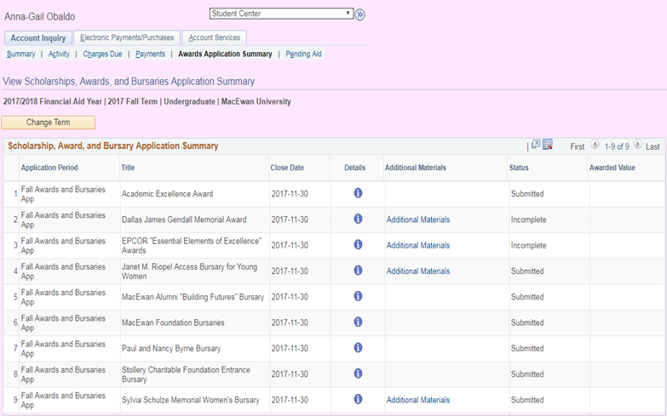
Application Summary
Notes:
Pernell: The Awards Application Summary allows the student to see all past and current SAB applications that have been submitted. This is done right from their Student Centre and the benefits are:
See a central listing of all their SAB applications.
The ability to track the status of each SAB application.
For applications that are still open students are able to update their responses to the subjective questions. They can also upload documents such as resumes, essays, and portfolios directly from the Awards Application Summary page.

Slide 10
Staff Maintenance
The application maintenance page is a custom page and it allows staff from the Student Financial Aid Office the ability to:
View each student SAB application and track status
Download attachments for use in adjudication
Award a student
Select alternate applicants
Log the emplid/username of the staff member that updated the application status
Process nominated awards
Notes:
Pernell

Slide 11
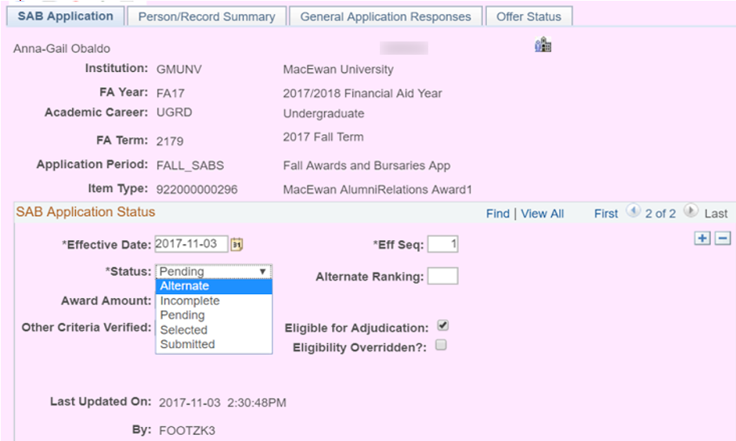
Staff Maintenance
Notes:
Pernell

Slide 12
Configuration Background
Delivered Pages:
Financial Aid Year Set Up
Fiscal Item Types
Financial Item Types
Message Catalog
Entity Groups
Customized Pages:
SAB Details
Application Period
Notes:
Ammara

Slide 13
ACHIEVEMENTS
Improvement of administration of SABs
Processing moved into PeopleSoft
Improved student experience
Provided a public search tool
Increased award rates:
Jason Lang: 400 more qualified applications that equated to $400,000
A Student Financial Aid department
6 staff who support the business process
457 active SABs and 9844 SAB applications.
Notes:
Ammara

Slide 14
LESSONS LEARNED
Terms of Reference Review
Aggressive Timelines for all phase of the project
New Subject Matter Experts in the business area
Notes:
Ammara
Some of the TORs needed clarification which impacted affected the timelines established at the start of the project.
Initial estimates were low and this combined with aggressive timelines posed some challenges to the project.

Slide 15
Public Search Tool
The Public Search Tool provides a listing of SABs that may be offered to MacEwan students. The benefit of this tool are:
Offering a flexible tool to search for SABs.
Easy to use and understand.
Provided details of each SAB.
www.macewan.ca/scholarships
Notes:
Pernell
The listing can be searched in a number of ways (keyword, category, filters), and these search parameters can be used simultaneously. For example, a user can search for SABs open to Bachelor of Arts students with children without having to run two separate searches.
The public search tool was set-up so that it would be easy for people to use and understand.

Slide 16
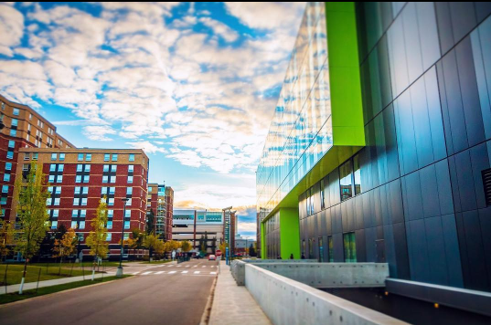
CONCLUDING THOUGHTS
ANY QUESTIONS?
Notes:
Pernell: These are pictures of the new Faculty of Fine Arts and Communications building, a state of the art facility that will not only serve the students but the public as well. There was a major campaign to raise funds for the building as well as to boost scholarship funding. The tool also allows MacEwan University to satisfy not only the needs of students but also parents, donors, and members of the public.

Slide 17
PRESENTERS
Ammara Wood
Pernell Blake
Process Analyst
NAIT
ammaraw@nait.ca
Functional Analyst
MacEwan University
blakep5@macewan.ca
ALL ALLIANCE PRESENTATIONS WILL BE AVAILABLE FOR DOWNLOAD FROM THE CONFERENCE SITE

Slide 18
THANK YOU!

