Slide 1
[sposser]
Sponsor Self Service

Slide 2
Presenters
Presenter 1
Ms. Reem Hamarneh
Business Analyst
College of the North Atlantic - Qatar
reem.hamarneh@cna-qatar.edu.qa
Presenter 2
Ms. Surayya Hazari
Associate Registrar
College of the North Atlantic - Qatar
surayya.hazari@cna-qatar.edu.qa

Slide 3
Purpose of the Project
Sponsors will have access to their sponsored student information online.
Sponsors can generate reports on Student’s Profile, Attendance, Transcript, and Enrollment on their own, at their convenience.
SPOSSOR saves lot of time and effort for both CNAQ staff members and sponsors.

Slide 4
Process Flow
PeopleSoft
Campus Solutions
Sponsored Students

Slide 5
Features
Personal Information
Demographic Information
National ID
Names
Contact Address
Phone Numbers
Email Address

Slide 6
Academic Information
Service Indicators
Academic Standing
Student Grades
Student Profile
Unofficial Transcript

Slide 7
Reports
Attendance Reports
Confirmation of Enrollment

Slide 8
Access
Login ID and Password
Forget Password option

Slide 9
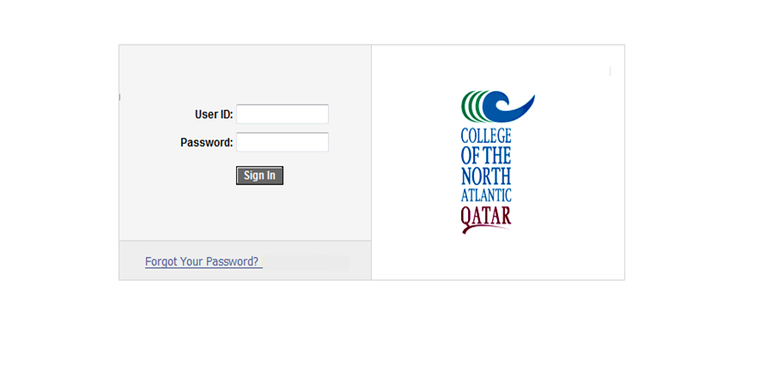
Mockup Pages
Login Pages

Slide 10
Sponsor Page

Slide 11
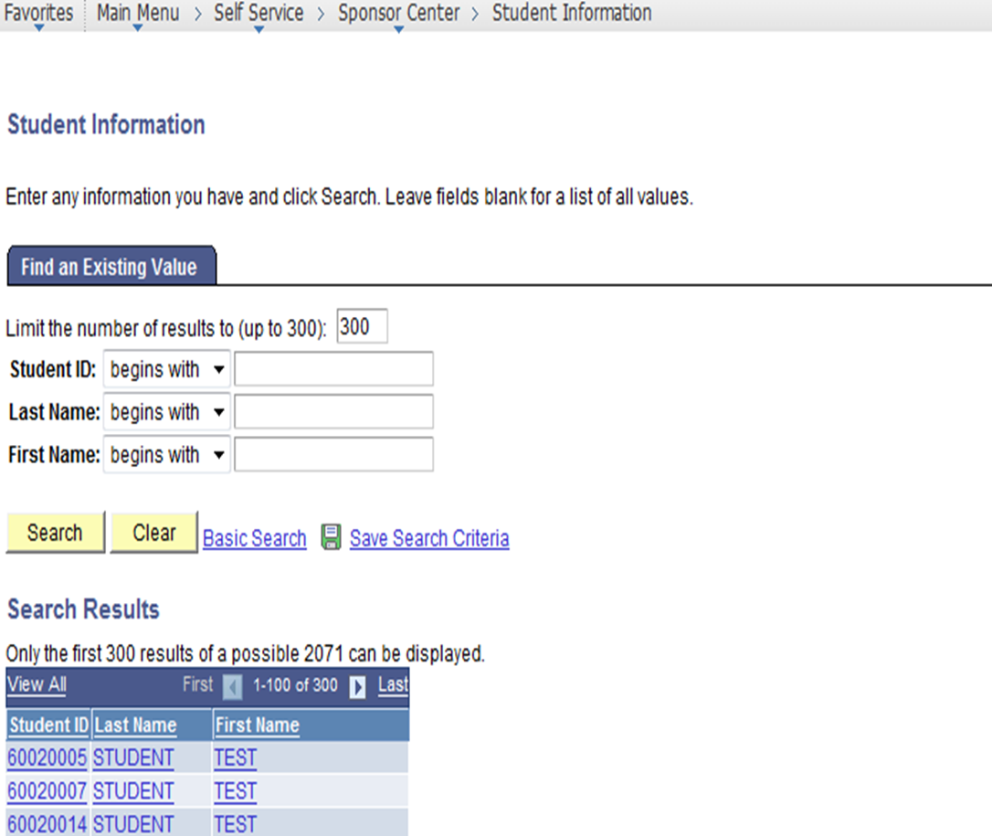
Student Information Search Page

Slide 12
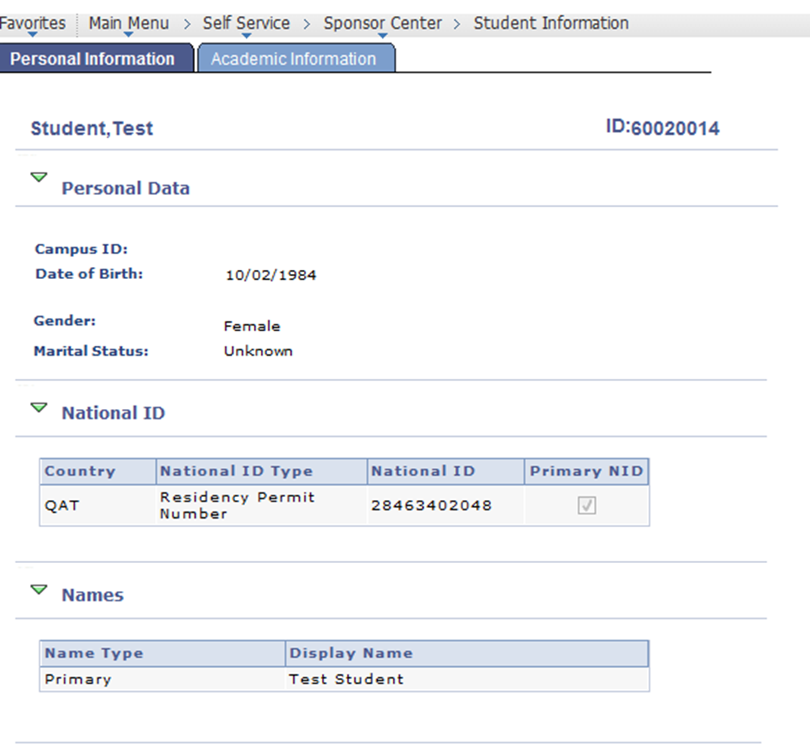
Personal Information Page

Slide 13
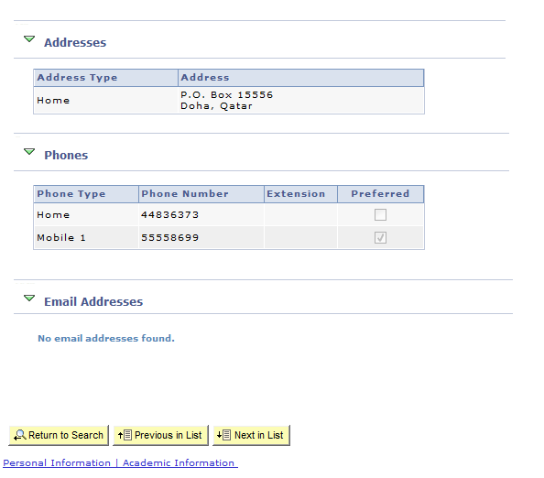
Personal Information Page ctd.

Slide 14
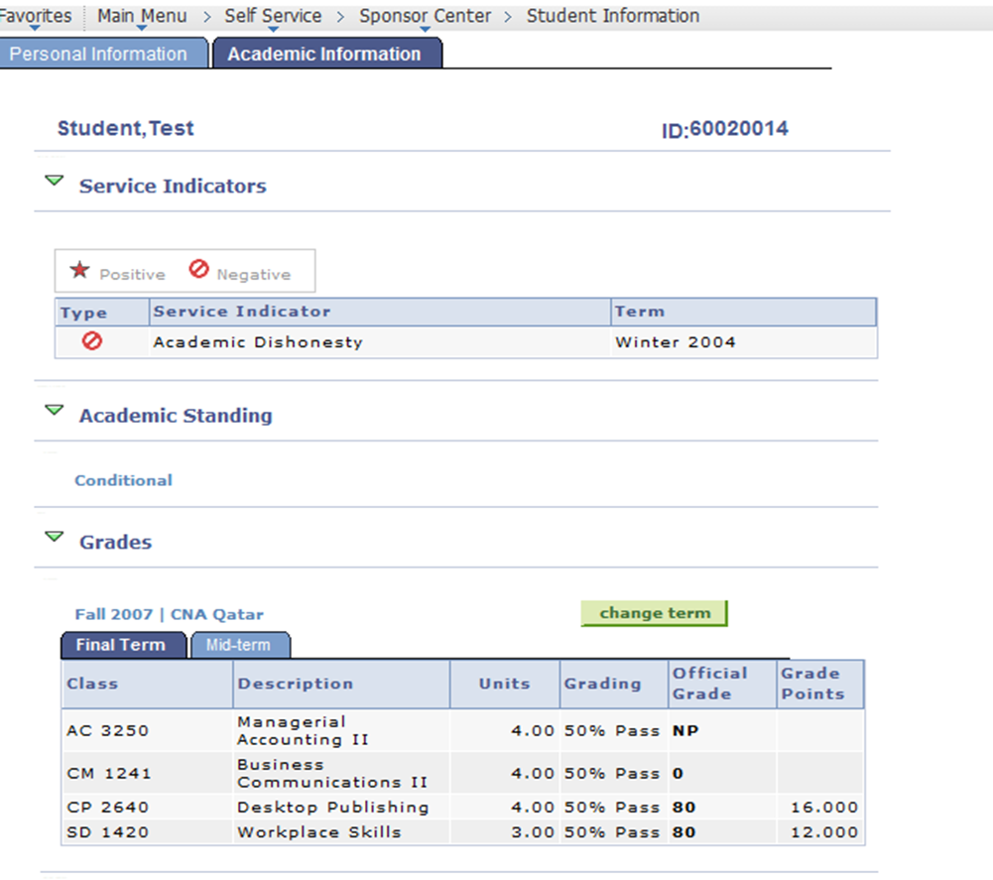
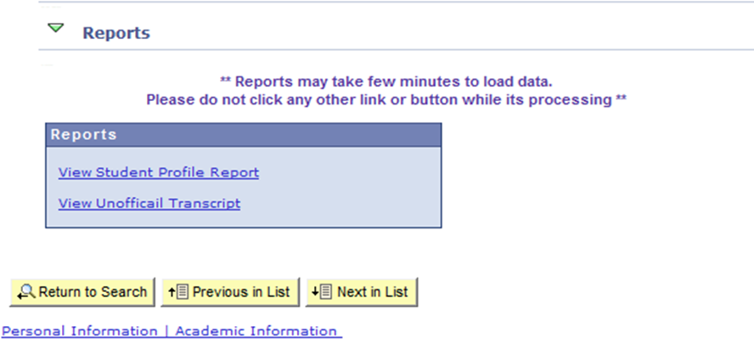
Academic Information

Slide 15
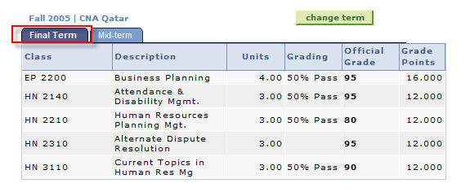
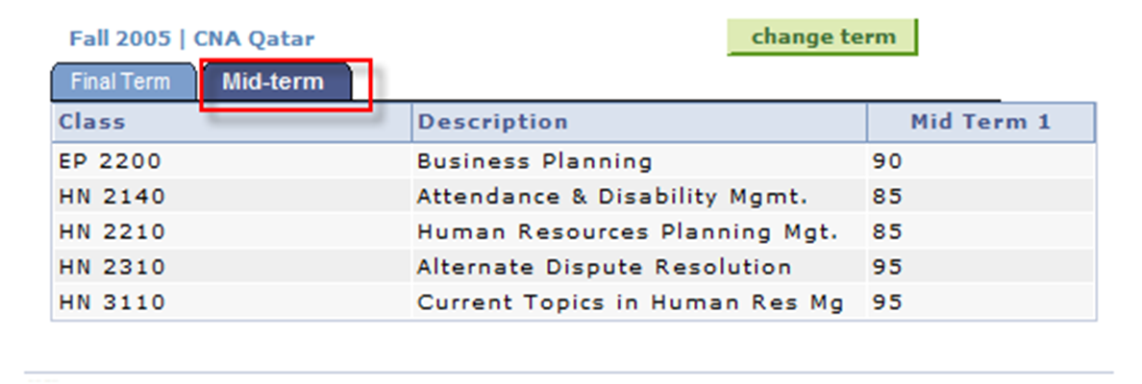
Grade Section – In Detail

Slide 16
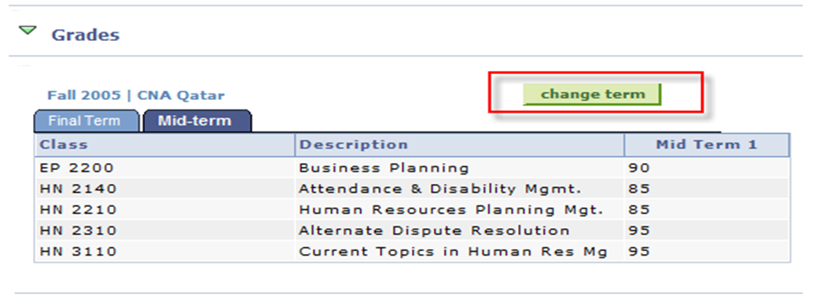
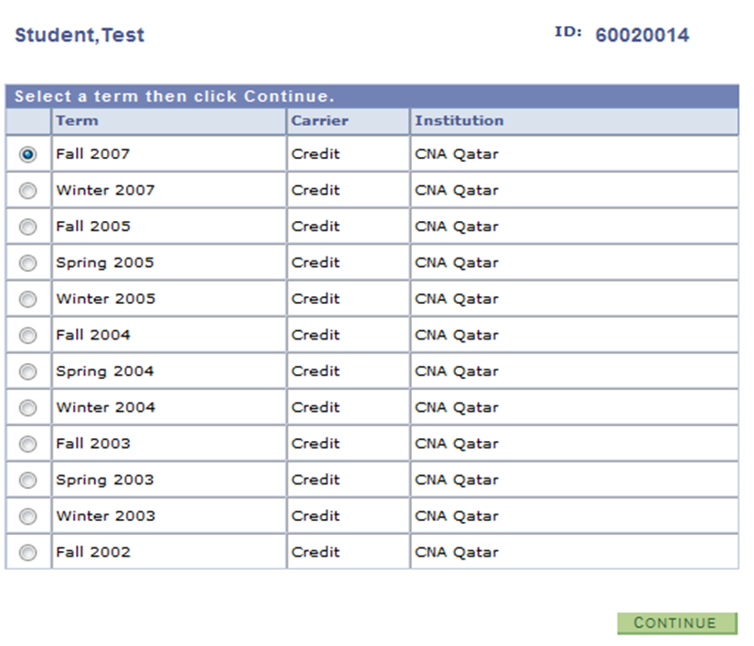

Slide 17
Batch Reports

Slide 18
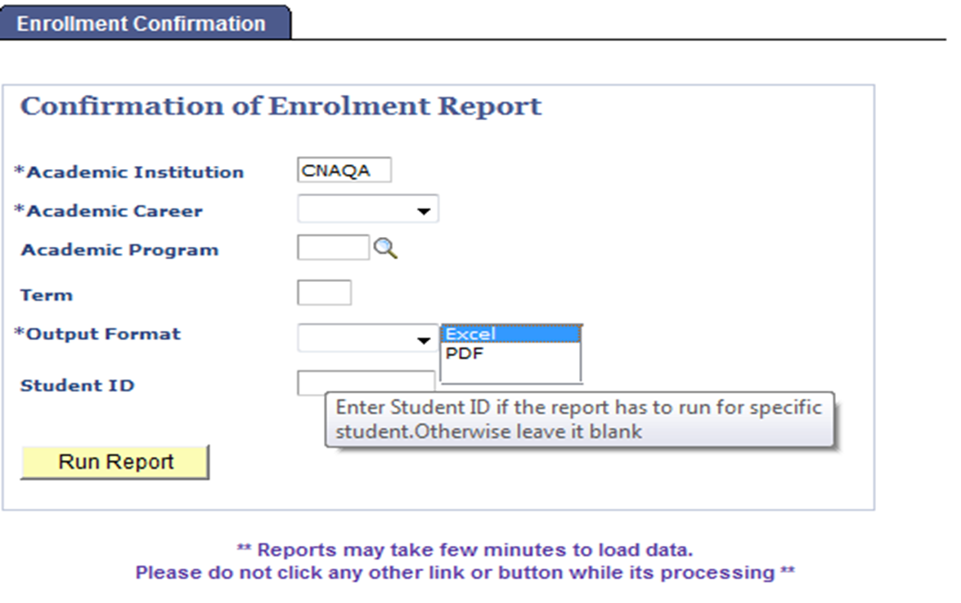
Confirmation of Enrolment Report

Slide 19
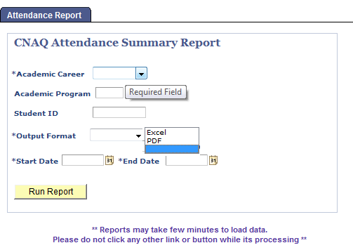
Attendance Report - Summary

Slide 20
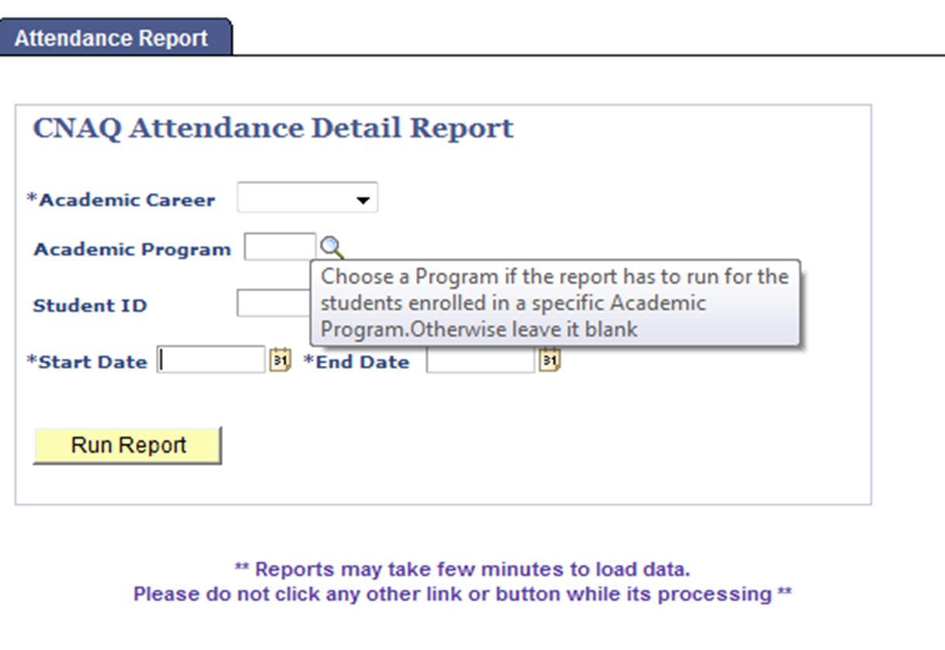
Attendance Report - Detail

Slide 21
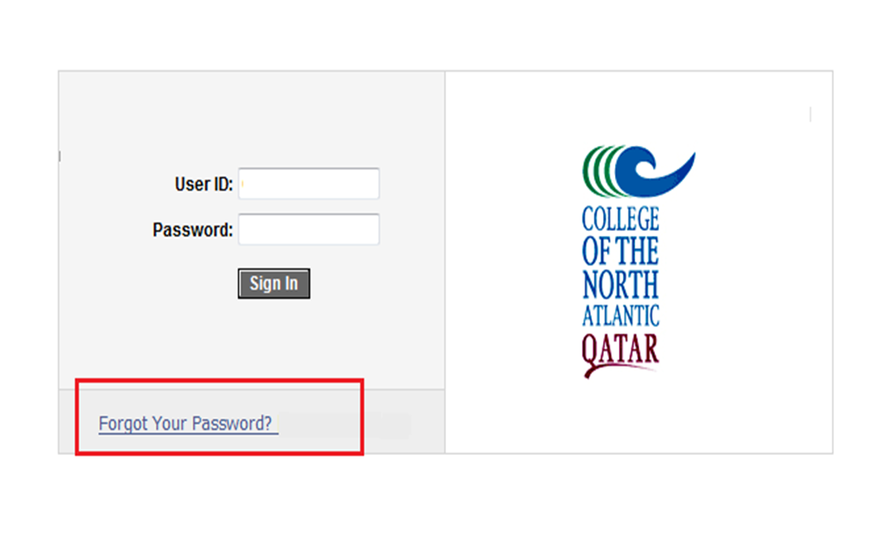
Forgot Password Link

Slide 22
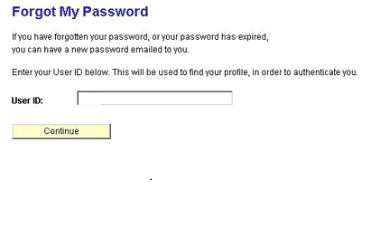
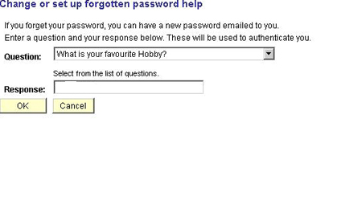
Forgot Password Link

Slide 23
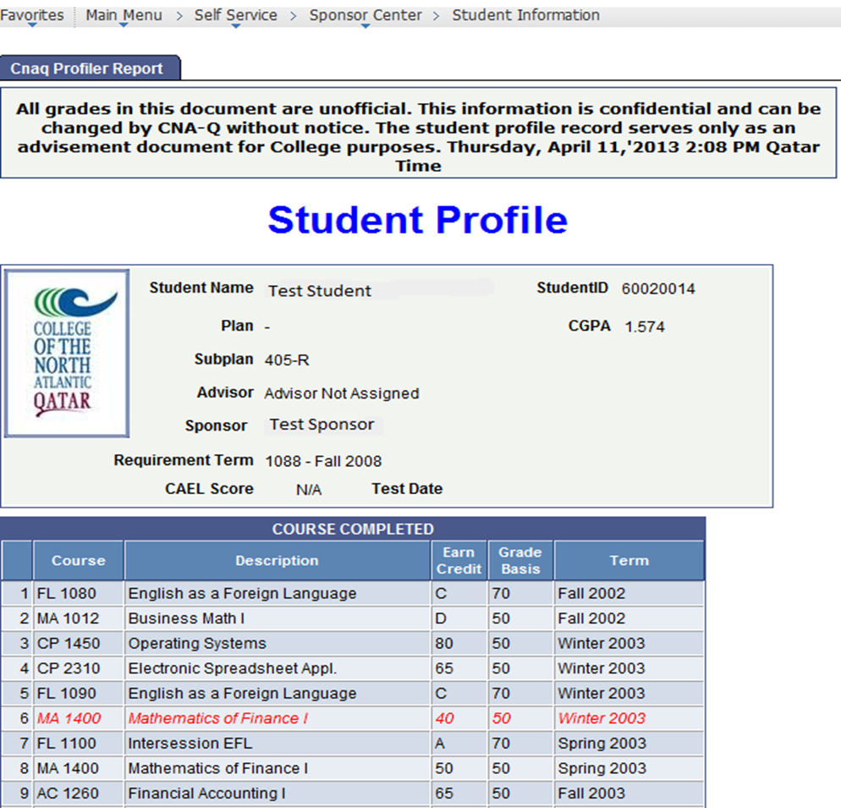
Sample Report – Student Profile

Slide 24
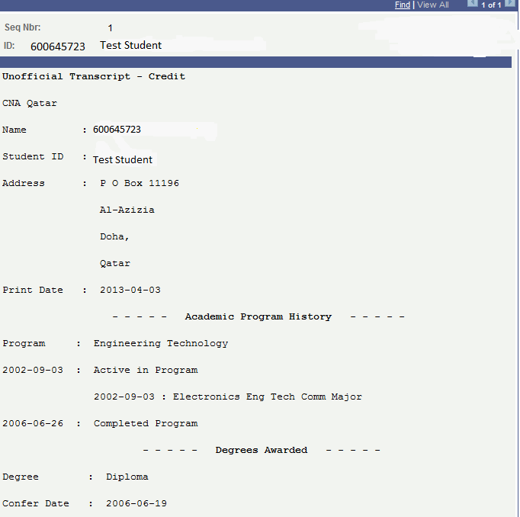
Sample Report – Unofficial Transcript

Slide 25
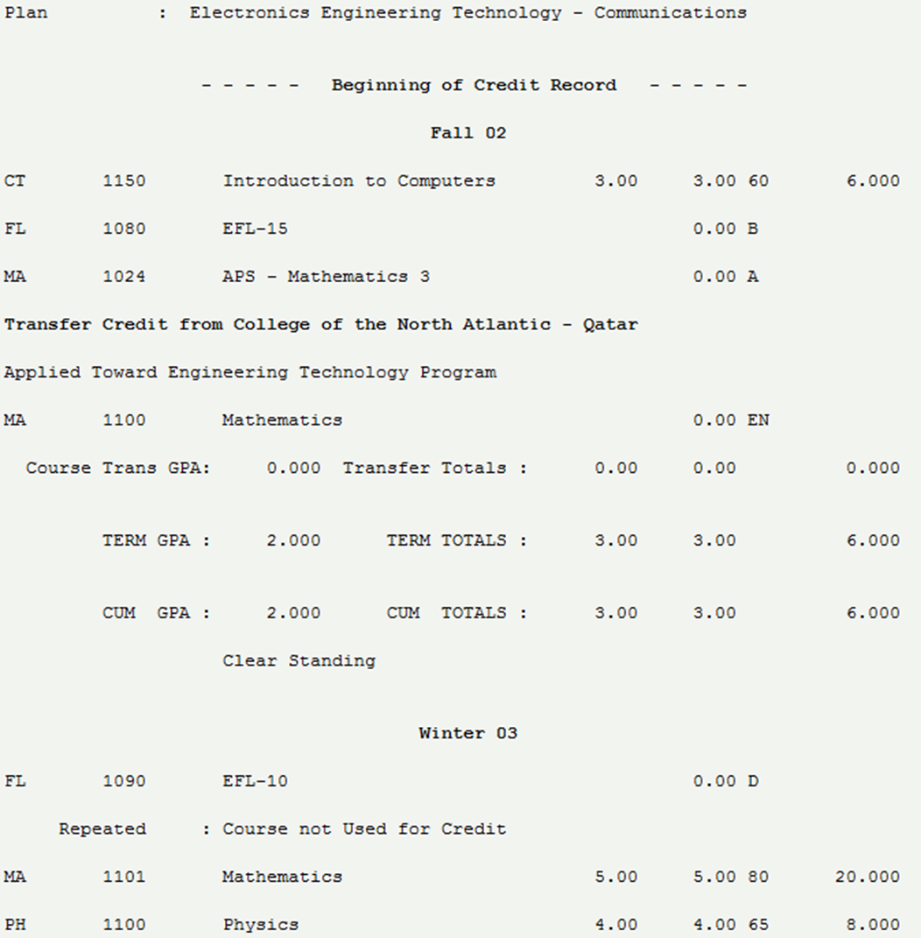

Slide 26
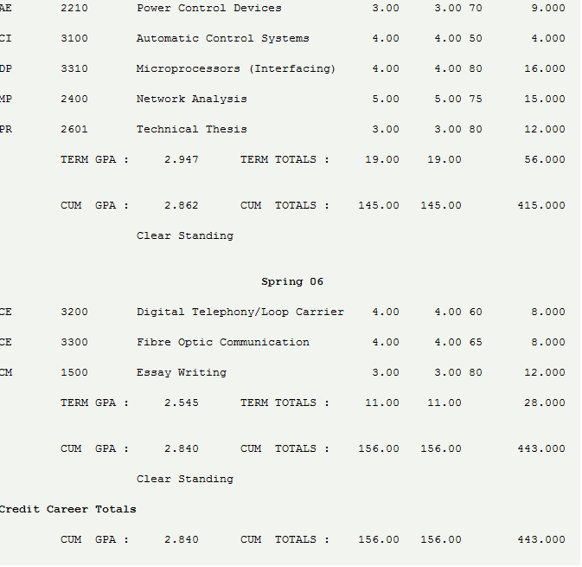

Slide 27
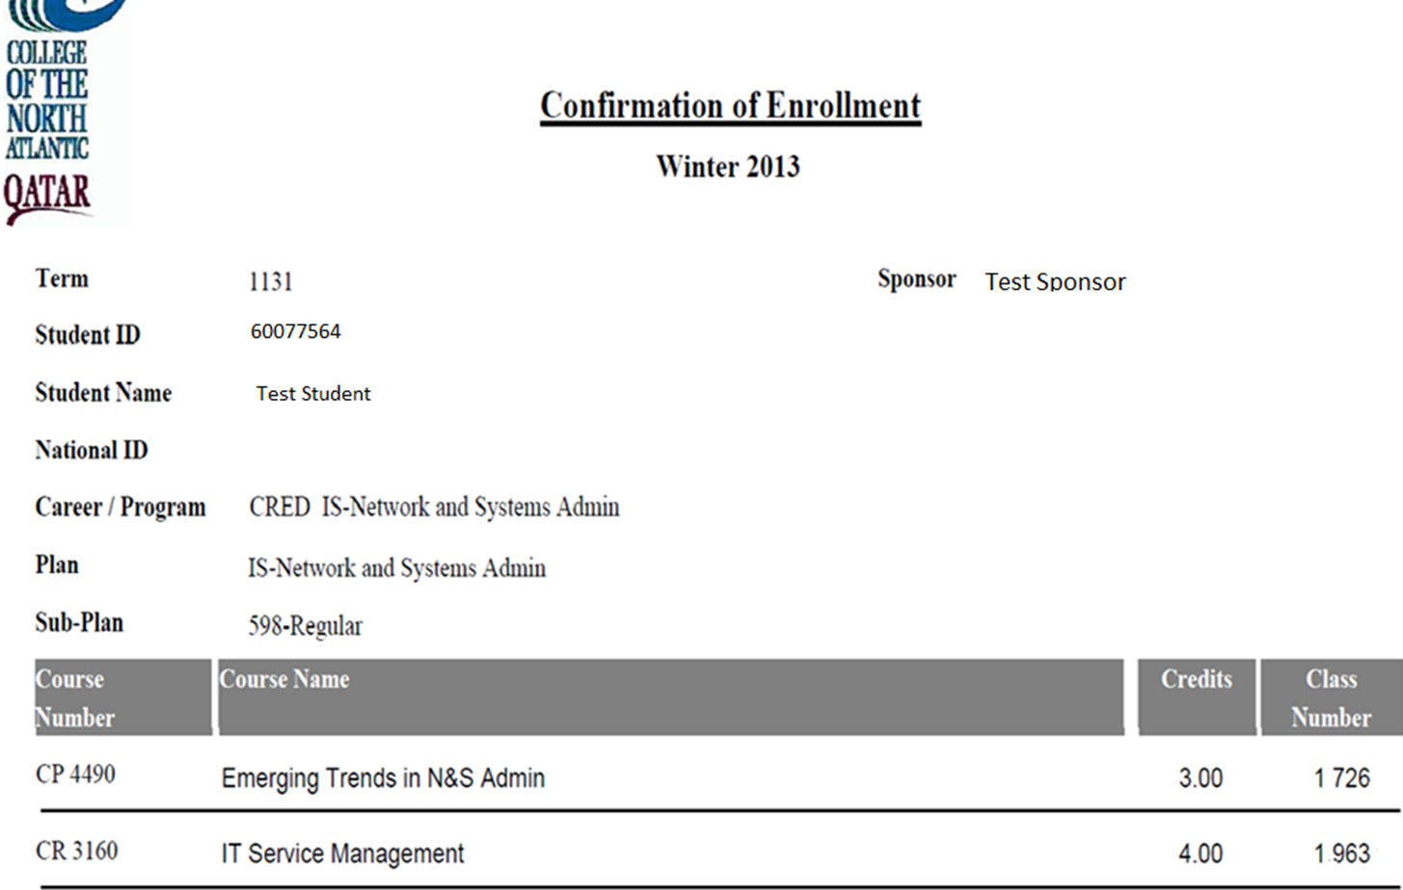
Sample Report – Confirmation of Enrollment

Slide 28
Questions?

