Slide 1
honors and awards
SESSION 5303
17 November 2015
01:20pm – 02:20pm

Slide 2
presenter
Denise Kelly
Queens University Belfast
denise.kelly@qub.ac.uk
Over 20 years experience working across Schools and Directorates within the University
Functional Development Lead since 2014
Worked with Campus Solutions since 2008
Specialising in the Student Records and Student Financials Modules
MSc in Organisation and Management; Prince 2 and ITIL

Slide 3
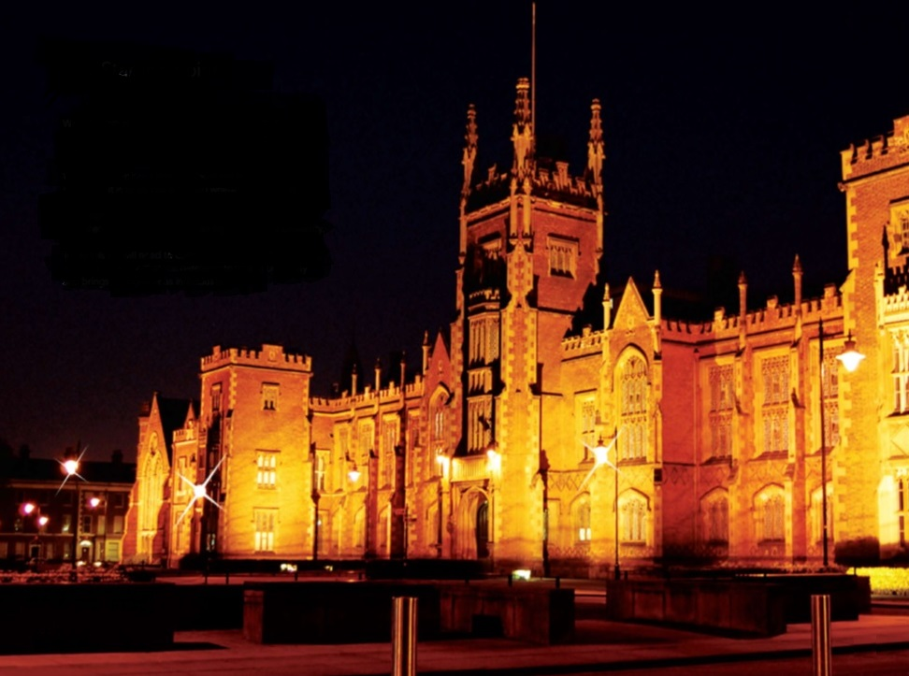
Queens university Belfast
Established by Queen Victoria in 1845.
The University is an international centre of research and education rooted at the heart of Northern Ireland with approximately 23,500 students.
The University is a member of the Russell Group of 24 leading UK research-intensive universities.

Slide 4
Queens & ORACLE
Campus Solutions locally branded as Qsis, implemented 2007-2008
Using all core modules
Campus Solutions v 9.0
PeopleSoft v8.54.07
Bundle 37

Slide 5
Honors and awards at qub
1
3
Development Purpose
Honor and Award Table
2
4
Honor and Award at Student Level
Reporting and Printing Certificates

Slide 6
Development purpose
QUB adhering to HEAR Diploma Supplement

Slide 7
HEAR - Diploma supplement
The Higher Education Achievement Report (HEAR) incorporates the model developed by the European Commission, Council of Europe and UNESCO/ CEPES for the Diploma Supplement.

Slide 8
HEAR - overview
Single comprehensive record of a learner’s achievement
Includes details of academic work, extra-curricular activities, employability awards and voluntary work that have been verified by your institution
purpose is to provide more information about individual student achievements and to enhance employability or further education opportunities.

Slide 9
HEAR – Prize and award project objectives
Consolidate
Consolidate current information held by Schools and centralise the process within the Student Information System (Qsis).
Functionality
Provide functionality for the recording of verified prizes and awards.
Reporting
Provide reports to support users in identifying students who have achieved a prize or award by term, prize/award code and school.

Slide 10
Honor and award at student level
Delivered functionality nothing more, nothing less!

Slide 11
Honor and Award – the student
Overview of delivered page
QUB - Business Terminology
QUB – Coding System
Comment Box

Slide 12
Individual student level

Slide 13
Business process terminology
Validated: An award that has been presented and approved by Academic Affairs through the Scholarship and Award Group.
External: An award that does not pertain to the students programme of study whilst at QUB and therefore will not appear as part of the HEAR
Internal: An award that pertains to the students programme of study whilst at QUB, if validated through the Scholarship and Awards Group will be classified as ‘official’ and therefore appear on the HEAR. If not validated through the Scholarship and Awards Group will be classified as ‘unofficial’ and will not appear on the HEAR.

Slide 14
Qub – coding system

Slide 15
Honor and award coding system
Facility
1 Arts, Humanities and Social Sciences
School
07 Queen's University Management School
01 School of Medicine, Dentistry and Biomedical Sciences
H&A Code - QUMS
0 - 499 = Undergraduates Awards
500 – 999 = Postgraduate Awards
2 Engineering and Physical Sciences
3 Medicine, Health and Life Sciences
H&A Code – SMED
0 – 249 Biomedical Sciences
250 – 499 Dentistry
500 – 749 Medicine
750 – 999 Postgraduate

Slide 16
Comment box

Slide 17
Queen’s University Management School – the first School with consolidated Prizes and Awards visibility in Campus as well as certificates printing directly using BI Publisher.

Slide 18
Honor and award table
Configuration Requirements

Slide 19
Honor and award – the table
Overview of delivered page
QUB – Common Attribute Framework - Configuration
QUB – Record Context

Slide 20
Honor and award table

Slide 21
Caf – common attribute framework
CAF comments field to associate the Prize and Award with Academic Org
CAF comments field to associate the Prize and Award with the date reward was received
CAF comments field to associate Prize and Award with full name to appear on certificate
CAF comments field to associate Prize and Award with additional information
CAF comments field to associate comment box at student level

Slide 22
CAF configuration

Slide 23
Record context

Slide 24
Reporting and certificates
PS Query
BI Publisher

Slide 25
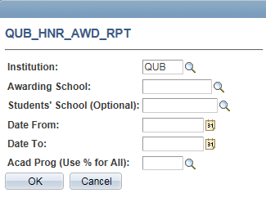
Reporting facilities
QUB_HNR_AWD_RPT

Slide 26
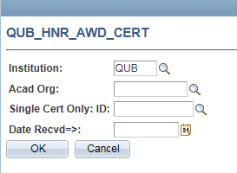
BI PUBLISHER - CERTIFICATES
QUB_HNR_AWD_CERT

Slide 27
Honor and award certificate
Student Name

Slide 28
Concluding thoughts
ANY QUESTIONS?

Slide 29
SUMMARY (QUB – Benefits)
Reporting
Central collection point all years/terms
Provides reporting functionality
Visibility
Student has transparency in Self- Service Account
Staff have single point of reference
Certificates
Direct Printing from Qsis
Single replacement certificates available

Slide 30
presenters
Denise Kelly
Queen’s University Belfast
denise.kelly@qub.ac.uk
all Alliance presentations will be available for download from the Conference Site

Slide 31
THANK YOU!

