Slide 1
Sessional Timesheet Reconciliation Presentation
SESSION #36007
9 November, 2016

Slide 2
presenters
Kellie McVey
Karen Dixon
HR Officer
University of the Sunshine Coast
kmcvey@usc.edu.au
HR Consultant (Remuneration & Systems)
University of the Sunshine Coast
kdixon@usc.edu.au

Slide 3
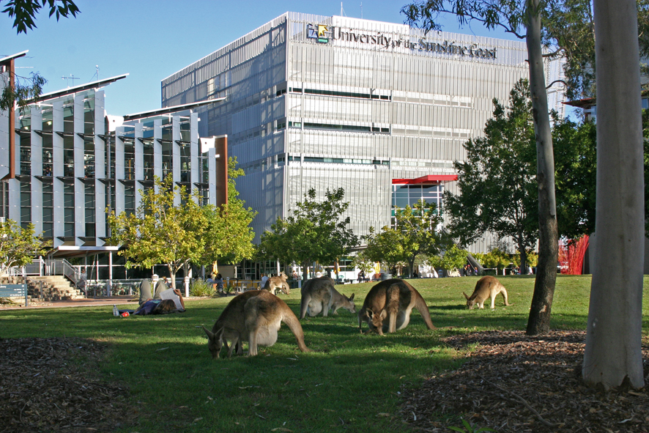
University of the sunshine coast
4 Campuses
Fraser Coast, Gympie, Sippy Downs & Southbank
2111 Staff

Slide 4
V9.0 (Ptools 8.54) currently upgrading to v9.2 (Ptools 8.55)

Slide 5
Sessional Worksheet

Slide 6
Manual Process
1959 Sessional and Casual Academic Appointments for 2015
Manual process –
Sessional staff are unable to claim more hours than what has been approved on their worksheet
Many sessional staff have multiple jobs and lose track of their hours claimed
Sessional’s rely on payroll staff to conduct manual audits on hours already claimed
Payroll run queries on hours paid and compare this to the latest worksheet for variance in hours
Requested Timeline
When a sessional calls/emails about their hours they are normally trying to enter a timesheet so the timeline requested is always a priority and immediate action is taken
If a request is against all job records by this could take anywhere from 5 min to over half an hour for the more complicated jobs

Slide 7
Manual Process
Manual processing
This brings our work to a standstill as it is priority to pay staff on time
Solution
Approx 120 hours to build and test

Slide 8
Automated Process – Timesheet Reconciliation
Automated Process
Online Timesheet reconciliation report was created and implemented into PeopleSoft including into Self Service
Report is assembled with information for the sessional
Graphs of hours claimed against hours approved for payment
Approved Appointment Totals
Timesheets Claimed in more detail
Report has the ability to download data to excel
Each column can be sorted
Latest worksheet is accessible from this report
Reconciliation
Immediate

Slide 9
Timesheet Report graph

Slide 10
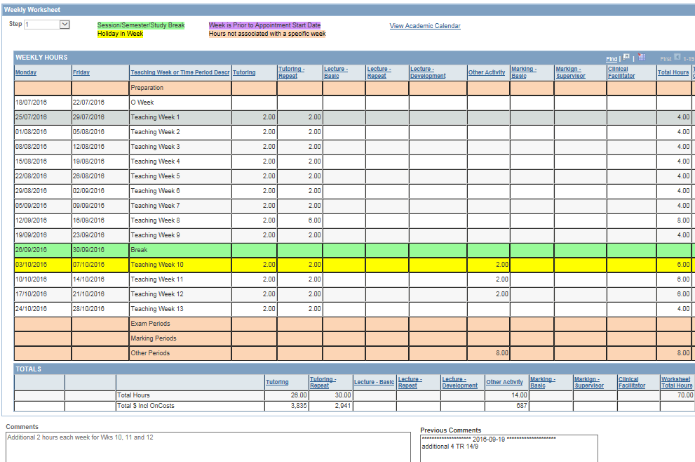
Worksheet view from graph

Slide 11
Approved appointment totals

Slide 12
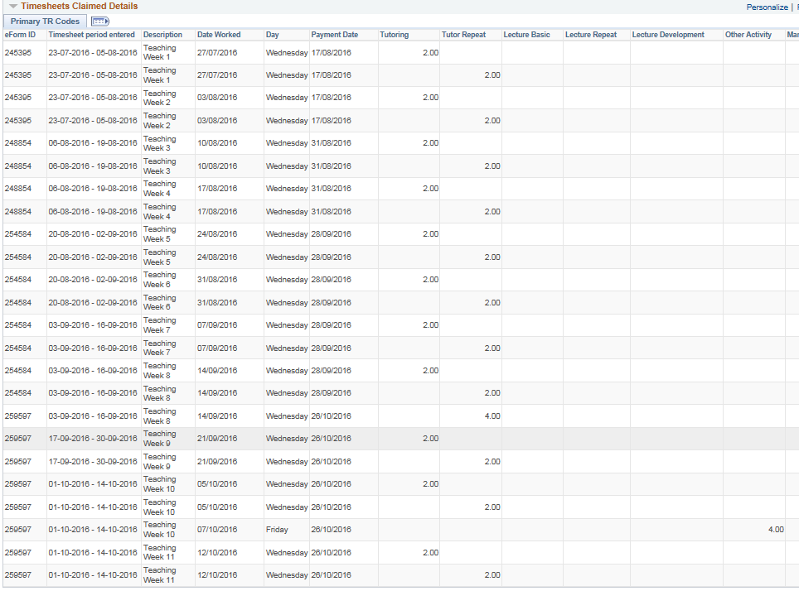
Timesheet Claimed Details

Slide 13
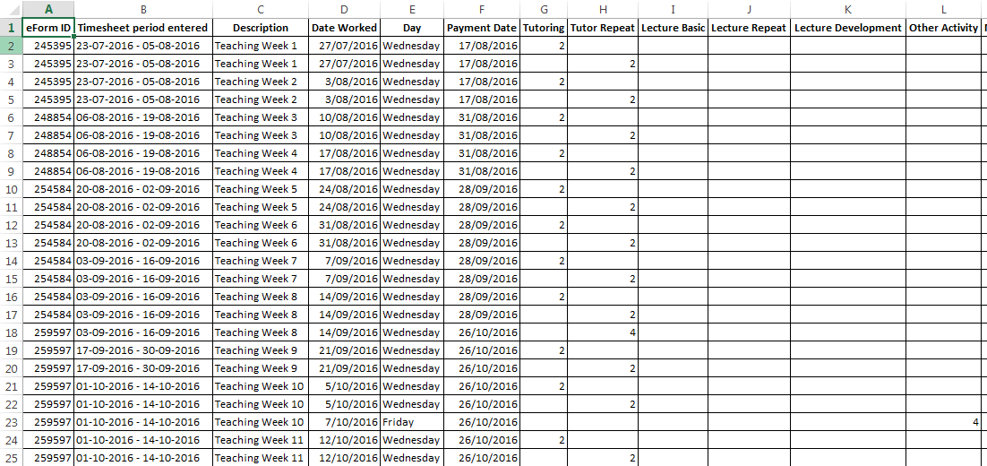
download to excel

Slide 14
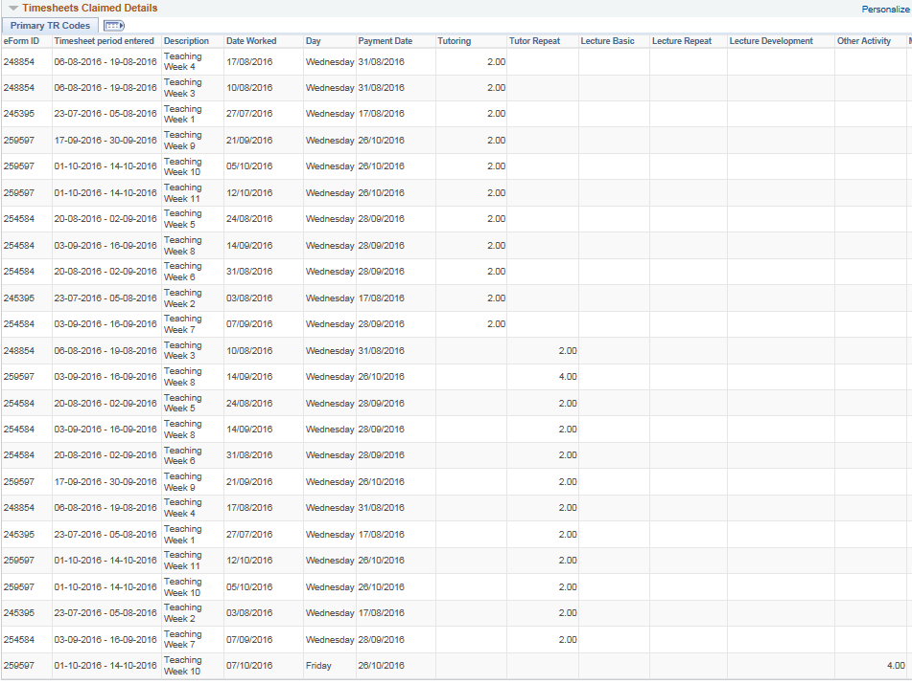
Sorting columns

Slide 15
SUMMARY
Reduction in phone and email enquiries
Timesheets submitted in a more timely manner
Sessional staff can access Reconciliation any day, any time as available via Self Service
Less enquiries for the Faculty/School Admin
Happy Payroll & Faculty Admin staff and Happy customers

Slide 16
ANY QUESTIONS

Slide 17
presenters
Kellie McVey
Karen Dixon
HR Officer
University of the Sunshine Coast
kmcvey@usc.edu.au
HR Consultant (Remuneration & Systems)
University of the Sunshine Coast
kdixon@usc.edu.au
all Alliance presentations will be available for download from the Conference Site

Slide 18
THANK YOU!

