Slide 1
Accounts receivable
SESSION 5
4 July 2019

Slide 2
presenter
Lemonia Nel
Business Analyst
University of the Free State
filc@ufs.ac.za

Slide 3
University of the free state

Slide 4
Ufs & Peoplesoft
PeopleSoft Finances 9.2
PeopleTools 8.55

Slide 5
Overview
BACKGROUND
CURRENT PROCESS
PROPOSED SOLUTION
SOLUTION
RESULT

Slide 6
Background

Slide 7
Background
Modules within PS Financials
UFS implemented Accounts Receivables and Billing in July 2011
Eliminate invoice books
More control over 3rd stream income
Posting statements ever since
Single email statement option

Slide 8
Background
Current modules in use at UFS within PS Financials

Slide 9
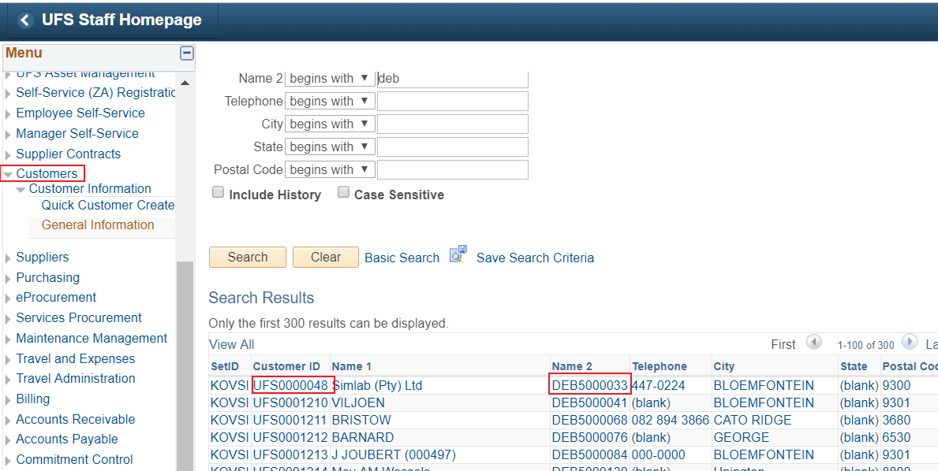
customers
Migrated customer info from CS External Organisations to Customers in PS Fin

Slide 10
Current process

Slide 11
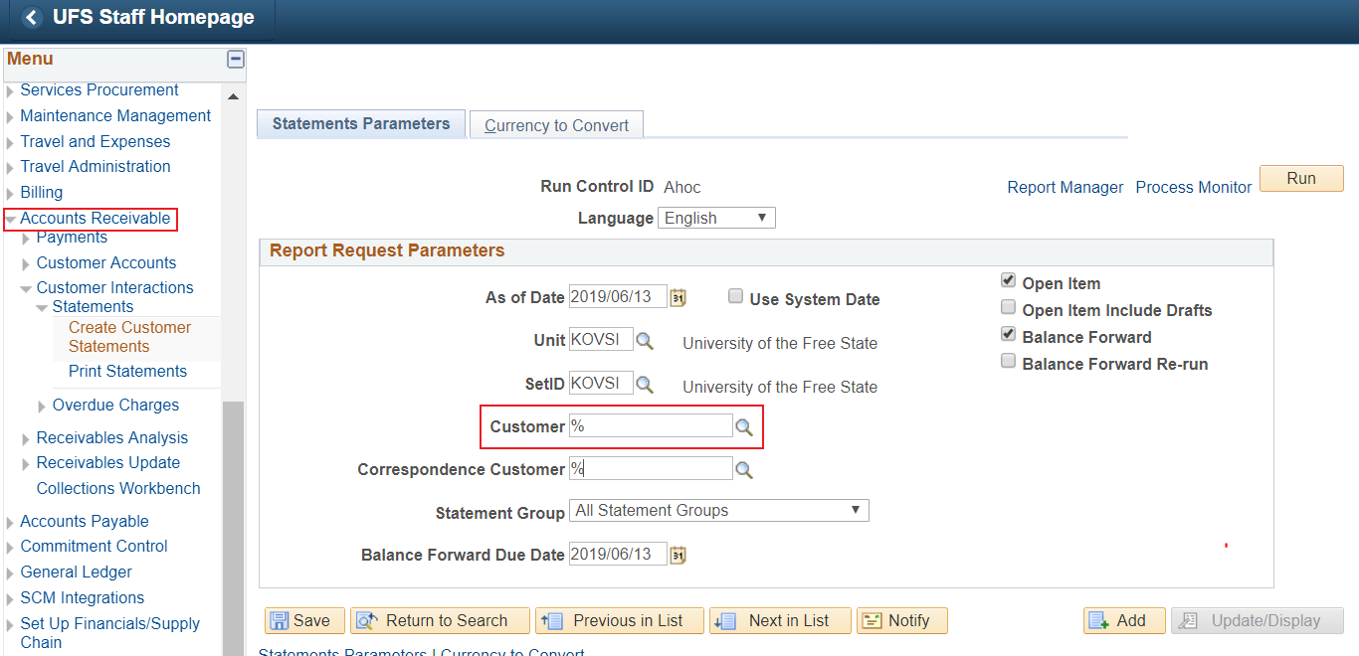
Current process
Print batch statements
Individually email statements

Slide 12
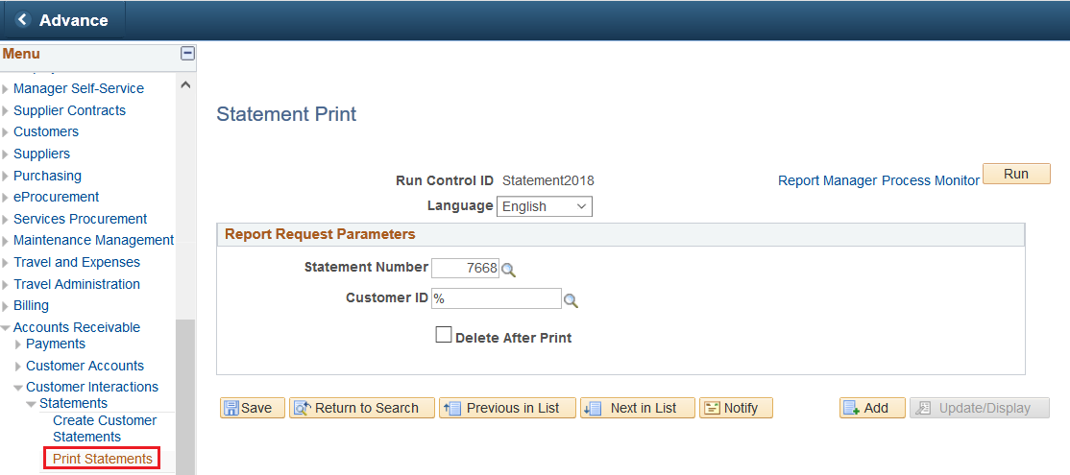
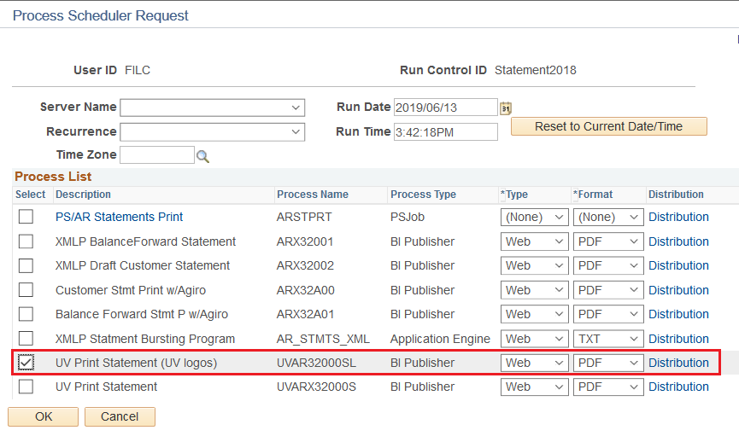
CURRENT PROCESS……

Slide 13
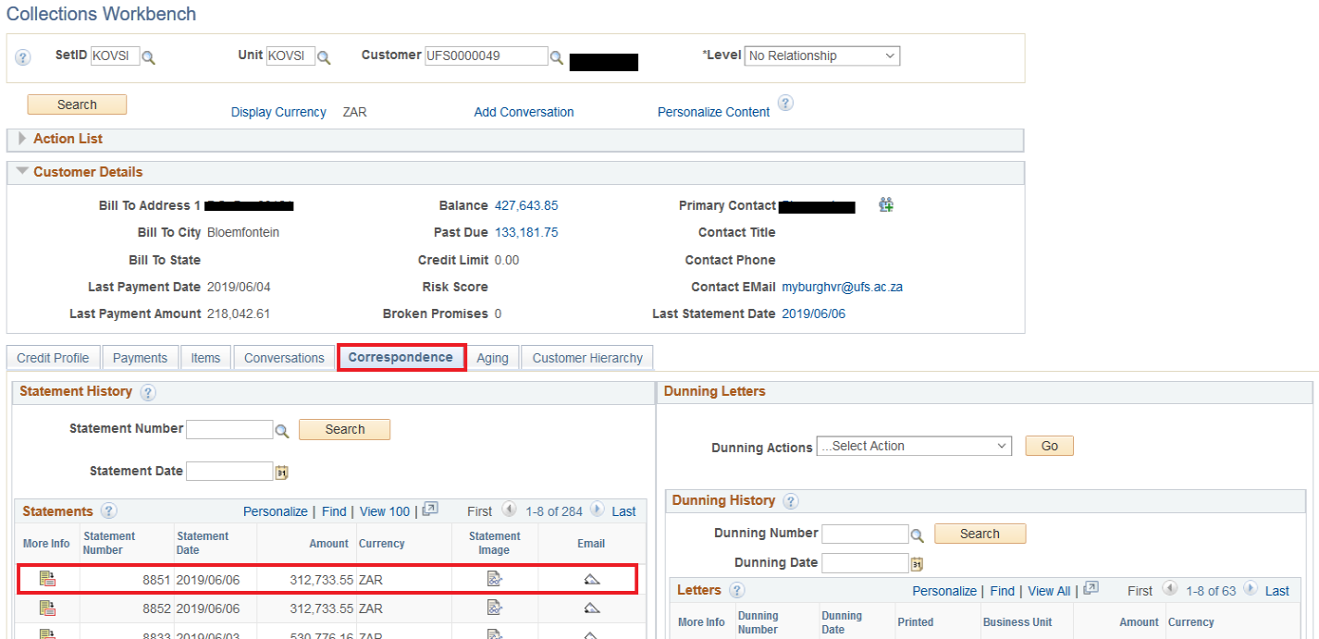
CURRENT PROCESS
Individual email statement

Slide 14
PROPOSED SOLUTION

Slide 15
Proposed solution…
Oracle would deliver email statements in PUM30 – Only Dunning letters single email option

Slide 16
solution
Use the delivered functionality that Collectors workbench offers on sending individual emails out and build on that
Our consultant created a completely loose standing run control component and application engine process.
This process relies on above functionality being in place first i.e. it builds on above delivered functionality to mail statements in batch

Slide 17
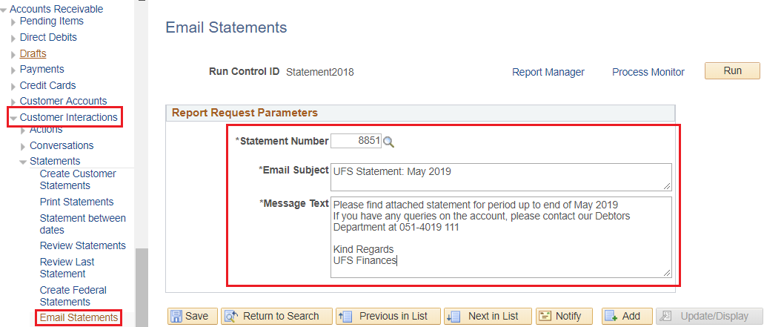
result

Slide 18
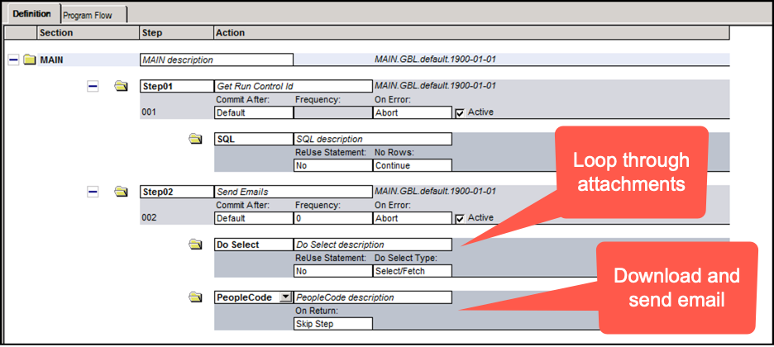
ResULT (technical)…..cont

Slide 19
ResULT (technical)….cont

Slide 20
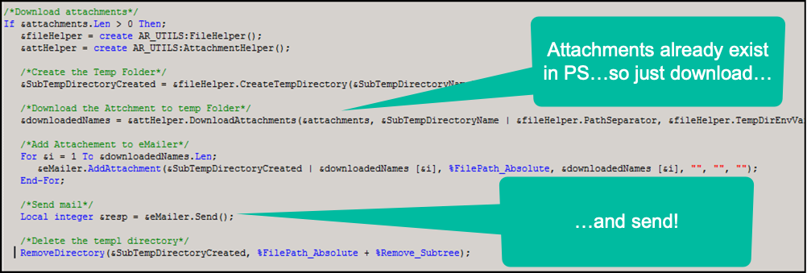
ResULT (technical)….cont

Slide 21
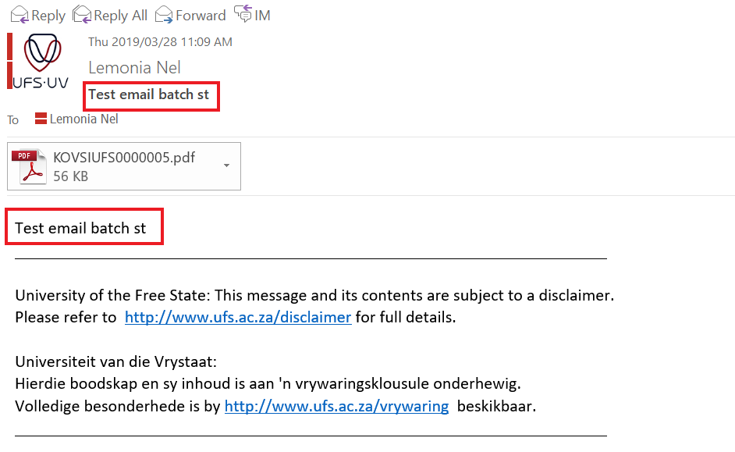
Result - outcome

Slide 22
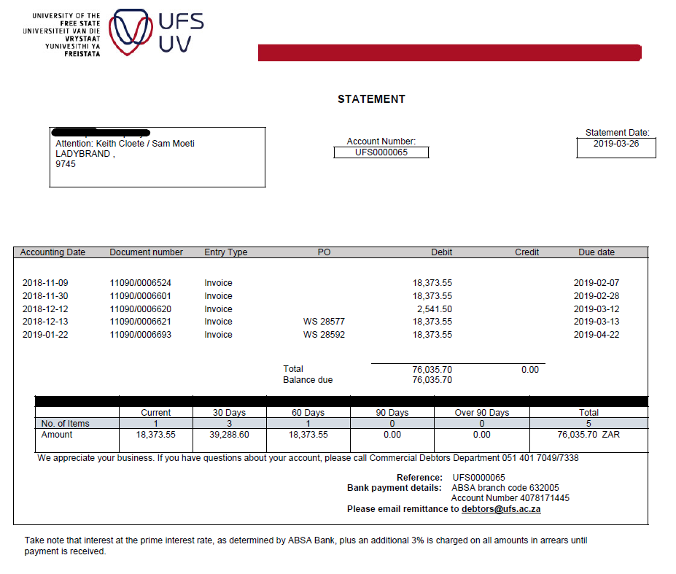
Result - outcome

Slide 23
Concluding thoughts
ANY QUESTIONS?

Slide 24
presenters
Lemonia Nel
Title of Presenter
University of the Free State
filc@ufs.ac.za
all Alliance presentations will be available for download from the Conference Site

Slide 25
THANK YOU!

