Slide 1
Query Report Viewer - A way to save time and solve issues
SESSION 5054
Mon, Nov 06, 2017

Slide 2
presenter
Sam Durant
Business Analyst
SIS Planning & Support Office
Concordia University
sam.durant@concordia.ca

Slide 3
Concordia University Montréal, Qc
Sir George Williams Campus
Enrolment Count* : 47 752
Undergraduate: 35 486
Graduate: 8 571
Continuing Education: 2 696
UFTE* : 28 757
Faculty & Staff : 6051
Two Campuses
*2016-17 numbers

Slide 4
Campus Solutions 9.0 (Live January 2015) Campus Solutions 9.2 & Peopletools 8.55 (targeted go-live April 1st 2018)
Loyola Campus - NDG
Current Production Environment
CS 9.0 Bundle 40
PeopleTools 8.54.10
Oracle RDBMS 12c

Slide 5
Overview
SECTION 1 - How to use the query report viewer
SECTION 2 – How to set up the BI publisher report
SECTION 3 – How to create the RFT template in word
SECTION 4 – How to set up security for query report viewer
SECTION 5 – Examples of how we have deployed at Concordia

Slide 6
The problem(s)
There were several problems or requirements that arose, for which we needed to identify an adaptable solution:
Often these issues or requests required a quick turnaround.
Lack of developer time available to work on a solution and competing priorities.
Output information needed to be in an understandable format for users.

Slide 7
Why use query report viewer?
To address these issues we have used query report viewer because:
The report can be completely created and maintained by a functional analyst with no technical development.
The reports are quick to create.
They are simple for users to generate.
The report can show results in a formatted way.
They are much easier to read and understand than a regular query.

Slide 8
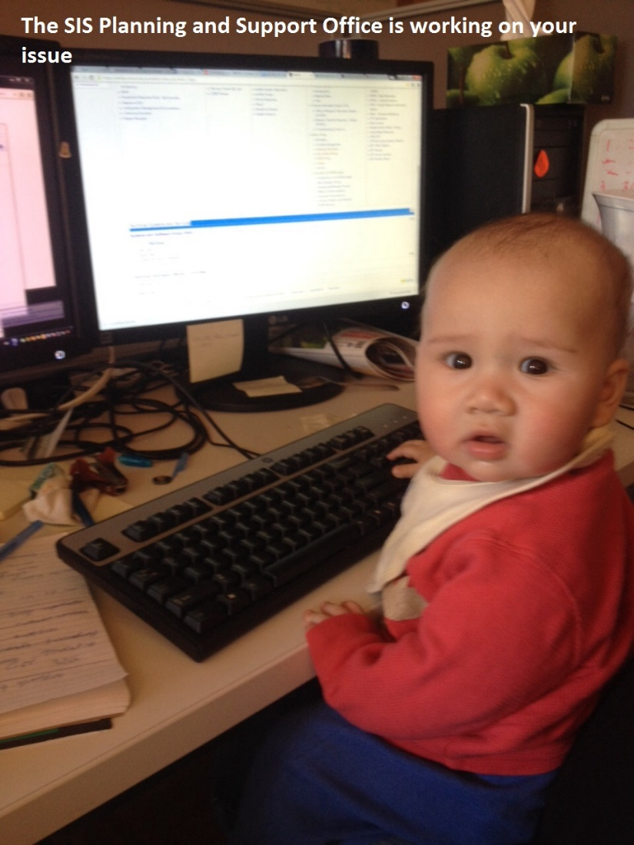
1. How to use the page
Even I can use query report viewer
This section will describe how you can use the page

Slide 9
Navigation
The navigation: Reporting Tools > BI Publisher > Query Report Viewer will take you to the page.
1

Slide 10
Searching
The user is then able to search for the relevant report.
It is recommended to establish a naming convention for different user groups to make the reports easier to find (e.g. at Concordia we prefix report names used by convocation with CU_CNV).
1
2

Slide 11
Opening
Before the user runs the report the option is available to pick the output format from one of the 4 options HTML, PDF, RTF or XLS. This allows users to choose the best option based on their needs.
1

Slide 12
PROMPTS
The same as with regular queries, it is possible to add any type of prompts that you would normally use in query manager.
1

Slide 13
EXAMPLE
The report will then open in your requested format. Below is a report example.

Slide 14
2. How to set up the report
This section details how to set up the report

Slide 15
qUERY
The first thing you need to do is to create a query that contains the data you wish to pull in to your report.
We will not go over the creation of the query and the use of query manager in this presentation as that is a large and complex session in itself.
NOTE
Your query can pull more data that you may need as you are able to add criteria within your report template.

Slide 16
Building the report
After you have created your query, you can start creating your report
Navigate to: Reporting tools > BI Publisher > Report Definition.
Then select ‘Add a New Value’.
NOTE
You have to create the report definition first as you need to pull the sample file from it to create your report template
1
2

Slide 17
Defining the report
You will then need to name your report.
Select the data source type of ‘Query’.
Enter the query name you created.
Then hit ‘Add’ to create your report.
1
2
3
4

Slide 18
REPORT PROPERTIES
On the first tab ‘Definition’ you will need to add some basic details as below:
Report Description – This is the description that will display to users.
Report Status – change this to ‘Active’.
Report category ID – This is used by security and it will be explained in section 5 of this presentation.
Owner ID- We default all our reports to ‘PeopleTools’.
1
2
3
4

Slide 19
ADDING THE TEMPLATE
On the second tab you will need to add details about the template (that you have not created yet – this is covered in section 3 of this presentation) and then upload it.
Description – We match this to the description on the ‘Definition’ tab.
Status – Change to ‘Active’.
1
2

Slide 20
Upload THE TEMPLATE
Click the ‘Upload’ button and then ‘Choose File’.
Select the Rich Text Format (RTF) template file that you will create for the report.
It is recommended to add a blank template at this point so you can save the report definition while you prepare your template.
1
2

Slide 21
TEMPLATE settings
The ‘Output’ tab can be used to change the default setting for output format type on the query report page.
You can also disable a format type if you do not want users to be able to select it.
2
1

Slide 22
3. How to create the template
This section will cover how to build the template for the report

Slide 23
Creating the template
In this section we will cover how to create the template file.
This will be created on word using Business Intelligence (BI) Publisher.
The functionality of BI publisher is very detailed and complex therefore we will just simply address the basics of what can be done.
NOTE
Trial and error will be needed to get the report looking as you wish. e.g. alignment of fields, grouping, text wrapping

Slide 24
Extract the data
First you need to extract your data. On the ‘Definition’ tab of the Report Definition created earlier, click the ‘Sample Data’ link and save the file to your system.
1

Slide 25
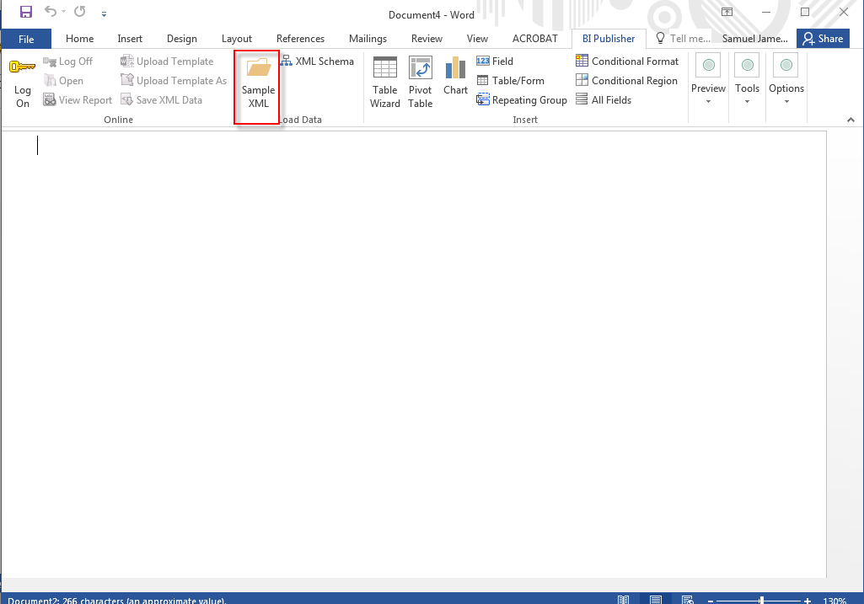
import the data
Then open Microsoft Word and navigate to the ‘BI publisher’ tab. Select the ‘Sample XML’ button and follow the steps to locate and open the data file you downloaded on the previous slide.
d
1

Slide 26
ADD FIELDS
The simplest part of creating a report is to add fields present in the query you created.
Click the ‘Field’ button
Choose the field you want
Click and drag the field to the page
NOTE
You can also manually type the data you want inserted, for example, by typing “A.EMPLID”
1
3
2

Slide 27
REPEATING GROUPS
The most common option you will be using is Repeating Groups. This allows you to repeat data from your query for a given field.
For example, you can create a repeating group for each student ID in your query. You can add data within a group and even have a group within another group.
Click the ‘Repeating Group’ button.
Pick your query.
Pick the criteria you wish the group to work on.
Select ‘OK’.
This code will then appear within the template body and you can then add information within these.
1
2
5
3
4

Slide 28
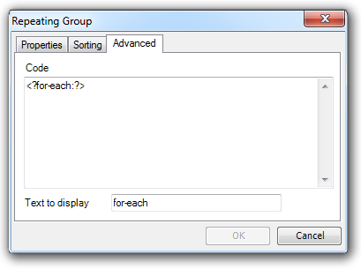
Sort order
You will want to sort your data when you use groups and this can be done on the second tab of the repeating groups window.
On the third tab is the code behind the drop in field.
You can change the text that displays in the body of the template. This will change how your fields are labeled and can be useful to track what a group does.
1
2
3

Slide 29
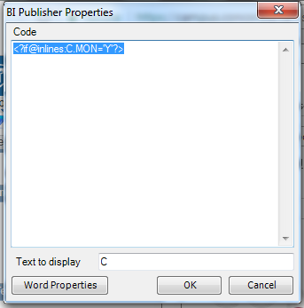
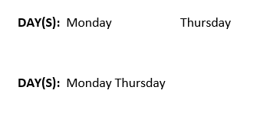
In lines
1
Sometimes you will want to have your output lined up together. To do this you will have to add ‘Inlines’.
Go to the third tab and add the @inline code into the code.
As you can see below the first example doesn't use Inlines whereas the second one does.
1
2

Slide 30
Conditional
Another important option is Conditional Regions which allow you to state that only data that matches your rule will be displayed.
For example, only students in a specific career.
Again you can have a conditional region within another region
Click the ‘Conditional Region’ button.
Select the data you wish the region to be governed by.
Change the rules the region is to follow and click ‘OK’.
This code will appear in the body of the template and you can then add information within this.
1
1
4
2
3

Slide 31
Tables There is also a feature that allows you to enter pivot tables into your report. There is an ‘Insert Table/Form’ wizard that walks you through the necessary steps. As this can be a complicated feature to configure, we will not be covering this in detail here.
Tables

Slide 32
How to set up security
The section will cover how to add security to your reports.

Slide 33
Report Definition
Role-based security can be added to a report definition to control which users can access it.
You simply have to change the ‘Report Category ID’ field on the report definition ‘Definition’ tab in order to limit access to the roles attached to that report category.
NOTE
You need to decide who has control over security.
You will need to decide which roles can access the report.
1

Slide 34
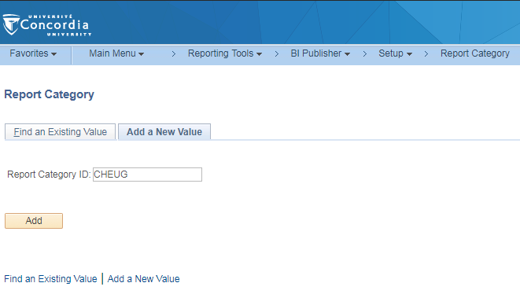
Report category
You can set up a new report category by navigating to:
Reporting tools > BI Publisher > Setup > Report Category
Then click ‘Add a New Value’.
Enter a ‘Report Category ID’ and select the ‘Add’ button.
1
2
3

Slide 35
ADDING ROLES
You can then add existing roles that you want to be able to access the report.
Add an ‘Owner ID’.
Add the roles you wish to be able to run the report and press ‘Save’.
NOTE
Make sure you also add the role of who will maintain the report. If you do not, the report definition will not appear in the search results for them.
1
2

Slide 36
Examples of how we have used the report
Use of the Query Report Viewer at Concordia

Slide 37
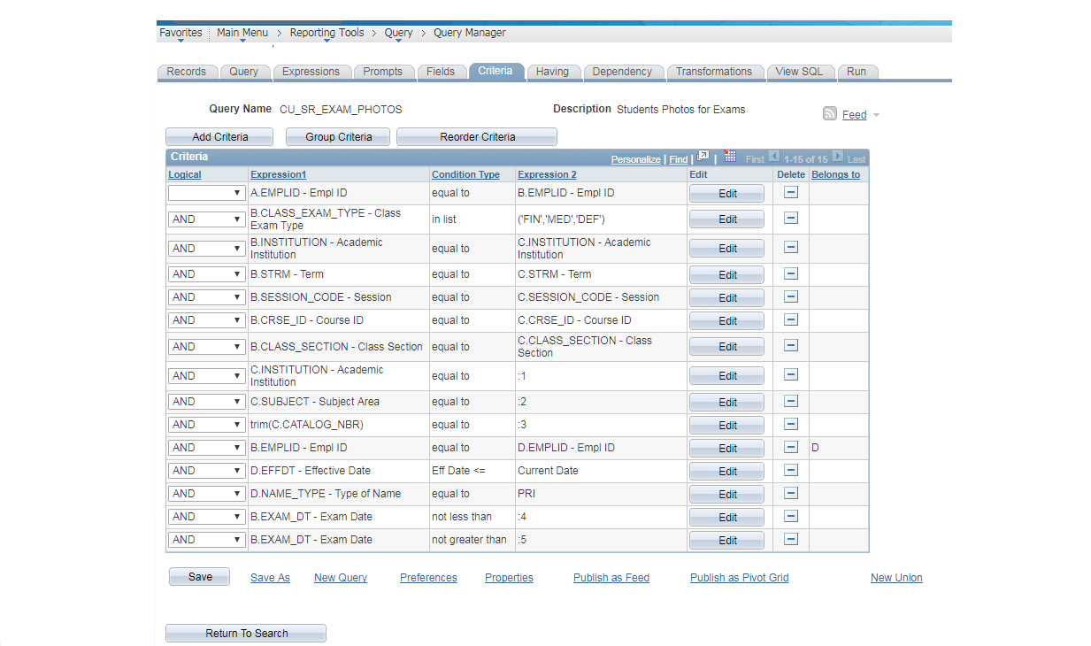
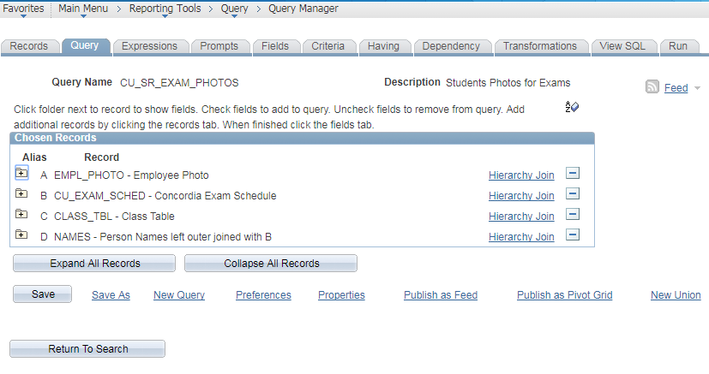
Exam rosters with pictures
Why - Due to a concern about academic integrity issues in exams, we required a quick and simple method of providing a list of examinee photos and details to the invigilators at the exam site.
For – Examinations Office
Query – Below is a quick example of the query

Slide 38
The Template
The report template set-up is very simple:
All of the fields are simple ‘drop-ins’.
There are only two repeating groups. One for the course title and the other for the students in the class.
2
1
1
2
1
2

Slide 39
Example
This produces a report that lists all the students in the exam along with their picture.

Slide 40
Scheduling errors
Why – Analysis of reported enrollment issues identified that there were regular mistakes being made during the creation of the academic schedule by departments. We required an easily understood report which would allow users to identify when these errors were made and correct them before the enrollment problems happened.
For - This report was created for the scheduling representatives in the faculties.

Slide 41
The Template
The report template lists all the errors that the detailed query finds, but allows sorting into the different types of errors using the query fields as well as the addition of explanatory text.
Here is the report template.
It repeatedly links the class table to a base table each time looking for a different error.

Slide 42
Example
Here is an example of a final report.
The report can be run with Faculty and Term prompts.
This is a good example of using the Query Report Viewer to present data in a more understandable format for users.

Slide 43
List of pre reqs/reserve caps
Why – There was a lot of confusion with departments not being aware of exactly which requisites or reserve capacities were configured in Campus Solutions for their courses. This was causing unnecessary enrollment issues for students as well as an extra burden on support teams. We required a way of reporting the set-up in a more simple and understandable manner for users.
For – Those users responsible for scheduling activities in the faculties and departments.

Slide 44
The Template
This template is slightly more complicated as it has to take into account all the different types of requisites in use.
Here is the report template.
It collates all the requisites on the system from the various set up levels.
It combines them in a tabular format with explanatory text.

Slide 45
Example
Here is an example of an output of the final report.

Slide 46
UniVERSITY retroACTIVE witHDRAWAL committee (URWC)
Why - Concordia has a committee which determines if students are allowed a late Discontinuation (DISC) or Did Not Enter (DNE) request. This committee requires a report of the students that have requested late DISC/DNEs as well as the generation of a letter to inform the students of the committee decision.
Who – The Office of the Registrar.

Slide 47
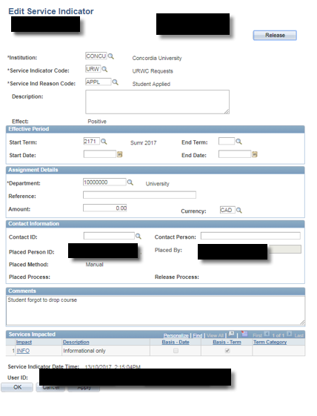
IDENTIFYING THE STUDENTS
We had to identify the students who would appear on the report.
To accomplish this we leveraged the delivered Service Indicator (SI) functionality.
When a student applied for a late DISC/DNE the staff member would add an SI code of ‘URW’ (URWC Requests) and the reason code of ‘APPL’ (Student Applied).
DNE = Did Not Enter
DISC = Discontinued

Slide 48
Below is the report template. It uses a repeating group to include every student. In the table the students data is displayed with conditional reasons to show their payment group and the classes they wish to receive a refund for.
The template

Slide 49
An example of the report output is below:
Final Example
After a decision is made by the committee, the users will edit the student’s SI and change the reason code to indicate the appropriate decision.

Slide 50
TEMPLATE
The letter report query has almost the same criteria as the report but looks for students with a ‘decision SI reason code’. The template as you can see below pulls in the student’s information and the committee decision. Conditional regions are used to show different text.

Slide 51
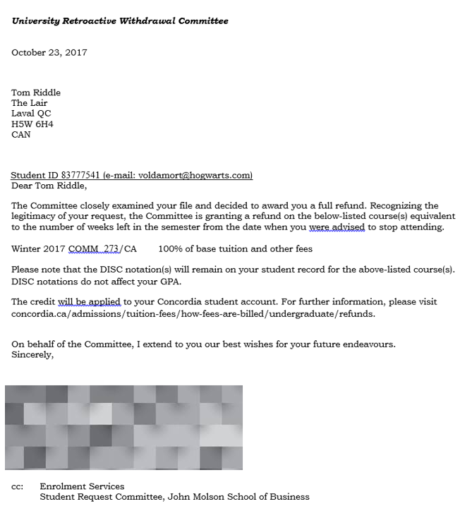
Example
The report is then run which gives a letter for each student with their decision filled in. These are then mailed to the student

Slide 52
Concluding thoughts

Slide 53
SUMMARY
Loyola Campus - NDG
Sir George Williams Campus
Any Questions

Slide 54
presenters
Sam Durant
Business Analysis
SIS Planning & Support Office
Concordia University
sam.durant@concordia.ca
all Alliance presentations will be available for download from the Conference Site

Slide 55
THANK YOU!

