Slide 1
Our Journey to the Cloud, What have we learned and how can you benefit?
SESSION 4010
April 29, 2019

Slide 2
presenter
Jo Ellen DiNucci
Associate Vice President of Finance and Administration
Boise State University, Boise, Idaho, USA
jedinucc@boisestate.edu
Vice President of Administration
Higher Education User Group
Jo Ellen started at Boise State on PeopleSoft implementation weekend in 1998. She has seen many PS upgrades and led the 2016 implementation of Oracle’s Cloud ERP product. She is now involved in the 2020 Oracle Cloud HCM implementation.
Jo Ellen’s oversees all the University business functions including student financials. She created the Office of Continuous Improvement (OCI) focused on business process and change management associated with the Oracle Cloud applications.
Jo Ellen is a HEUG board member and is currently Vice President of Administration.

Slide 3
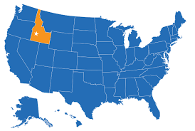
Boise State University

Slide 4
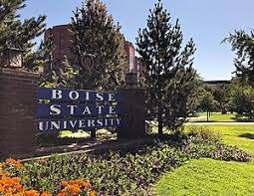
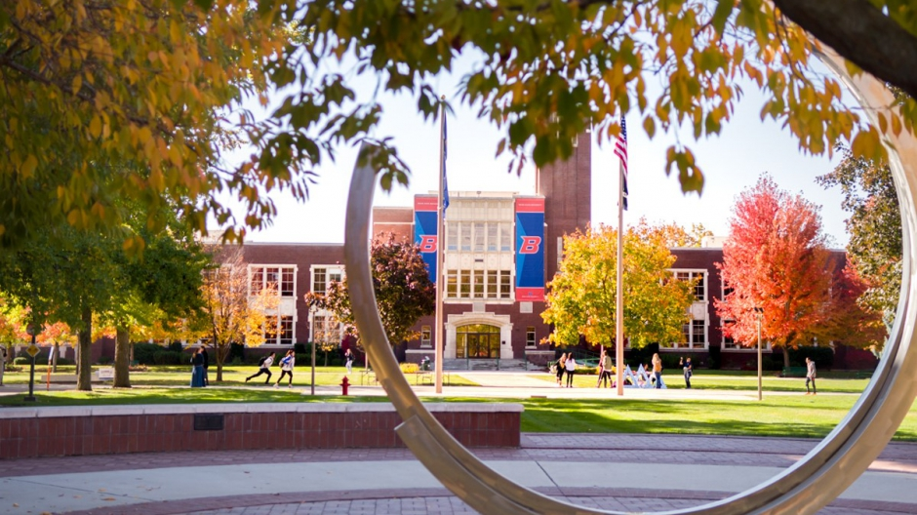
Quick Facts – Boise State University
25,500 Students
3,800 Faculty & Staff
180+ Degree Programs
$44 Million Sponsored Expense
Doctorial Research Institution (R2)

Slide 5
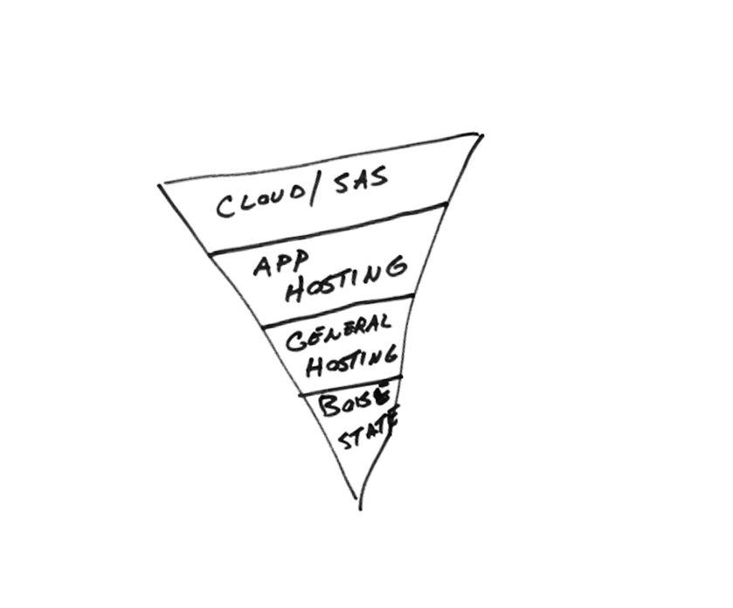
Boise State University & ORACLE
PS 9.2 CS
ERP Cloud PS
HCM 9.2 today
HCM Cloud – February 2020

Slide 6
2016 ERP Project
Fixed Assets
General Ledger, included COA conversion
Expenses/Accounts Payables
Purchasing
Accounts Receivable
Cash Management
Grants
Project Costing
Project Billing
Project Contracts
Oracle Transactional Business Intelligence
Kicked off April 2015, Go Live July 1, 2016
(15 Months)
NEW

Slide 7
2020 HCM PROJECT
Payroll
Time and Labor
Benefits
Absence Management
Employee Self-Service
Manager Self-Service
Compensation
Data Warehouse Reporting
Kicked off October 2018, Go Live planned February 2020
(17 Months)
NEW
Complete revamp of policies and business process across campus.

Slide 8
HEUG ERP/HCM Cloud Advocacy and Collaboration Team
Boise State University
Vanderbilt University
Pittsburg State University
Rutgers University, The University of New Jersey
University of Wyoming
University of Kansas
University of Derby, United Kingdom
University of California, Los Angeles
Stanford University
Work with 20+ other schools monthly, sharing tips/tricks and solutions.

Slide 9
Overview
1
3
Return on Investment:
Cloud vs. On Premise
Implementation:
High Level Tips and Tricks from Early Adopters
2
4
Post Implementation:
How does your world change?
What is needed for success?
Planning for Cloud:
Implementation Strategies

Slide 10
Return on Investment Cloud vs. On Premise
The most important difference isn’t cost!
Philosophical difference and the Boise State

Slide 11
ROI – On Premise
Notes:
In our historical on premise world, there is a lot of upfront cost, and disruption during the process and at least a year after the process while your campus adjusts.
Then the effort drops to nearly nothing and everyone is settled into a new world. The longer you do nothing the happier people are. People create workarounds and shadow systems to make the world what they want it to be and they really don’t want you to mess with them. So we wait until we have to because software is out of support and do it all again.

Slide 12
ROI – Cloud
New Normal = Constant Change
Notes:
The cloud looks the same for the first two years. Heavy lift, lots of cost and disruption and finally acceptance at the end of year two.
BUT then it is very different. Now you are having constant innovation and new functionality that you want to implement in order to maximize your ROI. You have a new normal of constant change. Change becomes your operation. ROI is only achieved IF you put in play the new functionality.

Slide 13
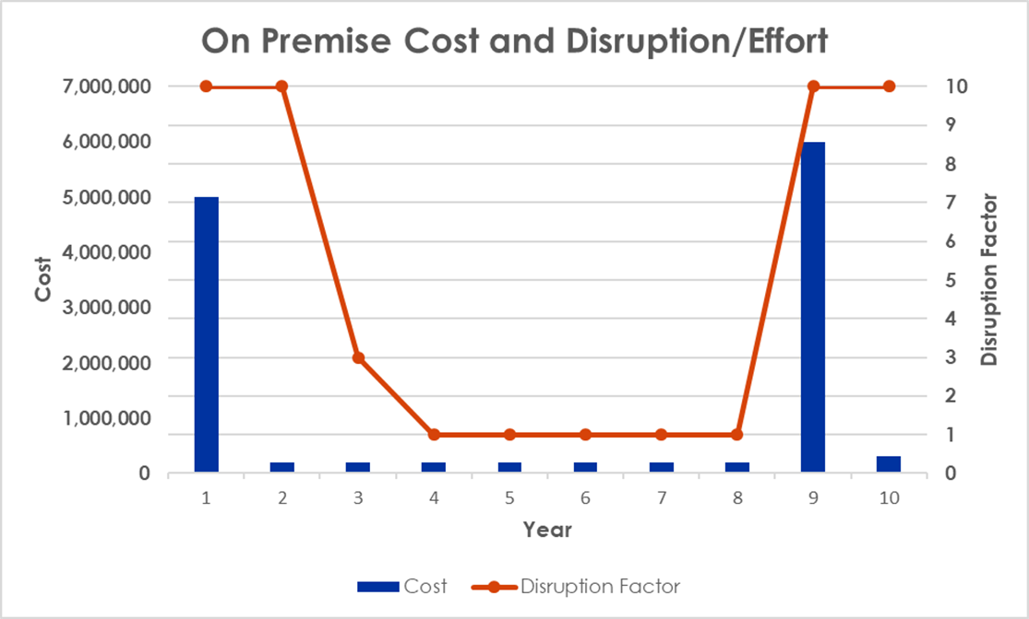
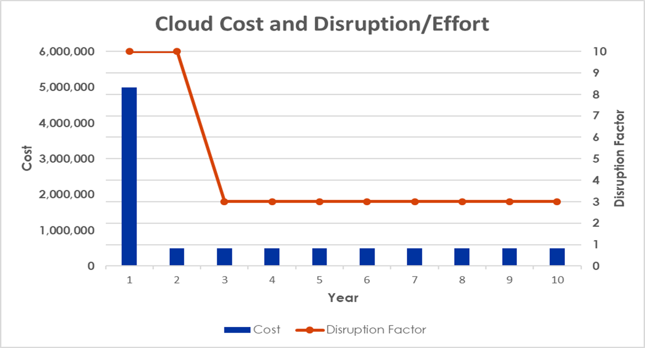
ROI – Compared
How fast can we adopt functionality and get value from our solution? Your “project” never ends, it becomes your operation.
CONTINUOUS IMPROVEMENT
How long can we make this platform last?
HANG ON TO OLD METHODS
Notes:
So it looks the same at first, but your value is delivered in two different ways.
In addition, the effort on the continuous improvement is much more functional that technical and I’ll get into that in a minute.

Slide 14
Boise State Experience
Three finance upgrades - NO ISSUES
Quarterly releases began 2019 – NO ISSUES
OIT does not manage system, primary involvement is testing integrations
PS developer resources redeployed to mobile technology and reporting
Shift effort to functional change management and business process improvement
Reduced ongoing cost of ownership

Slide 15
Boise State Experience
Highest value potential opportunity is efficiency throughout the organization
Continual business process improvement in every unit on campus has a compounding effect on Boise State’s ability to re-direct staff resources to teaching, research and student support

Slide 16
Planning for Cloud from Early Adopters
Implementation Strategies
Pace of Change
Contracting

Slide 17
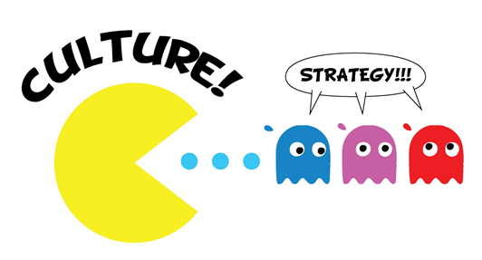
Implementation Strategies – best Practice?
Sequencing?
All at once
One right after another
One – Stabilize – Next
In-House or Outsource?
Change management
Campus engagement

Slide 18
Pace of change
Quarterly fixes are pushed to test the first Friday of the month
Quarterly fixes are pushed to production the third Friday of the month
Ready or NOT!

Slide 19
Pace of change

Slide 20
contracting
Implementer –
Experienced
Training - just in time, might be from implementer might be from vendor
Adapt to changing software, including new functionality (Change management risk)
Ensure definitions of roles are clear, who is accountable for what?
Request variable bid AND fixed fee bid, carefully consider your choice.
Question implementation under 12 months. Consider your own institutional bandwidth.

Slide 21
contracting
Why Oracle for Boise State?
Demonstrated organizational commitment to the cloud, significant resource allocation
Demonstrated commitment to our industry
Global experience in cyber security
Product breadth and depth
Knowledge of where we had been (PS) aided in transition
Price compared with value
Long-term experience with organization created trust
Able to fold under umbrella contract, no contracting issues arose
We are pleased with our experience.

Slide 22
contracting
Oracle –
If training to be provided by Oracle, plan out costs, don’t be surprised
We were allowed to “shelve” PS modules and use them until we converted but only pay for one product at a time. Had to disable the legacy system once live
Our overall licensing was essentially the same as our PS maintenance. This IS NOT available now, we were first to try. But value should still be there

Slide 23
Implementation: High Level Tips and Tricks from Early Adopters
It’s magic! No, just experience.
And what can you do now to get ready?

Slide 24
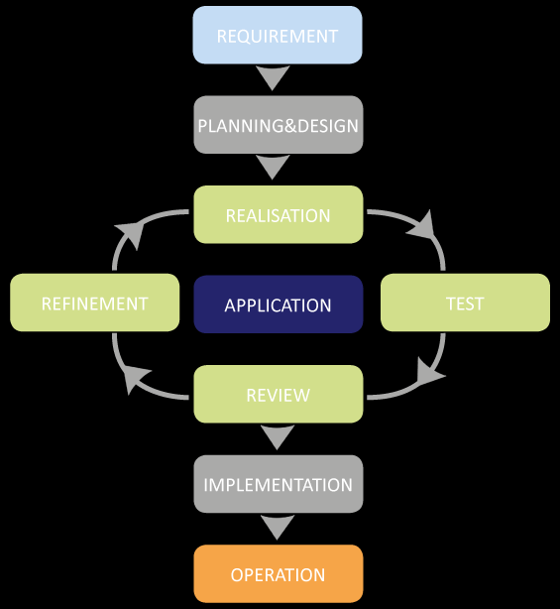
What Is the same?
Both need structured agile project methodology
Rapid Implementation

Slide 25
What Is different?
Focus on Fit Gap and Customization
Control your environments
Change management tends to be training and one-time
Focus on Business Process
Software changes during Implementation
Change Management is an Essential and Ongoing activity

Slide 26
Why not fit-gap in cloud?
Assumes:
We are the experts at how to automate a process
If it doesn’t work the way we do it today, it needs an additional automated solution
Customization is a cost-beneficial solution
Historically does not go deep enough into the organization, but looks at inputs and outputs to the software.

Slide 27
Why Business process in the cloud?
Business process considers the system, people and manual processes. All contribute to inefficiency.
Assumes ORACLE continues to introduce best practices into the system.
Our role is to work on the people and manual process

Slide 28
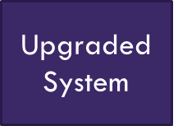
Why business process is so important
Step 4
Added Tasks Because
Very streamlined
Step 5
New Central Form
Step 3 Internal Process
Step 1
Need
Old System
Step 2
Department Approval
Chaos
Outside of Central Administration!
Central Process

Slide 29
Working together on business process
Very streamlined
Step 2
Approvals
Step 1
Need
Step 3 Process
Outside of Central Administration!
Central Process

Slide 30
BOISE STATE EXAMPLE Opportunity For Meaningful Change…
Process of gathering request on internal form or verbally may be eliminated
Manual routing will be eliminated
Process of gathering supporting documentation, making copies and filing paper copies may be eliminated
Transactions are auto-forwarded to UFS upon completion of approval workflow. Manual routing eliminated.
Transparency of transaction status may eliminate need for notation in shadow systems and eliminates need to contact UFS for status.

Slide 31
Change Management First…The Traditional Approach
Project Team
makes decisions
Communicate to campus
Conduct training 2 weeks before Go-Live

Slide 32
Traditional Change Management Let the Spinning Begin!!
Where is my data?
I don’t understand!
That doesn’t work for our business!
My staff doesn’t have time to add more tasks!
Wait…I don’t have the budget to cover that.

Slide 33
New outcome requires New Approach
Ensuring:
Required for Project Success
Design acceptance of broad political solutions
All voices are heard
Campus takes advantage of tool
We understand unit goals, accept the diversity of the University environment
Leadership support of project and decisions

Slide 34
Goals of Ongoing operation
Required to ensure we keep evolving
Sustainable methodology that doesn’t end with the go-live
Set us up to maximize cloud environment (Functionality releases every 3 months)
Faster solution delivery
Ability to adopt new functionality campus wide
Maximize product ROI

Slide 35
HOW?
What do we on the project team need to learn?
Project governance?
Engagement strategies?

Slide 36
IMPORTANT QUESTIONS?
How do they use the current system?
What are their pain points in their business process?
Where do you need conformity across campus and how will you get consensus?
Where can you allow individualized design and how will you facilitate that without customization?
Who are the decision makers? Does it vary by unit?
What are management’s goals? Do they vary by unit?
How do we get this information??

Slide 37
Campus Engagement Layers (Project governance)
Executive Engagement Committee
Campus leadership charged with ensuring engagement and ultimate success
Academic Dean’s and Associate Vice Presidents
Change Management Core Team
Full time staff from the Office of Continuous Engagement who are managing the entire process
Campus Liaisons
Project team member focused on preparing the division for change through communication, providing voice of the customer, and process redesign at the aimed at adoption.
Secret: You will need a form of these layers forever!

Slide 38
HCM Project structure (Project governance)
Traditional
Engagement
EQUAL

Slide 39
Campus Engagement Strategies (decision making and engagement)
Kick-off and “one page”
93 people on the project were invited. Represented an orientation to scope and timing. All provided a “One Page” of their role and responsibilities
Campus Liaisons
33 individuals across campus who were appointed by their leadership to engage in bi-directional communication activities
Facilitated Focus Groups
Intended to help with design and policy recommendations
Campus Small Group Meetings – recurring
Intended to focus on the wider business process including how best to utilize functionality at unit level

Slide 40
Presented to kick-off group
As Participants we actively contribute through positive engagement and idea sharing… even when it’s hard.
As Advocates we provide a voice in decision making for our departments, divisions, and campus as a whole.
As Change Agents we challenge the status quo to find innovative solutions.
ROLES
Every person in this room will play a critical role on our journey.
Asia Alliance 29-30 April 2019

Slide 41
One Page Examples
Executive
Team Member
Campus Liaison
93 separate One Page’s were created.

Slide 42
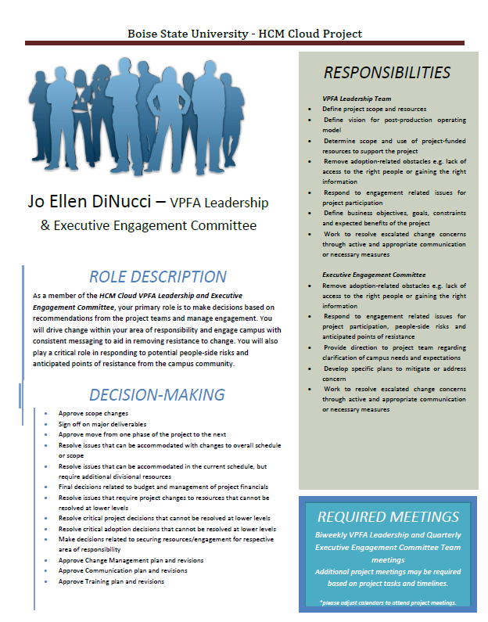

Slide 43
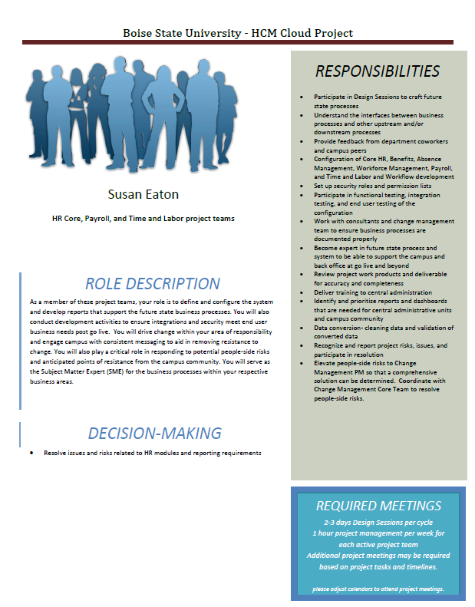

Slide 44
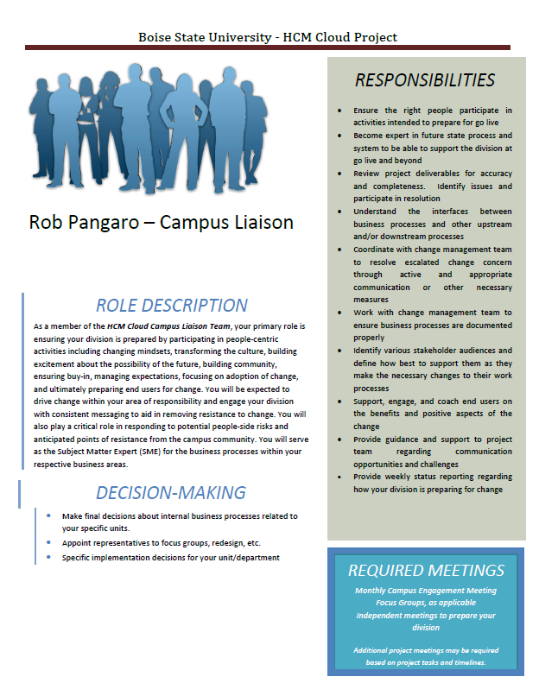

Slide 45
Campus Liaison
Each liaison was approved by their leadership to spend 15% of their time on the HCM Cloud Project and are expected to:
Be a success advocate for the project in written and verbal informal and formal communications
Support and promote intra- and inter departmental teamwork
Understand and consider the needs and impacts of your own work on others
Demonstrate an ability to problem solve and make timely decisions
Consistently share knowledge and information
Actively seek and receive feedback for improvement
In addition Liaisons are required to:
Attend monthly meetings or send representative as needed
Complete assigned project related tasks and communications
Complete weekly reporting status updates

Slide 46
Focus Groups – for consensus building (OCI run)
Determine recommendations for significant changes to processes or policy
Intentional Membership
All perspectives on campus
Typically meet 2 – 3 sessions
ERP Examples:
Approval Workflow – significant change, moved from highly customizable paper to automated standard
Internal Payments – unique, issues are in the portion of the process before it intersects with central admin
Tolerances – easy, but campus-wide impact
Reporting – arguably the most important deliverable

Slide 47
Campus Small Group Meetings (OCI run - recurring)
30+ groups on campus (a unique group shares one business process)
Help campus assess how functionality options within the product may impact future state business processes in the department.
Structure
Current State → New Functionality
Short bi-weekly sessions, allow time to absorb and assess
Tailored Agendas – not all departments need all processes (i.e. faculty hiring)
These represent the foundation of change management!

Slide 48
Campus small group meetings
Provide Information
Facilitate Conversation
Ensure Transparency
Provide structure
Central Facilitator Role (OCI)
Engage in Discussion
Brainstorm ideas
Make Recommendations / Decisions
Provide Feedback to Department
Departmental Participants

Slide 49
Campus small group meetings
Facilitation Strategies
Implementation Checklists - tasks to prepare for go live (i.e., identify forms impacted by chart of account changes)
Decision Tracking – note status (Proposed, In Discussion, Approved, Rejected).
Parking Lot – questions/topics outside the scope of the session
Go Live Checklist – final list of tasks to be ready for go live, such as identify who needs training (Campus goes live too!)
Facilitation and Business Process Improvement skills are critical in the cloud world.

Slide 50
HOW IT ALL INTEGRATES
Engaging the “Voice of the Customer”
Asia Alliance 29-30 April 2019

Slide 51
Post Implementation: How does your world change?
Now What?
What is needed for Success?

Slide 52
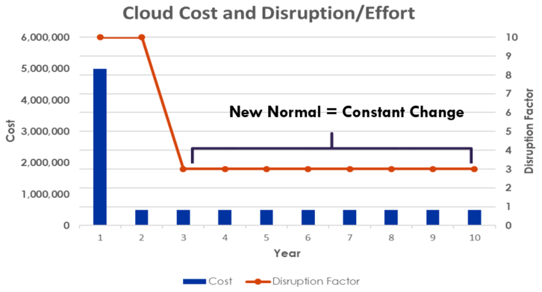
Continuous Improvement Mindset
ESSENTIAL!!!
Must have a structure to ensure you can adopt your new tool or the investment is wasted.
Must have a structure to manage through the pace of change or you risk interruption when patches are introduced.
Change management is no longer a project oriented process, but it is a continuous culture.

Slide 53
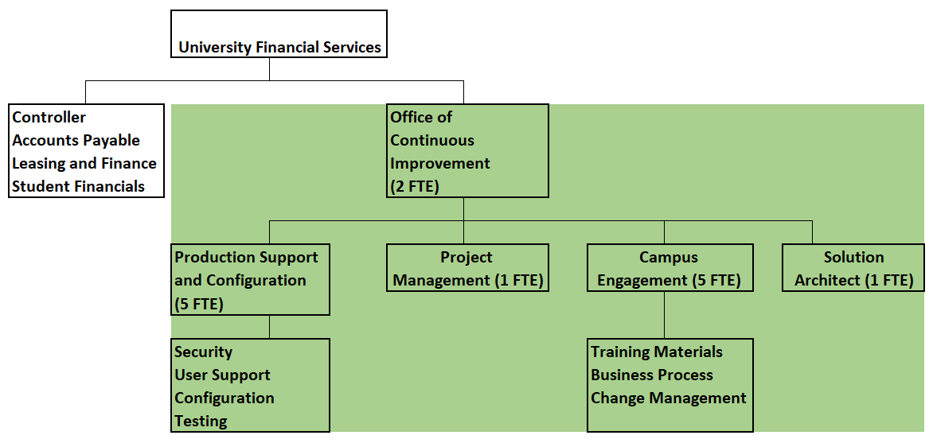
Continuous Improvement Mindset (OCI)

Slide 54
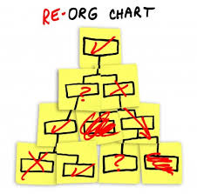
Organization Structure (Example)
Activity | On Premise | Cloud
Project Management, including timing and scope | OIT - PMO | OCI (Functional)
Testing | Functional – Back office only | OCI – Expanded to campus end-users
Database refreshes | OIT | Oracle
Upgrade/Patch (DBA) | OIT | Oracle
Manage SR’s | OIT | OCI
Campus Support | OIT and Functional users | OCI
Change Management | Project only, PMO | Continuous, OCI
Asia Alliance 29-30 April 2019

Slide 55
SUMMARY – Cloud is freeing for OIT and central administration
Central administration doesn’t have to control the outcome anymore because we aren’t customizing.
We help campus adapt to the solution, we don’t rewrite the solution to adapt to campus.

Slide 56
SUMMARY – TakeAways as you prepare
Think about staffing NOW:
Allow/encourage staff to shift into other technology
Outsource your on premise support over time to avoid a layoff scenario (we still have several key PS developers and will for at least 5-7 more years)
All resignations are replaced with different skill sets
Functional – PS funky techs replaced with Process Improvement Analysts, Facilitation skills
OIT – PS developers replaced with report writers and mobile developers
Start training current staff in new skills

Slide 57
SUMMARY – TakeAways as you prepare
Maximized ROI is based on continuous adoption of new functionality
Campus engagement must focus on end user business process
You must facilitate adoption, it won’t happen on it’s own
You can start incorporating unit level business process review with on premise solutions

Slide 58
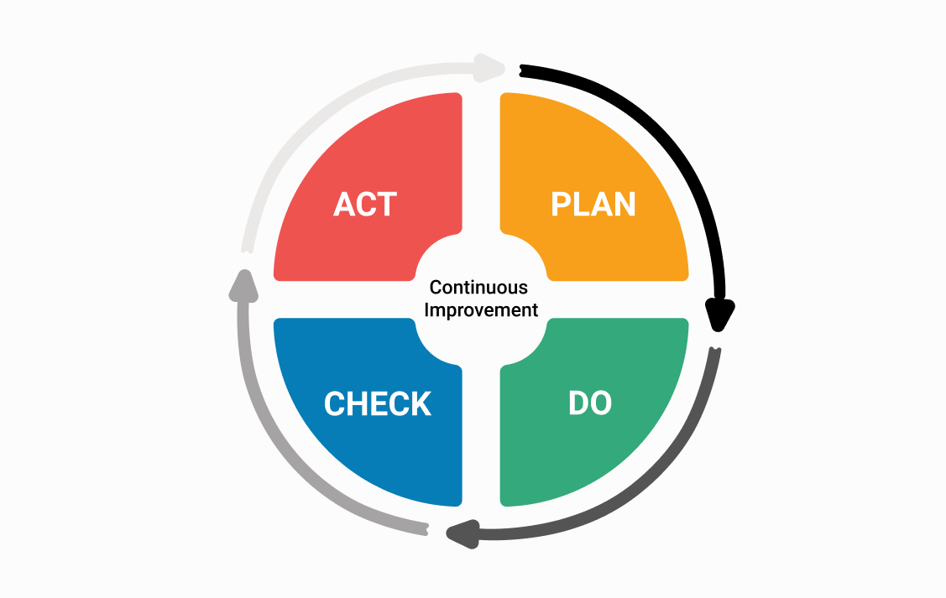
Thank you
QUESTIONS?

Slide 59
presenter
Jo Ellen DiNucci
Associate Vice President of Finance and Administration
Boise State University, Boise Idaho, USA
jedinucc@boisestate.edu
Vice President of Administration
Higher Education User Group
all Alliance presentations will be available for download from the Conference Site

Slide 60
THANK YOU!

