Slide 1
Brand your Student Selfservice Fluid Homepage!
SESSION 2036
16-10-2017

Slide 2
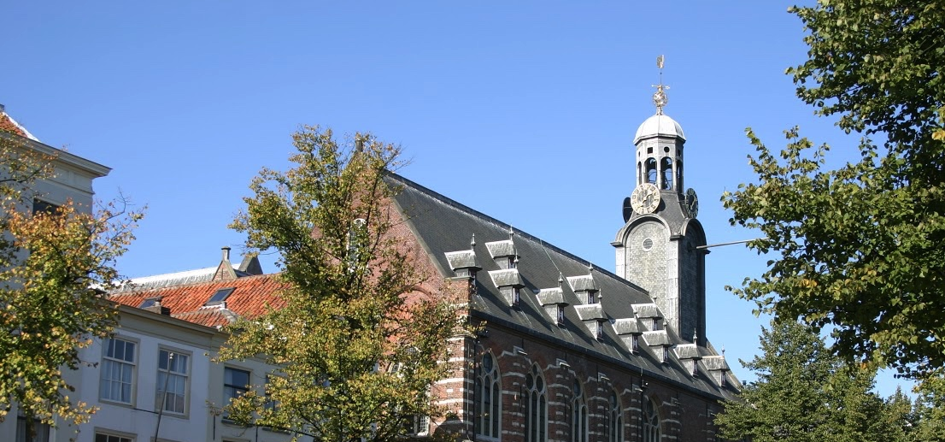
26.900 students in BA, BSC, MA, MSC, PhD
5.500 employees
10 FTE functional team
Campus Solutions since 2010
Peopletools 8.55.13 bundle 41

Slide 3
Some CY2 references

Slide 4
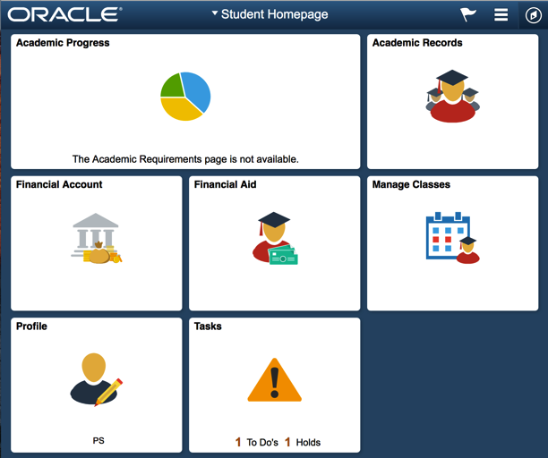
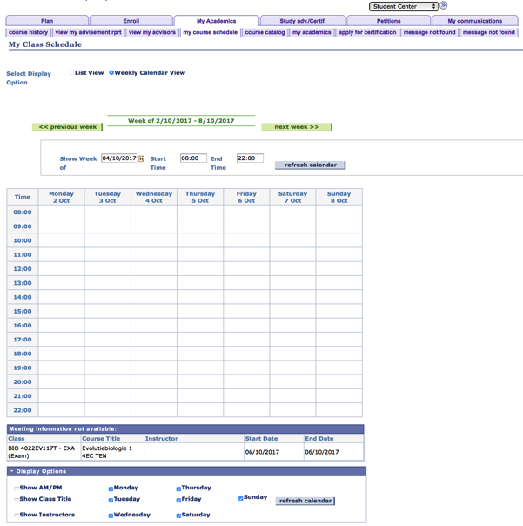
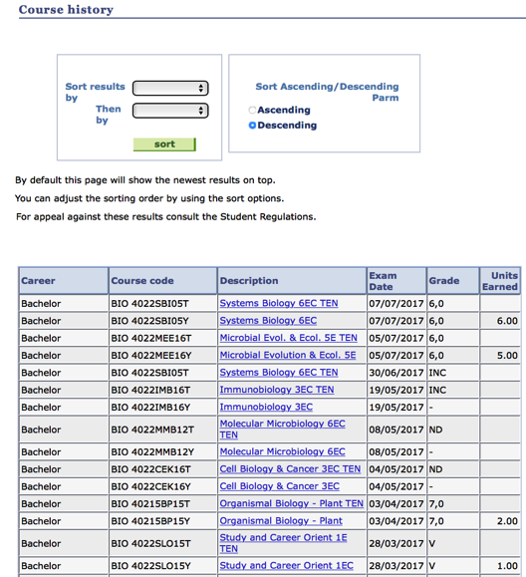
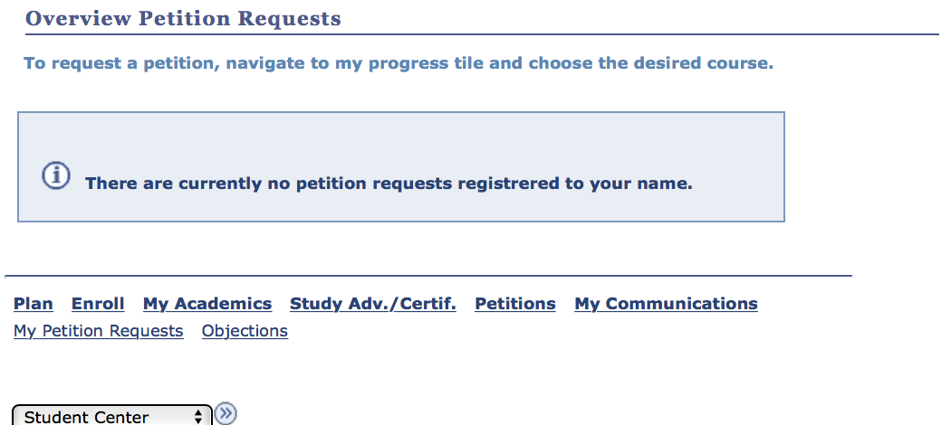
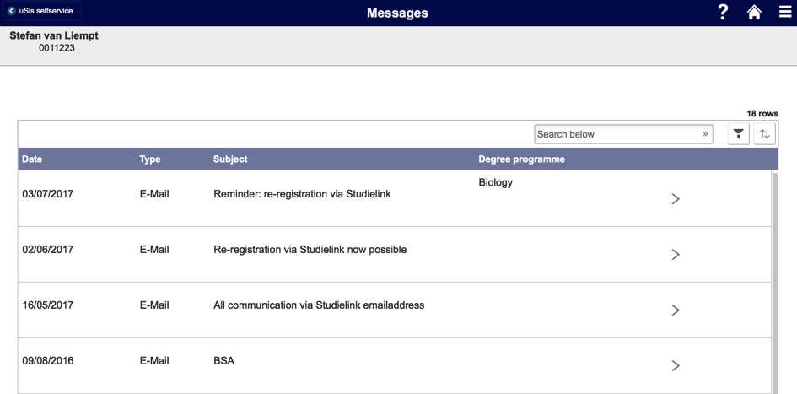
Business CASE
Phase1: Classic
Phase2: Fluid
Can we use Fluid to improve the current selfservice?

Slide 5
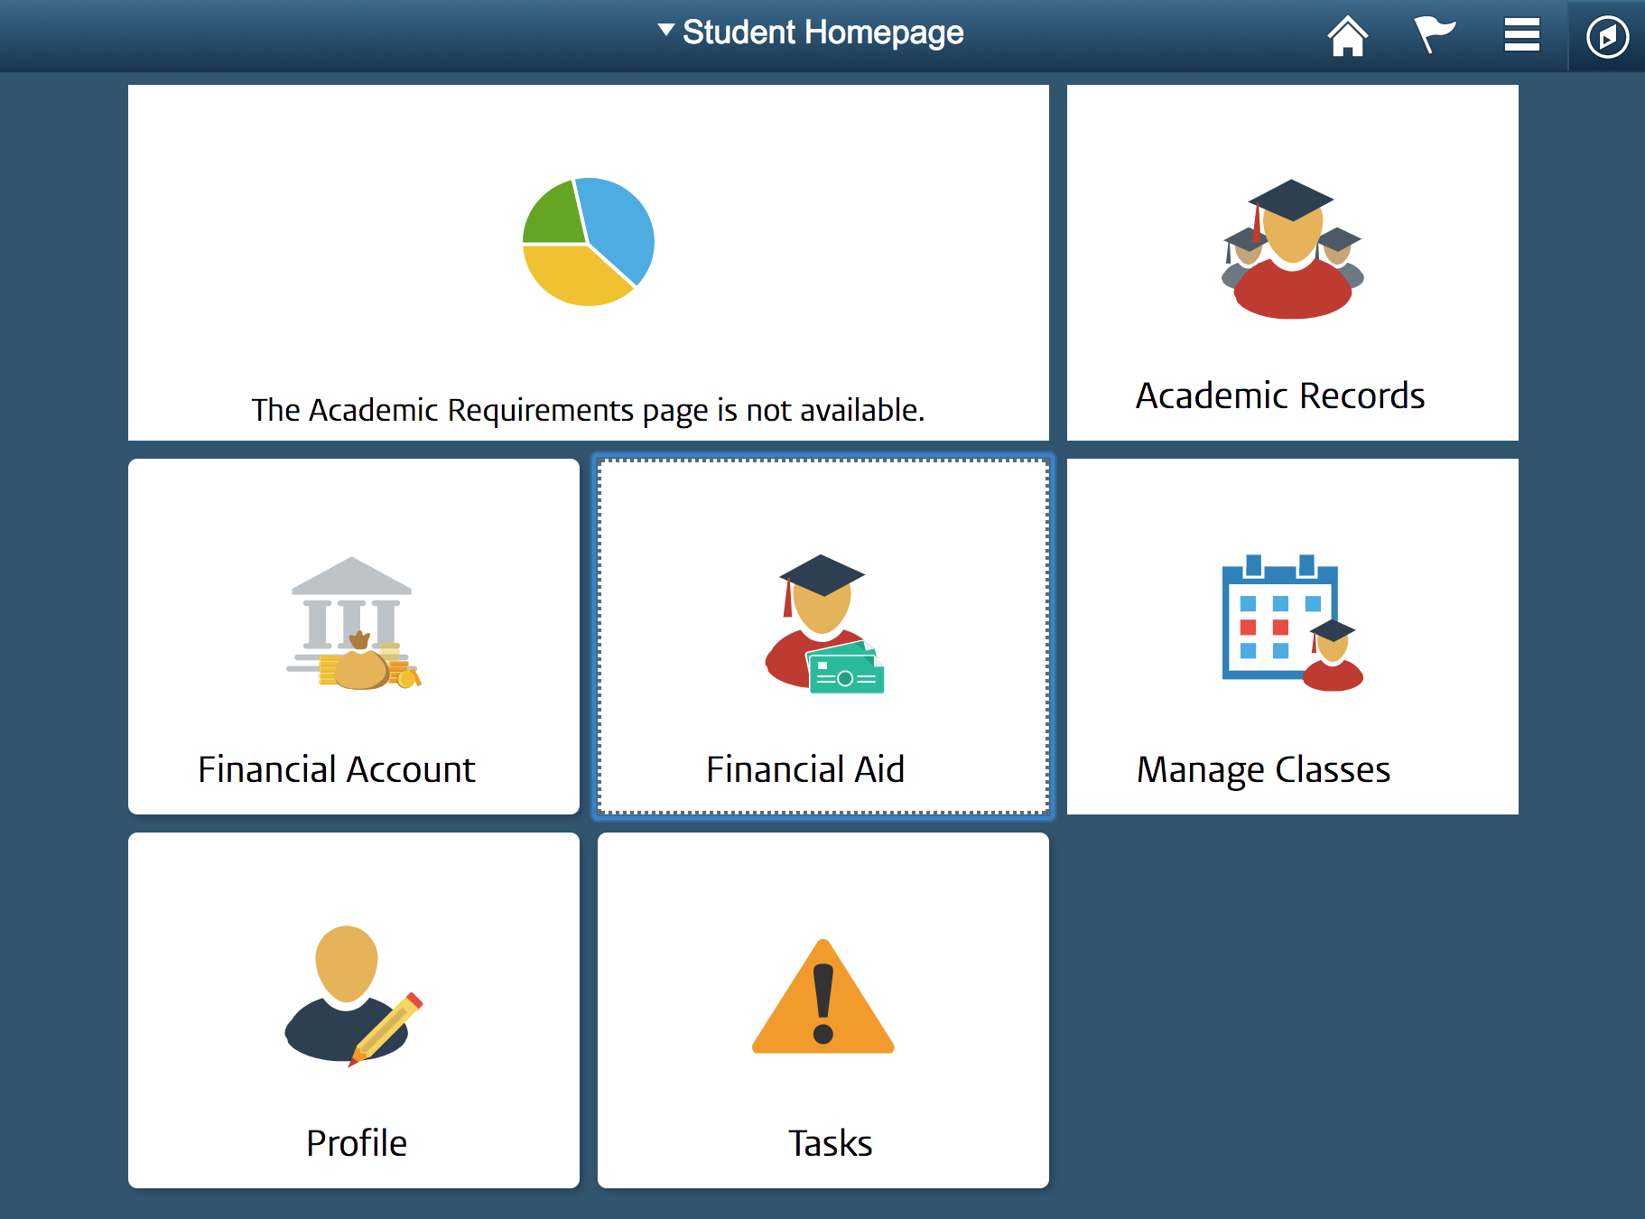
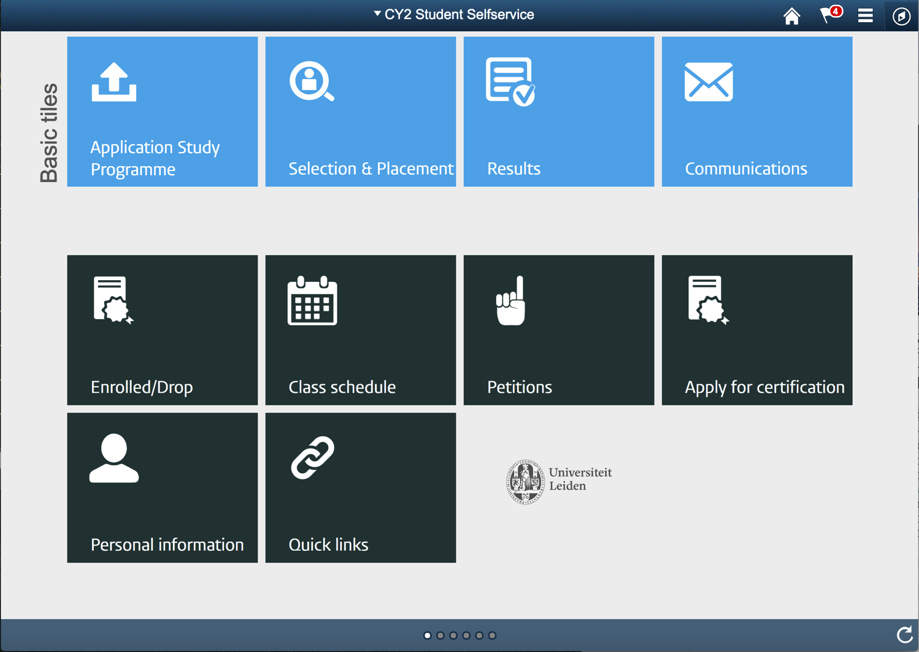
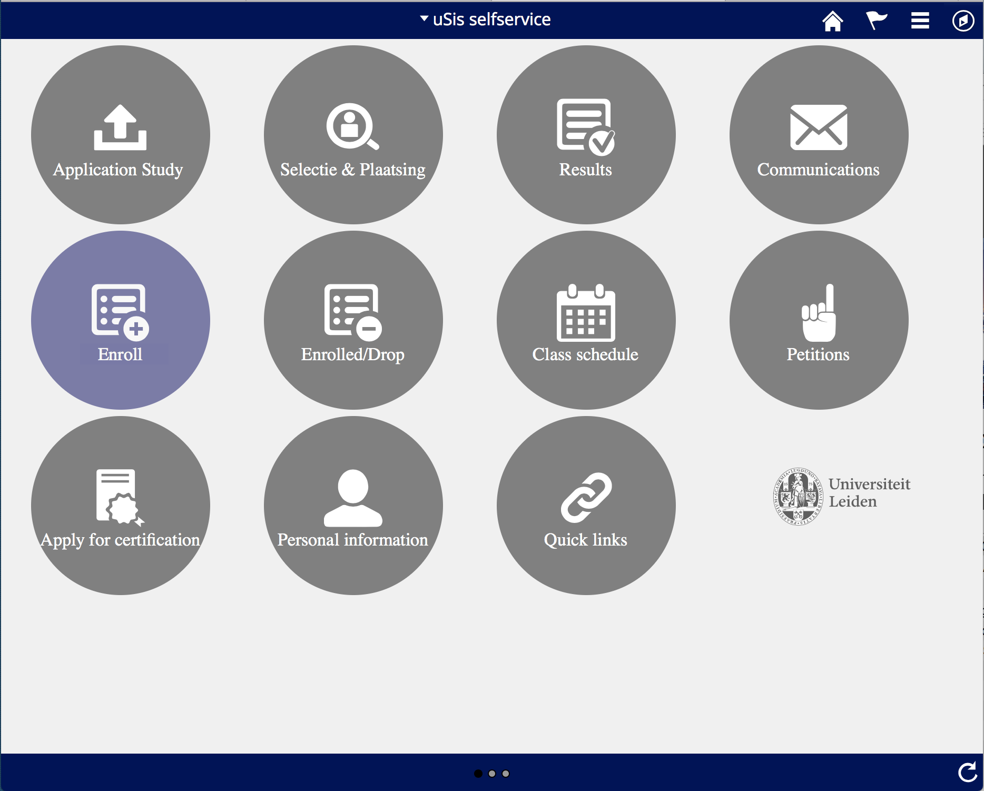
Branding

Slide 6
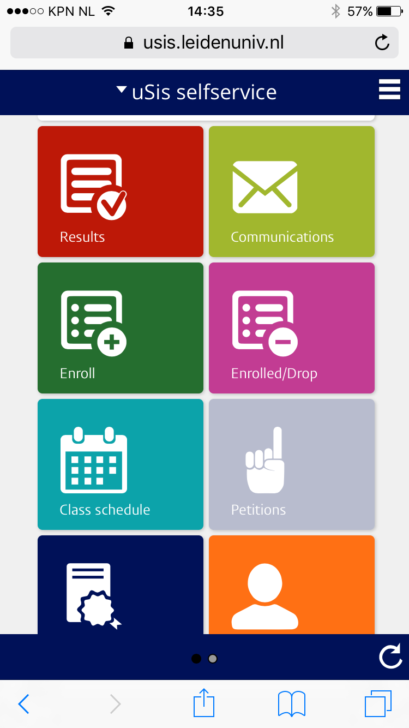
We wanted to get as close as possible to the Leiden university App

Slide 7
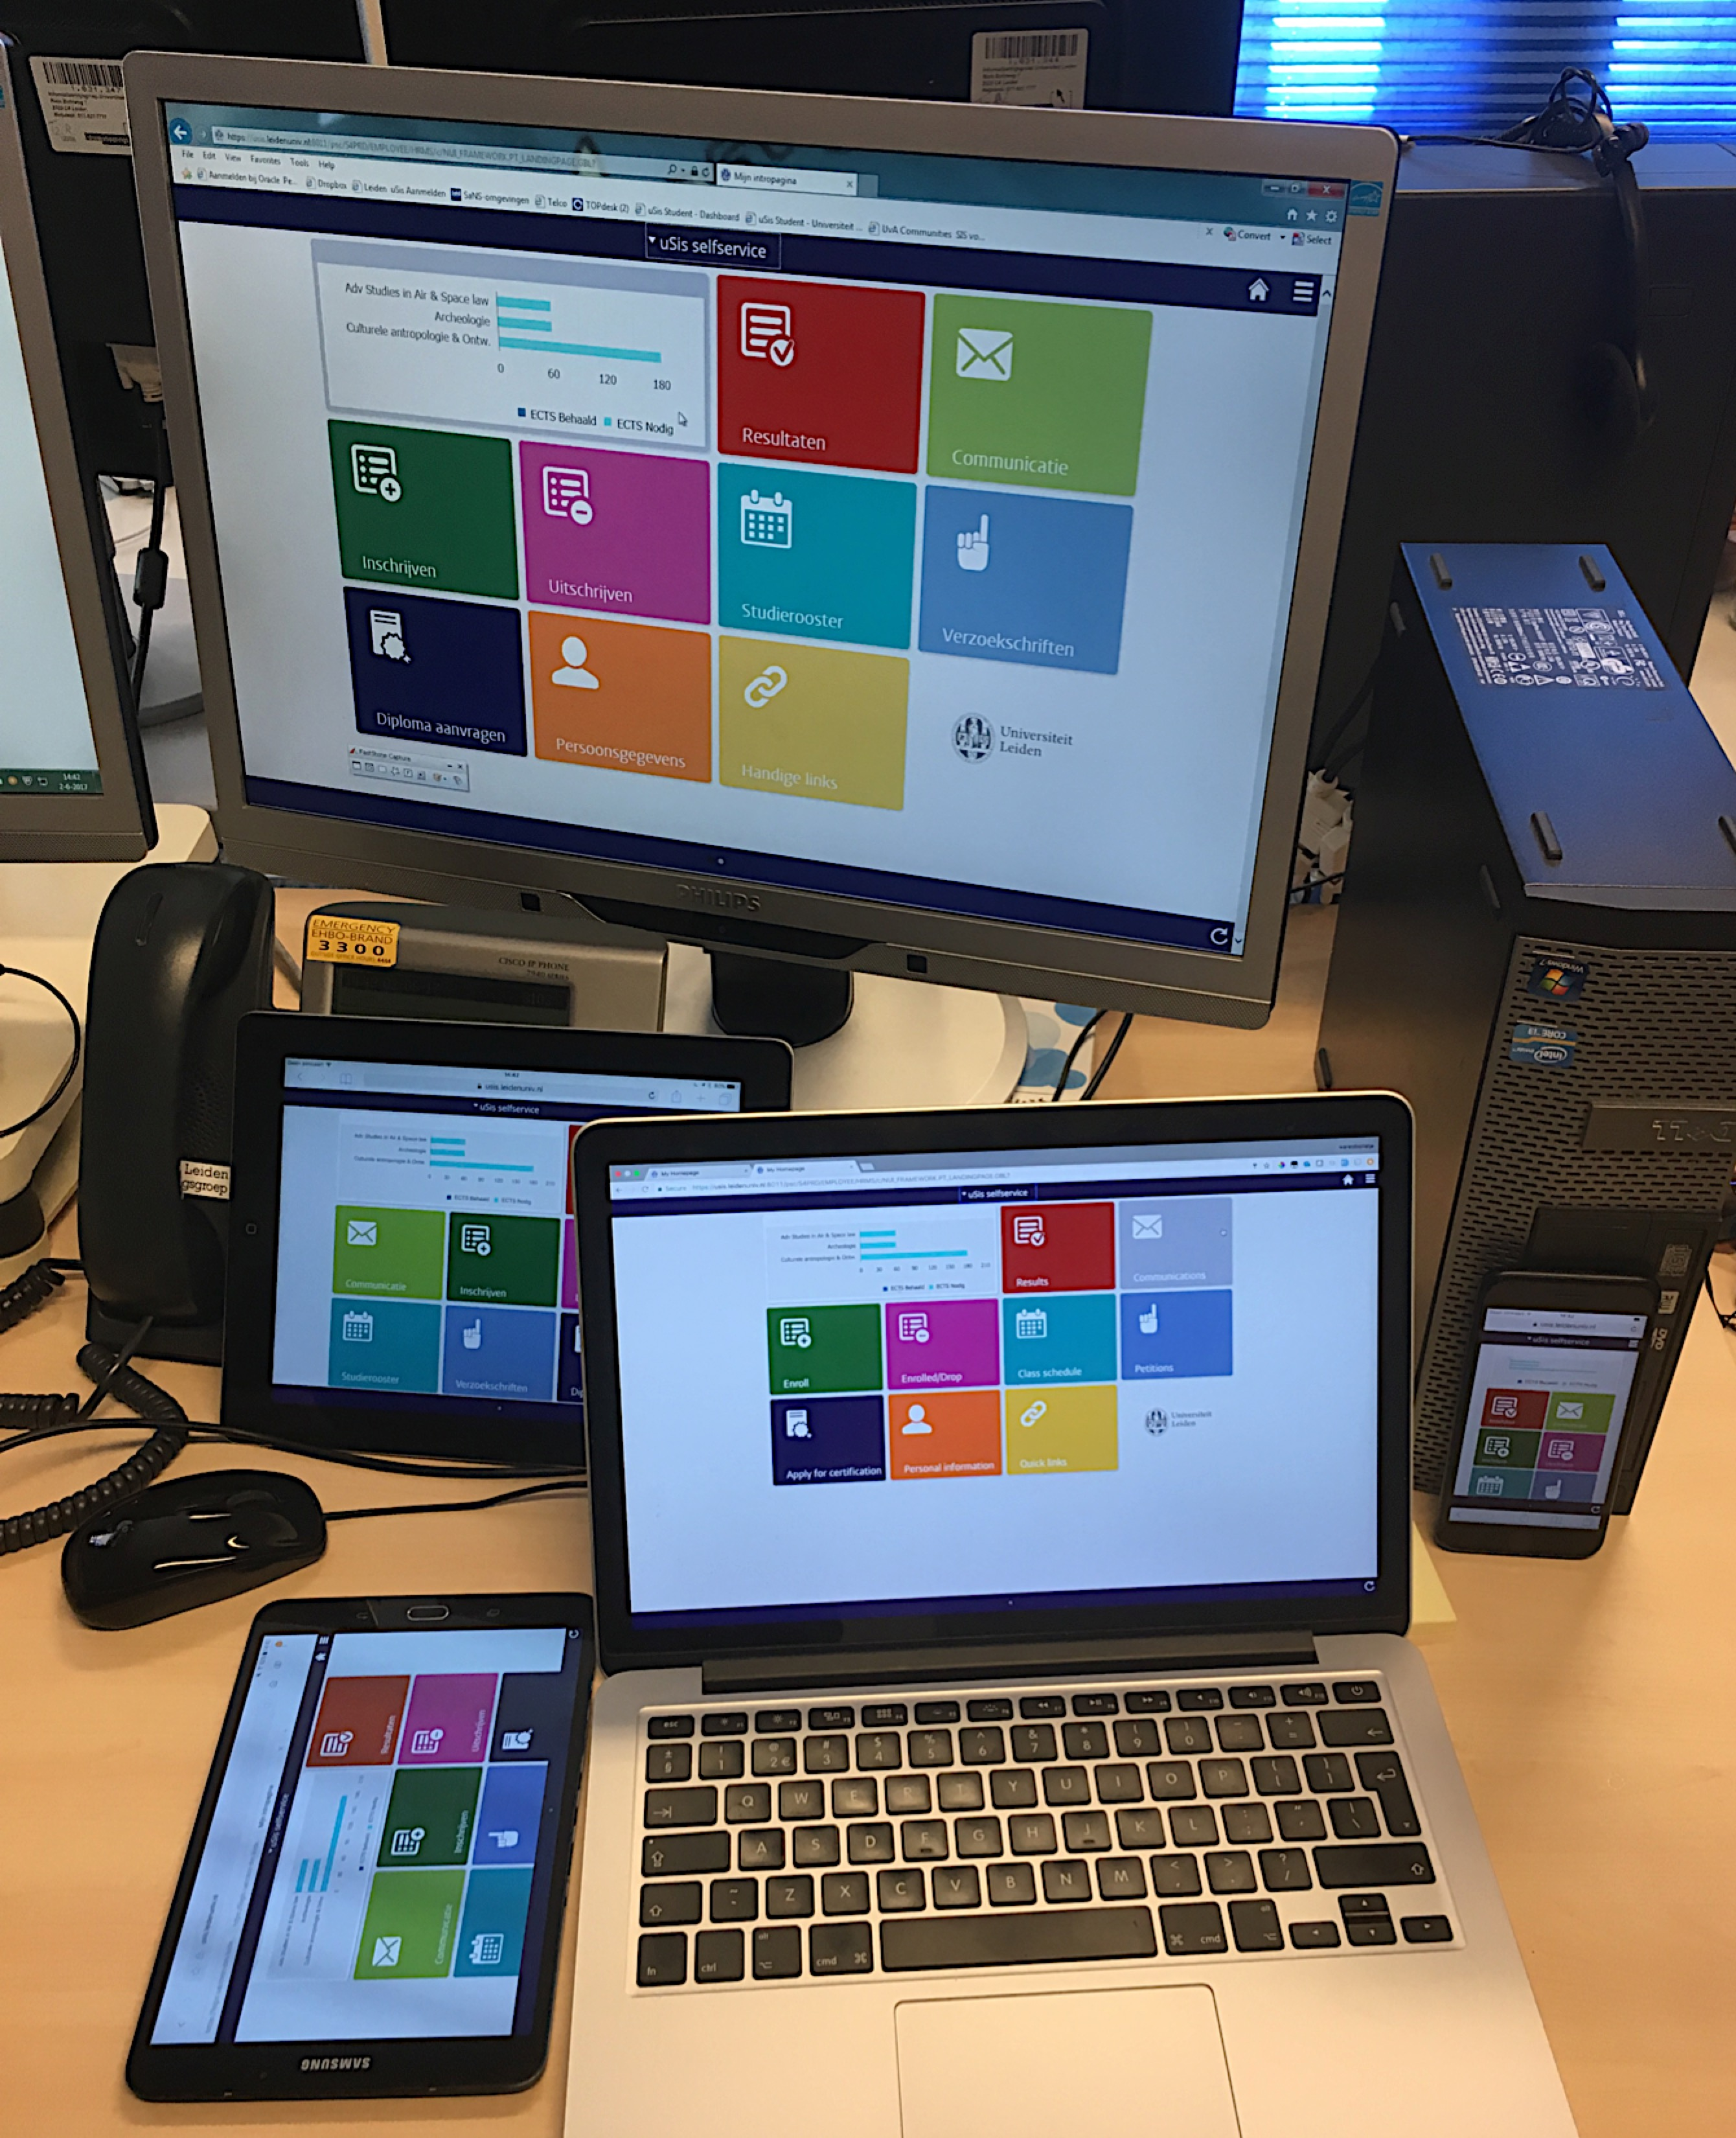
Version 1.0 – testing just before going live.

Slide 8
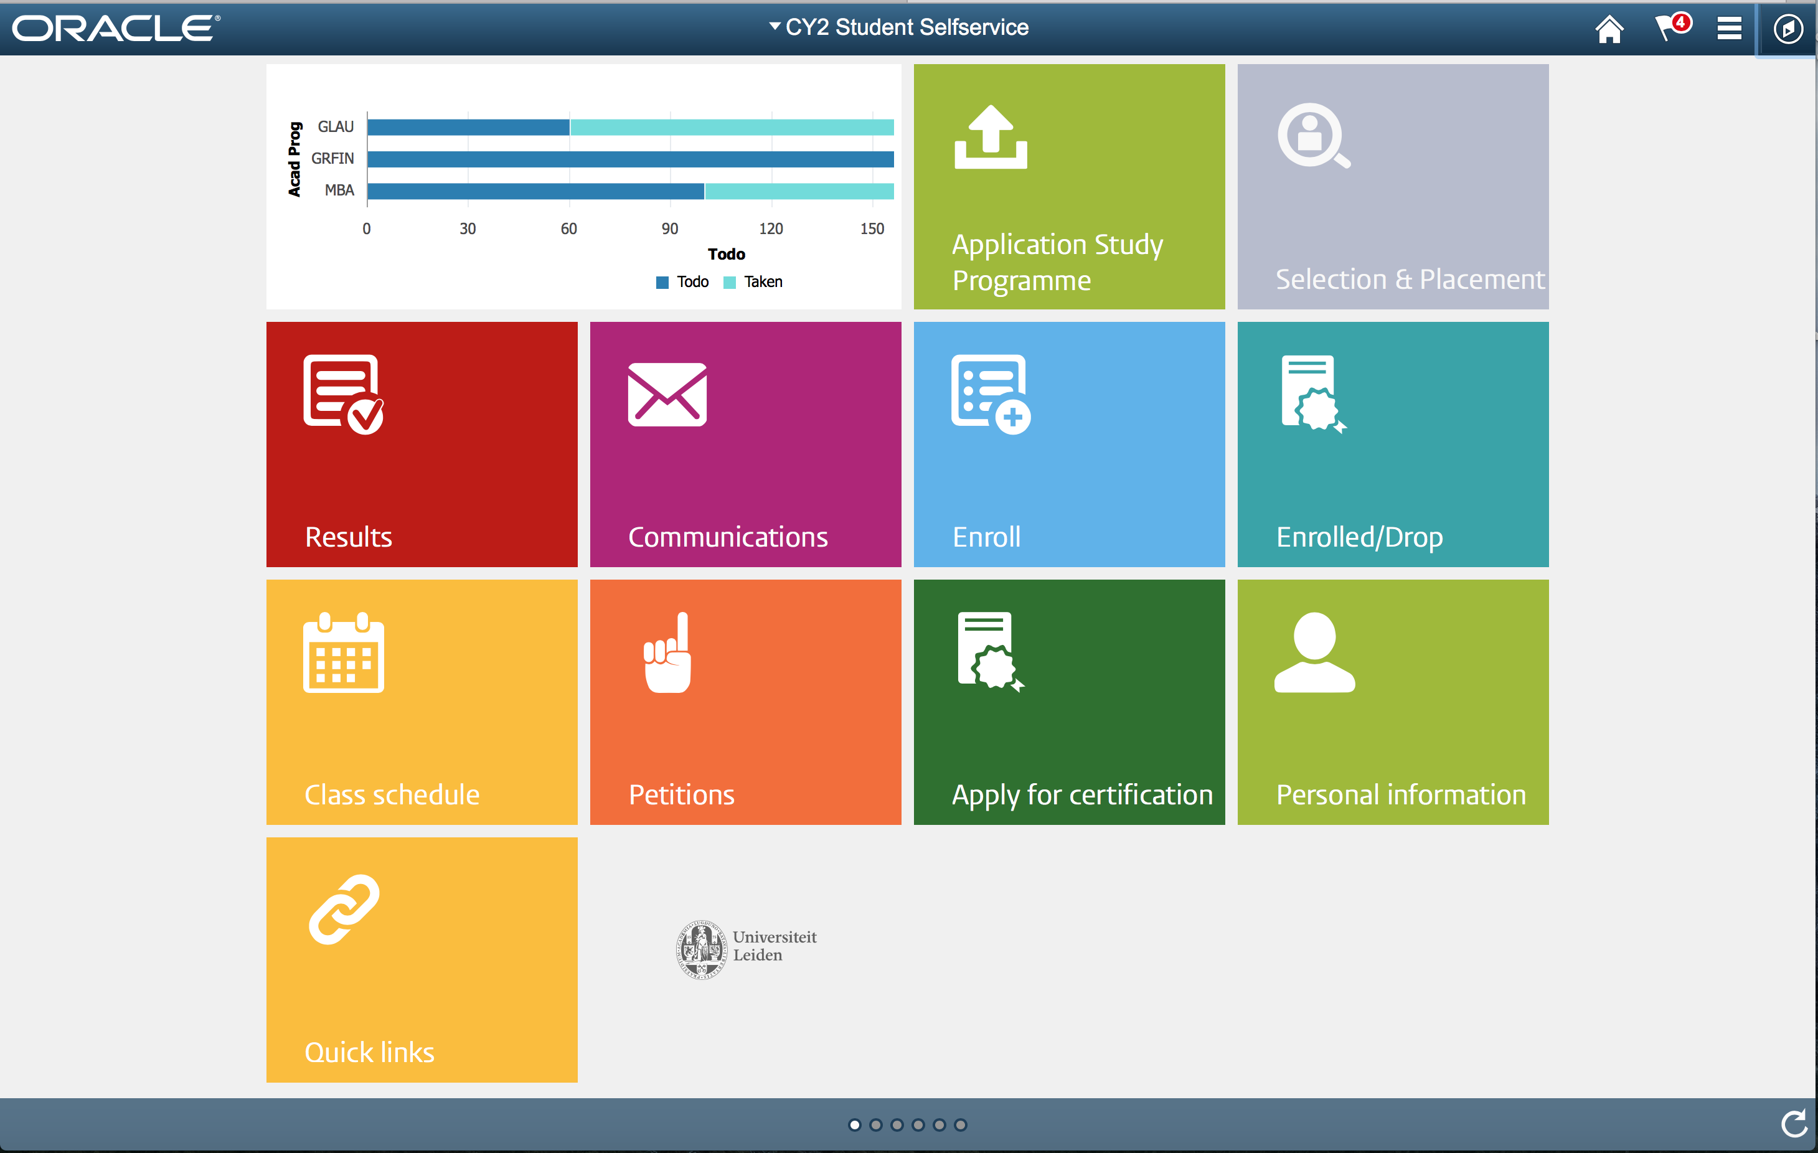
Hover color
Multi-colored tiles square tiles
Image location
Changed Font-type
And location
Embedded logo

Slide 9
Step-BY-STEP
1
Create a Role
2
Create a CSS branding object
3
Assemble a Theme
4
Assign a Theme to a Role
5
Define your CSS

Slide 10
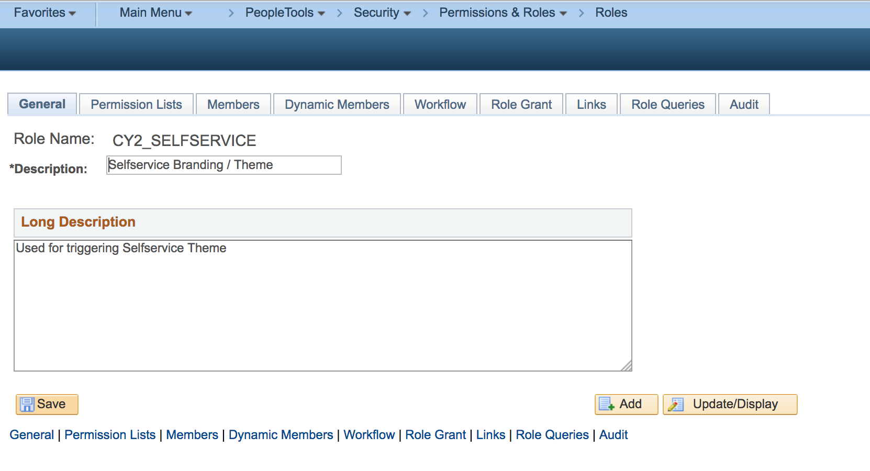
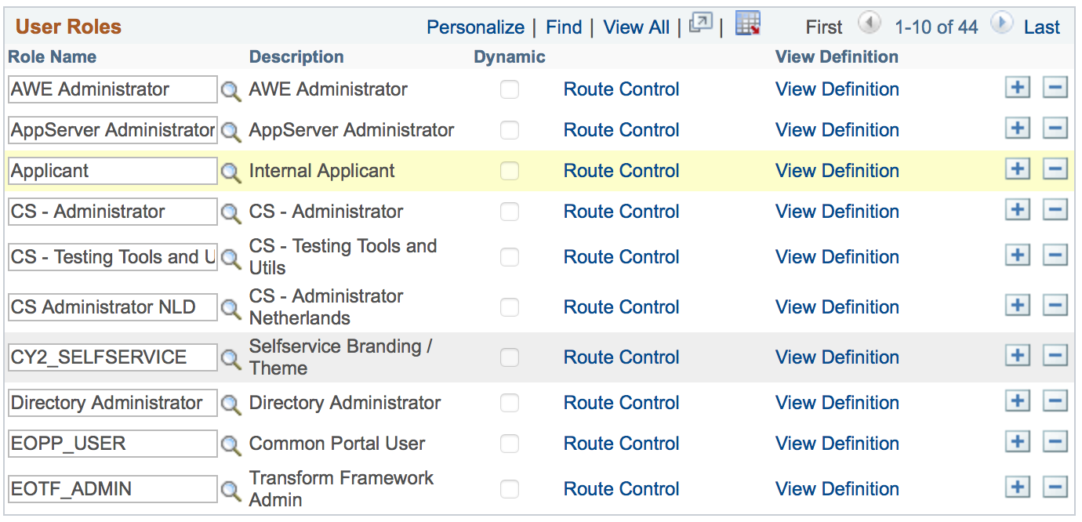
CREATE A ROLE Step1
Just a role is enough,
no permissions lists
attached.
Add it to a user

Slide 11
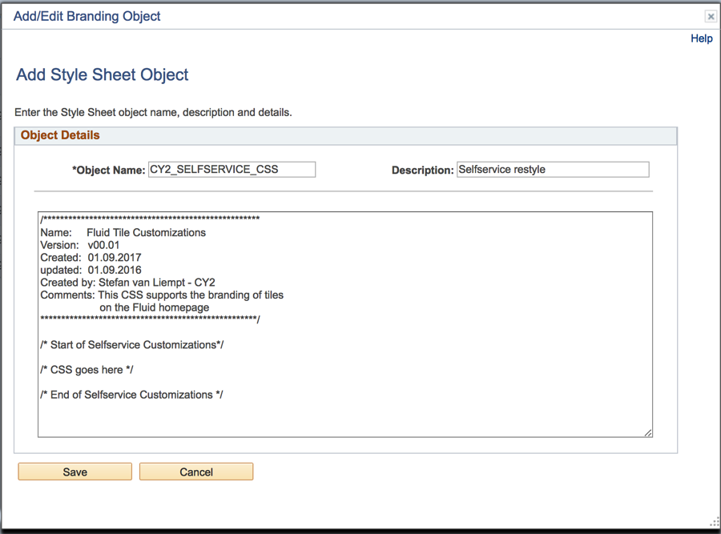
CSS branding object Step2
Peopletools > Portal > Branding > Branding Objects
Create a Placeholder CSS
We will fill it later

Slide 12
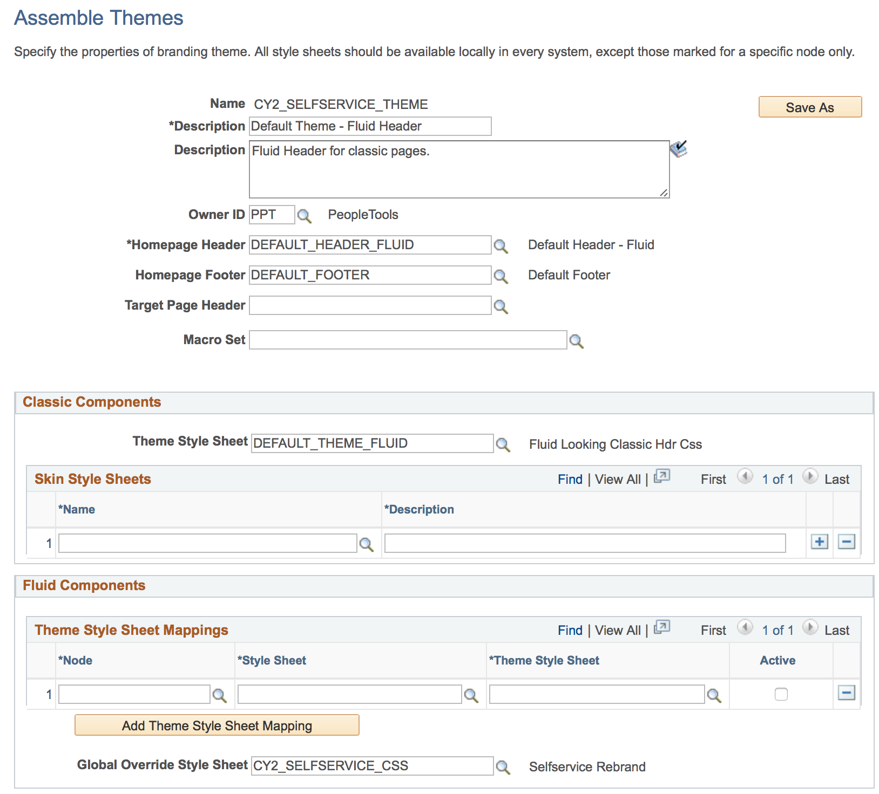
Assemble a theme Step3
Peopletools > Portal > Branding > Assemble Themes
Copy from the DEFAULT_THEME_FLUID
Add the CSS here

Slide 13
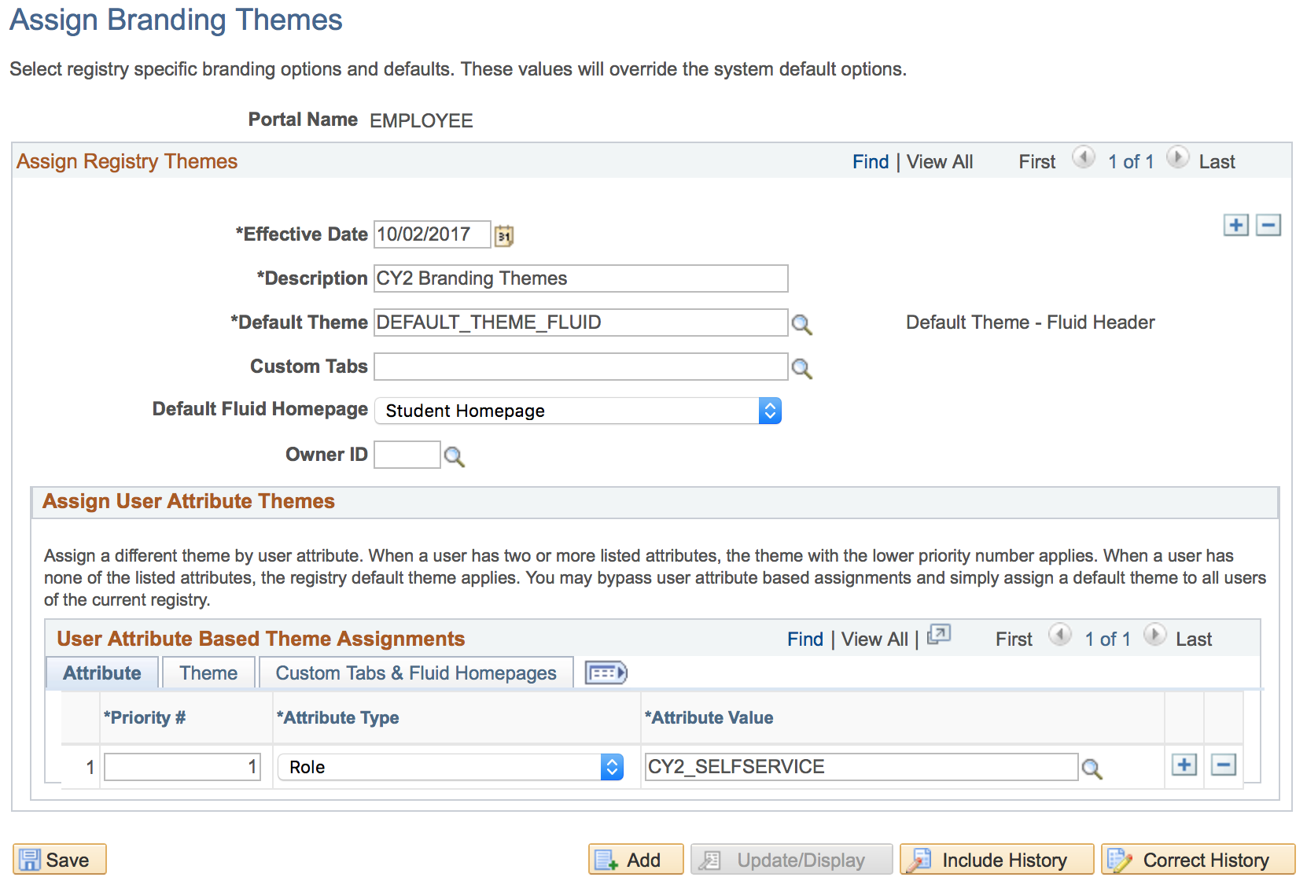
ASSIGN THEME to a role Step4
Then he will be assigned this theme
Everyone has the default
theme
And ‘land’ on this default Homepage
Except, when the user has
This role

Slide 14
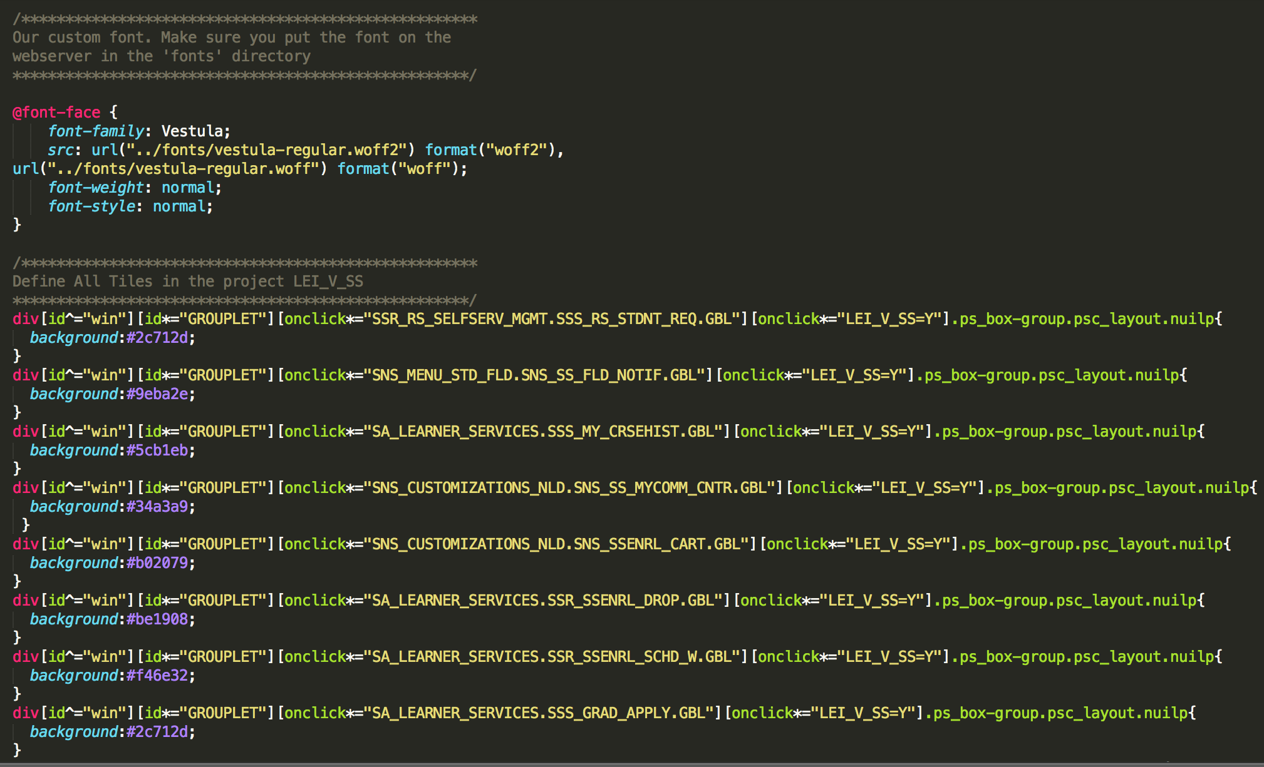
Define your css Step5

Slide 15
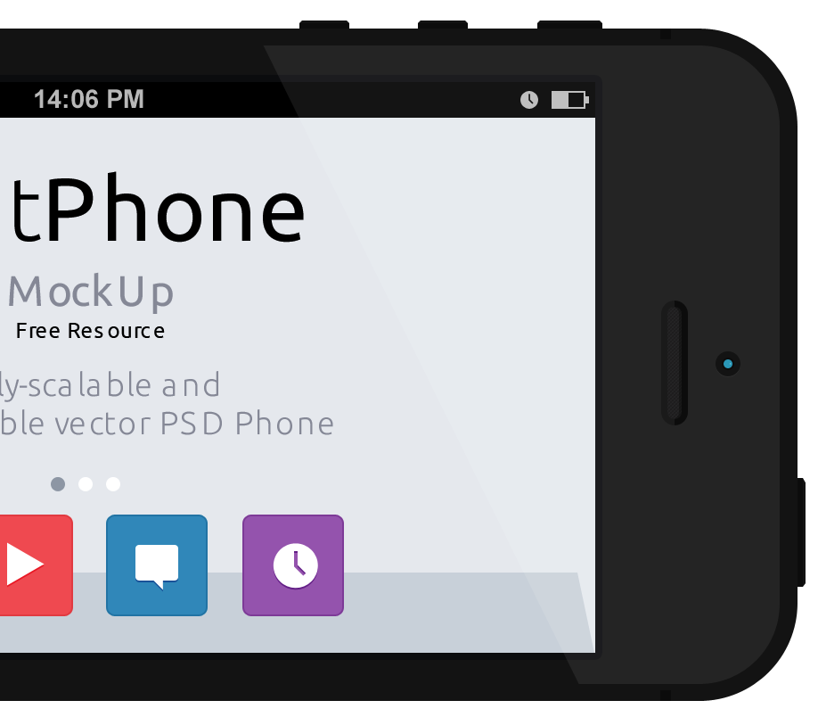
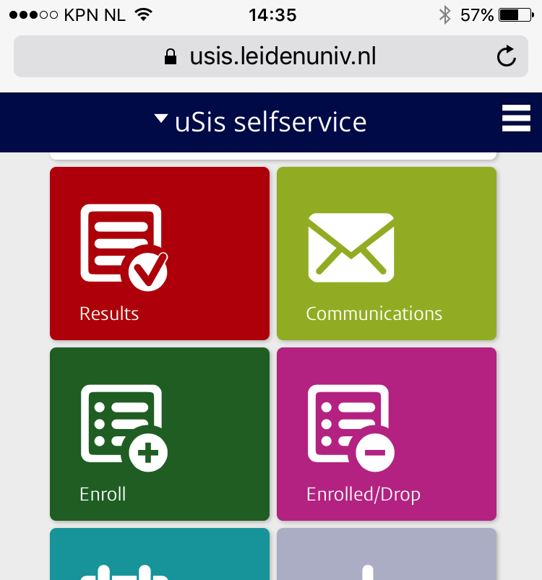
CSS specifics
Using inspector
Identify tiles
Create your CSS
DEMO
15

Slide 16
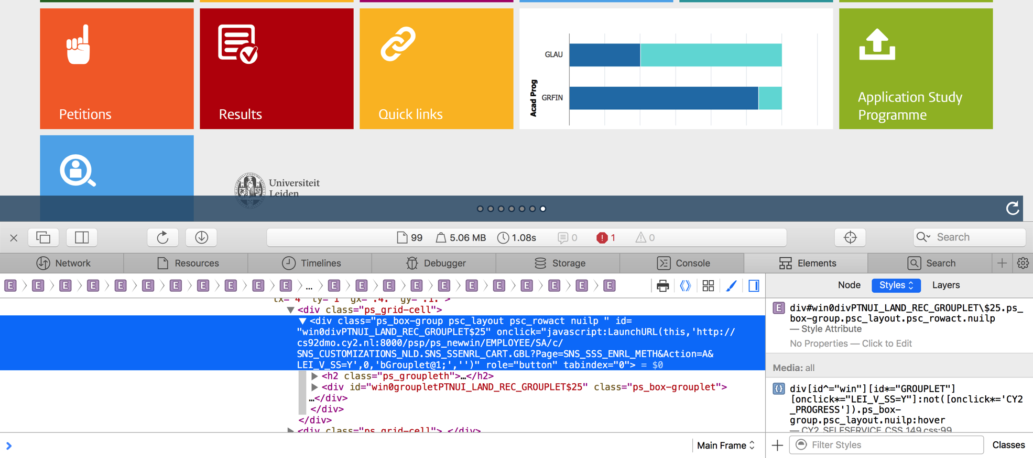
INSPECT THE HTML
Setup a foundation to Boost your styling!

Slide 17
The HTML of A tile Step4

Slide 18
The HTML of A tile Step4
<div id="win0divPTNUI_LAND_REC_GROUPLET$23"
class="ps_box-group psc_layout psc_rowact nuilp " tabindex="0" onclick="javascript:LaunchURL(this,'http://cs92dmo.cy2.nl:8000/psp/ps_newwin/EMPLOYEE/SA/c/SA_LEARNER_SERVICES.SSR_SSENRL_SCHD_W.GBL?LEI_V_SS=Y',0,'bGrouplet@1;','')" role="button">
<h2 class="ps_groupleth"><span class="ps-label" id="PTNUI_LAND_REC_GROUPLET_LBL$23">Class schedule</span></h2>
<div id="win0groupletPTNUI_LAND_REC_GROUPLET$23" class="ps_box-grouplet"><img id="LEI_V_ROOSTER_L_FL$23" class="ps_process" src="/cs/ps/cache/LEI_V_ROOSTER_L_FL_533.SVG" alt=""></div>
</div>

Slide 19
The HTML of each tile Step4
<div id="win0divPTNUI_LAND_REC_GROUPLET$23"
class="ps_box-group psc_layout psc_rowact nuilp " tabindex="0" onclick="javascript:LaunchURL(this,'http://cs92dmo.cy2.nl:8000/psp/ps_newwin/EMPLOYEE/SA/c/SA_LEARNER_SERVICES.SSR_SSENRL_SCHD_W.GBL?LEI_V_SS=Y',0,'bGrouplet@1;','')" role="button">
<h2 class="ps_groupleth"><span class="ps-label" id="PTNUI_LAND_REC_GROUPLET_LBL$23">Class schedule</span></h2>
<div id="win0groupletPTNUI_LAND_REC_GROUPLET$23" class="ps_box-grouplet"><img id="LEI_V_ROOSTER_L_FL$23" class="ps_process" src="/cs/ps/cache/LEI_V_ROOSTER_L_FL_533.SVG" alt=""></div>
</div>
Simply said:
A tile is a div element with “id” , “class” and “onclick” attributes.

Slide 20
The HTML of each tile Step4
<div id="win0divPTNUI_LAND_REC_GROUPLET$25"
class="ps_box-group psc_layout psc_rowact nuilp " tabindex="0" onclick="javascript:LaunchURL(this,'http://cs92dmo.cy2.nl:8000/psp/ps_newwin/EMPLOYEE/SA/c/SNS_CUSTOMIZATIONS_NLD.SNS_SSENRL_CART.GBL?Page=SNS_SSS_ENRL_METH&amp;Action=A&amp;LEI_V_SS=Y',0,'bGrouplet@1;','')" role="button”><h2 class="ps_groupleth"><span class="ps-label" id="PTNUI_LAND_REC_GROUPLET_LBL$25">Enroll</span></h2>
<div id="win0groupletPTNUI_LAND_REC_GROUPLET$25" class="ps_box-grouplet"><img id="LEI_V_INSCHRIJVEN_L_FL$25" class="ps_process" src="/cs/ps/cache/LEI_V_INSCHRIJVEN_L_FL_527.SVG" alt=""></div>
</div>

Slide 21
The HTML of each tile Step4
<div id="win0divPTNUI_LAND_REC_GROUPLET$25"
class="ps_box-group psc_layout psc_rowact nuilp " tabindex="0" onclick="javascript:LaunchURL(this,'http://cs92dmo.cy2.nl:8000/psp/ps_newwin/EMPLOYEE/SA/c/SNS_CUSTOMIZATIONS_NLD.SNS_SSENRL_CART.GBL?Page=SNS_SSS_ENRL_METH&amp;Action=A&amp;LEI_V_SS=Y”
</div>
How can we identify each tile? Id is dynamic, class attributes are similair.

Slide 22
The HTML of each tile Step4
<div id="win0divPTNUI_LAND_REC_GROUPLET$25"
class="ps_box-group psc_layout psc_rowact nuilp " tabindex="0" onclick="javascript:LaunchURL(this,'http://cs92dmo.cy2.nl:8000/psp/ps_newwin/EMPLOYEE/SA/c/SNS_CUSTOMIZATIONS_NLD.SNS_SSENRL_CART.GBL?Page=SNS_SSS_ENRL_METH&amp;Action=A&amp;LEI_V_SS=Y”
</div>

Slide 23
The HTML of each tile Step4
<div id="win0divPTNUI_LAND_REC_GROUPLET$25"
class="ps_box-group psc_layout psc_rowact nuilp " tabindex="0" onclick="javascript:LaunchURL(this,'http://cs92dmo.cy2.nl:8000/psp/ps_newwin/EMPLOYEE/SA/c/SNS_CUSTOMIZATIONS_NLD.SNS_SSENRL_CART.GBL?Page=SNS_SSS_ENRL_METH&amp;Action=A&amp;LEI_V_SS=Y”
</div>
If the div starts with “win”
div[id^="win”]

Slide 24
The HTML of each tile Step4
<div id="win0divPTNUI_LAND_REC_GROUPLET$25"
class="ps_box-group psc_layout psc_rowact nuilp " tabindex="0" onclick="javascript:LaunchURL(this,'http://cs92dmo.cy2.nl:8000/psp/ps_newwin/EMPLOYEE/SA/c/SNS_CUSTOMIZATIONS_NLD.SNS_SSENRL_CART.GBL?Page=SNS_SSS_ENRL_METH&amp;Action=A&amp;LEI_V_SS=Y”
</div>
If the div starts with “win”
and contains “GROUPLET”
div[id^="win”]
[id*="GROUPLET"]

Slide 25
The HTML of each tile Step4
<div id="win0divPTNUI_LAND_REC_GROUPLET$25"
class="ps_box-group psc_layout psc_rowact nuilp " tabindex="0" onclick="javascript:LaunchURL(this,'http://cs92dmo.cy2.nl:8000/psp/ps_newwin/EMPLOYEE/SA/c/SNS_CUSTOMIZATIONS_NLD.SNS_SSENRL_CART.GBL?Page=SNS_SSS_ENRL_METH&amp;Action=A&amp;LEI_V_SS=Y”
</div>
If the div starts with “win” and contains “GROUPLET” and the onclick contains “SNS_CUSTOMIZATION..GBL”
div[id^="win”]
[id*="GROUPLET"]
[onclick*="SNS_CUSTOMIZATIONS_NLD.SNS_SSENRL_CART.GBL"]

Slide 26
The HTML of each tile Step4
<div id="win0divPTNUI_LAND_REC_GROUPLET$25"
class="ps_box-group psc_layout psc_rowact nuilp " tabindex="0" onclick="javascript:LaunchURL(this,'http://cs92dmo.cy2.nl:8000/psp/ps_newwin/EMPLOYEE/SA/c/SNS_CUSTOMIZATIONS_NLD.SNS_SSENRL_CART.GBL?Page=SNS_SSS_ENRL_METH&amp;Action=A&amp;LEI_V_SS=Y”
</div>
If the div starts with “win” and contains “GROUPLET” and the onclick contains “SNS_CUSTOMIZATION..GBL” and also LEI_V_SS
div[id^="win”]
[id*="GROUPLET"]
[onclick*="SNS_CUSTOMIZATIONS_NLD.SNS_SSENRL_CART.GBL"]
[onclick*="LEI_V_SS=Y"]

Slide 27
The HTML of each tile Step4
<div id="win0divPTNUI_LAND_REC_GROUPLET$25"
class="ps_box-group psc_layout psc_rowact nuilp " tabindex="0" onclick="javascript:LaunchURL(this,'http://cs92dmo.cy2.nl:8000/psp/ps_newwin/EMPLOYEE/SA/c/SNS_CUSTOMIZATIONS_NLD.SNS_SSENRL_CART.GBL?Page=SNS_SSS_ENRL_METH&amp;Action=A&amp;LEI_V_SS=Y”
</div>
If the div starts with “win” and contains “GROUPLET” and the onclick contains “SNS_CUSTOMIZATION..GBL” and also LEI_V_SS and the class attributes are: ps_box-group, psc_layout, nuilp
div[id^="win”]
[id*="GROUPLET"]
[onclick*="SNS_CUSTOMIZATIONS_NLD.SNS_SSENRL_CART.GBL"]
[onclick*="LEI_V_SS=Y"]
.ps_box-group.psc_layout.nuilp

Slide 28
The HTML of each tile Step4
<div id="win0divPTNUI_LAND_REC_GROUPLET$25"
class="ps_box-group psc_layout psc_rowact nuilp " tabindex="0" onclick="javascript:LaunchURL(this,'http://cs92dmo.cy2.nl:8000/psp/ps_newwin/EMPLOYEE/SA/c/SNS_CUSTOMIZATIONS_NLD.SNS_SSENRL_CART.GBL?Page=SNS_SSS_ENRL_METH&amp;Action=A&amp;LEI_V_SS=Y”
</div>
If the div starts with “win” and contains “GROUPLET” and the onclick contains “SNS_CUSTOMIZATION..GBL” and also LEI_V_SS and the class attributes are: ps_box-group, psc_layout, nuilp
Then set the background
div[id^="win”]
[id*="GROUPLET"]
[onclick*="SNS_CUSTOMIZATIONS_NLD.SNS_SSENRL_CART.GBL"]
[onclick*="LEI_V_SS=Y"]
.ps_box-group.psc_layout.nuilp
{
background:#b02079;
}

Slide 29
The HTML of each tile Step4
<div id="win0divPTNUI_LAND_REC_GROUPLET$25"
class="ps_box-group psc_layout psc_rowact nuilp " tabindex="0" onclick="javascript:LaunchURL(this,'http://cs92dmo.cy2.nl:8000/psp/ps_newwin/EMPLOYEE/SA/c/SNS_CUSTOMIZATIONS_NLD.SNS_SSENRL_CART.GBL?Page=SNS_SSS_ENRL_METH&amp;Action=A&amp;LEI_V_SS=Y”
</div>
CSS
If the div starts with “win” and contains “GROUPLET” and the onclick contains “SNS_CUSTOMIZATION..GBL” and also LEI_V_SS and the class attributes are: ps_box-group, psc_layout, nuilp
Then set the background
C
div[id^="win”]
[id*="GROUPLET"]
[onclick*="SNS_CUSTOMIZATIONS_NLD.SNS_SSENRL_CART.GBL"]
[onclick*="LEI_V_SS=Y"]
.ps_box-group.psc_layout.nuilp
{
background:#b02079;
}

Slide 30
CSS Examples
CSS
C
div[id^="win”]
[id*="GROUPLET"]
[onclick*="SNS_CUSTOMIZATIONS_NLD.SNS_SSENRL_CART.GBL"]
[onclick*="LEI_V_SS=Y"]
Brand specific tile with background
.ps_box-group.psc_layout.nuilp
{
background:#b02079;
}
div[id^="win”]
[id*="GROUPLET"]
div[id^="win”]
[id*="GROUPLET"]
C
C
[onclick*="LEI_V_SS=Y"]
[onclick*="LEI_V_SS=Y"]
.ps_box-group.psc_layout.nuilp {
.ps_box-group.psc_layout.nuilp
> div > img.ps_process {
%BP(border-radius: 0);
%BP(box-shadow:none);
}
Brand all your
Custom tiles.
#1: drop shadow & radius.
#2: image location
margin-left:10%;
margin-top:0em;
width:65px;
}

Slide 31
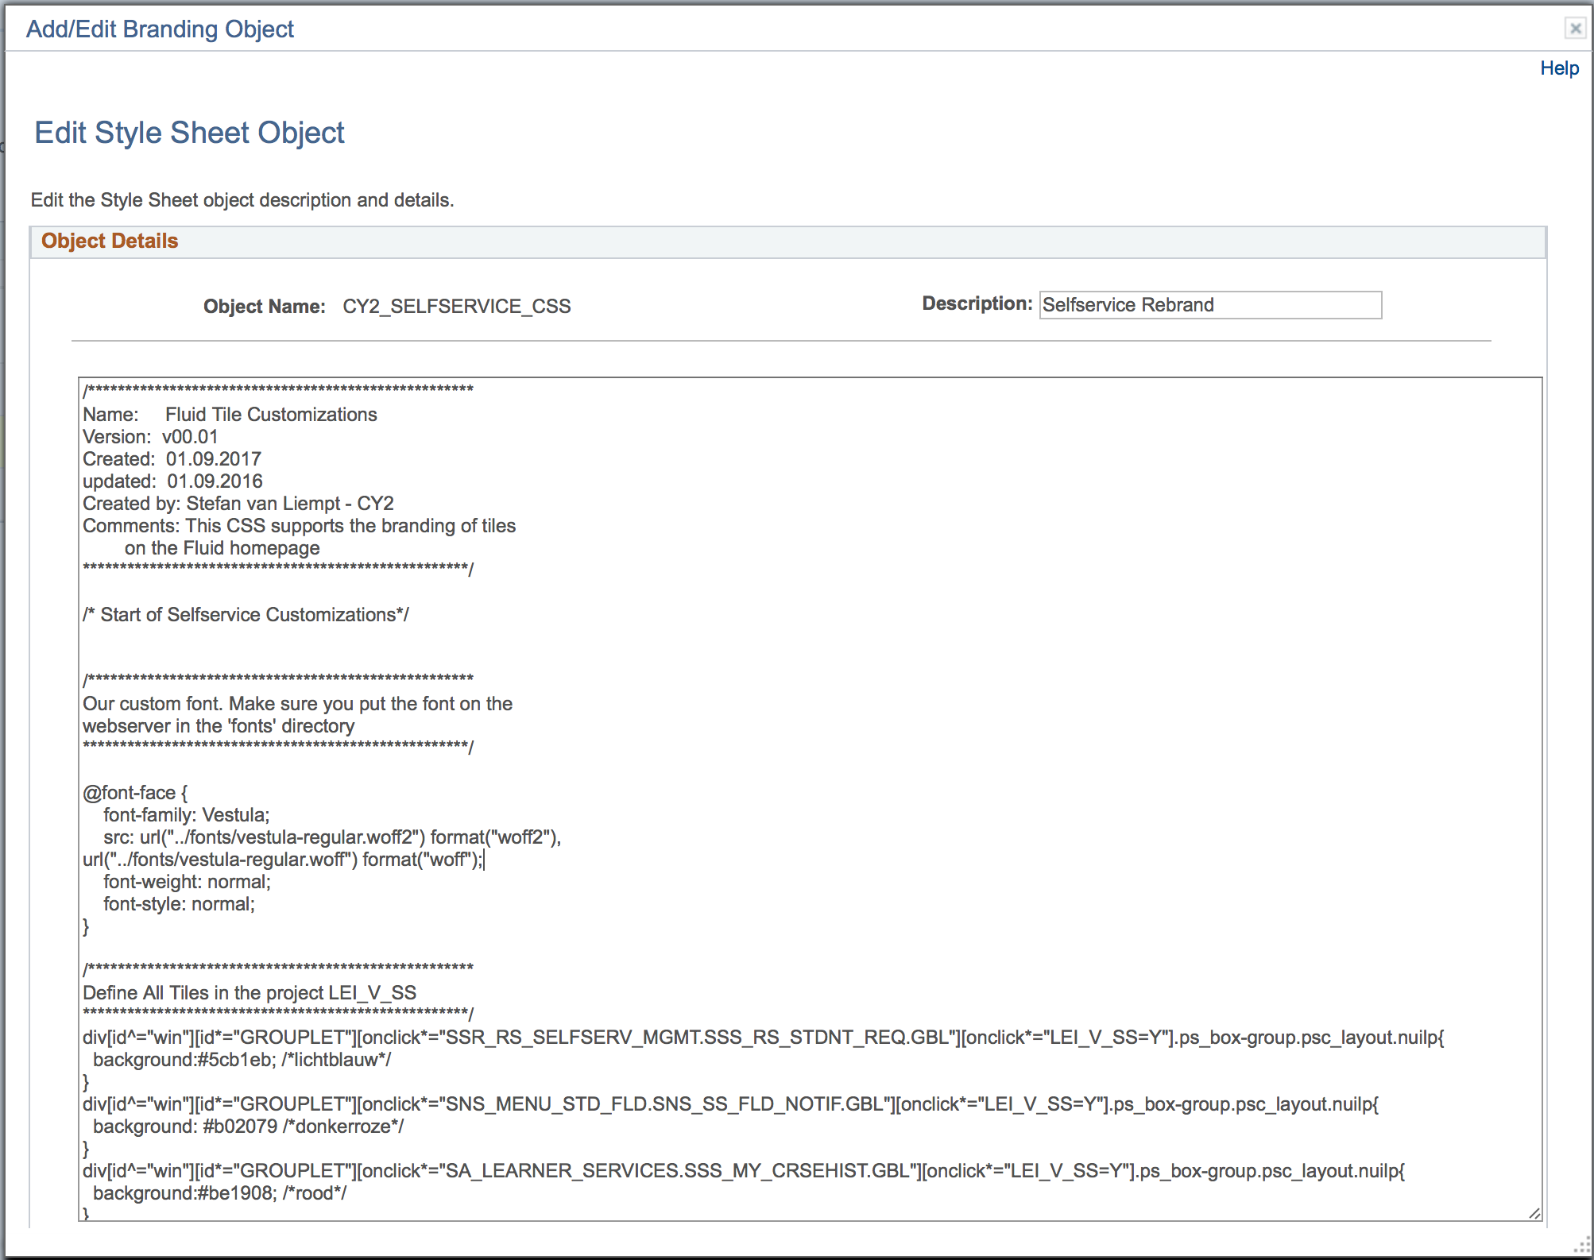
DEFINE YOUR CSS Step5
Peopletools > Portal > Branding > Branding Objects

Slide 32
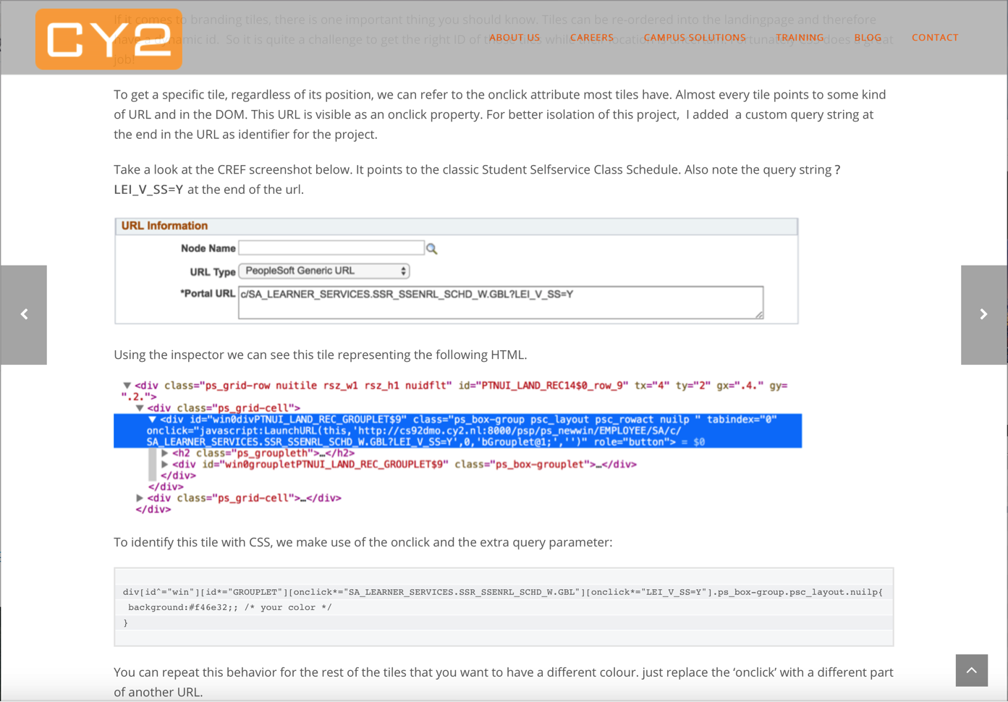
Download the complete CSS
http://cy2.nl/oracle-fluid-branding-tiles/

Slide 33
MACROSETS

Slide 34
Step-BY-STEP
1
Create a Role
6
Clone a Macroset
2
Create a CSS branding object
7
Copy Macro stylesheets
3
Assemble a Theme
8
Adjust your theme for Macro usage
4
Assign a Theme to a Role
9
Extend Macroset
5
Define your CSS
10
Adjust Stylesheet

Slide 35
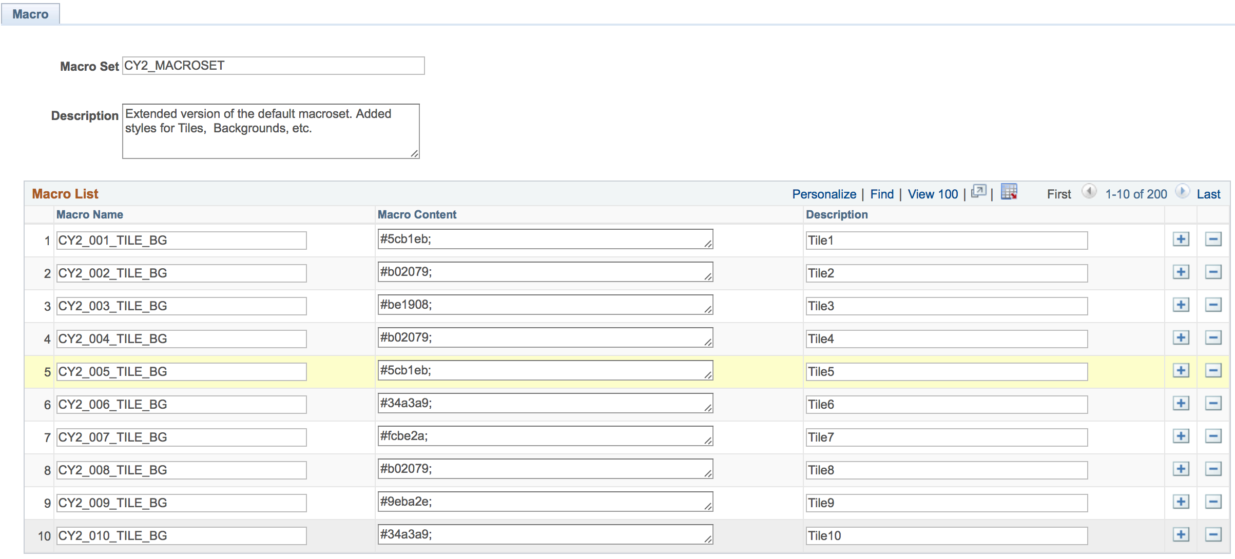
MACROSET
Peopletools > Portal > Branding > Macro Sets

Slide 36
MACROSET
Peopletools > Portal > Branding > Macro Sets
Attribute value
Refer to these Macro names
In your stylesheet

Slide 37
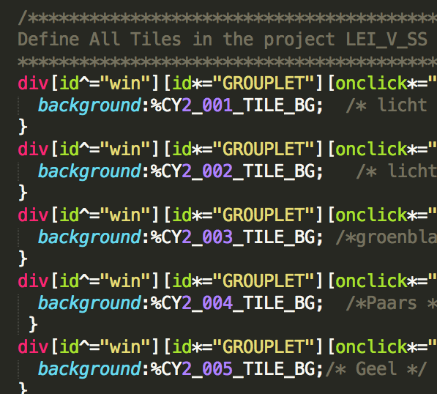
MACROSET
Peopletools > Portal > Branding > Macro Sets
Attribute value
Refer to these Macro names
In your stylesheet

Slide 38
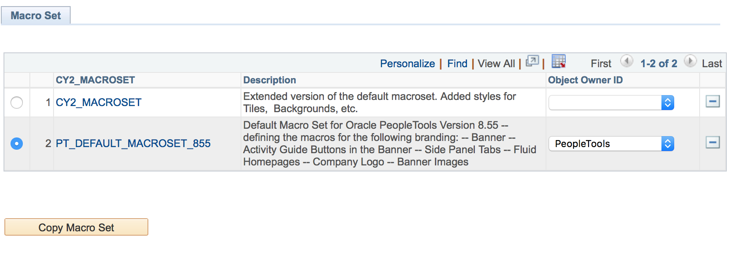
COPY MACRO SET Step6
Peopletools > Portal > Branding > Macro Sets

Slide 39
COPY MACRO STYLESHEETS Step7
In AppDesigner:
Open stylesheet PT_BRAND_CLASSIC_TEMPLTE_FLUID
paste the content in a new branding object CY2_BRAND_CLASSIC_TEMPLTE_FL
Do the same for PT_BRAND_FLUID_TEMPLATE > CY2_BRAND_FLUID_TEMPLATE

Slide 40
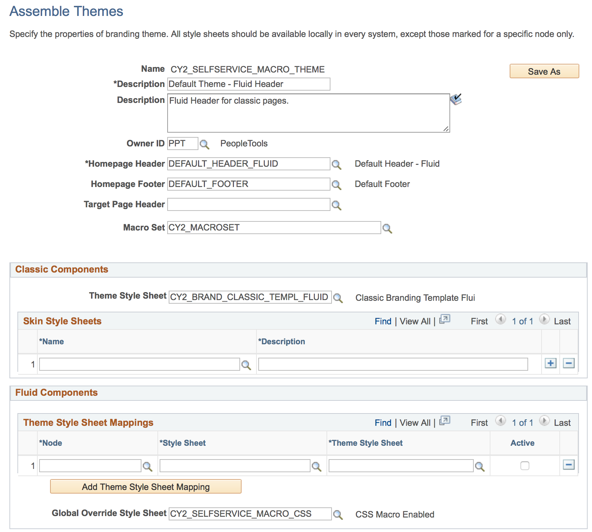
ADJUST YOUR THEME Step8
Peopletools > Portal > Branding > Assemble Themes
Add the Macro to both Classic and
Fluid override
stylesheet

Slide 41
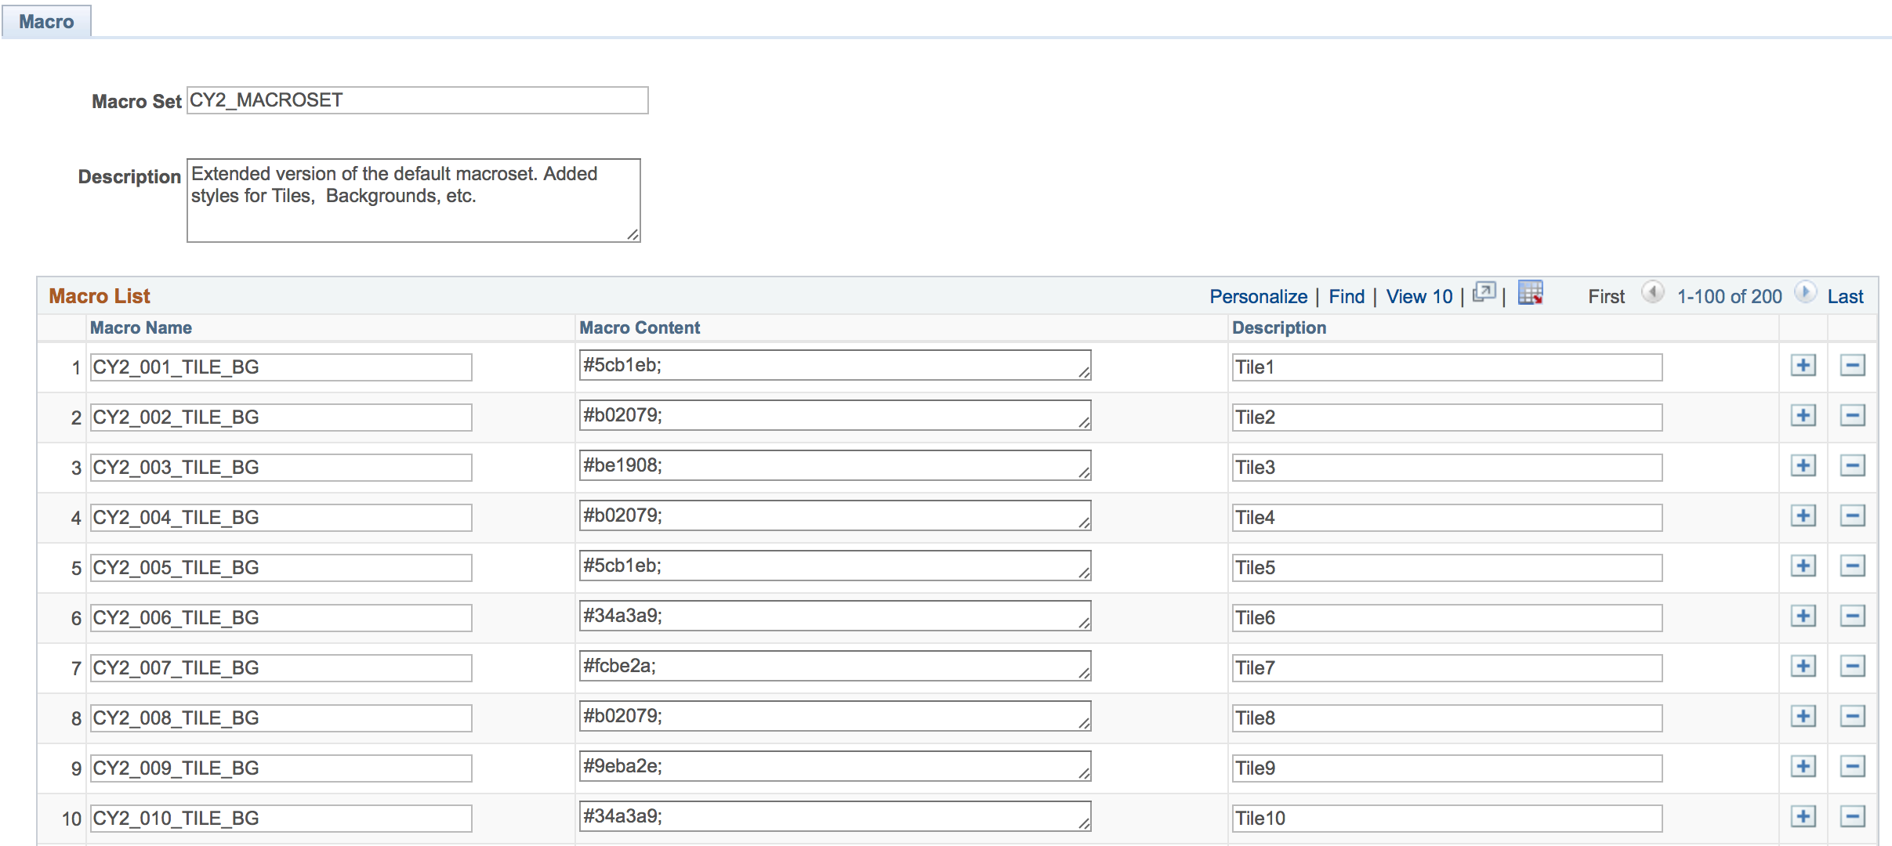
EXTEND MACROSET Step9
Peopletools > Portal > Branding > Macro Sets
Add some new rows in your macroset

Slide 42
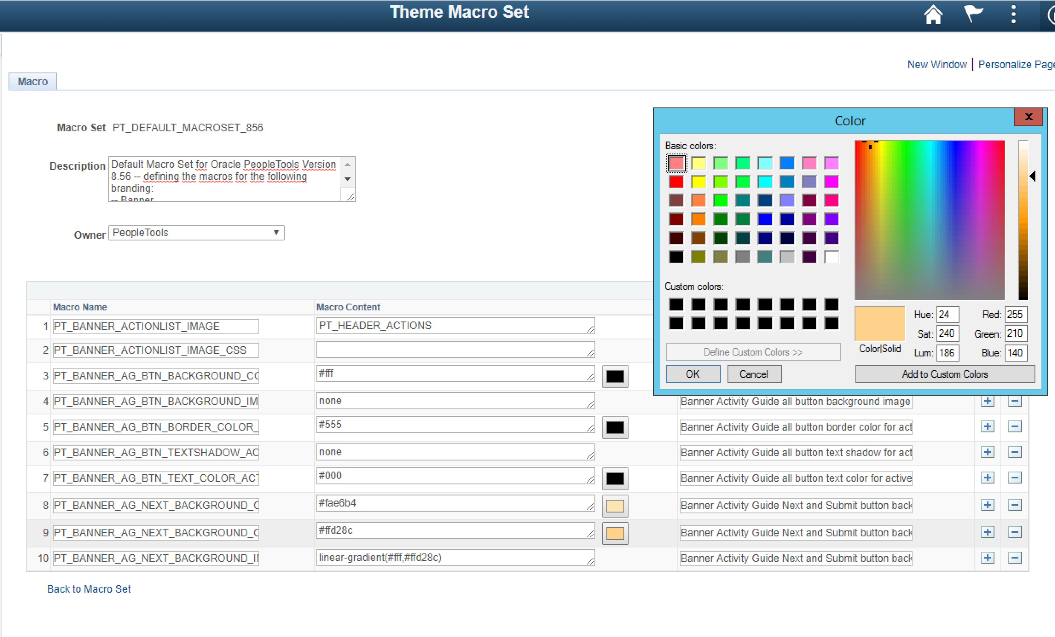
8.56 MACROSET Step9
Peopletools > Portal > Branding > Macro Sets
Choose your colors with a colorpicker!

Slide 43
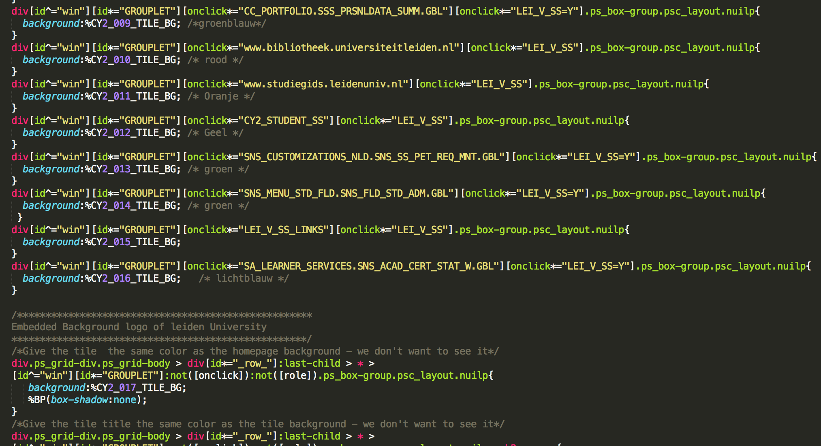
ADJUST STYleSHEET Step10
Replace anything
You like to be a macro
With %<name>

Slide 44
SUMMARY

Slide 45
Other sessions BY
Privacy and what's already available in your Campus Solutions environment October 17th: 10:10am – 10:40am
Fluid Forms and Approval Builder October 17th: 02:00pm – 03:00pm
What’s new in Tools 8.56 October 17th : 11:10 AM – 12:10 AM
Elmer Mackor & Lukas Degens
Wouter de Bruin
Ernst La Haye

Slide 46
THANK YOU!

