Slide 1
I Do Declare: Students Using Self-Service To Declare Their Major Is Possible!
Janice de Graaf
Shawna Jansen
November 7, 2017
Session Number: 5059

Slide 2
MacEwan University at a Glance
-Located in Edmonton, Alberta and founded in 1971 as Grant MacEwan Community College
-Approximately 19,000 students
-Diverse programming options: offers 8 baccalaureate degrees, 2 applied degrees, 43 diplomas and certificates
-PeopleSoft Campus Solutions version 9.2

Slide 3
Agenda
The problem
The student’s view
Behind the scenes configuration - how we accomplished it
By program (academic program table)
Two declaration periods with start and end dates
Academic Item Registry - “AIR”
Process for students and advisors
Competitive declarations
Advisor view
Approval and denial of competitive declaration requests
3C Communications
Requirement term

Slide 4
The Problem
Initially, students submitted declaration requests via a webform in the MacEwan portal. An email was generated and sent to a generic email account to be processed manually by the Office of the University Registrar.
Why move to automate?
The manual process included re-setting the webform on a regular basis and was only visible to the student
Change requests were not effectively communicated which led to frustrated students and more traffic in the advising and Office of the University Registrar
The volume of requests was increasing annually so efficiencies needed to be found

Slide 5
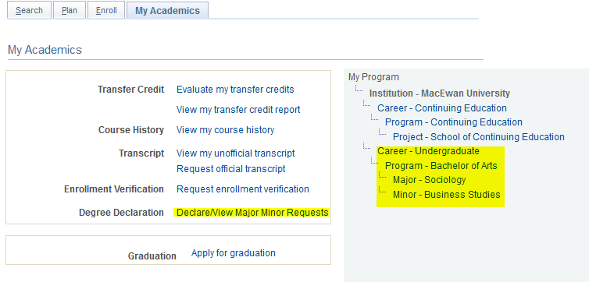
Student View
New “degree declaration” menu item added in the Academics tab of the Student Centre
All students see the menu item
Item is always displayed
Program information displayed

Slide 6
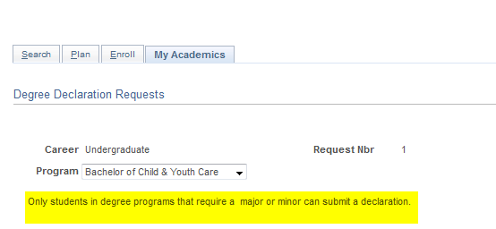
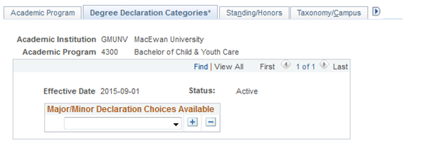
Student View - No Access
Students in programs that do not allow self-declarations will not have access to submit a declaration.
Behind the scenes: configuration on the Program Table determines which programs allow self-declarations.

Slide 7
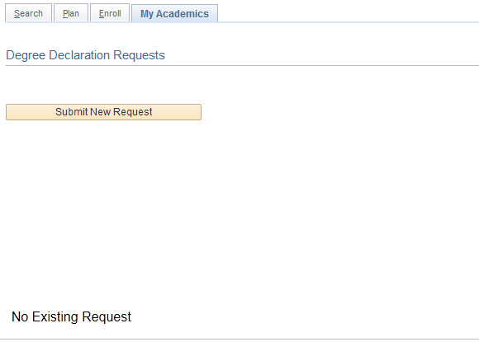
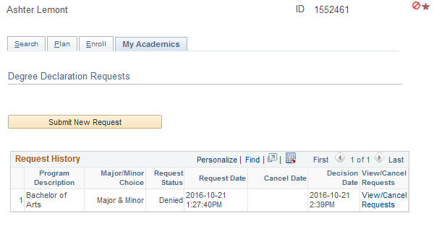
Student View
Only declarations submitted through the new system will appear on the Request History.
Students can track declaration submissions and status.

Slide 8
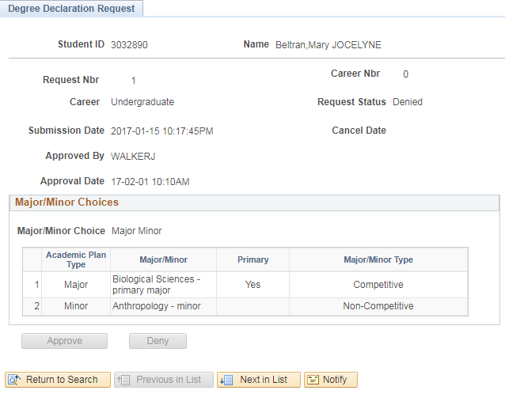
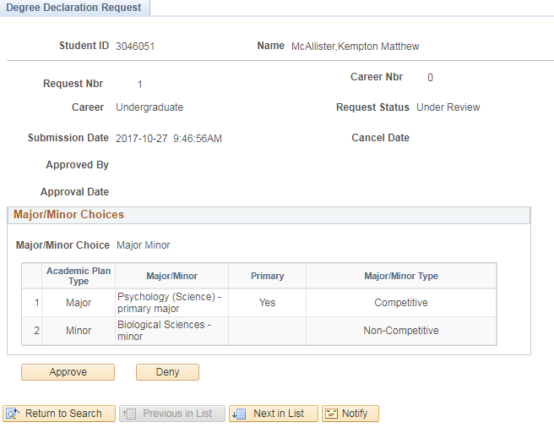
Student View

Slide 9
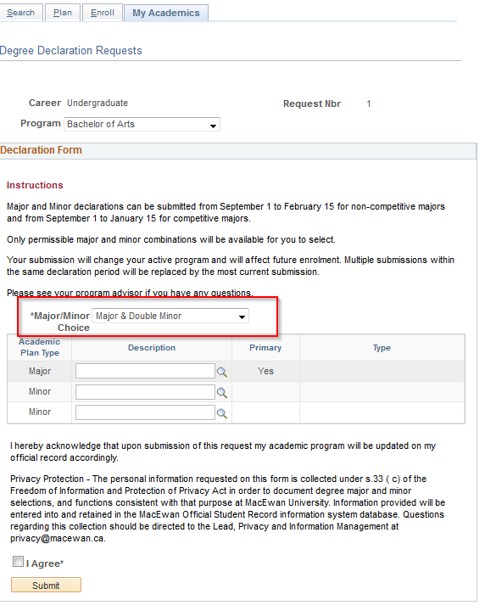
Student View
Students can select the combinations they want to declare. Depending on program, students can declare double majors, single major and minor, or single major and double minors
Prompt values will only display allowable choices
Only primary major is used in Alberta for government reporting purposes
Students cannot submit partial declarations, all applicable choices must be submitted together

Slide 10
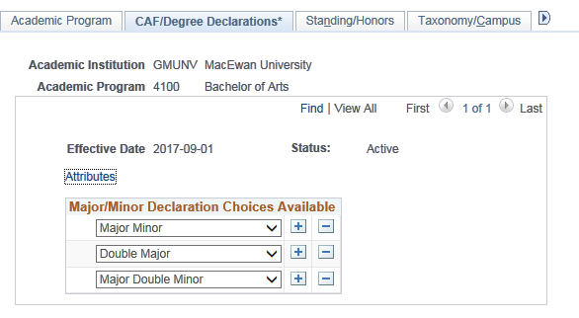
Behind the Scenes Configuration: Academic Program Table
New custom tab determines whether students can self declare online or not
Office of the University Registrar manages configuration
Declaration categories specified at program level
Configured for the following programs:
Bachelor of Arts 4100
Bachelor of Science 4400
Bachelor of Commerce 4200
Set Up SACR > Foundation Tables > Academic Structure > Academic Program Table

Slide 11
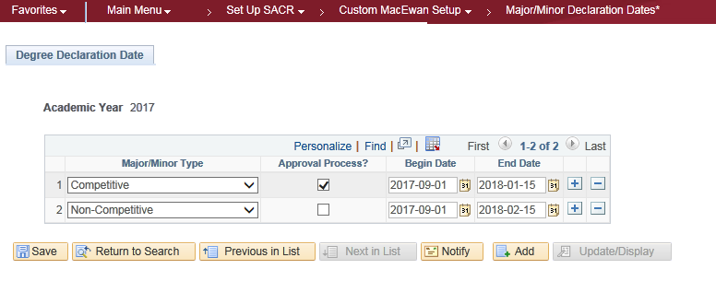
Behind the Scenes Configuration: Start & End Dates
Two declaration periods - configured annually by the Office of the University Registrar:
1. Competitive majors and minors September 1 – January 15
2. Regular (Non-competitive majors/minors) September 1 – February 15
Set UP SACR > Custom MacEwan Setup > Major/Minor Declaration Dates*

Slide 12
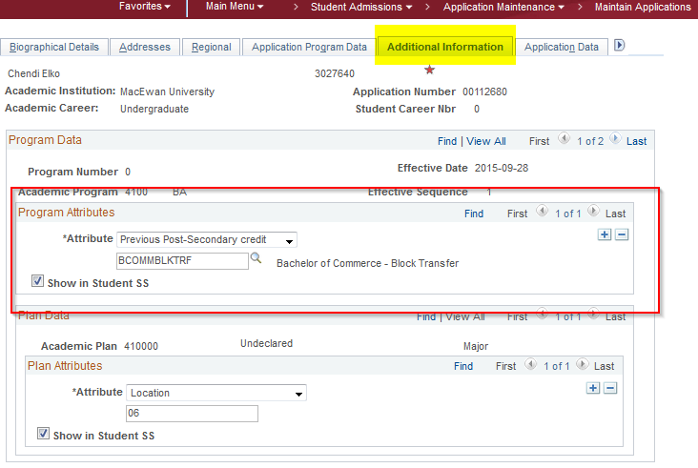
Previous Post-Secondary Attribute
Bachelor of Commerce Block Transfer students and Bachelor of Arts/Science students who are undertaking a second degree cannot declare a major
BCom: Admissions specialist will add plan and attribute (value BCOMMBLKTRF)
BA/BSC: Admissions specialist will add attribute only (value SUBBACC)
Students whose active program has the attribute will not be able to declare a major/minor
Student Admissions > Application Maintenance > Maintain Applications > Additional Information (tab)

Slide 13
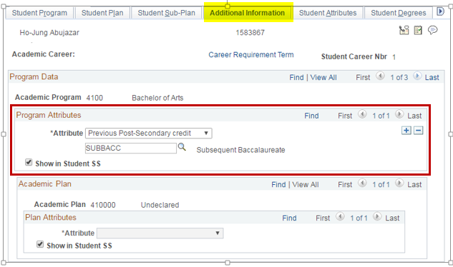
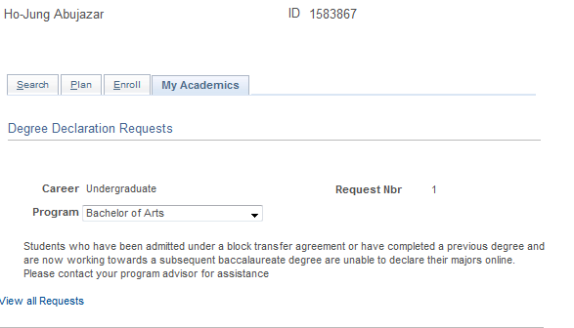
Student View – Block Transfer and Sub-Bacc Students
Attribute can be added after admission on Program Plan
Attribute will block students from declaring a major
Attribute value is for identification purpose:
Block transfers
Subsequent baccalaureates

Slide 14
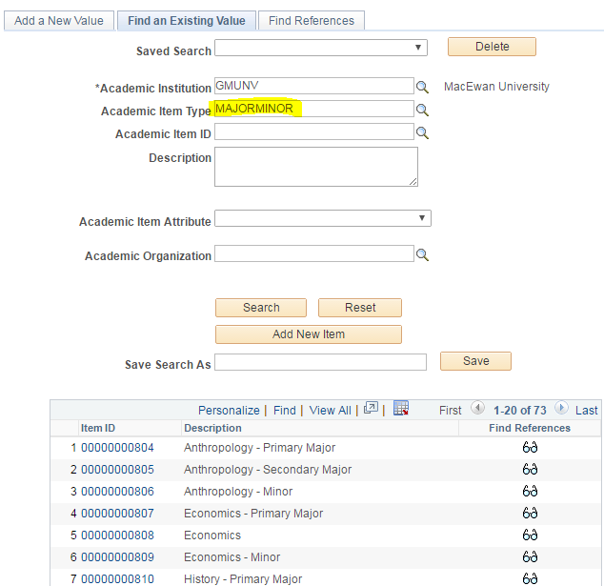
Behind the Scenes: “AIR” Major/Minor (Plan) Configuration
Academic Item Registry (AIR) used for plan configuration
Separate from academic plan setup tables. This allows the faculties access to update any newly approved majors or minors
Does not require annual configuration unless a plan becomes competitive or vice versa
Curriculum Management > Academic Item Registry > Academic Item Registry (AIR)

Slide 15
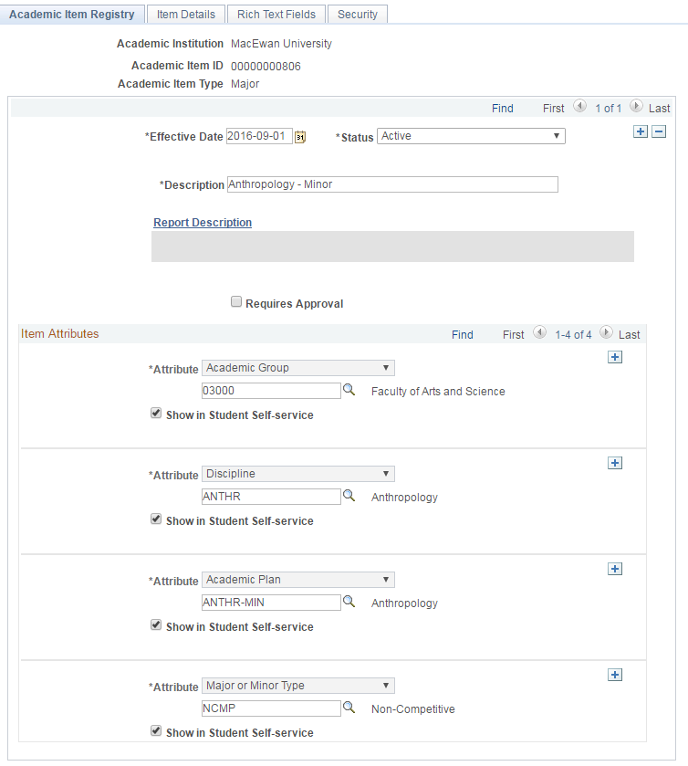
Behind the Scenes: Sample Plan Setup
Description will be displayed to student
Item attributes created using Common Attribute Framework (CAF)
Academic Group is equivalent to faculty/school at MacEwan
Effective dated to reflect any changes in available program majors/minors
Additional attributes exist

Slide 16
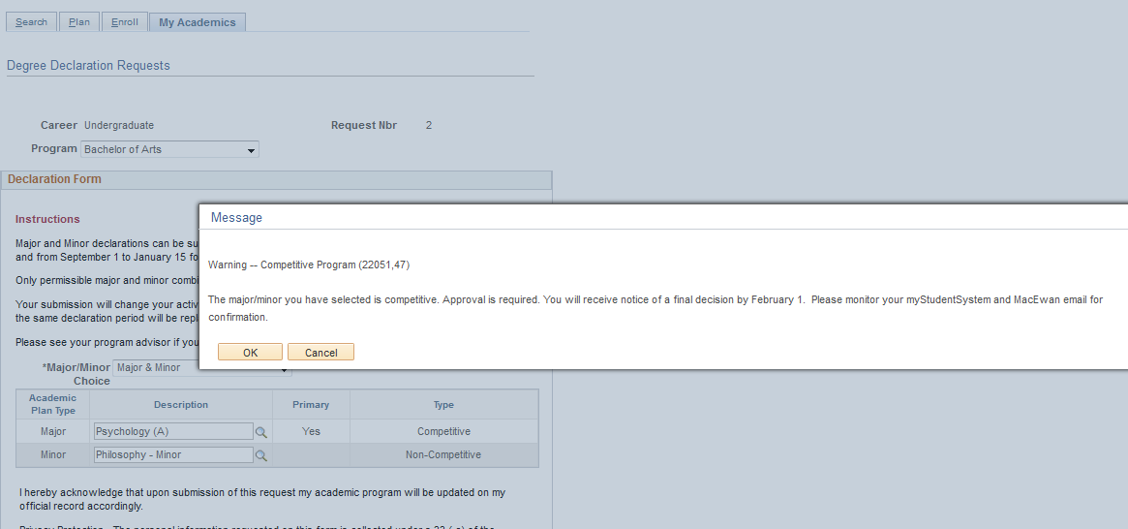
Behind the Scenes: Competitive Declarations
Competitive plans require manual intervention
Students notified of approval process through pop-up message
Students are also sent a 3C email to their MacEwan email

Slide 17
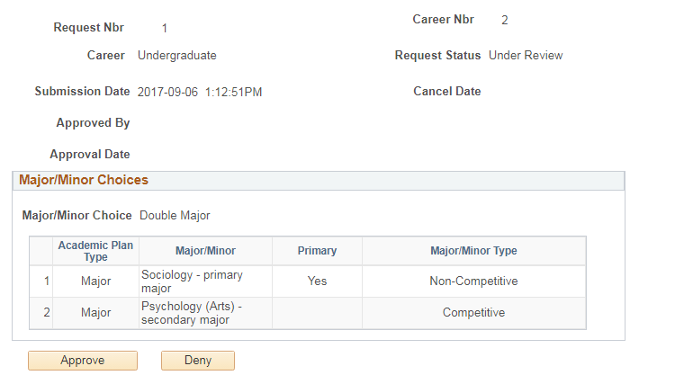
Behind the Scenes: Approving or Denying
Competitive Declarations
Declarations treated as individual request to be approved or denied by an advisor
Major and minors must be processed as one item
Unsuccessful students will have 15 days to make a new submission
Records and Enrollment > Career and Program Information > Degree Declarations*

Slide 18
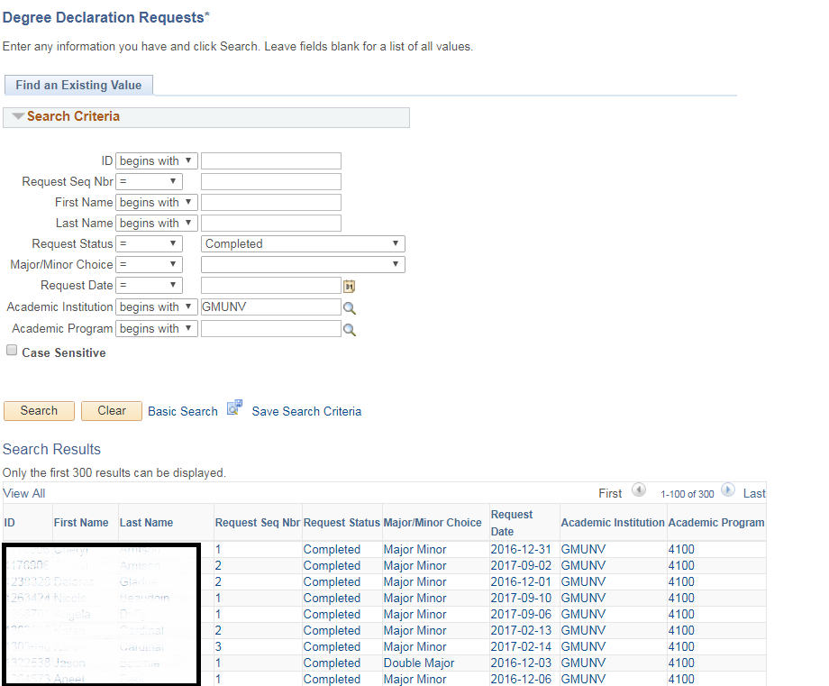
Program Advisor View
Can search by: - Declaration status
- Program
- Request Date
- Empl ID (Student)
- Name
- Sequence Number
While advisors can view, approve and deny requests, no one can change or cancel declarations Why?
Records and Enrollment > Career and Program Information > Degree Declarations*

Slide 19
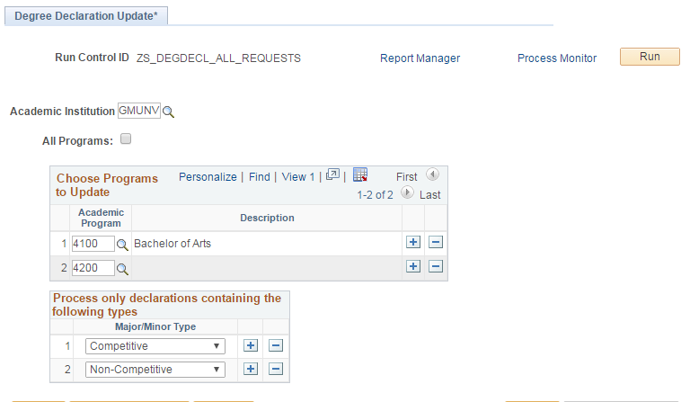
Behind the Scenes: Processing Declarations
Nightly batch process
Updates all requests, including program plan and subplan if applicable
Can be modified to run by program
Adds 3C communication to student record to send email notification
Records and Enrollment > Career and Program Information > Process degree declarations*

Slide 20
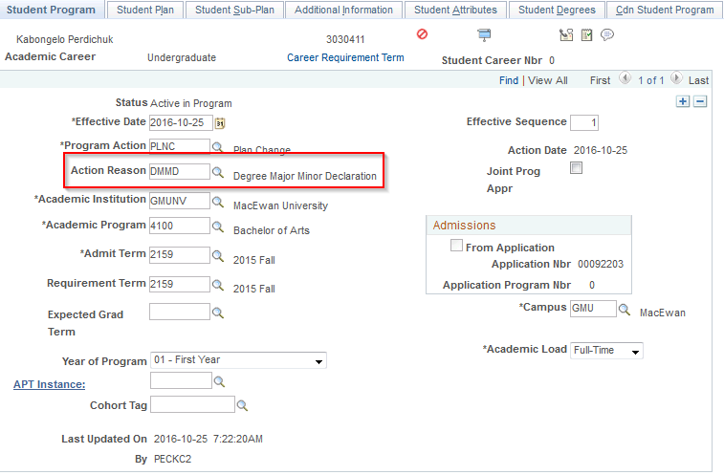
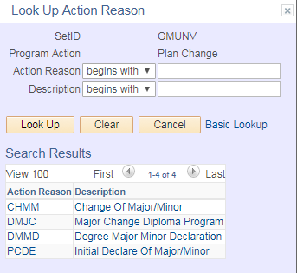
New Program Action Reason
New Program Action Reason
DMMD
Records and Enrollment > Career and Program Information > Student Program/Plan

Slide 21
Behind the Scenes: Auto (3C) Communications
Confirmation of Successful Program Stack Update R10
Major/Minor Deny Letter for Competitive Majors R11
Pending Letter for Competitive Majors R12

Slide 22
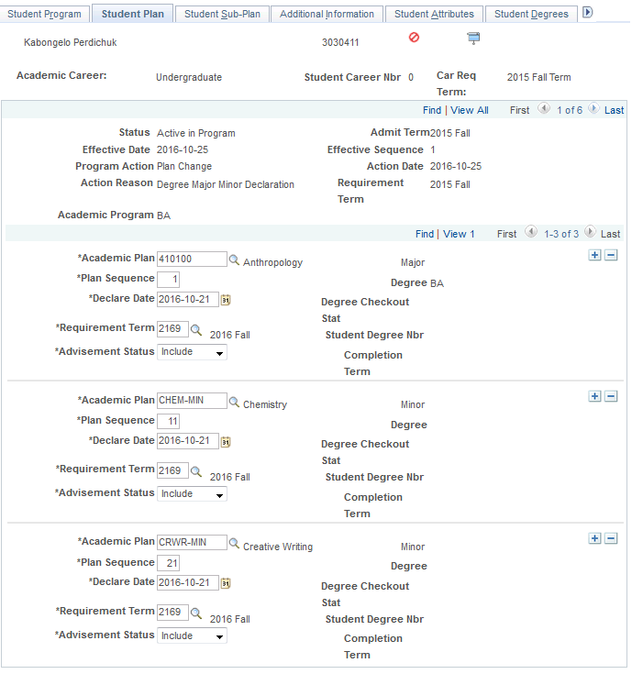
Requirement Term
Requirement Term = Term in which the declaration is submitted. Required for Academic Advisement purposes
Declare Date = Date declaration was submitted
Date | Requirement Term
September 1 – December 31 | Fall 21x9
January 1 – February 15 | Winter 21x1
Records and Enrollment > Career and Program Information > Student Program/Plan

Slide 23
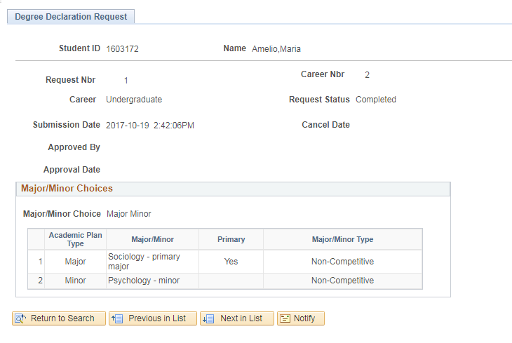
Final Request Status Updated

Slide 24
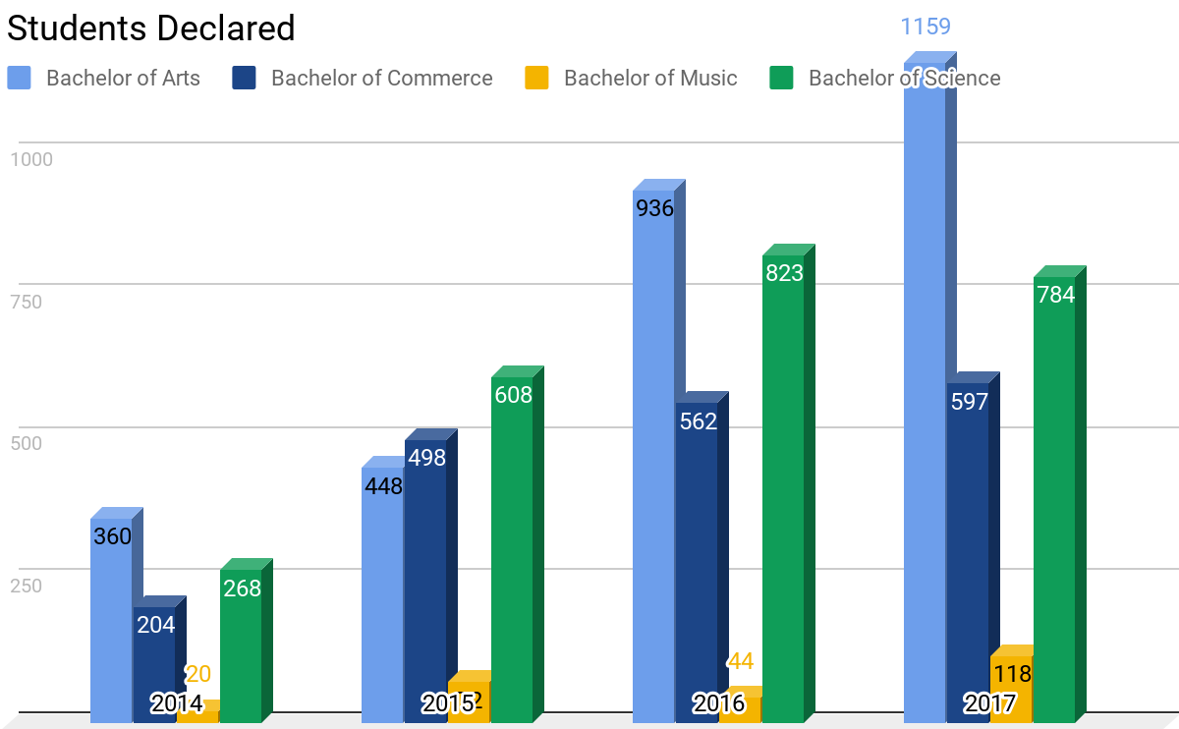

Slide 25
Presenters
Janice de Graaf
Academic Advisor
Faculty of Arts & Science
luij0@macewan.ca
Shawna Jansen
Functional Analyst
Information Systems & Scheduling
jansens@macewan.ca
Thank you!

