Slide 1
A Comprehensive Student Debt Center
MidHEUG 2017
Session Number: 3081 Fri, Oct 13, 2017 (10:20 AM - 11:10 AM)

Slide 2
Your Presenter
Ashley Bergemann
Marquette University
Financial Aid Systems Analyst

Slide 3
Overview
With rising college costs and 1.4 trillion in student loan debt, making sure students are aware of their borrowing and the financial impacts is increasingly important
CFR 685.304 requires schools to inform the student of the average monthly repayment amount and available repayment options based on the borrower’s indebtedness within 30 of the student withdrawing or failing to complete online exit counseling
2015 WI Act 284: Provide accrued debt, interest rates, standard repayment terms, estimated monthly payment, projected amount of interest, and projected total amount of the loans to each student at the beginning of the academic year

Slide 4
Marquette University
PeopleSoft 9.0
PeopleTools 8.55.15
12000+ students
5 Careers

Slide 5
Agenda
Institutional Loans (Truth in Lending Act)
Federal Direct Loans
Setup
Processing
Student Access
Recalculations
Administrator Access
Disclosures
Technical Considerations
Other fun stuff

Slide 6
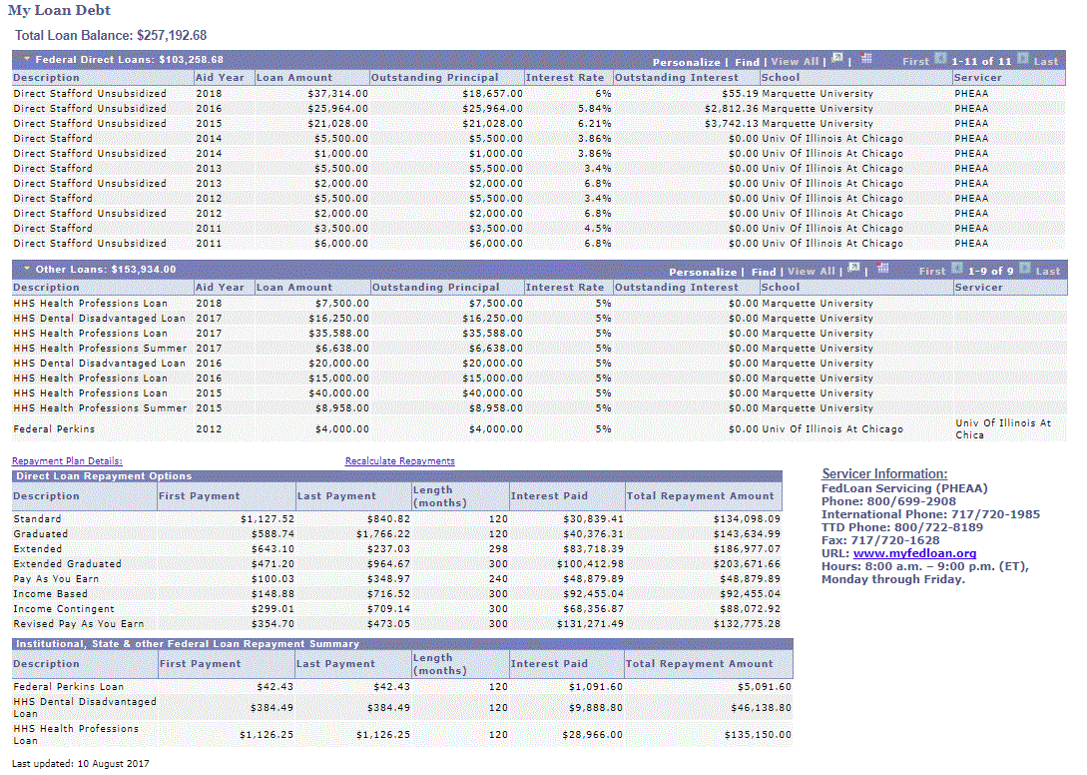
What is it?

Slide 7
Institutional Loans
Truth In Lending Act/TILA
Notes:
Application and Solicitation
Approval
Final – accept
Private education loan means an extension of credit that:
Is not made, insured, or guaranteed under Title IV of the Higher Education Act of 1965 (20 U.S.C. 1070 et seq.);
Is extended to a consumer expressly, in whole or in part, for postsecondary educational expenses, regardless of whether the loan is provided by the educational institution that the student attends;
Does not include open-end credit or any loan that is secured by real property or a dwelling; and
Does not include an extension of credit in which the covered educational institution is the creditor if:
The term of the extension of credit is 90 days or less; or
an interest rate will not be applied to the credit balance and the term of the extension of credit is one year or less, even if the credit is payable in more than four installments

Slide 8
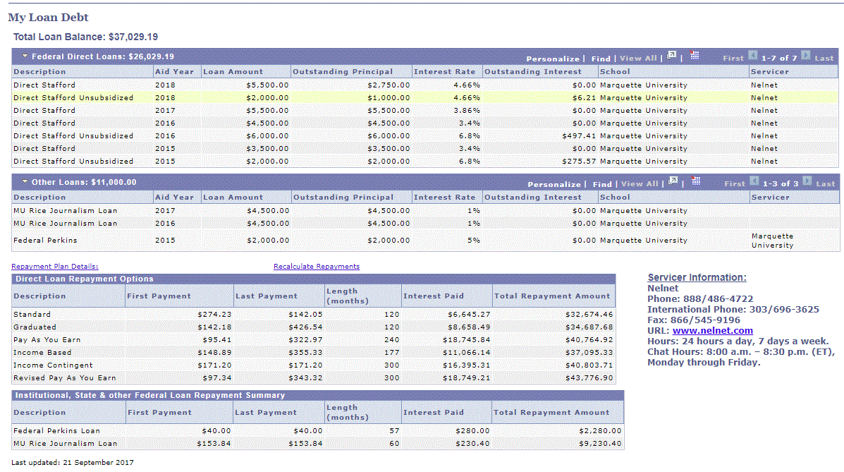

Slide 9
Regulation Z (Truth in Lending)
If you provide a loan that covers educational expenses, you must:
Disclosures must show:
Provide a disclosure at time of application or solicitation – when offered
Provide a disclosure at time of approval
Terms are valid for 30 days
Provide a disclosure when loan is accepted
Give 3 days to cancel
Require a Self-Certification Form
Interest rates
Repayment terms
Fees/penalties
Cost estimates
Eligibility
https://www.consumerfinance.gov/eregulations/1026-46/2013-30108_20150718#1026-46-d

Slide 10
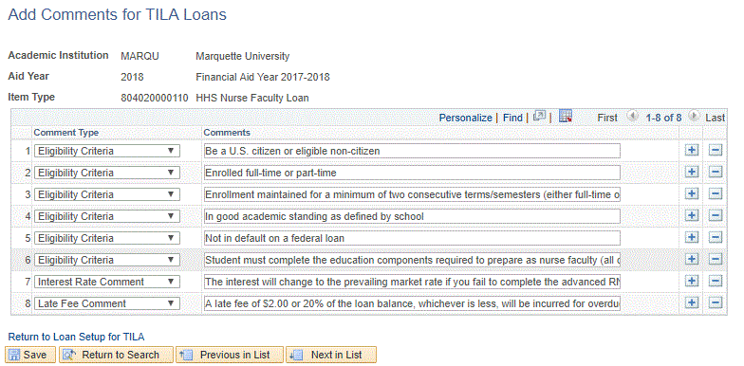
TILA Setup

Slide 11
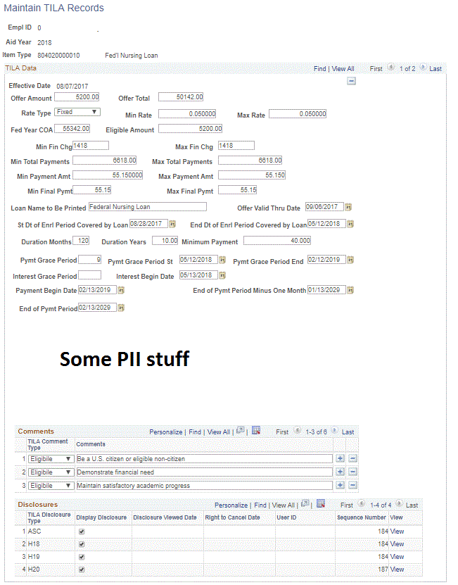

Slide 12
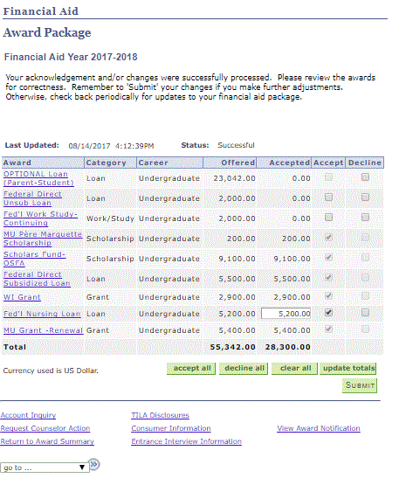
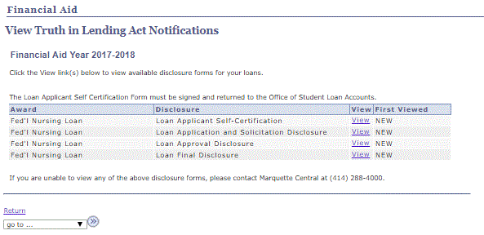
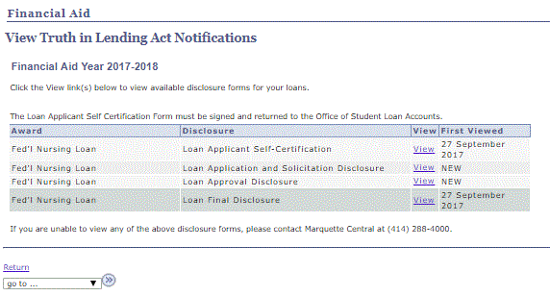
Self–Service Disclosure View

Slide 14
TILA – Continued
SQR runs daily to calculate
Assigns communications
Offer
Checklist assigned for Self-Cert
Acceptance
Checklist assigned for 3-day delay
Any disbursed loans are added together
Repayments calculated on summed loans, which is what appears in the Debt Center
If amounts are revised
Higher
New calculation and disclosures and checklists
Lower
Higher amount disclosures still meet requirements
Maintain page allows changes by TILA coordinator
Disclosures viewable in admin view or student view

Slide 15
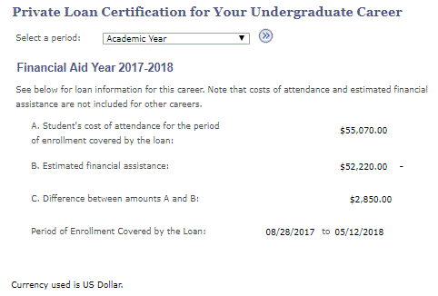
Since we’re talking about TILA – Private Loan Self-cert in Self-Service

Slide 16
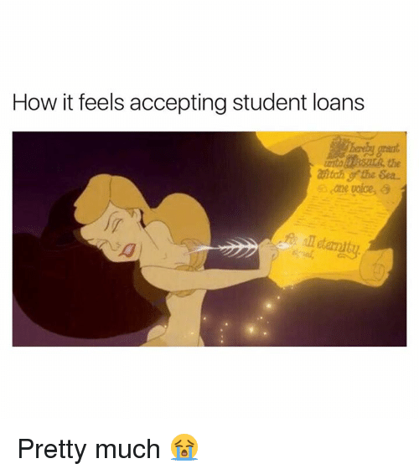

Slide 17
Federal Loans

Slide 18
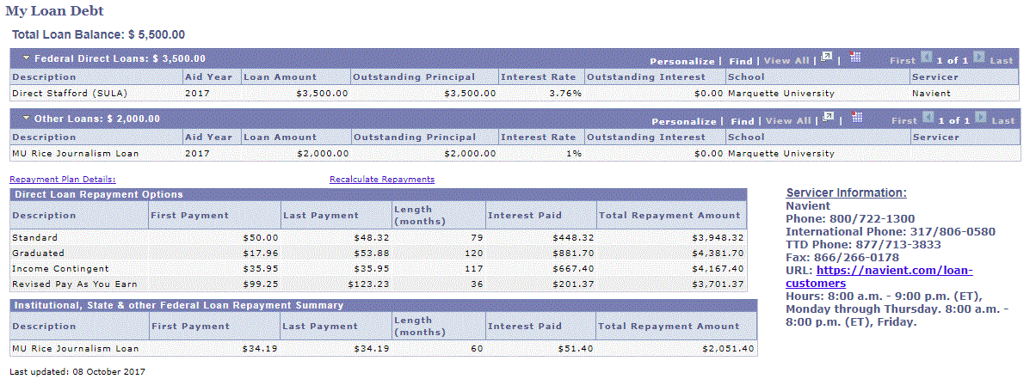

Slide 19
Factors in calculating federal repayment plans
AGI*
Number in family*
Residence*
HHS poverty guidelinesᶧ˚
Income percentage factorᶧ˚
Data files
NSLDS History in PeopleSoft
No outstanding interest included
Interest rate being added this weekend
Only as current as you request it
NSLDS School Portfolio
No interest rate
Only MU data
Only as current as when it was last delivered
Servicer School Portfolio
Only MU data
Multiple files
* Assumed values
ᶧ Value based on assumed values
˚ Annual federal updates

Slide 20
Outstanding interest matters
Why do we care about outstanding interest?
Interest is capitalized when you go into repayment
If you took out a $40,000 PLUS loan in 2015 you would have $9,000 of interest accrued
If you took out a $6,500 Unsub in 2015 you would have $1,000 of interest accrued

Slide 21
General Assumptions and Setup
Assume
1 in Family
Filing Status = Single
State = home address state
AGI = 30,000

Slide 22
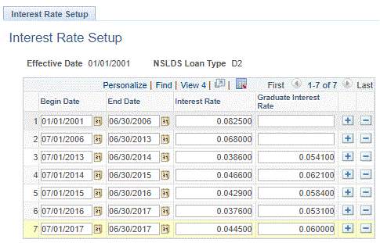
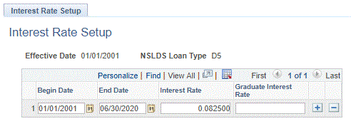
Interest Rate Setup
Default Interest Rates for
NSLDS School Portfolio
NSLDS PeopleSoft Tables (FAHEXTOP)
October 14th
Sometimes they are missing from servicer files
Consolidation max is 8.25%

Slide 23
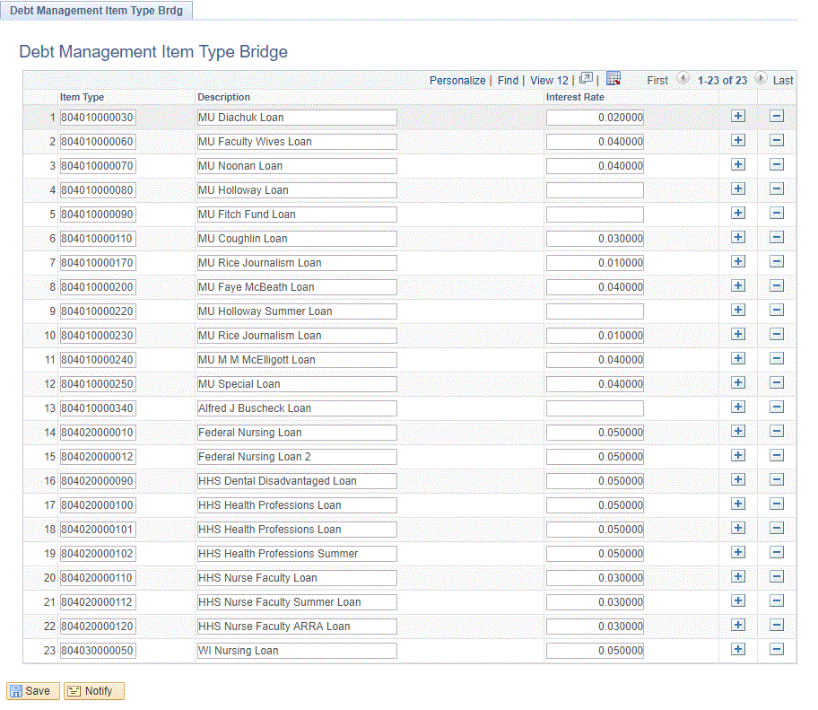
Interest Rates Continued
Interest Rates for other non-federal loans
Aren’t these in TILA setup
I’m not setting up loans we don’t give anymore!

Slide 24
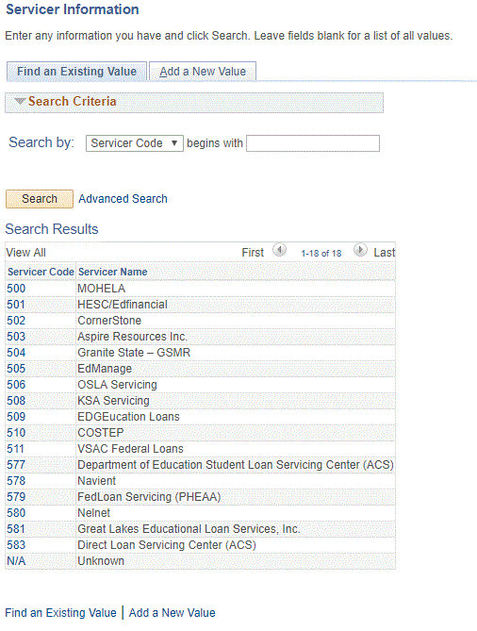
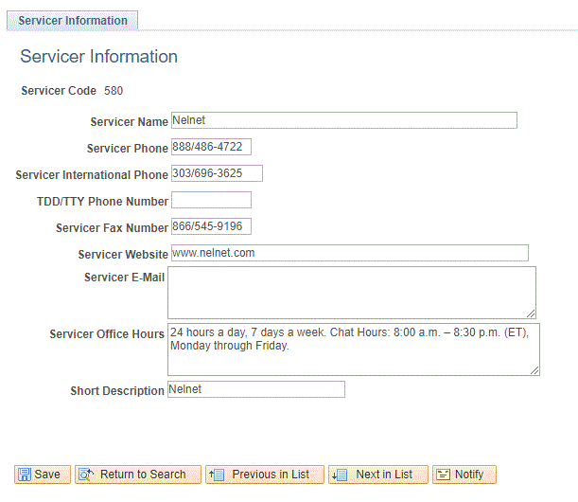
Servicer Setup

Slide 25
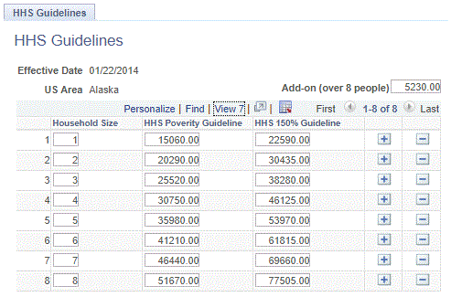
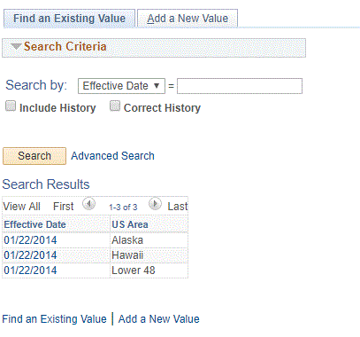
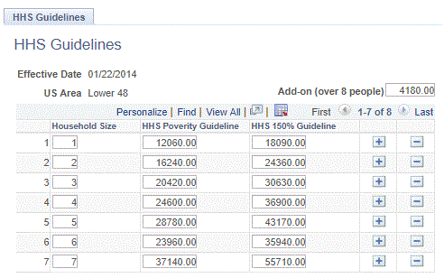
HHS Guidelines

Slide 26
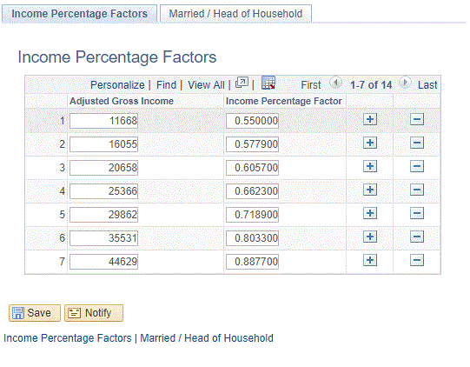
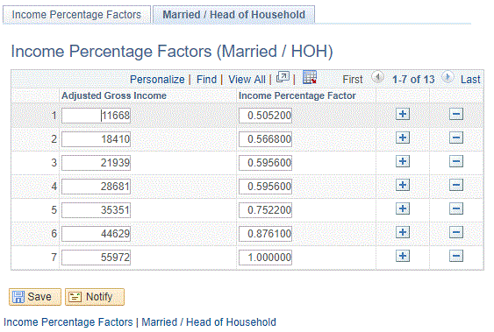
Income Percentage Factors

Slide 27
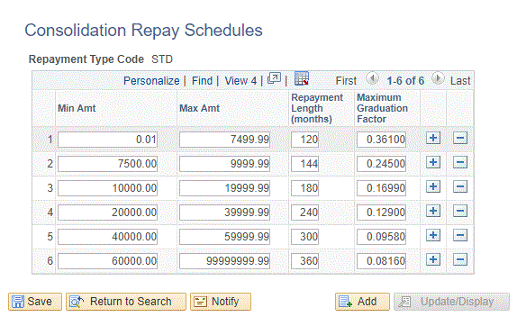
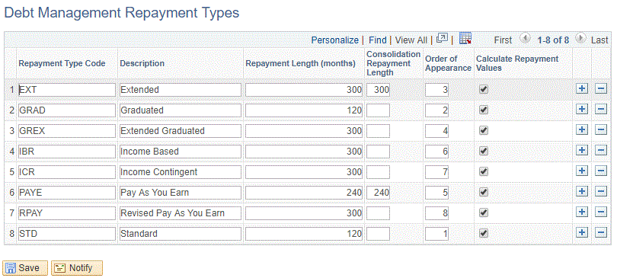
Repayment Setup/Consolidation
Consolidation loans have different rules
Repayment types calculated can be controlled

Slide 28
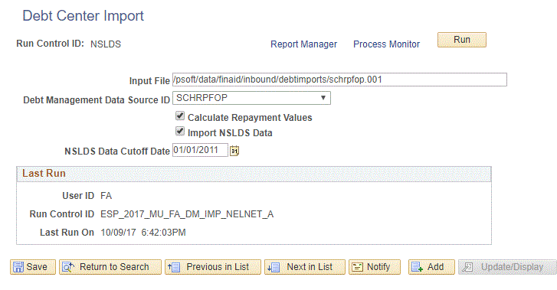
Data Sources/Loading the data
Files are named the same each download so no need to change run control
Calculate Repayment Values is checked on the last data load
This is what makes the calculations happen
Import NSLDS Data
Imports data from PeopleSoft NSLDS tables
Cutoff date was needed because past data was very messy
And anything not updated since 2011 shouldn’t really need to be used anyway
Each servicer should follow the PESC 2.0 format
Allows for variation
Interest rates
Date layout
Headers
Self-Service shows the last time data was updated based on the data source. If more than one was used, the minimum date is used
Notes:
A view is created that shows what data we’ll use. If the student has data from a servicer, that is used, if not, data from the Federal School Loan Portfolio will. Local NSLDS is always included.

Slide 29
Student Self-Service

Slide 30
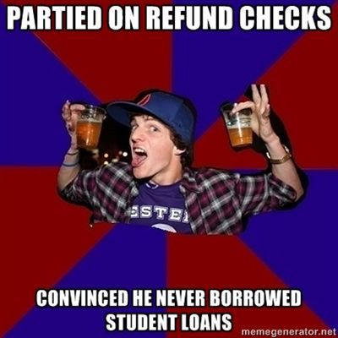

Slide 31
The student experience

Slide 32
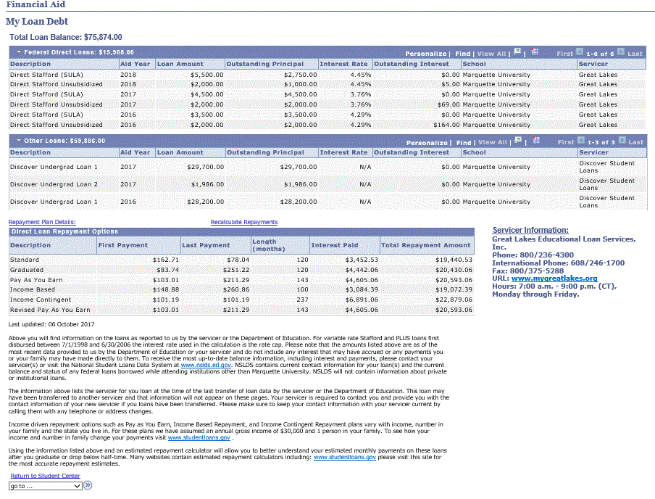
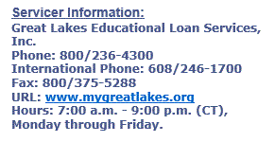

Slide 33
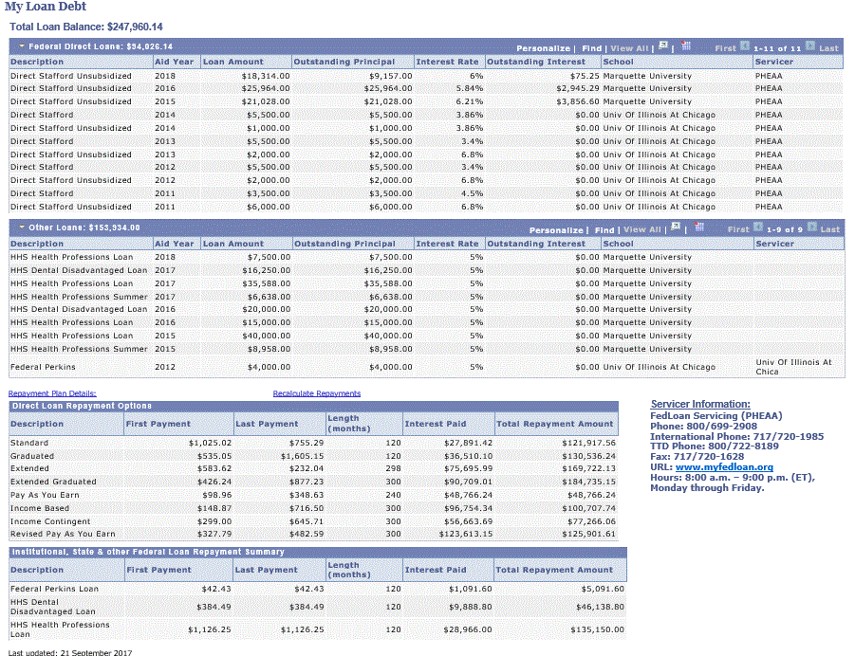

Slide 34
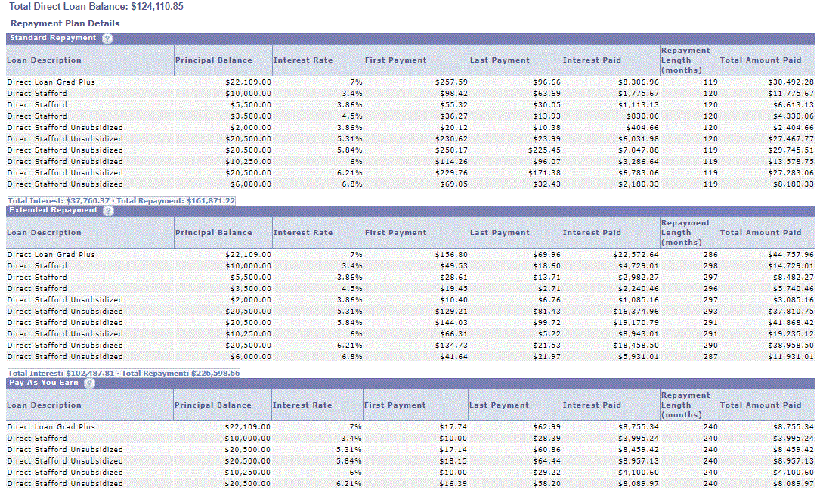
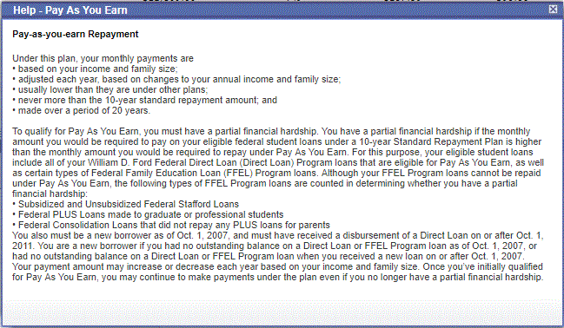

Slide 35
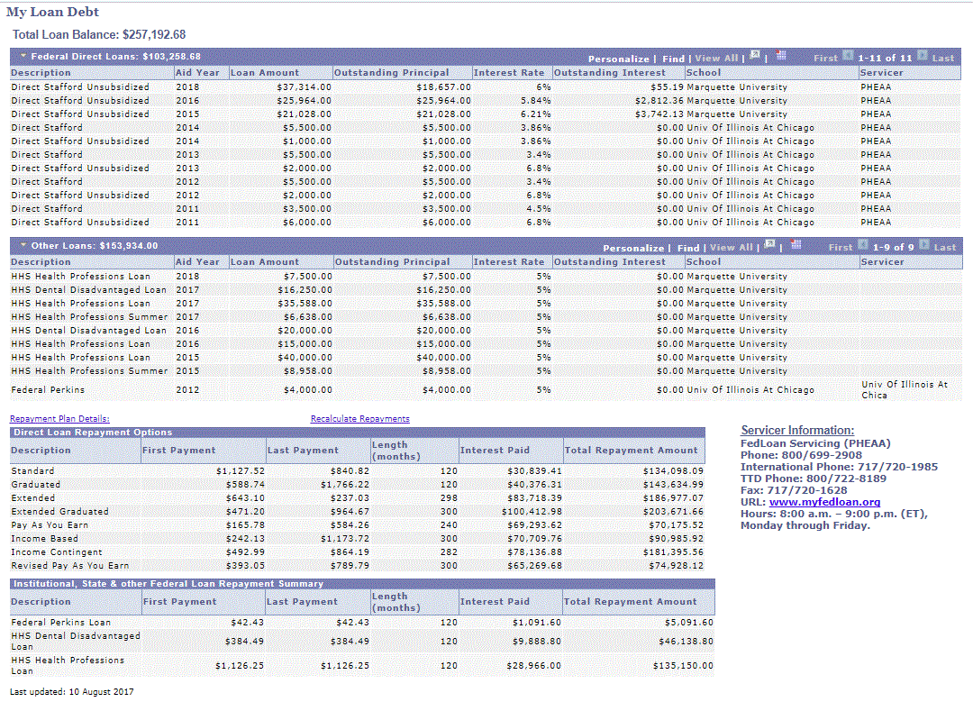

Slide 36
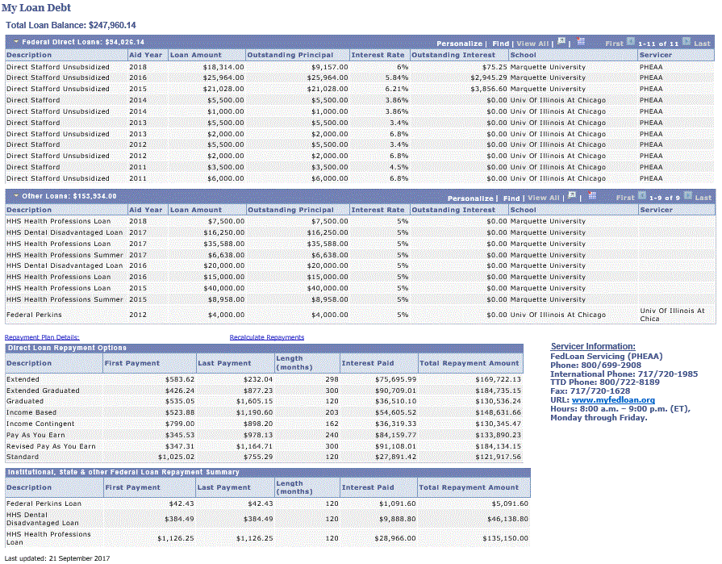
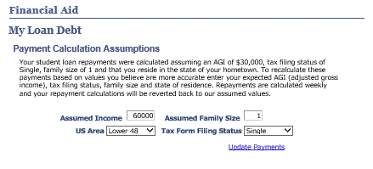
Recalculations

Slide 37
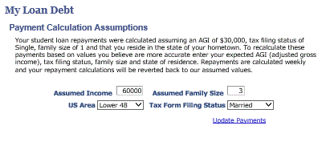

Slide 38
original
60,000
Married

Slide 39
Administrator Access

Slide 40
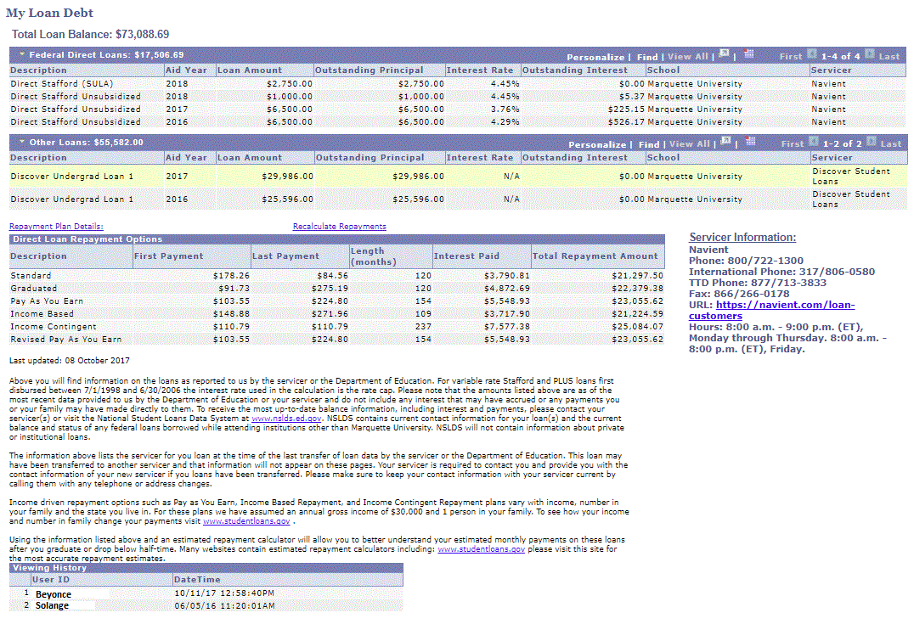

Slide 41
Hide access
Turns of link in self-service for student
If it is broken for someone
If someone is annoying
Link is also off when process is running

Slide 42
Disclosures

Slide 43
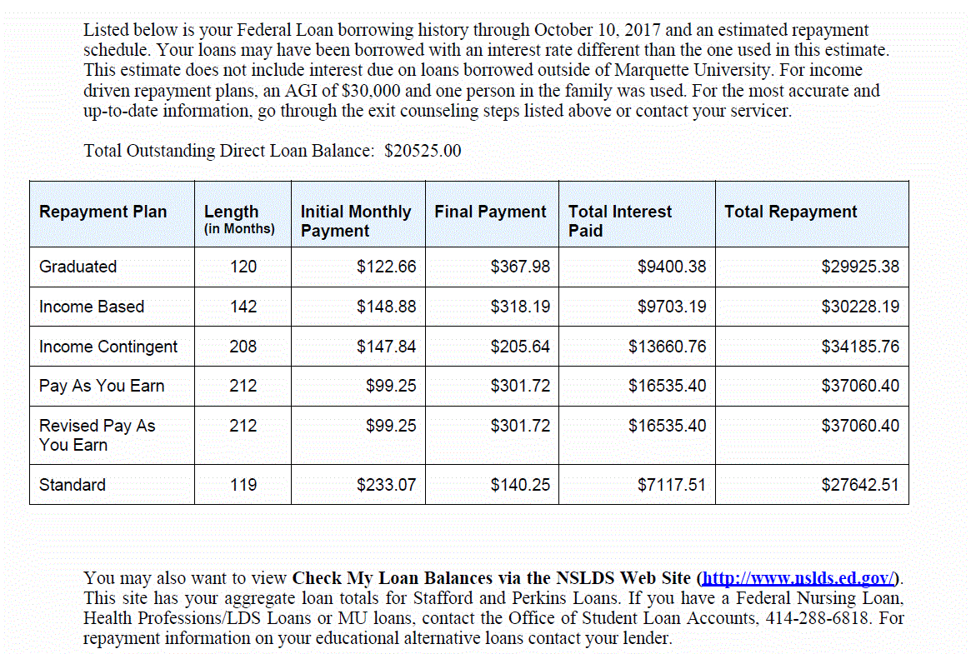
Exit Counseling
Inform the student borrower of the average anticipated monthly repayment amount based on the student borrower's indebtedness
Review for the student borrower available repayment plan options including the standard repayment, extended repayment, graduated repayment, income-contingent repayment, and income-based repayment plans, including a description of the different features of each plan and sample information showing the average anticipated monthly payments, and the difference in interest paid and total payments under each plan

Slide 44
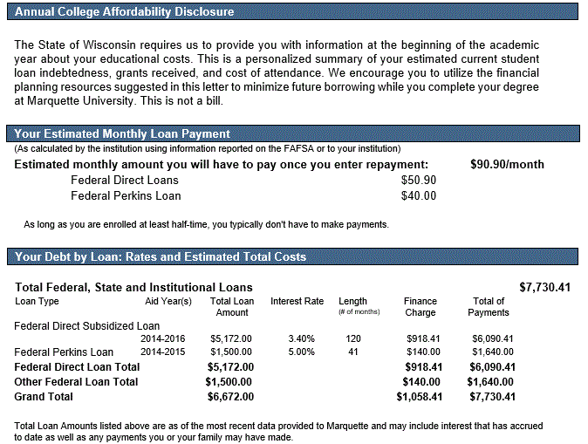
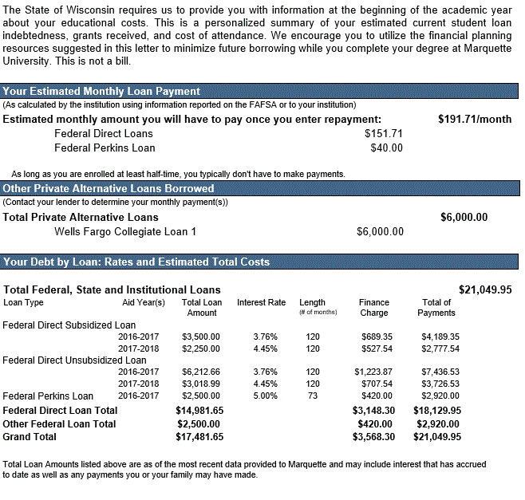
WI Act 284 Disclosure

Slide 45
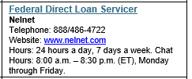
WI Act 284 Disclosure

Slide 46
WI Act 284 Disclosure

Slide 48
SELECT A.EMPLID
, A.NSLDS_AGGR_SUBSDZD
, A.SFA_NSLDS_LN_ELIG
, A.SFA_LIFETIME_ELIG
, D.SSR_PROG_LENGTH
, D.SSR_PROG_LENGTH*1.5
FROM PS_NSLDS_FAT_AGGR A
, PS_STUDENT_AID B
, PS_MU_FA_MINFAT_VW C
, PS_ACAD_PLAN_TBL D
WHERE ( A.EFFDT =
(SELECT MAX(A_ED.EFFDT) FROM PS_NSLDS_FAT_AGGR A_ED
WHERE A.EMPLID = A_ED.EMPLID
AND A_ED.EFFDT <= SYSDATE)
AND A.EFFSEQ =
(SELECT MAX(A_ES.EFFSEQ) FROM PS_NSLDS_FAT_AGGR A_ES
WHERE A.EMPLID = A_ES.EMPLID
AND A.EFFDT = A_ES.EFFDT)
AND A.EMPLID = B.EMPLID
AND B.EMPLID = :1
AND B.AID_YEAR = :2
AND A.EMPLID = C.EMPLID
AND C.EFF_STATUS = 'A'
AND C.AID_YEAR = B.AID_YEAR
AND C.INSTITUTION = D.INSTITUTION
AND D.ACAD_PLAN = C.ACAD_PLAN
AND D.EFFDT =
(SELECT MAX(D_ED.EFFDT) FROM PS_ACAD_PLAN_TBL D_ED
WHERE D.INSTITUTION = D_ED.INSTITUTION
AND D.ACAD_PLAN = D_ED.ACAD_PLAN
AND D_ED.EFFDT <= SYSDATE))

Slide 49
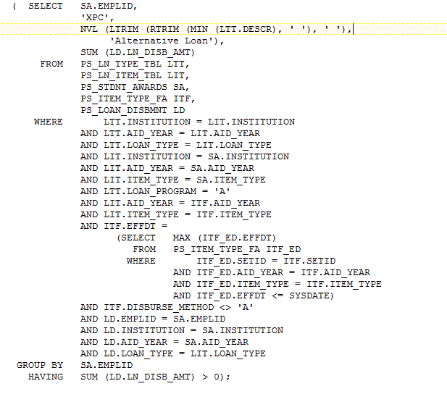
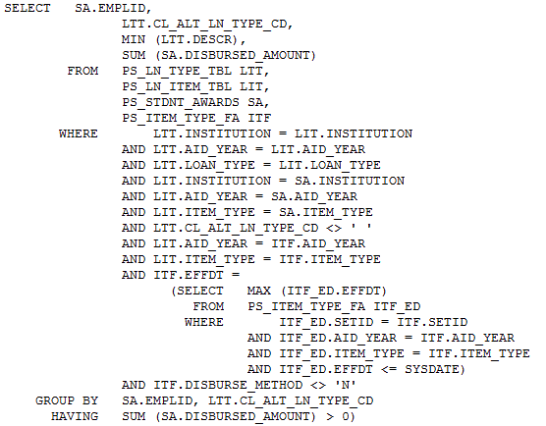
Group Alt Loans Together
Group by PS_LN_TYPE_TBL.CL_ALT_LN_TYPE_CD
Notes:
SELECT SA.EMPLID,
LTT.CL_ALT_LN_TYPE_CD,
MIN (LTT.DESCR),
SUM (SA.DISBURSED_AMOUNT)
FROM PS_LN_TYPE_TBL LTT,
PS_LN_ITEM_TBL LIT,
PS_STDNT_AWARDS SA,
PS_ITEM_TYPE_FA ITF
WHERE LTT.INSTITUTION = LIT.INSTITUTION
AND LTT.AID_YEAR = LIT.AID_YEAR
AND LTT.LOAN_TYPE = LIT.LOAN_TYPE
AND LIT.INSTITUTION = SA.INSTITUTION
AND LIT.AID_YEAR = SA.AID_YEAR
AND LIT.ITEM_TYPE = SA.ITEM_TYPE
AND LTT.CL_ALT_LN_TYPE_CD <> ' '
AND LIT.AID_YEAR = ITF.AID_YEAR
AND LIT.ITEM_TYPE = ITF.ITEM_TYPE
AND ITF.EFFDT =
(SELECT MAX (ITF_ED.EFFDT)
FROM PS_ITEM_TYPE_FA ITF_ED
WHERE ITF_ED.SETID = ITF.SETID
AND ITF_ED.AID_YEAR = ITF.AID_YEAR
AND ITF_ED.ITEM_TYPE = ITF.ITEM_TYPE
AND ITF_ED.EFFDT <= SYSDATE)
AND ITF.DISBURSE_METHOD <> 'N'
GROUP BY SA.EMPLID, LTT.CL_ALT_LN_TYPE_CD
HAVING SUM (SA.DISBURSED_AMOUNT) > 0)
UNION
( SELECT SA.EMPLID,
'XPC',
NVL (LTRIM (RTRIM (MIN (LTT.DESCR), ' '), ' '),
'Alternative Loan'),
SUM (LD.LN_DISB_AMT)
FROM PS_LN_TYPE_TBL LTT,
PS_LN_ITEM_TBL LIT,
PS_STDNT_AWARDS SA,
PS_ITEM_TYPE_FA ITF,
PS_LOAN_DISBMNT LD
WHERE LTT.INSTITUTION = LIT.INSTITUTION
AND LTT.AID_YEAR = LIT.AID_YEAR
AND LTT.LOAN_TYPE = LIT.LOAN_TYPE
AND LIT.INSTITUTION = SA.INSTITUTION
AND LIT.AID_YEAR = SA.AID_YEAR
AND LIT.ITEM_TYPE = SA.ITEM_TYPE
AND LTT.LOAN_PROGRAM = 'A'
AND LIT.AID_YEAR = ITF.AID_YEAR
AND LIT.ITEM_TYPE = ITF.ITEM_TYPE
AND ITF.EFFDT =
(SELECT MAX (ITF_ED.EFFDT)
FROM PS_ITEM_TYPE_FA ITF_ED
WHERE ITF_ED.SETID = ITF.SETID
AND ITF_ED.AID_YEAR = ITF.AID_YEAR
AND ITF_ED.ITEM_TYPE = ITF.ITEM_TYPE
AND ITF_ED.EFFDT <= SYSDATE)
AND ITF.DISBURSE_METHOD <> 'A'
AND LD.EMPLID = SA.EMPLID
AND LD.INSTITUTION = SA.INSTITUTION
AND LD.AID_YEAR = SA.AID_YEAR
AND LD.LOAN_TYPE = LIT.LOAN_TYPE
GROUP BY SA.EMPLID
HAVING SUM (LD.LN_DISB_AMT) > 0);

Slide 50
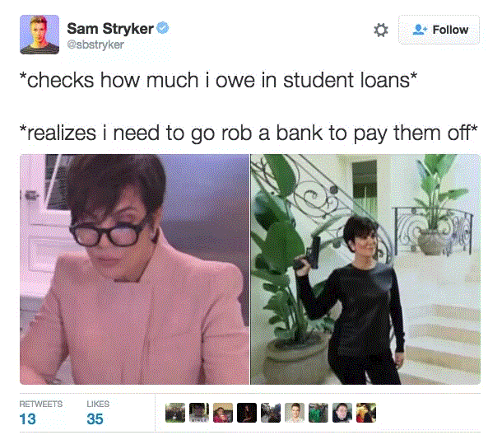

Slide 51
Technical Considerations

Slide 52
Technical Considerations
Application Engine is used to import Servicer files and normalize data
Populates a work table which then performs the calculations for all plans
Removes repayment plans that the student is not eligible for
Self-service pages are based off of views

Slide 53
Fun facts

Slide 54
Usage
TILA – 2012
Debt Center - September 2014
4,078/5,800 current students have logged in at least once
6,680 total students have logged in at least once
One student has logged in 230+ times
Annual notice sent in September/October

Slide 55
Future
Truth in Lending at acceptance of a loan
Use NSLDS interest rate
What happens if calculator
Allow students to add future borrowing into calculations

Slide 56
Questions?

Slide 57
Contact Information
Ashley Bergemann
Marquette University
Phone: 414-288-4774
Email: Ashley.bergemann@Marquette.edu

Slide 58
This presentation are available for download from the Conference site at https://www.heug.org/page/us-alliance-conference-files Note: Sessions from previous HEUG conferences are also available.

