Slide 1
Implementation of Corporate Travel management solution with Oracle integration in UJ
SESSION 11013
DATE Fri, Jul 05, 2019 (12:30 PM - 01:15 )

Slide 2
presenters
Leonardo Kleinhans
Venugopal Mettela
System Specialist
University Of Johannesburg
leonardok@uj.ac.za
Oracle EBS Integration Specialist
Tata Consultancy Services
venugopalm@uj.ac.za
Mr. Leonardo Kleinhans has more than 24 years experience in IT of which 24 years in Higher Education. He has held the position of System Administrator and later Java Developer at Unisa for 14 years. Furthermore, he has worked at the University of Johannesburg (UJ) for 11 years and is currently employed at UJ as the System Specialist that supports the Oracle Procure to Pay Modules, Oracle BI and all third party software used in the Finance Expenditure Division.
Mr. Venugopal Mettela has more than 14 years of experience Oracle Application EBS. Holds the position of Oracle apps Techno functional Consultant and Integration specialist in Finance and Supply chain Modules and Oracle Business Intelligence(BI). Currently working as Oracle EBS support consultant for supply chain and Finance modules at University of Johannesburg(UJ).

Slide 3
University of Johannesburg
An International University of Choice Anchored in Africa, dynamically Shaping The Future.

Slide 4
Agenda
Current Modules and Usage
UJ Travel Background
Business Challenges
Solution and Approach
Benefits
Conclusion

Slide 5
ORGANIZATION & ORACLE
UJ has significant footprint in Oracle technologies. Most of its Data base, ERP & BI systems are on Oracle.

Slide 6
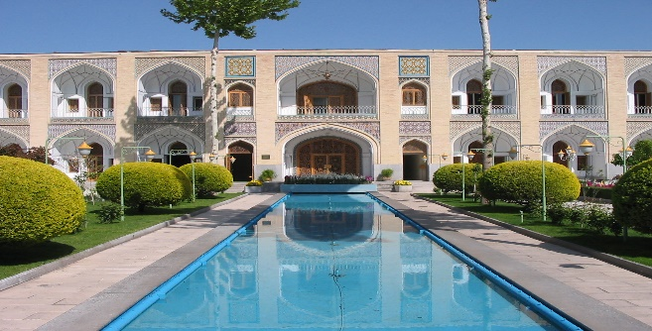
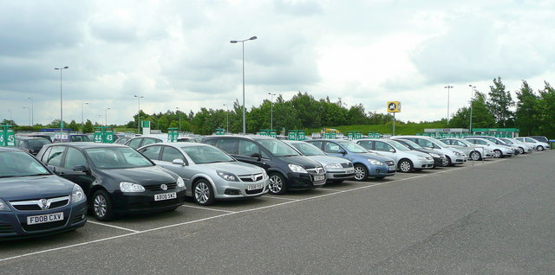
Online Travel Booking Tool– Project
Summary
Operational Intelligence - Executive Summary
Project Background
UJ has four travel management companies (TMC’s) which are currently used to provide quotations for travel. The situation is, however that we do not have an interface between the TMC’s and our ERP system so the resulting in delayed accounting and budget control
Objectives:-
This led us to look at an online booking tool which will interface immediately with our ERP and at the same time give visibility to our users of all flights and associated costs. Travel co-ordinators can then select their flights, accommodation and car hire and obtain approval from necessary line management
Highlights:-
Timely availability of key information for effective decision
Executive Reporting
Reduction in manual effort in Reporting
Availability of a single reporting platform
Faster Go To Market and quick turnaround time
Data Self service platform enabling users

Slide 7
Business Challenges
No End to End overview of Travel Process
Approval Process is manually/time consuming
No visibility of available travel budget across cost centre
Reporting Challenges
Insufficient Funds during payments
4 Travel Companies which provide quotations for travel
No interfaces between the TMC’s and ERP System
Search for an Online Tool that can Interface with our ERP
Allow Travel coordinators to book flights and submit for approval
We required to have a global distribution system (GDS)

Slide 8
Current Travel Process

Slide 9
New business Process Flow

Slide 10
Benefits of the Amadeus Online Travel Booking Tool
A Streamlined Booking Process with controlled Travel Spending
Travel Co-ordinators can select flights, accommodation and car hire
Travel Policy compliance
Travellers have better travel choices
Quick and easy management of travellers
A smarter way to deal with the high volume of travel
Time saving and reduction in travel cost and expenses

Slide 11
Lessons Learned
The project team ( business , functional, technical teams) need to be based on premises.
Dedicated User availability and commitment
Abide by timelines.
No changes to business processes during testing.
Manage scope creep/ risk and other issues timely and effective.
Superuser testing before UAT Testing.

Slide 12
Oracle Login

Slide 13
Login to travel system
User Login to

Slide 14
Search for flights

Slide 15
Select your flights

Slide 16
Search for hotel

Slide 17
Select hotel from list

Slide 18
Hotel details

Slide 19
Book a car

Slide 20
presenters
Leonardo Kleinhans
Venugopal Mettela
System Specialist
University of Johannesburg
leonardok@uj.ac.za
Tata Consultancy Services
Tata Consultancy Services
venugopalm@uj.ac.za
all Alliance presentations will be available for download from the Conference Site

Slide 21
THANK YOU!

