Slide 1
NO MORE ANALYSIS PARALYSIS! Concordia university’s online needs analysis process for needs-based awards
SESSION #5035
Nov 6, 2017

Slide 2
presenters
Alexander Lee
Business Analyst
Concordia University
alexander.lee@concordia.ca

Slide 3
Concordia University Montréal, Qc
Sir George Williams Campus
Enrolment Count* : 47 752
Undergraduate: 35 486
Graduate: 8 571
Continuing Education: 2 696
UFTE* : 28 757
Faculty & Staff : 6051
Two Campuses
*2016-2017 numbers

Slide 4
Campus Solutions 9.0 (Live January 2015) Campus Solutions 9.2 & Peopletools 8.55 (targeted go-live April 1st 2018)
LOY – Loyola Campus
Loyola Campus - NDG
Current Production Environment
CS 9.0 Bundle 40
PeopleTools 8.54.10
Oracle RDBMS 12c

Slide 5
I feel the need – the need for needs analysis

Slide 6
I feel the need – the need for need analysis
THE PROBLEM Why do we need this thing anyway?
THE SOLUTION How would we use this information?
THE APPLICATION What would a student see?
THE ADMINISTRATOR How do we work with the collected information?
THE NEXT STEPS What is still to be done?

Slide 7
We like to eat here
Burgers … mmm…

Slide 8
SECTION 1: the problem
Needs analysis: /ˈni:dz əˌnæləsɪs/
the process of defining the needs of a customer, business or organization before providing them with a service
https://www.macmillandictionary.com/dictionary/british/needs-analysis
Why do we need this thing anyway?

Slide 9
the PROBLEM
Why do we need a needs analysis process?
Eligibility for applications
Ranking and assessment by committee

Slide 10
THE PROBLEM
What information do we need to perform needs analysis?
Student’s financial information – similar to what is provided for US Aid Students on the ISIR

Slide 11
The Problem
Who has the information required?
A: THE STUDENT OF COURSE!

Slide 12
This place is great too
So much goodness at Concordia

Slide 13
SECTION 2: the solution
How do we use this information?

Slide 14
THE SOLUTION
How do we collect the information?
Application on self-service
Supporting documents required for declared income/expenses
Notification using 3Cs

Slide 15
THE SOLUTION
Basic assumptions
Single needs calculation per aid year
All students must prove need prior to applying for needs-based awards
Students on government aid have already proven need
Student can update their application

Slide 16
The Solution
What variables should we use to calculate a students need?

Slide 17
the solution
Needs Calculation
Expenses
 | (Weekly Allowances x FA Number of weeks)
+ | Cost of Attendance (Budgeted Tuition Calculation)
+ | Other declared expenses
= | Total Calculated Expenses
Income
 | Declared Income from all sources
+ | Financial Support from family
+ | Other Income
= | Total Calculated Income
Need
 | Total Calculated Expenses
- | Total Calculated Income
- | Adjustment (For situations not covered by standard algorithm)
= | Financial Need
Need calculation
formula
Notes:
Calculation formulas -
- Use of budget items to calculate generic cost of attendance
- Income (Including Bank Balances)
Support from outside sources
- Expenses
Weekly allowances
Declared expenses
- Other non-calculated items (for holistic review)
Parental and Spousal income (Parents if student is single, never married)
Number of siblings

Slide 18
When you want something different
And near to Concordia too!

Slide 19
SECTION 3: THE application
What would a student see?

Slide 20
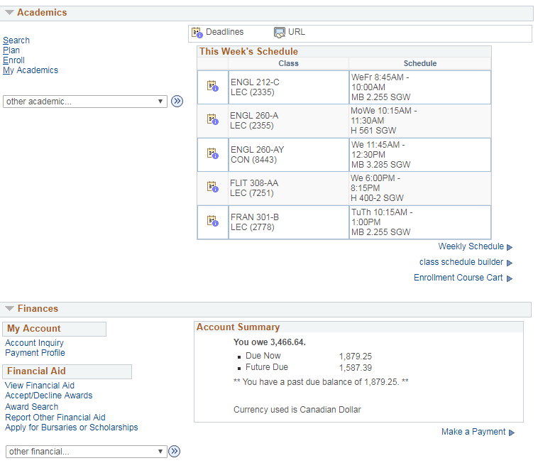
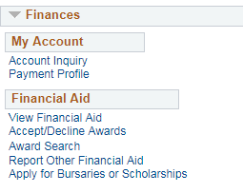
The application
Step 1: Student self service

Slide 21
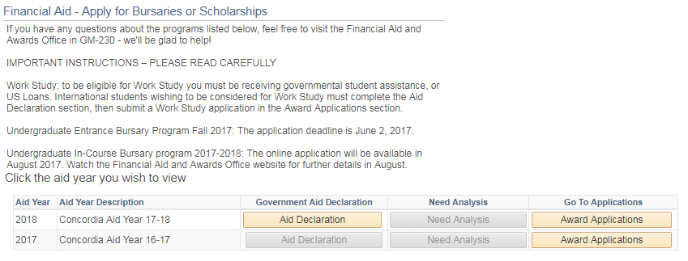
The application
Step 2: First visit
Notes:
Student’s first visit to the page for this aid year
Aid declaration is required to determine whether the student actually requires a full need analysis.
They click on Aid declaration…

Slide 22
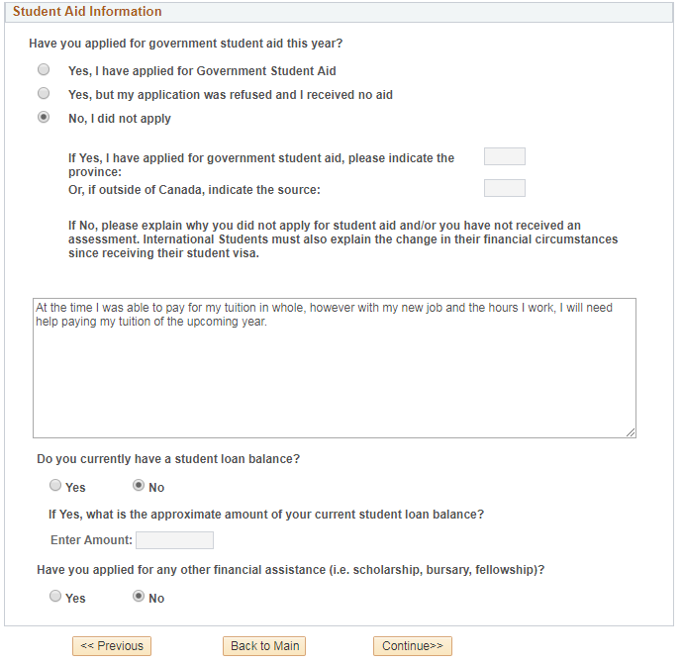
The application
Step 3: Aid declaration
Notes:
… and are taken to the “Aid Declaration” screen where they can tell us whether they have previously applied for government student aid or not.
If yes, they will tell us which province they applied to and whether they have a current balance or not.
If they have not applied we require a brief statement from them explaining why they did not apply.
Once the student submits this we use this information to determine the behaviour of the next screen.

Slide 23
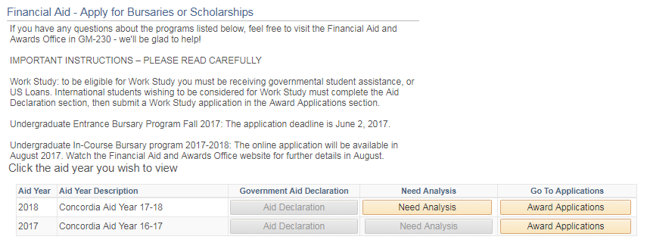
The Application
Step 4: After aid declaration
Notes:
The student has submitted their Aid Declaration and now we have come back to this main screen.
In this case the student has told us they did not apply for Gov’t aid and the Need Analysis button is now enabled.

Slide 24
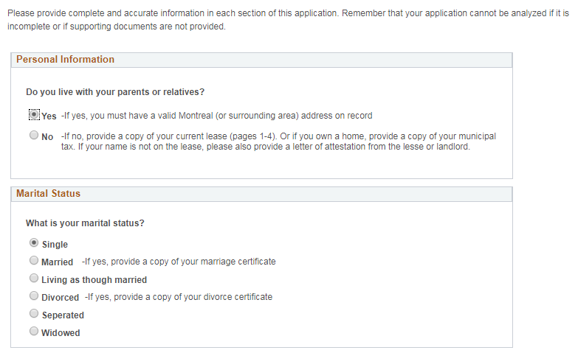
The Application
Step 4: Personal info
Notes:
Do you live with your parents or relatives?
-If no, provide a copy of your current lease (pages 1-4). Or if you own a home, provide a copy of your municipal tax. If your name is not on the lease, please also provide a letter of attestation from the lesse or landlord.
If you do not live with your parents/relatives, specify:
Do you share a residence with roommates?
If yes, how many people (Not including you) do you share the residence with?
What is your marital status?
Single
Married
Living as though married
Other
How many dependent children do you have?

Slide 25
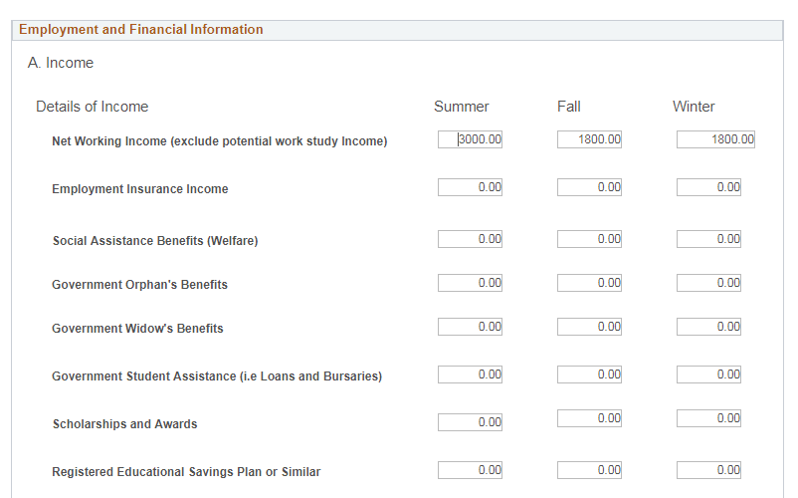
The application
Step 5: Income
Notes:
Income collected based on our Aid Year (Summer, Fall, Winter)
Net Working Income (exclude potential work study Income)
Employment Insurance Income
Social Assistance Benefits (Welfare)
Government Orphan's Benefits
Government Widow's Benefits
Government Student Assistance (i.e Loans and Bursaries)
Scholarships and Awards
Registered Educational Savings Plan or Similar
Financial Support (Including Payment of Tuition Fees, Books and Rent) From:
Parents
Spouse
Other Family Member (Specify)
Non-Family Member (Specify)
Other Income:
Alimony/Child Support Received from Former Spouse
Employment Training Allowances
Government Family Allowance
Investment Income (Gross Capital Gains, Interest Income,
Dividends, etc.)
Other Income Including Savings (Specify):

Slide 26
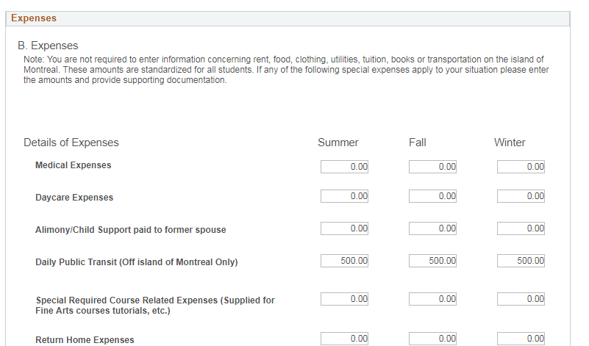
The Application
Step 6: Expenses
Notes:
Expenses collected based on Aid Year (Summer, Fall, Winter)
Medical Expenses
Daycare Expenses
Alimony/Child Support paid to former spouse
Daily Public Transit (Off island of Montreal Only)
Special Required Course Related Expenses (Supplied for
Fine Arts courses tutorials, etc.)
Return Home Expenses
Computer Expenses (One time Purchase of a new computer
for the duration of your studies)
Dental Insurance Payments
Quebec Acceptance Certificate
Entry Visa
Work Permit
Graduate Application Fees
Home Insurance Expenses
Quebec Government Computer Loan - Interest Only
Payment toward your Child's RESP or similar

Slide 27
The application
The remaining sections are not used in the needs assessment calculation but are used as part of a holistic approach by the award committees.
Holistic /həʊˈlɪstɪk/
thinking about the whole of something, and not just dealing with particular aspects
https://www.macmillandictionary.com/dictionary/british/holistic
Notes:
We do not use the data collected in the next two screens as part of the needs calculation but they are used as part of the committee review materials in their award selection process.

Slide 28
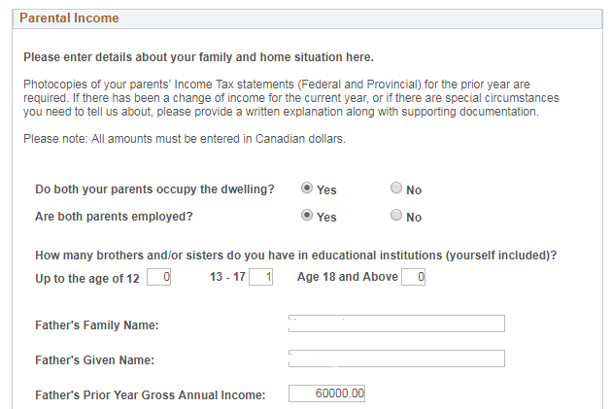
The Application
Section 7a: Parental income (if student is single, no children)
Notes:
Please enter details about your family and home situation here.
Photocopies of your parents’ Income Tax statements (Federal and Provincial) for the prior year are required. If there has been a change of income for the current year, or if there are special circumstances you need to tell us about, please provide a written explanation along with supporting documentation. Please note: All amounts must be entered in Canadian dollars.
Yes
No
Do both your parents occupy the dwelling?
Yes
No
Are both parents employed?
How many brothers and/or sisters do you have in educational institutions (yourself included)?
Father's Prior Year Gross Annual Income:
Mother's Prior Year Gross Annual Income:

Slide 29
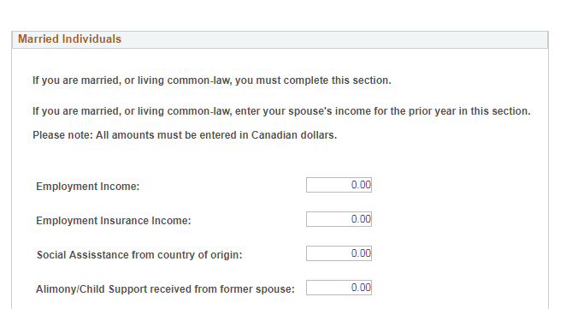
The application
Section 7b: Married individuals (if student is married)
Notes:
If you are married, or living common-law, you must complete this section.
If you are married, or living common-law, enter your spouse's income for the prior year in this section. Please note: All amounts must be entered in Canadian dollars.
Employment Income:
Employment Insurance Income:
Social Assisstance from country of origin:
Alimony/Child Support received from former spouse:
Student Loan/Bursaries:
Scholarship and/or fellowship:
Intrest on Investment:
Other:

Slide 30
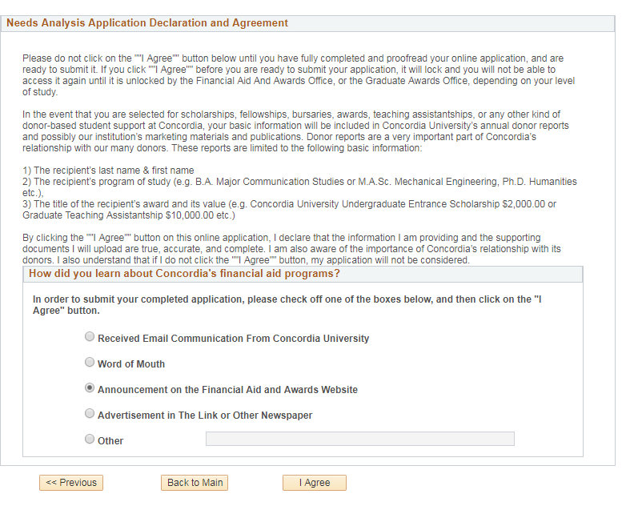
The application
Section 8: Declaration and agreement
Notes:
By clicking the ""I Agree"" button on this online application, I declare that the information I am providing and the supporting documents I will upload are true, accurate, and complete. I am also aware of the importance of Concordia’s relationship with its donors. I also understand that if I do not click the ""I Agree"" button, my application will not be considered.

Slide 31
The application
Section 9: After need declaration

Slide 32
The Application
Section 10: Award application selection
Award applications covered in session 34576 from Alliance ‘15
https://www.heug.org/p/do/sd/topic=933&sid=18698

Slide 33
Whoa! Another restaurant?
This is a good one!

Slide 34
SECTION 4: the administrator
How do we work with the collected information?

Slide 35
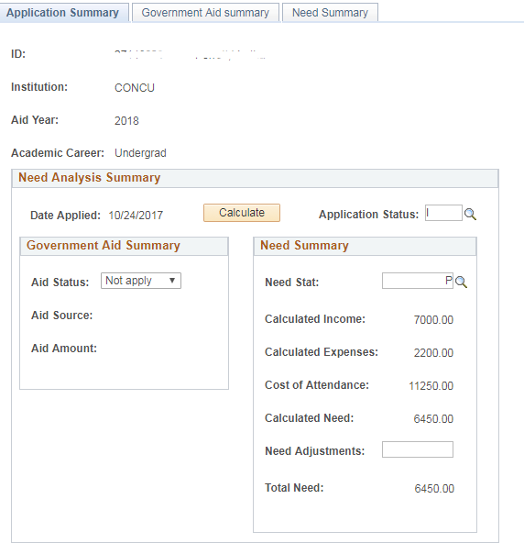
The Adminstrator
Application Summary

Slide 36
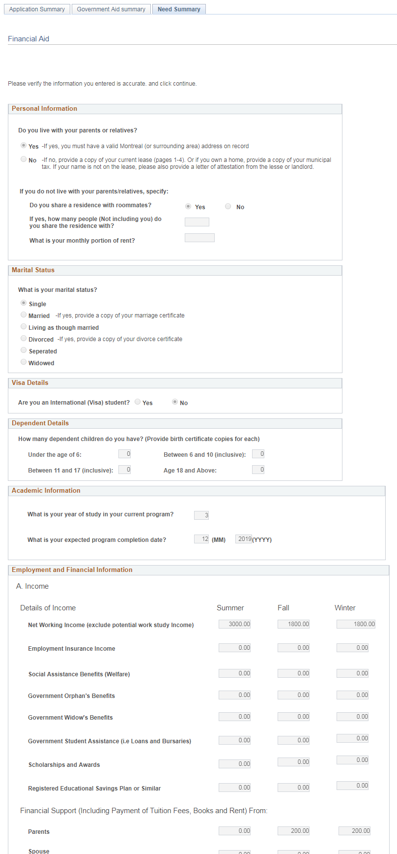
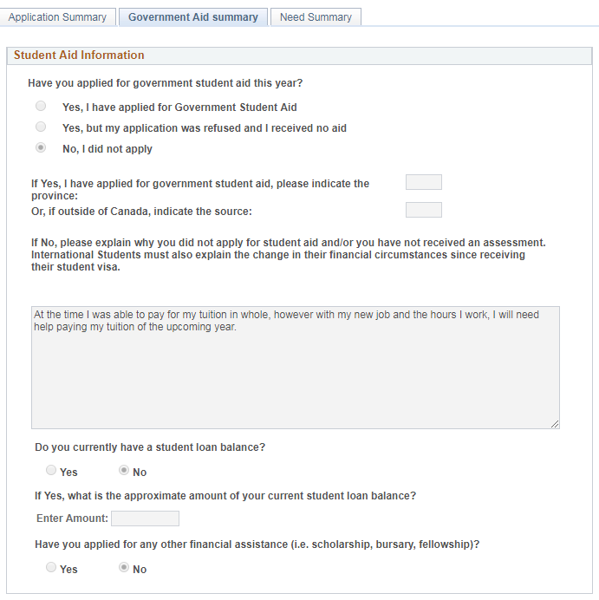
The Administrator
Can see the entire application both Government Aid Declaration and the Need Summary

Slide 37
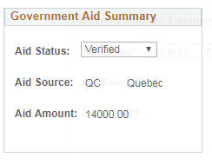
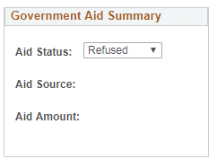
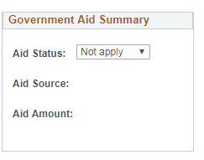
The Administrator
Government Aid Summary
Applied for Aid and Verified
Applied for Aid and Refused
Did not apply for Aid
No need analysis required
Student must complete needs analysis

Slide 38
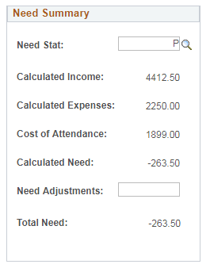
The Administrator
Need Summary

Slide 39
The Administrator
Need Summary

Slide 40
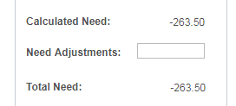
The Administrator
Need Summary

Slide 41
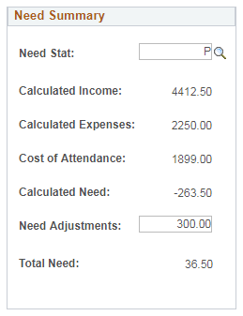
The Administrator
Need Summary

Slide 42
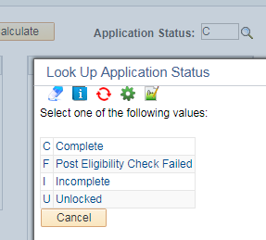
The administrator
Application Status
In the case where a student has new income to declare or if the job they were hoping to get in the summer didn’t pay as well as they expected we have the option of unlocking their application so that they can make their own updates.

Slide 43
The Administrator
What updates the calculation?
Admin clicks the “Calculate” button
Notes:
The Calculated and total need figures are not truly dynamic. They update when a change is made on the Admin Screen or The student updates their application.

Slide 44
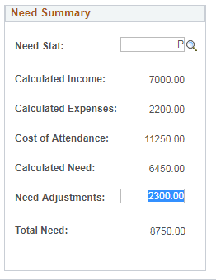
The Administrator
What updates the calculation?
Adjustment is made
Notes:
The Calculated and total need figures are not truly dynamic. They update when a change is made on the Admin Screen or The student updates their application.

Slide 45
The Administrator
Usage since Go-Live
2014-2015: 1697 applications
2015-2016: 4556 applications
2016-2017: 5326 applications
2017-2018 (to date): 3545 applications

Slide 46
The Administrator
Additions since Go-Live
Pre-populating of Government Aid section.
“God Mode” editing capability for selected users (Role-based)
Auditing of changes
OPRID
Date
Action
Old/New values

Slide 47
For when it’s raining…
It’ll do.

Slide 48
SECTION 5: the NEXT STEPS
What is still to be done?

Slide 49
The next steps
Process for full recalc
Interface for committee review

Slide 50
Sir George Williams Campus
Is M4 Burritos really our only option for Mexican cuisine near this campus?

Slide 51
Concluding thoughts
Loyola Campus - NDG

Slide 52
presenters
Alexander Lee
Business Analyst
Concordia University
alexander.lee@concordia.ca
all Alliance presentations will be available for download from the Conference Site

Slide 53
THANK YOU!

