Slide 1
Data governance in Action
SESSION 7024
Tuesday, November 5
3:00 pm – 4:00 pm

Slide 2
presenter
Lee Dreger
Senior Manager, Business Intelligence
ERP and Reporting
MacEwan University
dregerl@macewan.ca

Slide 3
Overview
MODEL - Resources and Organization
INITIATIVE – Business Glossary
RESULTS – Benefits and Challenges
CONCLUDING THOUGHTS – Questions
APPENDIX – Supporting Documentation

Slide 4
Governance MODEL
RESOURCES AND ORGANIZATION

Slide 5
Our definition
Data Governance is fundamentally about decisions and data. This includes deciding what the data means, where it should be used, how accurate it needs to be, and what rules it needs to follow.
TDAN.com
Performed by the business people who know and use the data.

Slide 6
Critical elements
Business Glossary: a record of the meaning of the data, so all the variations of it can be distinguished and erroneous comparisons eliminated
Data Quality: the condition of the data and its level of trustworthiness and adherence to policies
Roles & Responsibilities: the organizational structure that determines who takes responsibility for the care and maintenance of the data

Slide 7
Data Governance working Group (DAWG)
Director - HR Systems & Reporting | Director – ERP and Reporting
Director - Financial Services | Senior Manager - Campus Solutions
Executive Director - Expenses, Procurement and Contact Services | Director - IT App Services & PMO
Associate Registrar - Information Systems and Scheduling | Senior Manger – Business Intelligence (CHAIR)
Director - Student Financial Aid | Senior Manager – HCM and Finance
Associate VP - Planning & Analysis and Registrar
Assess data governance models and make recommendations.
Determine primary goals and mandate for data governance.

Slide 8
Data Stewards / Glossary PROJECT TEAM
Manager, HR Systems | Functional Analyst, Student Financial Aid
Functional Analyst, Human Resources | BI Analysts, CIO Office
Manager, Finance Admin Services | Team Lead, School of Cont. Education
Functional Analyst, Finance Services | IT Service Transition Analyst
Functional Analyst, Expenses Procurement and Contract Services | Change Mgmt. and Data Governance Coordinator – Registrar’s Office
Functional Analyst, Faculty Relations | Business Analyst, Human Resources/Finance
Admissions Consultant – Registrar’s Office | Business Analyst, Campus Solutions
Reporting Specialists – Institutional Analysis and Planning | Manager of Marketing, Office of Communications and Marketing
Research Analyst – Institutional Analysis and Planning | DAWG Chair
Identify and document the university’s data assets
Provide input to data governance structure.
Provide mentorship and education regarding data governance developments.
Develop mechanism for staff and faculty to contribute to issues and ideas.
Notes:
Too much duplication between groups so stewards group not that active until glossary is fully in sustainment
Finance participation has dropped off – too busy but continuing without them
Full commitment from most members

Slide 9
Consultation
Recommendation
Escalation
Stewardship
Sponsorship

Slide 10
Consultation
Recommendation
Escalation
Stewardship
Sponsorship
Creating new vocabulary
Aligning policy and procedural language
Collaboration and guidance for ERP projects

Slide 11
Governance initiative
BUSINESS GLOSSARY

Slide 12
Workflows
Draft, socialize, try it, change
Many revisions before we got it right
Final version?
Notes:
Mechanism to approve definitions within a functional area

Slide 13
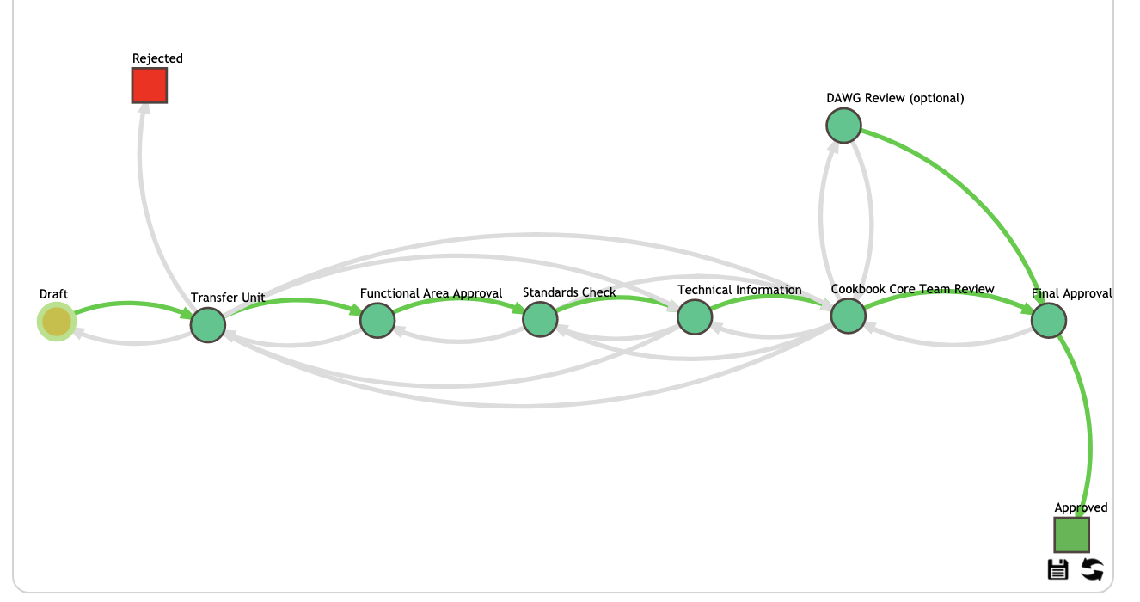
Workflows Admissions, Transfer Unit, recruitment, Student Financial Aid
Notes:
3 basic formats - one here and next 2 slides

Slide 14
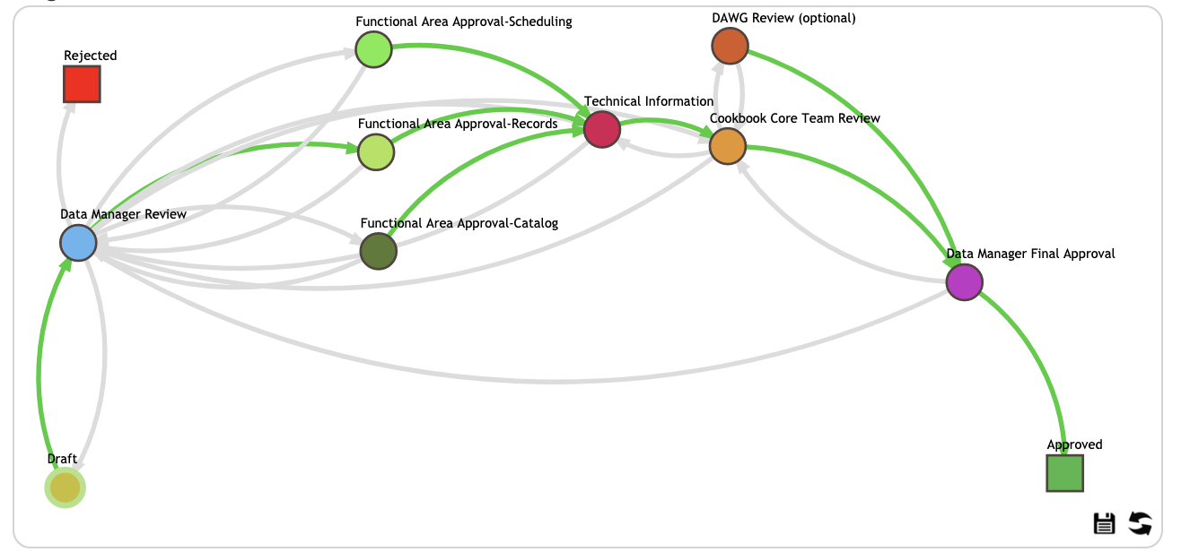
Workflow Records & Enrolment – Scheduling, Records, Course Catalog
Notes:
Functional Area approvers collaborate and review together where relevant
Data manager determines which path for functional review

Slide 15
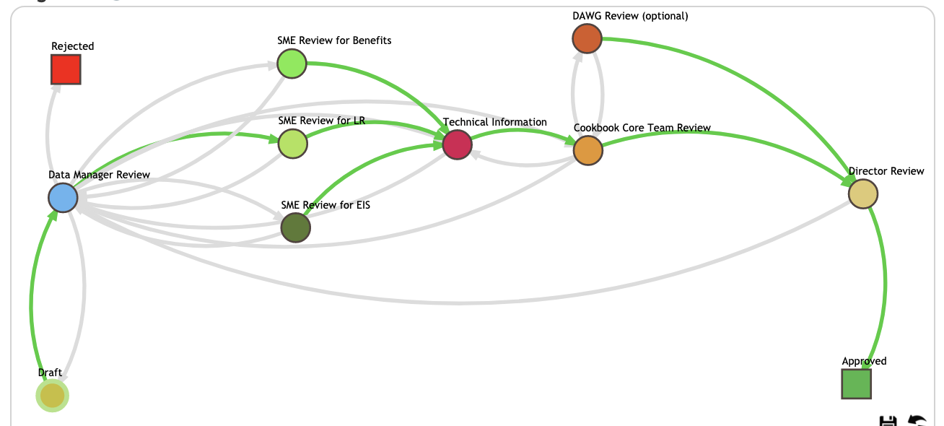
Workflow Human Resources
Notes:
Director has final review for approval

Slide 16
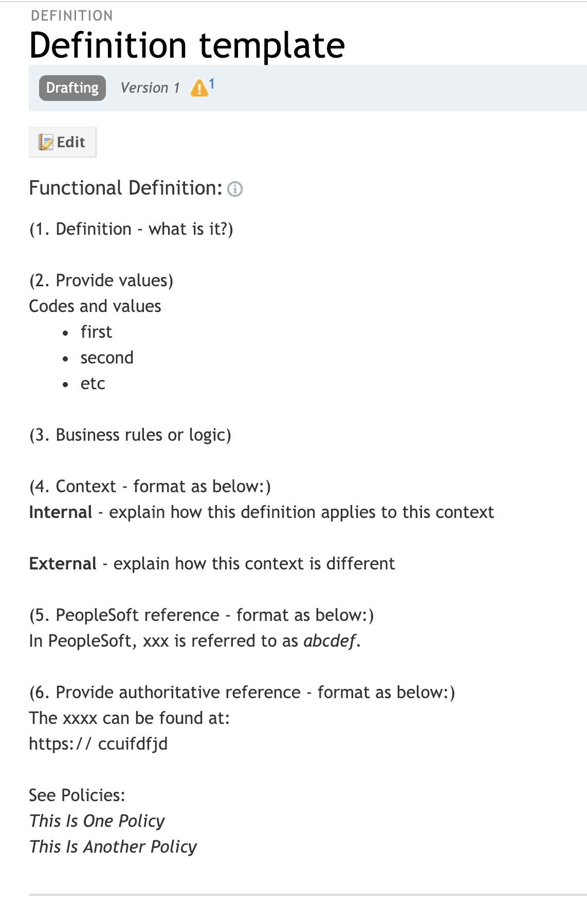
Functional Definitions
Reference official sources
MacEwan editorial style guide
Consistent format
Common business terminology
PeopleSoft terms are synonyms
Add business rules
List values if 10 or less, more add link
Use related definitions
Notes:
23 procedures and standards
** Show Standards document

Slide 17
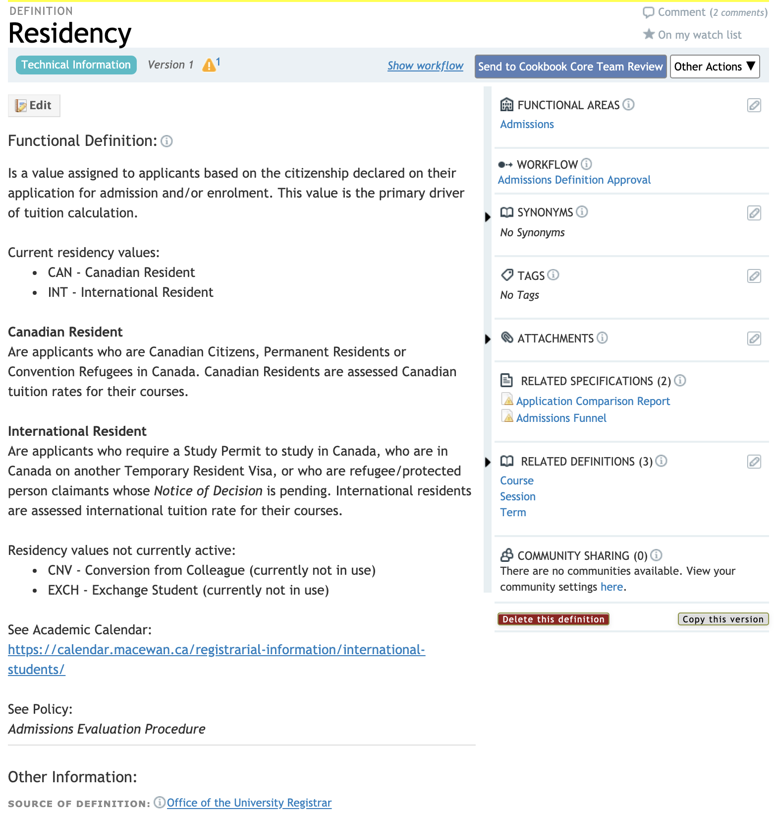
Notes:
Group continues to meet monthly to review content and progress
Admissions – 24
Records & Enrolment – 44
Student Financial Aid – 6
X-Functional – 8

Slide 18
Technical definitions
Business Analysts form technical groups for Campus and Finance/HR
Manager gets workflow notice from cookbook then assigns ehelpdesk ticket
Becomes part of daily workload with other tickets
Notes:
Governance expanded to include business analysts
Communication and assignment managed by technical lead – more efficient and less disruptive

Slide 19
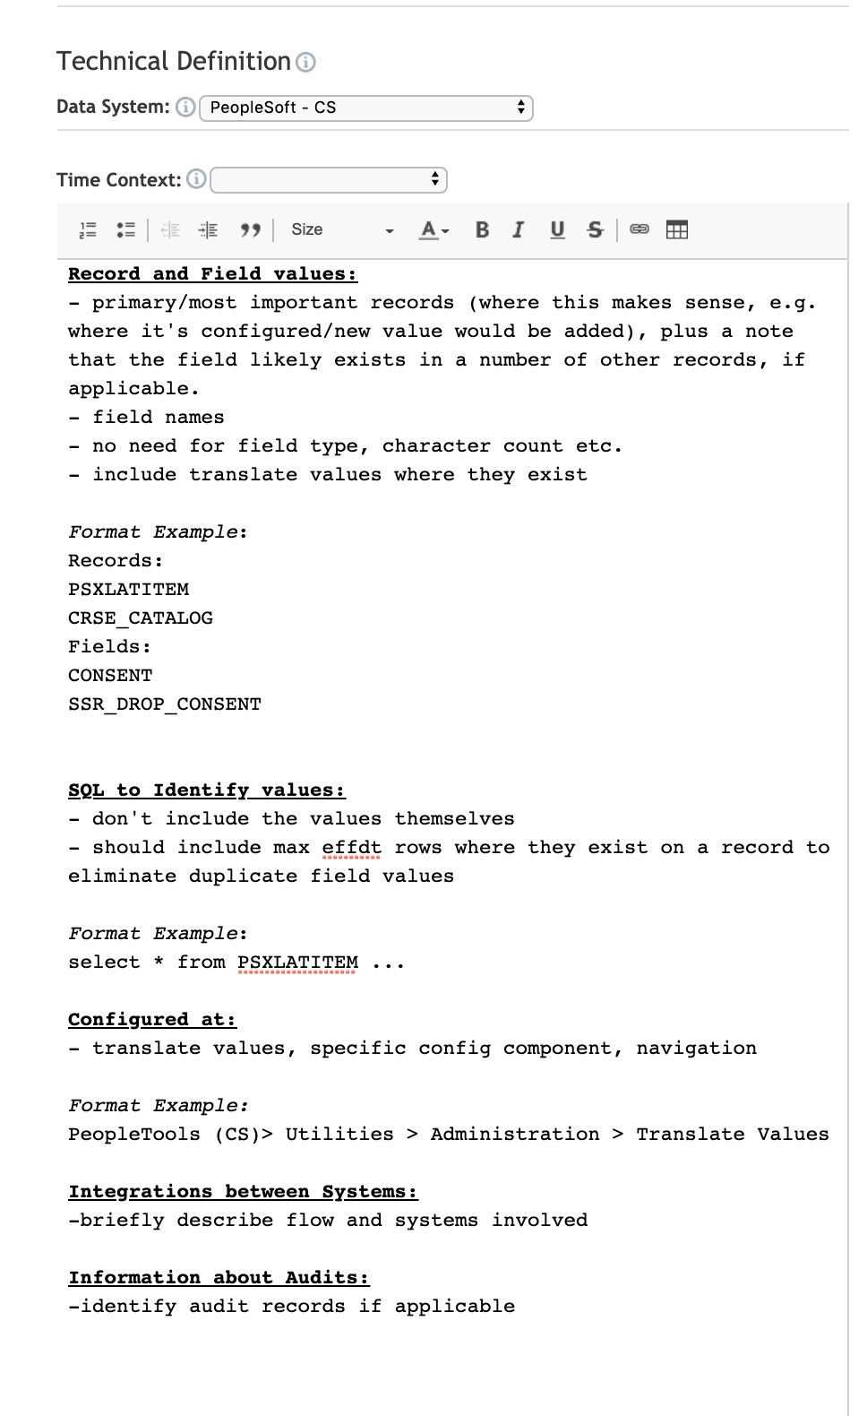
Technical Definitions - PeopleSoft

Slide 20
Technical Definitions – Business intelligence
Notes:
Work in progress – dimensional warehouse and transformation logic

Slide 21
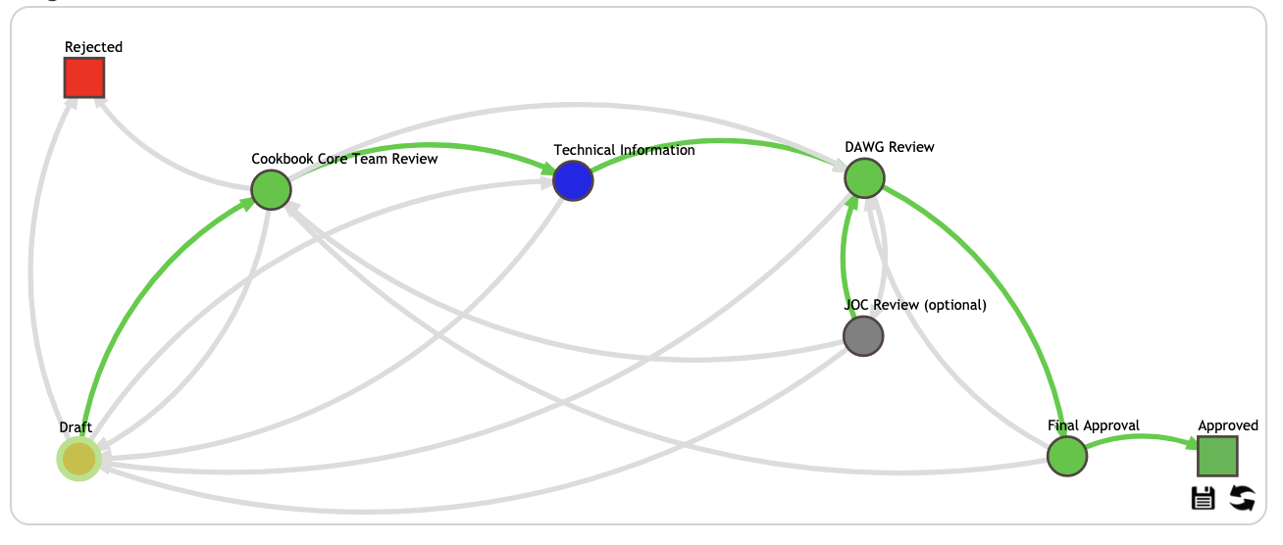
X-functional and governance
Consultation
Recommendation
Escalation
Stewardship
Sponsorship
Institution wide - cross multiple functional areas
Data Manager is Institutional Analysis & Planning
Notes:
Most immediate value coming from discussions and definitions in this area

Slide 22
Consultation
Recommendation
Escalation
Stewardship
Sponsorship
Business Glossary Decision Request
MacEwan ID --- MacEwan ID Number
MacEwan Network ID --- MacEwan Username
Subsequent definitions for:
Applicant (student and HR context)
Student
Alumni
Former Student
Future Student
HR terminology TBD
Notes:
** Show BG Decision Request
Provided prior to DAWG meetings – for review and approval and if need be to JIC
People – MacEwan ID Number – how far to make changes i.e. PeopleSoft screens

Slide 23
Consultation
Recommendation
Escalation
Stewardship
Sponsorship
Gender – consult with Office of Human Rights, Diversity and Equity
Student – consult with AVP Students and Teaching
Alumni – consult with Alumni Office
Notes:
Consulting with other areas broadens awareness of governance activities and provides legitimacy to decisions – fully representative

Slide 24
go live
Notes:
Log in to Cookbook – link to BI
Reciprocal links between glossary and BI dashboards

Slide 25
Notes:
Use of APIs to create pop up frames in our BI dashboards and URL links in pdf reports – show App comparison reports
Working on external authentication so users don’t need to sign in to view glossary

Slide 26
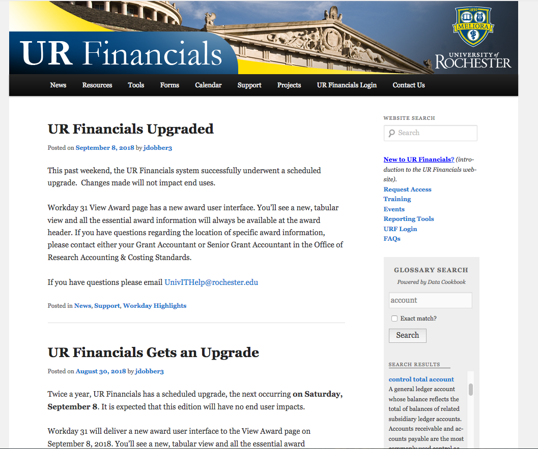
Glossary Search Box
Notes:
Planned for the Reporting and Governance portal page

Slide 27
Results
BENEFITS and CHALLENGES

Slide 28
Was the Implementation successful?
YES! (It Will Be)
Pilot definitions took over a year
Workflow issues
Approval consultation
Technical definitions – participation and buy in

Slide 29
What Benefits have been realized?
Valuable education across functional areas
Workflow approval process advanced governance program
Standards – awareness of what is important to know
Governance focal point
Driver for warehouse terminology
Notes:
Standards – inconsistencies in policies, terminology, misunderstandings from across silos

Slide 30
What are some of the challenges?
Slow process – needs continual leadership and focus
Team members are committed but busy and have other priorities
Data manager position change – how to transition
Not all business areas have capacity

Slide 31
How is it being received?
Project team very invested
Functional area leadership is supportive of process but still need to work our jurisdiction issues
Roll out tied to Reporting and Governance portal page planned for new warehouse go live
DAWG and Stewards - promotion strategy
Notes:
Promotion – present to Dean’s council and MacEwan Today

Slide 32
Concluding thoughts
ANY QUESTIONS?

Slide 33
THANK YOU!
all Alliance presentations will be available for download from the Conference Site

Slide 34
Appendix
SUPPORTING DOCUMENTATION

