Slide 1
Stipends in Financial aid
SESSION 8030
28 June 2016

Slide 2
presenter
Suzette Bergman
Project Manager
Visions Consulting
suzette@visions.co.za

Slide 3
your global partner in higher education

Slide 4
ORGANIZATION & ORACLE
Oracle Preferred partner for Higher Education across EMEA
Oracle Applications Partner of the Year 2015

Slide 5
Overview
FA Awards “as is”
Component to handle variable amounts

Slide 6
FA Awards and changes

Slide 7
Issue
FA Offered amount is total for the Aid Year and it is disbursed into separate amounts based on Disbursements rules
Want to change month amount after it has been posted

Slide 8
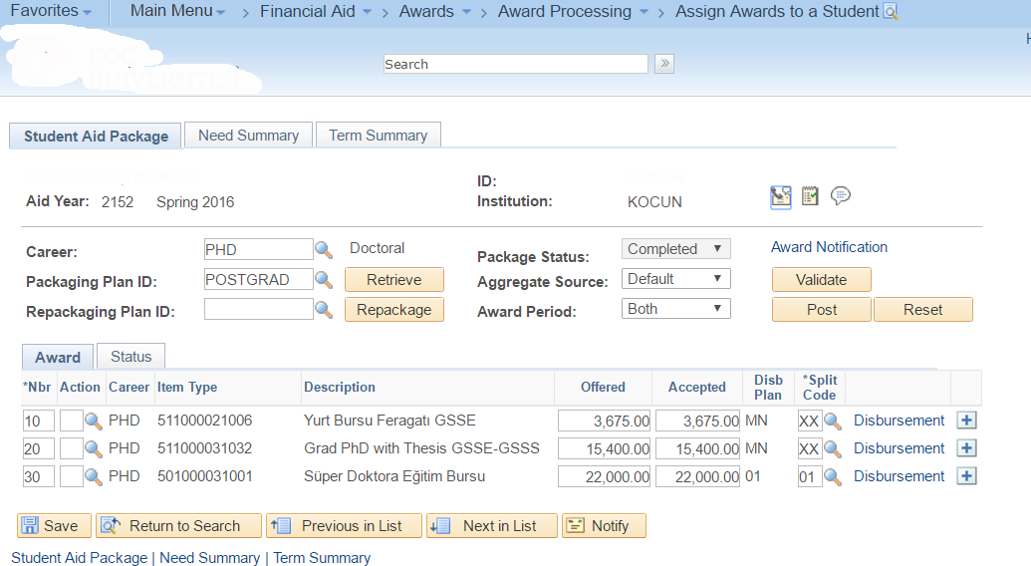

Slide 9
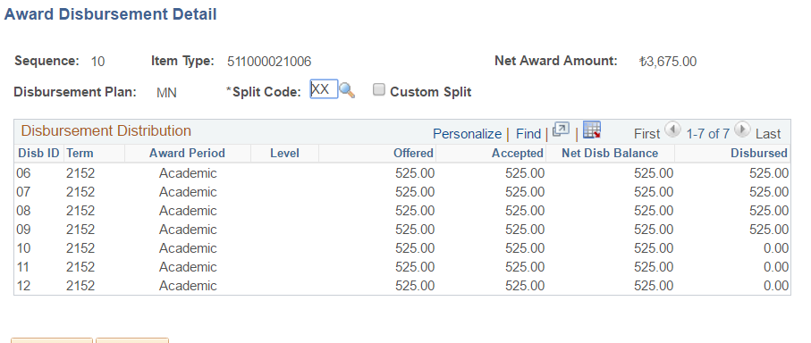
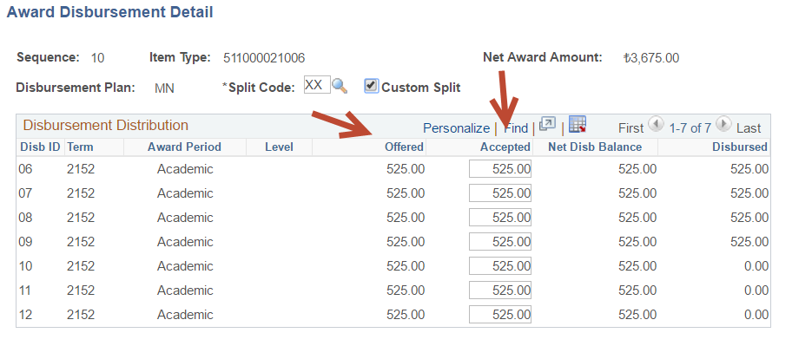

Slide 10
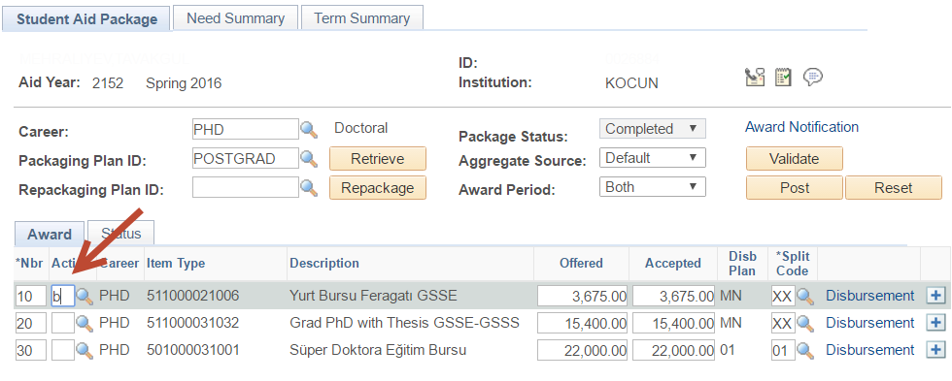

Slide 11
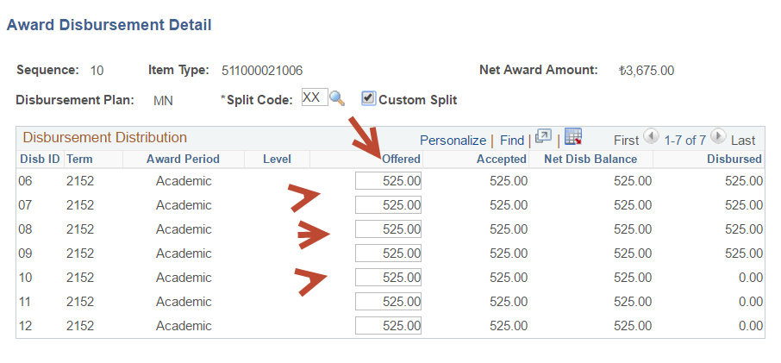
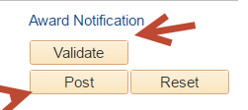

Slide 12
Solution

Slide 13
Solution
Create a component that uses the Award details and allow changes to a monthly amount that is not disbursed yet.
Approve the amount changed
Ensure that the “Award” component is updated correctly with new amount

Slide 14
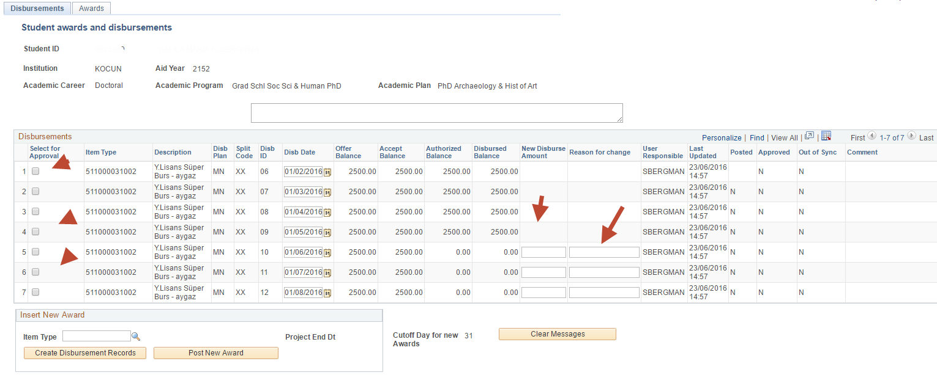

Slide 15
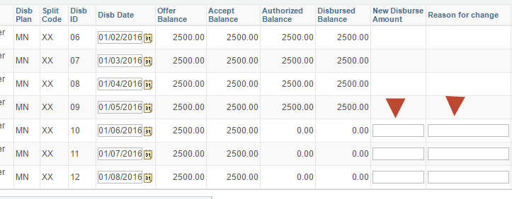

Slide 16
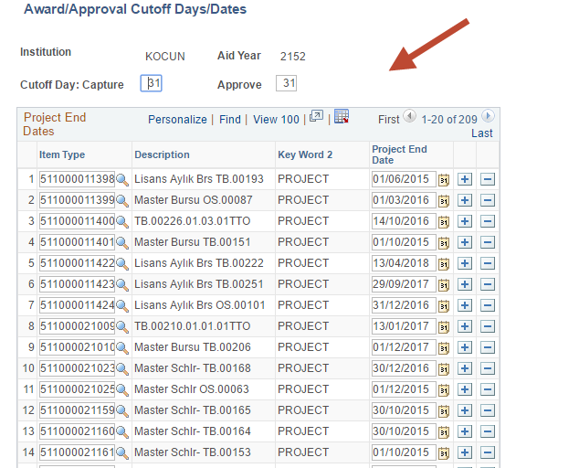

Slide 17
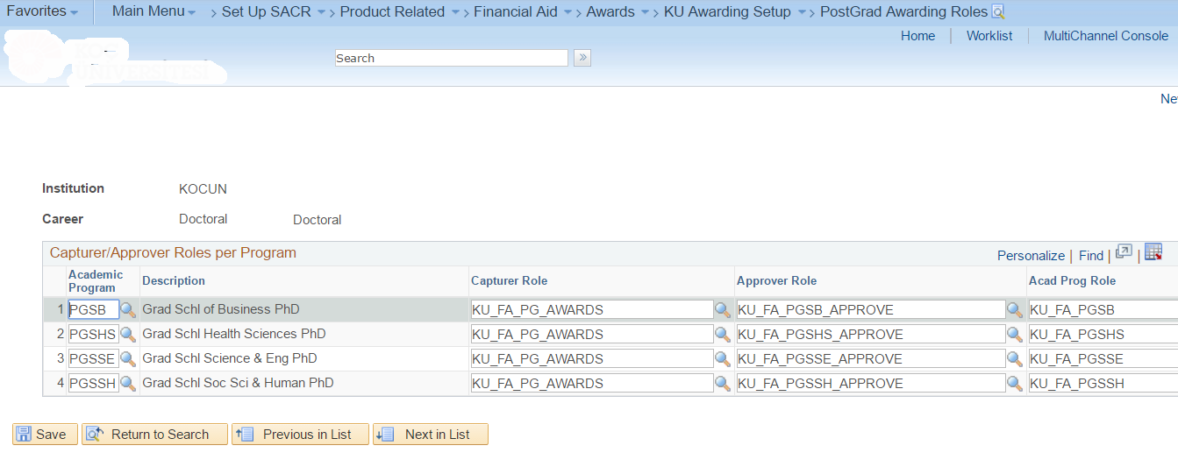

Slide 20
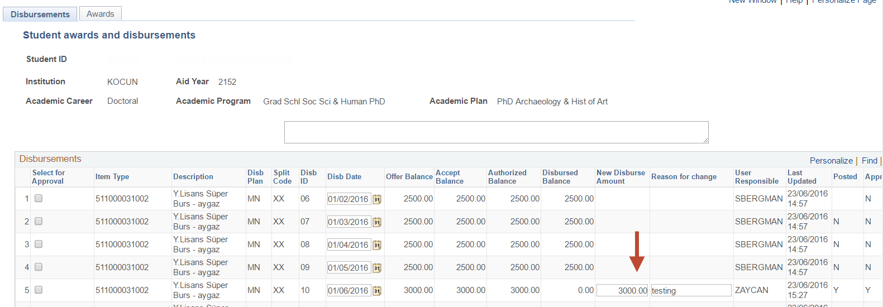

Slide 22
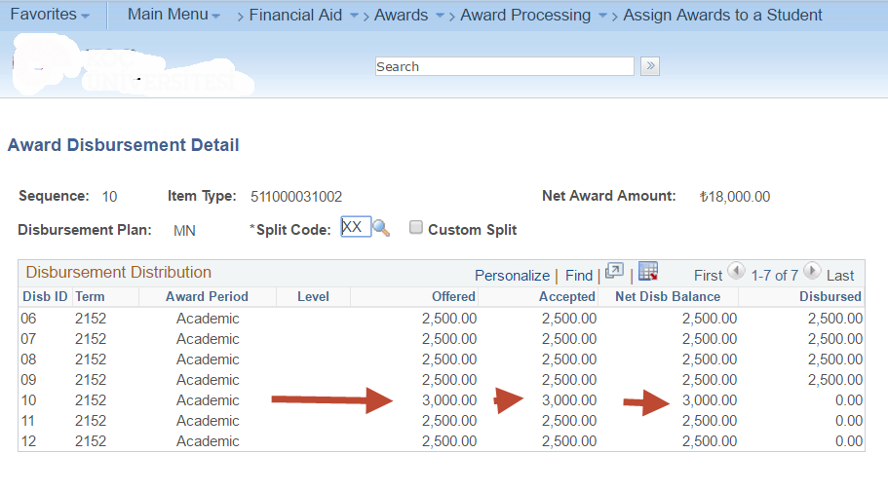

Slide 23
Questions

Slide 24
presenters
Suzette Bergman
Project Manager
Visions Consulting
suzette@visions.co.za
all SAHEUG Alliance presentations will be available for download from the Conference Site

Slide 25
THANK YOU!

