Slide 1
Connected vs. Composite Queries
SESSION: 7054
November 5, 2019
(11:30am ~ 12:30pm)
Notes:
Welcome to today's session "PeopleSoft Reporting Tools, Connected Query Versus Composite Query"

Slide 2
presenters
Wendy Xu
Shirley Marshall
Business Systems Analyst
McMaster University
xuwendy@mcmaster.ca
Business Systems Analyst
McMaster University
marshsh@mcmaster.ca
I have worked at McMaster for 17 years, involved in PeopleSoft implementation.
Currently working in Data Warehouse team providing query support, custom reporting, ETL and data maintenance.
I arrived at McMaster in the middle of the PeopleSoft deployment, 5 years ago. Currently I am on the Campus support team, working mostly with the Financial Aid and Academic Advisement modules.

Slide 3
Over 30,000 students from 113 countries
Close to1,000 faculty members from 55 countries, and over 4,600 full-time employees
One of Canada’s Best Diversity Employers for 2019
Notes:
Welcome to McMaster!
Our University has Over 30,000 students including undergraduates and graduates from over 100 countries
Close to 1,000 faculty members from 55 countries, and we have over 4,600 full-time employees
McMaster has been named one of Canada’s Best Diversity Employers for 2019

Slide 4
The Waterfall Capital of the World with over 130 falls
The First Tim Hortons opened
More than 24% of Hamilton’s population was born outside of Canada
Notes:
Here are a few Interesting Facts about our City
Hamilton is “ The Waterfall Capital of the World” with over 130 waterfalls
Many of us like Tim Hortons coffee … and Are you ever wondering where and when the Tim Hortons started? >> The Very First Tim Hortons under the name “Tim Horton Donuts” opened in Hamilton city east on Ottawa Street in 1964 (May 17)
As immigration myself, I am very proud to learn that More than 24% of Hamilton’s population was born outside of Canada….. AND actually today is my first time to do a presentation at conference in English......

Slide 5
McMaster & Oracle
PeopleTools
8.55.22
PeopleSoft
Version 9.2 (FSCM,HCM,CS)
Version 9.1 (Portal, DW)

Slide 6
Today’s focus
Why did we explore PeopleSoft reporting tools?
Brief overview of PS reporting tools
The advantages and limitations of using Connected vs. Composite queries
Scenarios: Connected query vs. Composite query
Samples of custom business reports
Notes:
Note the font type

Slide 7
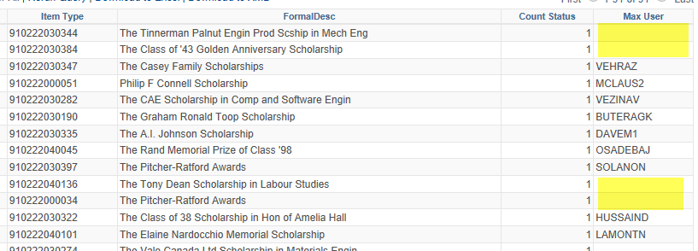
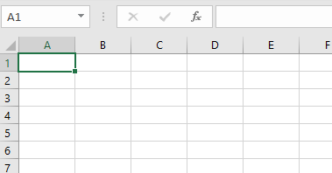
Why Explore PS Reporting Tools?
Notes:
Inaccurate data, too much manual effort to compile many downloads into one spreadsheet. Too many cycles.

Slide 8
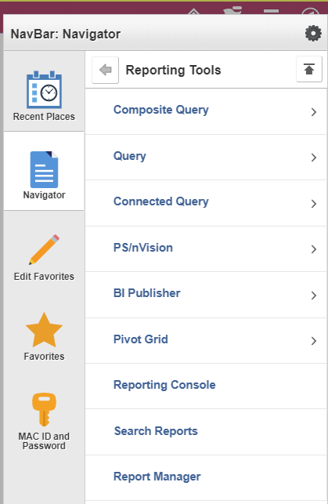
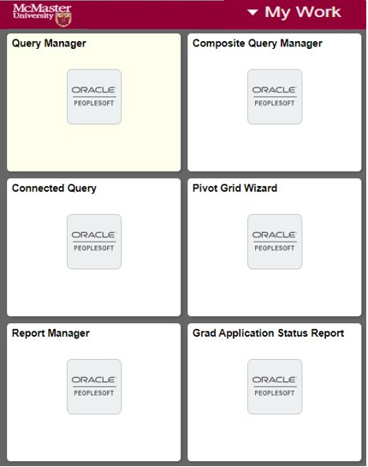
Reporting tools currently available in McMaster PeopleSoft Applications
Add your favourite Reporting Tools or Report to your homepage
Brief Overview of PS Reporting Tools
Query
Connected Query
Composite Query
BI Publisher
Pivot Grid
Notes:
A quick overview of PeopleSoft Reporting Tools we often use.
From Navigator, under “Reporting Tools”, We often use: Query, Connected Query, Composite Query, BI Publisher and Pivot Grid
You can add your favourite “Reporting Tools” to your homepage to save a few click going through Navigation

Slide 9
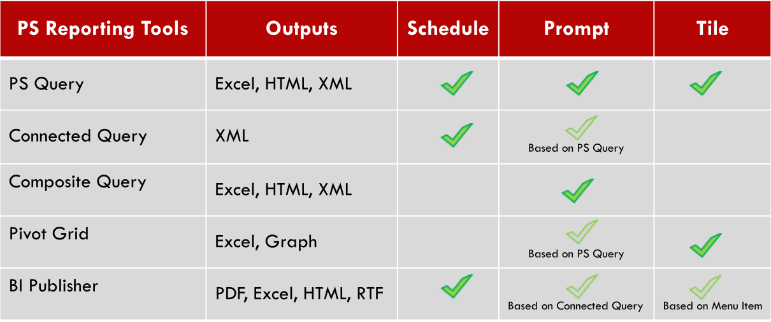
What are Connected & Composite Queries
Notes:
This chart is based on what we’ve learned and explored on the reporting tools we often used.
They have different or similar Outputs
For scheduling, PS query, Connected Query and BIP can be Scheduled
All the reporting tools are able to apply Prompt inside of the Tools or from other Tools
For easy access, we can create Tile for PS query, Pivot Grid, and BI Publisher report (BIP is based on Menu Item we create for the report)

Slide 10
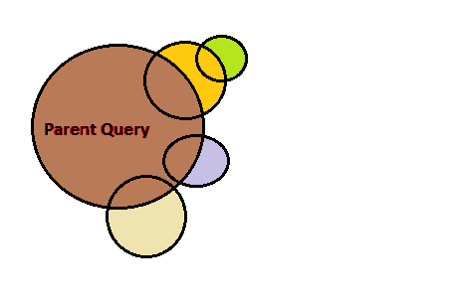
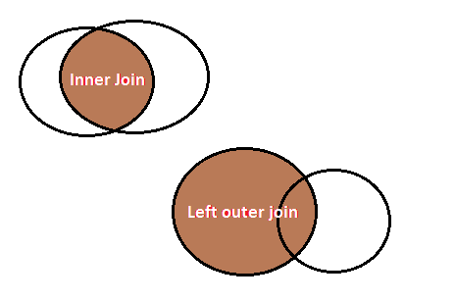
What are Connected & Composite Queries
Connected Query | Composite Query
Connect 2 or many PS queries with parent-child relationship One parent query can have one or many child queries and grand-child queries | Combine existing PS queries more flexible on joining Allow sibling queries at any level
Connected Query is built from PS Queries
Connected Query connects 2 or many PS queries with parent-child relationships
Notes:
* Connected Query:
- As the name tells it connects 2 or many queries together in a Parent-Child relationship;
- One parent query can have one or many child queries and grand-child queries
* Composite Query :
- combines existing PS queries in more flexible ways on joins
- it allows to add sibling queries at any level

Slide 11
Why Connected & Composite Queries
Connected Query | Composite Query
Break down single complex query into multiple simple queries
Improve issues with single complex query without programing coding
Can turn into analytics report using BI Publisher
Enhanced Connected Query with more flexibility on joining
Many features within the tool
Handy for preview and download output
Data output can be summarized into a visual presentations using Pivot Grid tool
Break down single complex query into multiple simple queries
Improve issues with single complex query without programing coding
Connected Query can turn to analytics report
Notes:
Why Connected Query:
- When PS Query become complicated, because we are trying to too many things at once that cause performance issue or other errors
- we can use Connected Query to break down a single complex query into several simple small queries
- avoid App Engine Program
- use BIP reporting tool to turn Connected query result into analytics report
Why Composite Query
- Composite Query is Enhanced Connected Query, especially more flexible on query Joins
- one of advantagle of using Composite Query, it has many features within the Tool
- including Handy feature to preview and download output
- with PT 8.55, Composite Query output can be summarized into a graphic report using Pivot Grid

Slide 12
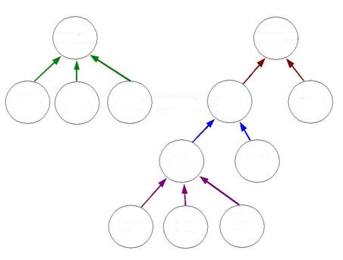
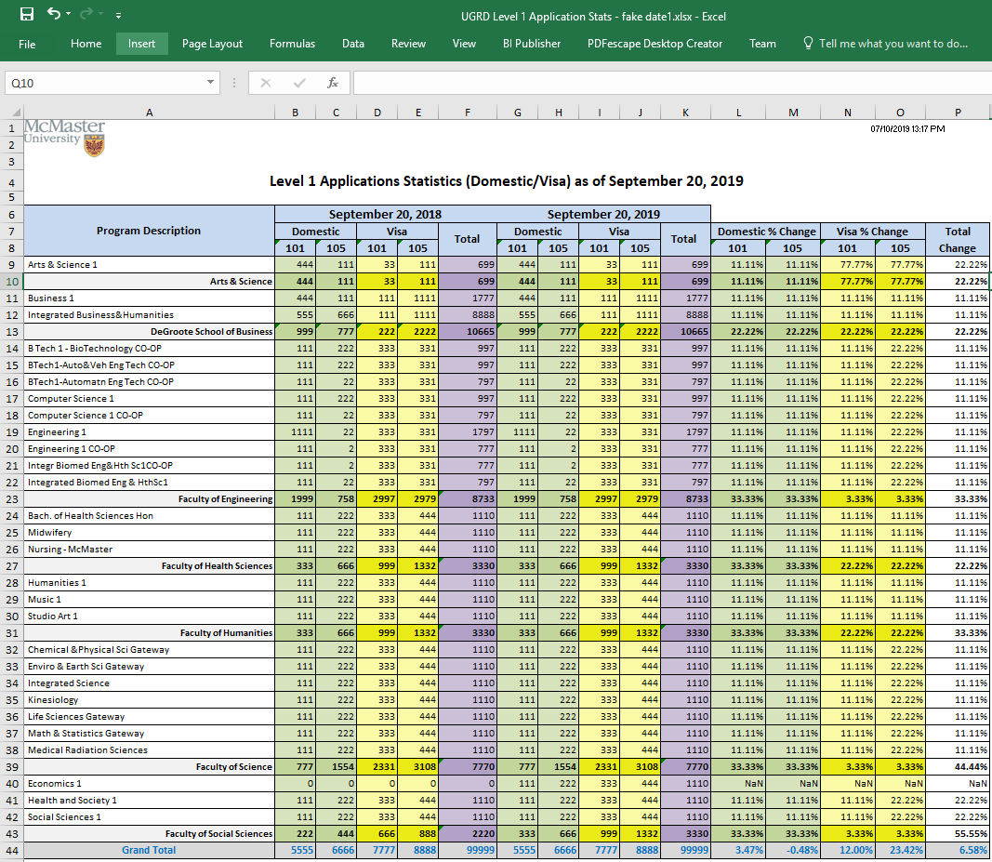
Structure
Features
Flow
Final Report Format
Data Source
Limitations
Flow
Structure
Features
Data Source
Final Report Format
Limitations
Connected Query vs. Composite Query
Notes:
PeopleSoft Composite query is the next generation of Connected Query, they have some common features and differences.
We are going to compare them in each following area:
Process Flow
Query Structure
Features within the Tool
With our current PeopleTool, they are also deferent in Data Source and Final Report Format
in order to use them effectively we also need to know their Limitations

Slide 13
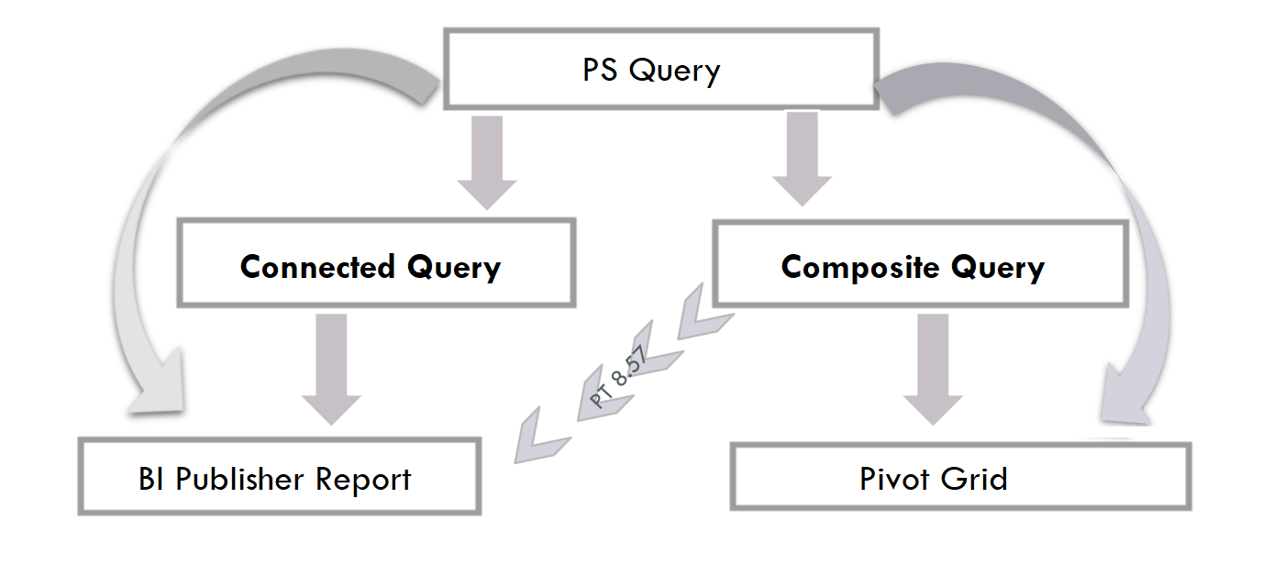
Connected Query vs. Composite Query
- Flow
PS Query
Data Source
Final Report Format
Notes:
This chart show the different process between Connected Query and Composite Query
- both built from PS query
- Connected query is used by BIP for final report
- on Composite query side, Pivot Grid is the final reporting tool to present Composite query result
- with newer PT 8.57, Composite query can also used by BIP

Slide 14
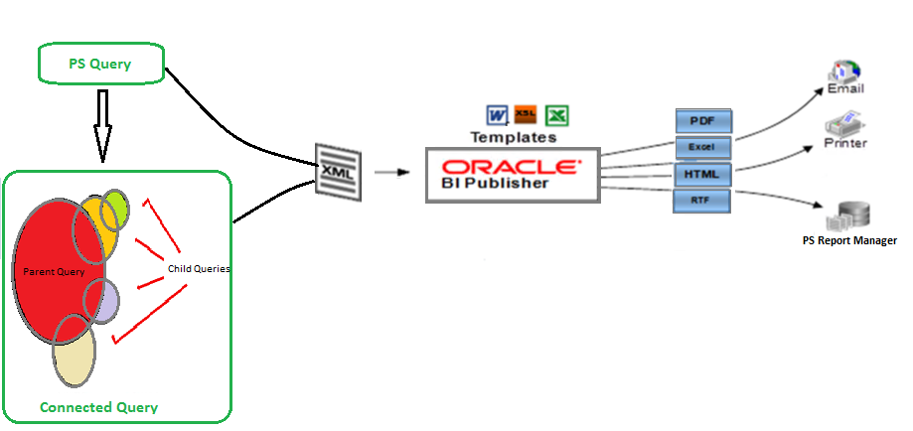
Connected Query → BI Publisher Report
Notes:
Let’s explain the Process in more detail:
- This is a process from A Query >> to >> Connected query >>
- Since XML is only output of connected query, we usually use BI Publisher which is MicroSoft Office Add-In tool to create a report template >> to generate a final report in multiple formats like PDF, Excel, HTML..
- By the way, PS query can also be used as data source with BI Publisher.

Slide 15
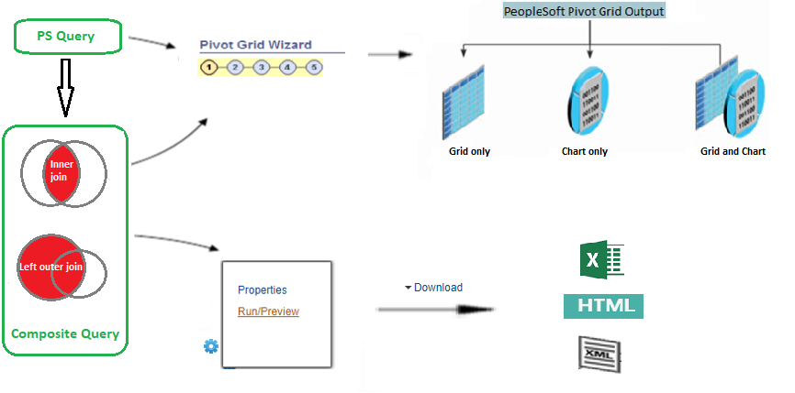
Composite Query → Data Download or Graphic Report
Notes:
* With our Current PT (8.55), Composite Query can be summarized to a graphic Pivot Grid report
* this chart also shows Composite Query data result can be Previewed and Download within composite query manger Tool into 3 type of files: as Excel, HTML, and XML
* again the PS query can also be used by Pivot Grid tool directly

Slide 16
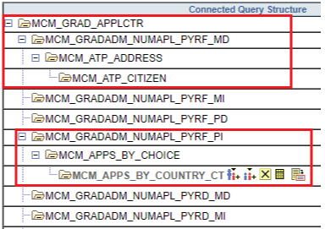
Connected Query vs. Composite Query - Structure
Connected Query | Composite Query
Multilevel hierarchy joins - left outer join only | Left outer join or inner join between PS queries
Notes:
The 2 types of query’s structure are different.
- Connected Query: A parent query can have multiple levels of child queries, and any child query can have multiple sibling queries within a hierarchy
- On other hand, the Composite Query can join PS query in both Inner join, and Left Out join as we explained earlier

Slide 17
Connected Query vs. Composite Query - Features
Connected Query Manager
Insert child or sibling query; and child query can be deleted Key fields mapping Open PS query in read-only
Notes:
Inside of Connected Query Manager Tool 1
we can Insert child or sibling query; and child query can be deleted anytime
click 'Mapping' icon to map the Key fields between Parent and Child query
Icon ' Open' opens PS query in read-only mode

Slide 18
Connected Query vs. Composite Query - Features
Connected Query Manager
Define Status Preview only in XML format
Notes:
Inside of Connected Query Manager Tool 2
- change default Status “in progress” to “Active”
- you can only preview the Sample XML file. If you need to get full XML output, you need to use Connected query scheduler

Slide 19
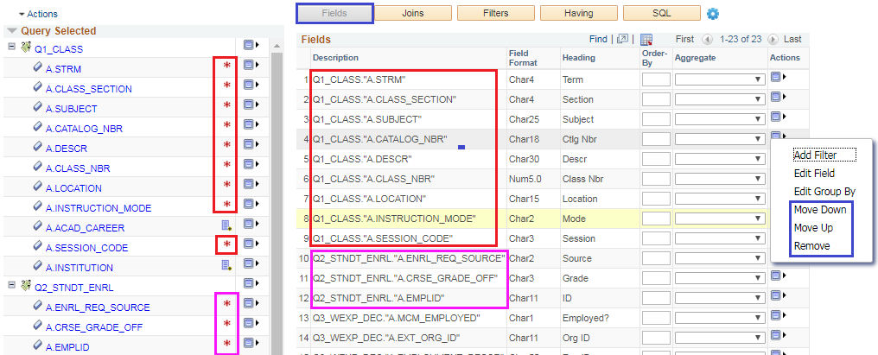
Connected Query vs. Composite Query - Features
Composite Query Manager
Fields can be selected, removed and moved up/down
Notes:
In comparing, now we are looking into the Composite Query Manager Tool (Inside of Composite Query Manager Tool 1)
- able to select Fields from each PS query for composite query output
- also they can be removed and put them in order (moved up/down)

Slide 20
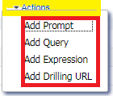
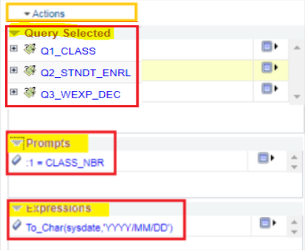
Connected Query vs. Composite Query - Features
Composite Query Manager
Add Prompt, Query, Expression
Notes:
Inside of Composite Query Manager Tool 2
Besides to add PS query within the tool(like PS query manager), we are able to Add Prompt, Expression under ‘Action’ menu
The right side showing the examples of Selected Queries, Prompt and Expression

Slide 21
Connected Query vs. Composite Query - Features
Composite Query Manager
Change Join
Notes:
Inside of Composite Query Manager Tool 3
Within the Toll, we can Change ‘Join Type’ by click on the join link >> open the ‘Query Join Details’ dialog box >> change from there

Slide 22
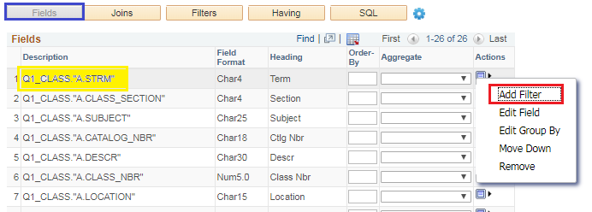
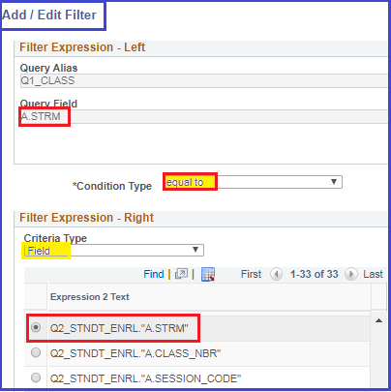
Connected Query vs. Composite Query - Features
Composite Query Manager
Add Filter (Criteria)
Notes:
Inside of Composite Query Manager Tool 4
- example to Add a criteria within Composite Query manager tool

Slide 23
Connected Query vs. Composite Query - Features
Composite Query Manager
View/Edit/Remove Filters (Criteria) View SQL
Notes:
Inside of Composite Query Manager Tool 5
Within the tool, we also able to View/Edit/Remove criteria by select on “Action” drop down menu
And Click the “SQL” button to View the script behind the Composite Query

Slide 24
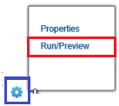
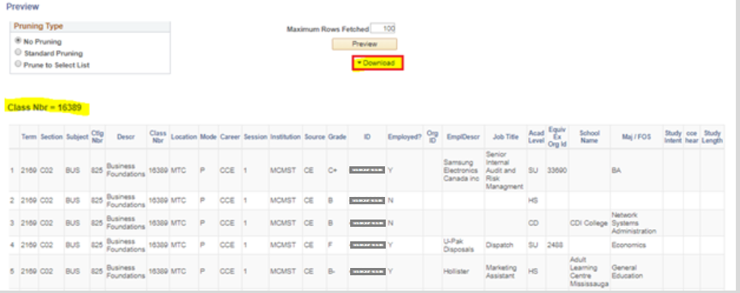
Connected Query vs. Composite Query - Features
Composite Query Manager
Run/Preview output data
Notes:
Inside of Composite Query Manager Tool 6
This is very handy and useful feature within Composite Query Manager tool, click on “Run/Preview” to get output
There is a ‘Download’ button where you can download the output

Slide 25
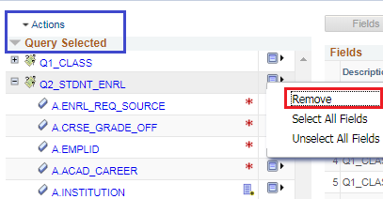
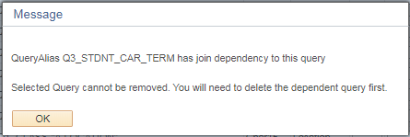
Connected Query vs. Composite Query - Features
Composite Query Manager
Can not Remove PS Query when query field selected
Notes:
Inside of Composite Query Manager Tool 7
It is a little bit tricky to remove a PS query from Composite Query once it is been added.
we Cannot remove PS query if we selected any field for output, But, if we “unselect” all the fields from that PS query first >> then we are able to remove it

Slide 26
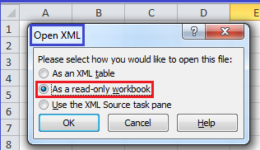
Connected Query vs. Composite Query - Features
Connected Query other features
 | Connected Query Scheduler
Connected Query Viewer | Open XML output in Excel
Connected Query Quick Start
Notes:
Here are some Features that Only Connected Query has under PeopleSoft Reporting Tool menu:
Connected Quick Start which is 5 steps wizard, it is very useful for your first connected query, but it is only allow One child query
Connected query can be scheduled by its scheduler to get a full XML file instead of Sample XML file inside of the tool
One of useful trick I usually use, if you want to check connected query xml result, you can open a blank Excel spreadsheet, and load the XML file as read-only workbook.
Connected Viewer is similar to PS query Viewer for read-only

Slide 27
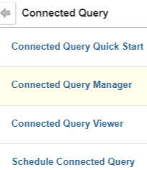
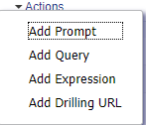
Connected Query vs. Composite Query - Features Summary - Features Summary
 | Connected Query | Composite Query
Under Menu
Within the Tool
Notes:
In a summary what we had compared so far, all the features between Connected Query and Composite Query features:
- Under Menu, other than the ‘Manager’ tool, Connected Query has more tools like: Quick Start, Viewer and Scheduler
- within the 'Manager' Tool:
Composite has many features like: Add prompt, Expression, select Fields, change join, add Criteria , view SQL, and a handy action to Preview and Download the data output.
Within the Tool, connected query only able to add/delete PS query and preview the sample XML output

Slide 28
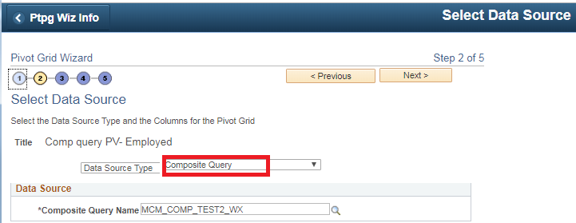
Connected Query vs. Composite Query - Data Source
Connected Query | Composite Query
Notes:
Another Different between Connected query and Composite Query is Data Source
- Connected query is Data Source for BIP
- Composited query is Data Source for Pivot Grid with our current PT version

Slide 29
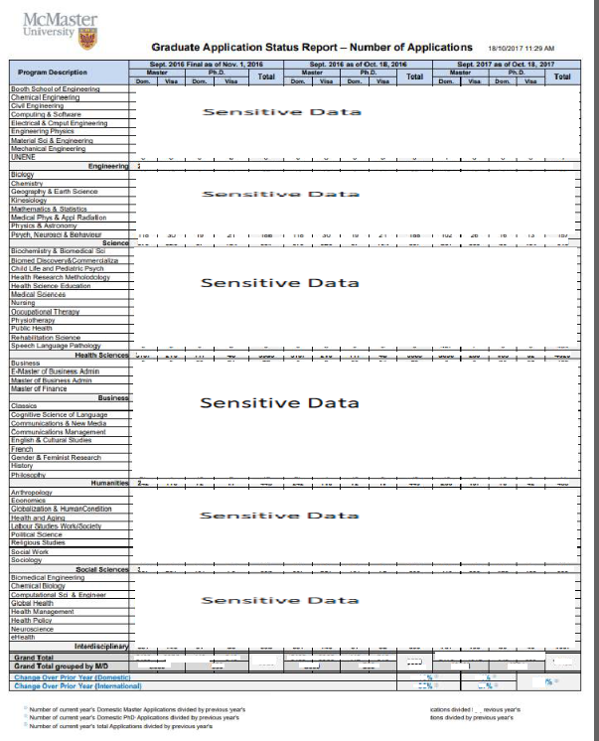
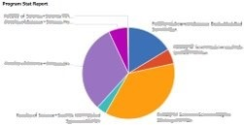
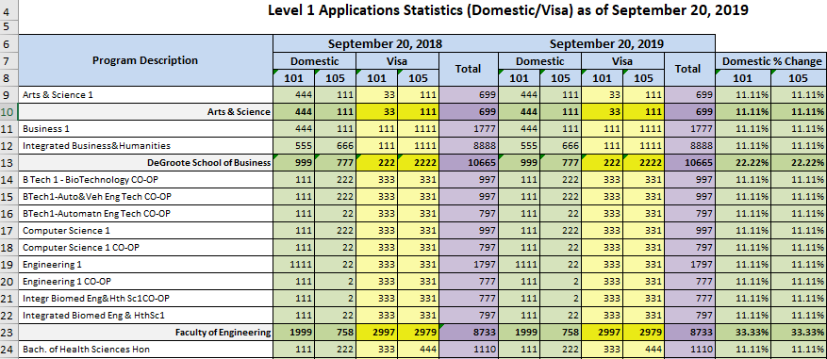
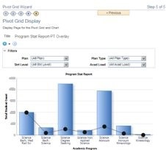
Connected Query vs. Composite Query - Final output
Connected Query | Composite Query
Notes:
Because Connected query and Composite query are different in Data Source, so their Final Report format are also different, least with our current People Tools
- Connected Query’s final output is BIP report
- Composite query’s final output is Pivot Grid, but the data output can be downloaded within the tool

Slide 30
Connected Query vs. Composite Query - Limitations
 | Connected Query | Composite Query
Common | Not for final data output; mostly used for data source Field mapping between PS Queries can Only use database record field. PS Query Expression is Not available for field mapping
Differences | Only left outer join Output only in XML No PS query manager features Can not preview and download data | Not for large data volume (recommend < 10,000) Can not be scheduled Cartesian join between siblings queries is possible
Notes:
In order to use these reporting tools correctly and more efficiency, we also need to know their limitations.
- The common limitation of both:
unlike PS Query, these tools used as Data Source, not Final Data Output
another limitation we found, although PS Query Expression is very useful, and we can add the Expression as output field, BUT, the PS Query Expressions are not available to Field Mapping when joining PS queries in both Connected query and composite query
- The differences:
Connected Query:
only can join PS query in Left Outer Join relationship
only has XML output
within the Tool, only can add/delete/view ps query, no other Editing features
cannot preview and download data output within the tool
Composite Query:
The biggest limitation we found of Composite query is not suitable for large data return, the Oracle recommendation is no more than 10,000
No other Tools available besides the Composite Query Manager, unlike connected query which has Viewer, Scheduler, and Quick Start
Because sibling queries can be added at any level, that may cause Cartesian join when the relationship is one-to-many or many-to-many

Slide 31
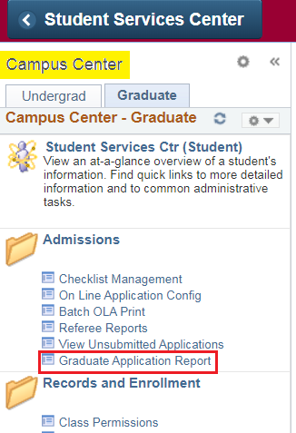
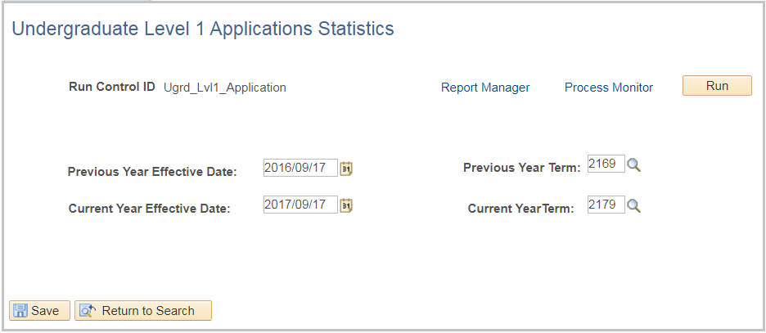
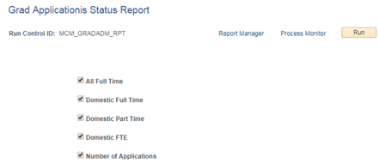
Connected Query &
BI Publisher Examples
Graduate Application Status Reports
Graduate Application Report
Undergraduate Enrolment Tracking Report
Notes:
Here are our show cases using connected query and BI Publisher reporting tools
The 5 Graduate Application Status Reports replaced manually processes, and the new custom Run Control page allow user to run multiple reports at Once
Graduate Application Report also saved a lot of manually efforts for Program Administrators
Undergraduate Enrolment Tracking Report is another good example to replace manually reports

Slide 32
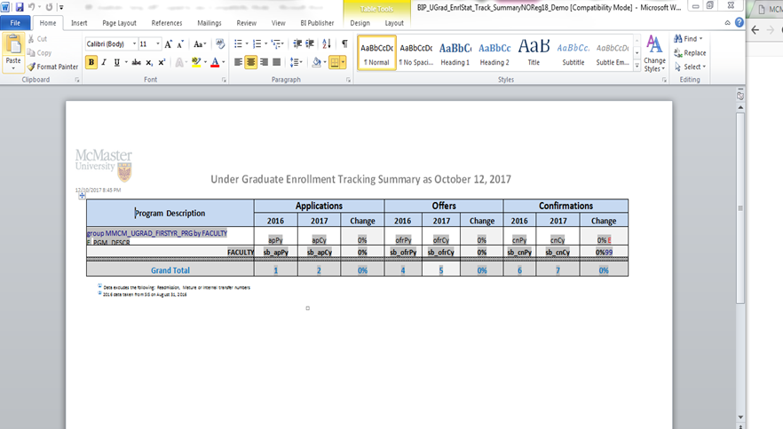
Connected Query & BI Publisher Examples
BIP Template
Notes:
this is sample BIP template within Microsoft word, in here we can use Word features for report layout and format, as well formulas for totals and conditional formating

Slide 33
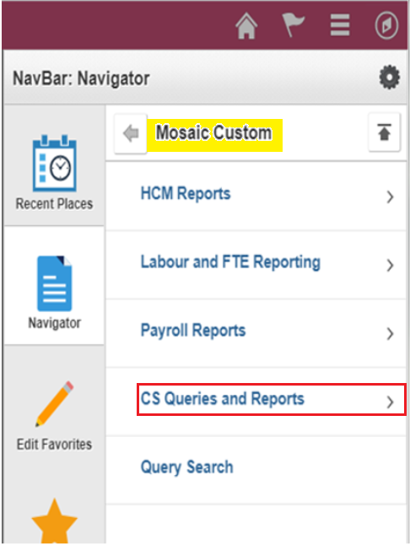
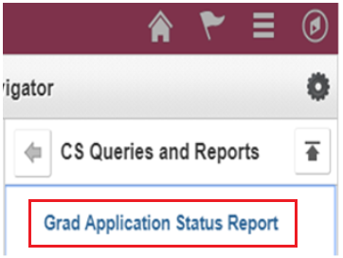
Connected Query & BI Publisher Examples
Create New Menu Item
Notes:
- We usually create new Menu Items for BI Pubplisher reports that built on connected queries
- here are example of menu item under Navigator, or add a link on Campus Work Center

Slide 34
Connected Query & BI Publisher Examples
Create New Run Control
Notes:
Examples of Run control:
- the back screenshot: allows user to run multiple reports at once
- the front screenshot: with Prompt values

Slide 35
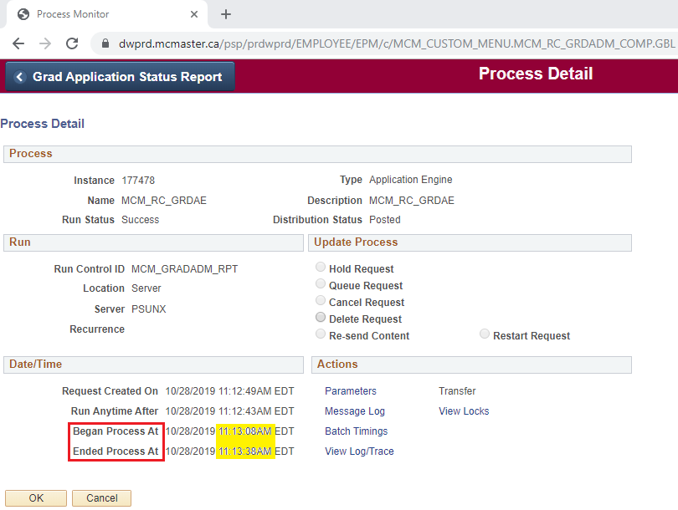
Connected Query & BI Publisher Examples
Performance
Notes:
- The BI Publisher report built based on Connected query is huge saving on time!
- here is time record of 5 Grad reports run at once and finished in 30 seconds!

Slide 36
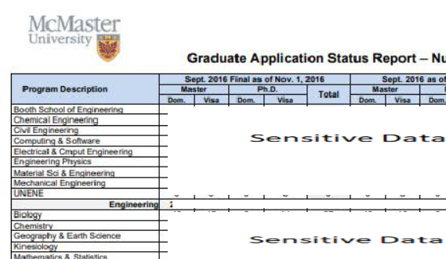
PDF output
Notes:
This slide and the next showing the common final BIP reports output - PDF and Excel

Slide 37
Excel output
Note: All numbers are fictional

Slide 38
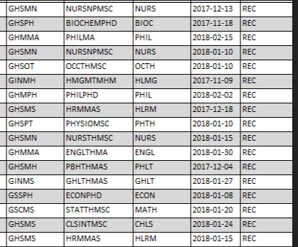
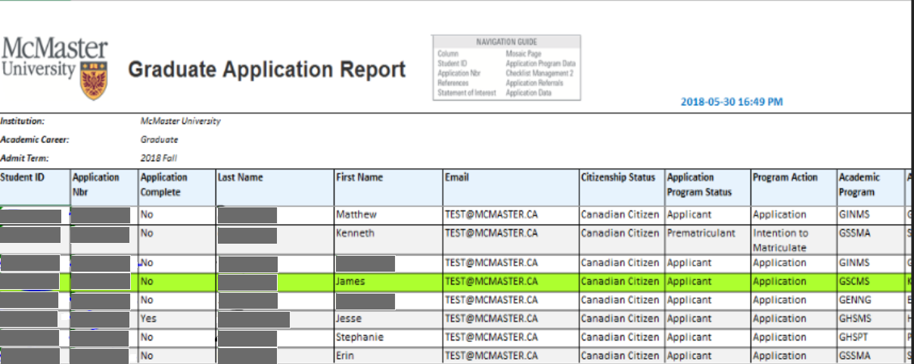
Connected Query & BI Publisher Examples
Conditional Formats
Notes:
The features including:
highlight every other row for easier reading
All newly submitted applicants are highlighted in green
Quick hyperlinks that taking user directly to Transaction Pages without log in Mosaic again and search for individual that users had to do in previous manually process

Slide 39
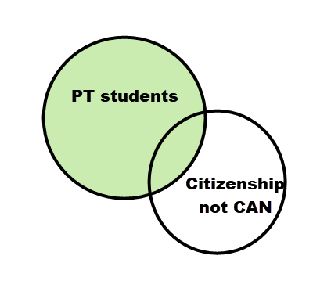
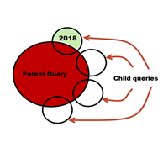
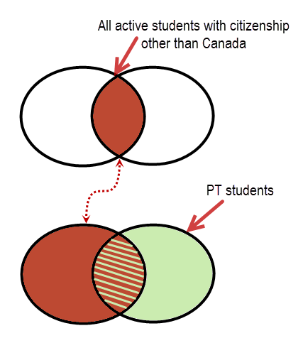
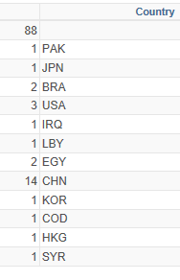
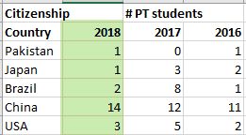
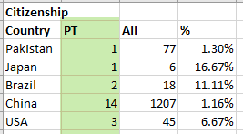
Query vs. Connected and Composite Query
Query | Connected Query | Composite Query

Slide 40
Composite Query Example #1
Create a list of all awards that require an application. For each award, count how many applications have been received to date.
If an inner join is used, the awards with no applications are missing from the report
If a left outer join is used, the count is still 1 for the awards with no application since there is still a row returned for that award

Slide 41
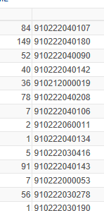
Composite Query Example #1
By creating a “parent” query with all of the awards that require an application, and a “child” query with a count of applications per award, the resulting Composite query (using left outer join) shows ALL of the awards from the parent query with the matching data from the child query

Slide 42
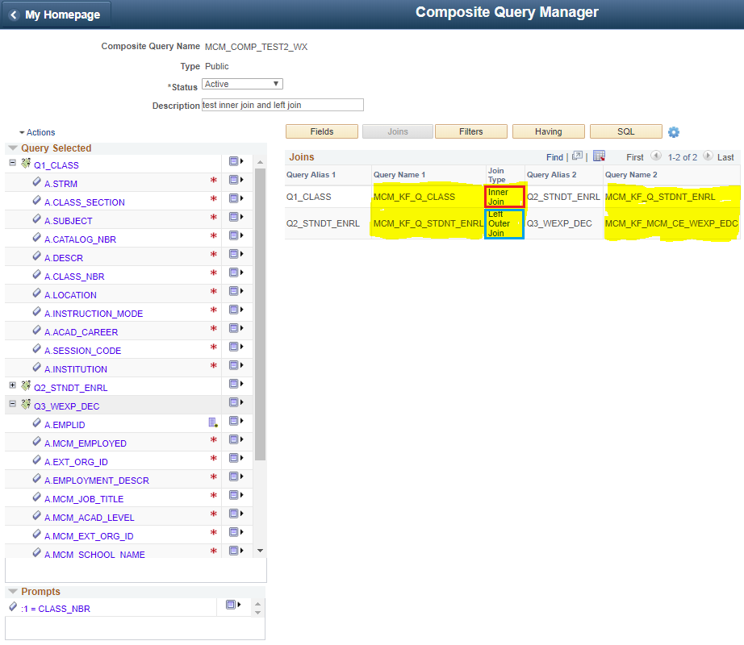
Composite Query Example #2
Composite Query Manager
Notes:
another example of using Composite Query:
- the original query joins large tables with both inner join, left outer join
- it often time out
*** so we broke down into 3 smaller PS Queries, and combine them to create A Composite Query with Inner Join and Left Outer Join

Slide 43
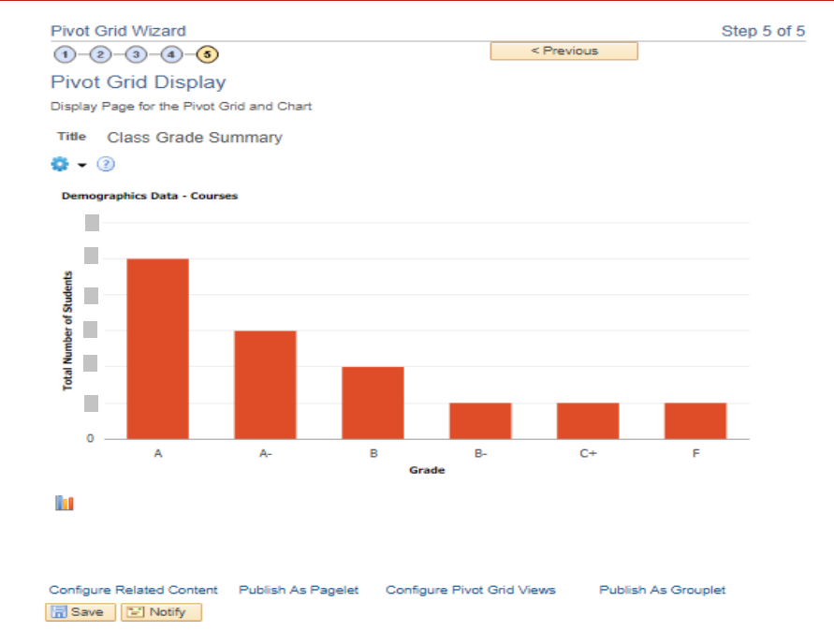
Composite Query Example #2
Pivot Grid using Composite Query
Notes:
and then built a Pivot Grid Chart to show the Class Grade Summary

Slide 44
Proposed process
UTS
Business Users
Provide Training
Pass quiz
BI Publisher
Create PS Queries
Pivot Grid
Composite Queries

Slide 45
conclusion
Connected and Composite Query are based on PS Query.
Both are very useful to break down single complex queries, replace tricky aggregates and avoid programming.
Connected Query with BI Publisher can turn data output to a powerful analytical report.
Composite Query is handy for downloading data output and translating it into a visual graphic presentation with Pivot Grid.

Slide 46
Questions?

Slide 47
presenters
Wendy Xu
Shirley Marshall
Business Systems Analyst
McMaster University
xuwendy@mcmaster.ca
Business Systems Analyst
McMaster University
marshsh@mcmaster.ca
all Alliance presentations will be available for download from the Conference Site

Slide 48
Thank you!

