Slide 1
Student Financials and Financials
Birds of a Feather

Slide 2
Student Financials and Financials Birds of a Feather

Slide 3
BOF Moderator
Carolee Berge Cohen
38 years of Higher Education Experience
19 years using PS: Implementation, Functional Support, Upgrades
Started with CS/HR in Version 7, 1998, Financials in 2008.
Split CS and HR databases in 2015.
Manage functional business analysis supporting the CC, FA and SF modules, CS Security and Integration with HR and Financials
Former Student A/R Manager
HEUG SF Product Advisory Group (2000-2001 and 2008-2012), various working groups and other HEUG volunteer positions

Slide 4
University of Minnesota
5 Campuses - enrollment
Twin Cities 52,557
Duluth 11,806
Crookston 2,653
Morris 1,932
Rochester 273
4 SF Business Units and
SR Institutions
Twin Cities/Rochester
Duluth
Morris
Crookston

Slide 5
University of Minnesota and Oracle
Tools Version 8.55.17
Possible upgrade to 8.56 next year
Oracle Version 12.1
PeopleSoft Versions:
Portal interaction hub 9.1 R3
Campus Solutions 9.2 – image 6
as of 9/23/17!!!
HCM 9.2 – image 21
(will be bringing in image 23 in two wks)
Financials 9.2 – image 18
(next image project in planning stages through Image 25)

Slide 6
Overview
The objectives of this session are to:
Ask questions of your peers
Share possible solutions to common challenges
Exchange other information of interest to attendees

Slide 7
Agenda/Contents
Submitted Questions
Open Forum
Timely List Topics

Slide 8
Submitted Questions
Questions received prior to MIDHEUG

Slide 9
Late Fees
Who is using the delivered Late Fee process?
Kathy Tynon – Peru State College
Pros and Cons
If not using the delivered process, what do you use?
Did you modify the delivered process
Did you create a new process

Slide 10
More questions

Slide 11
Open Forum
Questions from the floor

Slide 12
Topics
Tuition calc
Refunding
Third Party
Payment Allocation
Credit History
GL Interface

Slide 13
More Topics
Invoicing
Communications (3Cs)
Collections
Self-Service
Cashiering
Payment Plans
1098-T

Slide 14
Financials Topics
Accounts Receivable/Billing
GL
Accounts Payable
Procure to Pay
Budgets
Grants, Contracts

Slide 15
List Serve topics
Recent list issues that need more attention

Slide 16
Hot Topics?
Plans for moving to any cloud products
Exciting new developments you’d like to share?

Slide 17
Questions? We don’t have to stop after MIDHEUG!
Join the Forum on HEUG Online
Select My Subscriptions to add forums
Select Add Subscription button and choose Campus Solutions as the category, Student Financials as the topic or choose Financials as the category, then select a module

Slide 18
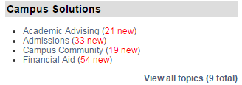
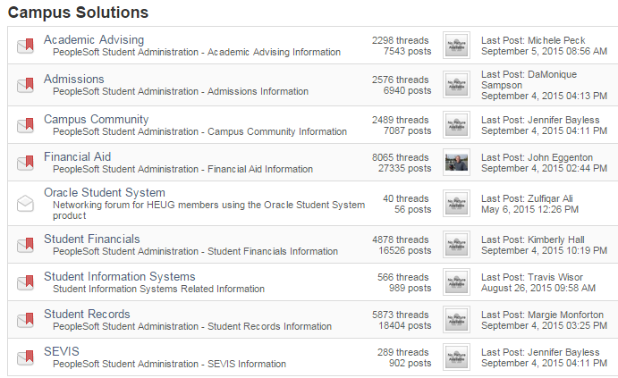
Forums
View Forums via email or in HEUG Online
On the Forums page, navigate to Campus Solutions or Financials, View all topics and select your choice from the list

Slide 19
Contact
Carolee Berge Cohen
Associate Director, Information Technology
Academic Support Resources
University of Minnesota
E-mail: c-cohe@umn.edu

Slide 20
Next year’s conference
October 12 and 13, 2018
Brookfield, Wisconsin
Volunteers are needed for next year’s conference planning. Please talk to Carolee if you would like some idea of the time commitment and the opportunities available. We need your help to make this conference a success!

Slide 21
This presentation are available for download from the Conference site at https://www.heug.org/page/us-alliance-conference-files Note: Sessions from previous HEUG conferences are also available.

