Slide 1
Presentation Title
SESSION 3031
May 07, 2018

Slide 2
PRESENTERS
Joseph Egan
Paul Goldman
EVP of Global Business Solutions
UniLink
j.egan@unilink.com.au
Director
HSBC
paulgoldman@hsbc.com.hk
As EVP of Global Business Solutions Joe works with universities around the world helping them achieve efficiencies and savings by implementing best practices in ecommerce.
Prior to joining UniLink he served as the Director of Fiscal Policy for the Board of Higher Education in Massachusetts.
As Director in HSBC Global Markets Asia Pacific, managing Transactional FX solutions. He works with clients to solve their needs on the thematics of efficacy, streamlining and simplification in an environment of transparency and enablement.
Prior to HSBC, Paul was a director of Macquarie Bank FICC in both Sydney and Hongkong.

Slide 3
WHO ARE UNILINK
We work with universities to solve their payment, reconciliation and customer service issues.
Established 1989 in Melbourne.
We have customers in Australia, New Zealand and Singapore.
Our OneStopSecure platform allows universities to easily create any type of transaction which can be integrated to the appropriate back end system.
Oracle Global Partner.

Slide 4
WHO ARE HSBC
HSBC is one of the largest banking and financial services organizations in the world. Our purpose Our purpose is to be where the growth is, connecting customers to opportunities, enabling businesses to thrive and economies to prosper, and ultimately helping people to fulfill their hopes and realise their ambitions. Our strategic priorities We aim to be the world’s leading and most respected international bank. We will achieve this by focusing on the needs of our customers and societies we serve, thereby delivering long-term sustainable value to all our stakeholders. We have a set of three interconnected and equally weighted priorities to help us deliver our strategy: Grow the business and dividends Implement Global Standards Streamline processes and procedures Each priority is complementary and underpinned by initiatives being undertaken within our day-to-day business. Together they create value for our customers and shareholders, and contribute to the long-term sustainability of HSBC. | Customers: 51m
 | Employees: 230,000+
 | Located in: More than 65 countries and territories
 | Offices: Over 6,100
 | Market capitalisation: USD155bn
 | Listed on stock exchanges in London, Hong Kong, New York, Paris, Bermuda

Slide 5
Todays Student
Todays Student
Tech Savvy
They are Global
Are people born after 1999. They are much different than millennials or any other generation to attend a university.
They grew up with technology and demand a modern experience
Approximately 80% rely on technology for communication, social engagement and to transact business.
They expect to pay online but also with convenient and familiar payment options such as credit cards, WeChat Pay, Alipay China UnionPay, PayPal, Apple Pay, international payments etc…

Slide 6
CUSTOMER EXPERIENCE
76%
91%
84%
Make purchases online
Use credit card money or other payment services
Own at least one smart phone

Slide 7
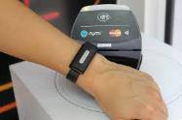
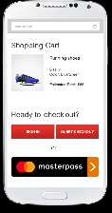
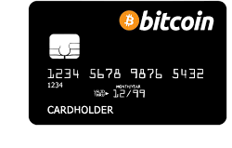
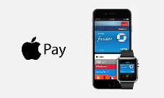
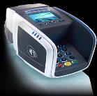
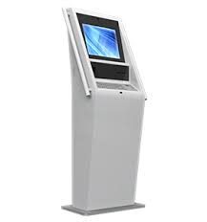
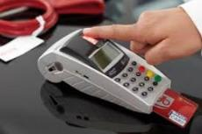
WHERE ARE WE HEADED?

Slide 8
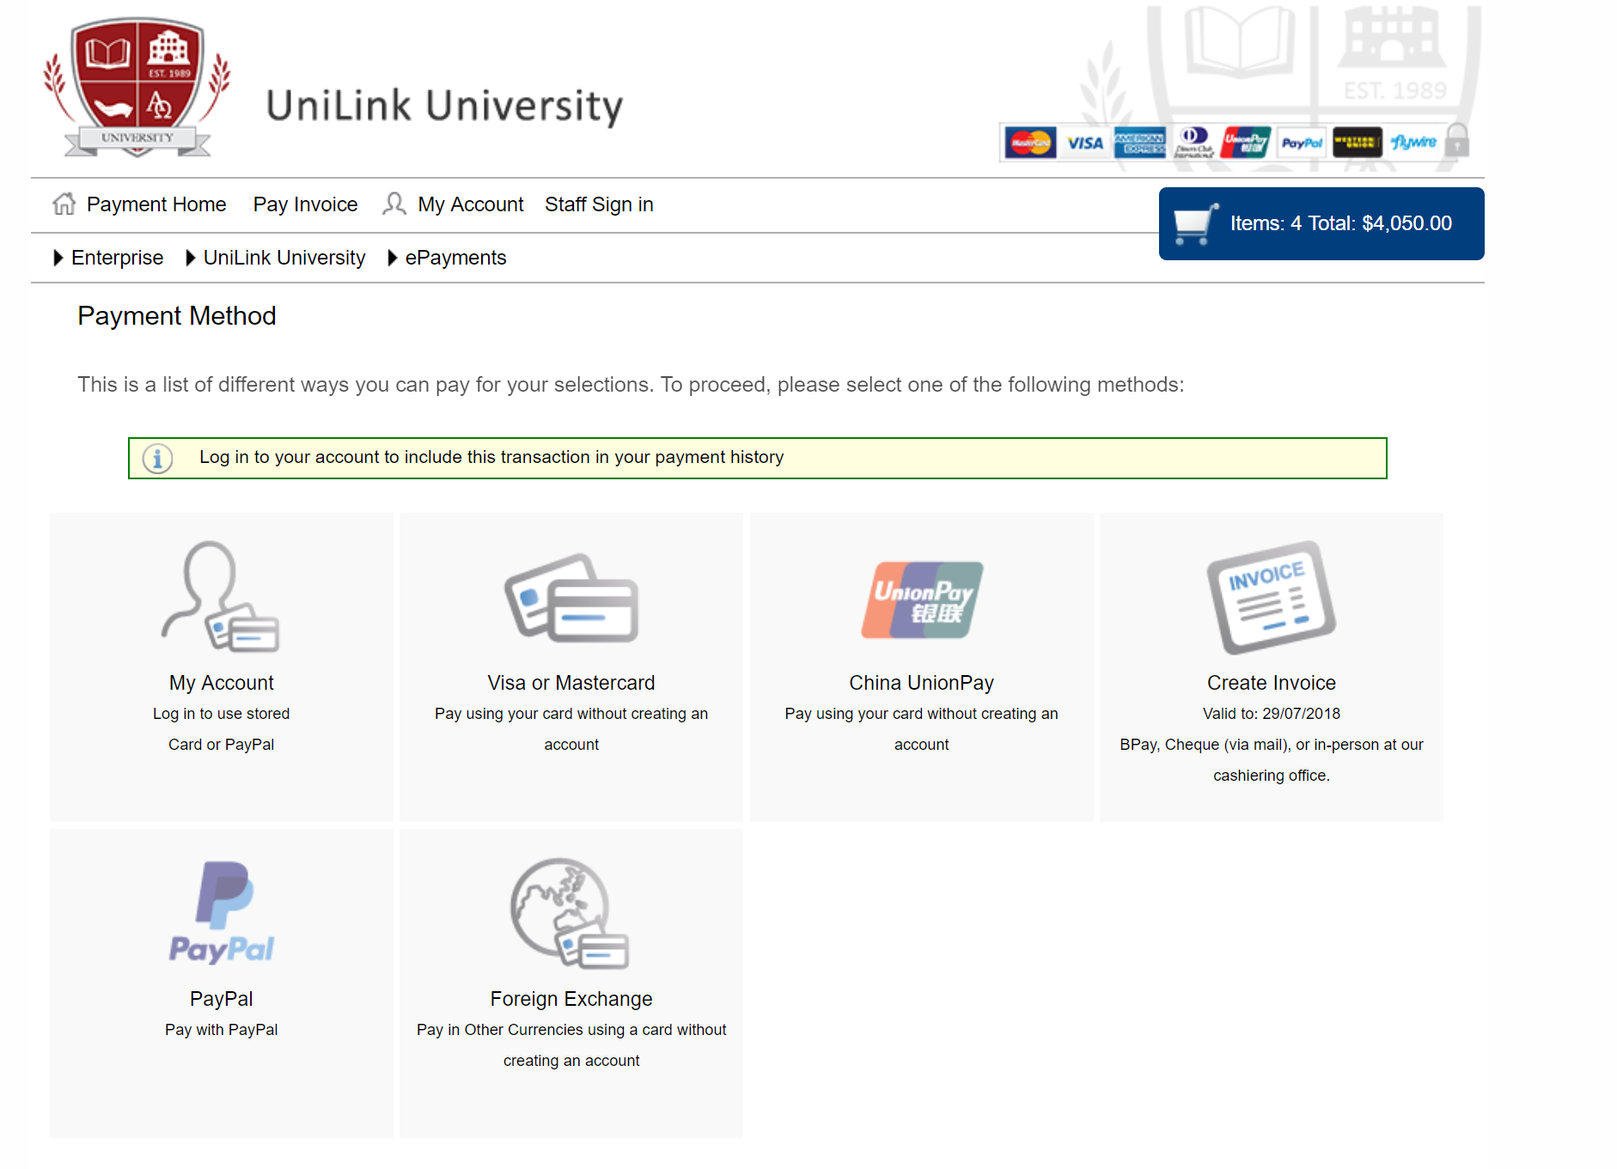
MAKING IT EASIER TO PAY

Slide 9
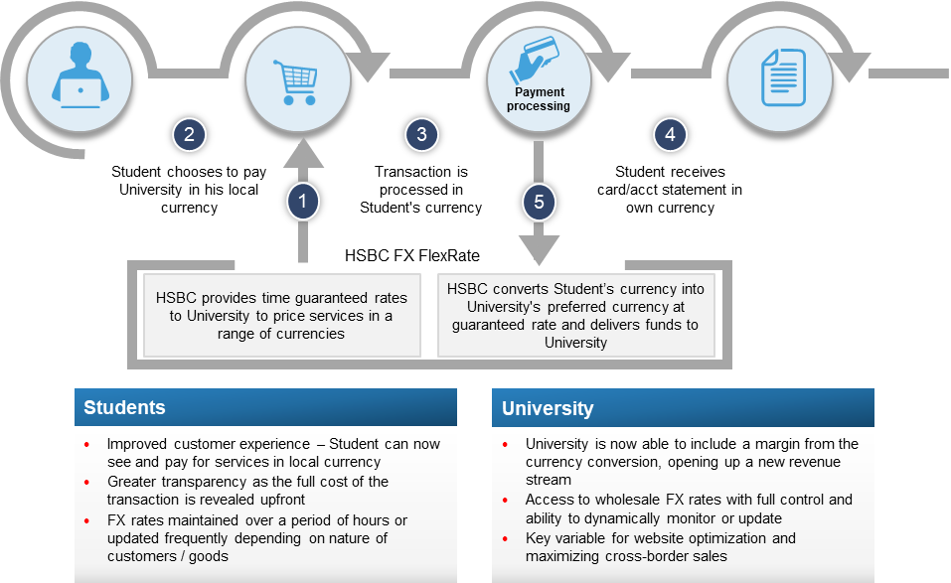
HSBC TRANSACTIONAL FX HSBC MULTI-CURRENCY PRICING (MCP)

Slide 10
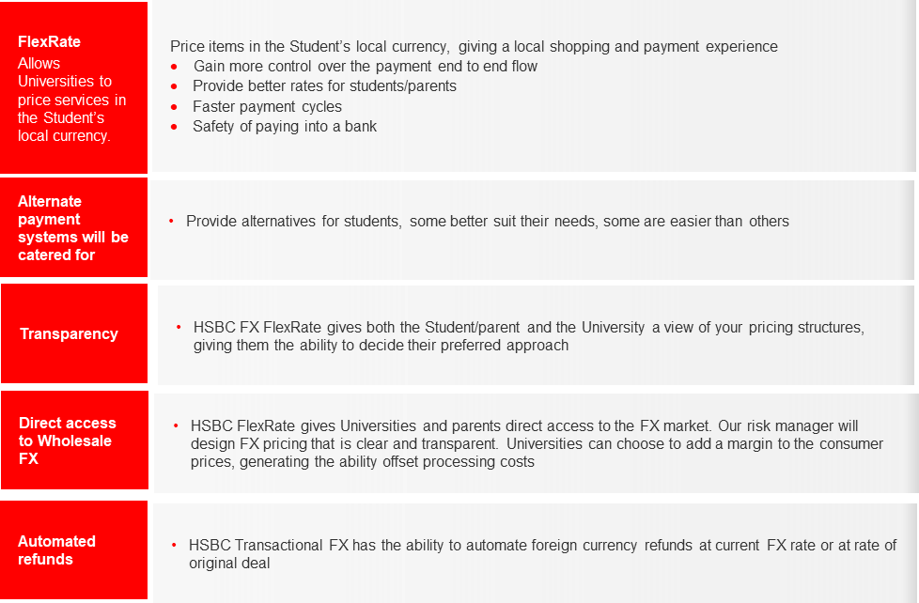
HSBC TRANSACTIONAL FX BENEFITS

Slide 11
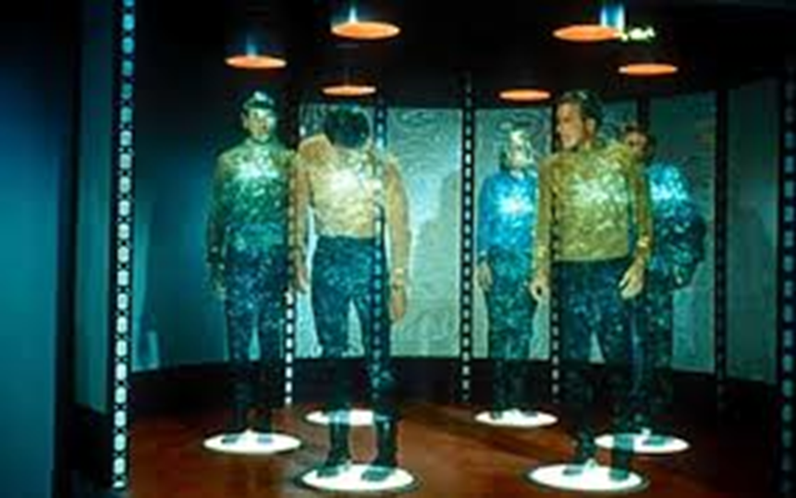
DIGITAL TRANSFORMATION

Slide 12
WHAT SHOULD WE ALL BE DOING?
What do tomorrows students want?
Do their requirements makes sense?
Do they add value to the university and students?
Are there any barriers?
Identify
Strategy
Develop a plan to implement and maintain the requirements
Address the barriers
Work with partners and subject matter experts
Alignment to students expectations
Benefits
Better customer service
Easier for students to transact business
Improved digital ecosystem
Repeat
Your strategy needs to continuously evolve
The requirements of students change

Slide 13
BENEFITS
Centralised
Platform
Local/Global
Partnerships
Security and
Compliance
Increased
Efficiencies
Customer
Service
Smart
Mobility
Multiple
Payment Options
Data Validation
and Integration
Customer
Portal
Reporting and
Reconciliation

Slide 14
THANK YOU!

