Slide 1
Common Attribute Framework for Everyone, not just Bravehearts!
SESSION 37049
October 11, 2016
10:00-11:00AM
Room Edinburgh C

Slide 2
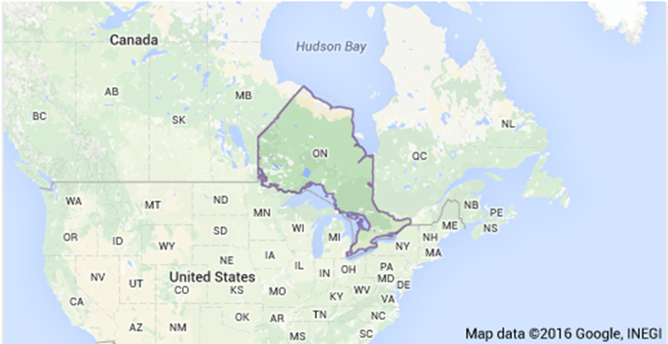
presenter
Dorothy Chapman
Systems Manager
University of Waterloo
dlchapma@uwaterloo.ca

Slide 3
- Founded in 1957 with 74 students
- Today: 30,600 undergraduate, 5,300 graduate students
- 15 per cent international undergraduate, 36 per cent international graduate students
- Operates the largest post secondary co-op program of its kind in the world (19,000+ students in co-op).
- More info: Waterloo Facts

Slide 4
WATERLOO & ORACLE
Campus Solutions 9.0
PT 8.53, Bundle 33
HR 9.1
PT 8.53, Bundle 14

Slide 5
Overview
About the Common Attribute Framework (CAF) What is CAF, Attribute Types, Display Options
Setting up Common Attribute Framework Delivered or Build, Setup: Attributes & Record Context
Filters & Security Using filters, Security for setup and end-users
Using Common Attribute Framework Use Cases, Migrating CAF, Reporting, Processes
Lessons Learned Processes, Query, 2 SR’s with Oracle

Slide 6
About the Common Attribute Framework
What is CAF
Attribute Types
Display Options

Slide 7
What is Common Attribute Framework (CAF)?
Challenge: ‘Custom fields’ needed to respond to unique requirements, from within the institution, 3rd party data sources or various levels of government.
Oracle’s solution: The Common Attribute Framework allows users to add ‘unique fields’ without customizing or creating a bolt-on.
The CAF gives users the tools to create a variety of field types to be added where needed.
CAF delivery began with Bundle 26, July 2012.

Slide 8
More on CAF
End User: New field on a delivered page
Techie: A data element (with attributes) associated with a Record
What can CAF do?
“Extending a record with an attribute is similar to adding a new field to that record. The advantage of extending a record with an attribute is that there is no impact on any existing functionality in the system that uses this record. Additionally, it is possible to change the number and order of attributes at runtime dynamically without having any impact on existing extensions to this record.” [PeopleBooks 2014, Campus Community, Working with Common Attribute Framework]
One more thing to note: There is integration between the Entity Registry and the new Common Attributes Framework. Attributes will automatically be handled as properties on the entity. [Oracle Campus Solutions Statement of Direction – 2013-2014]

Slide 9
CAF Delivery
First Delivered in Bundle 26, July 2012
Program Enrollment
Activity Management
Research Tracking
Bundle 27 – Oct 2012
Financial Aid - Packaging
Student Records – Class Associations
External Organization – Formal Description
Bundle 31 – Oct 2013
Admissions
Bundle 32 – Jan 2014 & 34, 35, …
Test Scores – CAF examples, additional data elements

Slide 10
Attribute vs Framework
A Common Attribute is:
Data entity, similar to a field
Each data entity has a type (e.g. text, date, #, LOV)
A data entity can have formatting requirements and/or validation
A data entity (with a set of attributes) is associated with a record, similar to adding new fields to a record.
Dynamic – can be setup so to add/remove fields at runtime
The Framework is:
A consistent approach
Extending the data model throughout Campus Solutions
Reducing time in the development lifecycle
Available to functional users

Slide 11
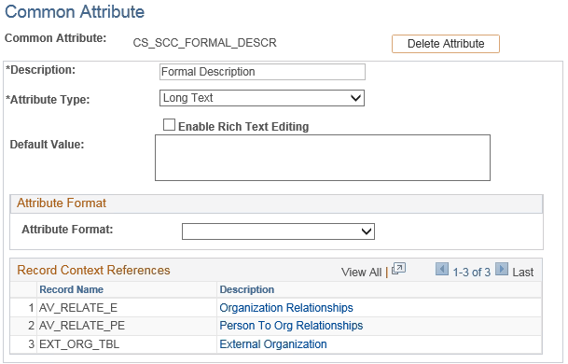
Attributes & types
Common attributes have properties:
Name
Type
Default value
Format (e.g. @ in email)
There are attribute types:
Date
Time
Yes/No
Number
Long text
Text (maximum 50 characters)
Short text (maximum 20 characters)
List of Values (LOV)

Slide 12
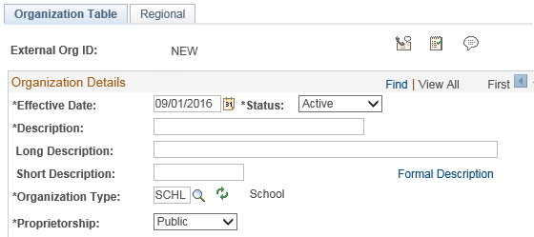
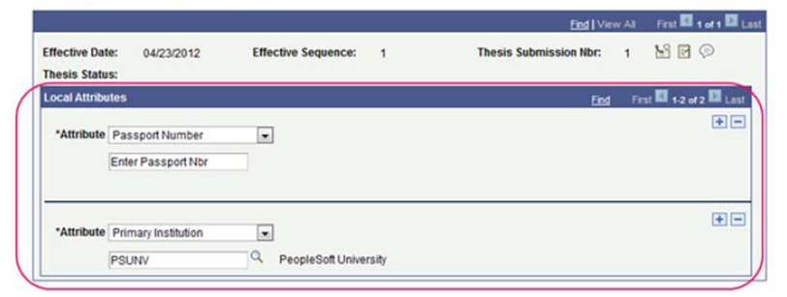
Display options
There are three display options:
Link that opens a new ‘subpage’
Fixed in position
Not repeatable
Single column
Appears in a scroll area
Appear on main data page
Repeatable
Custom Common Attribute Application Programming Interface (API) – not covered

Slide 13
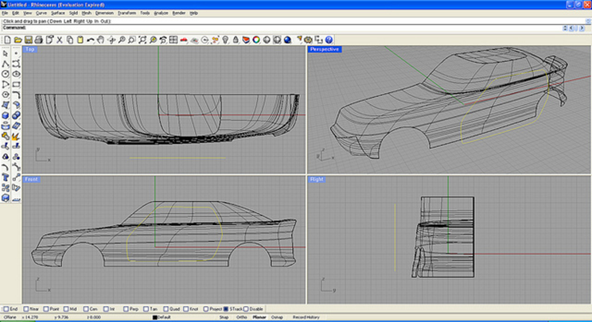
Setting up common attribute Framework
Delivered or Build
Setup Attributes
Setup Record Context

Slide 14
Delivered or build?
Does an attribute exist? As of bundle 33, 83 attributes are delivered.
> Set Up SACR > Common Definitions > Common Attribute Setup > Common Attribute
Is the record CAF enabled ? 45 records are available as of bundle 33.
> Set Up SACR > Common Definitions > Common Attribute Setup > Record Context
Is a PIA page enabled to display the attribute? Look at the page…. Does is have:
a link such as Additional Fields, Formal Description, Attributes
or a scroll area like then you probably have CAF enabled.
Still not sure? Application Designer.

Slide 15
Considerations
Evaluate the business/use case for new field(s) on page.
Have a coding convention, can it be maintained long term?
Ongoing work to maintain customizations of menus, pages, records, fields (and potentially setup tables too) vs delivered CAF functionality?
Technical vs Functional resources to build & maintain the new fields(s)?
Long term, how many new fields could potentially be added to the page?
What is the correct level (on the page) to place the CAF?
Think about ‘date’ vs ‘effective date’.
How should the new field(s) display on the page? Link vs scroll area vs custom?
Brand new field(s) vs de-customizing?
If de-customizing, think about downstream processing & data conversion.
Other processes updating the page – do they insert child CAF row?
Include new attributes in end-user training, test plans, query.

Slide 16
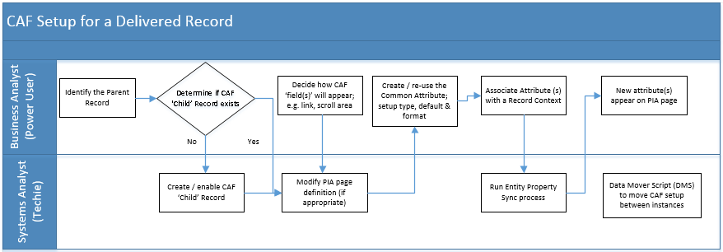
Setup flowchart

Slide 17
Attribute setup
P.S. If you want to view the Attribute Type details: Set Up SACR > System Administration > Utilities, Common Attributes Setup > Attribute Type
P.P.S. Delivered Attribute Types can not be changed.

Slide 18
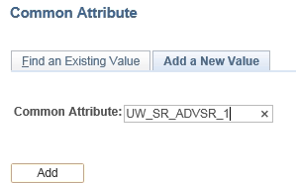
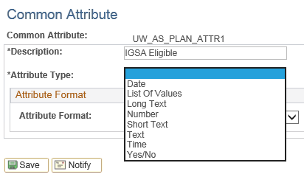
Attribute setup
Add a New Value
Have a naming convention!
Select the Attribute Type
If using your own List of Values (LOV), it does not need to be setup before creating the new attribute.

Slide 19
Attribute setup
Select the Attribute Type and the page changes:

Slide 20
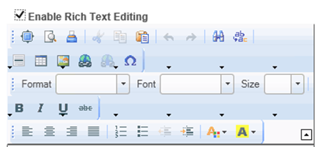
Attribute setup

Slide 21
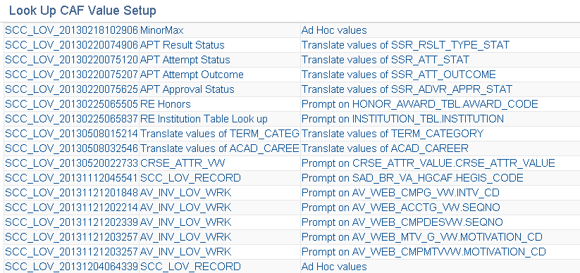
Attribute setup: LOV ‘delivered’
Use a delivered one – be careful; Oracle is using it/them elsewhere!

Slide 22
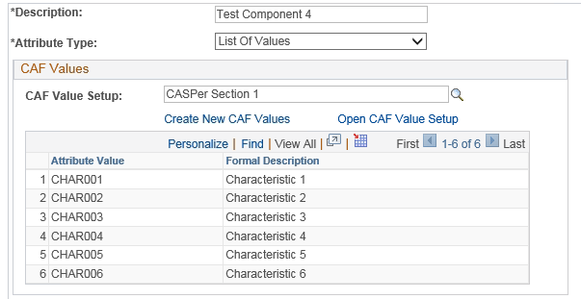
Attribute setup: LOV ‘Create new’
Create your LOV using “Create New CAF Values”

Slide 23
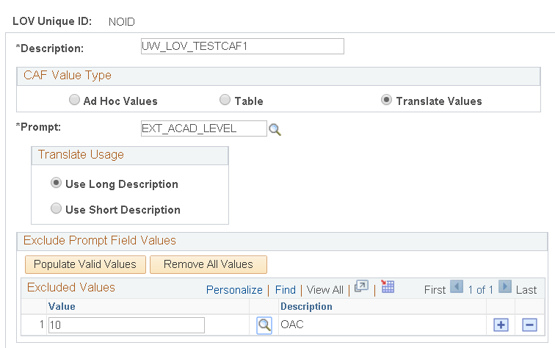
Attribute Setup: LOV Translates

Slide 24
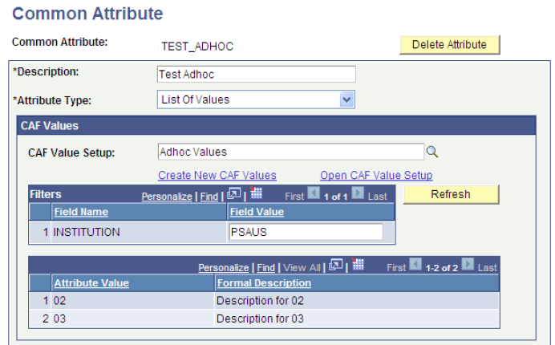
Attributes - LOV Filter
Note: After filter setup is complete and SAVED, you can ‘test’ your filter.
Enter a valid field, e.g. ‘INSTITUION’, then ‘PSAUS’.
Click the Refresh button.
Valid CAF values for specified institution appear.
1
2
3

Slide 25
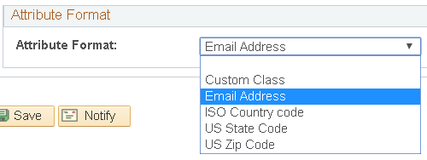
Attribute Format
A few Formats are delivered. Developers can write a ‘Custom Class’ using PeopleCode for specific formatting or validation requirements. [see PeopleBooks, Campus Community, Working with Common Attribute Framework, Writing Custom Logic for Validation and Formatting]

Slide 26
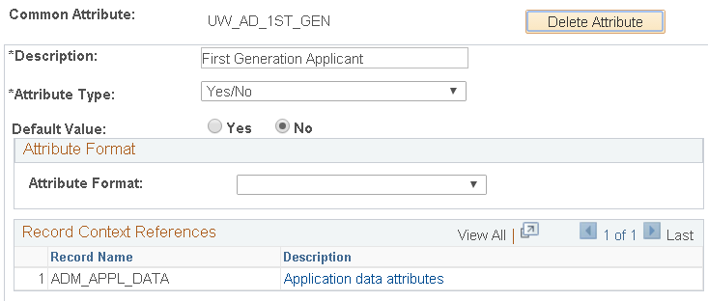
Attribute example
After the Attribute is saved, the ‘Delete Attribute’ becomes available. You can also see which record(s) the Attribute is attached to.

Slide 27
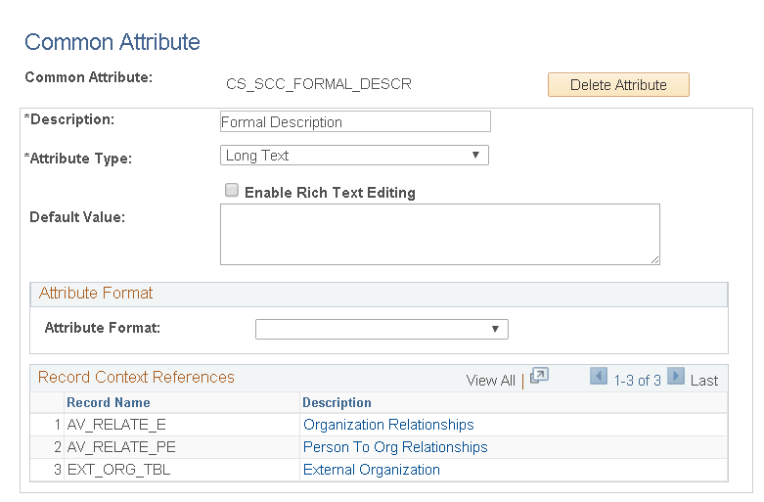
ATTRIBUTE Example

Slide 28
Record Context setup

Slide 29
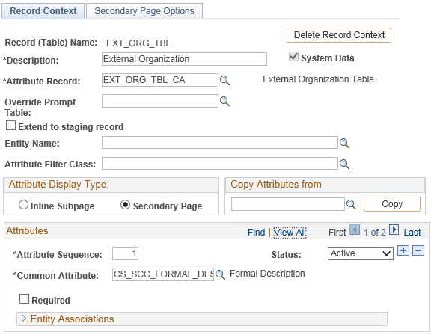
Record Context SETUP Delivered
The External Organization table is delivered with the attribute ‘Formal Description’ AND you can add additional user-defined attributes.

Slide 30
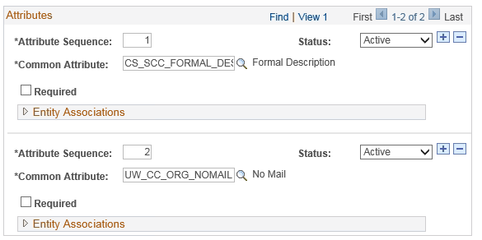
Record Context SETUP: Added to
The ‘No Mail’ attribute was added by UWaterloo.

Slide 31
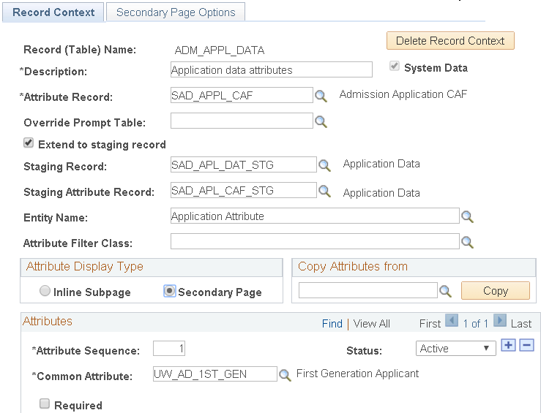
Record Context Setup required
Entity sync will need to be run!

Slide 32
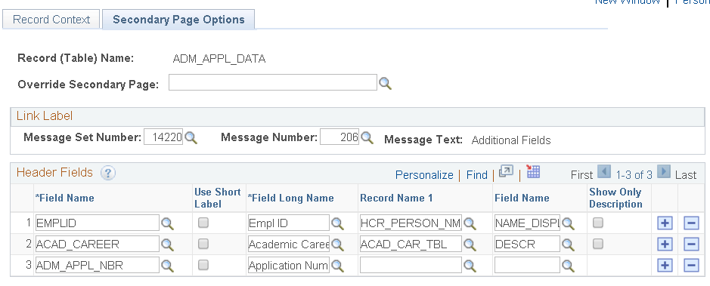
Record Context – Secondary Page
Label for the link to secondary page. It appears on PIA page. This is from the delivered Message Catalog – if you want a different Label, use your institution’s Message Set Number & Message Number.

Slide 33
Record context: header fields

Slide 34
25 CAF limit??
Phil Wilkinson
RE: Number of CAF fields warning
August 14, 2014 04:35 PM (in response to Alison Rackler Lewis)
Hi both
The 25 CAF field limit applies to CAF implementations where the CAF fields are shown on a secondary page rather than an inline page, as the secondary page will only show the first 25 on screen. However, PDL uses inline pages to display its CAF values, and so the limit is not relevant in this case.
From: http://www.heug.org/p/fo/st/post=271404&anc=271404#p271404

Slide 35
Adding CAF where it’s not delivered
With thanks to Phil Wilkinson for this blog. https://www.heug.org/p/bl/ar/blogaid=2032
I was recently asked how, in simple language, to implement the CAF on custom pages, or on pages where Oracle have not yet delivered the framework.
The implementation is relatively simple.
Find the page that you want to activate the CAF for, and identify the parent record – e.g. for Application Data page, the parent record is ADM_APPL_DATA
Create a new custom record with the same key structure, and insert sub record SCC_CAF_SBR into it
Decide if you want a new page for CAF on your component, or want to have a subpage with a link on the existing page. I recommend the first as you then don’t customise the delivered page, only the component
Option 1 – new page
Create a new page using the parent record from step 1 to create your ‘header’. If the record is effective dated, you’ll also need to put the relevant scroll structure in place
Insert subpage SCC_CAF_SBP onto the page. Save
Insert page into component.
Option 2 – link on existing page
Insert subpage SCC_CAF_LAUNCH_SBP onto the page and save.

Slide 36
It’s not delivered, continued…
Navigate to Setup SACR > Common Definitions > Common Attributes Setup > Record Context
Add a new value
Enter the name of the parent record, and click Add
Complete the page as appropriate, using your new record as the ‘Attribute Record’
Select if your CAF implementation is option 1 (Secondary Page) or Option 2 (Inline Subpage)
On the second tab, configure the link text using Message Catalog and configure the page header – view one that’s delivered for guidance with that, but it’s basically what will appear at the top of the page when opened.
Save
That's you done - you can now configure your CAF fields and attach them to the CAF record.

Slide 37
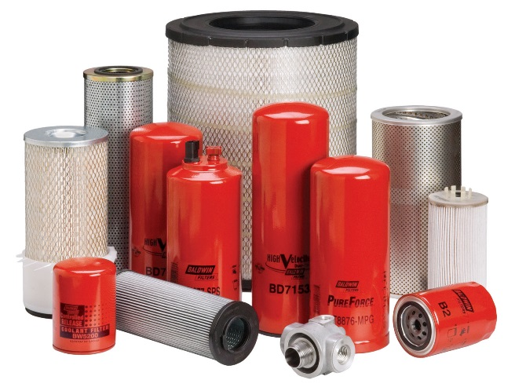
Filters & security
Filters
Security for Setup
Security for end-users

Slide 38
Filters
When an attribute with an LOV using Ad Hoc Values or Table is SAVED, and the
associated CAF value setup in the CAF Values - the LOV definition page uses a filter field, the Filters grid is available on the Common Attribute component.

Slide 39
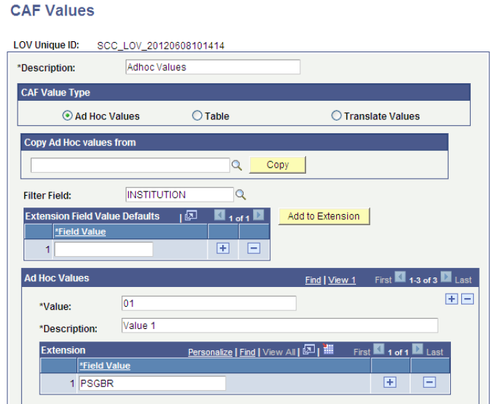
filters
Return to the saved LOV setup.
Manually add the institution below its valid CAF values (and save again).

Slide 40
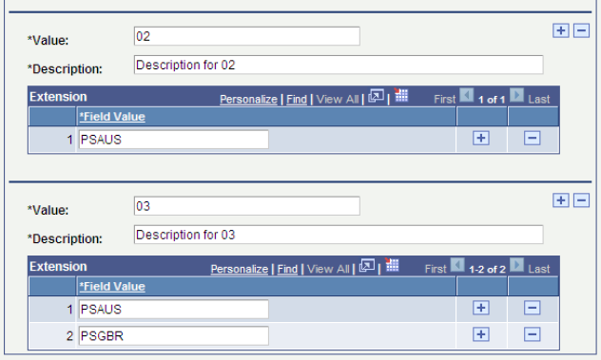
Filters
During setup, it might seem a little odd to specify the LOV ‘value’, then attach the institutions for which it will display…. But it works! The end user selects the institutions and the valid CAF values will appear.

Slide 41
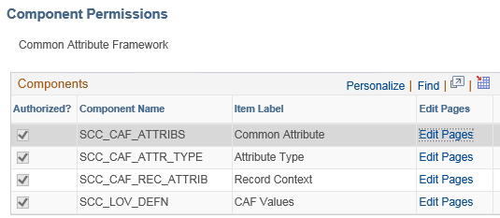
Security for CAF setup
2 Functional Security Roles for CAF
Setup CAF – 1 permission list & 1 role
Maintain LOV – 1 permission list & 1 role
Component: SCC_CAF_COMMON_ATTRIBUTES
1 Technical Security Role with
Entity Sync Process
Component: SCC_ENTITY_SYNC

Slide 42
Security for End users
Security setup for end-users: NONE!
CAF takes on the permissions of the parent record/page.
The good: no extra security setup
The not so good: can’t have different security for the main page and a CAF subpage
Add relevant records to the appropriate Query Tree / Access Group.

Slide 43
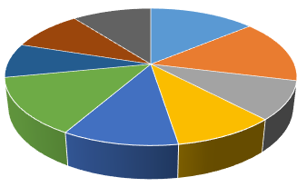
Using CAF
Use Cases
Migrating CAF
Reporting
Processes

Slide 44
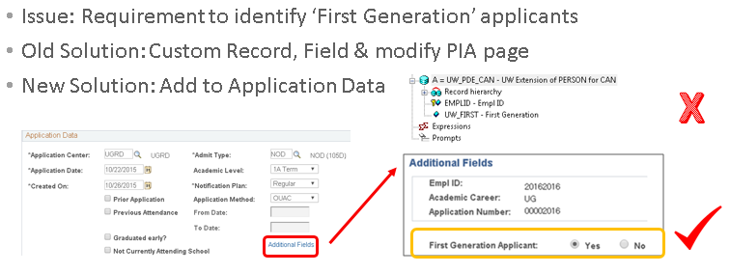
Use Case Admissions
‘Custom’ Field to CAF

Slide 45
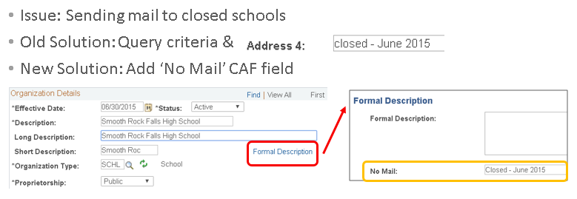
Use Case External Organization
‘Repurposed’ field to CAF

Slide 46
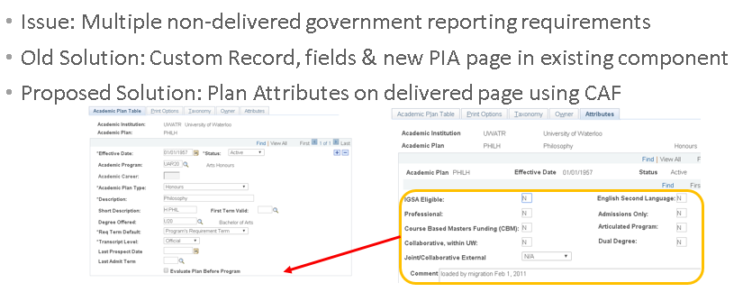
Use Case Academic Structure
Replace ‘custom page’ with CAF

Slide 47
Migrating CAF between Instances
Manual option:
Rebuild it all by hand in each instance.
With technical assistance, get a Data Mover Script written.
2 sample Data Mover Scripts provided by
Beverly Forbes, University of North Texas Systems
On the HEUG listserve item# 297763 July 16, 2015
CAF_EXPORT_TEMPLATE.dms
CAF_IMPORT_TEMPLATE.dms

Slide 48
Reporting – Query Tree
Add CAF records to the appropriate Query tree to get attribute descriptions, types, etc.
Add ‘area’ specific CAF records to the appropriate Query tree. E.g.
SAD_APPL_CAF Admission Application CAF
AV_DONR_APPCAF Donor appreciation
EXT_ORG_TBL_CA External Organization Table
SSR_PLAN_CAF Student Plan CAF Table

Slide 49
Processes
Attributes that you build (using a custom CAF record) are not picked up by delivered processes, even if a process uses the parent record the CAF is attached to.
If a delivered process uses component interface (CI) it should update the CAF table(s) – check carefully!
Custom SQR’s / Application Engines must get the parent record/ child record hierarchy and key fields correct, and allow for ‘existing’ and ‘null’ values.

Slide 50
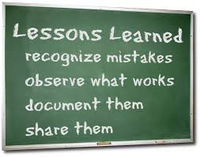
Lessons learned
Processes
Query
2 SR’s with Oracle

Slide 51
Lessons learned Processes
SQR’s built/delivered before CAF existed will update the parent record, but NOT the CAF (child) record.
Have a technical resource do a search on existing processes to see how many processes do insert/update/delete on a potential parent record
Attach a custom CAF record to a ‘low traffic’ parent record - it is a better choice than a ‘high traffic’ parent record
E.g. Application data has fewer row inserts than Application Program
Make sure the attribute sequence number is filled in [a required field!] and matches the parent; also populate the SSR_SHOW_STU_SS and SCC_AUDIT_SBR
If the CAF is attached to a parent record with historical data, make sure these rows are matched and built in the CAF record [system does this for ‘manual’ transactions]
The ‘number’ attribute format does not retain leading zero’s – if you need leading zero’s, use a ‘text’ format attribute

Slide 52
Lessons learned Query
Use a left-outer join when there may be ‘blank’ values in the CAF record
When a Record has >1 Attribute, qualify the query on ‘Attribute’ or ‘Null’ to return all values
Beware of Effective Date (is usually a standard join) so results may be missing
An expression using FIELDNAME+ in manual outer joins facilitates >1 outer join in a single query
CLOBB errors on long text fields might be resolved by using ‘substring’

Slide 53
Lessons learned CAF BUGS
‘Required Flag’ not working as expected on Record Context
Oracle SR 3-12975553611
Using the Application Program Data page in Update/Display mode, on a record that was created before the attribute, if you insert a new row & click 'Save' there is no error message & record saves. Using the Application Program Data page in either 'Include History' or 'Correct History' mode, on a record that was created before the attribute, if you insert a new row & click 'Save' the error message appears "The attribute 'YourAttribute_descr' is required. (14097,1) Please enter data in the attribute before saving." If the attribute is setup as Not Required why does this error message appear? We know the data rows in ADM_APPL_PROG and SAD_PROG_CAF must be in sync. We've observed that 'historical' data rows are created in SAD_PROG_CAF when using Update/Display & no error message appears. In the first round of testing we didn't have a default value for the attribute & thought that was causing the issue. Next round of testing we gave the attribute a default value but this did not resolve the issue as the historical rows created do NOT contain the default value. We suspect that the 'save' function of Update/Display is only checking the current row & not the historical rows, & that the 'save' function for Include History and Correct History looks at all the rows in the CAF record & is somehow tripping over the empty/blank attribute values.
CAF Attribute Status Set to Inactive Allows Users to Edit on Attribute Page
Oracle SR 3-13102360062, Bug 24407409

Slide 54
Concluding thoughts
Summary
Resources
Question time

Slide 55
SUMMARY
Many things to consider before choosing CAF or custom
Minimal technical time to setup PIA page display & run Entity Sync process (after setup & some changes)
Majority of setup & maintenance done by functionals/business users
Timely delivery of user-defined fields
Reduces potential problems when testing (particularly for bundles/PUM images)
Well documented

Slide 56
Resources - Oracle
PeopleBooks
Campus Community Fundamentals, Working with Common Attribute Framework
Student Records, Using Common Attribute Framework for Student Academic Projects
Bundle Documentation: 26, 27, 30, 31, 36, 38
Most Recent Updated PeopleBooks Chapters Spreadsheet: A spreadsheet of CS PeopleBook chapters is updated each time a new CS 9.0 Bundle is delivered. There is a tab for each book with any updated chapters listed alphabetically in the sheet along with the number of the latest bundle in which the chapter was updated.
Sign in required to My Oracle Support
Search Knowledge Base for Document ID 1523915.1
Transfer of Information Sessions Available for Campus Solutions New Features Document 1565375.1
Campus Solutions 9.0 - Additional Features April 2013 TOI: Understanding the Common Attribute Framework Functional Overview
Campus Solutions 9.0 - Additional Features April 2013 TOI: Adding or Removing Common Attributes for Prospect/Admissions Data Load Functional

Slide 57
Resources – Alliance conferences
Alliance 2014
33114 CS Architecture 3: Common Attribute Framework Overview
Alliance 2015
34102 Getting Started with the Common Attribute Framework (CAF)
34350 Tracking Academic Standing Appeals with Common Attribute Framework
Alliance 2016
35651 Using Common Attribute Framework in Admissions and External Organizations
35591 Embracing Common Attribute Framework in a Business Process
35140 Common Attribute Framework on CR Designations

Slide 58
Question time!

Slide 59
presenter
Dorothy Chapman
Systems Manager, Admissions
University of Waterloo
Waterloo, Ontario Canada
dlchapma@uwaterloo.ca
all Alliance presentations will be available for download from the Conference Site

Slide 60
THANK YOU!

