Slide 1
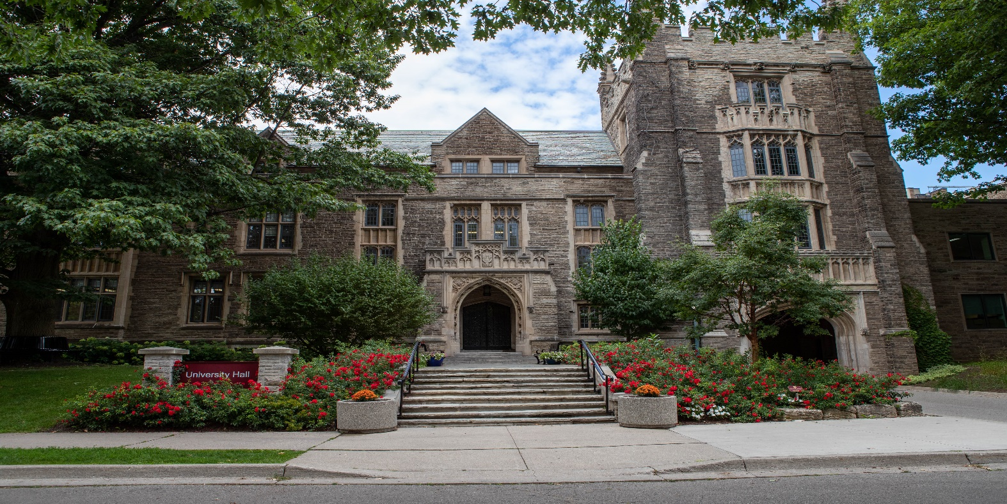
Automagically uhip
SESSION 7015
Wed. Nov. 6, 2019

Slide 2
presenters
Ana Pereira
Mark Russom
Coordinator for International Students
McMaster University
ferreiar@mcmaster.ca
Business Analyst
McMaster University
russom@mcmaster.ca
McMaster graduate
10-year employee at McMaster
UHIP Administrator (one of many hats)
Loves meeting students from all over the world each year
15-year employee at McMaster
IT background in application development
Member of the implementation project team with a primary focus on Student Financials and secondary focus on other Campus Solutions modules
Resident “mad scientist” in Financial Affairs since the CS implementation

Slide 3
McMaster university

Slide 4
Brighter World Infographic
CANADA ALLIANCE 4 - 6 NOVEMBER 2019

Slide 5
Peoplesoft Versions
CS 9.2 PUM 7
FSCM 9.2 PUM 25
HCM 9.2 PUM 24
PeopleTools 8.55.22

Slide 6
agenda
Impetus for automation
The “Temple” of UHIP (foundation and pillars)
Reporting
Future Plans
Questions (and Answers)

Slide 7
The impetus for automation

Slide 8
Why did we automate?
Completely manual process
Re-keying of data
Prone to human error
Insanely time-consuming, especially at the start of the academic year

Slide 9
Volume of data (2019-20 academic year)
6200+ qualified students
1400+ disqualified students (who were originally qualified)
Approx. 5900 students enrolled with Sun Life
Approx. 15% increase in volume over 2018-19

Slide 10
The “temple” of uhip

Slide 11
UHIP
Insurance Enrollment
Coverage Administration
PRA Reconciliation
Qualification
Configuration

Slide 12
configuration

Slide 13
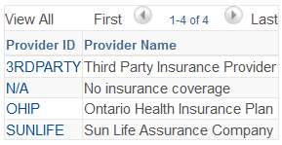
configuration
Set Up SACR > Product Related > Student Financials >
International Health Coverage > Provider Table
The reason for having 3RDPARTY, N/A, and OHIP
will become evident later on. Stay tuned!

Slide 14
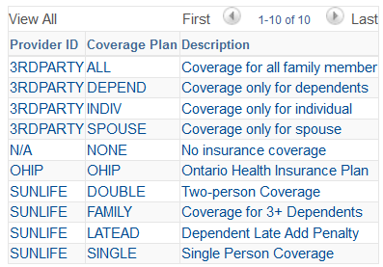
configuration
Set Up SACR > Product Related > Student Financials >
International Health Coverage > Coverage and Rates

Slide 15
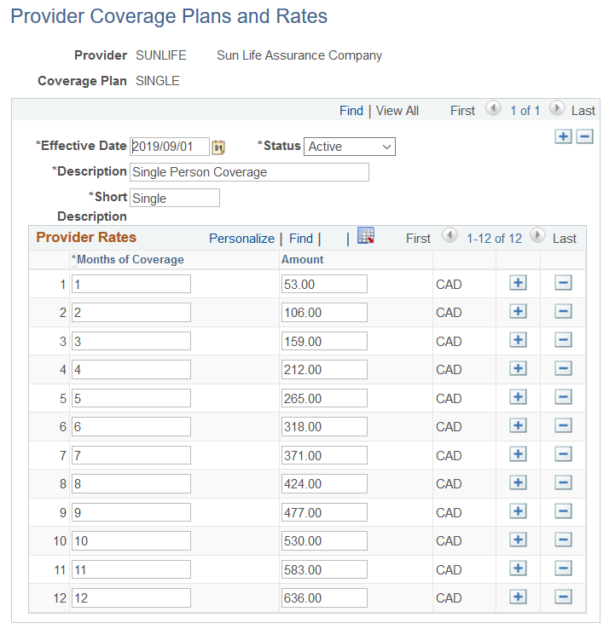
configuration

Slide 16
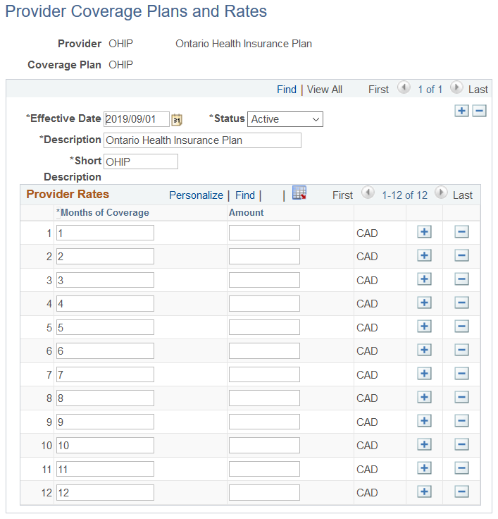
configuration

Slide 17
qualification

Slide 18
Qualification
A nightly batch run which qualifies students for a specified academic year. The qualification criteria are:
students in UGRD, GRAD, MED, and DIV careers
certain Nursing programs are exempt
citizenship statuses of ‘Work Authorization’, ‘Student Visa’, ‘Approved in Principle for Permanent Residency’, ‘Other Visa’, ‘Refugee’
non-deceased
In addition, the process does the following:
rolls over previous years’ exemptions and dependents
re-validates qualifying status of students not yet enrolled with Sun Life
disqualifies those students no longer meeting the above criteria
calculates the cost of insurance

Slide 19
Insurance enrollment

Slide 20
Insurance enrollment
An on-request batch run which builds the necessary enrollment data for Sun Life in XML format. The enrollment criteria are:
students who are qualified (either manually or automatically)
have not yet been insurance enrolled
cost of insurance > $0
academic load exists (to avoid enrolling no-shows)
In addition, the process does the following:
reports all errors and warnings for follow-up action (e.g. missing postal codes, empty enrollment files)
retrieve the newenrol.xml file from Process Monitor job log
UHIP Administrator submits to Sun Life via secure portal
Sun Life transmits error report as a result of file submission

Slide 21
Coverage administration

Slide 22
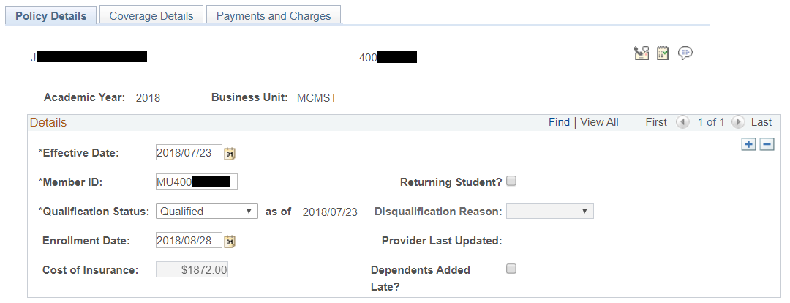
Coverage administration

Slide 23
Coverage administration
The 12-month coverage ‘window’
In Coverage Administration, you always see what a student’s coverage looks like for the entire 12-month academic year, even if there is no UHIP coverage. This is where the other providers “3RDPARTY”, “N/A”, and “OHIP” come into play. These ‘providers’ act as placeholders for the periods in time where there is no UHIP coverage.
Example: Student has UHIP coverage from September through December, and then obtains OHIP coverage for the remainder of the academic year. On the ‘Coverage Details’ tab you would see two sets of coverage details – one for the period of UHIP coverage September through December, and one for the period January through August where the student was covered by OHIP.
The positives for doing this are a simplified means of calculating the cost of insurance, plus being able to see at a glance the entire picture of coverage for the whole academic year.

Slide 24
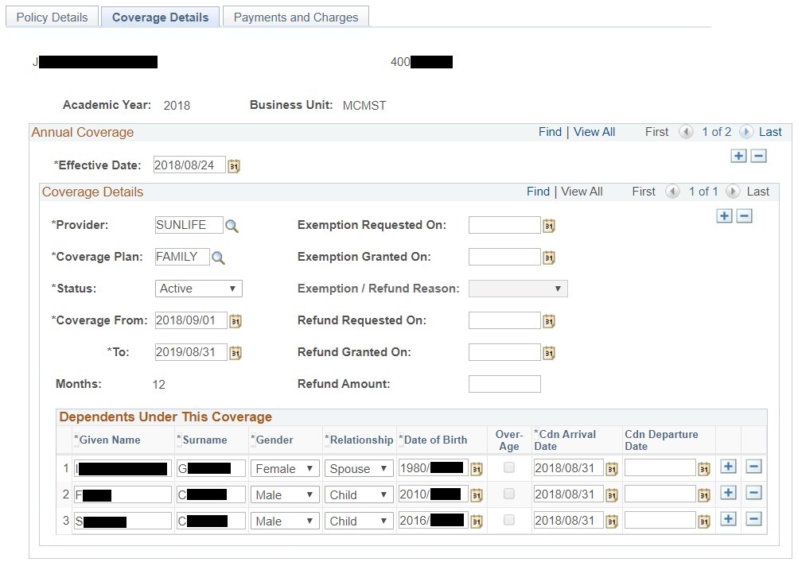
Coverage administration

Slide 25
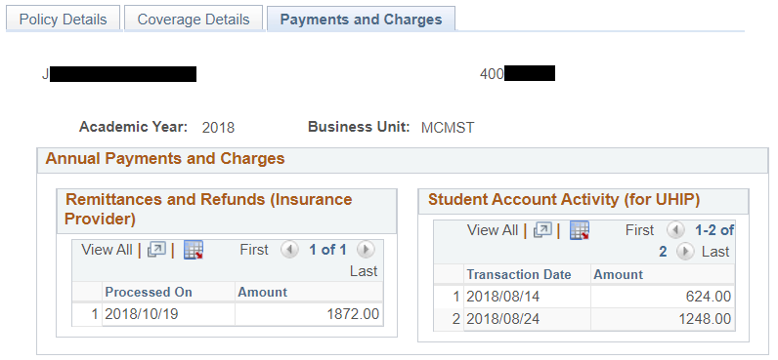
Coverage administration

Slide 26
pra reconcilation

Slide 27
Pra reconciliation
Three-step process:
1. Load and validate the PRA
Take the PRA Excel spreadsheet from Sun Life, save it as a CSV file.
Upload the CSV file to the “Landing Zone” (file repository).
Run a batch process which loads the PRA into Peoplesoft and validates the input.
The validation determines whether or not McMaster and Sun Life agree on the out-of-balance state of the student. A report highlights those cases where:
Sun Life considers the student out-of-balance but McMaster doesn’t
McMaster considers the student out-of-balance but Sun Life did not report them
Sun Life and McMaster disagree on the out-of-balance amount
The validation process creates a ‘draft’ PRA with a line for each entry on Sun Life’s original PRA. For all students where Sun Life and McMaster agree on the amounts, the agreed-upon remittance or refund amount is pre-populated on the draft.

Slide 28
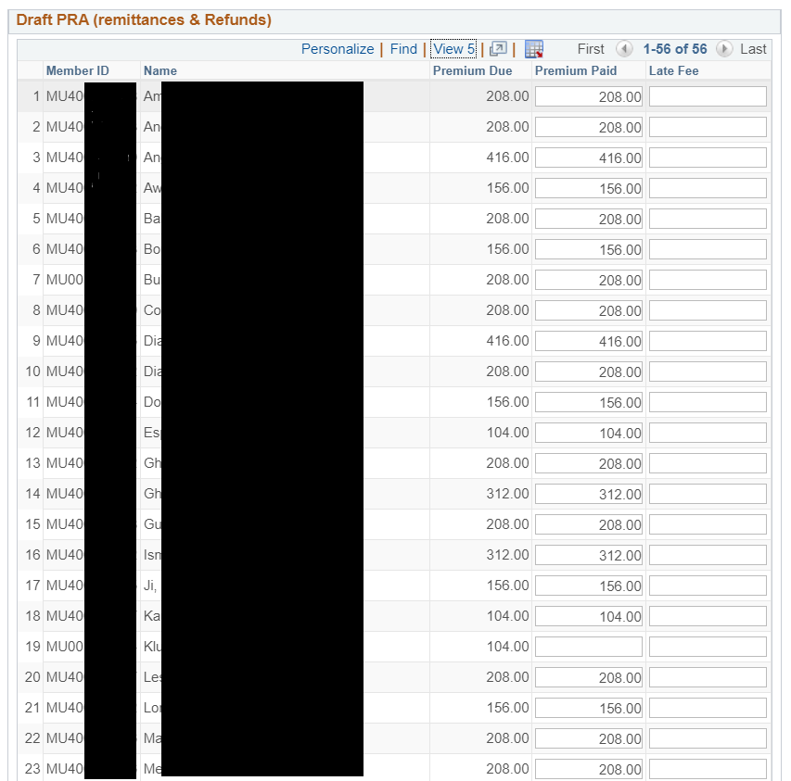
Pra reconciliation

Slide 29
Pra reconciliation
2. Adjust the draft remittances and refunds
In Peoplesoft, pull up this ‘draft’ PRA and adjust any of the remittance or refund values which were pre-populated in the first step. Add any other values you wish, ore remove ones who you’ve changed your mind about.
Generate the final PRA
Once you are satisfied with the ‘draft’ PRA, you can generate the final PRA. This will be a CSV file, which can then be sent to Sun Life. Sun Life has reviewed this format and deemed it acceptable.

Slide 30
reporting

Slide 31
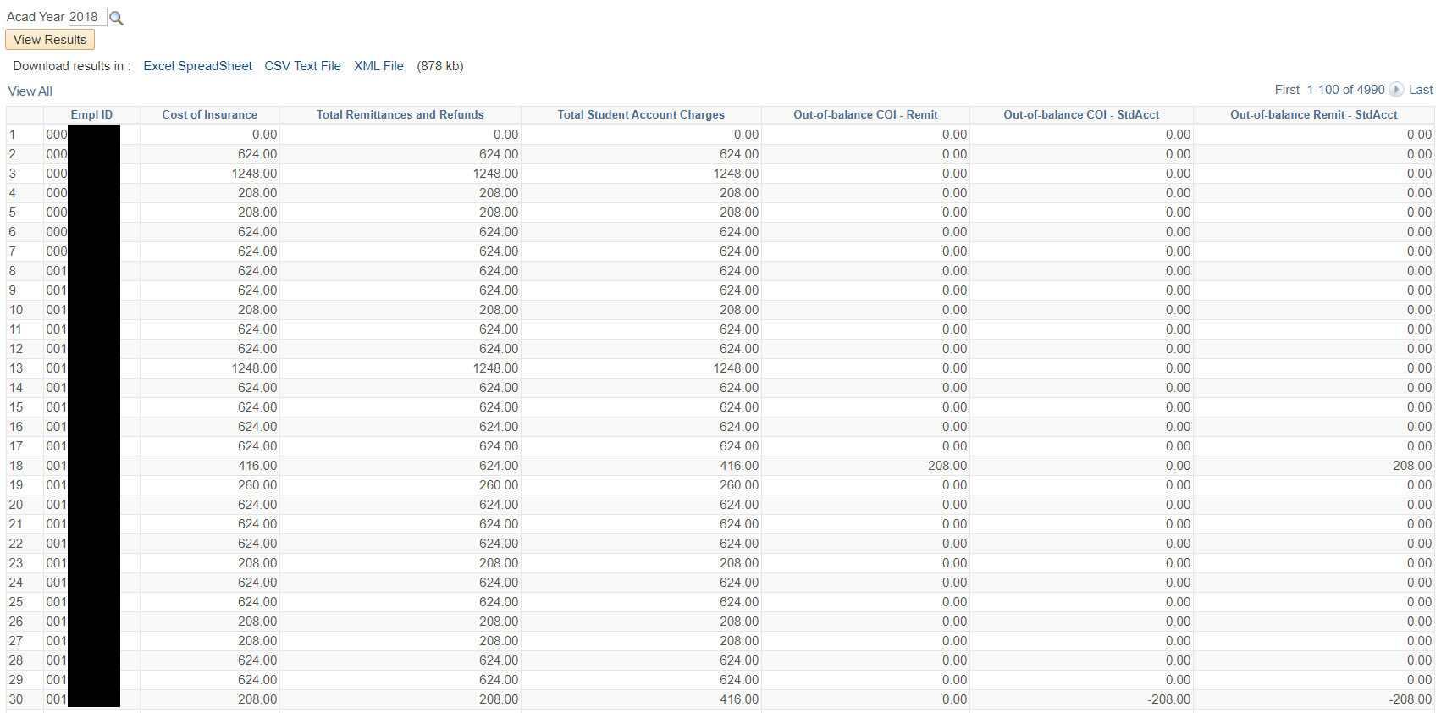
reporting
We have the ability to run our own out-of-balance report. This report itemizes each student’s cost of insurance, what has been charged to their student account, and what has been remitted to Sun Life. So, it’s always easy to see where your accounts stand in terms of reconciliation.

Slide 32
Future plans

Slide 33
Future plans Things we’d like to do when we have a few spare moments
Add dependent-only coverage
Improve rollover process (during qualification)
Apply any future changes to XML enrollment file as required by Sun Life
Connect Peoplesoft Comments feature to UHIP admin screens (3C button set)
Self-service admin page for modifying exemption reasons (must be effective-dated!)

Slide 34
questions

Slide 35
presenters
Ana Pereira
Mark Russom
Coordinator for International Students
McMaster University
ferreiar@mcmaster.ca
Business Analyst
McMaster University
russom@mcmaster.ca
all Alliance presentations will be available for download from the Conference Site

Slide 36
Thank you!

