Slide 2
Online Reporting Made Easy with Pivot Grid
Presenter Information
Jasir Illias
ERP System Specialist
Abu Dhabi University
Jasir.illias@adu.ac.ae
SESSION 1025
16-Nov-2016

Slide 3
Agenda
Review Existing options of Online Reporting available in PS
Introduction to Peoplesoft Pivot Grids
Introduction to Peoplesoft Pivot Charts
Application and Examples

Slide 4
Peoplesoft Reporting
PS Query

Slide 5
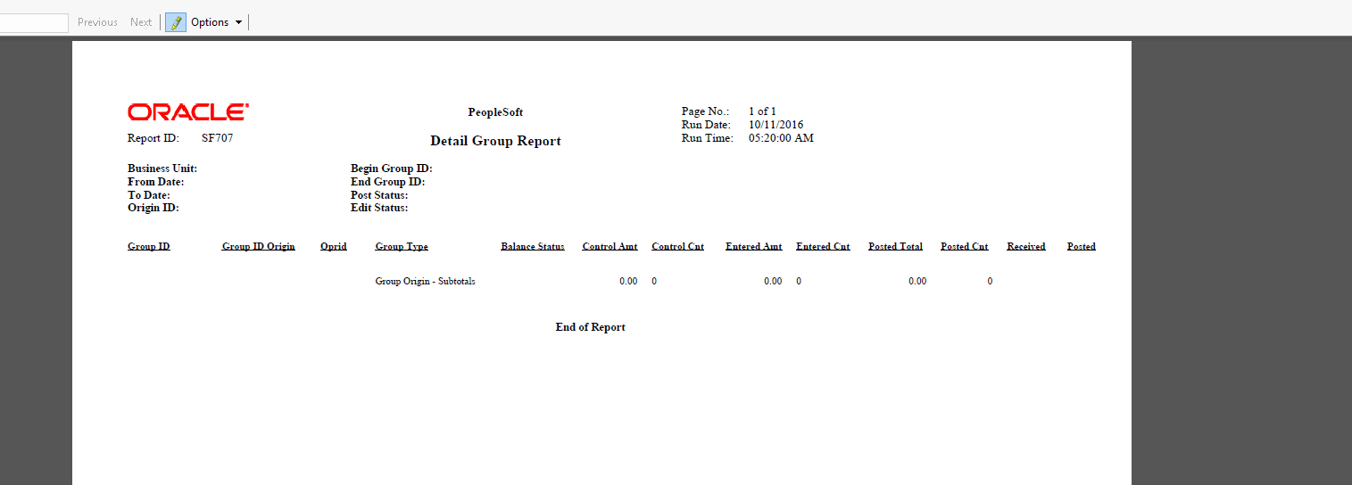
Peoplesoft Reporting
XML Reports

Slide 6
Peoplesoft Reporting
SQL Reports

Slide 7
Pivot Grids
Enables end user to visually analyze data in a dashboard.
Provides the basic BI functionality right in Peoplesoft.
Data could be viewed in different views by pivoting and filtering options available out of box.
Simple to setup with wizard

Slide 8
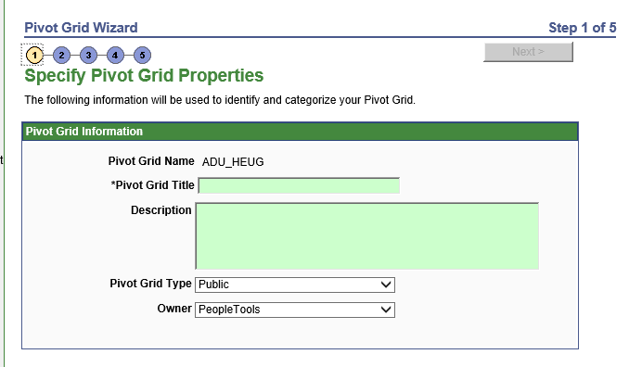
Pivot Grid Wizard
Pivot Grid wizard is a 5 step wizard which will guide you to setup a pivot grid .

Slide 9
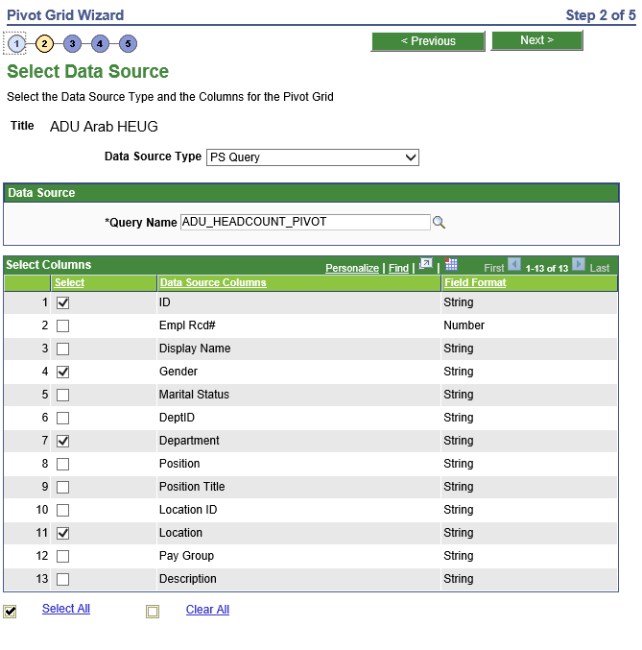
Pivot Grid Wizard

Slide 10
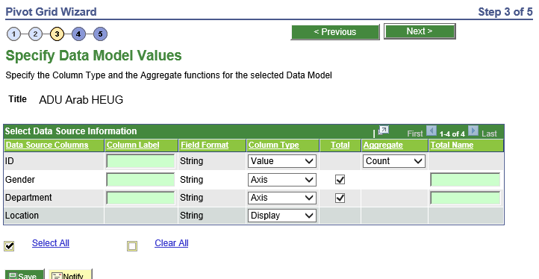
Pivot Grid Wizard

Slide 11
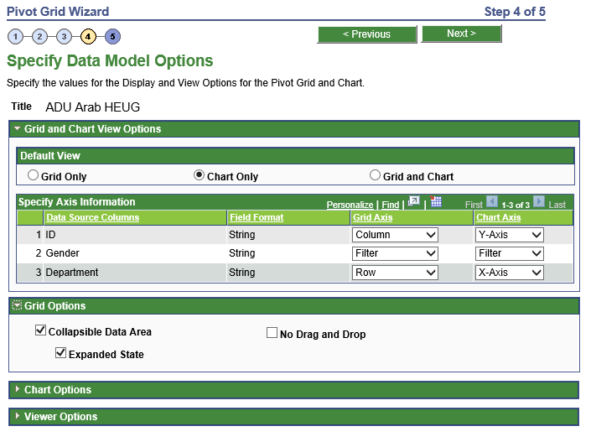
Pivot Grid Wizard

Slide 12
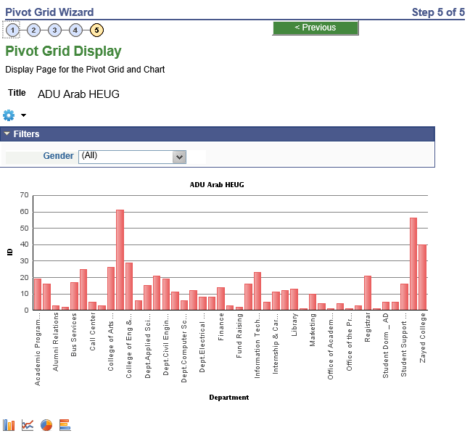
Pivot Grid Wizard

Slide 13
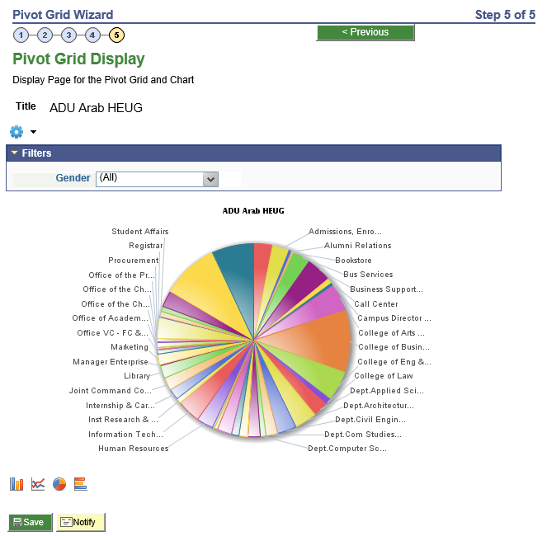
Pivot Charts

Slide 14
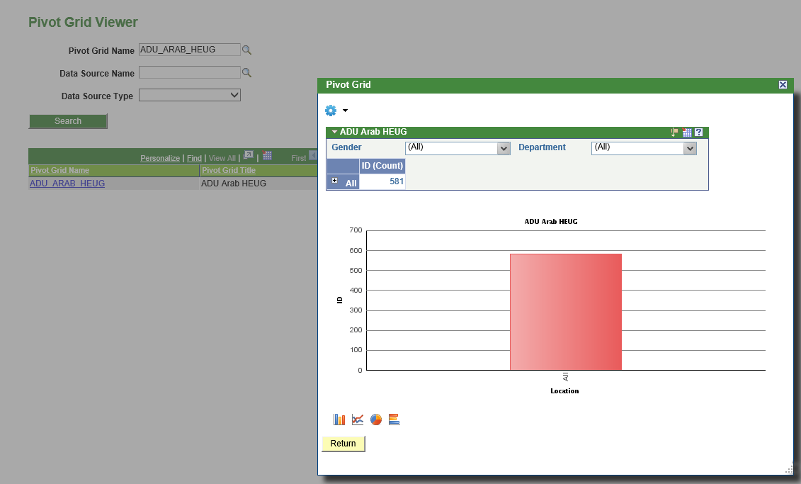
Pivot Grid Viewer
Enables end user to view and work on Pivot grids created

Slide 15
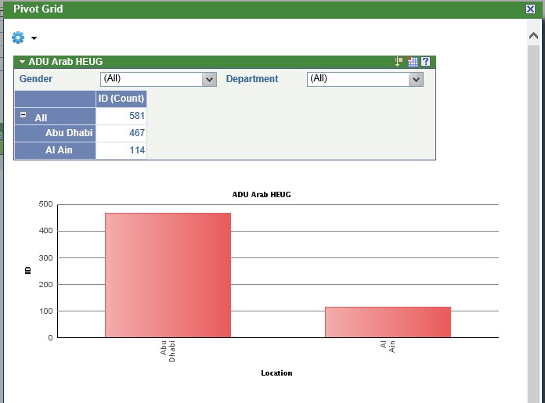
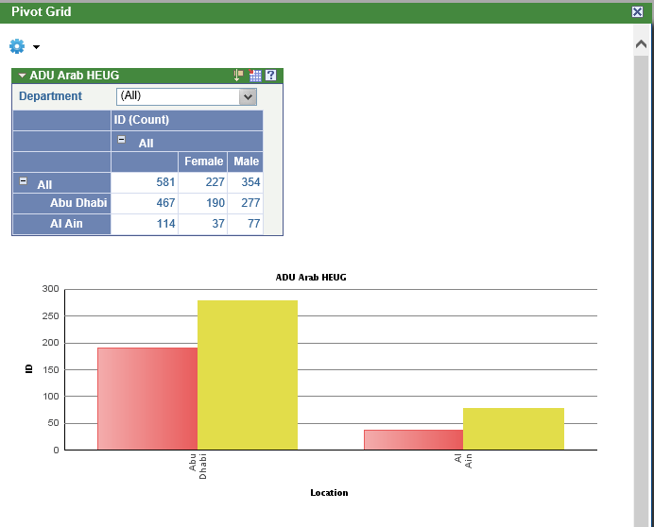
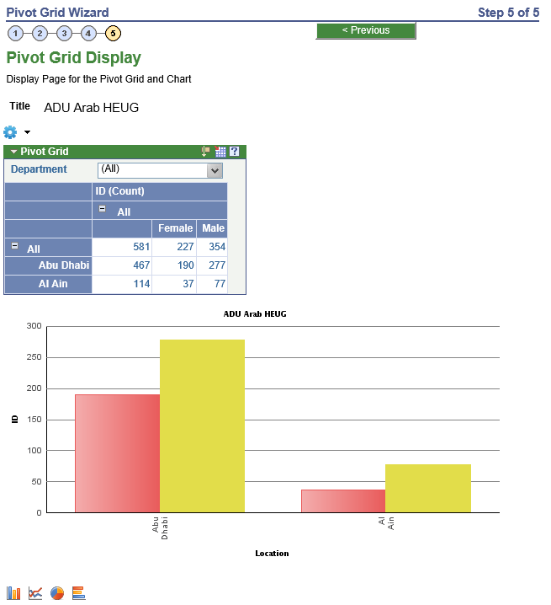
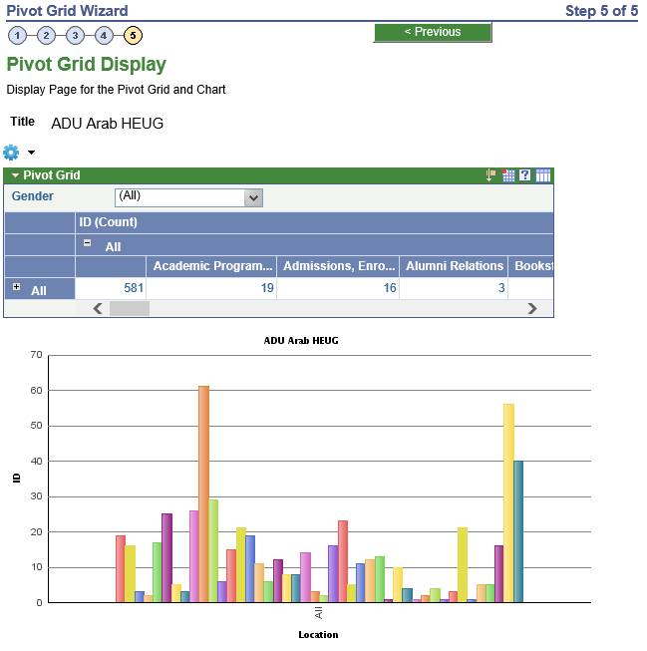
Pivot Grid Viewer

Slide 16
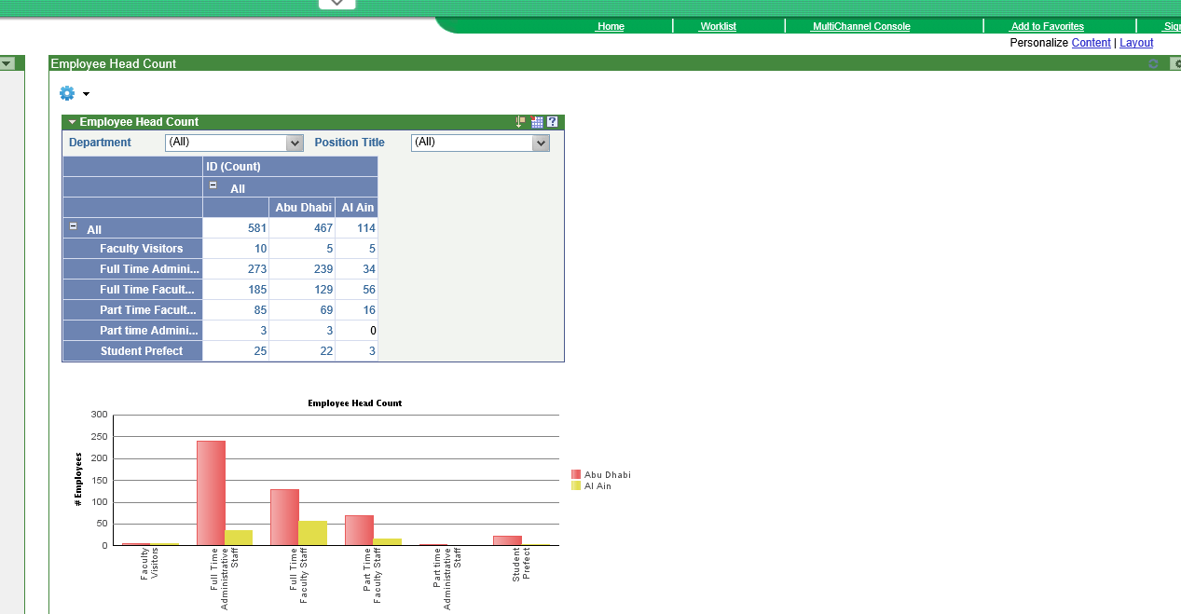
Pivot Grid Examples and Application
Pivot Grids and Charts could be registered as pagelets and could be deployed in home page for users.
Detailed reports available on the click of a button.
Drilldown capabilities can be incorporated in pivot grids to generate drill down reports.

Slide 17
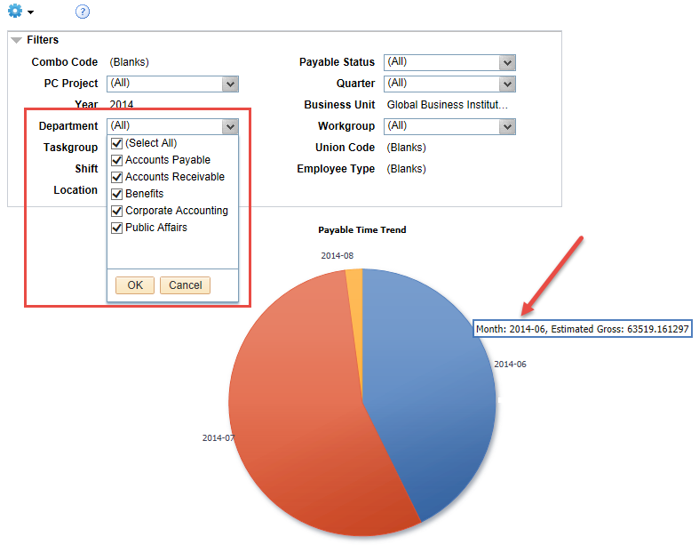
Pivot Charts Across the globe

Slide 18
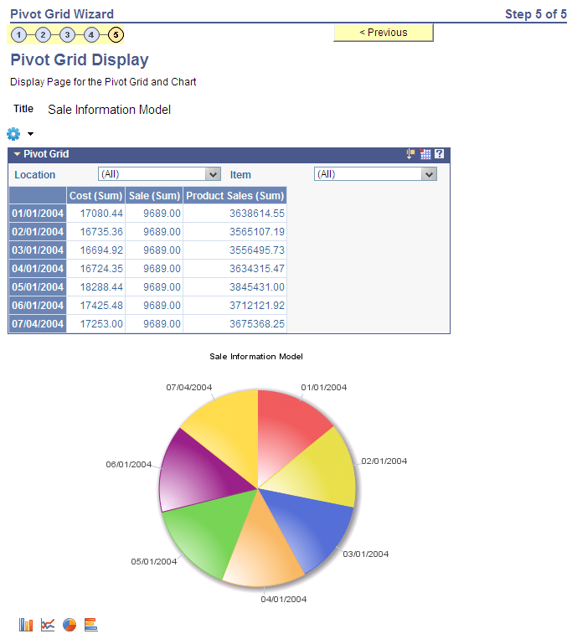
Pivot Charts Across the globe

Slide 19
Q & A

Slide 20
Contact Us
Jasir Illias,
ERP Systems Specialist
Abu Dhabi University
Jasir.illias@adu.ac.ae
ERP Team,
Abu Dhabi University
erpsupport@adu.ac.ae

