Slide 1
AHPRA reporting: from 3 days to 3 minutes - and other timesavers
SESSION 36014
9 November

Slide 2
presenter
Bonnie O’Connor
Team Leader
Student Administrative Systems Support
The University of Queensland
b.oconnor@its.uq.edu.au
https://au.linkedin.com/in/bonnie-oconnor
While my role is about leading the functional team I am also a hands on business analyst with a string of very useful developments to my name. I am the current UQ expert in timetable integration and class signon matters and have provided a variety of developments in that space and other modules to meet the needs of our users.

Slide 3
The University of Queensland
50,000+ students
6,500+ staff
2 Main Campuses
6 Faculties + Graduate School

Slide 4
UQ & ORACLE
Campus Solutions 9.0 PT8.55.05
Financials 9.2 PT 8.55.03
Oracle Service Cloud 2015 SP2

Slide 5
AHPRA – why? That’s easy – the reporting load is untenable
What to report | When | How | Responsibility
Currently enrolled students in an approved program of study | AHPRA issue formal notice to coincide with census date | excel spreadsheet template on AHPRA website | SFG
Intended completions | 6 weeks prior to intended graduations | written notice to AHPRA - template on AHPRA website | SFG
Completion of approved program of study | within 60 days of completion *UQ require report on day of conferral | written notice to AHPRA - template on AHPRA website | SFG
Cessation of enrolment/withdrawal | within 60 days | written notice to AHPRA based on query report – within 60 days of last report | SFG
Persons not enrolled in an approved program of study, but undertaking a clinical placement and do not hold registration in that profession | as soon as practicable | written notice to AHPRA | School/Faculty to provide details to SFG for inclusion in reports

Slide 6
AHPRA – why? That’s easy – the reporting load is untenable
What to report | When | How | Responsibility
Currently enrolled students in an approved program of study | AHPRA issue formal notice to coincide with census date | excel spreadsheet template on AHPRA website | SFG
Intended completions | 6 weeks prior to intended graduations | written notice to AHPRA - template on AHPRA website | SFG
Completion of approved program of study | within 60 days of completion *UQ require report on day of conferral | written notice to AHPRA - template on AHPRA website | SFG
Cessation of enrolment/withdrawal | within 60 days | written notice to AHPRA based on query report – within 60 days of last report | SFG
Persons not enrolled in an approved program of study, but undertaking a clinical placement and do not hold registration in that profession | as soon as practicable | written notice to AHPRA | School/Faculty to provide details to SFG for inclusion in reports

Slide 7
Presentation Overview
1
3
Configuration to support automation:
Maintain common data
QTAC File cleaner:
Another time saving development
4
2
Automate reporting:
3 processes for AHPRA
Preview of signon registration profiles if time allows

Slide 8
Configuration to support automation:
Maintain common data

Slide 9
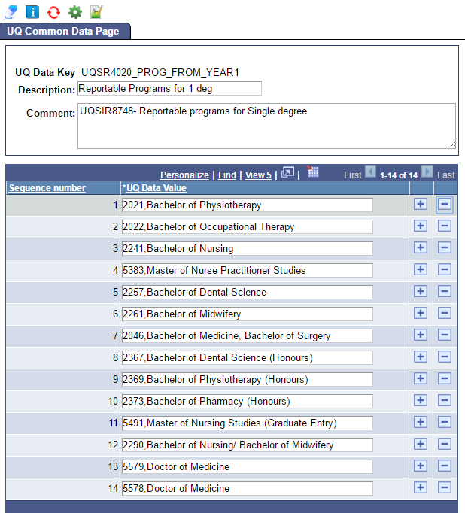
Easily identify and update reportable programs
5578
– actual program code
Doctor of Medicine
– reportable name, could actually be different to the UQ name

Slide 10
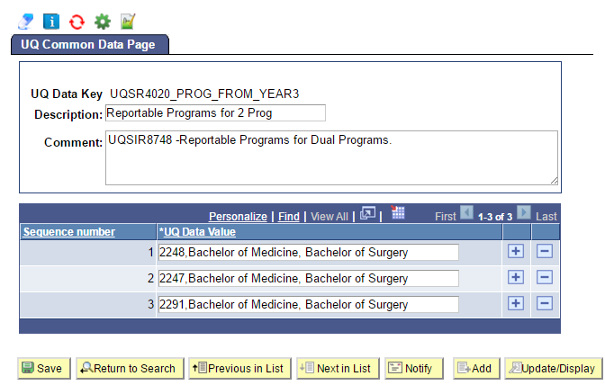
Easily identify and update reportable programs
Dual Degrees
Configured separately so different reporting trigger can apply (reportable after 2 years of FT study)
Reportable program name is configured removing the non-reportable component

Slide 11
AHPRA reports x 3
Census report
60 day report
Graduation report

Slide 12
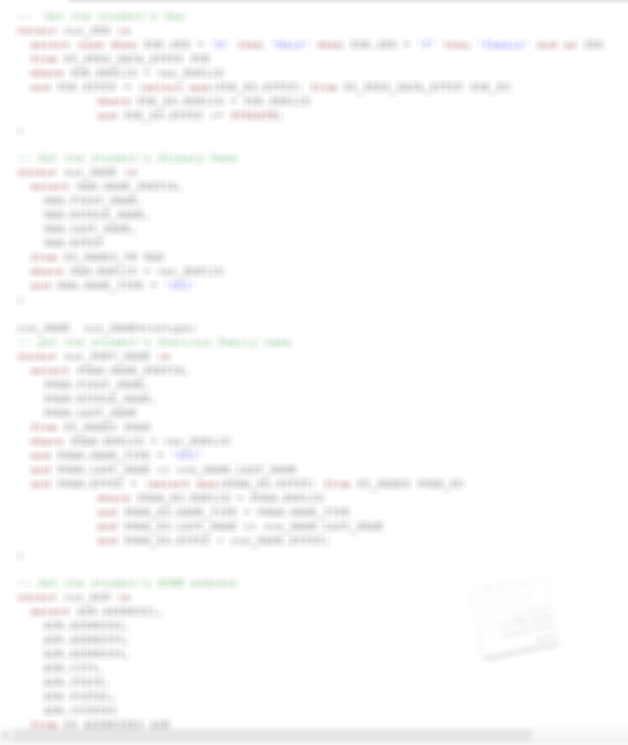
Census report
Notice under section 88 of the National Law for Student Registration - gives us 14 days to provide a report in the specified format for the specified cohort
Title
First given name
Middle given name(s)
Family (legal) name
Previous family name
Date of birth
Sex
Email
Student ID
Address (examples) Unit Type Unit Number Level Number Level Type Street Number Street Name Street Type or Lot Number Street Name Street Type or PO Box RMB 123
Suburb
State/Territory
Postcode
Country
Name of Approved Program of Study / Clinical Training - Profession
Approved program of study/Clinical Training Commencement Date
Approved Program of Study/Clinical Training Expected Completion Date
Approved Program of Study/Clinical Training Actual Completion/Cessation Date
Approved Program of Study/Clinical Training Completion/Cessation Reason

Slide 13
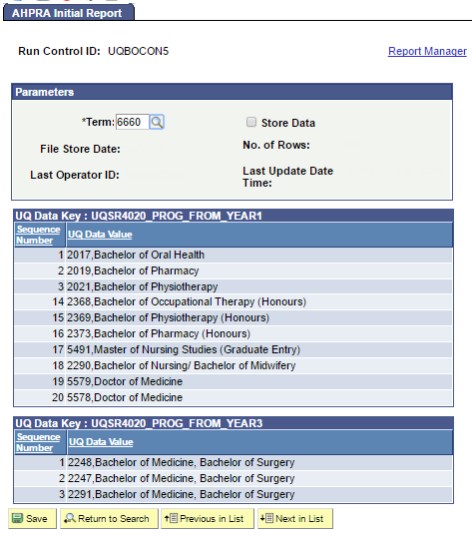
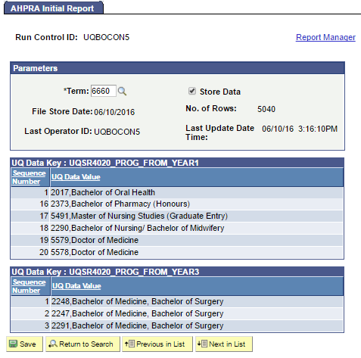
Run control
App Engine process/BI Publisher
Can be run in report only
Displays common data
Once stored, cannot be rerun for that term

Slide 14
Output
Output slide removed to maintain student privacy.

Slide 15
60days later – do it again
This report will compare the current state with the stored report and report (in the identical format) instances where there is a change
BI Publisher

Slide 16
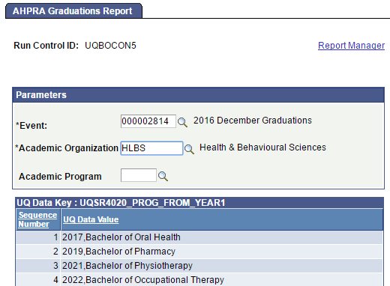
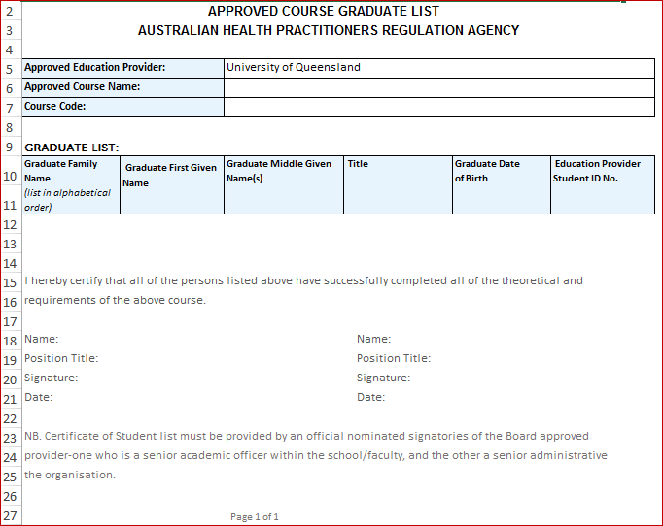
INSTANT Graduation REPORT
AHPRA requirement is within 60 days of Graduation
UQ requirement is as soon as graduation conferred
Ability to split by faculty very easily
Can go down to program level
Output in AHPRA format – requirement recently changed from PDF to excel – ability to respond to such changes

Slide 17
QTAC File cleaner
Search and destroy replace capability

Slide 18
More time saving in production support
Major round offers – 8,500 to 10,000 applicants
Usually processed throughout the night with staff working to 4 or 5am
In January 2016 2 staff spent more than 5 hours checking the file – commencing around 6pm this took them nearly to midnight before they could even upload the files to the input area
Even in the new same day process, stopping to check every row of the files before uploading is unsupportable
The developer on this project was way ahead of the curve – we asked for a process that would check and report erroneous characters or missing mandatory data – we got this:

Slide 19
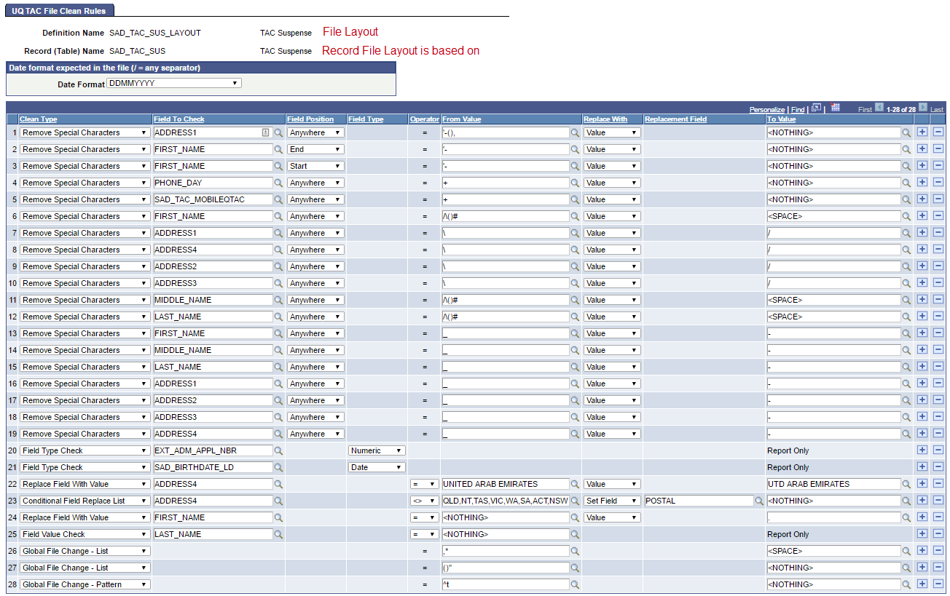
New development – File Checker

Slide 20
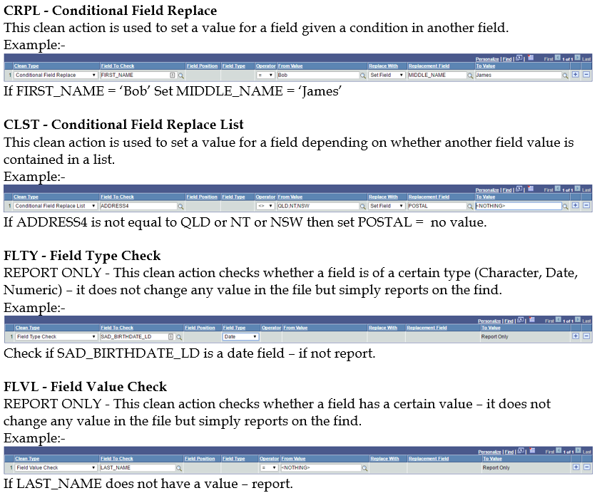

Slide 21
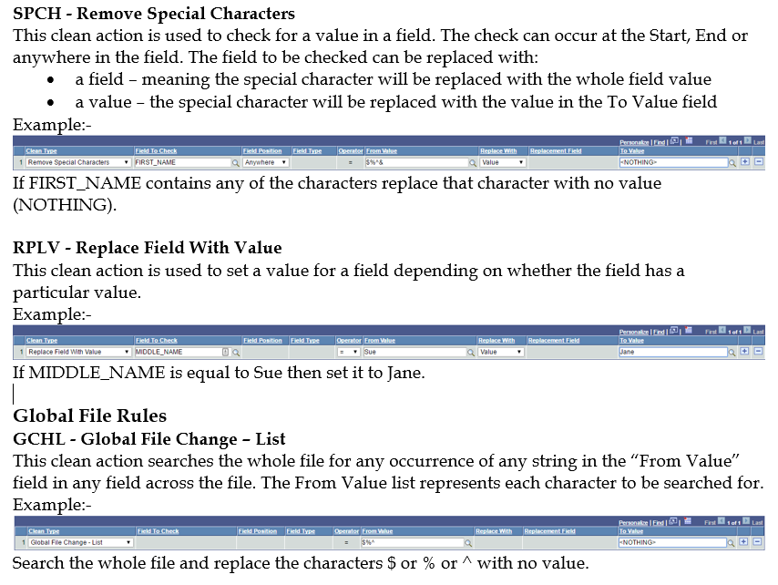

Slide 22
Concluding thoughts
ANY QUESTIONS?

Slide 23
SUMMARY
We focus so much effort on providing functionality for our users but time spent on internal processes can really pay big dividends.

Slide 24
presenters
Bonnie O’Connor
Team Leader
Student Administrative Systems Support
b.oconnor@its.uq.edu.au
all Alliance presentations will be available for download from the Conference Site

Slide 25
THANK YOU!

