Slide 1
Celebrating 10 years of failure Because you won’t succeed from the start
SESSION 5526
22 October 2019

Slide 2
presenters
Sarah Kobus
Jasper Faber
Process/ Information Analyst
University of Amsterdam / Amsterdam University of Applied Sciences
kobus@uva.nl
Head of Student Information Systems
University of Amsterdam / Amsterdam University of Applied Sciences
faber@uva.nl

Slide 3
University of Amsterdam
60,500+ applications
40,500+ enrolments
62 Bachelor programmes
137 Master programmes
151 Non Degree programmes
3000 PhD students – 550 promotions/year
6000+ staff

Slide 4
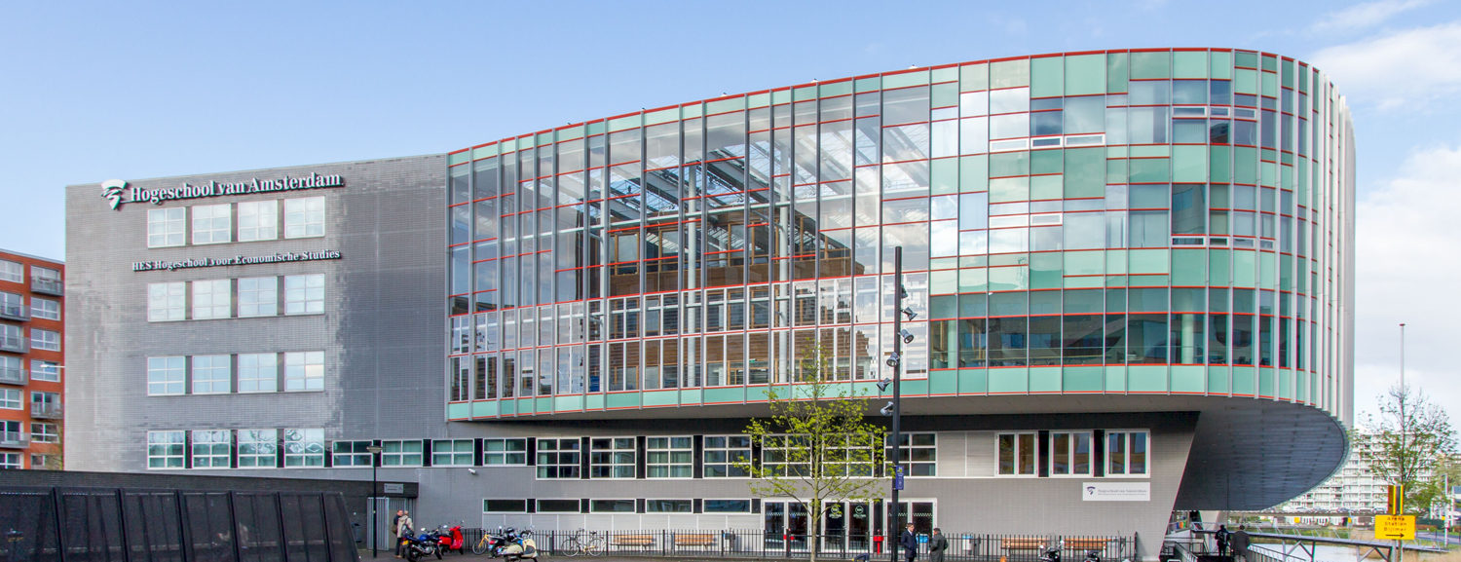
Amsterdam University of Applied Sciences
45460 students
7 faculties
72 bachelor programmes
17 master programmes
3 Associate degree programmes
4000+ employees

Slide 5
ORGANIZATIONs & ORACLE
CS 9.2
PT 8.56.16
PUM 9 ML

Slide 6
Getting to know each other
Use the scale on the right to indicate how familiar you are with the concepts on the left:
Design Thinking
User Experience (UX)
Project Management
LEAN
Agile
Never heard of it
I read something about it
I’ve done this/used this a few times
People come to me with their questions about this
I am an expert in this field

Slide 7
Getting to know each other
On a scale from 1 to 10, how effective is your organization at learning from failure?
1. We keep making the same mistakes and we don’t know why
to
10. We plan for our mistakes, analyze and catalogue them so we can learn as a team

Slide 8
It all started with great intentions
This will not be a children’s bedtime story
Notes:
Image from Shrek the movie

Slide 9
We selected and implemented our new SIS
02
04
01
03
05
Write a lengthy and inclusive list of requirements
The best system wins!
We need a new SIS!
Follow the rules of European public tenders
Implement the winning system
Notes:
The solution is always a system, clearly
Preferably get senior managers to do this, to give the project enough weight. It should also be easy to assess the current needs and predict the future ones for them
This actually is a good idea
Obviously the people in step 2 have been so thorough that this will happen
Once the system is live, you’re done

Slide 10
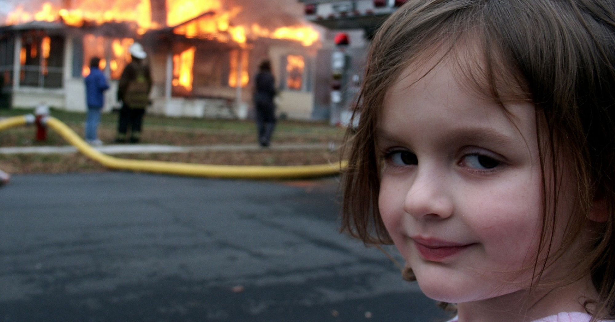
Not everything went well
We warned you it would be scary
Notes:
Spoiler: the solution wasn’t (just) the system.
If you put garbage in a digital system, you get digital garbage
Too little time and effort was invested in optimizing underlying processes

Slide 11
Second chances – improving the road to student housing for internationals
Analyze current processes by interviewing Housing Officers
Make a lengthy and inclusive list of requirements
Select the most compatible system
Have a clear go-live date
Digital
Transforma-tion
Analyze
Require-
ments
Go Time!
Testing and
Training
Design
Make a (harmonized) functional design
Involve users in testing and start their training before go-live

Slide 12
Not all stakeholder’s expectations were met
But at least we’ve learned a valuable lesson!
Notes:
The lesson being that you will always fail

Slide 13
What did we miss?
People
Processes
1
2
3
Systems
Notes:
We did not ask the students what their actual needs were!
We underestimated the complexity of the processes – how hard could it be?
We assumed too often people spoke the same language, did not invest enough in making ideas and expectations explicit
We trusted people to be rational and involved for the institutional common good
A crunching and unmovable deadline caused ‘go-fever’, where issues were stalled or even disregarded to meet deadlines

Slide 14
Identifying different domains
- No-fail zones
- Little-fail zones (Zone of Experts)
- Often-fail zones (Zone of Innovation)
Notes:
Failure is still a bad thing in most areas, to fail intelligently you need to plan where to fail

Slide 15
no-fail zones
Foundation to build trust for innovation Area of “best practice” Stability, dependability, predictability, robustness
Talented bug finders
Identify principles (i.e.: our failure will not hurt students) Define metrics for success/KPI’s
Methods: Six Sigma, waterfall
Robustness can turn into rigidity can turn into frailty
Notes:
Best practice & KPI’s: define the oscillations you allow away from the ideal structure
This domain needs rules we all agree on to function well

Slide 16
Expert zones
More room for failure Reductionist analytical domain
Failure may hurt credibility of experts – management support necessary Need time for analysis
Incremental innovation
Methods: LEAN, Agile
Notes:
Reductionist analytical: reduce the problem to the right granularity, i.e. the smallest component you have influence over, and fix that. Then repeat.
This domain doesn’t work so well when you truly need to turn a corner

Slide 17
Innovation zones
Novel practice - failure guaranteed Safe-to-fail experiments as analytical tool
Context is essential The whole is different from the sum of it’s parts Feedback back and forth: iterativeness embeds the system in it’s environment Running up and down the abstraction ladder (how&why)
Methods: Design Thinking, UX, Agile for experiments
Highly inefficient
Notes:
Cannot foresee the end product, it emerges from design process
Context is essential means you can’t just plonk a solution into a different environment
Abstraction ladder: stakeholders wants are interesting, but need to translate it to underlying needs, then test assumptions

Slide 18
Planning for failure
Fail early
Fail cheaply
Decide (and make explicit) what failure and success means
Don’t explain away warning signs
Make your assumptions/world view explicit and be willing to adjust as new information comes in
Don’t go off the deep end
Make sure cause and effect are at least coherent in hindsight
Adjacent innovations
Evolution and exaptation

Slide 19
Questions to evaluate failure
- Did you learn?
- Did the effort involve genuine uncertainty?
- Did you plan carefully?
- Was the cost contained?
- Was the cost of failure smaller than doing nothing or conducting further analysis?
- Were the risks of failure understood?
- Did you take action to mitigate risk?

Slide 20
Celebrate the Trash heap
For she has many wise things to teach

Slide 21
How to (stand up and) walk away
- Plan periodic checkpoints in advance
- Evaluate pluses and minuses: are we actually delivering anticipated returns?
- Are there more pressing projects?
- If possible, involve an objective informed outsider for trigger pulling
- Clearly spell out the reasons for stopping
- Look at how capabilities and assets can be recouped, make sure to share lessons
- Identify who will be affected and plan to address disappointment or damage
- Plan an event for closure
- Take care people involved can go on to new opportunities
Notes:
Are we doing the right thing?
Are we doing the right thing at the right time?
If we are not doing the right thing, how can we make sure the losses are minimal?

Slide 22
presenters
Sarah Kobus
Jasper Faber
Process/ Information Analyst
University of Amsterdam / Amsterdam University of Applied Sciences
kobus@uva.nl
Head of Student Information Systems
University of Amsterdam / Amsterdam University of Applied Sciences
faber@uva.nl
all Alliance presentations will be available for download from the Conference Site

Slide 23
THANK YOU!

