Slide 1
Enforcing Development Standards UniSA's Automated Approach
SESSION 36035
November 10, 2016

Slide 2
presenter
Robert Lacina
Senior Information Technologist
University of South Australia
Robert.Lacina@unisa.edu.au

Slide 3
University of south australia
6 Campuses
4 City, 2 Regional
35,000+ Students

Slide 4
UNISA & ORACLE
Campus Solutions v9.0
(Bundle 35)
PeopleTools 8.54.10
CRM for Higher Education v9.1
(Bundle 13)
PeopleTools 8.53.04

Slide 5
Overview
1
3
INTRODUCTION
What’s this all about?
SOLUTION
The Idea
Application Engine
Self-Testing
2
4
BACKROUND
UniSA Standards
Change Migration
Problems
FUTURE?
Potential Future Enhancements

Slide 6
INTRODUCTION
What’s this all about?

Slide 7
INTRODUCTION What’s it all about?
At UniSA, PeopleSoft developers are required to follow a set of technical and development standards when creating or maintaining PeopleSoft objects and code
For various reasons, these standards aren’t always adhered to
Non-compliance with standards should be picked up by review of compare reports at migration time, but some still slip through
This presentation will show an approach taken by UniSA to try and detect these before they make it production
Hopefully make the application easier to maintain and upgrade in future

Slide 8
BACKGROUND
What triggered UniSA’s approach?

Slide 9
BACKGROUND
When UniSA had an in-house developed student system (written in Cognos Powerhouse) there were no defined development standards.
The use of development standards began with the introduction of PeopleSoft Student Administration
First draft with SA 7.6
Reviewed in 7.6 → 9.0
Specification Register
Every change requires a full technical specification to be written

Slide 10
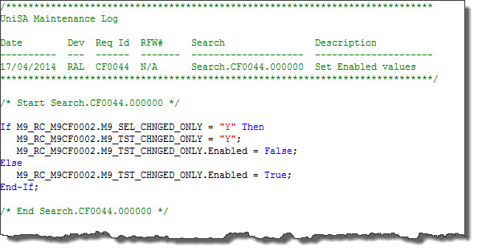
“RULE-OF-THUMB” unisa STANDARDS
Add Project to Specification Register
New objects, prefix = “M9” and follow object-specific naming standards
Require “Change Control Block”
Existing program code never deleted or changed directly, just commented out
Every program code change surrounded by a start/end “search” comment

Slide 11
DEVELOPMENT AND MIGRATION
Development Database
Rarely refreshed
Developer Unit Test Database
Refreshed every few months
Developers migrate their own changes from Development to Unit Test
Migration Team migrates from Unit Test to User Test and Production
Senior PeopleSoft developers
Not exclusively dedicated to this task, usually have their own development work
Non-compliant changes still slipping through

Slide 12
SOLUTION
The UniSA Approach

Slide 13
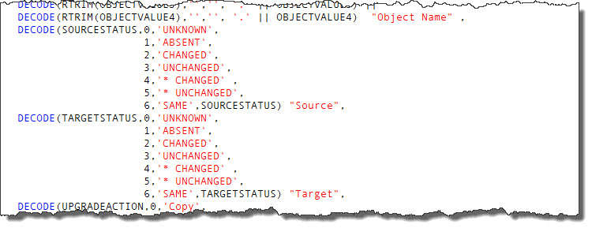
THE START OF AN IDEA
PeopleSoft Patches
Difficulty in getting a consolidated list of customised objects affected by the patches
Found some SQL online to interrogate patch projects and filter out customised objects
Exported results to Excel to use as a checklist

Slide 14
THE START OF AN IDEA
Would it be possible to write a program to check for compliance?
Written as an application engine as a side project
Available for all developers to use prior to migrating their changes to Unit Testing and/or User Testing Databases
Based on my patch project SQL
Pre-requisite is that a compare report must have been run for the project
Generates a report listing all objects in the project with pass or fail result
Give an overall pass or fail result for the project
Only checking compliance – not verifying code

Slide 15
Tested objects
What objects to test?
About 120 different PeopleTools object types
Around 60 of these are in used within UniSA projects
Started with 3 objects – Records, Pages, Record PeopleCode
Which tables store the object data?
PS%DEFN Tables
Search on Google for PeopleTools Meta Data Tables

Slide 16
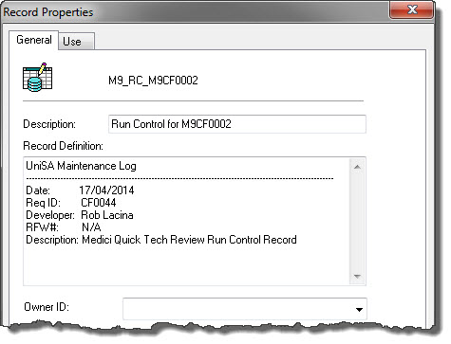
BASIC TESTS – Object Properties
Application Designer Objects – With a “Properties” Dialogue
Non-blank description
UniSA Change Control Block
Comment with the Req/Project ID

Slide 17
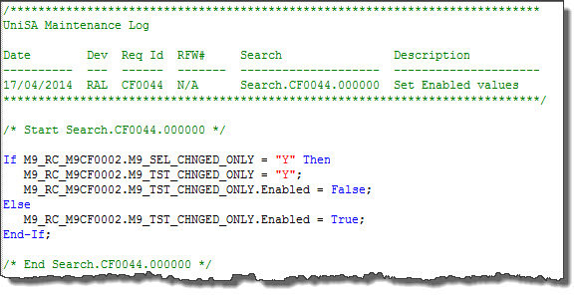
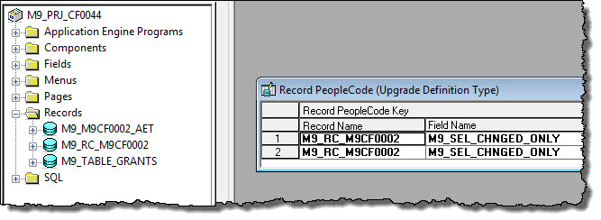
BASIC TESTS – without Properties
Application Designer Objects – Without a “Properties” Dialogue
A UniSA Change Control Block
A Comment with the Project ID
“Parent” Object in the Project
Non-App Designer Objects

Slide 18
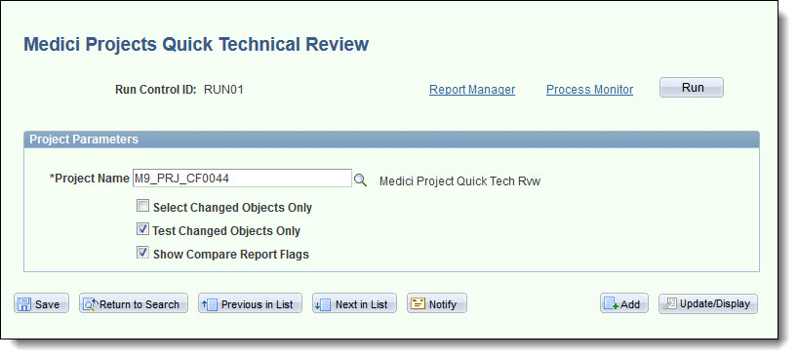
RUNNING THE PROCESS
Run Control Page

Slide 19
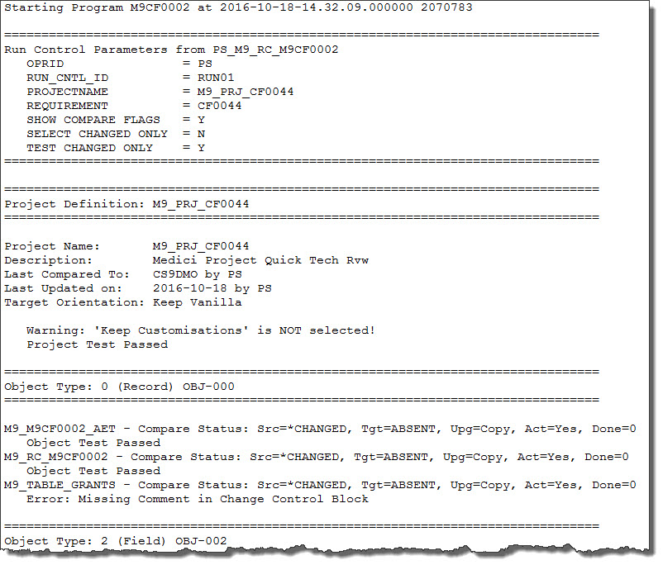
RUNNING THE PROCESS

Slide 20
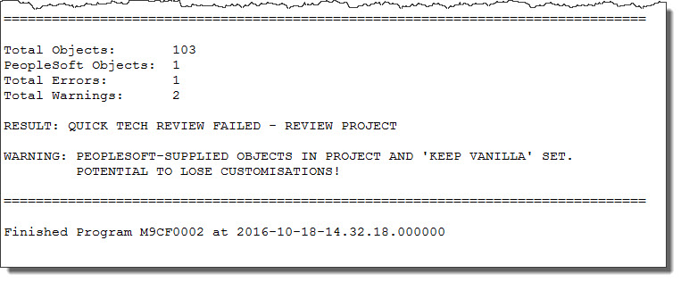
RUNNING THE PROCESS

Slide 21
ADDITIONAL TESTS – compare report
Has a compare report been run?
Absent in both Source and Target
Flagged as “Delete” but “Copy” not set

Slide 22
ADVANCED TESTING
Table grants for other applications
Table alters and view rebuilds drop grants
Applications break = Angry DBAs!
Any grants to other schemas listed in the report
Two issues…
Initial report queried DBA_TAB_PRIVS directly
Golden Gate

Slide 23
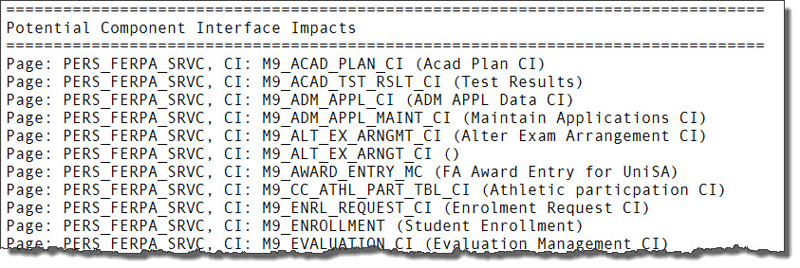
ADVANCED TESTING
Component Interface impacts
App Designer doesn’t show affected CIs
SQL to find affected CIs
Limited to CIs that only exist on UniSA permission lists

Slide 24
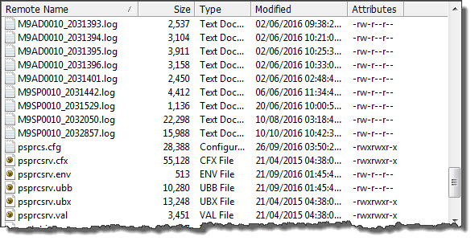
ADVANCED TESTING
File creation using %FilePath_Absolute
Output being created in process scheduler config folder
Added additional check in PeopleCode

Slide 25
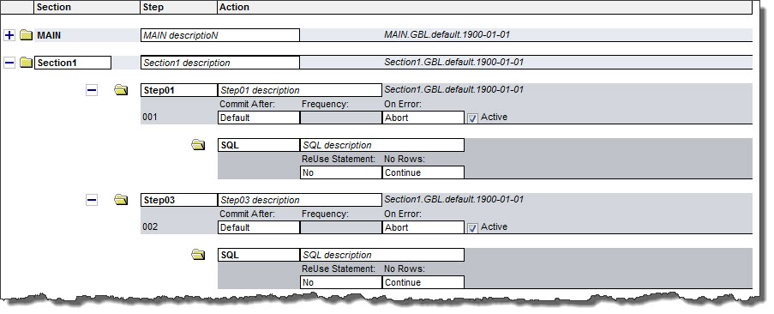
ADVANCED TESTING
New process definitions missing parent program
Application Engine sections & step names and descriptions

Slide 26
Some Minor issues
Not all objects are able to be tested in a meaningful way
Still a few tests to be configured

Slide 27
Future?
Potential Enhancements

Slide 28
Future ENHANCEMENTS?
Check PeopleCode for Start/End Blocks
Problem is that PeopleCode is broken into chunks within PSPCMTXT
Scan SQR and COBOL programs
Rarely write new SQRs, never COBOL! Modifications to SQRs and COBOL infrequent

Slide 29
Concluding thoughts
ANY QUESTIONS?

Slide 30
presenter
Robert Lacina
Senior Information Technologist
University of South Australia
Robert.Lacina@unisa.edu.au
all Alliance presentations will be available for download from the Conference Site

Slide 31
THANK YOU!

Slide 33
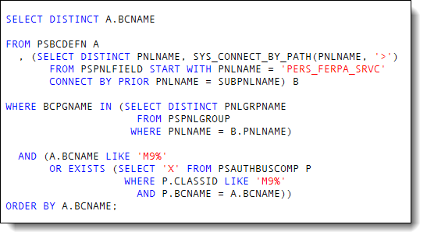
Component Interfaces by page:
Object Types: Change Assistant folder - peopletoolsobjects.xml

