Slide 1
Course Finder data project
SESSION 37013
11 October 2016

Slide 2
presenters
Paula O’Neill
Queens University Belfast
paula.oneill@qub.ac.uk
Worked for Queen’s since 2005.
Started in Student Records Office as an Administrator. Moved onto PeopleSoft implementation team in 2007 as Student Records Office Expert.
Functional Development Lead in 2011 and projects to date have included Management of Examination Process, HEAR, Programme Specification, Examination and Disability Analysis and Course Finder Data Project.

Slide 3
Your organization
Established by Queen Victoria in 1845 and one of the United Kingdom’s 10 oldest Universities.
The University is an international centre of research and education rooted at the heart of Northern Ireland with approximately 23,500 students.
The University is a member of the Russell Group of 24 leading UK research-intensive universities.

Slide 4
Queens & ORACLE
Campus Solutions locally branded as Qsis, implemented 2007 – 2008
Using all core modules
Campus Solutions v 9.0
PeopleSoft V8.54.07
Bundle 41

Slide 5
Course Finder Data at QUB
1
3
Initiation:
Development Purpose
Design:
Workflow and Approval
2
4
Requirements:
Data Capture Process
Implementation: Reporting and Publication of Course Finder Data
Notes:
Queen’s University uses Campus Solutions as the core product for the storage of all course and student information. Marketing data relevant to our courses currently sits outside Campus. To facilitate one of the University’s core objectives, in storage of master data and content, a project was undertaken to focus on the data elements of the Digital Channel required for prospect students and other stakeholders who engage with the University. The Course Finder Data project aims to develop new functionality within Campus which will allow input, storage and approval of all marketing information relevant to a course.
This information can then be made available though XML output for publishing via multiple sources, for example web and printed prospectus.

Slide 6
Development Purpose
Facilitate the University’s Core Objectives adhering to CMA requirements

Slide 7
Project Background
Queen’s identified that a complete review of communication and marketing techniques was required
Digital Data Working Group established to focus on data elements of the Digital Channel
Purpose is to provide a central mechanism to fully manage the capture of core data for all programmes offered by the University which can be utilised by external facing systems.

Slide 8
Project Objectives
Consolidate
Consolidate current information held by stakeholders to centralise the process within the Student Information System (Qsis).
Functionality
Provide functionality to capture, record and make available for publishing from Qsis data relevant to the Course Finder, ensuring there is a single source for this data.
Reporting
Provide reports to support users in identifying courses which require attention.

Slide 9
Data Capture requirements
Marketing data related to the course

Slide 10
Data requirements
Consultation Group established with subject matter experts from across the University.
Emphasis on data capture requirements from each area
Identify data types and data owners
Agree workflow and audit process

Slide 11
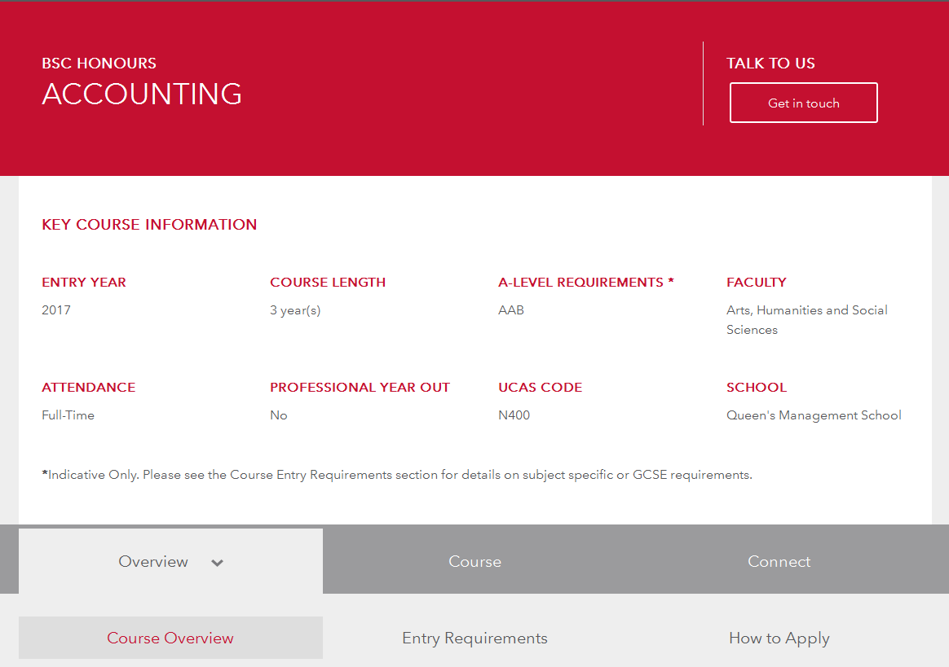

Slide 12
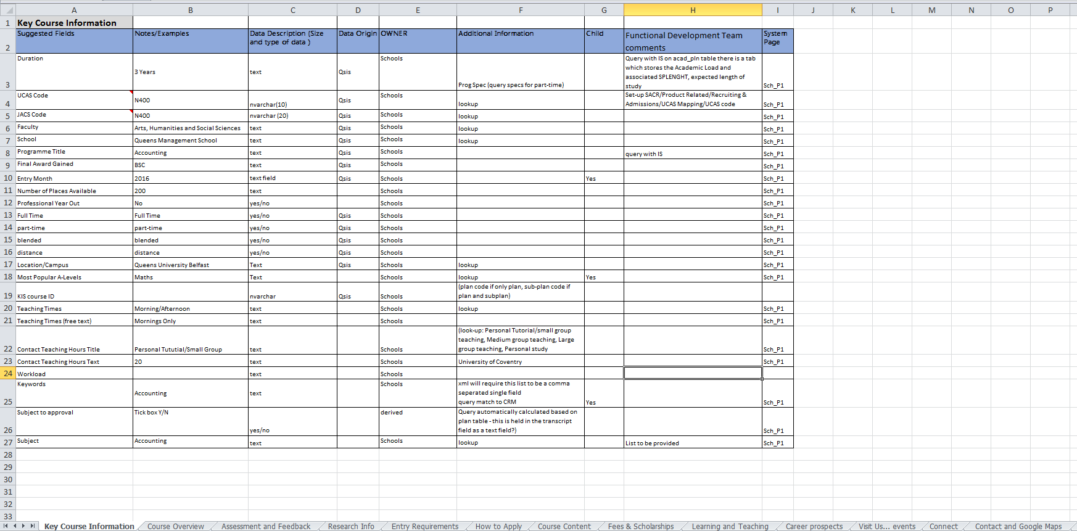
Data Schema

Slide 13
Workflow & approval
Submit – Approve - Publish

Slide 14
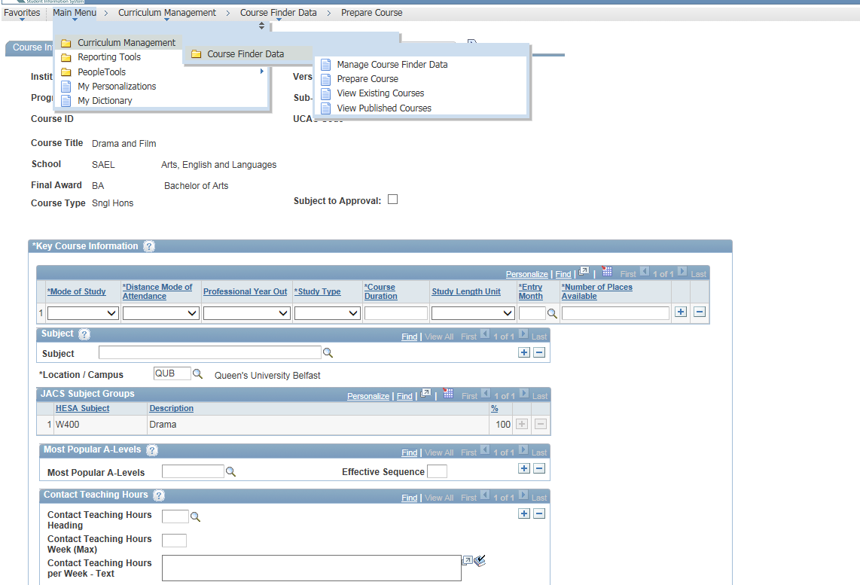
Qsis functionality
New component designed.
Utilised existing data already held within Qsis.
Broken into a number of pages which can be assigned to Roles.
Workflow/Approval page – audit table.

Slide 15
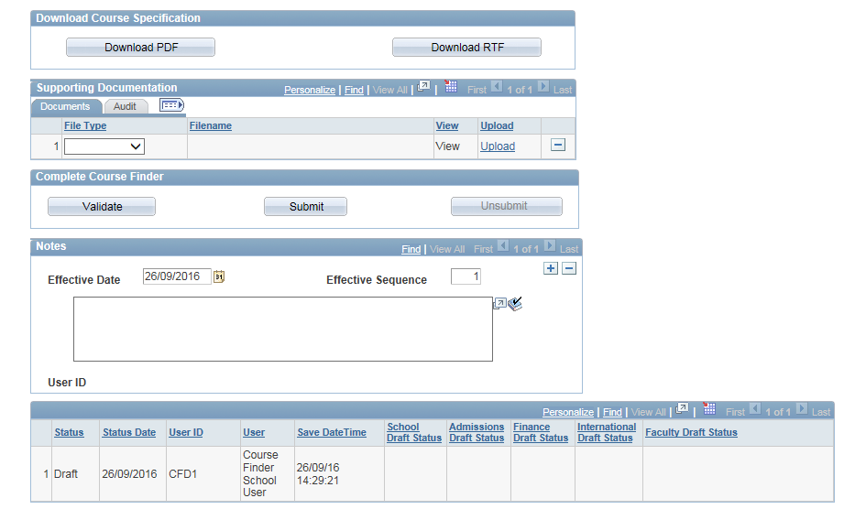
Qsis functionality

Slide 16
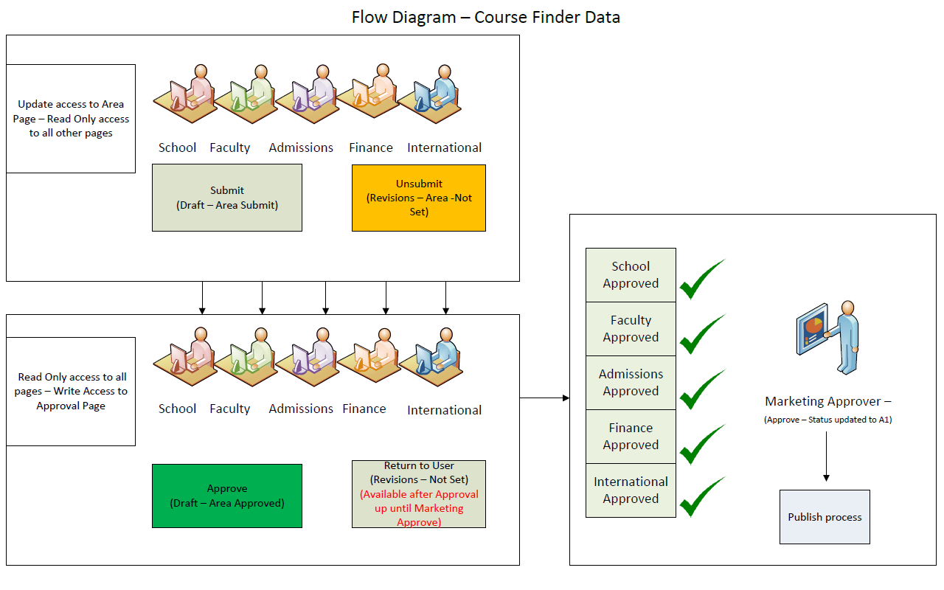

Slide 17
Reporting & Publication
Approved entries fed out via XML for publishing

Slide 18
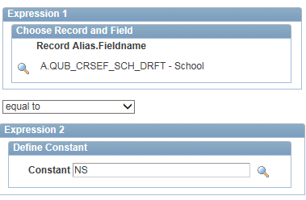
Reporting Criteria

Slide 19
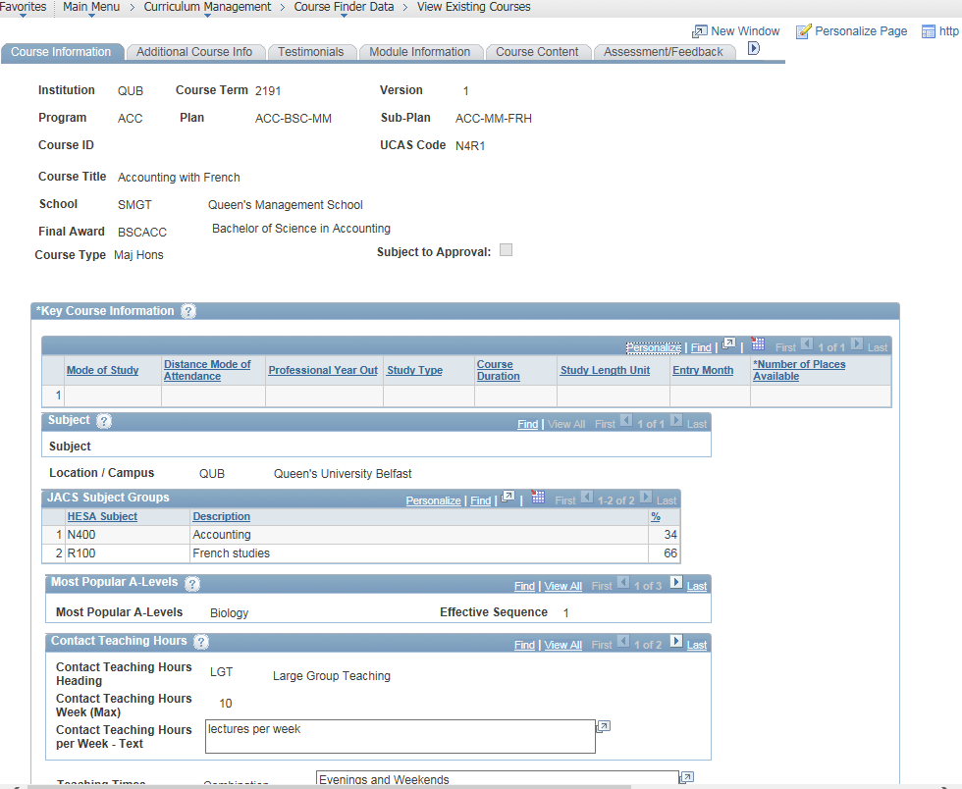
Staff Pagelets

Slide 20
XML Output
View of all core tables added to a file layout
File layout used in Peoplecode to build up an XML output file
XML file published to on-line group who render this to the presentation layer.
Issue
PeopleSoft file layout – max of 16 records per file.
Course Finder Data project has 40 tables in the file layout and PeopleSoft couldn’t cope causing the process to fall-over.
Development on-going to create the raw XML file by querying the views all in the People code.

Slide 21
Concluding thoughts

Slide 22
QUB – Benefits
Enhance
Enable Marketing to take a digital led approach to promoting course information and significantly reduce duplication of effort between faculty and centre to ultimately benefit recruitment objectives.
Visibility
Staff have single point of reference
Audit of course Approval
Publishing
Direct Publication of core Course Data directly from Qsis.

Slide 23
presenters
Paula O’Neill
Queen’s University Belfast
paula.oneill@qub.ac.uk
all Alliance presentations will be available for download from the Conference Site

Slide 24
THANK YOU!

