Slide 1
UniSA Campus Solutions Upgrade - Fast &Furious 9.2
SESSION 5021
November 9, 2017

Slide 2
presenter
Robert Lacina
Senior Information Technologist
University of South Australia
Robert.Lacina@unisa.edu.au
Notes:
Hi – I’m Rob Lacina. I've been working with student systems for almost 30 years and with PeopleSoft student administration for about 17 years.

Slide 3
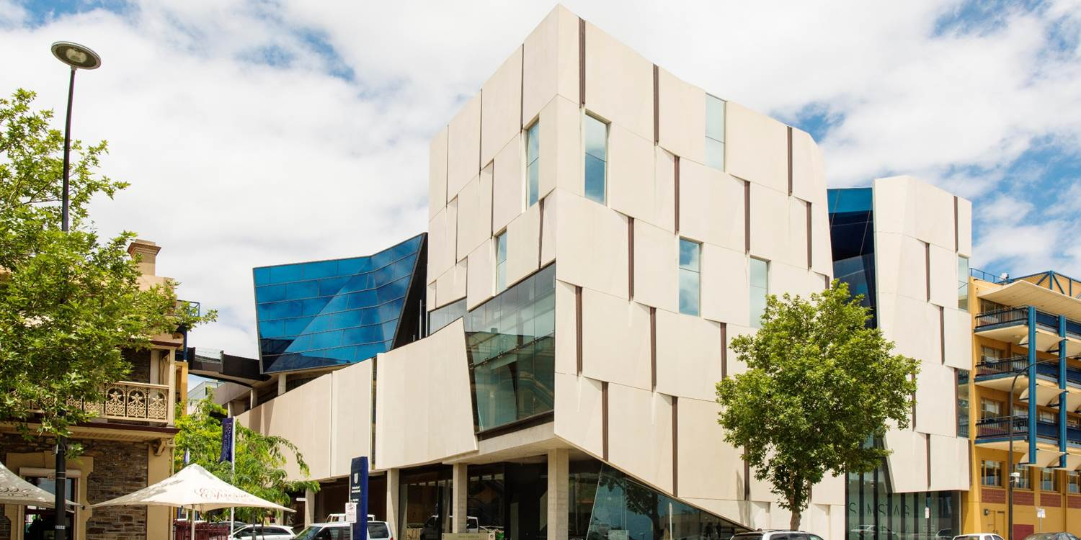
University of south australia
6 Campuses
4 City, 2 Regional
35,000+ Students
Notes:
Quick overview about the University of South Australia

Slide 4
UNISA & PEOPLESOFT
Campus Solutions v9.2
(Update Image 4)
PeopleTools 8.55.15
CRM for Higher Education v9.1
(Bundle 13)
PeopleTools 8.53.04
Notes:
At UniSA we’re running two PeopleSoft systems, Campus Solutions and PeopleSoft CRM for Higher Education. However, this is being phased out as we move towards using Oracle Service Cloud CRM.

Slide 5
Overview
1
3
INTRODUCTION
THE UPGRADE
2
4
BACKGROUND & PLANNING
ISSUES
Notes:
Here’s just a quick overview of how I’ve split up today’s presentation.

Slide 6
INTRODUCTION
What’s this all about?

Slide 7
INTRODUCTION What’s it all about?
UniSA’s Upgrade to from Campus Solutions 9.0 to 9.2
Background to the upgrade
Timelines, Budget & Staff
Upgrade Environment and Process
Issues faced
Notes:
So what’s this presentation about?
As the title of the presentation says, this is about the upgrade to Campus Solutions 9.2 that UniSA did at the beginning of this year.
[CLICK] I’ll talk briefly about the background to the upgrade as well as the timelines, budget and staff used
[CLICK] Followed by our upgrade environment and process.
[CLICK] And I’ll finish up with a discussion of some of the major issues we came across.
There’s a lot to go through in this presentation and the timing is tight, so I’m not going to spend a lot of time on the planning and pre-upgrade stuff and if possible can you save any questions until the end.

Slide 8
BACKGROUND
History and Preparation

Slide 9
Last major upgrade
The last “major” upgrade to the University’s student system was the upgrade from Student Administration 7.6 to Campus Solutions 9.0. back in 2007/2008
Planned to take 18 Months
Budget $7M
Big Project Team
Initial & Test Moves were done by Oracle’s Upgrade Lab
Notes:
[ALL DOT POINTS AUTO APPEAR]
Our last major application upgrade occurred 10 years ago. This was a major undertaking by the university. As you can see we had a generous timeline, budget and staff allocation. The other major takeaway from this is that we used the Oracle upgrade lab to perform the initial pass and first test moves.

Slide 10
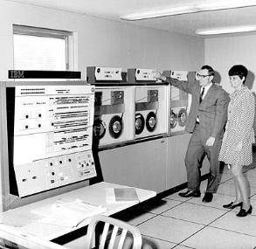
The existing system
Last patched in 2015
Brought up to the minimum level required to upgrade to 9.2
However, we did apply a legislative patch December 2016
Notes:
[ALL DOT POINTS AUTO APPEAR]
We last patched our existing system in 2015. We were already looking ahead to doing the upgrade, so we patched to CS Bundle 36, HR Bundle 26 and PT.8.54.10, which was the minimum required patch level to perform the upgrade to CS9.2.
A spanner in the works appeared when we needed to apply a critical patch for a legislative HECS change in 2016. However, since Change Assistant won’t apply a patch unless all the relevant pre-requisites have been applied, I needed apply the changes manually. This patch caused a minor issue with the upgrade, which I’ll talk about later in the issues section of the presentation. (Bug: 24622026 if anybody asks),

Slide 11
Ongoing maintenance
Patching is usually only done once per year
CS Bundles and PeopleTools Patches applied in the same cycle
8-10 Weeks
Oracle CPU Patches
Notes:
[ALL DOT POINTS AUTO APPEAR]
Patching done once per year, usually around June or July. There’s never really a quiet time of year to do this but this is the closest.
Since this is usually the only downtime we get, we always do a PeopleTools patch/upgrade at the same time as the CS bundles.
Patching/Testing Cycle 2 Weeks to apply patches to DEV/Test and re-apply any customisations, 6-8 weeks of testing by the users.
Exception is Oracle CPU patches. Although we only apply WebLogic and Java patches, because these can be applied to individual servers with taking down the entire application. Since PeopleTools patching requires the redeploying all the PIAs, Application Servers and Process Schedulers, this is a major disruption to the business. However, we are looking at negotiating with the business to come up with a workable method to apply the PT patches.
I’ve recently seen a post on the HEUG Technical forum where someone was asking if Universities hired external consultants to assist with PeopleTools upgrades.
For us, all application patches and PeopleTools patches/upgrades have been done in-house, just using the current staff.

Slide 12
First upgrade using PUM Images
PeopleSoft CRM 9.1 to 9.2
The Big Mistake!
Project ultimately abandoned
The major learning?
Notes:
[AUTO] Our CS upgrade wasn’t our first attempt at doing an upgrade using PUM. With PUM Images being introduced as the method to do upgrades, in 2015, we decided to try and upgrade our PeopleSoft CRM system using the new methodology.
[CLICK] However, there was one Big Mistake made with this upgrade – using an Update Image to perform the upgrade rather than a certified Upgrade Image.
The odd thing is that I believe that the upgrade itself was still successful. All the Change Assistant steps completed successfully and the system appeared to be functioning as expected. However, I don’t believe I was alone in doing this as shortly after doing this upgrade The were a lot of posts emphasising the difference between an Update Image and an Upgrade Image.
[CLICK] This upgrade project was ultimately abandoned. After the upgrade, we only really had two technical staff that understood the intricacies of how PeopleSoft CRM worked and the customisations we made, one of whom left shortly after the 1st test move. In addition, this system is slowly being phased out in favour of Oracle Service Cloud CRM.
[CLICK] The major learning from this exercise was that it was possible to perform an upgrade using the PUM methodology using just in-house resources.

Slide 13
CS UPGRADE TIMeline…
Planned for 1st half of 2017
Hoping for PT8.56
Started in Feb 2017
Go-Live in July 2017
Notes:
So now we get to the start of our upgrade.
The upgrade was planned for the first half of 2017.
[CLICK] However, we were hoping to upgrade to PeopleTools 8.56 as this was due to be released in December 2016. Alas, the release was delayed and we couldn’t hold off any longer, so went with PT 8.55.
[CLICK] So we started our upgrade in February,
[AUTO] and planned to go live with the upgrade at the beginning of July

Slide 14
BUDGET…
$0.00
Technical Upgrade Only
Treat like a “regular” patch
Notes:
Let’s talk about money!
[CLICK] Oracle stated that this was more of a technical upgrade rather than a full-blown system upgrade
[CLICK] We treated this as a “regular” patching exercise, albeit with an extended timeline. The experience with the CRM upgrade showed that it could be treated as such. A little more involved maybe, but not too different
Since this was not a “funded” project and treated as “regular” patching, the budget was a grand total of…
[CLICK] Show me the Money!

Slide 15
Staff…
X
No formal project team
PeopleSoft Technical Staff
DBAs
Other Technical Staff
Business Testing Team
Other IT Teams to test interface to their systems
Go-Live
Notes:
[INTRO] Usually when do have a major project at UniSA, a formal team is set up.
[CLICK] Because this was being treated like a “normal” patching exercise, we didn’t assemble a formal team.
[CLICK] Initially 1 PeopleSoft person to do the upgrade – Initial Pass, Redo the customisations and Test MTP
Another PeopleSoft system admin, when servers ready to be built and configured
Once the system was available for testing, the rest of our PeopleSoft development team would be assigned to look at and fix any issues found
[CLICK] No dedicated DBAs – We negotiated that if we needed DBA assistance, we’d get our issues looked at as a priority. They were short-staffed so we also planned which environments were to be refreshed or become a copy of our MTP copy well in advance.
[CLICK] Systems Infrastructure Person to build new Servers as well as other non-PeopleSoft developers in our team to work on integrations etc.
[CLICK] Business Testing
1 Coordinator
~25 Staff to test the functionality applicable to their area
[CLICK] Asked other teams in IT to designate a tester when interfaces were ready.
[CLICK] Over the Go-Live weekend, we had staff (DBAs, SI, Network etc.) allocated to be on call should any issues arise

Slide 16
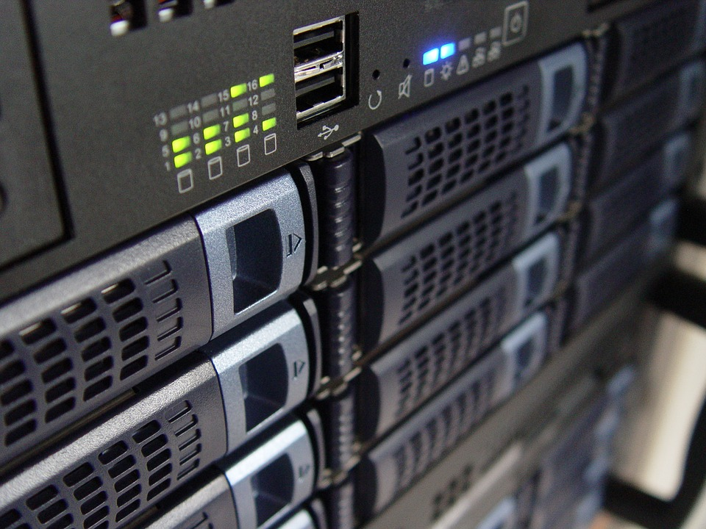
SERVER REPLACEMENT…
All existing “Physical” servers
Planned to use all VMs
All existing RH6 DEV/TEST VMs
File server
Database servers not replaced
Elastic Search servers
Split one server into three
Notes:
All existing physical servers passed end-of-life. In addition, they were all RH6 servers, wanted to move to RH7
[CLICK] Planned to replace the physical servers with VMs
[CLICK] All existing DEV/TEST VMs to be rebuilt using RH7
Split into smaller VMs – one set for each environment
[CLICK] File servers were also well past end-of-life, try to move off them for about 3 years.
[CLICK] Also wanted to use Elastic Search, So needed to build them as well
[CLICK] Existing server model was one box:
PIA
Application Server
Process Scheduler
In the new model, each environment would have its own set of smaller servers.
i.e. The PIA was on a separate VM to the Application Server, and the Process Scheduler is another separate box.
In addition, we also wanted to explore the option of having two Unix process schedulers. (Not all environments)

Slide 17
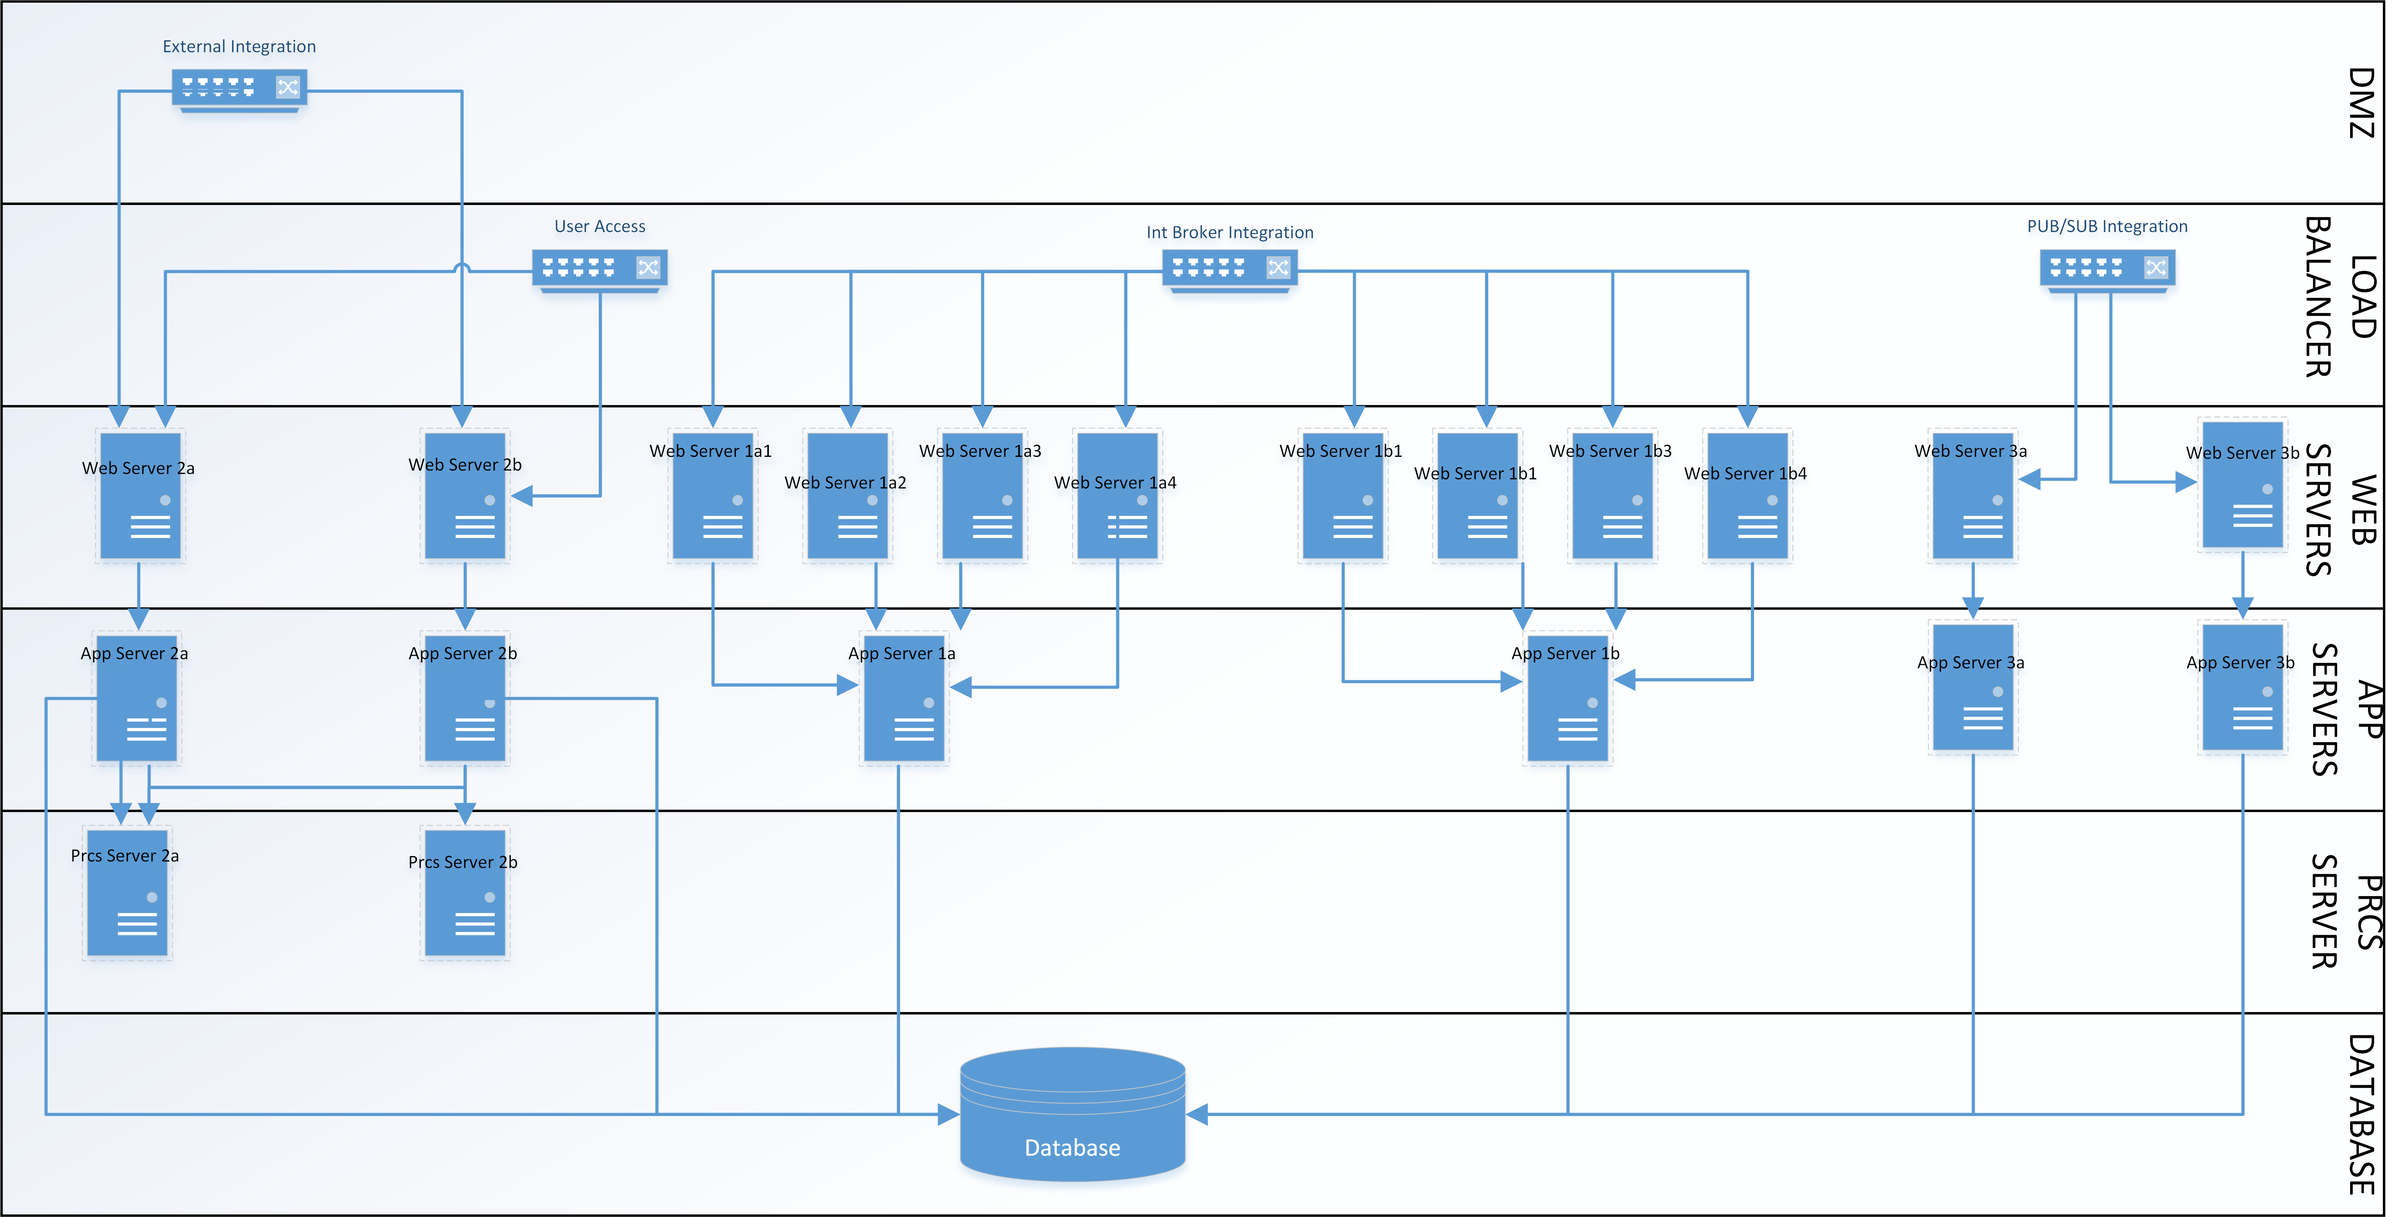
SERVER REPLACEMENT…
Notes:
New Server Architecture

Slide 18
Concurrent Projects…
New CRM
New Placement System
Ongoing work
No Change Freeze
Doubled up on migrations
Notes:
So what other work was happening at the same time that had impacts on our student system?
The major project – A New CRM – Oracle Service Cloud, along with all the integrations required with our CS system
[CLICK] New Student Placement System (Ongoing)
[CLICK] Some minor ongoing project work
[CLICK] Effectively no change freeze
[CLICK] This meant any changes had to migrated twice – once for going into production prior to go-live of the upgrade and also into the upgrade test environment.

Slide 19
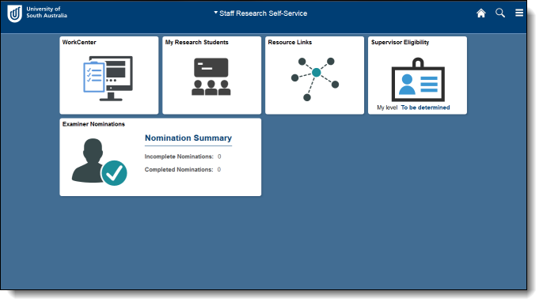
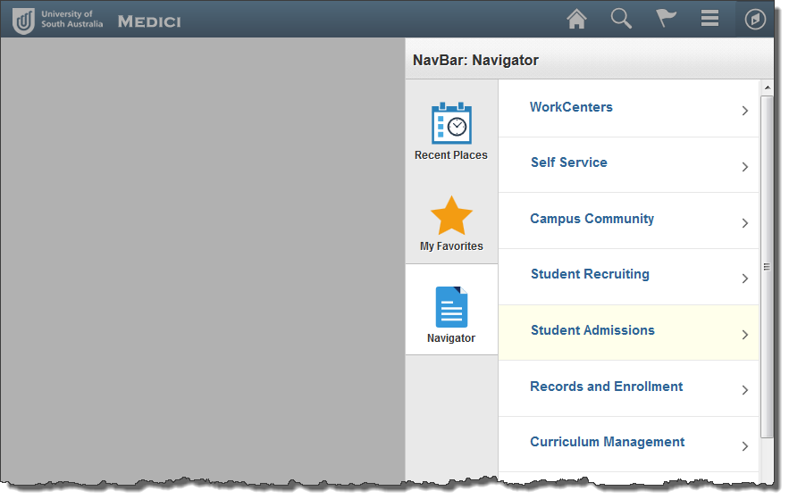
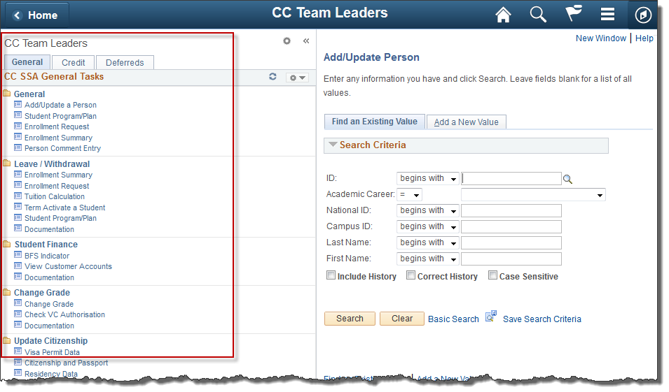
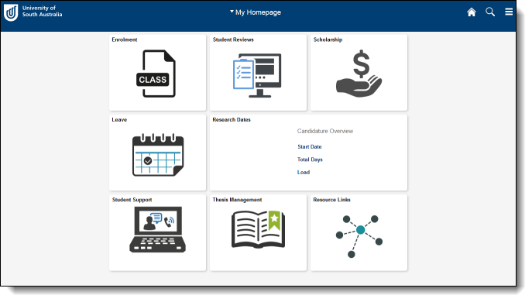
Moving towards FLUID…
Business wanted to investigate the potential of using fluid functionality
We already have some Fluid Home Pages
Starting with just Fluid navigation
Workcentres OK, but disabled the ability to add “menu”
Notes:
[BUSINESS CASE] One of the selling points, so to speak, of doing the upgrade, was the possibility of moving some of the business functional tasks to use full fluid functionality.
[CLICK] We already have some fluid home pages. These were added as part of our Research Management project. We have a Research Staff Home Page and a Student Home page
However, regular users still used the normal “classic” navigation.
[CLICK] To get the users used to the concepts of fluid, we’re still using “classic” home pages, but we’ve switched to fluid headers and navigation.
[CLICK] The users can still use workcentres and navigation collections, but they can’t “cheat” with the new navigation by adding the classic menu to their home page.

Slide 20
In summary…
CS 9.2…
Upgrade to CS 9.2
Replacing all existing servers
Implementing Elastic Search
Changing look and feel
Implementing a new CRM
No change freeze
No additional funding
Handful of developers
All to be done in five months!
….…Fast
and
Furious!
Notes:
So, just to summarise… As well as doing the technical upgrade to CS9.2
[CLICK] We were replacing the entire server infrastructure
[CLICK] Implementing Elastic Search, which no one knew anything about
[CLICK] Changing how users navigate around the system
[CLICK] Also implementing a new CRM system, which needed to interface with the Student system
[CLICK] No Change freeze – any ongoing fixes and changes needed to be tested in both the existing environment and the upgraded environment
[CLICK] No additional funding
[CLICK] All done by the number of people that could almost be counted on the fingers of a one-armed man.
[CLICK] And to be done in five months
Hence the reason for the title of this presentation –
[CLICK] CS9.2 Fast and Furious!

Slide 21
UPGRADE
How we did the upgrade

Slide 22
Upgrade setup
Spare PC sitting on my desk
Used VirtualBox Upgrade and Update Images
Ran Change Assistant on the same PC
For the Go-Live, moved the PC into our HelpDesk area
Notes:
So what setup did we use for the upgrade and update images?
[CLICK] Had a spare PC, which I moved onto my desk
[CLICK] Installed VirtualBox along with the Upgrade and Update images
[CLICK] Also ran Change Assistant on the same PC, that way we could just leave it running and not have to worry about what I was doing on my regular PC
We all know about how reliable the power grid is in South Australia. The last thing we wanted was for the power to go out while the upgrade was running, so…
[CLICK] For the go-live weekend, we moved the PC into our HelpDesk area, which has UPS protected power points.

Slide 23
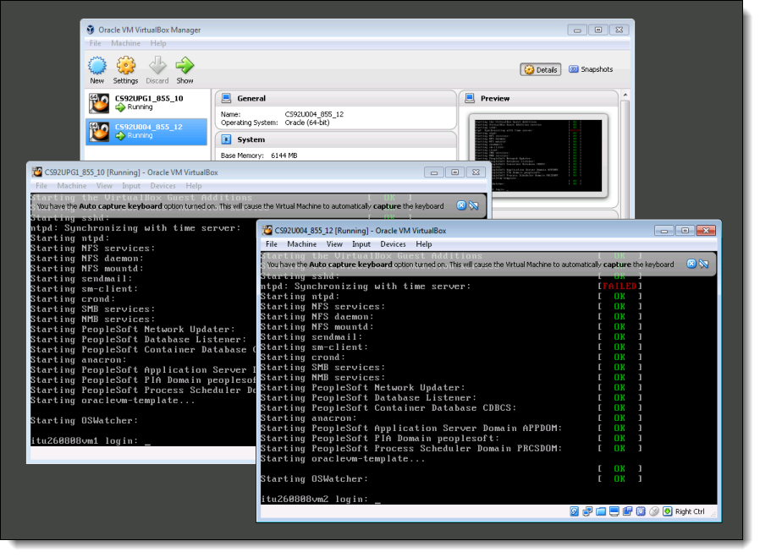
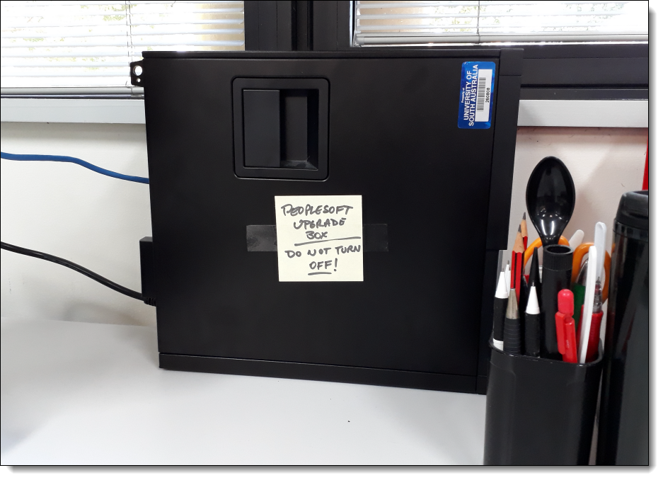
PUM INSTALLATION
Notes:
At the moment this is also our “Demo” database server (Still using Update Image 4)
Haven’t made a decision yet about how to move forward, but pretty sure we’ll go with native OS install rather than a VirtualBox install.

Slide 24
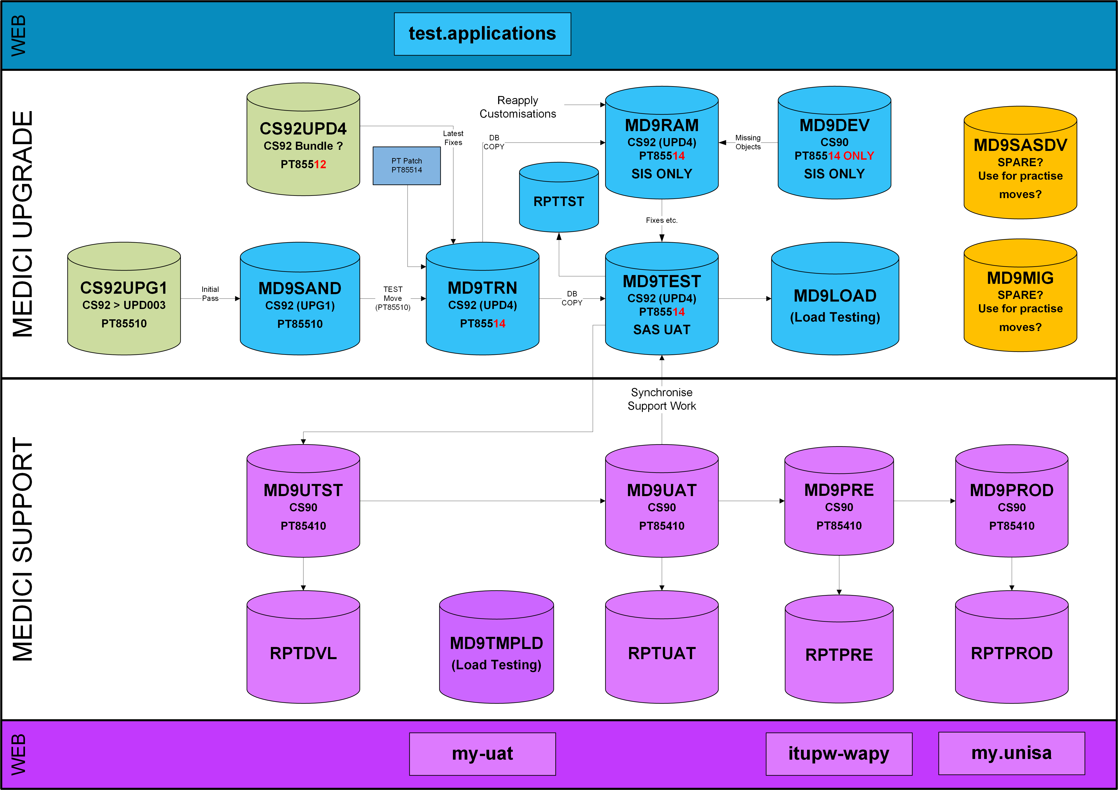
UPGRADE ENVIRONMENT
Notes:
[CLICK] PUM Images
[CLICK] Initial upgrade done to our “sandpit” database, at PT8.55.10 (same as the upgrade image)
[CLICK] 1st Test MTP was done to our training database that is never used for training
[CLICK] This then had the latest PeopleTools patch applied PT8.55.14, as the Update Image 4 had a PeopleTools dependency (needed to be at least 8.55.12)
[CLICK] We then used update Image 4 to create the delta change package, which was applied to the “training database”
[CLICK] The upgraded database was then used to refresh the left over database from our research project.
This database then had any customisations to PS delivered objects applied. This, then became our new de-facto development, as any issues identified during testing would be fixed here first, then migrated into the upgrade test environment.
[CLICK] When these were ready, our test database was refreshed, using the MD9RAM database as the source.
[CLICK] To help with the re-customising process, our DEV database was then was also upgraded to PT 8.55.14, so that we could run compare reports between the CS9.0 environment and CS9.2 environment. In theory, this meant we could also copy objects directly between the environments if required. However, during the upgrade it became clear that using the existing development environment for this purpose was not the best idea. I’ll elaborate on this when I get to the upgrade issues section.
[CLICK] Once testing had been underway for a while, the test database was copied into out load testing environment to start load testing.
[CLICK] All of the databases in the lower section were left at the existing Campus version for ongoing support. This meant that any current fixes had to go into two test environments to make sure they worked in both versions.
The one and only new environment we had created for the upgrade was the creation of a temporary load test environment so that load tests could be run in both versions for comparison purposes.

Slide 25
INITIAL PASS(ES)
Did a test Initial Pass in Dec 2016
Get a feel for the process
Formed the basis for documenting the process.
First “real” initial pass in Feb 2017
Most of the issues with the running upgrade here
No issues with Change Assistant jobs
Notes:
[INTRO] Because the upgrade was planned for the second-half of 2017, we did a test initial pass, using upgrade image 0
[CLICK] This was really just to get a feel for the whole process. There was no real attempt to sort out any issues or errors encountered here – they were just noted for future reference, ignored and we moved on.
[CLICK] What I did do was to start documenting the process, using the Change Assistant job exported to an Excel spreadsheet. I split this into “sections” that matched the steps in Change Assistant.
[CLICK] As I stated earlier, we would have liked to do the upgrade moving to PT8.56, which was supposed to be released in Dec 2016. However, this didn’t occur and the business wanted to move ahead with the upgrade in the first half of the year.
By the time we were ready to move forward with the upgrade, Upgrade Image 1 had been released as well as update image 4, so these are the versions we went with. We started the upgrade in February this year.
[CLICK] Most of the issues we had with the upgrade occurred in the initial pass. These issues would also arise in the test move but because they were identified here first, the impacts were minimised by the time we got to the test move and even more so by the final move.
[CLICK] For the most part, there were no issues with creating or running the Change Assistant jobs. Any issues I encountered were really due to not setting the environment parameters correctly. Any quirks to setting the CA parameters were documented. Most of the issues and fixes we ended up doing were really more to do with data and dddaudit/sysaudit problems.

Slide 26
Upgcust – identify Custom objects
Took about two hours to run
Over 35,000 Customised Objects
Plan to retire some customisations
Waaayyy too many to go through
Chose customisations to retire at the Project level
Notes:
[Intro] So really the big thing in the initial pass is the identification of customised objects and doing the keep-drop decisions.
For us the compare report took about two hours to run…
[CLICK] … and it identified about 35,000 customised objects.
[CLICK] We made the decision that we would try and retire some customisations, particularly those we knew were no longer current or had been replaced by new changes.
[CLICK] However, there’s no way it would be possible to go through each individual object, decide whether or not to keep it and then manually set the upgrade and copy flags in Application Designer.
[CLICK] So we thought it might be possible to automate the process by choosing which customisations to keep and which ones to drop at the project level. i.e. look at each of our projects that existed in application designer and decide whether or not we wanted to keep that particular change.

Slide 27
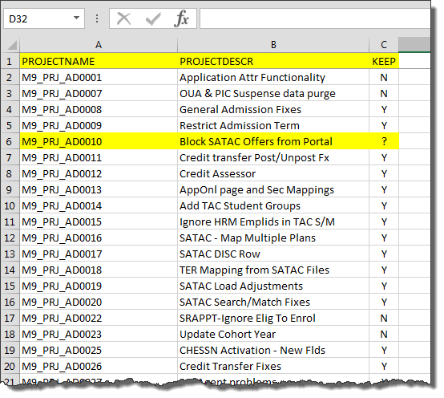
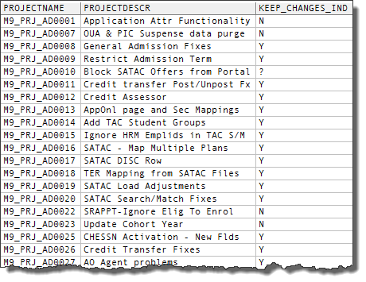
Upgcust – KEEP/DROP
Extracted a list of all projects
Had 3 or 4 meetings to go through the list
Loaded the spreadsheet into a temp table
Wrote script to set object copy flags
Any “Keep” Bolt-ons were kept
Any “Keep” Customised PS Objects left as Drop
Notes:
[INTRO] Since we have a proper naming convention for all of our changes, it was easy to identify them all. We extracted list of all projects – missed the “old” 7.6 project definitions
[CLICK] To go through the list of projects, Keep/Drops: Only the tech staff involved
Keep/Drops: Flagged projects where we knew functionality had been replaced or we thought we no longer used it.
[CLICK] Once we’d gone through the list, Created a temporary table “PS_M9_KEEP_DROP” in the TARGET database (i.e. MD9SAND) and loaded the spreadsheet data into that.
[CLICK] PL/SQL:
- Reset all Copy flags to “No”
- Cycle through each object in UPGCUST. If it was a bolt-on object (i.e. any object created by us) and it was in a “Keep” project, set copy = “Y”
- The reason no customised “delivered” objects were kept was so that we wouldn’t overwrite any codes changes etc. delivered as part of the upgrade
- Checked and refined object selection criteria. While most of our objects follow a specific naming convention, there are some exceptions.
- This set approx. 18,200 objects to “Keep”

Slide 28
First TEST MOVE
All DDD/SYSAUDIT fixes
Fix scripts created in initial pass were run
Preserving users – MVPRDEXP & MVPRDIMP
Preserving custom permission lists and roles
Notes:
[INTRO] Prior to starting the test (and final) MTP all the DDDAUDIT , SYSAUDIT fixes, as well as any scripts used to fix issues that occurred during the initial pass.
As a result the test moves ran without any major issues.
[PAUSE BEFORE CLICKING] There were two major considerations for the test and final MTP:
[CLICK] 1 - All the user data is considered PeopleTools data. The last thing we was is to blow away user in the upgrade target data base by overwriting them with the data in the source database during the application upgrade. This happens during the application upgrade pass, but after the PeopleTools upgrade. Since the application upgrade doesn’t change these tables and they will have the correct structure (including the new password field), I just commented out the relevant lines in the MVPRDEXP and MVPRDIMP data mover scripts. [SCREENSHOT]
[CLICK] 2 - For custom permission lists and roles, I had to take a different approach. These objects are also included in the same data mover scripts, so I could have just commented out the relevant sections. However, this would also mean any new Oracle-delivered permission lists and roles added by the application upgrade would not be copied from the source database. Again, any structural change to permission list and role definitions happen during the PeopleTools upgrade pass. The difference is that unlike user in PSOPRDEFN, these can be added to a project and migrated between databases at the same PeopleTools release. So once the PeopleTools upgrade had completed (when stops at the “review final audits” step), all of our custom permission lists and roles were added to a project and copied over to the source database. They are then copied over into the target database during the MVPRDEXP/MVPRDIMP steps.

Slide 29
Update image 4 delta package
No major dramas here
Pretty much just a standard patch apply
Did have one very minor issue
Notes:
[ALL POINTS AUTO]
No major dramas here. The new method where you upload the target information to the PUM Update image and it compares the updates missing to build a custom change package seems to work really well and is actually a really cool feature in the new system
We did have one very minor issue. I’m not sure what happened during the package creation, but there was an easy workaround.
Normally, when you apply a patch bundle, there are a few data mover scripts to import objects that can’t be imported via a project file copy. These include the message catalogue entries, new roles, trees etc.
During the change assistant run for the delta package, the steps to run these data move scripts were filtered out by changes assistant and there were no data scripts created out of the PUM update image at the time the change package was created. Since this was the first time using the PUM Update image to create a change package I really didn’t think anything of it at the time.
The issue with the missing objects as found during testing when users noticed that some folder tabs were labelled the “Message not Found”. It turns out that on some pages, “text” labels have been replaced by message catalog entries, and these particular messages were missing.
Since the change project definition had the objects in the definition, it was easy enough just to copy them directly into the test database and merge them in with the other fixes.

Slide 30
Re-applying customisations
PeopleCode & SQL Project
Scripts to extract code to files
Used “Beyond Compare” to merge
Pages & Components
COBOL & SQR
Importance of comments and documentation!
Notes:
[INTRO] So once the test move was completed and the Update Image delta package was applied, we needed to re-apply customisations to PeopleSoft-Delivered objects
[CLICK] Created a project to store all the PeopleCode and SQL objects that belonged to “keep” projects but were not in “bolt-oN” objects (i.e. code flagged as customised, but attached to a PeopleSoft-delivered object.
[REST AUTO]
I’ve not used the PeopleSoft delivered tools to merge code, so instead I wrote a script to extract all of the PeopleCode and SQL in this project to text files from the upgraded database. These was the new “vanilla” versions of our customised code. I then copied the just project definition to one of our non-upgraded test databases and reran the extract script to get the customised version of all the code to another set of text files.
Then, using Beyond Compare, I merged the customisations back into the “vanilla” code, which was then copied and pasted from a text editor back into the definitions in the upgrade database.
[CLICK] A list of customised vanilla pages and components was exported to Excel, and any customisations were redone manually based on observable differences in the pages and changes listed in the object comments or in the technical spec for the relevant change.
[CLICK] As with the PeopleCode, any customisations to delivered COBOLs and SQRs were merged using Beyond Compare.
[CLICK] It’s at this point you will discover how well your developers are documenting their changes (or not!)

Slide 31
testing
Copy of re-customised upgraded DB
Sanity check & integrations working
Created an issues register in Sharepoint
Handed it over to the functionals to test
Rest of our developers!
By the time of sign-off ~230 issues were raised
Notes:
[INTRO] Once all the identified customisations were re-applied the database was copied to a new database to be the user test environment.
[CLICK] We (the development team) then did a sanity check and made sure that all the integrations to other test systems were working.
[CLICK] As for any PeopleSoft patching cycle, we created an issues register on our SharePoint site to which the functionals have access to log any issues
[CLICK] Then opened it up for testing! This was for all the functional testing as well as all interfaces to our other systems, including the Service Cloud CRM
[CLICK] This is the point where the rest of our development team became involved, as any issues raised were then farmed off to be fixed.
[CLICK] Signoff on testing was a week before the planned go-live date. By this time roughly 230 issues were found in testing, 218 were fixed and 12 were outstanding, but none were considered to be show-stoppers.

Slide 32
Issue resolution
Problem added to issue register
Fixes done in temp dev
Migrated to the test database
Fixes consolidated into one big project for go-live
Notes:
[INTRO] If the users found any issues they were passed on to their testing coordinator who added them to the issues register.
Before raising the issue, they were supposed to test the same scenario in a non-upgraded database to verify that it was in fact an upgrade issue and not some pre-existing bug. This was not always done and a few issues were found to be pre-existing, in some cases for years!
Also the quality of how issues were reported varied wildly – like ‘Page X is broken’
[CLICK] Any fixes or object re-imports for issues found in testing were done in our temporary dev upgrade database.
[CLICK] Once the fix was verified, it was then migrated to the test database for user testing
[CLICK] For go-live, all the fixes were consolidated into one big project and migrated to production after all of the change assistant steps had completed.

Slide 33
DRY RUNS
Only 1 person knew how to do the upgrade
Two “Dry Runs” to train another person
Verify my documentation
Accurate timings
Notes:
[INTRO] Up to this point, there was only one person who knew how to run the upgrade steps in Change Assistant.
[CLICK] To bring another person up to speed, we refreshed our pre-production environment in the weeks before go-live to get another person up to speed and practice the upgrade steps in Change Assistant. This also served to validate the steps and issued I’d documented in my initial pass and 1st MTP
[AUTO] Because the initial pass and 1st test move were done slowly to try and get a good understanding of the process, we weren’t really sure about how long the final pass would actually take. So the other purpose of the dry runs was to try and get accurate timings so we could plan the rosters for the go live weekend.
The business also tested the final result and identified a few more issues that needed attention before we went live,

Slide 34
GO-LIVE
A detailed walk through
Ran the upgrade without stopping
Plan was to run the upgrade from Friday-Saturday
Hand over to business on Sunday
Go-Live to the University Community on Monday
Notes:
[INTRO] While all of the testing was taking place, a rough draft of the go-live plan was being developed. This also required coordination from other teams, since the student system was not going to available for the whole weekend. Based on the timings of the dry run, we developed a detailed walk through. In the walkthrough, we added a number of go, no-go check points.
[CLICK] In order to minimise system downtime, the upgrade was run without stopping.
[NO CLICK!!!! ] Since there were only two of us who knew how to actually run the upgrade, we split this into 8 hour shifts. But this had to coordinated in such a way that we had a hand-over period at the end of the previous shift without also violating HR polices about the number of hours spent on premises working. During each shift, we also had at least one other PeopleSoft technical person on hand in case of any issues arising, even though they didn’t know how to run the upgrade if needed.
[AUTO] We started the upgrade at the close of business on the Friday night and run straight through until the upgrade was completed on the Saturday night. In terms of actual time, from the start of the Change Assistant steps, to final fixes project being migrated into production was almost exactly 24 hours. All the new server setups and external system changes were being done concurrently with this as well
Once the upgrade was completed, the system was handed over to the business at 9:00pm on the Sunday night for final testing and signoff.
Sunday testing identified ~10 Issues
[CLICK] Final testing was a go, and the system went live to the rest of the University at 9:00am on the Monday
Had about ~25 Issues after we went live and closed of the upgrade issues register. We’re still identifying issues, but now these are just being treated as regular service calls, since the number is very low.

Slide 35
ISSUES
Yes, we had some issues!

Slide 36
Initial pass – pEOPLEtOOLS upgrade
No issues with the PUM Image Installs
DDDAUDIT & SYSAUDIT Cleanup
Custom Indexes
Encrypting Passwords
Compare to file for PPLTLS84CUR
TableSpace Alter script - PSFILE_ATTDET
Create Views – “ALLVIEWS” project
Notes:
No issues installing the PUM images or generating the upgrade templates. All went very smoothly.
[CLICK] Took the opportunity to really try and clean up the DDDAUDITS and SYSAUDITS.
[CLICK] We had an issue going back to when we upgraded from PT8.53 to 8.54 when Oracle removed descending Indexes from the database. We had a lot of custom indexes that replicated indexes with descending keys, but with ascending indexes. These failed to build back then but never got around to removing them. This time around I actually got rid of them.
[CLICK] The first real issue in the upgrade was the failure of the encrypt passwords step. This step failed with what appeared to be a java error but was actually due to the encrypt password command attempting to encrypt blank passwords in PSOPRDEFN. This was fixed by setting the encrypted field to true for all the entries in PSOPRDEFN where the existing password was blank.
[CLICK] The compare report takes a long time to run. In past years we’ve always skipped this step because we don’t generally make changes to PeopleTools objects. However this time it need to be done as we made a lot of changes to LDAP processing for our Research portals to allow for single-signon, so all of these need to be reapplied.
[CLICK] PSFILE_ATTDET - this table holds file attachment data. We use this table to store student applications. However, it splits the documents into smaller chunks. As a result this table has millions of rows. In the alter script it creates a copy of the table an copies all the data across. The last time I let this run to completion, this one table took 19 hours to complete. When comparing the DDL stored in the modified database with the original DDL, there are no significant differences. Prior to this script running, I edited it to remove this table.
[CLICK] Previous PeopleTools upgrades have always used Datamover with the CREATE_ALL_VIEW command This always ran to completion with a list of views that failed to build at the end. This time around they loaded all the views into a project and generated an SQL script to build them all. Because the initial pass database was our sandpit database, any DB Links we use weren’t actually pointing to a databse, so all views that used DB links failed, causing the whol step to abort. Needed to find the bad view, remove it, as well as all the previous steps that completed and rerun the step.

Slide 37
Initial pass – APPLICATION UPGRADE
PSRECFIELD_TMP
Field SSR_RS_THESIS_TITL
Record SSR_HECS_ELEC – Alter with deletes
Notes:
[INTRO] PSRECFIELD_TMP contains a copy of all the record definitions. This step failed with unique constrain errors because there were still entries in the from the last upgrade. Deleted all of the existing data and reran the step.
[CLICK] SSR_RS_THESIS_TITL – Oracle have reduced the size of this field from 300 characters to 254. This a affected a small number of existing research student data. We’ve made this a rich-text field and most of the issues were because the someone had copied and pasted the text from a Word document and the rich-text editor converts any special formatting into HTML tags, increasing the length of the data when it’s stored in the database. Most of these were fixed by stripping the formatting and re-entering the data.
[CLICK] In December 2016 we had to apply a legislative patch, which added a new field to record SSR_HECS_ELEC. However, PUM Upgrade Image 1 does not contain this patch. When the alter with deletes step was run during the upgrade, this new field was dropped, along with the associated student data. So that this didn’t happen during the test and final moves, the modified record definition was copied into the final upgraded initial pass database. During the test and final MTP, the field wasn’t dropped, preserving the data. Since we didn’t have a change freeze, any changes with new record fields that went into production while we doing the upgrade also had their record definitions also migrated back into the IP database.

Slide 38
TEST MOVE
All DDD/SYSAUDIT & Additional Fixes
Users Preserved – MVPRDEXP & MVPRDIMP
Preserving custom permission lists and roles
Records with new fields
DB Links in the Test MTP database
Notes:
[INTRO] As stated earlier, prior to starting the test (and final) MTP all the DDDAUDIT , SYSAUDIT fixes, as well as any scripts used to fix issues that occurred during the initial pass. As a result the test moves ran without any major issues.
[CLICK] Because of the changes MVPRDEXP and MVPRDIMP data mover scripts, the existing users were preserved.
[CLICK] As were the permissions and roles that we’d copied via project into the source database.
[CLICK] The problem with SSR_HECS_ELEC dropping the new field wasn’t an issue, as the since the source definition now had the new field
[CLICK] At UniSA we have many more different development and test environments than other systems in use. As a result, not all of our PeopleSoft environments have corresponding environment to integrate with for other systems. Our other systems usually only have a dev, test, pre-prod for development and testing. Since the test move was done using the training database, the biggest issue was still the creation of the views using DB Links, as these still all failed due to no matching training system to integrate with. It wasn’t until we created the actual test database that we could verify that these views built correctly.

Slide 39
Post-upgrade (PRE-TESTING) issues
The PSFT_CS Node
Roles with invalid Permission lists
PTPT1000 Weblibs etc.
Integration services and queues
Notes:
[INTRO] So these are the issues that needed attention after the upgrade, prior to opening up for testing by the users.
[CLICK] The really major fix was to the default local node. All the PUM Images have PSFT_CS as the default local node, and the PSFT_HR node appears to have disappeared. However, after the upgrade, while our databases had a PSFT_CS node definition, the PSFT_HR still existed and was still the default local node. I’ve searched through all the log files generated during the upgrade and looked through the upgrade templates to see if there was a step that was missed or failed, but I’m still none the wiser.
What we ended up doing, was to rename the PSFT_CS node PSFT_CS_OLD, ran the APPMSGPURGE process and then renamed the PSFT_HR node to PSFT_CS. We then reconfigured all the integration gateway settings to use PSFT_CS instead of PSFT_HR. We also needed to do this in our PeopleSoft CRM system.
[CLICK] We had some custom roles, including a major system administration role that had one or more PeopleSoft-delivered permission lists that no longer existed in CS9.2. These were HR and/or payroll related. Since the list was still attached to the role, but the permission list didn’t, this prevented some users from logging on. This discrepancy was actually listed in the final SYSAUDIT reports but missed. Running the fix script listed in PeopleBooks solved the issue.
[CLICK] The PeopleTools upgrade comes with a whole new set of weblibs attached to the delivered permission list “PeopleSoft User” (PTPT1000). However, since this permission list gives far more access to the system than we allow for a regular user, we use a modified cloned version of PTPT1000 instead. This modified version was missing a whole stack of these new weblibs and users were getting an error when trying to log in. We added in the missing weblibs and also needed to add this permission list to the “my HomePage” and “Navigation Bar” security in portal structure and content.
[CLICK] We found that once the system started up, integration messages between the CS system and PS CRM were not being processed. This was because a number of services and service operation handlers had been made inactive and a number of queues were set to paused. Activating the services etc. solved these issues.

Slide 40
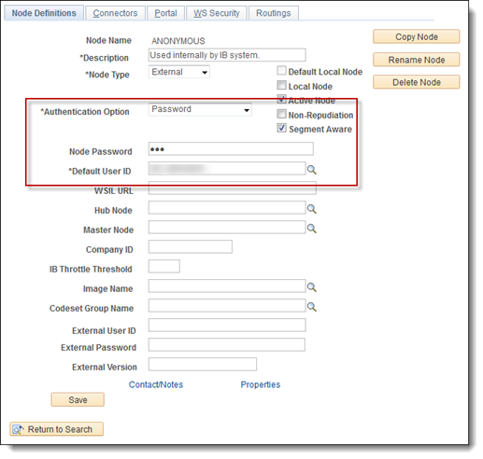
Post-upgrade (PRE-TESTING) issues
“Regular” PeopleTools issues
Anonymous Node
Time Zone
Disable fluid by default on mobile devices
Disable Fluid Homepage Tile
Notes:
[INTRO] The next group of these are the changes that seem to occur after every PeopleTools upgrade. I’ve seem these occur over and over again.
[CLICK] The “Anonymous” node gets reset: The ANONYMOUS node configuration gets reset after the Tools upgrade reset. The upgrade had set the Authentication option=None and User ID = PSADMIN, so need to reset the authentication to “password” and enter our default username and password.
[CLICK] The Time zone gets reset to pacific time, needed to reset it to our local time zone
[CLICK] We also disabled Fluid Homepage as the default for mobile devices. This was something we discovered by accident in our last PT upgrade to PeopleTools 8.54. There is a new setting which displays a fluid homepage by default, if the system detects that the user is using a mobile device rather than a standard PC. Since we’re not using fluid homepages, this needed to be disabled.
[CLICK] On a related note, since we’re not using fluid home pages at the moment, we didn’t want to confuse the users who might accidentally click on the fluid homepage tile, so we disabled that as well.

Slide 41
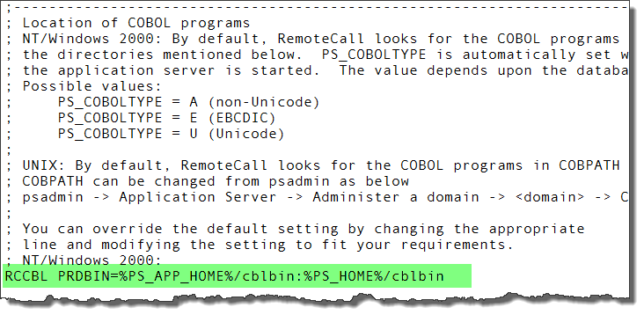
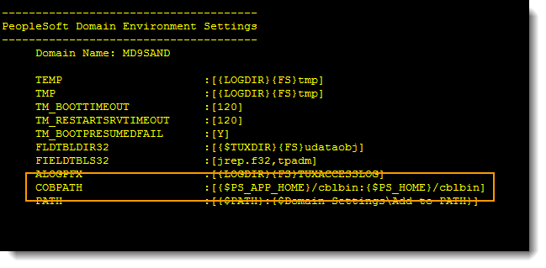
Testing issues
Custom Portal Definitions
Remote Call Cobol
Missing/Broken customisations
Use of or DEV database to restore missing objects
Configuration/Reference tables
Cosmetic issues
Load Testing
Notes:
[INTRO] Next up we have the issues identified by user testing
[CLICK] The biggest issue uncovered by the users in testing was in our custom research student and staff fluid pages developed in CS9.0. When these were implemented, two custom portal definitions were created – STAFF and STUDENT (vs EMPLOYEE) for the regular users. Any portal registry structures attached to these would not migrate between databases – We’d get “Parent Object not in target” errors. i.e. the relevant portal definition was missing in the target database. Even adding the portal definitions to a project wouldn’t fix the issue. It turns out that even in the old system, these portal definitions weren’t migrated by project copy but were created manually in each database. So that’s what we ended up doing for this upgrade – manually creating the custom portal definitions.
[CLICK] Remote Call Cobol. With this upgrade we moved to decoupled homes – Separate APP_HOME, PS_HOME and CFG_HOMES. We set up
[CLICK] The next biggest issue – missing and broken customisations. While the keep-drop decisions were reasonably valid, some of the projects we chose not to keep had objects that were re-used by other projects we chose to keep, but those objects were not included in the keep project because they weren’t being changed in that particular project. So we just needed to copy those objects from a non-upgraded CS 9.0 database into the new system.
[CLICK] Which brings me to my next point – the use of our DEV database to bring over missing objects. I mentioned earlier in my presentation that we did a PeopleTools-only upgrade to our development database. It became apparent very early on that this was not really the best database to use for this. The problem is that the DEV database has a lot of rubbish in it – really in two main categories.
1 – Changes to objects and code that never made it into production and inadvertently moved into the upgraded database
2 – Code/Objects different in DEV to PROD. This usually occurs where a project has been migrated to a test environment but then any issues found there were fixed in situ and never migrated back into the DEV environment
Ended up not using the DEV environment and pulling objects from our pre-production environment instead, since this was most like the current production environment (regularly refreshed from production and only changes signed off approved for release get migrated there).
[CLICK] Another issue was some PeopleSoft-delivered tables where we had modified or added values and had been overwritten with old/default PeopleSoft data. Solved these by exporting the data from a current database and importing into test and the source database. That way in the MTP pass, the modified entries would come over.
[CLICK] Delivered cosmetic changes issues. It appears that Oracle ran some sort of process over the existing page to change their appearance. Unfortunately this also appears to have broken the formatting. We took the stand that we we’re not going to fix the appearance of any pages that had formatting issues unless we had already customised that page or the formatting issue was so bad that the page was unusable.
[CLICK] Lastly, load tesing. Since we moved to all VMs, our enrolment load testing couldn’t match the performance of the existing physical boxes. Tried lots of tweaks to the VMs, but ultimately we replaced the enrolment VMs with physical boxes. Since these boxes were earmarked for replacement anyway, these were paid for out of the existing capital budget.

Slide 42
go-live (& post) issues
Elastic Search
Missing custom pages on PS components
Users Missing Favourites
Ongoing issues with missing customisations
Notes:
[INTRO] To finish up on the issues, these are the issues that were discovered after during and after the go-live weekend
[CLICK] No major issues with the upgrade itself, however, we couldn’t get Elastic Search to work properly. This seems to be a security issue (WEBLIBS in permission list), as the search was working for the development team, but not regular users. They would search for something, but when clicking on the search results, they would get kicked out of the system. Eventually we got it working by rebuilding the custom PTPT1000 permission list from scratch in production.
[CLICK] Another issue after going live was where we had added a custom page to an existing PeopleSoft-delivered component. It turns out that the customised pages and components were all there, it’s just that all of the security for the custom page was gone. As you recall, we preserved all the permission lists after the PeopleTools upgrade, which would have been copied over to the upgraded database when the MVPRDIMP.dms was run during the application upgrade. However, the modified components were only copied from the test database into the product after the upgrade steps were complete. One of the step run in Change Assistant is portal security sync. Since the permission list contained a page that was not yet copied into the upgraded database, the security was reset. Fixed manually by generating a list of pages and their security settings out of the backup copy of the production database and then manually fixing the permission lists in production.
[CLICK] All through the upgrade testing process, the users kept asking if their “favourites” would be preserved. Since in all passes of the upgrade there seemed to be no issues with these for the technical team or the main system testers as all their favourites were present. Since we did nothing special to preserve them, the answer to the users was “yes, they’ll be there”. Turns out this was not the case. Only really affected new users in the system who were not in the system at the date the production copy used for the initial pass was taken. In addition, the tables used to store the user favourites are not grouped together with the rest of the “user” tables in the MVPRDEXP/MVPRDIMP data mover scripts. Luckily, favourites are also an object you can add into a project and migrate between databases (Who Knew!), so we went into the backup copy of production, created a new project containing the user favourites and imported them into the upgraded copy of production.
[CLICK] Still have an ongoing issue where we are finding missing customisations. Since we had an accelerated testing regime where only critical functionality was tested, I suspect these will keep popping up until after July next year, when we’ve gone through a full year of processes etc. and the odd piece of functionality in the system which is rarely used might show an issue.

Slide 43
Concluding thoughts
ANY QUESTIONS?
Notes:
So to summarise, we did our upgrade in five months as well as replacing all of our existing infrastructure, with no special budget and a handful of existing staff, most of whom were still working on their own project work.
Our upgrade has now been live for four months and during that time we’ve run through a number of critical processing periods for finance, graduations, admissions and enrolments
Multiple tuition calc cycles
For Admissions, we’ve been running weekly TAC loads as well as daily OUA and other external party admissions
Did a major graduation event in August
In October we opened the system up for continuing students.
During this there were no issues relating to the upgrade. So it appears that the upgrade has been a success for us.
The next real challenge will be patching.
Any Questions?

Slide 44
Shameless plugs!
For more information regarding Elastic Search and our Server Build Process for the upgrade – see the following UniSA Presentations at this year’s Alliance Down Under:
Elastic About Search / Let's Go Alerting with Splunk
Session Number: 5030 by Somu Kala
Thursday 1:30 PM - 2:15 PM : Arbour A2 Room
Master of Puppets
Session Number: 5063 by Jarrod Martin
Thursday 2:20 PM - 3:05 PM : Arbour A2 Room

Slide 45
presenter
Robert Lacina
Senior Information Technologist
University of South Australia
Robert.Lacina@unisa.edu.au
all Alliance presentations will be available for download from the Conference Site

Slide 46
THANK YOU!

