Slide 1
The Page and Field Configurator – easy as pie
SESSION 6011
Thu, Nov 08, 2018

Slide 2
presenter
Murray Gould
Functional Analyst
University of the Sunshine Coast
mgould@usc.edu.au

Slide 3
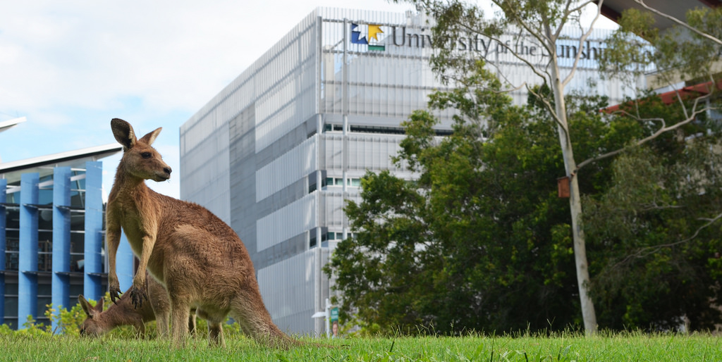
Your organization
16,594 students
new campus opening 2020 USC Moreton Bay
(Petrie, North Brisbane)

Slide 4
USC & ORACLE
PeopleSoft 9.2
Peopletools 8.56.07
PUM 8

Slide 5
Overview
Configure Field Properties hiding, renaming, default value
Configure Page Visibility visibility and display only
Criteria field and value
User List criteria user IDs, roles, exceptions
Sequencing Apply criteria to multiple user list criteria

Slide 6
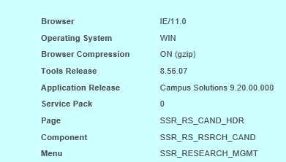
How to Configure a Page
Identify the page that will be configured and the component it belongs to (SHIFT+CTRL+J)

Slide 7
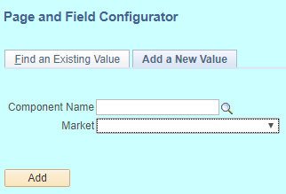
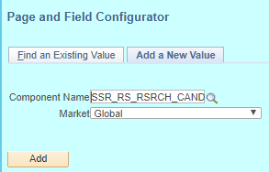
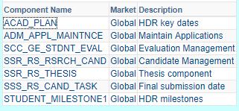
Select the component
Navigation: Enterprise Components, Page and Field Configuration, Page and Field Configurator
Select Add a New Value and enter the component name and Market: Global

Slide 8
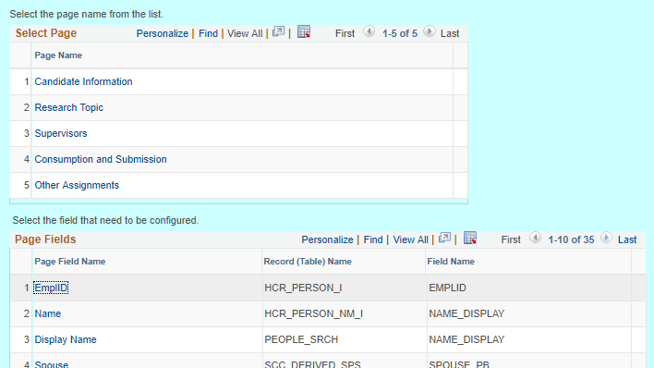
Configure Field Properties selection

Slide 9
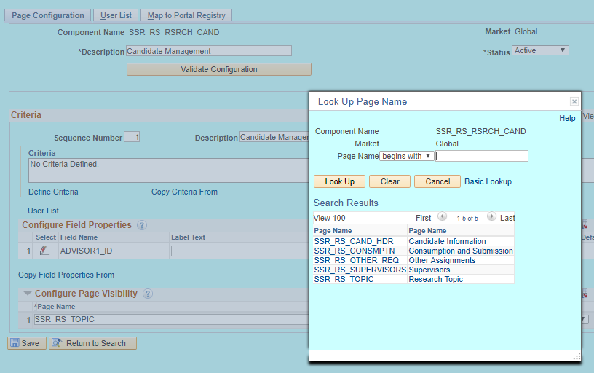
Configure Page Visibility selection

Slide 10
Configure Field Properties
Notes:
Demo how to use user id exception and can now see/not see fields

Slide 11
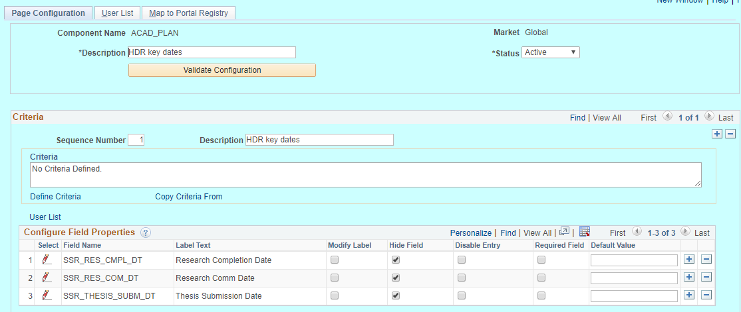
configuration Example 1: Field properties – hiding fields

Slide 12
Required field warning
If the required field is deselected by default the field can be hidden

Slide 13
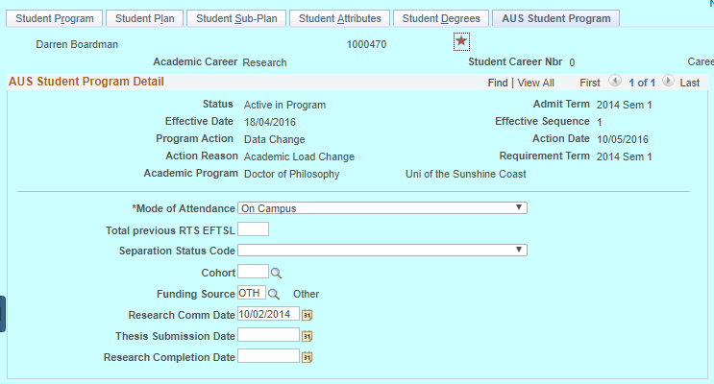
Before configuration applied

Slide 14
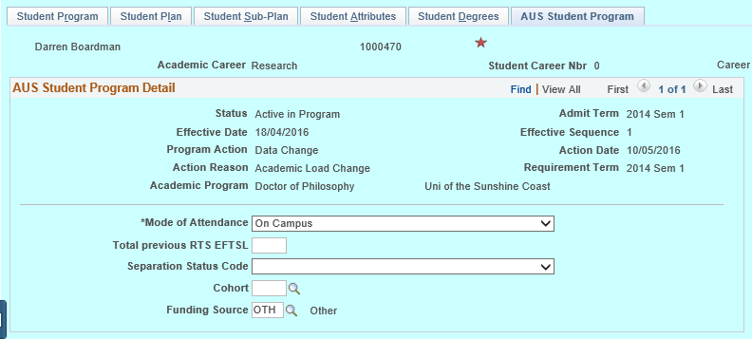
Hidden fields

Slide 15
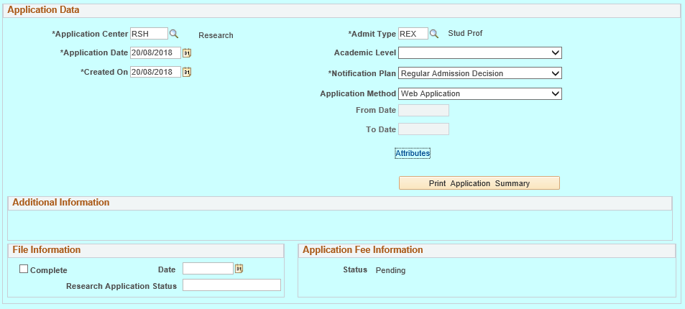
configuration Example 2: rename field

Slide 16
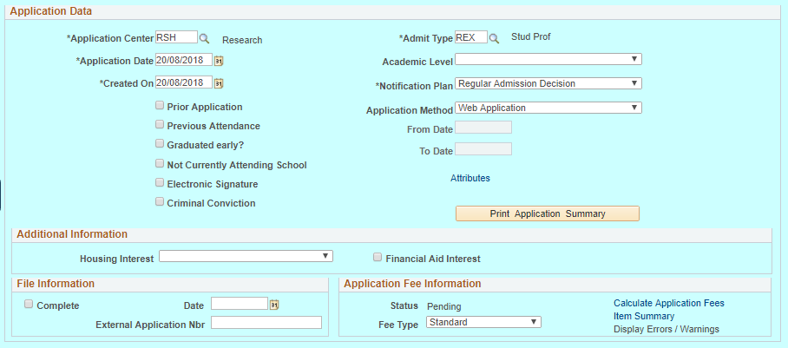
Before Rename configuration

Slide 17
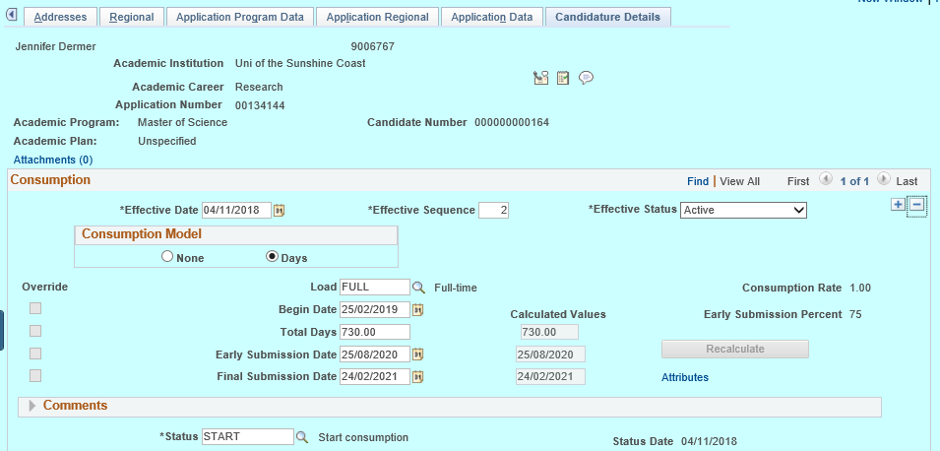
configuration Example 3: default value

Slide 18
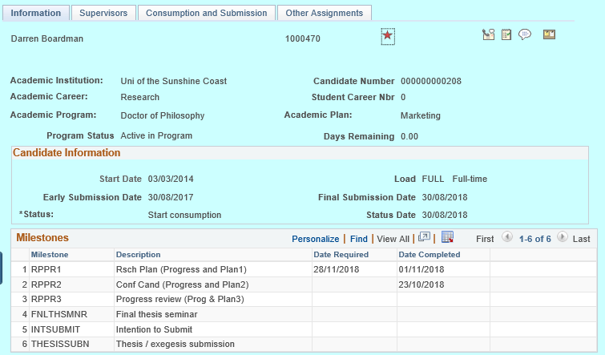
Configuration Example 4: Hide a label

Slide 19
Before configuration applied

Slide 20
Configure Page Visibility

Slide 21
Page visibility and display only

Slide 22
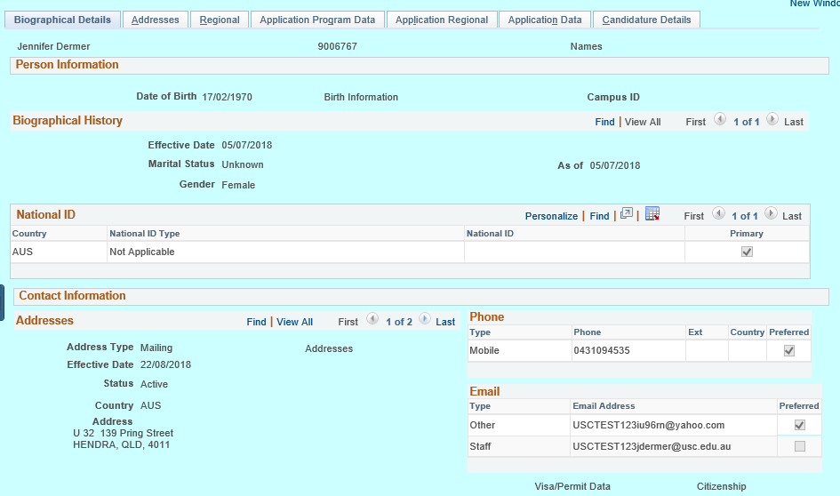
Pages hidden and reAd only

Slide 23
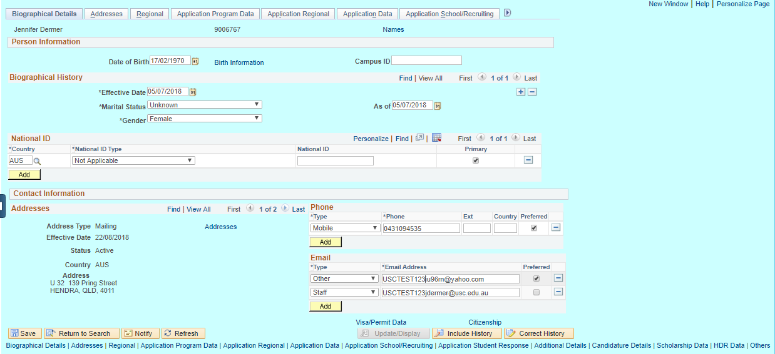
Before page configuration applied

Slide 24
Criteria

Slide 25
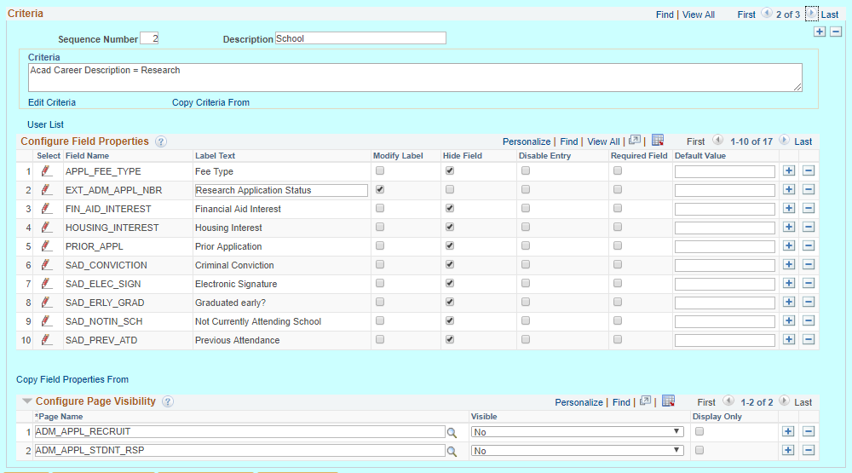
Criteria configuration

Slide 26
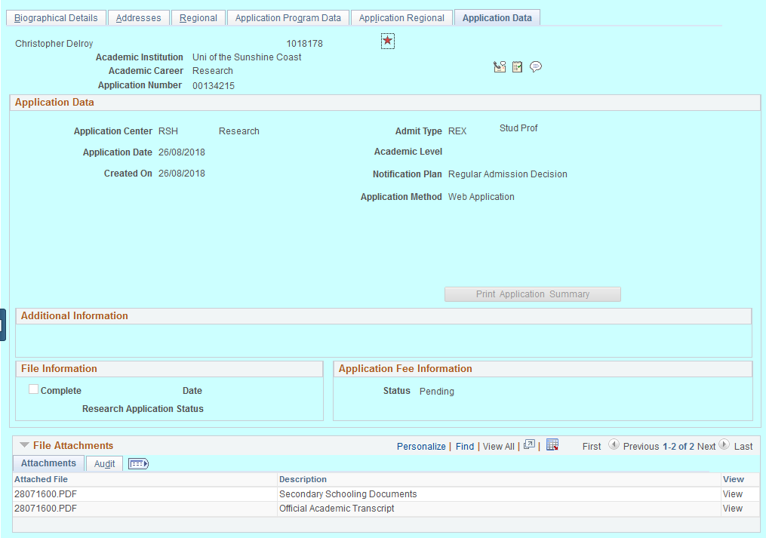
Faculty View: Research career (RSCH)

Slide 27
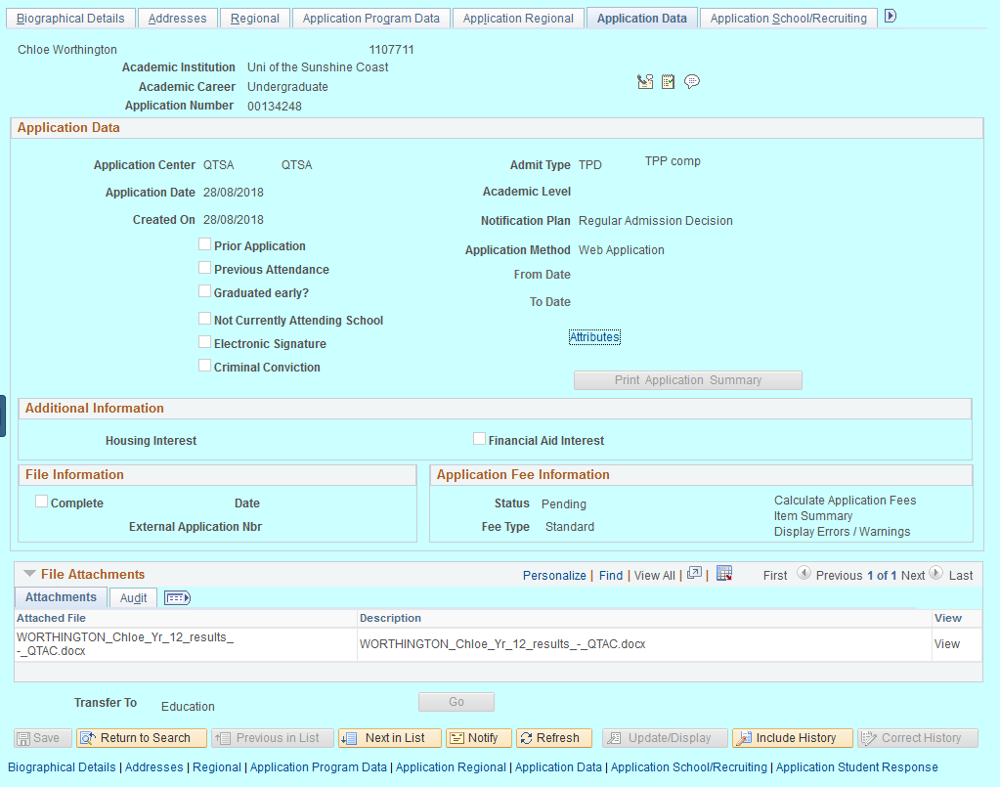
Faculty View: non-RSCH careerS

Slide 28
Sequencing

Slide 29
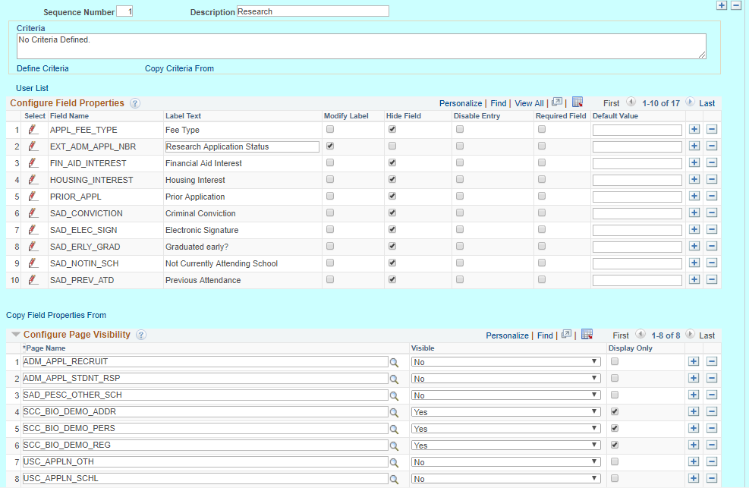
Sequence 1 - research

Slide 30
Sequence 2 – school staff role 1

Slide 31
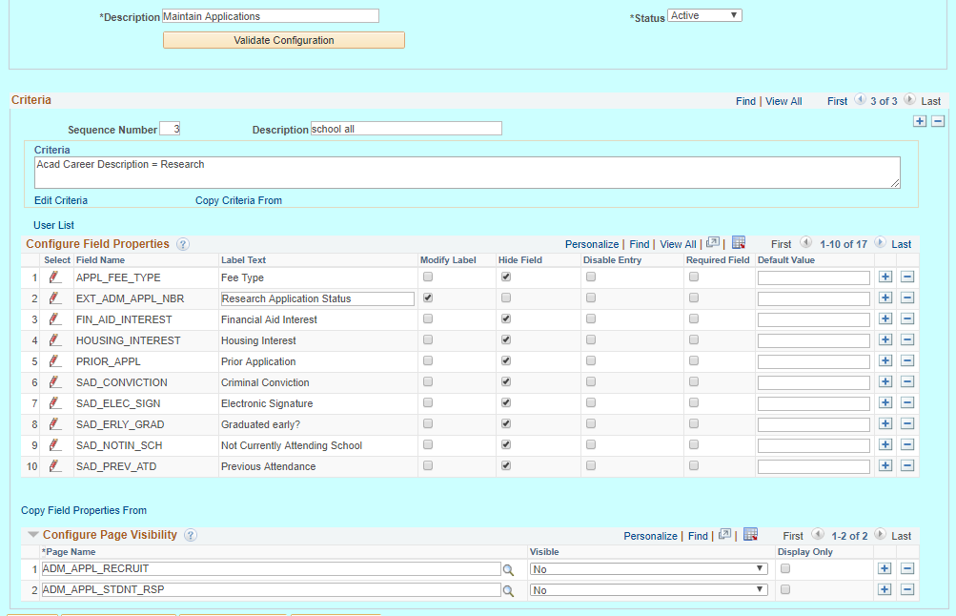
Sequence 3 - school staff role 2

Slide 32
User List criteria

Slide 33
User List options
All users with exceptions by user ID
A role with user id exceptions
A user id/list of user id’s
Multiple roles using sequencing
You can create a user list at the Header Level where one user list covers the entire component or, at Sequence Level, where aseparate user list is defined for each sequence number.

Slide 34
All users with exceptions

Slide 35
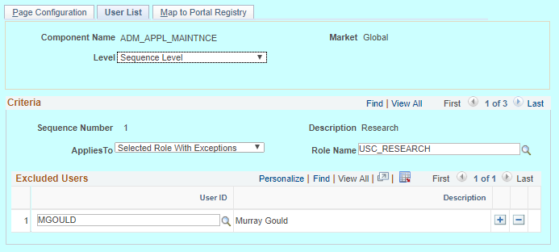
A role with exceptions and sequencing

Slide 36
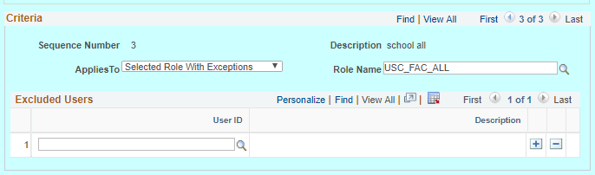
A role with exceptions

Slide 37
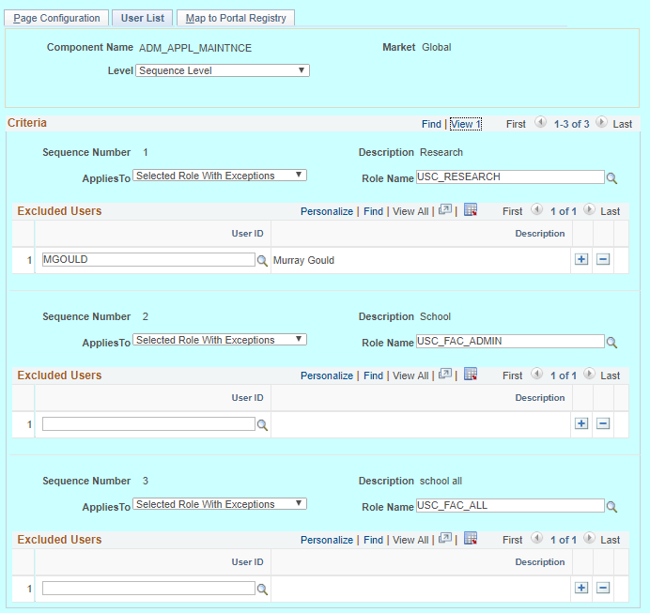
Sequence level criteria

Slide 38
Hints, tips and info

Slide 39
Device Form Factor
Device Form Factor section is used to select the form factor for which the criteria is applicable. If you select all the check boxes it indicates that irrespective of the form factor the selected criteria is applied.
Note: This feature is applicable only for fluid components.

Slide 40
Use of configuration
You can select only the field made visible in the application designer for configuring in the utility. Radio buttons and non-data entry fields will not be available for selection in the list
You can only hide the fields which are made visible in the application designer. The fields made invisible in application designer cannot be made visible
You can disable a field only if it is by default editable in the application designer. The field which is already disabled in application designer or PeopleCode cannot be made editable
You can make a field mandatory which is not configured as required in the application designer. The field which is made as required in application designer or PeopleCode cannot be made not-required
A page which is already Display Only in Application Designer or PeopleCode cannot be made editable

Slide 41
Use of configuration (cont’d)
The configuration can be applied only to a registered component in the system. Secondary pages and other modal pages or components could not be controlled using the configuration.
While defining the criteria, the selected field should contain a value either from defaults or from existing transaction data. If criteria is configured on work record fields where data is populated dynamically, then at the time of criteria evaluation (Post Build event) if the system does not finds a value for the field, the criteria would fail and the configuration will not get applied.
At the run time of the component, the criteria will be evaluated only once at the time of component load. Any change in the field values selected for criteria evaluation thereafter will not result in re-evaluation of criteria.

Slide 42
Use of configuration (cont’d)
Validate Page Configurations - used to verify the validity of the configurations after any system update or application of fix or patch. Any changes to the page or page field meta data of the fields and pages selected in Page and Field Configuration will be reported as validation error
Map to Portal Registry page - Access to this page is restricted based on the access to People Tools Events Mapping component
Minimum People Tools version of 8.55.15/8.56.02
Ongoing Page and Field Configurator development

Slide 43
Concluding thoughts
ANY QUESTIONS?

Slide 44
presenters
Murray Gould
Functional Analyst
University of the Sunshine Coast
mgould@usc.edu.au
all Alliance presentations will be available for download from the Conference Site

Slide 45
THANK YOU!

