Slide 1
Oracle Service Cloud
Roadmap
May’17 to Feb’18
last updated: 9/11/17

Slide 3
May 2017

Slide 4
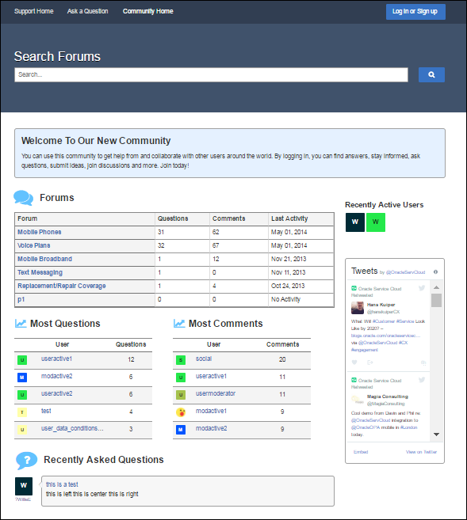
Improved Community Overview
May 2017: Community Home Page
Community “Home“
Capability Highlights
New community home page: Provide a quick glimpse of overall community activity
New forums overview: new widgets provides better visibility into community structure
Recently active users: new widget shows members who have recently participated
Key Benefits
Improves participation and engagement via a stronger community center and “front-door”
Reduces implementation timelines for customers seeking a more traditional community experience
Extends the conversation via a new Twitter discussions widget
Forums Overview
Recently Active Users
Notes:
This feature includes several community administrative and back-end enhancements, as well as functionality for web users.
The main new feature is a community home page which is being added to the reference implementation.
acts as a "front door" to the community
contains both new and existing widgets in order to give users an at-a-glance, high level view of community and other relevant activity
This package also includes:
enhancements to discussion and account management pages
Improved workflow for choosing profile pictures (which builds off the avatar features from the previous two releases)
Twitter Reference: This is It is a widget that wraps twitter posts.
You can specify an account (@OracleServCloud), or a hashtag (#ModernCX) or a query string
Doesn’t do much more than that

Slide 5
Guide Agents to Answers
May 2017: BUI Guided Assistance
Capability Highlights
Guide Agents to knowledge solutions using a serious of questions and answers in BUI.
Key Benefits
Guide agents through a series of questions and answers to diagnose issues, reduce agent training time and ensure consistent troubleshooting and resolution.
Notes:
MORE DETAIL
The implementation is to add the Guided Assistance relationship item to a custom incident. Once added, the Guided Assistance relationship item functions as a container for displaying guides to your staff that can be rendered in the Browser UI. Guides can be displayed manually, based on a guide search or selection performed by an agent. They can also be loaded dynamically, based on a workspace or script rule. For example, you can design a workspace rule to display a guide automatically when the editor loads based on the incident’s category, or you can load a different guide when an agent selects a certain incident disposition.
OUT OF SCOPE
For Agent Guides/Guided Assistance there will be two gaps:
In the Service Console there is a left panel at runtime that lets the agent quickly see where they are in the guide tree and quickly navigate to a particular node. That panel and the related “Expand Navigator” and “Navigate” buttons will not be available.
In the Service Console an administrator can add Guided Assistance as a page level action for incidents (button in the ribbon). That page level action will not be available in the Service Browser UI. Guides will only be available if the Guided Assistance control has been dropped onto the incident workspace.

Slide 6
Automate Decisions
May 2017: BUI Policy Automation
Capability Highlights
Execute policy interviews within a Browser UI incident workspace.
Leverage existing workspaces that use these controls. The same workspace configuration is used for both Browser UI and Service Console.
Key Benefits
Policy Automation streamlines information increases productivity and delivers consistency
Notes:
MORE DETAIL
For OPA there will be no gaps between what is offered in Service Console and what will be available in the Service Browser User Interface.
This feature will extend the Oracle RightNow Policy Automation integration (OPA) implemented in 13.2 thru access from the Browser UI. It will:
Enable the agent to deliver rich interactions with the customer using OPA interviews
Take advantage of complex rules that may frequently with no training or customizations
Capture information collected by OPA to prove how decisions were made

Slide 7
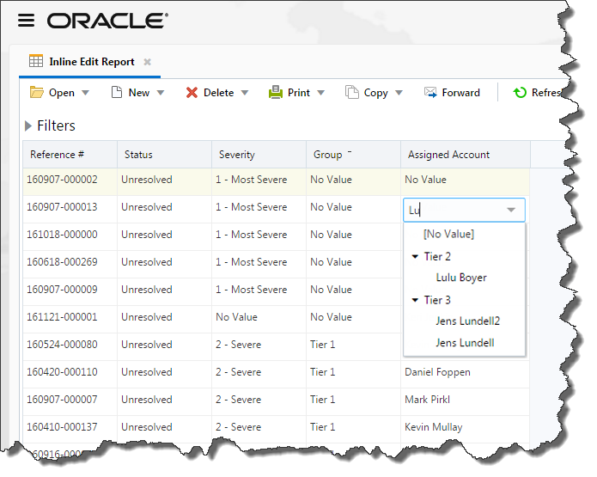
Modify Data Directly Within Reports
May 2017: BUI Report Inline Edit
Capability Highlights
Complete edits without opening the object
Change data within cells of an enabled report
Search for menu values when making edits
Key Benefits
Save time updating records at a glance
Easier editing of records
Automatically saves to edited record
Notes:
Another feature in the Agent Desktop for Analytics is the ability to edit record data directly in reports without the need to open reports. We are currently planning inline edit within reports for the May 17 timeframe. This will include the use of the inline editable columns configured in the Service Console report designer. This allows the selection of specific columns and the ability to auto save after independent edits. The same search capability found in workspaces will allow you to easily find and select values within large lists as you perform your edits.

Slide 8
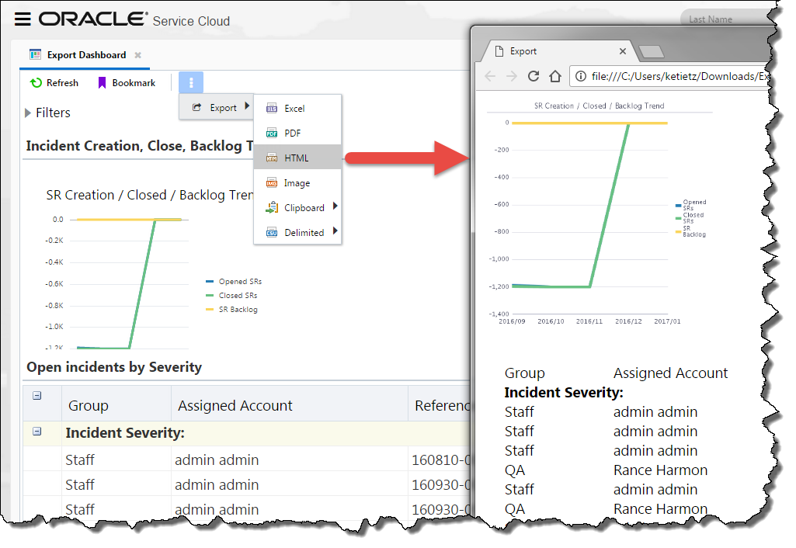
BUI Export Enhancements
May 2017: Dashboard Export
Capability Highlights
Save dashboard output to a local file
Select from remaining different export formats including:
Image, Clipboard (HTML, Tab, & Comma Delimited)
Export additional report functionalities
Key Benefits
Continue OSvC data analysis on your desktop
Export more complete data set
Notes:
We are completing the export functionality with BUI for May 17 release. This includes dashboard export and 2 additional export formats bringing the list of format to 6 ( * = New in May 17):
PDF
Excel
HTML
Image *
Clipboard (Comma delimited, Tab delimited, HTML) *
Delimited (Comma, Space, Tab, Pipe, Caret, and Custom)
In the first phase, Report export, we did not support all reporting functionalities in the exported files. In this release we added the ability to export reports using the following Analytics runtime functionality:
Report headers/footers
Support for column widths in exports
Support for custom report styles
The ability to export reports in record layout.
This rounds out our export functionality for BUI.

Slide 9
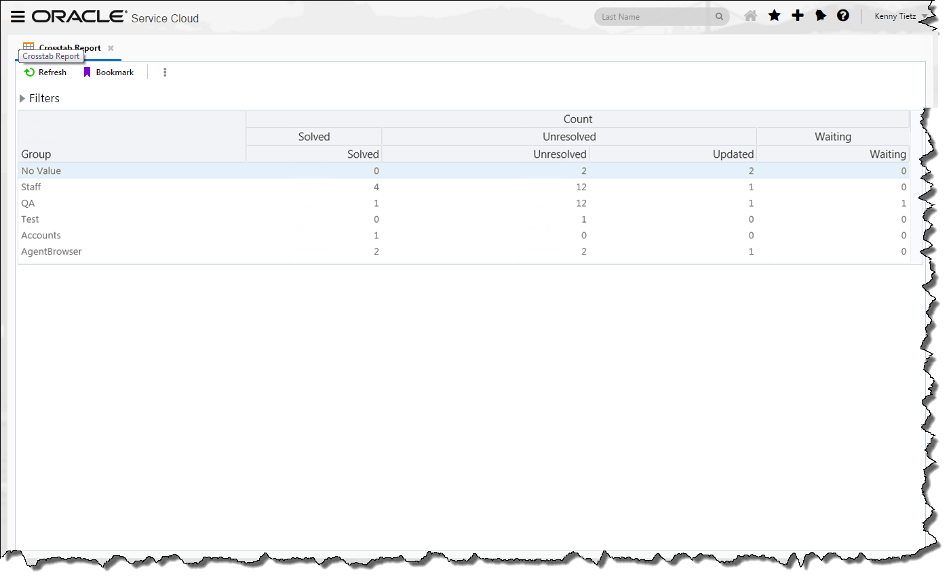
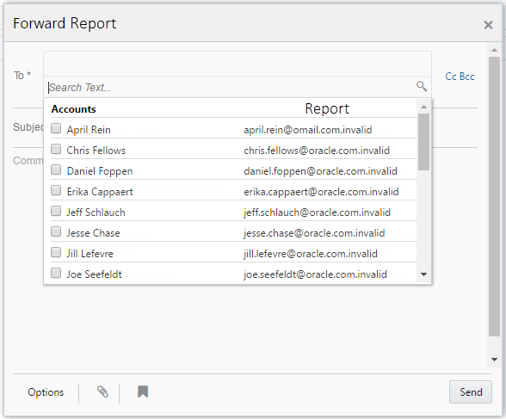
BUI Runtime Support
May 2017: Report Crosstab and Forward Support
Capability Highlights
Crosstab support for reports
Group data by row and column output
Forward reports and dashboards using HTML format
Key Benefits
Organize report output for easier visual representation of data
Share reports and dashboard data with others (users or non-users).
Notes:
Before we get into the report and dashboard designers we wanted to include support for a few more runtime functionalities for Analytics. We will be supporting reports that are configured with Crosstabs. These are pivot table-like displays that allow users to group data by row and column output. In addition, we will be allowing reports and dashboard to be forwarded in HTML format to recipients that are either Service Cloud users and/or those that are not (i.e. staff account selection or freeform email).

Slide 10
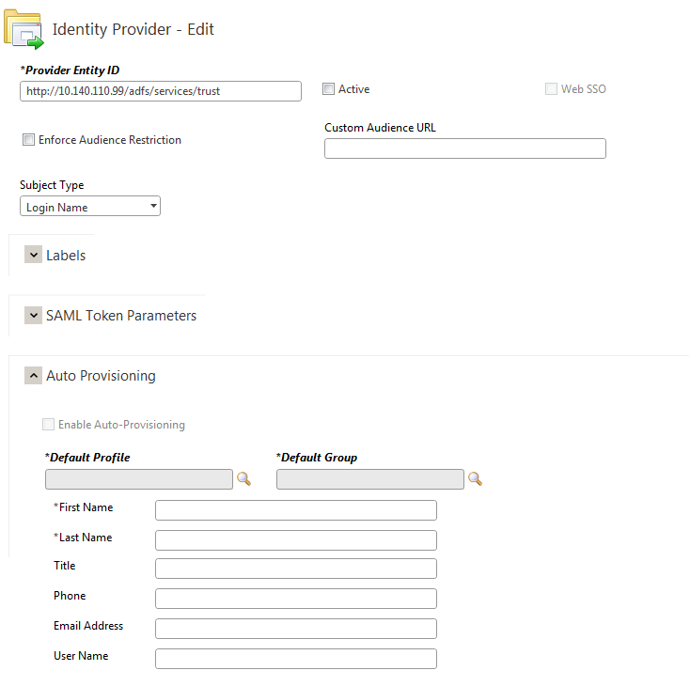
Enhanced Data Protection and Privacy
May 2017: Encrypted SAML Token
Capability Highlights
Accept Encrypted Access Tokens from external Identity Providers
Support Multiple Algorithms to be able to decrypt a range of encrypted tokens
Key Benefits
Enhanced Protection prevents leakage of sensitive personal data even if token is intercepted
Configurable IdP-level Algorithm to support different encryptions for different Identity Providers
Notes:
An increasing number of our customers have business need to use access tokens to not only pass authentication details but also additional business information. Sometimes, the information contained on the access token might be sensitive such as Social Security Number. Though all Service Cloud traffic is over https, some customers might require the additional layer of security provided by encrypting the token. Therefore, we will be enhancing our SSO framework to accept encrypted tokens sent by other Identity Providers and decrypt them prior to use.

Slide 11
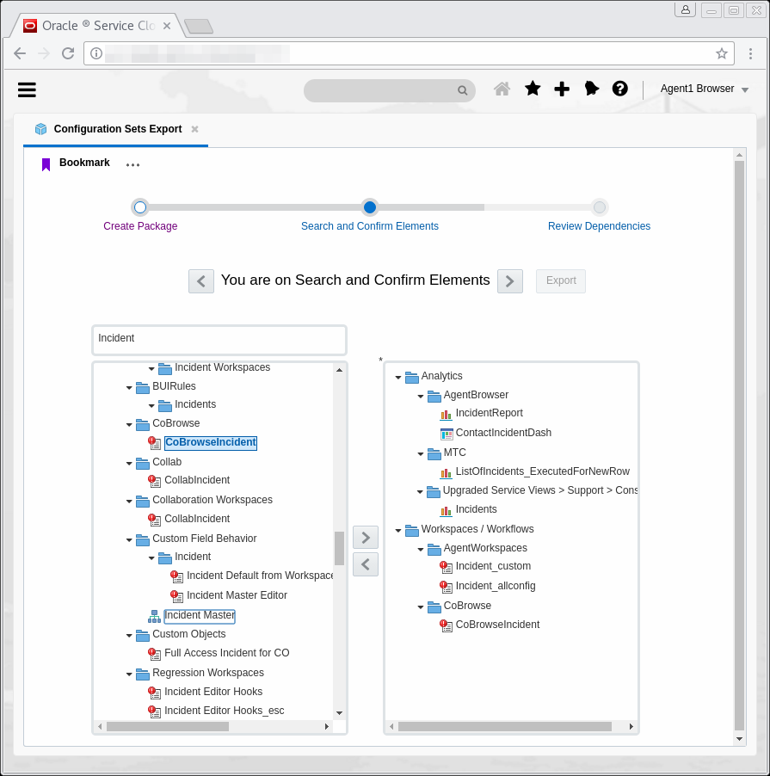
Package and Deploy Reports and Workspaces
May 2017: Element Manager (Limited Release)
Capability Highlights
Export and Import a set of related configuration artifacts from one site or interface to another in a single package
Workspaces and Reports with dependencies are supported
Single/Consistent UI for export/import process across product entities
Key Benefits
Drastically reduce effort to collections of changes between OSvC instances
Reduced Manpower required for managing changes to OSvC instances over time
Limit human involvement and error in export/import dependency management
Ability to archive configurations as exported packages that can be saved and reused later
Item Selection for Export
Notes:
Currently, related sets of configurable components must be manually exported/imported for those systems that support export/import, or manually reproduced from dev, to test, and finally into production independently of each other. This leads to inefficiencies and frustration as configuration items are missed or incorrectly transcribed. Given the large number of configurable items and the coupling between them, missing a configuration item or incorrectly transcribing it can be quite likely.
OSvC Element Manager will enable configuration settings and configurable components to be grouped, packaged, migrated and deployed across Oracle RightNow Service Cloud instances in an automated fashion to enable development, test, production lifecycle management of customer configurations.
Select one or more items to export quickly in a search window
Items downloaded to your PC in a single file.
Import that 1 file into one or more destination sites with just a few clicks.
17.8 will be limited release phases where customers that request access to the feature will be given access through product management.

Slide 12
AUGUST 2017

Slide 13
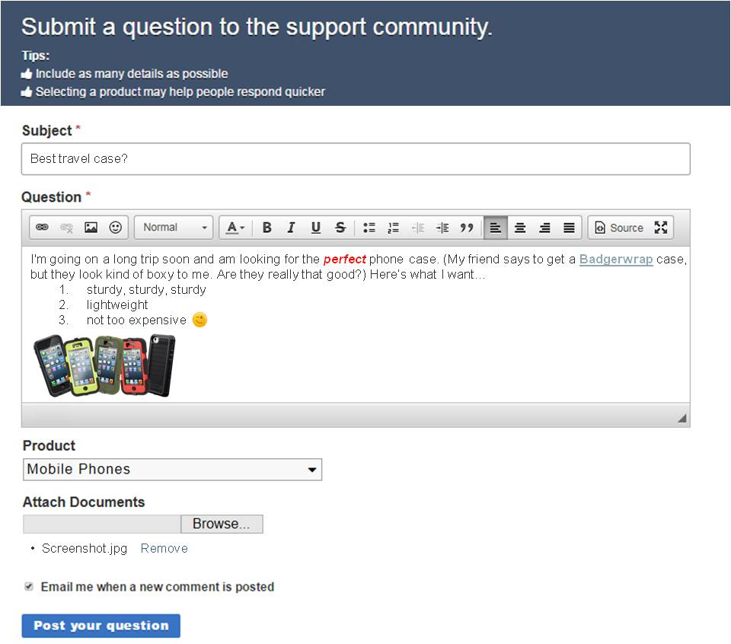
Create Visually Compelling Community Content
Aug 2017: Community Self Service
Capability Highlights
Rich Media and Formatting: Provide more options for users to construct informative posts
Inline Images: Embed hotlinked images within the body of community questions and answers
File Attachments: Attach relevant screen shots and documents to provide details to aid troubleshooting
Key Benefits
Increase community effectiveness by giving customers more control over how they present their questions and answers to the community
Build a more visually engaging site by allowing users to insert images into their discussions
Format community content
Hotlink images
Attach files
Notes:
Customers expect to have control over the content the generate in community discussions, to present things in as informative and engaging a way as possible, ensuring that others easily understand their questions so they can provide prompt, effective answers. The advanced formatting features in this release give users a host of tools, with control over colors, sizing, alignment, bullet points, and more. They can also insert hyperlinks and hotlinked images as well as – and perhaps most importantly – smileys. And because a picture (or document) can be worth a thousand words, especially in support scenarios, they can attach files to their posts to provide supplemental information.
Note that this release supports files attached to community questions and comments, but not to users…i.e., the ability for users to upload their own avatars.

Slide 14
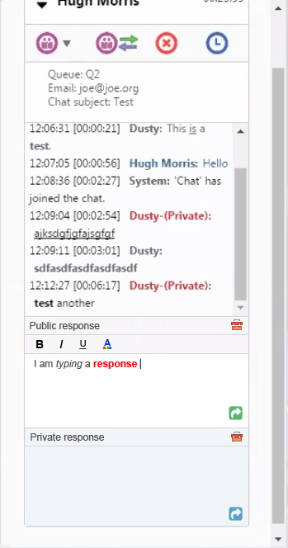
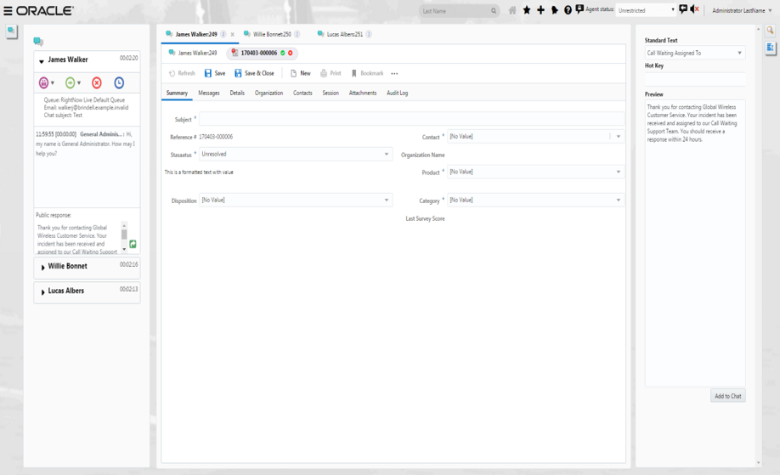
Chat Browser UI – Productivity Enhancements
Aug 2017: Chat Browser UI
Capability Highlights
Standard text– send pre-composed messages through chat
Rich Text editing – emphasize or highlight parts of your message
Key Benefits
Improved chat experience - personalized and well structured responses
Integrated – single source standard text for incidents, chat and other add-ons
Notes:
17.8 BUI Chat still has meaningful functional Gaps to the Smart Client.
Priority gaps for the Tier 1 Agent include:
-Knowledge Integration
-View Attachments
-Transfer + Conferencing parity (basics already exist)
-Undocking the Chat Window
Priority gaps for Tier 2 / additional agents include:
Co-browse integration
Page Peek
Visitor Browser History
We are not yet targeting the Chat Supervisor or Admin (set-up) roles

Slide 15
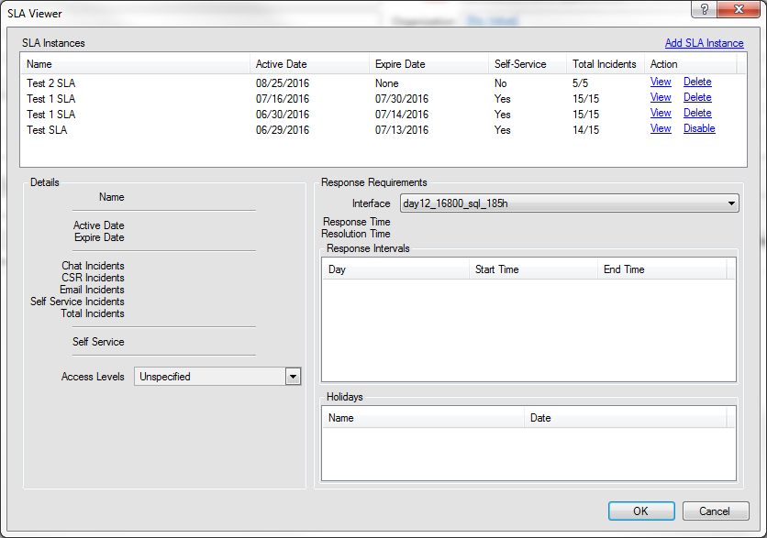
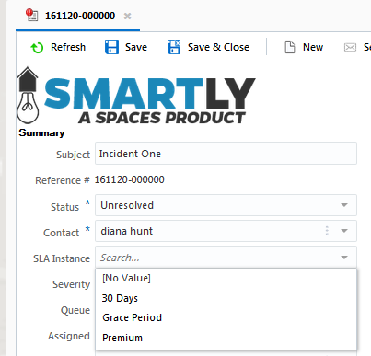
Working with Service Levels
Aug 2017: Service Level Agreement Support
Capability Highlights
View and Edit service level agreements for Organization and Contacts.
Assign service level agreement to incident.
Key Benefits
Support SLAs using the Agent Browser User Interface.
Notes:
MORE DETAIL
We will support the original SLA controls on the org, contact, and incident objects without any gaps in functionality. (.NET parity)
This includes the SLA Container control that is on the Org and Contact Workspace by default
The SLA Viewer can be added to the Organization and Contact Workspace
The SLA field in Incident is supported
This does not include the Incident SLA Milestone control

Slide 16
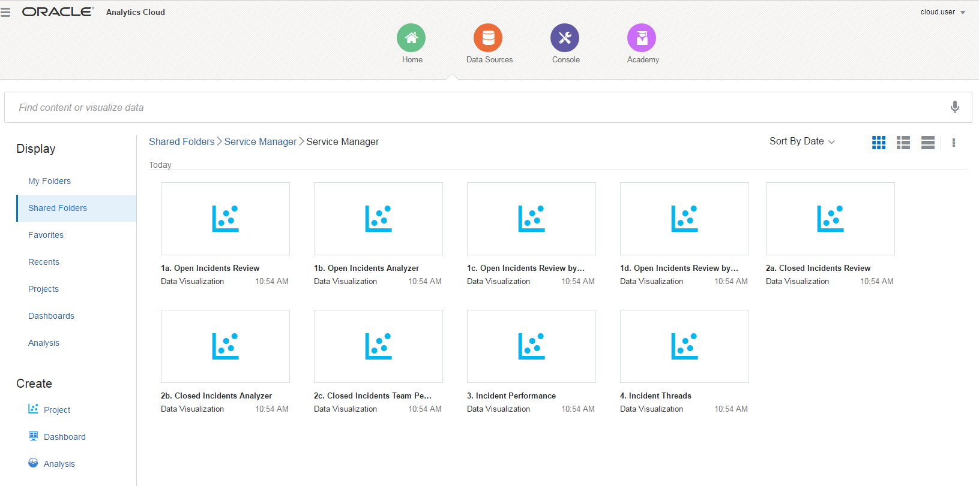
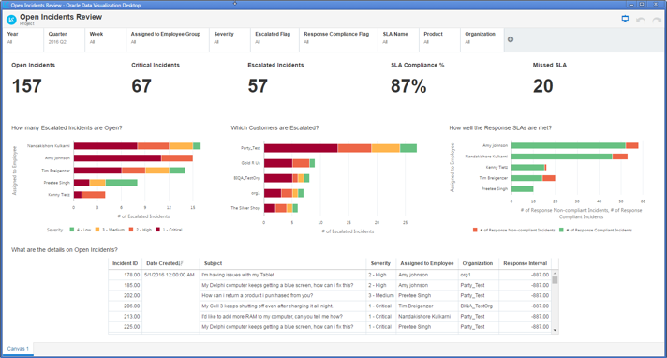
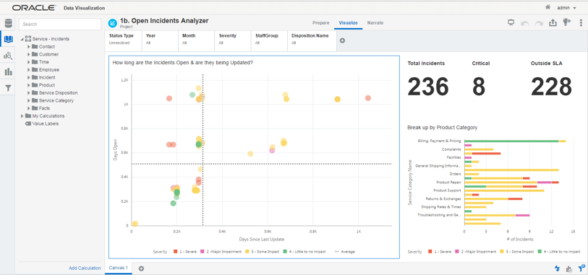
OAC Accelerators: Integrated BI Reporting
Aug 2017: Advanced Analytics for Oracle Service Cloud
Capability Highlights
Data Visualization (DV) Content Pack
Extract a OSvC data for analysis
Review data mash-ups from one or more sources
Advanced Analytics Starter Kit (OAC)
Explore Oracle Cloud BI tools
Replicate data using OSvC REST API’s and Data Sync
Executive and Manager personae content packs
Key Benefits
Accelerator for OSvC data into OAC/DV
Advanced Analytics:
Cross source reporting
Long-term historical trending
Time series analysis
Evaluate large data volumes
Investigate computationally-intensive analyses
Notes:
The adoption of business analytics across enterprises has seen a paradigm change over the past few years. Enterprise application customers are constantly looking to gain actionable insights from their transactional data, in a timely manner. This includes operational reporting, self-service data exploration and enterprise wide business analytics, to be consumed across desktop and mobile applications.
To complement the deep transactional reporting already available in Oracle Service Cloud with extended insights, two new analytic accelerators are now available using the Oracle Data Visualization (DV) and Oracle Analytics Cloud (OAC) products. Both accelerators come with live connectivity to your Service Cloud environment for immediate access to these insights. This includes powerful self-service data visualization capabilities to make spotting trends easier, cross pillar reporting, advanced trending, and much more.
The two analytic accelerators being introduced are:
Data Visualization (DV) Content Pack: This is a light weight, self service, data exploration tool using Oracle Data Visualization that provides Service Managers, Executives and Analysts visibility into service performance across one or more service centers.
Ideal for line of business users who want to extract a subset of your data from Oracle Service Cloud for analysis
Blend with other data sources – Sales Cloud, Field Service, Excel spreadsheets, 3rd party
Self service data exploration, visual analysis, collaboration and story telling
Consume the application offline on a desktop, using a browser or on your mobile device
Advanced Analytics Starter Kit: This is a fully replicated analytics solution using the Oracle BI Cloud Service providing Executives, Service Managers, Analysts and Supervisors more strategic analytics. It is a highly functioning operational data store out of the box supporting broader, deeper and faster analytics.
Ideal for an IT managed deployment with full replication of Service Cloud data using the objects exposed via the Service cloud REST API’s
Offers advanced analytics such as aggregated reporting spanning several data sources or departments, long-term historical trending, time series analysis, analyses that require querying of large data volumes, and support for other computationally-intensive analyses
Supports everything possible within the Data Visualization Content Pack and much more, all built on the same platform, therefore it’s easy to scale up the departmental prototypes into an IT managed enterprise solution
OUT OF SCOPE:
This accelerator is a starting point for customers that wish to utilize Oracle BI Cloud tools (Oracle Analytics Cloud) and/or ad-hoc mash-up of data using a quick extraction of data from Service Cloud or other CX pillars. Additional report creation is available, but customers have to create them. Additionally, OAC is an IT managed implementation of Oracle cloud BI.

Slide 17
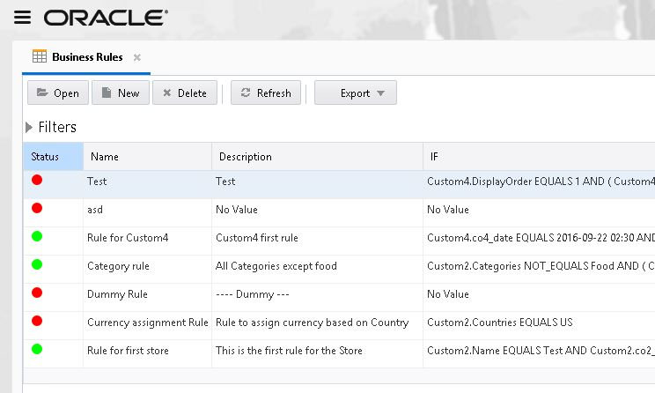
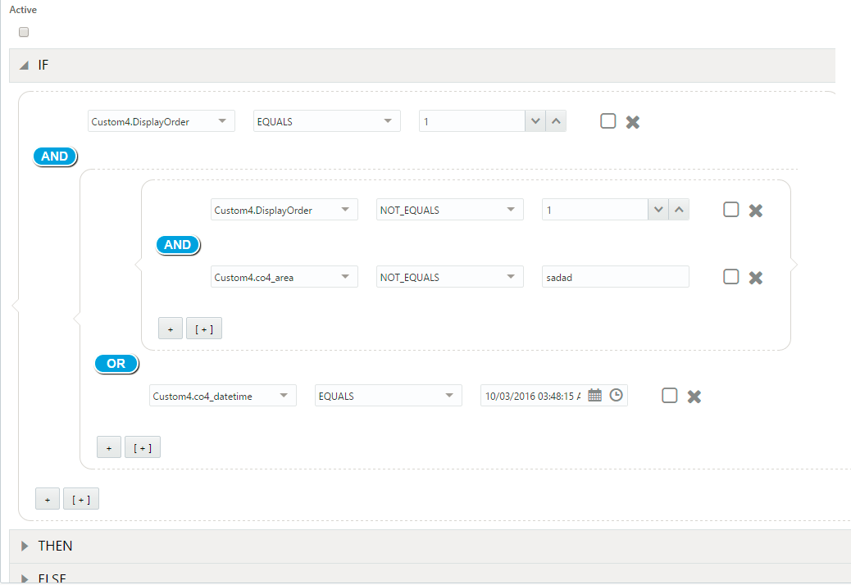
Automate Business Processes for Custom Objects
Aug 2017: Business Rules for Custom Objects
Capability Highlights
New Business Rules Engine initially supports just custom objects
Improved User Interface for better usability and scalability for rules management
Reporting capability on rules, conditions and actions
Audit Log for full visibility into who/when made the changes
Key Benefits
Automate business processes for custom objects improved
Ability to export rules in multiple file formats for ease of sharing and readability
Ability to execute Object Event Handlers to support custom business actions
Notes:
LIMITATION: This is the first of multiple releases. In this first release, which is only available in the Browser UI, business rules can only be applied to custom object (Create/Update/Delete) operations. In a future release it will support a business rule on an incident having a condition against a custom object related to the incident.
Business rules provide a powerful tool to automate all common business tasks from one centralized place improving overall efficiency and accuracy of any organization to meet SLAs for their customers. Legacy rules provide these benefits for standard objects but there were some challenges with the implementation:
The overall design is very complicated which makes it difficult to improve and innovate in this area.
No analytical report support on business rules data that leads to customer’s dissatisfaction.
No support to automate business tasks on custom objects.
In this phase, we are providing a new Brower based UI to manage business rules for Custom Objects with reporting capabilities. Several usability and scalability issues identified with the current UI implementation will also be addressed.
In future releases we will provide full support/feature parity for standard objects e.g. Incidents, Contacts etc. currently supported with Rules

