Slide 1
Advising Notes Building a student story
SESSION 6020
November 13, 2018
Notes:
Crowd participation:
What kind of note taking software do you have at your institution?
Advising notes
Institution wide note taking
Silo-ed note taking
No note taking
Describe NAIT old way
This presentation is about NAIT’s current way

Slide 2
presenters
Brian Trenholm
Joel Rackel
Assistant Registrar
Northern Alberta Institute of Technology
btrenhol@nait.ca
Senior Process Analyst
Northern Alberta Institute of Technology
jrackel@nait.ca

Slide 3
Northern Alberta Institute of Technology
A Leading Polytechnic Committed to Student Success
Notes:
Many types of education: Apprentice, Non-credit, and credit programs (upgrading, certificate, diploma, and degree).
Diverse campus where advising happens all over.
Students not assigned an advisor.

Slide 4
NAIT & ORACLE
PeopleSoft Campus Solutions v. 9.0 bundle 38
PeopleTools 8.55.18
Notes:
650 Campus Solutions users
Also use finance and HR systems
Present for 9.0 but include 9.2 elements which we will go over as they have an impact on our current situation
Planning on upgrading to 9.2 PUM image 8 in June 2019

Slide 5
Presentation objectives
After this presentation, you will be able to:
Understand why advising notes are useful
Understand Advising Notes as delivered in 9.0 and 9.2
Recognize the benefit of Advising Notes customizations, security and reporting tools
Apply the NAIT approach to get staff to “buy-in”

Slide 6
What is advising notes?
A page to record notes about interactions with students
Allows attachments and action items
Can be assigned to a staff member
Communication channel with students

Slide 7
Why use Advising notes?
Advising Notes:
Building a Student Story

Slide 8
Why Advising notes?
Build a complete story
Consistency
Centralize
Advising statistics
Notes:
Build a complete story. Minimize they said x over here, when they really said Y
Consistent data entry across multiple areas
Ensure all users have access to the data they need and are using the same system.
Centralize: Retire Microsoft CRM, Access Databases, Spreadsheets
Statistics: Hard to track advising - How do you track advising services? Its not as easy as something like an application. This is what makes it tracking and advising stats possible at NAIT
Transition: now that all notes are in one system, we can get statistics.

Slide 9
Why take notes in campus solutions?
Core student data is in Campus Solutions
One System to learn, use and upgrade
Connects the pieces of the student lifecycle
New features coming all the time
Notes:
Core student data:
No interfaces to build and maintain; all data in same place
One system to maintain and upgrade
Reporting: can easily join advising notes data to other tables
One system:
Your staff are already familiar with it.
Student lifecycle: prospect, applicant, student: the more we can use PS, the easier it is to get that complete picture.
New features
Pagelets, notifications, workcenters, fluid.
When you upgrade PS, you upgrade your note taking system too.

Slide 10
Advising notes as delivered
Advising Notes:
Building a Student Story

Slide 11
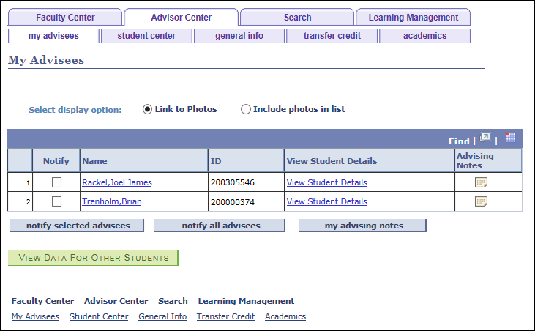
Where are advising notes?
Self Service > Advisor Center > My Advisees
Notes:
Two ways to create/view advising notes
First way is designed for the Advisor / Advisee relationship
The first way to get to advising notes is through the Advisor Center
You can only view notes for your advisees on this page.
There will be a row for each advisee.
Click on the note icon to launch that student’s advising notes
You will be able to see all the advising notes, no matter who created them

Slide 12
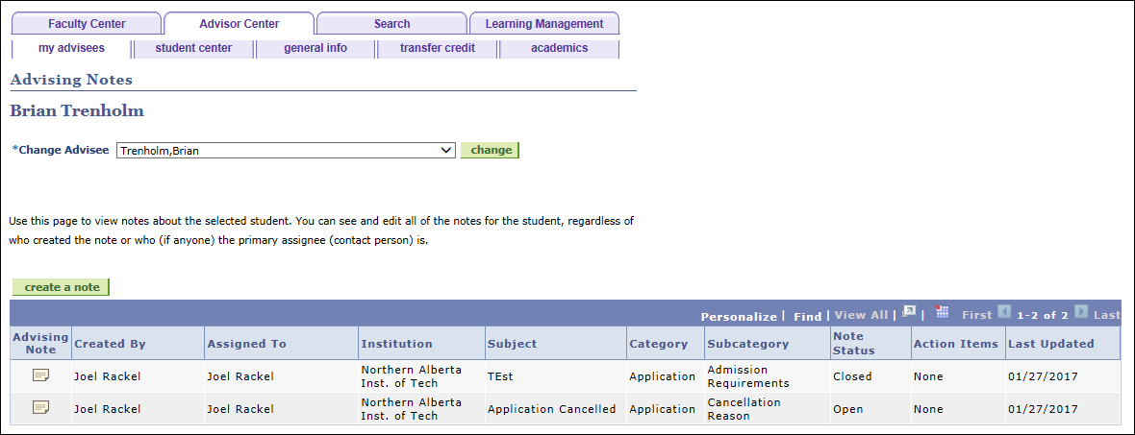

Slide 13
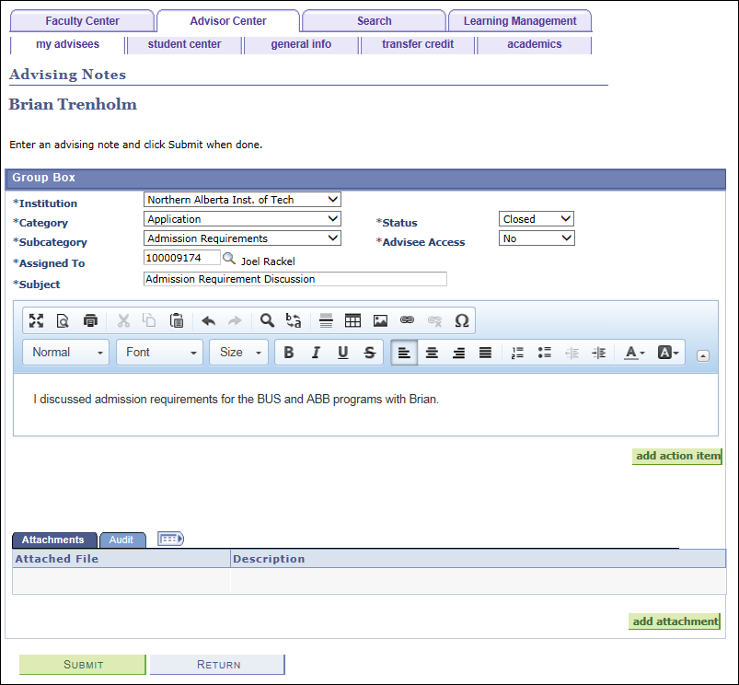

Slide 14
Where are advising notes?
The Admin Page
Academic Advisement > Student Advisement > Advising Notes
Curriculum Management > Instructor/Advisor Information > Advising Notes
Records and Enrollment > Student Background Information > Advising Notes
Notes:
Not restricted to the Advisor / Advisee relationship
Discuss how this is the “admin” page
The Advising Notes (administration) page is intended for an “administrative super user” with unrestricted access to all advising notes in the system.
Besides creating and updating notes, an administrator can edit note text, reassign notes and reopen closed notes.
NAIT doesn’t assign advisees to advisors, so we only use the admin page.

Slide 15
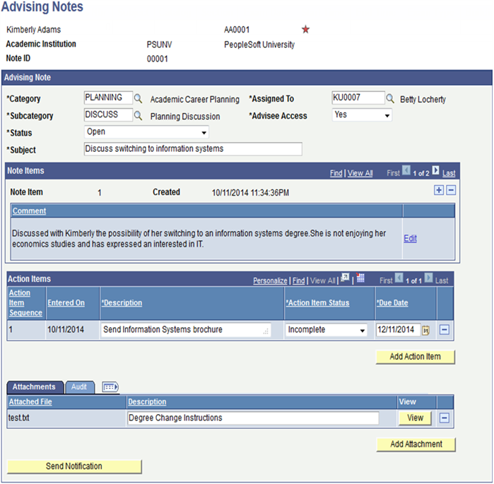
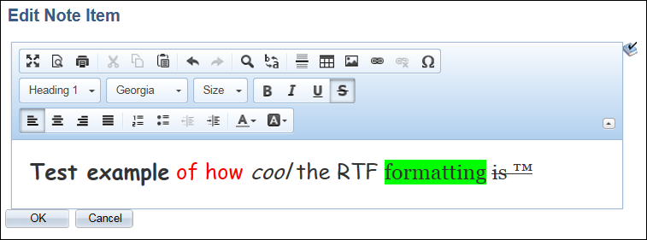
Notes:
Categories
Status
Assigned To
Advisee Access
Subject/Note
RTF Formatting
Mention tables and images are possible too
Action items
Attachments
Send Notification
Sends email, with link to self-service

Slide 16
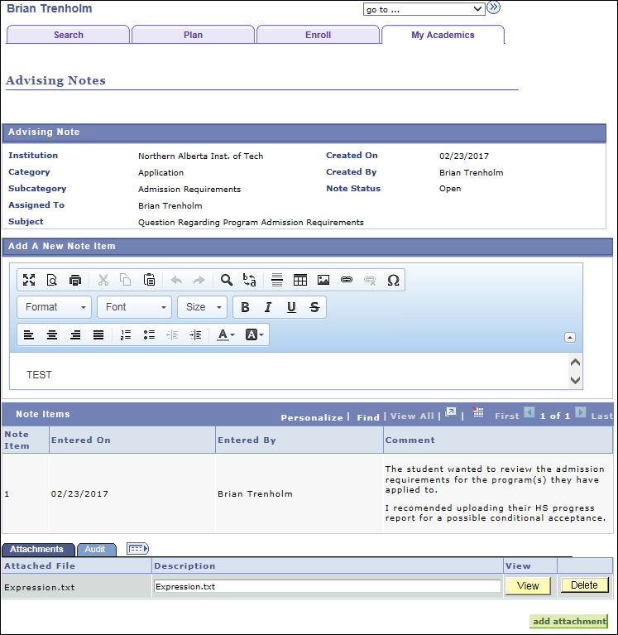
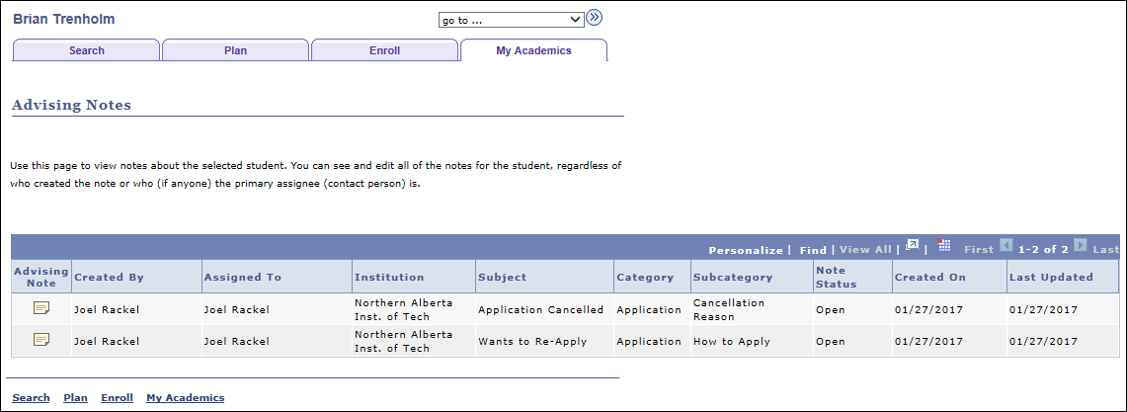
Student Self-service
Notes:
If you enable it student can
add note items such as comments.
add or delete attachments to the note but cannot delete the advisor’s attachments.
advisor is automatically notified when the advisee submits an update.
Students cannot create their own notes. Only add to notes released to them.

Slide 17
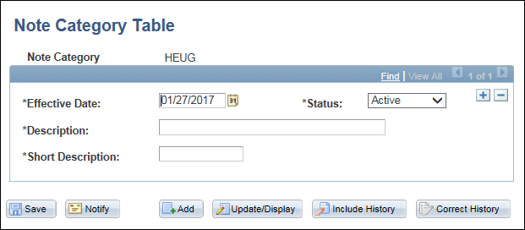
How to set up advising notes
Define Note Categories
Set up SACR > Product Related > Academic Advisement > Note Category Table
Notes:
Decide on your categories and subcategories early if possible as it does have an impact on reporting
Importance of accuracy when determing how these will be used.
Adding new is okay but should have a level of check / balance
Removing or modifying gets messy

Slide 18
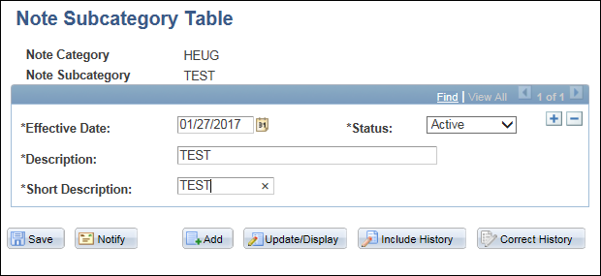
How to set up advising notes
Define Note Subcategories
Set up SACR > Product Related > Academic Advisement > Note Subcategory Table
Notes:
Subcategories must be within a category

Slide 19
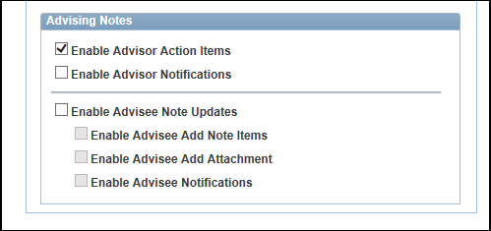
How to set up advising notes
Define Setup
Set Up SACR > Common Definitions > Self Service > Academic Advising
Notes:
Notifications, if selected, allow the advisor to notify the student (puts on button the page).
Bottom portion’s selections are for the student self-service setup
There are a couple additional controls for the student center that add additional links to the Advising Notes but they are not required to begin using them

Slide 20
How to set up advising notes
Security for Advisor Center
Menu: SSR_ADVISEE_OVRD
Components/Page:
SAA_SS_ADVNOTE
SAA_SS_ADVNOTE_ADD
SAA_SS_ADVNOTE_STU SAA_SS_ADVNOTE_SUM

Slide 21
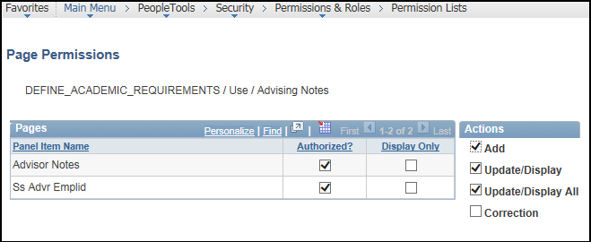
How to set up advising notes
Security for Admin Page
Menu: DEFINE_ACADEMIC_REQUIREMENTS
Component/Page: SAA_ADV_NOTE

Slide 22
How to set up advising notes
Security for Student Self Service
Menu: SA_LEARNER_SERVICES
Component/page:
SAA_SS_ADVNOTE
SAA_SS_ADVNOTE_STU

Slide 23
Customizations, SEcurity and reporting
Advising Notes:
Building a Student Story
Notes:
Now that you understand advising notes as delivered, we can talk about how NAIT uses advising notes.
Don’t be afraid of the word customizations here. These are small bolt ons.
Before we talk about customizations and reporting, let’s talk about NAIT’s advising notes philosophy, or why we did what we did.

Slide 24
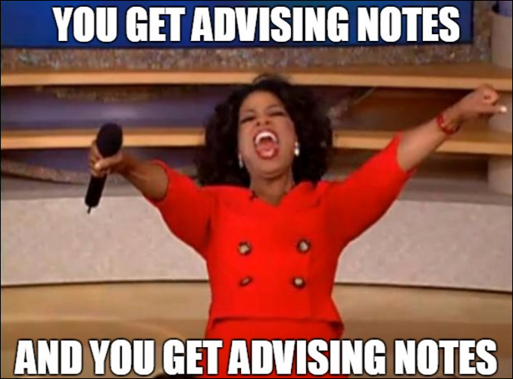
NAIt’s advising note philosophy
Advising Notes are not just for Advisors
Notes:
NAIT does not just use advising notes in the context of an Advisor / Advisee relationship
Advising at NAIT is any service, assistance, information that can be provided to a prospect, student, alumni, etc.
We do not use the Advisor Center and related advisee assignment processes

Slide 25
NAIt’s advising note philosophy
Notes are there for all staff to see
(Almost all notes)
Notes:
Student interaction details should be shared
More concise information
Under the spotlight people are less likely to enter opinionated information
This is part of the reason why we use the admin page and not advisor centre.

Slide 26
NAIt’s advising note philosophy
One interaction = One note
Notes:
Each student / staff interaction is entered as a single note
Even if a second inquiry is on the same subject / topics, it makes easier to track volume and repeat advising
Option is there to ad multiple rows to Note details but the above reasons are why we chose this approach

Slide 27
NAIt’s advising note philosophy
Open status means there is work to be done
Notes:
Eliminates the grey area
Easy to identify what still needs to be done

Slide 28
Customizations
Additional fields
Notes:
Customized fields based on what was needed going forward
2 required (Service Area, Contact Method)
Contact method is on advising notes 9.28 image 8
Drop downs are translate values
Duration number field
Service Now link to direct staff to existing data in external software (Pulls in identity based on student ID/Email)
Only a small number of staff use this system but for them it is a key application for their business

Slide 29
customizations
Defaults for note entry
Notes:
EMPLID of user auto-populates the assigned to field once a new note is opened
Service Method defaulted for each user based on business unit and setup under SACR > User Defaults

Slide 30
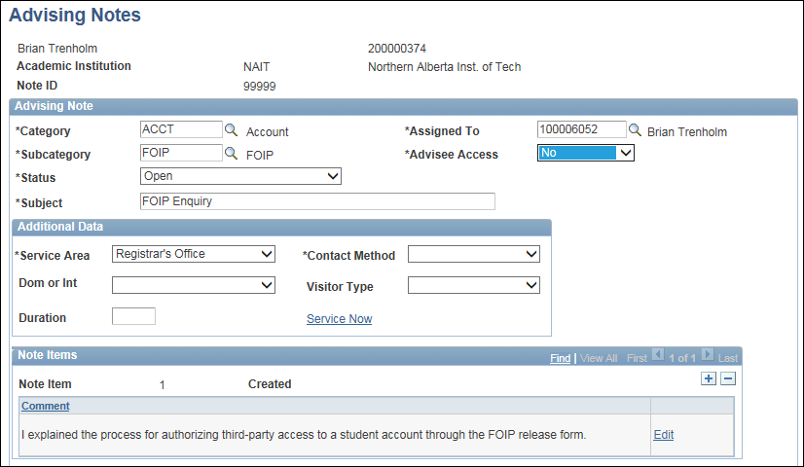
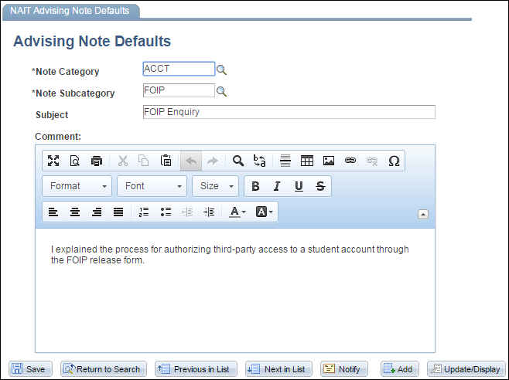
customizations
Default subjects and notes
Notes:
Setup page was created to allow for default information when creating notes
Significantly increased speed of entry for commonly used note items
Fills in subject and Note detail once the user enters / leaves the subcategory field
All defaults can still be edited to modify or add to the info. as necessary
Can be used to prompt staff for important details
From this example only a category code, a few TABS and a subcategory code have been entered.

Slide 31
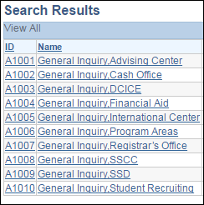
customizations
Generic ID
Notes:
Used to track “quick” issues where you reasonably would not capture a name / ID
Eliminated the need for departments to use Excel or Access to track “foot traffic” related items
Separate from existing Employee / Student ID numbering system to avoid any confusion
Split by department
Transition: these last 4 have been very minor customizations that will help your project succeed. They don’t change the functionality of the feature, they just make it easier to use.
Our next customization is more major, and can illustrate what is possible.

Slide 32
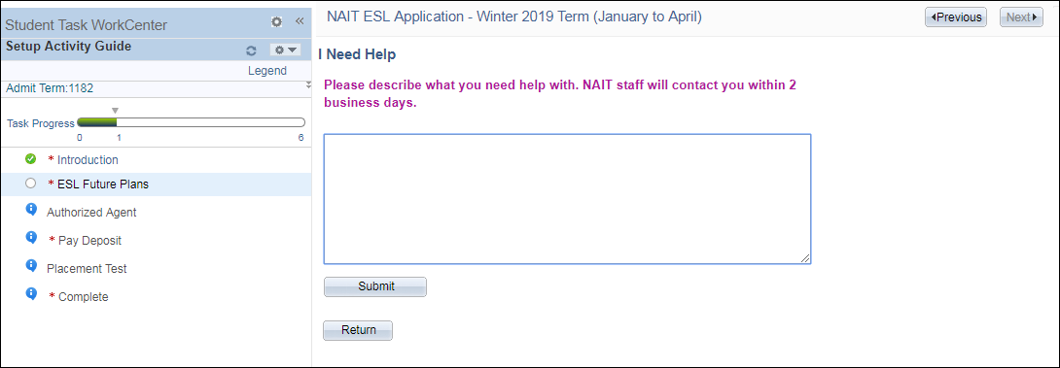
customizations
Auto Note Creation
Notes:
ESL I Need Help. ESL applicants create advising notes when they don’t even realize it.
Why?
Takes the burden off student to contact staff and enter the note anyways
No integrations with external email
Know exactly who and where they are in the process
Apprenticeship purchase order
Show in pagelets for staff to address

Slide 33
Security
Delivered 9.0 Bundle 36 Security
Advisor / Advisee only
Admin page
Notes:
Delivered security refresher
Advisor center
Admin page – for everybody

Slide 34
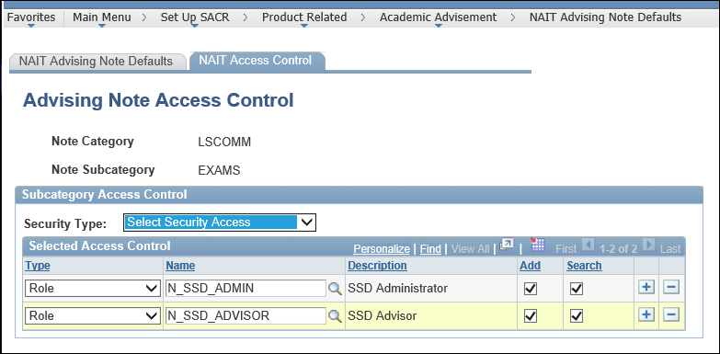
Security
NAIT custom security
Notes:
NAIT custom security
Categories only for Learning Services. They needed a place to store on line, we thought, why not PeopleSoft, why not advising notes.
Completely restricted to those staff.
Can’t view note.
Does not show up in query or in search
Same set up, used existing roles and permissions
Subcategory level!!

Slide 35
Security
PeopleSoft 9.2 image 7 security
Notes:
9.2 image 7 PeopleSoft security
Access control based on NAIT’s design!!!
Define by category: What users, permission lists, or roles can view which categories.
Category level, not subcategory like our customization.
Super user: Select to allow users to view and update all notes created by any user in this note category. A super user can also change categories, update Note Item text and delete notes in this note category
NAIT is moving to adopt the delivered functionality for advising notes, and reduce our customizations.

Slide 36
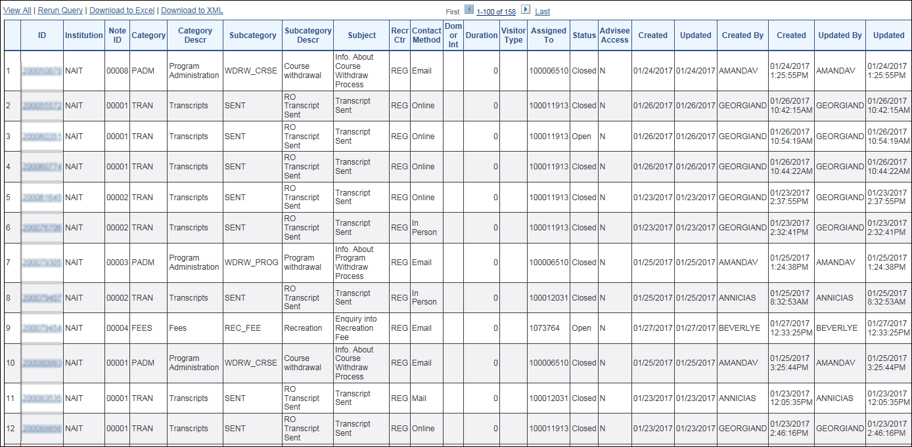
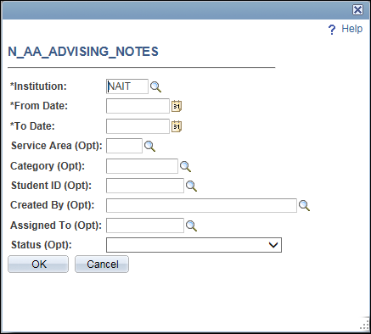
Reporting - Queries
Advising Notes by Date
Notes:
Flexible prompts with a range of optional criteria
Main query for looking at the detailed note information
Contains enough fields to do some in-depth analysis
Links to Advising Notes to view the Note Details / Attachments

Slide 37
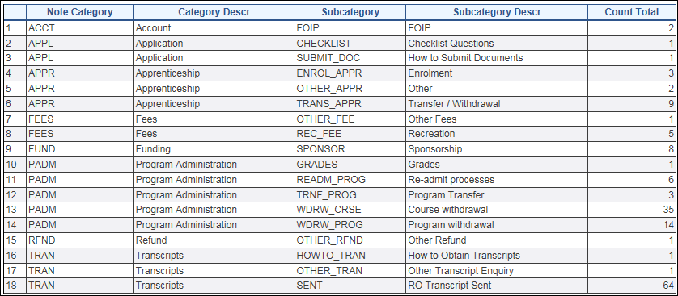
Reporting - Queries
Advising Notes Summary
Notes:
Same flexible prompts are used
Count of Category / Subcategory notes for the time period selected
Provides a good overview of the types of interactions
Quick reference of volume to evaluate for future process enhancements

Slide 38
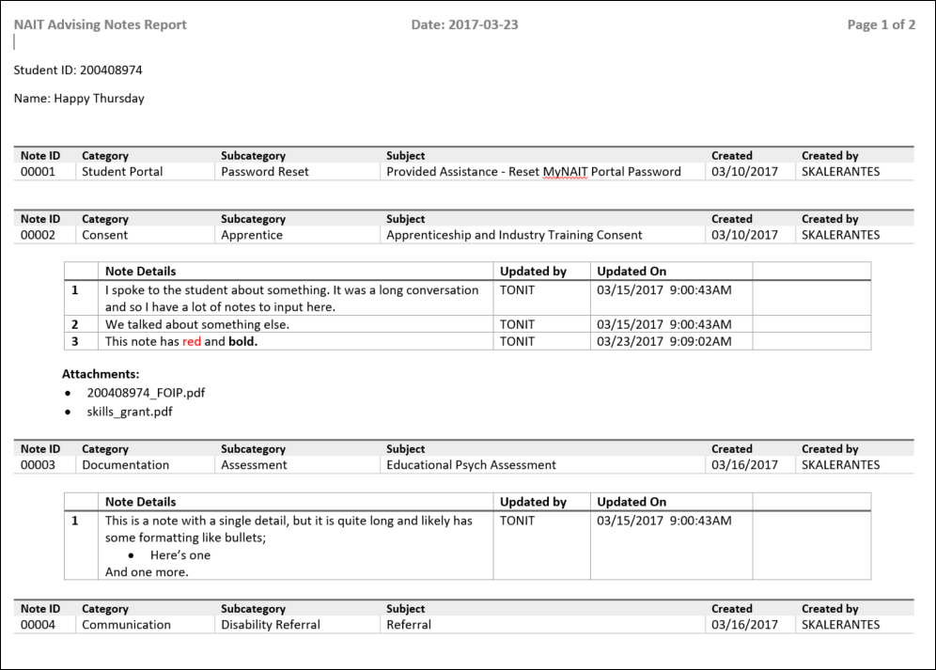
Reporting - Queries
Individual Student Report
Notes:
Report for individual students
Formats the notes, so they can be easily read for a FOIP request.
Shows the rich text, not html tags (like query).
Filter by categories, if you wish.

Slide 39
Reporting - Pagelets
My Open Advising Notes
Notes:
Pagelet for front line staff to keep track of incomplete work
Mandatory addition to the Home page (can only be minimized)
Lists notes in Open status
Counts the days old and highlights notes over X days
Full details contained in query, Name / ID in pagelet
Drilling URL Name links Student Centre, ID Links to Advising Notes

Slide 40
Reporting - Pagelets
Recently Update Notes
Notes:
Last 10 notes created / updated by user display here
Used to reference recent work and provide the quick link drilling URLs
Full results contain the last 7 days of notes

Slide 41
Reporting - Pagelets
Reassigned Advising Notes
Notes:
Same drilling URLs and information presented in a similar manner
Displays any advising notes assigned to another staff member and in OPEN status
Allows those who have handed off a case to someone to keep track of it and ensure it gets handled
Displays up to 10

Slide 42
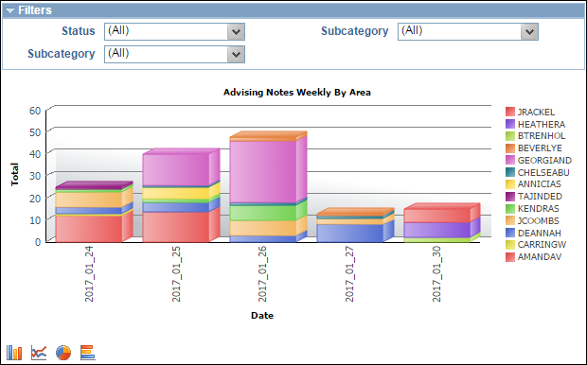
Reporting - Pagelets
Advising Notes Weekly By Area
Notes:
Pivot grid for supervisors to keep a high level view on their student advising activities
Displays in chart form
Uses user defaults to show only staff within the same business unit
Problem with our server infrastructure where if no results were available in the query it would run endlessly / crash

Slide 43
How to get staff to buy in
Advising Notes:
Building a Student Story
Notes:
Advising notes doesn’t work if the staff at your institution don’t take notes

Slide 44
How to get staff to buy in
Sell the benefits
Notes:
When you first explain what advising notes is, people will focus on how much time it will take to create the notes.
There must be a greater value from the results than you get for the work put in
Sell the benefits – explain why its worth the time.
Tell story about how much time this actually saves.
On initial go live: make sure you have queries, pagelets and pivot grids.
Make sure they can see the reporting benefits immediately.

Slide 45
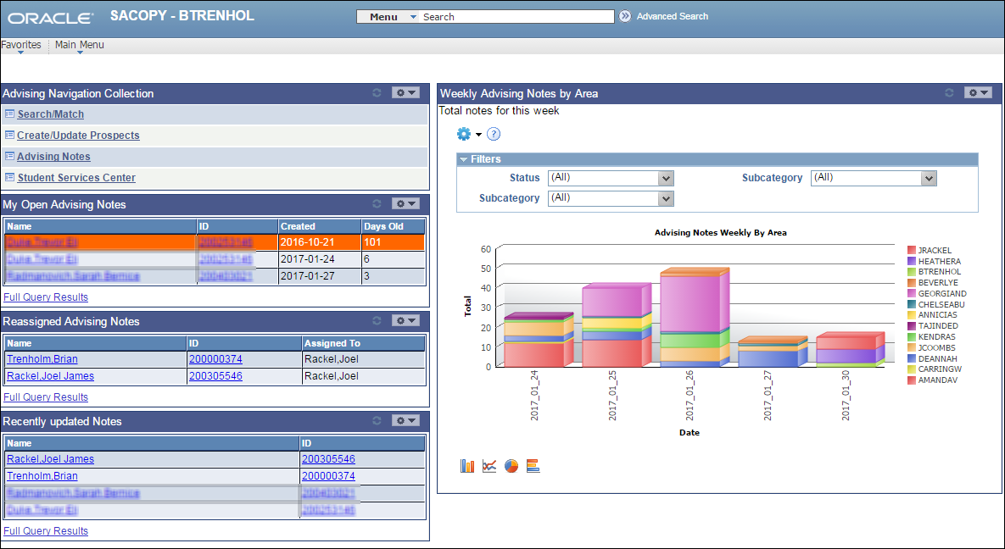
How to get staff to buy in
Make it easy
Notes:
Show that, even though you’re asking them to do more work, the project team has done all they can to make it as simple as possible.
Customize to populate default subject and notes
Create navigation collections
Deck out their homepage with navigation collections, pagelets, pivot grids.

Slide 46
How to get staff to buy in
Make a working group
… and make them work
Notes:
Who should be in your working group?
Advisors
Leaders in all the areas you want to roll out advising notes to
Make them establish guidelines for entering notes
Make them develop the categories and sub-categories
The working group ends up as subject matter experts: you have champions at go live.
Testing

Slide 47
How to get staff to buy in
Communicate
Notes:
Communicate
From you to your working group
AND from your working group to the end users.
Working group members champion the change.
Regular meetings and updates so everyone in the institution knows this coming.
Transition: how did we do? Did our staff buy in?

Slide 48
Advising note usage at NAIT
Notes:
Three years of data
Over 500,000 notes created
Year over year trends
Range between 9,000 and 19,500 notes per month
Average 14,081

Slide 49
PROJECT Results
Build a complete story
Consistency
Centralize
Advising statistics
Notes:
Now have complete story from start to finish, across all student service areas.
Created note-taking guidelines, same quality of notes.
No more dual entry.
Eliminated Microsoft CRM, Access databases, and excel spreadsheets
Tools and reports, data is in hands of functional users. We don’t need integrations or fancy data merging to get advising data!
The project has changed over the years since implementation. Evolution.

Slide 50
Presentation objectives
Understand why advising notes are useful
Understand Advising Notes as delivered in 9.0 and 9.2
Recognize the benefit of Advising Notes customizations, security and reporting tools
Apply the NAIT approach to get staff to “buy-in”
Notes:
Note: anyone going live check the Oracle bugs. They are in the 9.0 and 9.2 roll-outs

Slide 51
Questions?
Advising Notes:
Building a Student Story

Slide 52
THANK YOU!

