Slide 1
Advances in Data Migration DMS to DMW (Plus Phire!)
SESSION 7032
Nov 5, 2019

Slide 2
presenter
Amos Cohoe
Senior Systems Analyst
Queen’s University
Amos.Cohoe@queensu.ca
PeopleSoft developer since 2013, primarily in Campus Solutions.

Slide 3
Queen’s University
~18000 Undergrads
~5000 Grads
~6500 Staff
~10 Campus Solutions staff

Slide 4
Queen’s & ORACLE
CS 9.2, Image 9
HR 9.2, Image 24
FN 9.2, Image 28, Fluid
All running PT 8.56

Slide 5
Presentation Overview
1
3
Data Mover Scripts
The past…
Data Set Designer
And other setup / config
2
4
Data Migration Workbench
Overview and Demo
Conclusion
Use Cases

Slide 6
Data Mover Scripts
The Past…

Slide 7
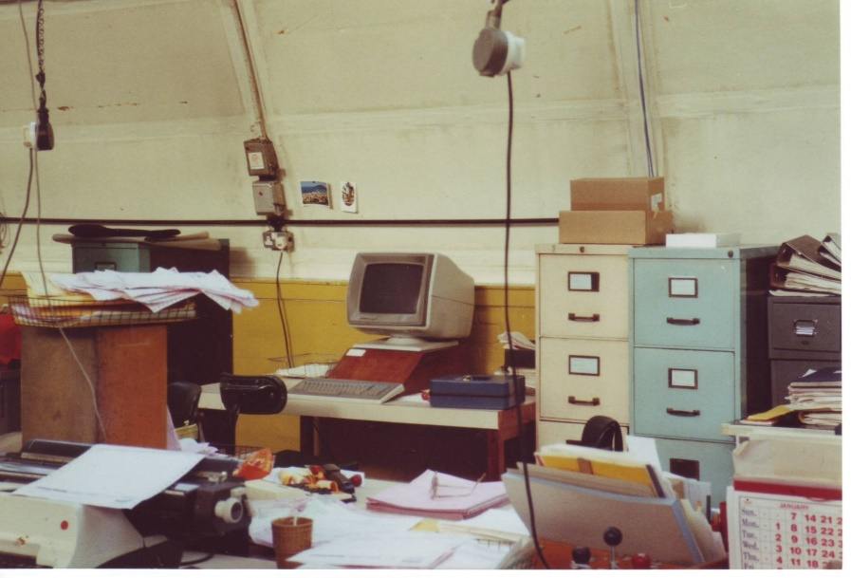
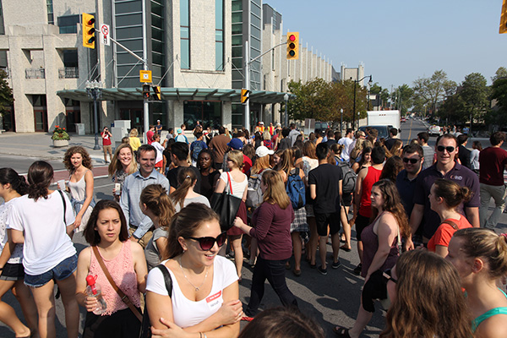
Data Mover Scripts
Suppose I’m moving config from here
To here!
(Dev)
(Prd)
Notes:
Mention manual changes in PRD – they are risky! Anything more than… 1-2 boxes / fields, don’t do!

Slide 8
Data Mover Scripts
A simple one might look like this.

Slide 9
DATa mover Scripts
But if you need just the right row of data…

Slide 10
DATa mover Scripts
Then I can run it, using Data Mover.

Slide 11
DATa mover Scripts
Then I’ll have to pass it off to an Admin, as I certainly can’t run a DMS against Production.

Slide 12
DATa mover Scripts
And between each step, I should verify that all the right data shows up in the PIA. (No orphans, no missed keys, etc)

Slide 13
DATa mover Scripts
Pros
They can move a lot of data.
Cons
Requires dev time (and business analyst / SME to validate)
Needs secondary validation (unless you’re really, really sure you got all the necessary IDs correct, and respected the record structure)
Data file and DMS execution exists outside normal migration to PRD path (historical issue)

Slide 14
Data migration workbench
Overview and Demo

Slide 15
Data migration workbench
PeopleTools 8.53 is released!
And with it, Data Migration Workbench.

Slide 16
DMW Features
Designed for
Easily migrating application configuration data
Relatively static data
Small amounts of data

Slide 17
Demo begins!

Slide 18
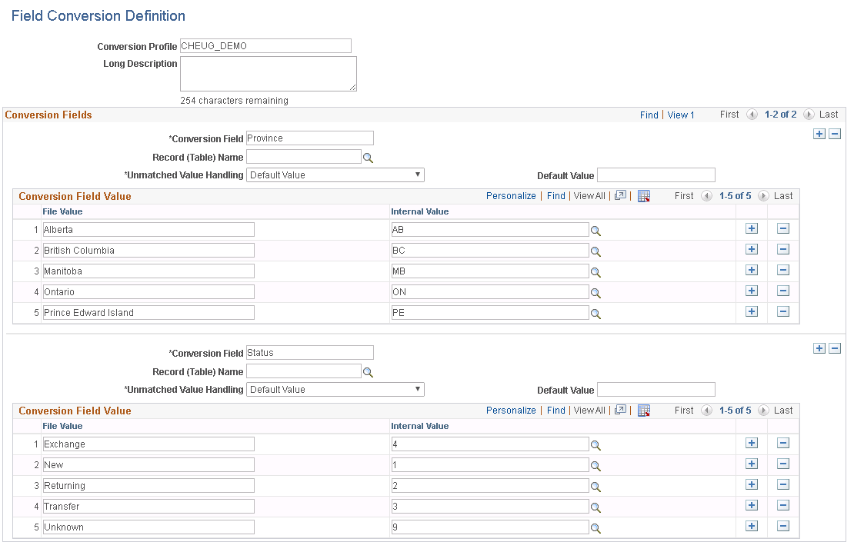
Demo Slides
Data we want to copy on the left, instance to copy to on the right

Slide 19
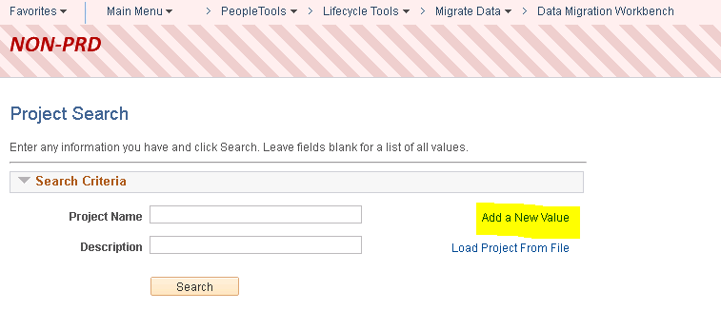
Demo Slides
Navigate to Data Migration Workbench and Add a New Value

Slide 20
Demo Slides
We’re moving File Parser Field Conversions this time.

Slide 21
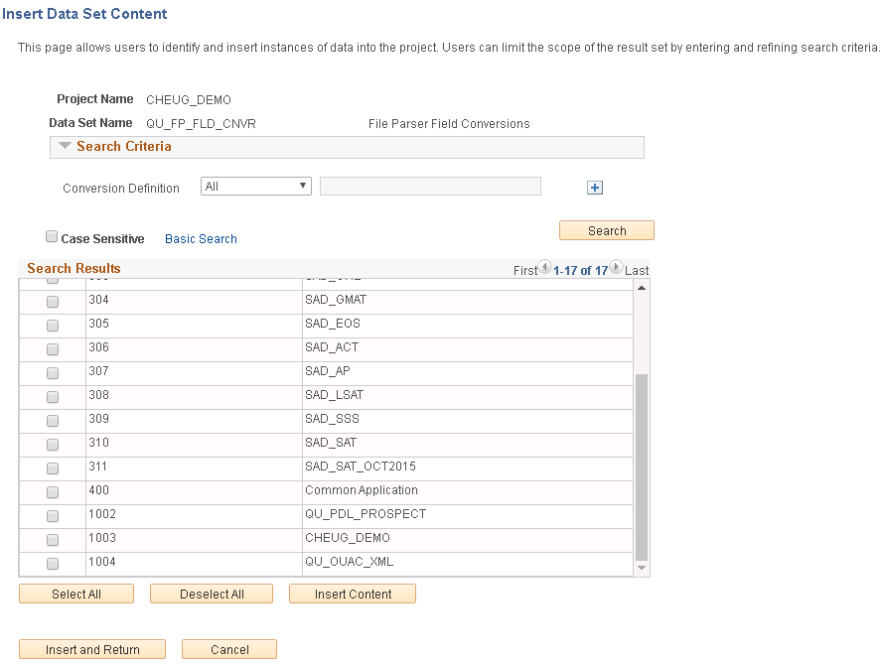
Demo Slides
Now, we’re searching for the data to insert into our project.

Slide 22
Demo Slides
Insert and Return, then Return again to get back to the project page. Hit Save and you’ve got a Project with data in it!

Slide 23
Not Demo Slides
Pre-Phire next steps:
Copy to File
Log in to Target Instance
Load Project from File
Hit Submit for Copy

Slide 24
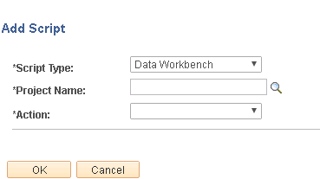
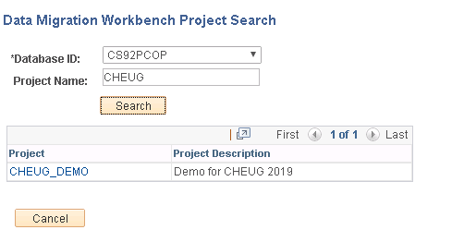
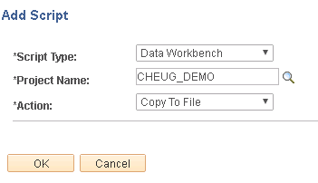
Demo Slides
Assuming you have Phire and are proficient with it, we’re adding a script to an existing CR.

Slide 25
Demo Slides
Execute the script against the instance containing the config.
That copies the config data to the file repository
Phire automatically changes the script Details to “Copy from File”
Execute the script against the target instance.

Slide 26
Demo Slides
Data isn’t there…

Slide 27
Demo Slides
Execute the script

Slide 28
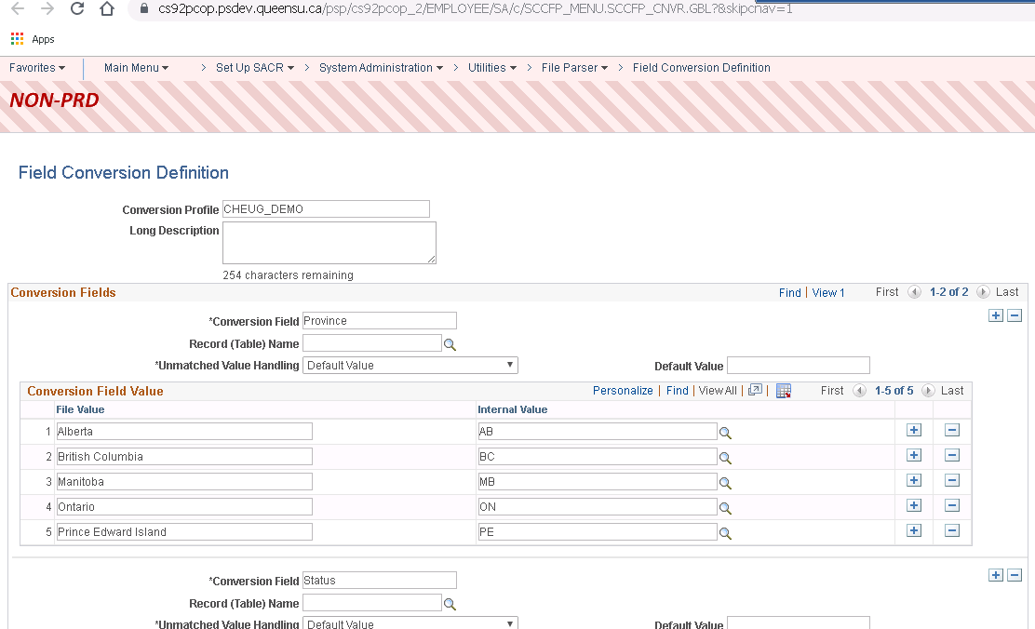
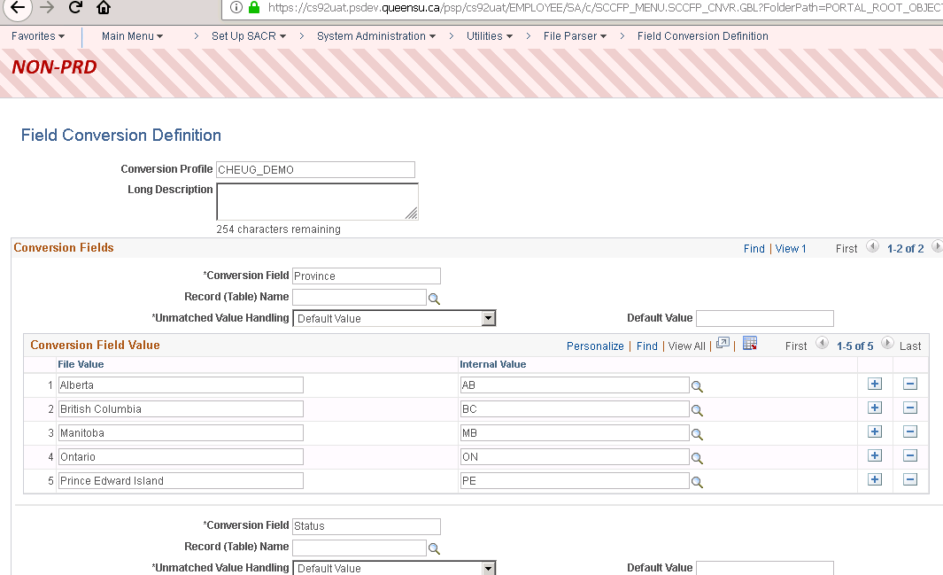
Demo Slides
And now it is!

Slide 29
Conclusions (Pros)
No backend – no scripts, SQL, code, elevated privileges
Data confirmation at a glance – when selecting the data to insert into my project I could see the description
Ease of migration – can migrate anywhere, even back to the original instance (following a refresh?)
Record hierarchy – taken care of in data set design
So what makes this all possible? Aka, how can I make this work?

Slide 30
Data set designer
And other setup / config

Slide 31
Data Set Designer
PeopleTools > LifeCycle Tools > Migrate Data > Data Set Designer
Used to create Data Set Definitions
Data Set Definitions
Define the shape or structure of data to migrate
Made of records that contain the data to migrate.

Slide 32
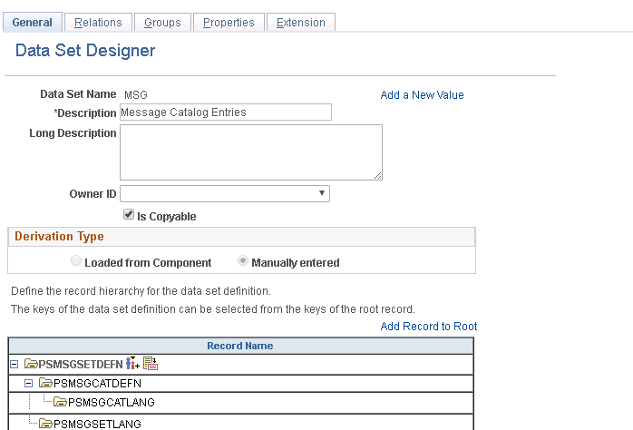

Slide 33
Data Set Designer
In PT 8.53 there were two ways to create a Data Set Definition.
As of 8.54, there is one way: adding records manually.
Previous method “Generate from Component” still works, it’s just hidden*.
*instructions to unhide provided in the appendix. Use at your own risk!

Slide 34
Demo 2 begins!

Slide 35
Demo 2 Slides
Looking at Field Conversion Definitions component in App Designer, we see it has three records behind it.

Slide 36
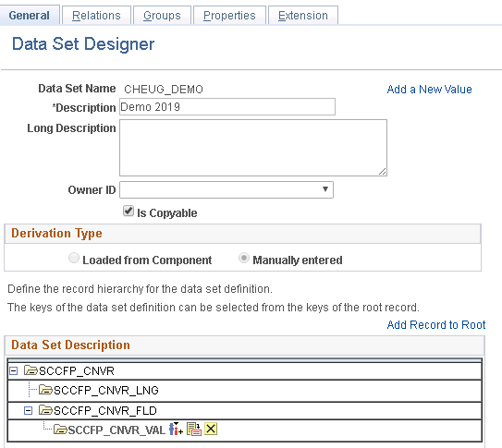
Demo 2 Slides
I have added the three records, starting with the parent record at the root.
Note: the definition of a child record is a record that contains all the keys of the parent. This is broader than the App Designer notion of parent or child. This can be helpful and/or confusing.
Check “Is Copyable” to allow data to be copied between instances
Save the definition

Slide 37
Demo 2 Slides
Relations allow joining multiple Data Sets together by related fields.
If you have Record A that contains the keys of Record B and Record C, but not necessarily as keys, you might be able to use Relations.
You start with record A, and then link it to both B and C with their respective keys.
Screenshots on subsequent slides

Slide 38
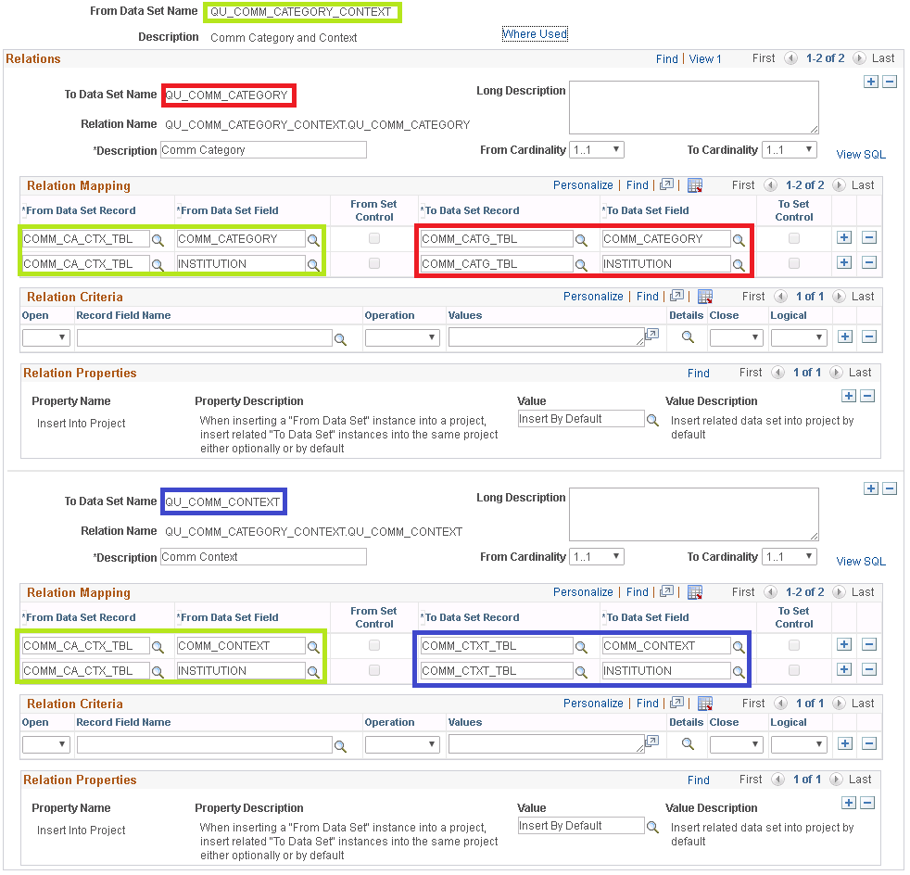
Demo 2

Slide 39
Concluding thoughts
ANY QUESTIONS?

Slide 40
Conclusions
Hopefully, better idea of what DMW can do
And how to do it!
Ideally you have something in mind that you want to try with DMW.

Slide 41
Use Cases
Configuration data
Communication Generation
File Parser
External Test Scores -> Test Tables
Etc.
Test data
Student in specific program/plan, status, etc
Or, if you have other ways of doing these things, I’d like to know that too!

Slide 42
presenters
Amos Cohoe
Senior Systems Analyst
Queen’s University
Amos.Cohoe@queensu.ca
all Alliance presentations will be available for download from the Conference Site

Slide 43
Appendix – Further References
PeopleBooks: https://docs.oracle.com/cd/E92519_02/pt856pbr3/eng/pt/tlcm/concept_ApplicationDataSetOverview.html?pli=ul_d185e102_tlcm
Unhide the Generate from Component option:
Open Component PTADSDEFNSEARCH in App Designer
Unhide hidden page PTADSDEFNSEARCH_GC
New Tab appears on the Search page

Slide 44
Thank you!

