Slide 1
customisations and Enhancements to PS FSCM (Finance) suites
SESSION 9064
05 July 2017

Slide 2
presenters
Clinton Pearson
Business Analyst
University of Pretoria
clinton.pearson@up.ac.za
I have been involved at UP since 2008. I was responsible for the FSCM implementation, initially as an external consultant, and now employed by the University.

Slide 3
University of pretoria
Established 1908

Slide 4
UP & ORACLE
PeopleSoft FSCM 9.2
PeopleSoft HCM 9.2
PeopleSoft CSM 9.2
PeopleSoft CRM 9.2
PeopleTools 8.55

Slide 5
Overview
We would like to share some of our learnings and enhancements with you, in the hope of making your processes more efficient/streamlined as well creating a culture of sharing between our organisations
General/Common We look at non module specific enhancements/developments
General Ledger/Commitment Control Some GL enhancements
Procure to Pay eProcurement → Purchasing → AP

Slide 6
Overview – Next Session
This next session(just after this 1) includes:
Asset management Look at some really cool enhancements – Physical verification, mass physical and financial changes, asset removal
Project costing status report 1 report for everything
Inventory – with eProcurement Check your stock level before ordering – real-time!
WorkCentre’s & dashboards We’re slowly evolving
What’s next Fluid

Slide 7
What is a Round Table session
This is an information SHARING session
It must be interactive
The round table is what it says – we sit around the table and talk
We share our issues and solutions
We share – be it code, ideas, solutions, etc

Slide 8
General enhancements
We will look at some non-module specific enhancements and developments

Slide 9
General enhancements
These “General Enhancements” are common across all modules
ERS – Enterprise Request System
SOD – Segregation of Duties
General Security Enhancements

Slide 10
ERS – EnteRprise request system
In house tracking system
From initiating the request, design, specification, duration, development, user testing and finally implementation of the finished product.
Used by management, developers and users to measure and monitor performance, efficiency and workload.

Slide 11
ERS – Enterprise request system
All the information that may be recorded per request

Slide 12
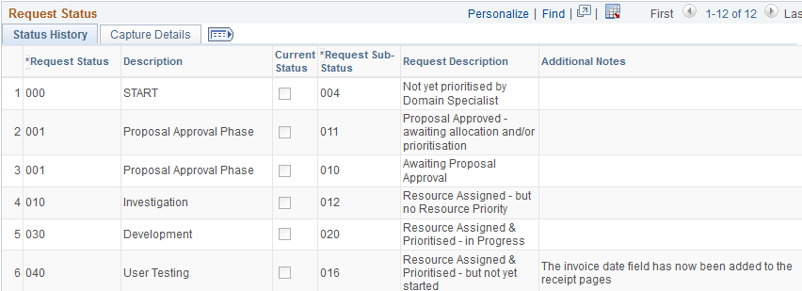
ERS – Enterprise request system

Slide 13
General enhancements
These “General Enhancements” are common across all modules
ERS – Enterprise Request System
SOD – Segregation of Duties
General Security Enhancements

Slide 14
SOD – Segregation of duties
Going to the Alliance Conference has many advantages
Meet new people
Share different ideas
Shared with us from Canada’s McEwan University
How many times have your auditors requested to do a SOD audit? How much money does this cost the organization?
Well here is our solution!

Slide 15
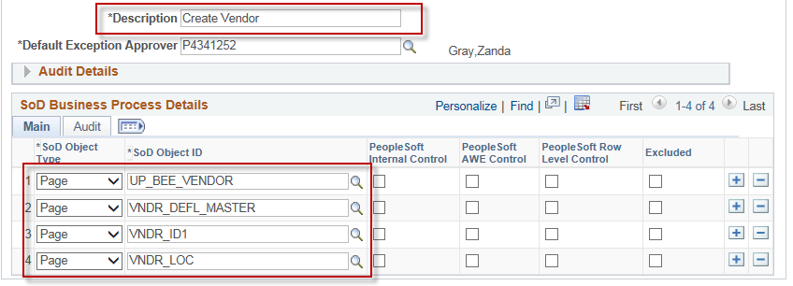
SOD– segregation of duties
Configuration
Business Process Definitions – these are mostly standard business processes for example Create Vendor, Approve Vendor

Slide 16
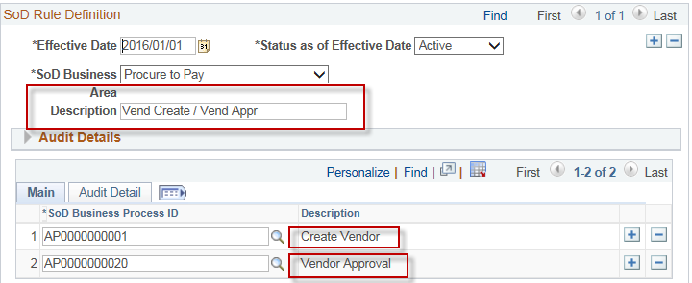
SOD– segregation of duties
Configuration(Cont)
Create your Rules – This entails which of your Business Processes together would relate to a SOD incident for example – If a user has both the ability to create a vendor and to approve a vendor

Slide 17
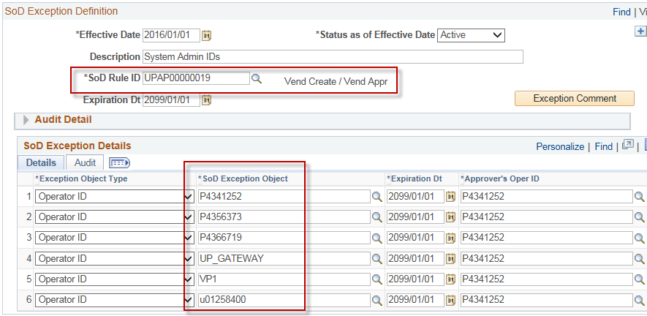
SOD– segregation of duties
Configuration(Cont)
Exceptions definition – Specify the allowable exceptions

Slide 18
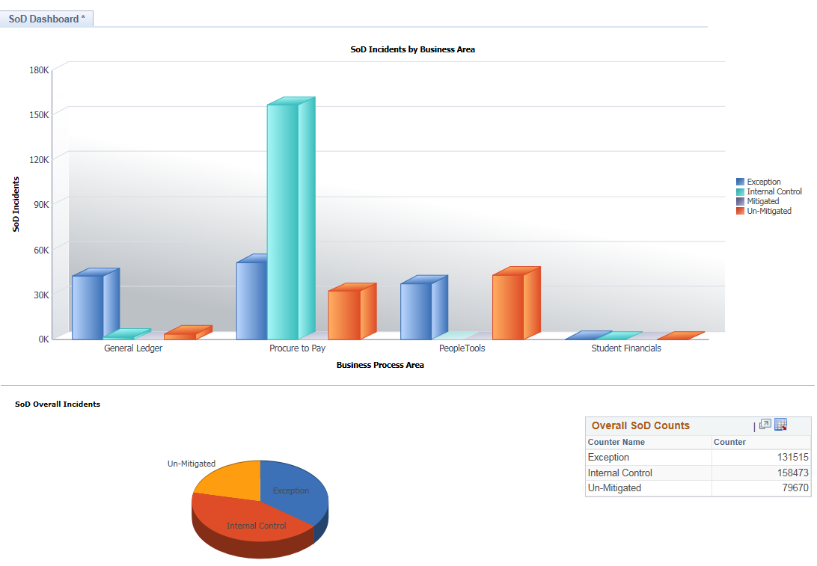
SOD– segregation of duties
Run the exception report

Slide 19
General enhancements
These “General Enhancements” are common across all modules
ERS – Enterprise Request System
SOD – Segregation of Duties
General Security Enhancements

Slide 20
Security – Default user profile(s)
Custom function developed
Load single user
Load multiple users
Huge saving on time

Slide 21
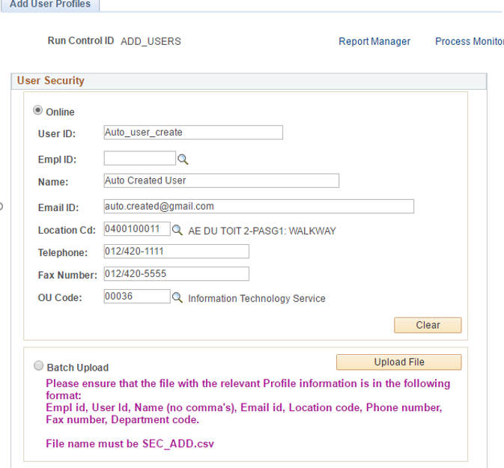
Security (cont)
Add the user profile or select batch upload

Slide 22
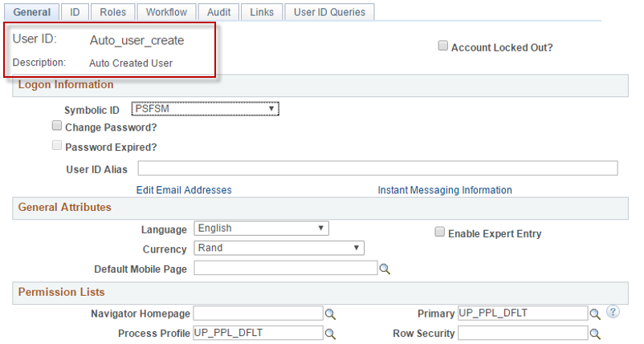
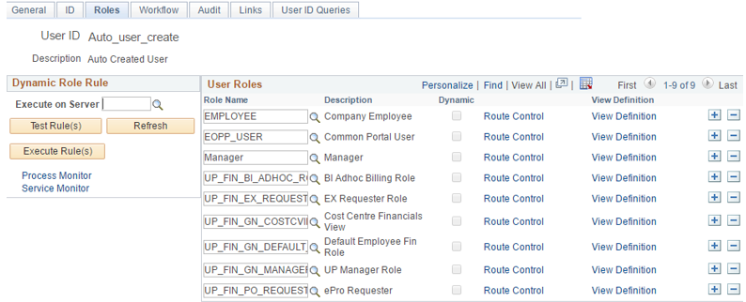
Security (cont)
User profile created with default roles

Slide 23
Security (cont)
Various other defaults applied

Slide 24
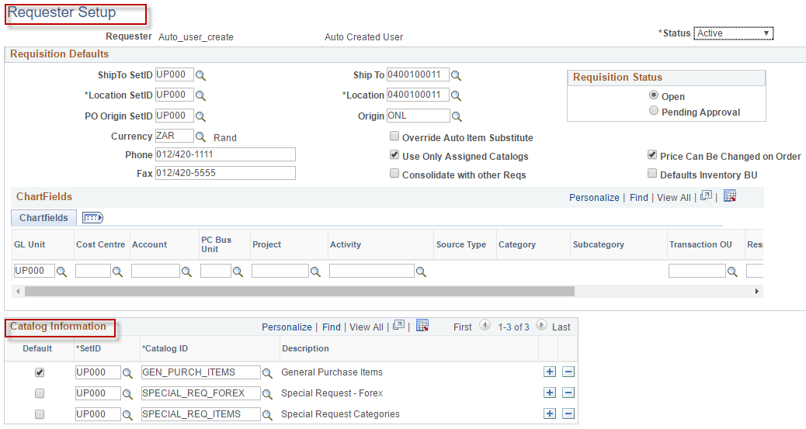
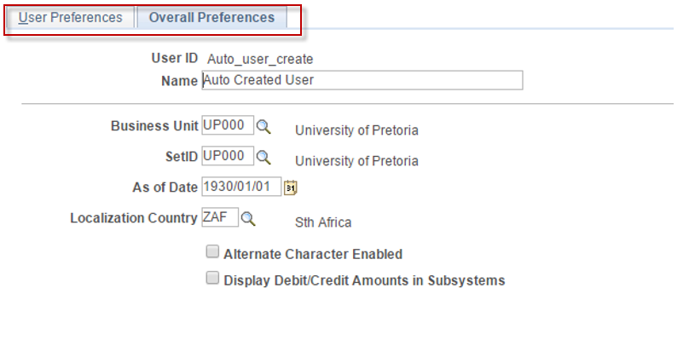
Security (cont.)
Requestor Defaults and User Preferences

Slide 25
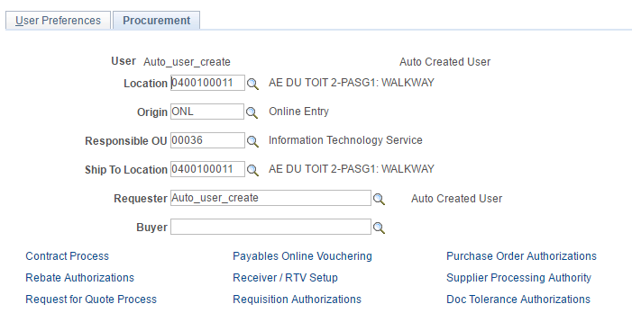
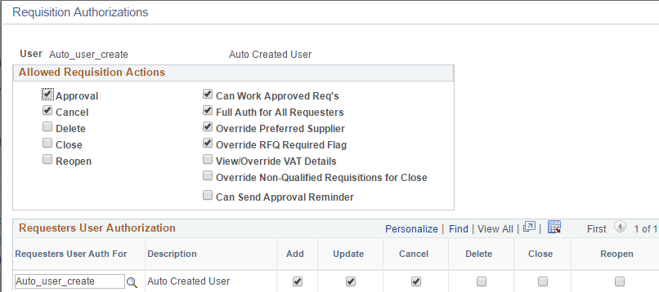
Security (cont.)
Procurement Defaults

Slide 26
General ledger/Commitment Control
3rd party commitment control

Slide 27
GL & KK
3rd Party Commitment Control
Foreign Exchange Rate Load

Slide 28
3rd party commitment control
Both FSCM Peoplesoft and non-FSCM Peoplesoft applications are now budget checked
HRMS
Vehicle Rentals/Hiring
Maintenance Management
SMS

Slide 29
GL & KK
3rd Party Commitment Control
Foreign Exchange Rate Load

Slide 30
Foreign exchange rate loads
We have subscribed to XE
Rates are loaded daily
Achieve accurate rates for forex transactions

Slide 31
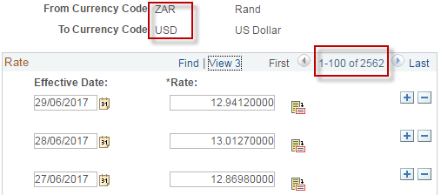
Effortless exchange

Slide 32
PROCURE TO PAY
Looking at eProcurement, PO and Accounts Payable

Slide 33
Procure to pay
BEE Supplier Information
ERS Vouchering – Evaluated Receipt Settlement

Slide 34
BEE supplier information
Keep track of supplier BEE information
Run reports to identify certificate expiration

Slide 35
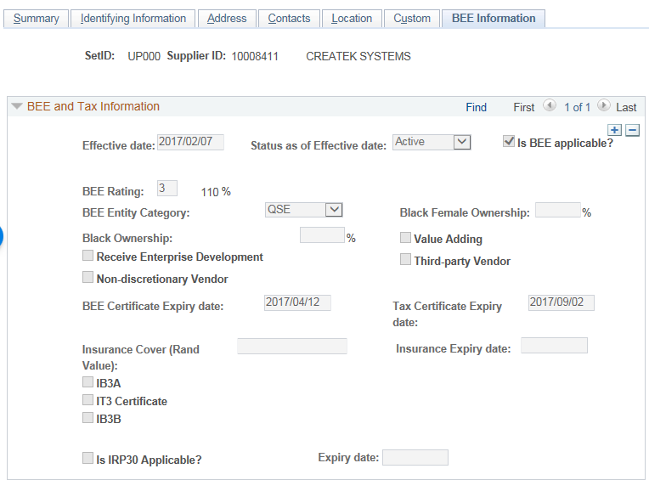
BEE Supplier information
Using the existing Supplier Component

Slide 36
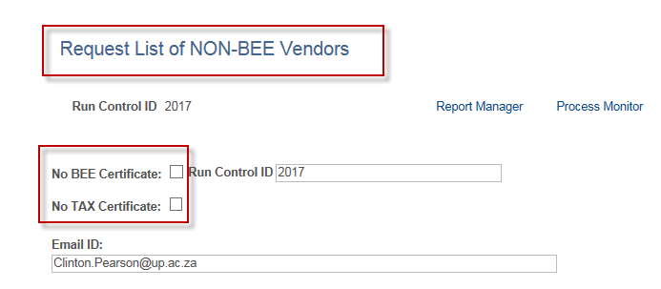
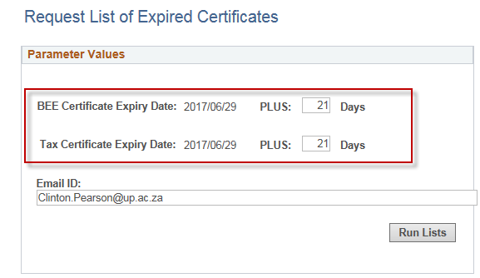
BEE Supplier reporting
See who are non BEE Suppliers
View expired BEE &Tax Certificates

Slide 37
Procure to pay
BEE Supplier Information
ERS Vouchering – Evaluated Receipt Settlement

Slide 38
Evaluated receipt settlement
System creates vouchers/invoices from receipts
Decentralised vs centralized receiving of documents
Workflow for approval to pay invoices

Slide 39
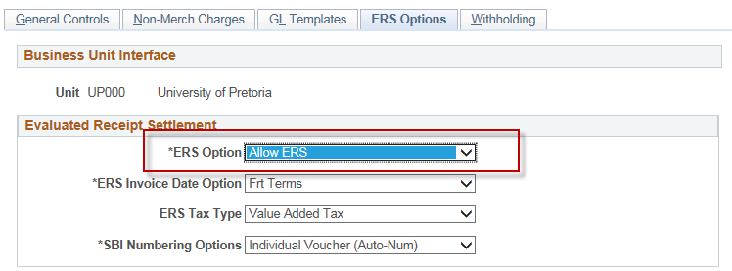
ERS Configuration
Business Unit Configuration

Slide 40
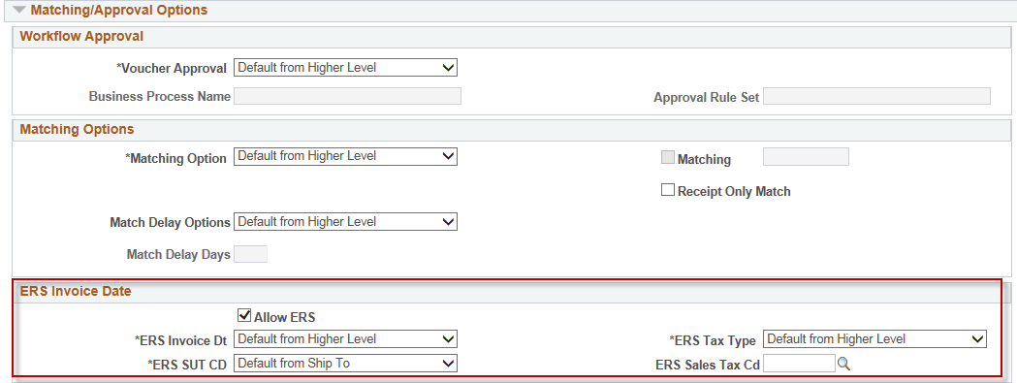
ERS Configuration (Cont..)
Supplier Configuration

Slide 41
Process before ers
Create PO
Dispatch PO
Capture Receipt or NOT
Manual Approval of Invoice
AP waits for Invoice from Dept
Receive Goods
Invoice captured manually in PS

Slide 42
Process after ers
Create PO
Dispatch PO
Receipt Captured centrally
Voucher build creates Voucher
Workflow for approval of invoice
Invoice sent electronically

Slide 43
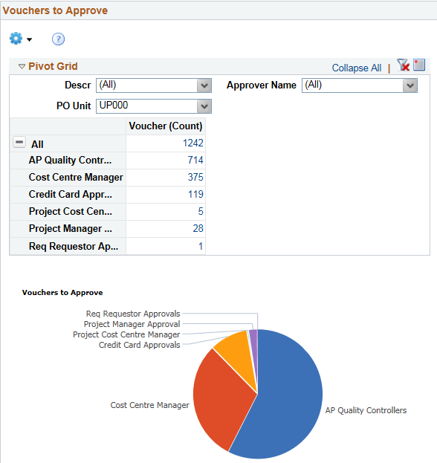
ERS benefits
Accounts payable’s workload reduced
Accounts payable efficiency improved
Data entry errors reduced
Better insight into outstanding supplier debt
Less manual intervention

Slide 44
Concluding thoughts
ANY QUESTIONS?

Slide 45
THANK YOU!

