Slide 1
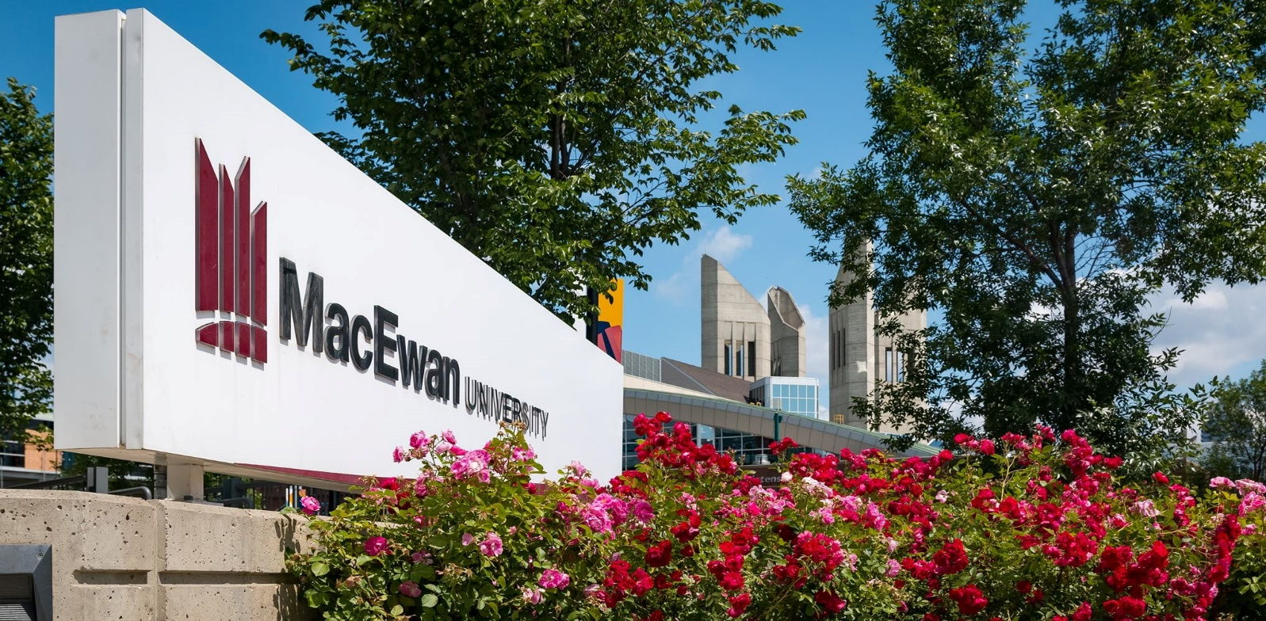
Fluid navigation
SESSION 6051
November 12, 2018

Slide 2
Topics
Current State and Scope
Branding
Navigation Collections
Homepages and Dashboards
Tile Wizard
Data Migration Workbench
Elastic Search

Slide 3
Current state and scope
History of CS at Waterloo

Slide 4
Current State
Went live with Campus Solutions in 2001
Nearly all of student and applicant self-service is custom built
Upgraded to 9.2 in Feb, 2018 – live on 8.55, PUM5
Live with Appsian PeopleUX for mobile devices since Nov, 2014
Used for students, applicants, and alumni – over a 100 pages mobilized
Continuing to use this technology
Prototyped Fluid Navigation on 8.55
Upgrading to 8.56, PUM10 in Feb, 2019 with Fluid Navigation

Slide 5
Fluid navigation/Peopleux Demo
What is Fluid Navigation –
Homepages / Dashboards
Portal Search
Tiles made from Navigation Collections
How Waterloo uses Fluid Navigation and PeopleUX
No Fluid pages!

Slide 6
Scope
Three or more Homepages – all Classic Pages
Student Center Homepage (students, alumni, applicants)
Faculty Center Homepage
Staff Homepage
Dashboards when there are not enough Tiles for a Homepage
Navigation Collections with external links to create context-sensitive help
Deployment of Elastic Search for staff
Standards for how to deploy these technologies for the purpose of navigation

Slide 7
Implementation methodology
Implement Fluid as part of an upgrade because –
Some perceived Fluid Navigation implementation as onerous
8.56 / PUM10 provides a more comprehensive version of Fluid self-service
Skip 8.57 as it is being delivered in the Oracle Cloud first
Built an 8.55 prototype following go-live and solicited feedback
Used a usability study from “super staff” – those people that use CS all day
Refactored the prototype based off of themes in the study
Reused all student Navigation Collections from PeopleUX in Fluid

Slide 8
Key Messages
“All new Oracle functionality depends on Fluid Navigation”
“No new functionality is being deployed – only the navigation is changing”
“Fluid Nav supplements Classic Nav – it doesn’t replace it”
“Nav Collections contain frequently accessed items – not all items”
“Favorites, Recent Places, and Search replace breadcrumbs – reducing clicking”
“Changes are made based usability survey trends”
“No customizations will be made to the Navigation” *
“A mixture of Classic, Classic+, Fluid, and PeopleUX pages are unavoidable”

Slide 9
Configuration and migration Effort
Fluid Navigation is quite easy to configure –
Technical or Functional responsibility?
Most effort is around identifying user groups and frequently used content
Migration is confusing –
A variety of tools and each is slightly different
Most objects can migrated using one of –
Data Mover
App Designer
Data Migration Workbench

Slide 10
branding
Colours and Icons

Slide 11
branding
Significant new features in 8.55, making branding easier than 8.54
Macro Sets are one of these features
This blog entry pe0ples0ft.blogspot.com details an example
A detailed activity, but less tedious than before!
Chrome DevTools can be used to inspect elements to find values to change
Configured via the PIA –
PeopleTools > Portal > Branding

Slide 12
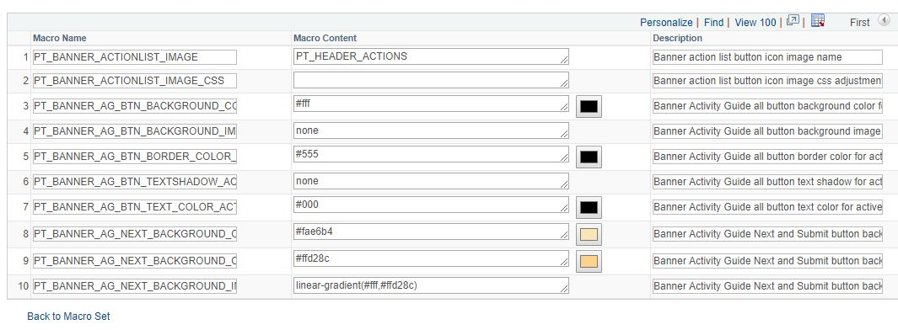
branding
Macro Set –

Slide 13
Branding
Step 1 – Theme Style Sheet Definition
Cloned PT_BRAND_CLASSIC_TEMPLTE_FLUID to UWSA_CLASSIC_TEMPLTE_FLUID
Step 2 – Global Override Style Sheet Definition
Cloned PT_BRAND_FLUID_TEMPLATE_856 to UWSA_BRAND_FLUID_TEMPLATE
Step 3 – Homepage Header Definition
Cloned DEFAULT_HEADER_FLUID to UWSA_DEFAULT_HEADER_FLUID
Step 4 – Marco Set Definition
Cloned PT_DEFAULT_MACROSET_856 to UWSA_DEFAULT_MACROSET_856
Step 5 – Theme Definition
Connect the above four items together
Cloned DEFAULT_THEME_FLUID to UWSA_DEFAULT_THEME_FLUID

Slide 14
Branding
Configure the related elements for brand alignment
Configure the Branding Theme –
PeopleTools > Portal > Branding > Branding System Options

Slide 15
Branding
Migration – Data Mover, App Designer, and Data Migration Workbench –
E-FLUID: How To Migrate Various Portal Branding Objects
Theme Definitions (Data Mover or Data Migration Workbench) –
PS_PTBR_THEME, PS_PTBR_THMATTR, PS_PTBR_THEME_CSS, PS_PTBR_THEME_DEL
Header/Footer Definitions (Data Mover or Data Migration Workbench) –
PS_PTBR_LAYOUT, PS_PTBR_LTATTR, PS_PTBR_LTELT, PS_PTBR_LTELTAT
Marco Definitions (Data Mover or Data Migration Workbench) –
PSMACROSET, PSMACRO
Stylesheets (App Designer and Data Mover) –
Theme Style Sheet Definition (App Designer)
Global Override Style Sheet Definition (App Designer)
Import PS_PTBR_OEBJCT_TBL into the target to view in Branding Objects (Data Mover)

Slide 16
SVG Files
Fluid Tiles require the usage of SVG files
Upload SVG images –
PeopleTools > Portal > Branding > Branding Objects > Image
Once uploaded, images can be associated with Tiles or Nav Collection items
Example SVG files can be downloaded from Wikimedia Commons
Waterloo is using Font Awesome Pro –
Extensive collection of images – nearly 4,000 images
Used pervasively throughout the web
Also used in Waterloo’s PeopleUX implementation

Slide 17
What is an svg?
From Wikipedia –
Scalable Vector Graphics (SVG) is an XML-based vector image format for two-dimensional graphics with support for interactivity and animation. The SVG specification is an open standard developed by the World Wide Web Consortium (W3C) since 1999.
SVG images and their behaviors are defined in XML text files. This means that they can be searched, indexed, scripted, and compressed. As XML files, SVG images can be created and edited with any text editor, as well as with drawing software.

Slide 18
Student center

Slide 19
Staff homepage

Slide 20
Faculty Center

Slide 21
Working with svgs
PeopleTools does not recognize all types of SVGs
Some result in errors – like default implementation from Font Awesome
A tool like Inkscape can be used to make them compatible
Inkscape is an open source editor – https://inkscape.org
Migration – App Designer and Data Mover –
After migrating via App Designer, images will not appear in the PIA Branding Objects
Export PS_PTBR_IMAGE_TBL into the target to view in Branding Objects

Slide 22
image objects

Slide 23
SVG demo
Create an SVG and upload it

Slide 24
Navigation collections
Working links
and collections

Slide 25
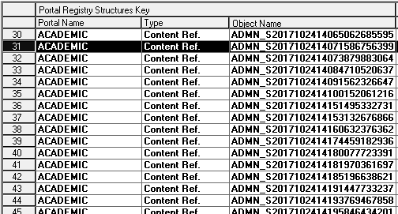
Navigation collections
For Waterloo, all Tiles are built from Navigation Collections –
PeopleTools > Portal > Portal Utilities > Navigation Collections
Initial Nav Collections were based off of user favourites
Query PSPRUFDEFN to see what users have bookmarked as favorites
Stored in PSPRSMDEFN
Migration – App Designer

Slide 26
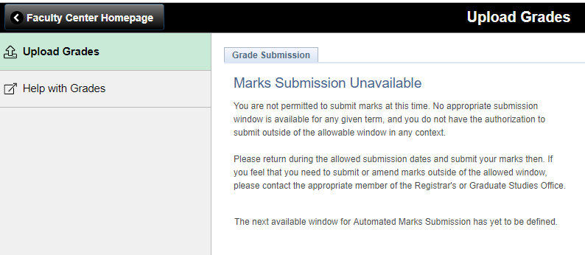
Navigation collection example
Waterloo also created links to existing external help websites
A link to a custom page and a link to help page

Slide 27
External links
To create a link to an external site, ensure the CREF has a –
URL Type of Non-PeopleSoft URL
No Template is checked
Display on Small Form Factor is checked
In the Nav Collection, ensure the Open in a new window is selected

Slide 28
Navigation Collection demo
Create a link and add it to a new Navigation Collection

Slide 29
homepages
Working with Homepages

Slide 30
Homepages
Homepages are Content References of type Fluid Homepages
Created using the Add Content Reference link under Fluid Homepages –
PeopleTools > Portal > Structure and Content > Fluid Structure Content > Fluid Homepages
Select the Usage Type of Fluid Homepage
Select Required – Fixed, forcing homepages to appear (if the user has security)
Order in the Homepage Navigator is determine by the sequence number
To prohibit personalization, create with a Behaviour of Required – Fixed
Migration – Data Migration Workbench, Data Mover or App Designer

Slide 31
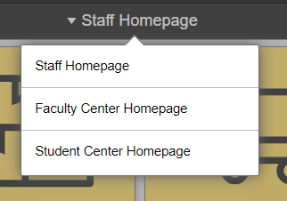
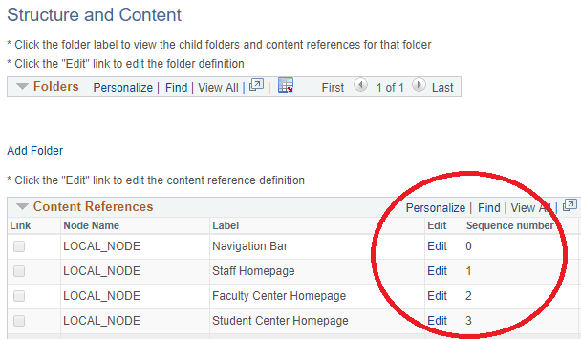
Homepage placement
For Waterloo, the Homepages are sequenced as follows –

Slide 32
Homepage Security
Set using the Security tab – PeopleTools > Portal > Structure and Content > Fluid Structure Content > Fluid Homepages > < homepage name > > Edit > Security
Can be configured with Roles or Permission Lists
Assign security to Homepages and Tiles vs. changing a permission list
At least two ways to migrate security – Data Mover or App Designer
Source (Data Mover) –
EXPORT PSPRSMPERM where portal_objname in ( 'VALUE1', 'VALUE2', 'ETC' );
Target (Data Mover) –
DELETE FROM PSPRSMPERM where portal_objname in ( 'VALUE1', 'VALUE2', 'ETC' );
import *;

Slide 33
Homepage security
In App Designer…
Use the Set References from Source in App Designer

Slide 34
Dashboards
Dashboards are a type Homepage
Homepages can be turned into Dashboards by checking Operational Dashboard
Or – Dashboards can be defined –
PeopleTools > Portal > Dashboard > Manage Dashboard Pages > Fluid Dashboards
Not just used for displaying analytic information
Can be used to group Tiles when there are not enough Tiles for a Homepage
Once configured, display as a Tile by setting Dashboard Properties –
Properties > Dashboard Page Link > Parent Folder > < Fluid Pages >

Slide 35
tiles
Working with the wizard

Slide 36
Tile wizard
An easy way to create Tiles – just a couple of clicks!
This Alliance 2018 presentation provides an excellent overview
Tiles are published under Folders
To organize content, created a new folder for custom Tiles –
PeopleTools > Portal > Structure and Content > Fluid Structure Content > Fluid Pages
Migration – Data Migration Workbench –
E-FLUID: How to Migrate Fluid Objects from One Environment to Another

Slide 37
Tile wizard
Once a Tile is published, it can be associated with a Homepage –
PeopleTools > Portal > Structure and Content > Fluid Structure Content > Fluid Homepages > Student Center Homepage > Edit > Tile Content
All Tiles are set to Required – Fixed – prohibiting personalization
Tiles can also be associated with the NavBar
Like Homepages, a Sequence Number is used to control the order

Slide 38
Tile Security
When –
Adding a Navigation Collection Tile to a Homepage and –
When using Public security –
The user will receive an empty Navigation Collection
(if they are not authorized to any of the content)

Slide 39
Tile Security
To have the Tile display only if the user has access to some of the content, security can be set based on the following SQL –
select * from psroleclass where classid in (
select distinct(classid) from psauthitem where PNLITEMNAME in (
select portal_uri_seg2 from psprsmdefn where portal_prntobjname = ‘<collection name>’));

Slide 40
Tile Security
Set using the Security tab – PeopleTools > Portal > Structure and Content > Fluid Structure Content > Fluid Page > < folder > > < content reference > > Edit > Security
Like Homepages, security can be migrated via Data Mover or App Designer

Slide 41
Tile wizard demo
Accessible in the PIA –
PeopleTools > Portal > Tile Wizard
Created with the type of Navigation Collection – Optimized
Published under a custom Waterloo folder for organization
Navigation Collections are made collapsible
All other default settings accepted

Slide 42
Data migration workbench
Tiles and Homepages

Slide 43
Data migration workbench
Projects are created via the PIA –
PeopleTools > Lifecycle Tools > Migrate Data > Data Migration Workbench
The project name cannot be the same as an App Designer project
But App Designer projects can be created to override a workbench project!
Used to migrate objects – objects typically created with a wizard
Objects are defined as Application Data Sets and custom ADS can be created
Requires File Locations exporting and importing projects
File Locations are directories accessible to the Process Scheduler
Provides the ability to compare between databases

Slide 44
Data migration workbench
Projects can be copied to the File Location
Object integrity is verified using Check Integrity
Projects are imported using the Load Projects from File
All of the above steps are done with a job called PTADSAEPRCS
For a successful Tile migration, all Tile components should first migrate –
Images
Navigation Collections
Containing Portal Registry Structures

Slide 45
Application data sets
Homepages – PSPRSM_HOMEPAGETILE
Tiles Created with the Wizard – PTPPB_GROUPLET

Slide 46
Data migration workbench Security
For all functionality, access to the following pages are required –
PTADSADMINRPT – Administrator Reports
PTADSADMINRPTSRCH – Administrator Reports Search
PTADSDEFNSEARCH – Data Set Search
PTADSDMW – Data Migration Workbench
PTADSDMWSEARCH – Data Migration Search
PTADSPROP – Data Set Properties
PTADSSUMRPT – Data Set Summary Report
PTPRJREPOSDEFN – Manage File Locations
RUN_PTADSAEPRCS – Run ADS Copy/Compare

Slide 47
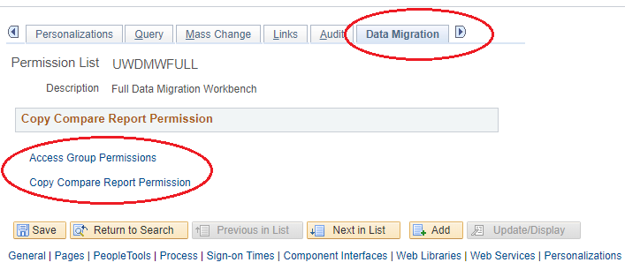
Data migration workbench Security
A separate Tab called Data Migration with two configuration options –

Slide 48
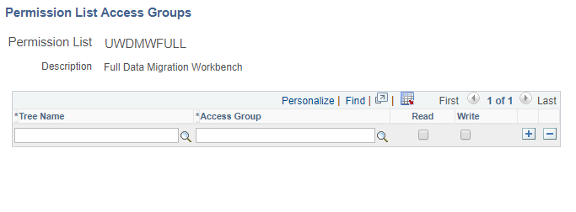
Data migration workbench Security
Access Group Permissions –
Used to restrict the type of modelled objects that can be migrated
Built using Trees and Access Groups
If nothing is specific, anything can be migrated

Slide 49
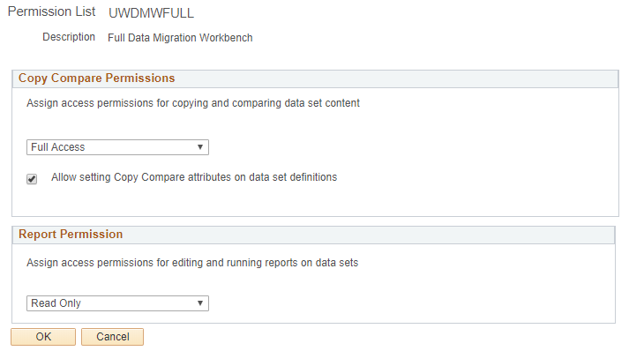
Data migration workbench Security
Copy Compare Report Permissions –

Slide 50
Elastic search
Using global search

Slide 51
Elastic search – Global Search
Only used for global search at this point
Enabled via Display Global Search in Header
PeopleTools > Portal > General Settings
Minimum security required –
Menu – PORTAL_ADMIN
Component – PTSF_GBLSRCH_FLUID
Page – Search Results
Web Libraries – WEBLIB_PORTAL.PORTAL_SEARCH_PB.FieldFormula.ISCRIPT_PortalSearch
Search Groups – PTPORTALREGISTRY

Slide 52
Elastic search – Global Search
Content References with Hidden from portal navigation appear in results
Results are not filtered based on security
Users may see items they do not have access to
Search index needs to be re-built if new portal content is added
Only items registered in the Portal will appear in results!
Nothing in a Navigator Tab will be returned in search results

Slide 53
Concluding thoughts
ANY QUESTIONS?

Slide 54
THANK YOU!

