Slide 1
EDXperience
SESSION 5001
November 9th, 2017
16:25 – 17:10

Slide 2
presenter
Kartik Warrier
Senior Business Analyst
University of Adelaide
kartik.warrier@adelaide.edu.au
As a part of the Procure to Pay Project, I was instrumental in rolling out the eProcurement module across the University. Am currently working on enhancements and additional initiatives in the P2P space to improve compliance and increase efficiency.

Slide 3
The University of adelaide
Established: 1874
Campuses: 3
Faculties: 5
Divisions: 3
Students: 25,000
Staff: 3,500 (excl. casuals)

Slide 4
ORGANISATION & ORACLE
PeopleSoft Finance, HCM, Campus Solutions and CRM
PeopleSoft Finance 9.2
PeopleTools 8.55
Oracle 12.1
PUM(Mirror) #22 full

Slide 5
eProcurement
12 PunchOut and 3 Internal catalogues
2400 active requestors across 9 Faculties / Divisions
2000 Purchase Orders per month
200 Ship To Locations across multiple sites
65% of requisitions originate from PunchOut catalogues
150 Departments or Cost Centres

Slide 6
Overview
EDX
What is EDX
How does it work?
UoA's set up
Configuration and Customisation
Benefits
Controls and Fall back
Implementation Activities
Summary
Q&A

Slide 7
EDX
UoA’s Journey

Slide 8
EDX – electronic data exchange
EDX : data exchange between systems without using dedicated or exclusive processes
Data is shared in cXML format (commerce eXtensible Markup Language).
Standard protocols and nomenclature are used to exchange data in cXML format using Web Services.
Think of it as an SMS exchange between the two systems
EDX / EDI has been around for more than 20 years – but it has had very poor uptake in the Education sector.

Slide 9
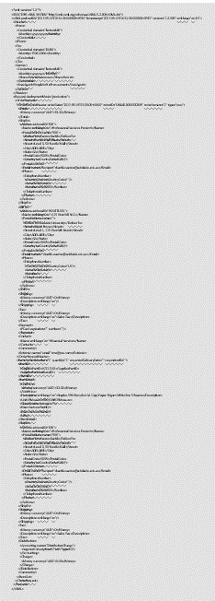
EDX – how does it work?
Buyer ERP
Middleware
Middleware
Seller ERP
<?xml version="1.0"?>
<!DOCTYPE cXML SYSTEM "http://xml.cxml.org/schemas/cXML/1.2.008/cXML.dtd">
<cXML payloadID="2017-05-18T16:31:38.000000+0930" timestamp="2017-05-18T16:31:38.000000+0930" version="1.2.008" xml:lang="en-US">
<Header>
<From>
<Credential domain="NetworkID">
<Identity>yyyyyyyyyy</Identity>
</Credential>
</From>
<To>
<Credential domain="DUNS">
<Identity>750412066</Identity>
</Credential>
</To>
<Sender>
<Credential domain="NetworkID">
<Identity>yyyyyyyy</Identity>
<SharedSecret>xxxxxxxxx</SharedSecret>
</Credential>
<UserAgent>PeopleSoft eProcurement</UserAgent>
</Sender>
</Header>
<Request deploymentMode="production">
Purchase
Order
T
T
T
T
Acknowle-
dgement
T
Transformation – ERP to CXML or CXML to ERP

Slide 10
EDX – how does it work? (cont.)
Buyer’s ERP
Middleware
Middleware
Seller’s ERP
CXML is used for
Requisitions
Purchase Orders
Advance Shipment Notifications (Receipts)
Invoices
Requisition
Shopping Cart
Purchase
Order
Acknowle-
dgement
Acknowle-
dgement
ASN
Acknowle-
dgement
Invoice
Requisitions are flipped to Purchase Orders, which are in turn flipped to ASNs and Invoices – thus ensuring completeness and data integrity.

Slide 11
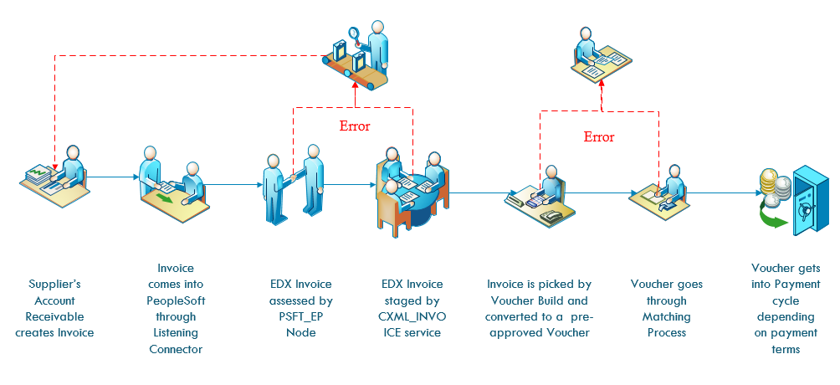
EDX – how does it work? (cont.)
EDX INVOICES – an example of how it flows through to payments
The end to end process can be completed in less than 60 minutes…
Notes:
There are no people involved in the base process. People get involved only for reviewing exceptions.

Slide 12
EDX AT UoA: A brief history
2015
ePro roll out commenced
Configuration of EDX commenced
2016
One Supplier live on EDX
EDX POs – random failures
Daily recon & manual PO dispatch
EDX discontinued
2017
Project: Focussed activity with a consultant
Successful proof of concept: POs and Invoices
One Supplier configured
Target to get top Suppliers on EDX

Slide 13
EDX – how are we using it?
EDX used for:
Requisitions
In use since June 2015.
12 PunchOut catalogues
Purchase Orders
Active for 3 PunchOut catalogues.
4 more being rolled out
Invoices
In Use for 3 PunchOut catalogues,
4 more being rolled out by end 2017
ASNs
Being investigated
UoA
Supplier
Requisition
Shopping
Cart
Purchase
Order
Acknowle-
dgement
Acknowle-
dgement
Middleware
Middleware
ASN
Acknowle-
dgement
Invoice
Used for highest transaction volume suppliers – accounting for about 65% of our requisitions.

Slide 14
EDX – how are we using it? (cont.)
 | Requisitions, Purchase Orders, and Invoices |  | Requisitions only
Completed
WIP
Scheduled

Slide 15
EDX – how are we using it? (cont.)
Data displayed is count of invoices received by EDX mapped against total invoices. Source: PeopleSoft query

Slide 16
EDX Configuration & Customisation
Configuration
Domains, User Ids, &Shared Secrets
URLs, Nodes, & Routings
Server access, Firewall set ups, and Security Certificate Whitelisting
Customisation
Validation protocol
Customise cXML message for supplier
Ship To Address on PO (transformation)
Invoice customisation by Supplier

Slide 17
EDX Benefits
Before | After
PO manual data entry – errors and duplication by Supplier. Required effort to resolve and reconcile. | Supplier does no Data entry – eliminate potential errors / lead time / duplication.
We tracked Invoice received date, PO dispatched date, etc. for KPIs. Had to process hard copies or pdfs | Instant transfer of information – no lead time or processing
We did manual data entry for Invoice processing, including approvals, and rework | Invoice processing requires no attention – unless there’s a Match Exception
Credit notes processed for duplicate invoices / incorrect deliveries | Credit notes reduced to less than 10% of previous volumes
Invoices filtered as SPAM / Junk mail and missed. | Negligible risk of system exposure –messages do not carry links or files

Slide 18
EDX Controls and Fall back
Exception reports to spot failures
Features being configured to inform User / Supplier in the event of failure.
Duplicates and incorrect details checked by PeopleSoft during Matching process.
Payments released according to agreed payment terms after 3 way match succeeds.
In the event of a problem, EDX POs and Invoices can be easily switched to email – pdf option by the transaction officers themselves. Does not require any immediate system configuration change.

Slide 19
EDX Implementation Activities
Purchase Orders and Acknowledgements
Correct Ship To Addresses
Additional details on the PO – e.g. Cost Centre
Diverted deliveries – to store or central Hub
Custom Report to check dispatch failures
Future activities:
Attachments by EDX
Special Requests by EDX
Advance Shipment Notification (ASN) to auto-populate Receipts

Slide 20
EDX Implementation Activities (cont.)
Invoices
Customisation to Supplier’s Invoice
Business Unit and Supplier ID
Firewall issues: MiddleWare or Direct?
Action on failed invoices – monitoring of Synchronous services
Future Activities:
UOM mismatch
Credit Notes by EDX

Slide 21
Summary
EDX offers a secure and instant option to transact commercial data between organisations- with benefits of drastically reduced process time, elimination of errors and resolution requirements, and ability to automate transactions.
PeopleSoft handles CXML data directly, and thus EDX set up and maintenance are not very complicated - for PunchOut catalogue suppliers.
Alternate Email option for EDX always available and can be used by the operating persons directly if required – without requiring any system support.
EDX is an enabler towards getting more Suppliers onto Online catalogues – since it helps to reduce the transactional overhead.

Slide 22
Q&A
ANY QUESTIONS?

Slide 23
presenter
Kartik Warrier
Senior Business Analyst
University of Adelaide
kartik.warrier@adelaide.edu.au
all Alliance presentations will be available for download from the Conference Site

Slide 24
THANK YOU!

