Slide 1
Managing Professor Workload from Scheduling through Payroll
SESSION 6016
November 13, 2018
Notes:
We’d like to share with you our journey of implementing a Scheduling and Workloading solution that is now in production since the Spring 2018 term.

Slide 2
presenters
Phil Robitaille
Toni Umerez
Sr. Business Analyst
Sheridan College Institute of Technology and Advanced Learning
philippe.robitaille@sheridancollege.ca
Manager, Compensation, Pension & Benefits and HRIS
Sheridan College Institute of Technology and Advanced Learning
toni.umerez1@sheridancollege.ca
Project Lead for Sheridan Academic Logistics – Workload Planning & HR Integration
Project resource for Workload Planning & HR

Slide 3
Sheridan College Institute of Technology and Advanced Learning
The Creative Campus
Course Based & Block Based Registration
Degree and Diploma-granting, Apprenticeship & Continuing Ed
3 Campuses in 3 Cities
Six Faculties
23,000 FT & 18,500 NFT Students
Notes:
Diversity is often recognized as a factor in terms of standardizing enterprise systems. Sheridan College has many diversities that represented constraints and challenges in rolling out standard scheduling for all learning contexts. Sheridan has:
Both Course Based Registration (CBR) for degree programs and Block Based Registration for diploma programs
Available rooms to schedule classes range across our Oakville, Brampton and Mississauga campuses
Skills/Apprenticeship and Continuing Education courses and Dual Credit courses have start and end dates quite separate from regular post-sec courses
Joint programs with various Universities including York, UofT and Brock

Slide 4
ORGANIZATION & ORACLE
Campus Solutions CS9.0
Human Capital Management HCM9.2
Infosilem Encampus Timetabler 8.1.0
Notes:
Sheridan is in the early stages of migrating to:
Campus Solutions CS9.2 and,
Timetabler 11.0

Slide 5
Overview
1
3
SA/SAL
Academic Foundations
Professor Setup
Term Planning Groups
Faculties
SA/SAL
Workload Planning
Non-Full-Time Profs
Full-Time Profs
2
4
Infosilem Scheduling
Timetabler
Web Service API
DCU
HR
Teaching Contract Load
Load Simulator
Payroll Audit
SA
CLASS SCHEDULE
Notes:
Sheridan College Institute of Technology and Advanced Learning has deployed a customized PeopleSoft application integrating Faculty scheduling with Campus Solutions, Human Resources and Payroll functions to achieve process efficiencies across the institution. The application ensures; workload compliance with the Academic Employees Collective Agreement, improved processing of Non-full-time contracts and, enables a growing variation of teaching deliveries across three physical campuses.
The Sheridan Academic Logistics (SAL) bolt-on to PeopleSoft includes a number of modules for Curriculum Planning, Term Planning and Workload Planning. This presentation describes the Workload Planning module in Campus Solutions CS9.0 and its HR-facing Contract Loading module in HCM9.2. Central to this solution is PeopleSoft integration to Infosilem's EnCampus Timetabler scheduling software and it's Data Collection Utility (DCU 8.1.0) used for decentralized Faculty term planning of couse sections and professor assignments. Workload Planning provides the tools for Faculties to setup the teaching assignments from DCU and to print Standard Work Forms for Full-Time professors and contracts for Non-Full-Time professors. These "Workload" documents are generated with BI Publisher as the workload is adjusted through the planning process with changing assignments captured from Timetabler/DCU and refreshed using integration broker connectivity to the Timetabler API. The presentation concludes with a discussion of innovations made in loading contracts with more precision in terms of earnings distribution, supervision, work location and ad-hoc schedule.

Slide 6
Components Out of Scope
SA/SAL
Academic Foundations
Professor Setup
Term Planning Groups
Faculties
SA/SAL
Workload Planning
Non-Full-Time Profs
Full-Time Profs
Infosilem Scheduling
Timetabler
Web Service API
DCU
HR
Teaching Contract Load
Load Simulator
Payroll Audit
SA/SAL
Curriculum Planning
SA
Class Schedule
Notes:
Gross simplification of Workloading including SA/SAL inputs/outputs.
Scheduling is loaded with the courses that are running in a term based on the program maps in SA/SAL Curriculum Planning.
In addition to Workload, the class schedule to peopleSoft is an additional and critical load point for scheduling data.

Slide 7
Background
The context and business drivers for change

Slide 8
Project Drivers
Present State | Desired State
Closed architecture with legacy system | Leverage enterprise systems with PeopleSoft & Infosilem Encampus Timetabler
Decentralized professor salary entry | Standard Salaries administered in HR
“Siloed” Workload data inaccessible to HR | Workload data available in multiple and extensible views; Academics, HR, Payroll
Uncontrolled over-rides for Faculty exceptions | System-derived factors enforce academic rules
Alignment with Collective Agreement ad-hoc and expensive | System enforces Collective Agreement provisions
Uncontrolled multiple contracts and SWFs across institution | Enforce a single contract or SWF for Professors
Workload data not available for all Faculties and No-SWF conditions | Accommodate variance in term start/end and incorporate Workload Memos
Problematic contract loading to HR/Payroll | Seamless contract loading
Lengthy contracting cycle times | Reduced contracting cycle times
Notes:
A number of pain points existed in the present state in terms of both technology and process.

Slide 9
Glossary
Term | Definition
APA | Academic Portfolio Administrators that lead the planning of courses in programs in Faculties
API | Application Programming Interface used to load data from DCU to PS
BBR | Block Based Registration
CBR | Course Based Registration
DCU | A browser-based Timetabler client used as a Data Capture Utility by Sheridan APAs
FT | Full-Time Professor
NFT | Non-Full-Time Professor
SAL | The Sheridan Academic Logistics bolt-on to PeopleSoft includes a number of modules for Curriculum Planning, Term Planning and Workload Planning
SWF | Standard Work Form set out by the Collective Agreement and issued to FT Professors term over term
TCH | Teaching Contact Hours
Notes:
A definition of terms before we get started.

Slide 10
SA/SAL Academic Foundations
Setup and Manage Academic Groups, Professors, Administrators and HR Actions

Slide 11
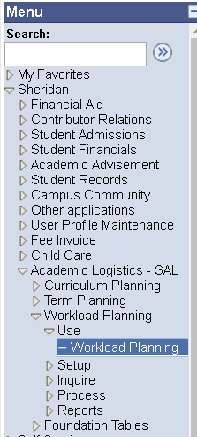
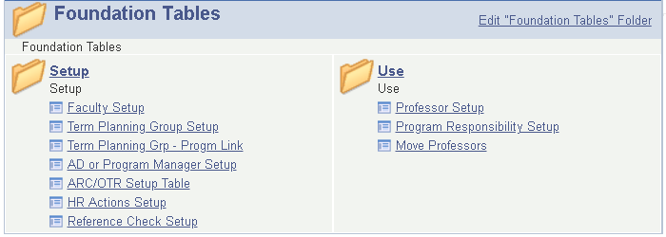
SA/SAL Foundation Tables Setup
Professor Setup
Setup professors in Term Planning Groups in Faculties
Notes:
Initial analysis found that a great number of data relationships were poorly defined in PeopleSoft.
To enable SAL Curriculum Planning, Term Planning and Workload Planning, Sheridan implemented foundation tables to ensure the on-going maintenance of:
Faculties
Term Planning Groups in Faculties to replace legacy system departments
Programs in Term Planning Groups
Associate Deans responsible as supervisors for programs and professors
HR Actions to facilitate professor on-boarding and salary maintenance
HR/APA on-boarding templates for email notifications
Program responsibility for coordinators and Associate Deans
And last but not least, Professor Setup – the key enabler of centralizing salary calculations in HR

Slide 12
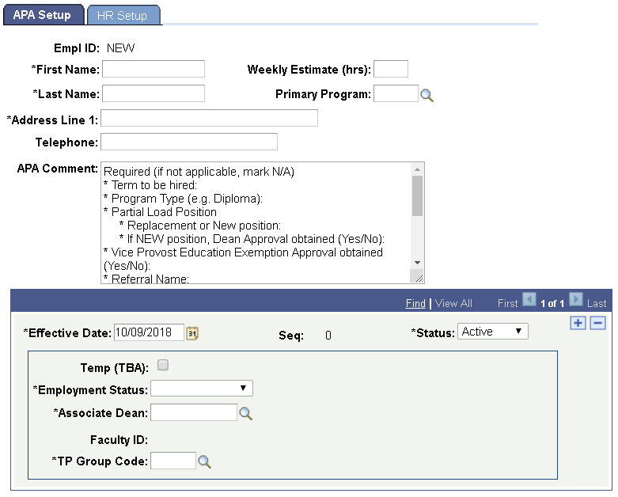
Professor Setup – SA Side
On-boarding New
“Chicken & Egg”
APA Setup used by Academic Portfolio Administrators in the Faculties
Employment Status
Full-Time
Non-Full-Time
Notes:
With over half of the professors being NFT for any given Faculty/TPG, the timely on-boarding of NEW professors introduces critical cycle times where the supply of professors is in contention term-over-term across the Greater Toronto Area.
The Professor Setup component expedites the hiring of a professor as initiated by the Faculties while ensuring conformance with HR practices and standards.
The weekly estimate of hours and the primary program are indicated for NEW professors so that HR can accelerate the necessary salary calculation and enable draft printing of contracts.
Professor contact information is used only as a control point to alleviate the potential of duplicate employee IDs. Once on-boarded, this contact info is replaced with data from BioData.

Slide 13
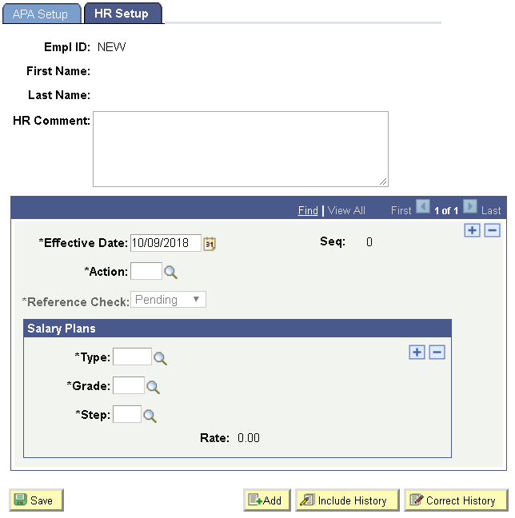
Professor Setup – HR Side
HR Setup used by HR Talent Acquisition
Actions
Check References
Salary Calculation
Rate & Step Increases
Multiple Salary Plans
Part-time
Partial Load
Sessional
Notes:
On the HR side of the professor setup component, Talent Acquisition specialists from HR can procure a reference check. When no longer PENDING, a REF action can be assigned and the component will then permit the entry of a new EMPLID. – and then perform a salary calculation for Part-Time, Partial Load and/or Sessional.
In Workload, to accelerate contracting, draft contacts can be printed even when the reference check is pending.
In HR contract loading, draft contracts are flagged as invalid.

Slide 14
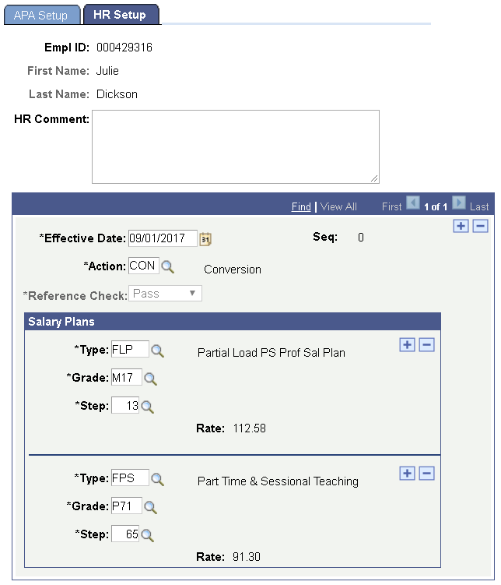
Professor Setup – Existing Prof
Multiple Salary Plans
Workload Planning uses appropriate plan given Teaching hours assigned
Notes:
Existing professors, can have as many as five salary plans – two in all practical senses.
Sheridan prof could have any of the four types of Partial Load salary plans as prescribed in the collective agreement for various; Post-Secondary, Non-Post-secondary Instructors vs Professors.
Sheridan prof could have one of two types of Part-time and Sessional salary plans; one for standardized rates or, one for grand-parented or exception rates.
In Workload Planning, the appropriate rate will be applied given the TCH of workload; FPS/X for part-time TCH less than equal to 6 and, sessional TCH greater than 12 or, FLP/I for TCH between 6 and 12.

Slide 15
Infosilem Scheduling
Academics create course sections for enrollment demand and assign professors then, Schedulers build schedule.

Slide 16
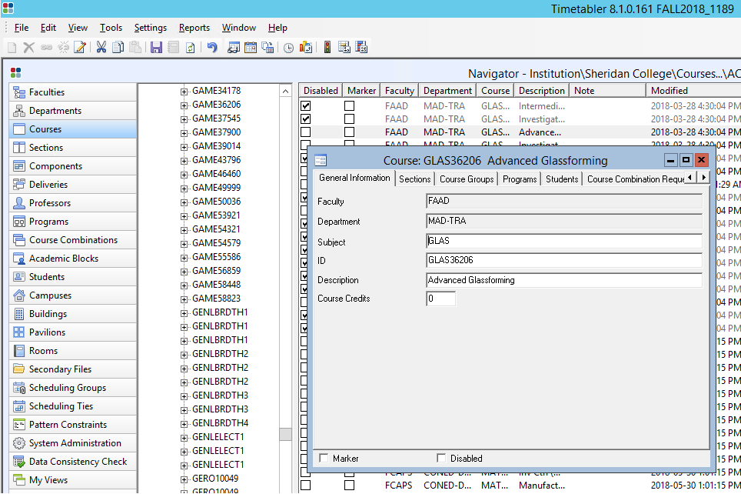
Timetabler
Timetabler Desktop
Used by Office of the Registrar - Schedulers
Notes:
The Timetabler database used by Schedulers in the Office of the Registrar provides a feature-rich desktop client. In this case, we are displaying course GLAS36206 in the MAD (Material Art & Design) TPG.

Slide 17
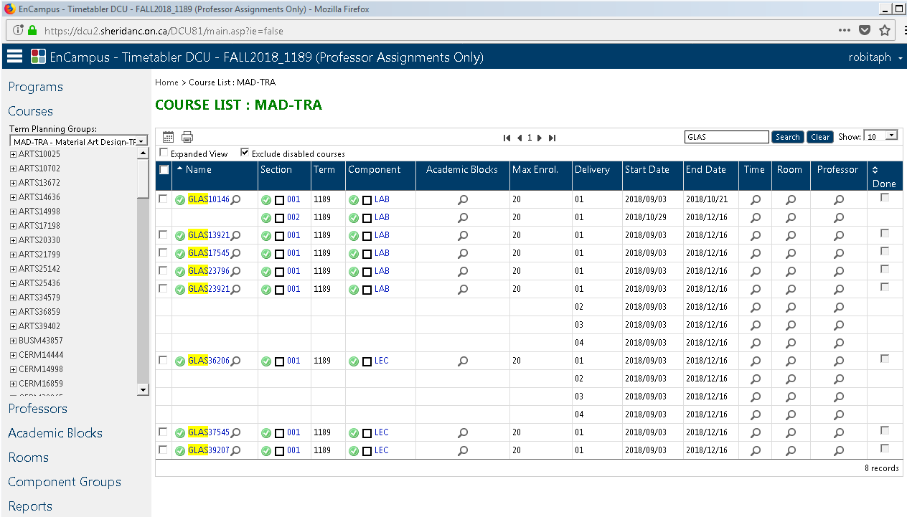
Timetabler – Data Capture Utility
Course View
Timetabler DCU
Used by Academic Portfolio Administrators in Term Planning Groups
Notes:
In Contrast, DCU provides a simplified browser client appropriate for rapid data entry by APAs. This DCU COURSE view displays the same course information for GLAS36206 .
In DCU, APAs create the sections needed to meet the demand of enrollment projections for a course in a program in a Term Planning Group. Section 001 is created for course GLAS36206.
Courses can be added for a term where they are “off-schedule” and not on the program map to afford student opportunities to repeat a class.
Component groups are permitted to enable the combining of sections where there are multi-component courses. Eg. Combining lectures 101 -103 for larger classes while maintaining smaller class sizes for the corresponding lab work.

Slide 18
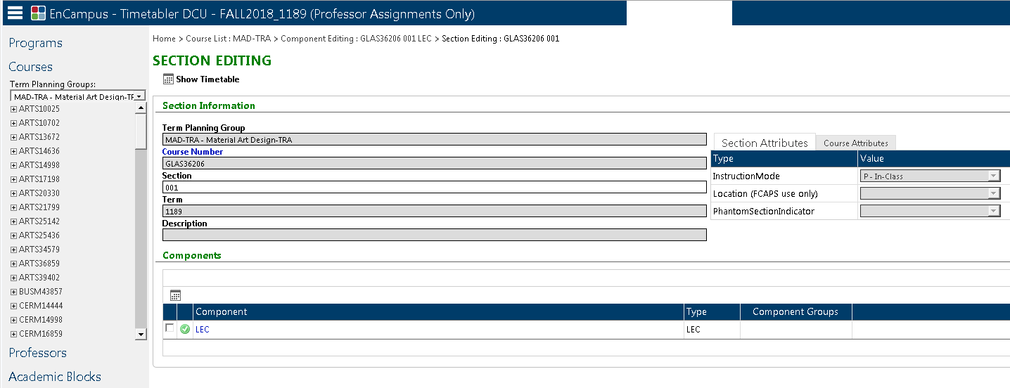
Timetabler – DCU Section View
Section View
Components in Section
Instruction Mode
In-Class
Hybrid
Online
Notes:
The SECTION view provides a more detailed display of any section in the course. In this case, for term 1189, section 001 of the GLAS36206 course is seen to have a single LEC component and it is planned as an In-Class instruction mode.
Workload will validate that the instruction mode is supported with an existing evaluation factor as defined in SAL Curriculum Planning.

Slide 19
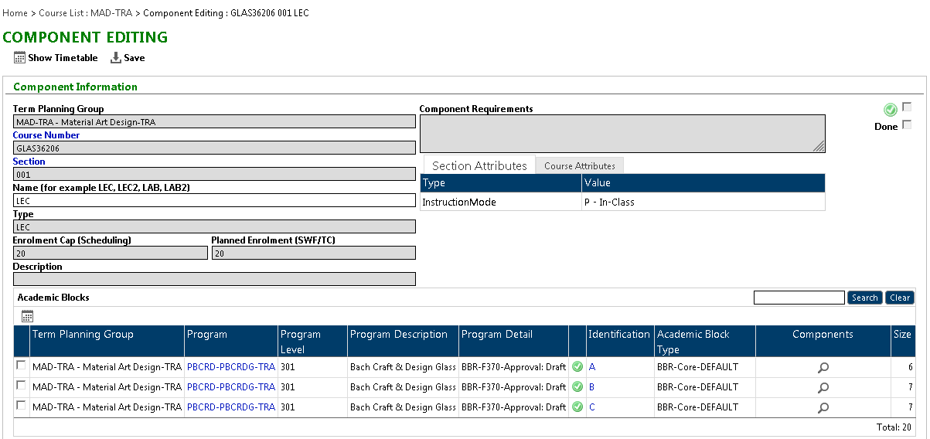
Timetabler – DCU Component View
Component View
Planned Enrollment used by Workload
Program Students in Course Section
Academic Blocks in Component
Notes:
The COMPONENT view provides a more detailed display of LAB or LEC components in the course section. Academic blocks are used as the key for Workload Planning, to distinguish what programs have students in the class. In this case, the LEC component of GLAS36206 section 001 has blocks A, B, and C from program-plan PBCRD-PBCRDG.
Workload will validate the academic block and look-up the GL Responsibility Centre (department cost centre) for the program-plan.

Slide 20
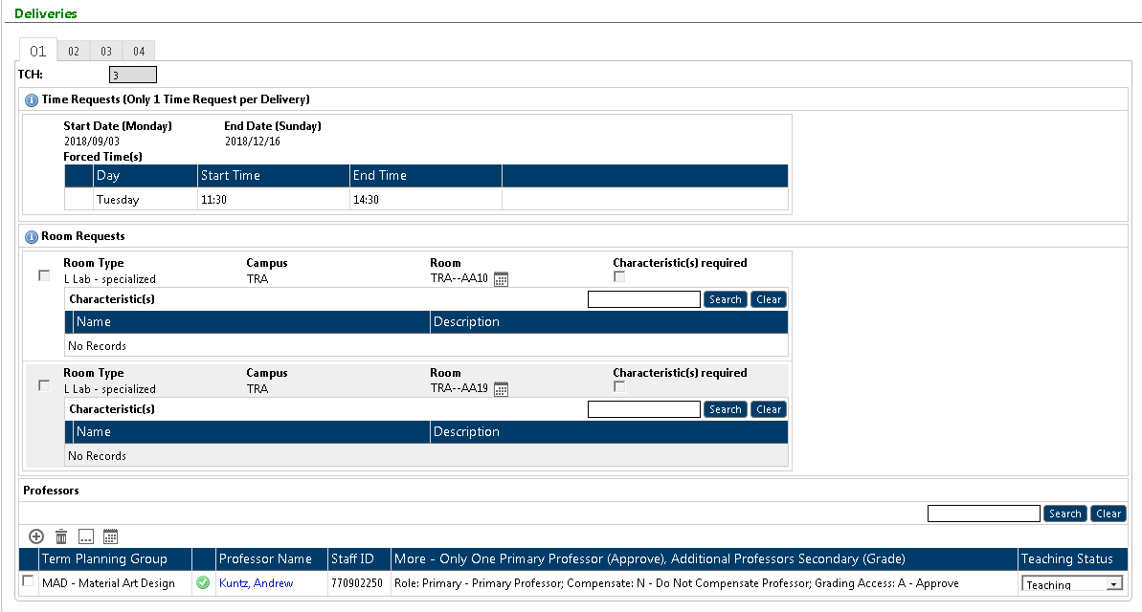
Timetabler – DCU Component View Cont’d
Component View Cont’d
Deliveries in Component
Teaching Contact Hours for Delivery 01
Consistent with SWF conventions, assignments must start on a Monday and end of a Sunday
Professors assigned to Delivery
Notes:
The COMPONENT view also lists the deliveries in a lab or lecture. For instance, four concurrent deliveries are provide here for short Mon, Tues, Wed and Thurs classes each week.
Conversely, deliveries can be used sequential. For instance. A 7 week “7A” delivery with one professor and a second 7 week “7B” delivery with a different professor.
In any event, assignments are validated to start on a Monday and end on a Sunday. This work week is the convention established in the collective agreement. Whereas, HR/Payroll weeks start on a Sunday and end on a Saturday.
Finally, one or more professors can be assigned to the component at the bottom. Clicking on this professor, will bring us to the Professor view.

Slide 21
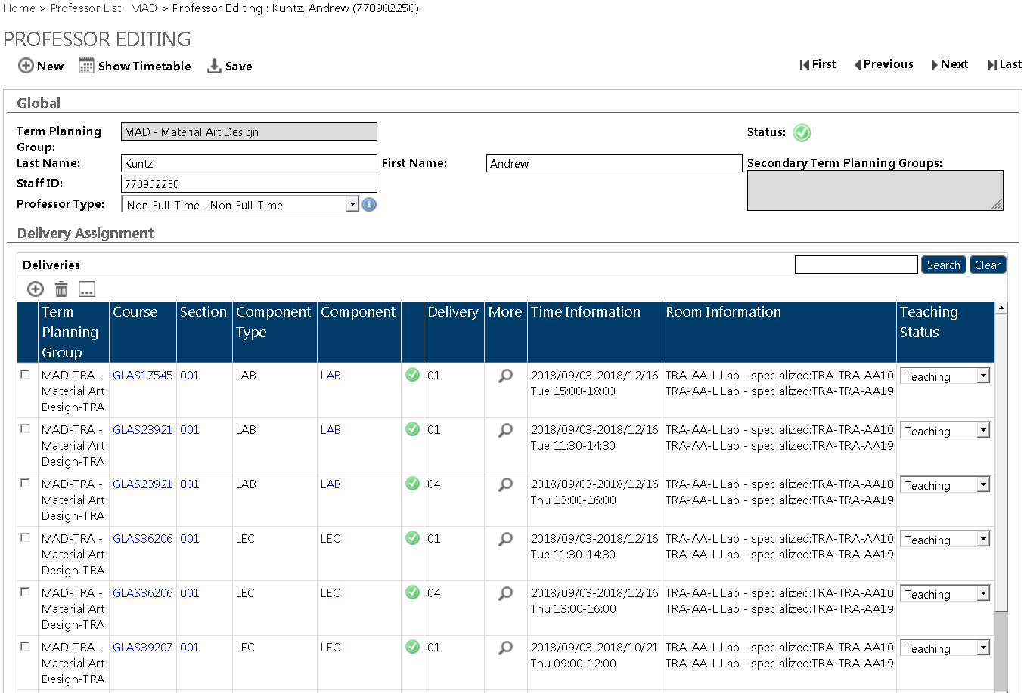
Timetabler – DCU Professor View NFT
Non-Full-Time Professor gets Contracted in Workload Planning
Deliveries Assigned to Professor
Compensate = YES
Compensate = NO
Early End Date
Notes:
The PROFESSOR view displays all of the assigned deliveries for a professor.
This NFT professor has a number of classes in addition to the GLAS36206 section 001 which happens to have a COMPENSATION setting of NO. This one is not compensated and will not be included in Workload.
Course GLAS17545 section 001 has COMPENSATE = YES and it will appear in Workload
Course GLAS39207 is also set to COMPENSATE = YES. Whereas the other courses have a start/end of Sept 3 to Dec 16, this course ends 7 weeks early on Oct 21. This will introduce the need for two sub-periods.

Slide 22
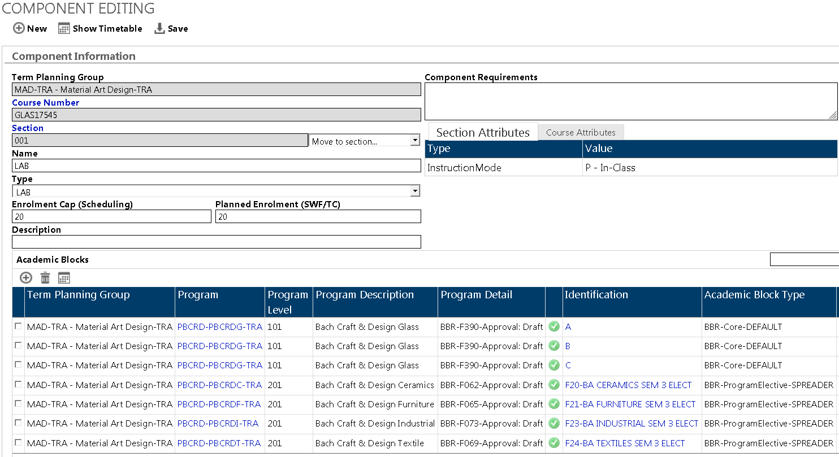
Timetabler – DCU Component View
Multiple Academic Blocks
Notes:
So, circling back to DCU for the compensated course GLAS17545, you can see a good many academic blocks applied to the LAB. We’ll see how Workload represents these shortly.

Slide 23
SA/SAL Workload Planning
Teaching Assignments from DCU are merged with nonteaching assignments to build workload with one or more Sub-periods

Slide 24
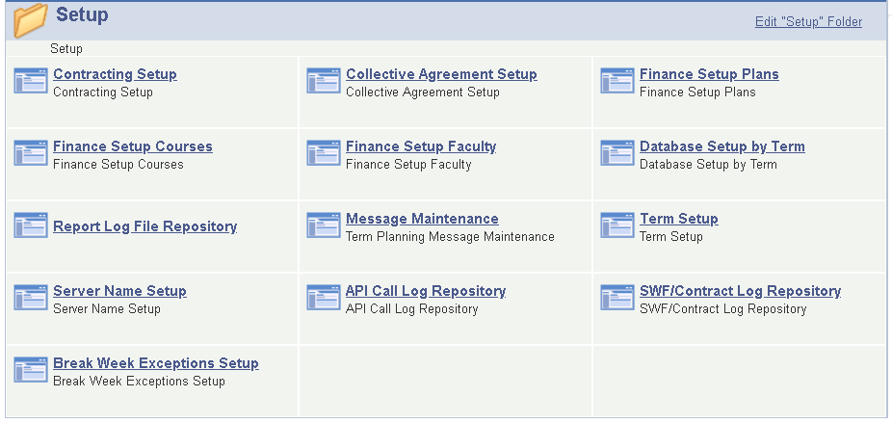
SA/SAL Workload Planning Setup
Notes:
In addition to academic setup tables for SAL, Workload Planning has a number of setup tables used to implement parameters for:
The collective agreement
Contracting particulars
Finance setup of Plans with GL Responsibility Centres for BBR
Finance setup of courses with GL Responsbibility Centres for CBR
Break weeks in a term and plans with exceptions – such as joint programs

Slide 25
Workload Sub-Periods
Post Secondary Academic Term
Professor Assignments
GLAS17545 001 LAB
GLAS23921 001 LAB
GLAS39207 001 LEC
TCH
3.0
6.0
3.0
TOTAL
Sub-Period 1
7 weeks
Sub-Period 2
8 weeks
Excluding Break Week
Term Start
12.0
9.0
Term End
Notes:
Another little “wrinkle” to discuss involves the real World of teach. It would be too each to Workload Professors if all of them had the same homogenous 14 week academic term with the same break week.
In reality, workload is broken down into sub-periods as a function of the assigned deliveries in teaching contact hours as well as any irregular assignments for Nonteaching such as 7 weeks allocated for curriculum development.
This visual can be used to see the effect of blending two courses of 14 week duration with one course of 7 week duration. Workload Planning will break this into two sub-periods. One sub-period with TCH of 12 and another with TCH of 9. Both of these happen to be a partial load for the contract professor.
Consider the case where a professor has one course section for a joint program using a university break week, and a second course section for a college program using a standard college break week that is not the same week as the University break…. Does the Prof get two weeks of breaks?? Think about it!

Slide 26
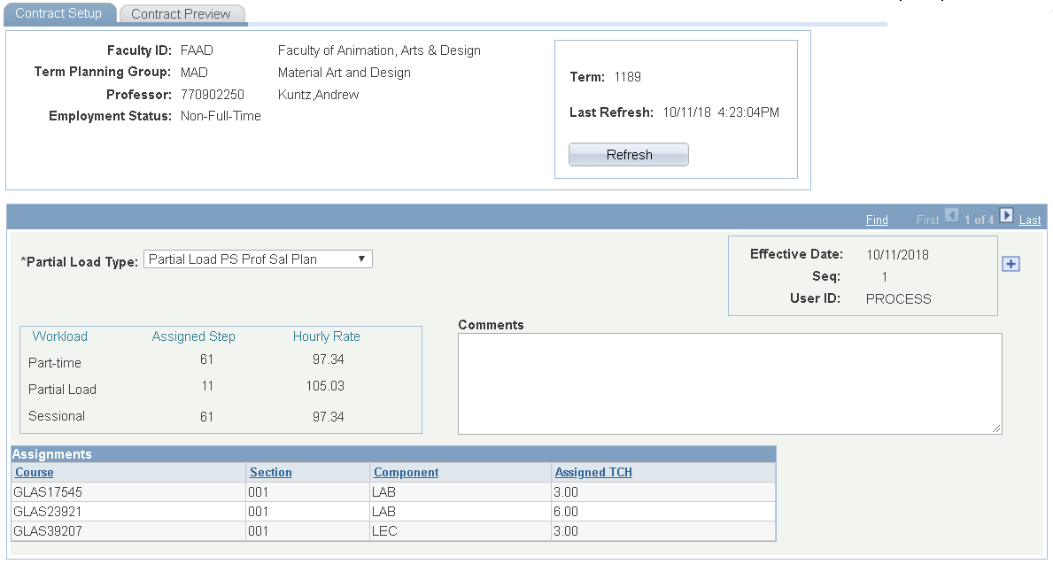
Workload Planning – Contract Setup
Contract Setup for NFT Professors
Refresh from DCU
Activated by user or, initiated upon a Page Open event
Salary Plans available for Professor
Teaching Assignments for Professor
Setup Records
Reflect various states of DCU Refresh & Salary setup
Notes:
Contracts are required for NFT Professors. There is very little to setup for NFT professors term-over-term except:
Refreshing the stack of workload assignments from DCU to reflect the latest DCU change
Ensure that the Partial Load type is the one desired for the term if workload is partial load
Its’ that simple.
Salary rates are pulled in from the Professor Setup table as discussed earlier. This prof has salary calculations for all three workload types. The step is displayed for APA reference but not displayed on the contract.

Slide 27
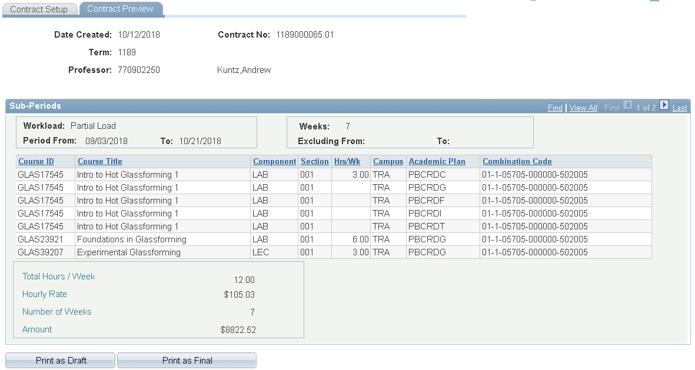
Workload Planning – Contract Preview
Sub-period of Workload uses Partial Load Rate at TCH=12
Multiple Academic Blocks in GLAS17545 Section 001
Print as Draft or Final
One of Two Sub-Periods
Early Ending section forces subdivision of periods
Notes:
The Contract Preview tab on the other hand, is used to visualize the workload as it will be rendered onto a contract using BI Publisher.
Note that our 7 week course GLAS39207 has broken up the workload into two sub-periods.
The workload type for the sub-period is partial load and the partial load rate is applied.
Also note that the academic blocks from DCU are used to identify what programs are using what course sections. This information is used later by the contract load where Toni will show earnings distribution in HR.
And finally, contract numbers are unique across the institution. They begin with a term prefix and have six additional decimals. The most noteworthy thing about contract numbers is that they include revision indicators. Workload will manage multiple FINAL revisions.

Slide 28
Workload Planning – Contract Preview
Sub-period of Workload still using Partial Load Rate at TCH=9
7 Week GLAS39207 drops from workload
Second of Two Sub-Periods
Notes:
In the contract preview of the second sub-period, GLAS39207 is dropped from the stack of assignments.

Slide 29
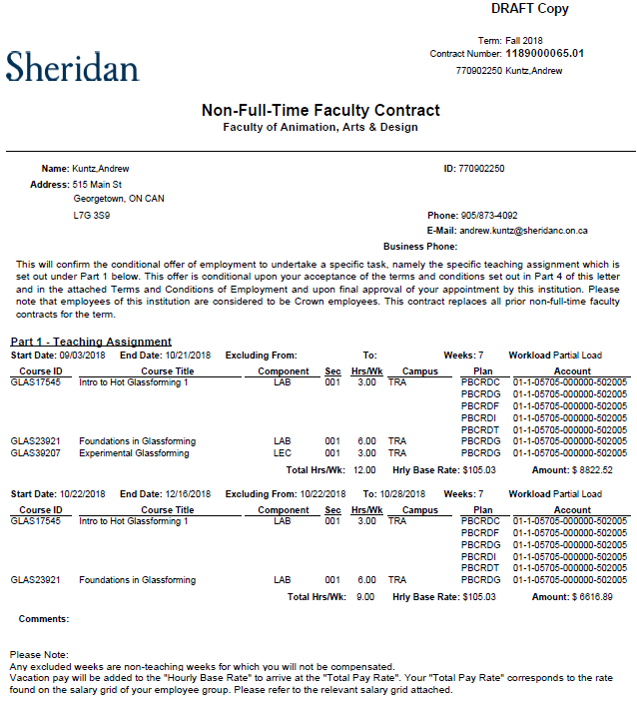
Workload – Contract Printing
First of Two Sub-Periods
Second of Two Sub-Periods
Notes:
Contract Preview tab allows the printing of drafts and finals in an ad-hoc fashion.
A Workload Printing component is available to users to support batch printing of multiple professors in a TPG. Both printing methods use BI publisher.
Terms and conditions of employment print out on finalized contracts for distribution to the employee

Slide 30
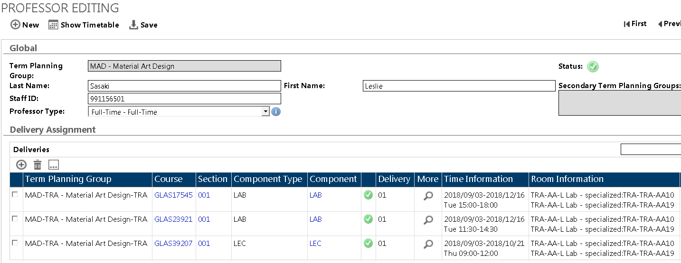
Timetabler – DCU Professor View FT
Full-Time Professor gets SWF’d in Workload Planning
For Demonstration Purposes – Assigned the same Deliveries as NFT Prof
Notes:
For the sake of this presentation, consider the system behavior if we assigned a FT professor to the very same workload as seen with the NFT professor.

Slide 31
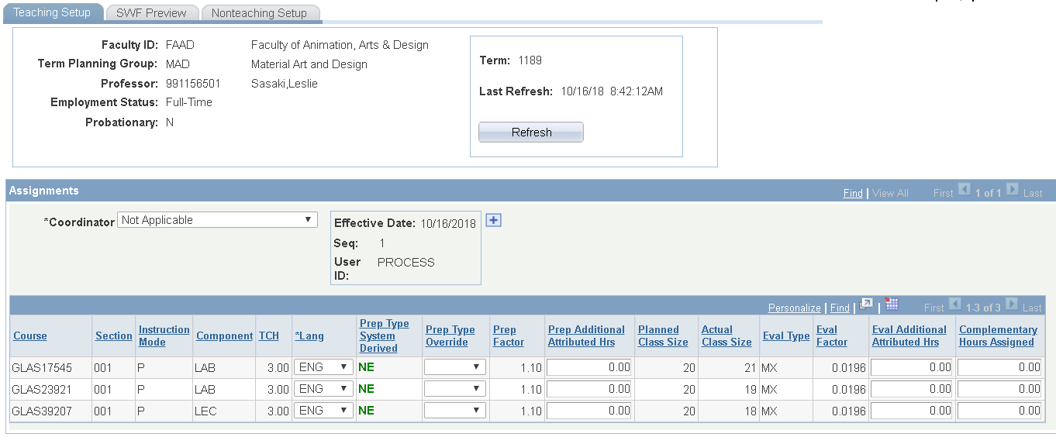
Workload Planning – Teaching Setup
Teaching Setup for FT Professors
Refresh from DCU
Activated by user or, initiated upon a Page Open event
Audited over-ride of System-derived Preparation type
Teaching Assignments for Professor
Setup Records
Reflect various states of DCU Refresh & Over-rides
Notes:
Again, setup is conducted for each professor term-over-term.
You will note that the SWF’ing of a FT professor involves many more setup considerations. Notably:
The coordinator field is adjusted to NA, Step I or Step II to derive the appropriate ancillary complementary function attribution
Each teaching assignment from DCU is listed in the workload stack of assignments and:
The system derives the appropriate preparation type based on the professor’s history teaching the course – pursuant to the collective agreement
A Prep Type over-ride is provided for cases that cannot be derived like; courses having a recent major revision and special courses as defined in the collective agreement
Additional Preparation and Evaluation attributed hours can be added
Evaluation Type is NOT over-rideable – it is not a function of the Professors’ history with the course, rather, it is a function of the course’s topical evaluation plan as set out in SAL Curriculum Planning for any of the course’s instruction modes.
Note that course assignments CANNOT be added in Workload. They must be created in DCU.
Also, the DCU assignments will be refreshed upon a REFRESH button click or, in the event of a page open or tab-over

Slide 32
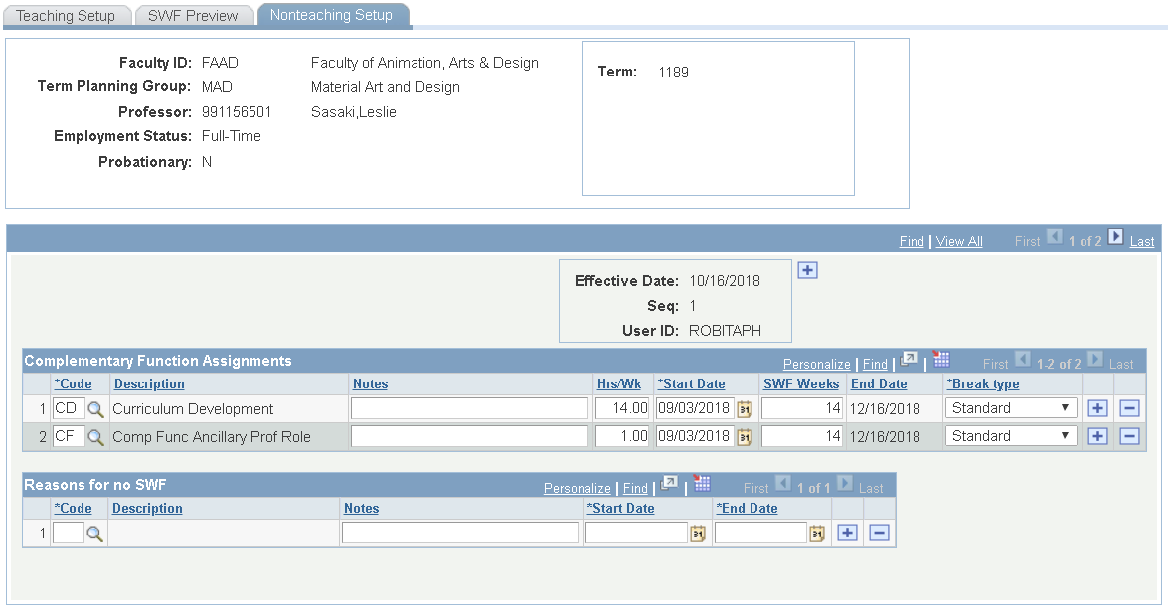
Workload Planning – Non-Teaching Setup
Non-Teaching Setup for FT Professors
Non-Teaching Complementary Function Assignments for Professor
Record Periods of no workload for Ministry reporting
Setup Records
Reflect various states Non-teaching setup
Notes:
Unlike NFT professors, FT professors have workload comprised of both teaching and nonteaching assignments.
In the event that a professor has a workload of 100% nonteaching, the system will treat the period as workload in place of teaching and issue a “Workload Memo”
In the event that a professor has NO workload in the term, APAs identify the reason for no SWF which is required in Ministry reporting.
Nonteaching periods are merged with teaching periods to establish sub-periods of SWFing.

Slide 33
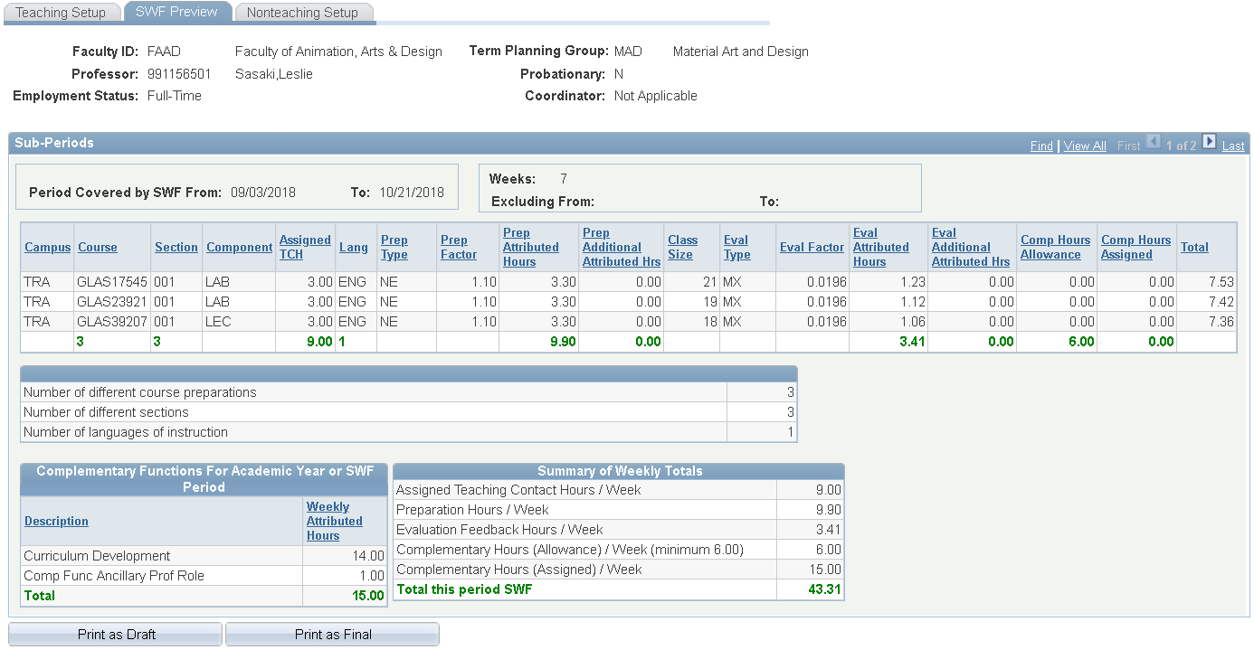
Workload Planning – SWF Preview
At Day 1, Class size switches from planned to actual enrollments
Summary from Teaching tab
One of Two Sub-Periods
Summary from Non-teaching tab
Notes:
Just like the Contract Preview for NFT professors, the SWF Preview is used to display the particulars for FT workload.
Given the 7 & 14 week teaching assignments, and the 14 weeks of nonteaching assignments, the system builds two sup-periods of workload for this professor.
In the planning stages, the class size uses the Planned Enrollment from Teaching Setup. At Day 1 of class start, the previewed class size reflects the actual enrollment displayed in Teaching Setup and derived from the PS Class table.

Slide 34
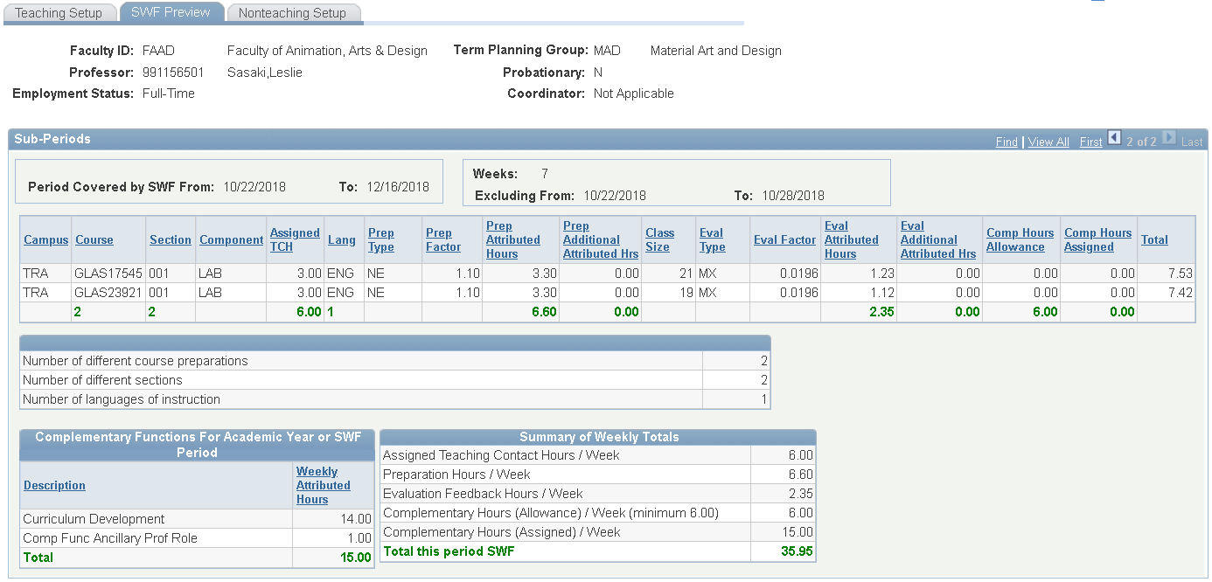
Workload Planning – SWF Preview
7 Week GLAS39207 drops from workload
Second of Two Sub-Periods
Notes:
Just as we saw with NFT sub-period 2, we see again that the 7 week GLAS39207 section is dropped from the workload.

Slide 35
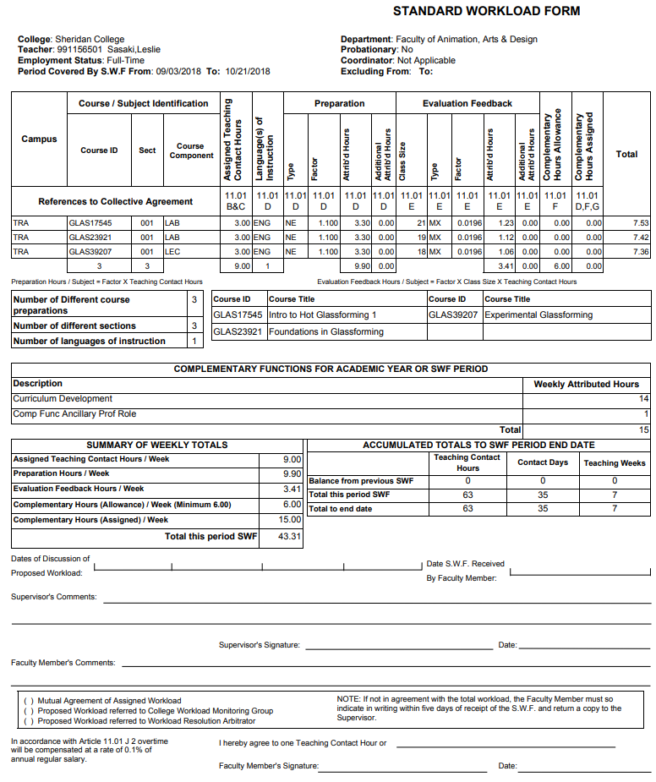
Workload – SWF Printing
First of Two Sub-Periods
Second of Two Sub-Periods – Page 2
Notes:
SWF Preview tab allows the printing of drafts and finals in an ad-hoc fashion.
A Workload Printing component is available to users to support batch printing of multiple professors in a TPG. Both printing methods use BI publisher.

Slide 36
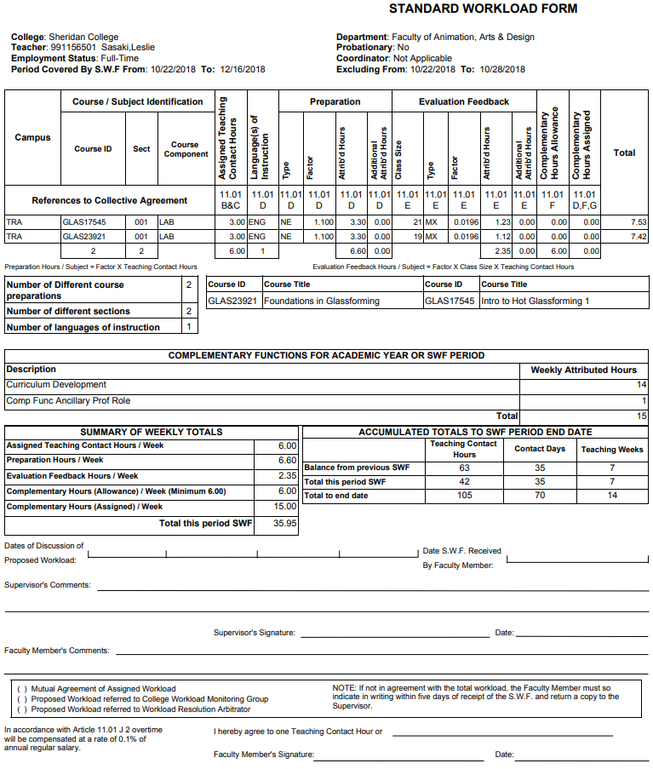
Workload – SWF Printing
Second of Two Sub-Periods
Notes:
Here’s the second sub-period where GLAS39207 is dropped from workload.

Slide 37
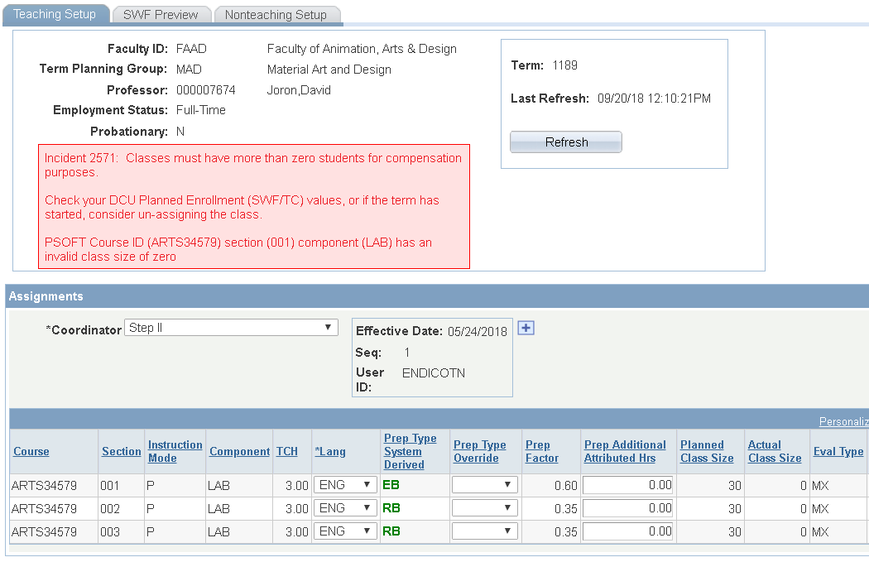
Workload – Validation & Errors
Following a Refresh of Workload Assignments from DCU…
Workload validates the DCU assignment captured in staging tables from the API’s XML response
Notes:
The integration of Timetabler DCU and PeopleSoft required a great deal of consideration for error handling. With each clidk of the REFRESH button, Workload performs dozens of validations of staged DCU data before it is added to the stack of assignments.
Here’s an example where the system prompts the APA user that ZERO enrollments are not valid. The error messaging includes a suggested recovery and run-time specifics about the offending case – ART34579 in this example. The user must alleviate the invalid case and attempt a new REFRESH to remove the pink error message. Workload will not permit printing of draft or final contracts or SWFs until all error messages are eliminated.

Slide 38
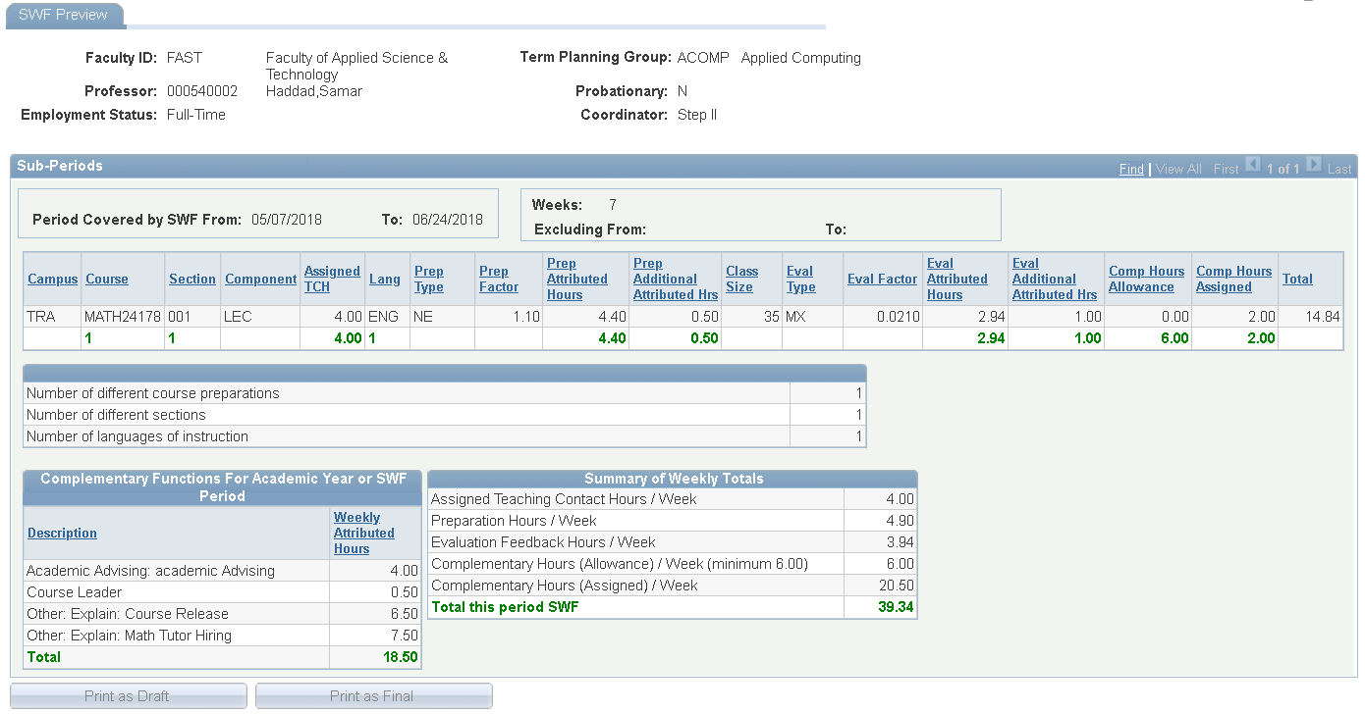
Workload – Inactivate Term
Setup Tabs are removed for inactive term
Print buttons are disabled for inactive term to prohibit new revisions
Notes:
To cover the potential where a professor needs to be replaced for the rest of the term, the term is kept active right up until the last day of class.
When the term is made inactive, Setup tabs are removed with PeopleCode and print buttons are disabled. User can access a read-only view of workload details. Workload is thereby frozen from changes in teaching and/or nonteaching.
All workload history is available in SWF and Contract form in Workload History to multiple functional areas.

Slide 39
HR Teaching Contract Load
The bridge between SA and HR\Payroll contracts

Slide 40
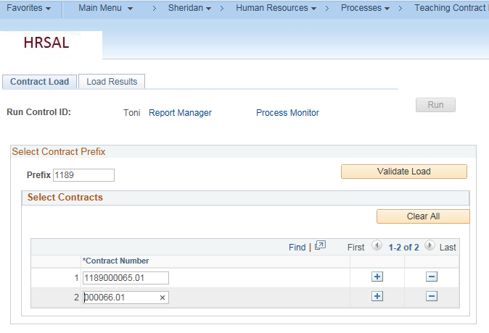
Loading part-time Teaching contracts
Able to perform some contract validations before running the process
Notes:
Receipt of hard copy of contract triggers the load by Payroll team
Able to default the term code to eliminate keying long contract numbers
Load the contract number to job data – can load to different empl_rcd numbers and us as a key in reporting
Acts as a more reliable interface that utilizes component interface

Slide 41
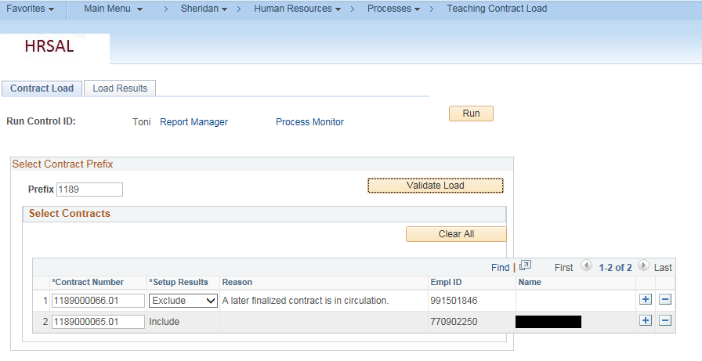
Contract validation
Can choose to wait for the new version or interface this one
Notes:
Basic validation results are displayed here – contract is in draft mode, no schedule, contract was already loaded, reference checks not completed
User can decide to interface the contract or choose not to
Once the “Run” button is clicked – it interfaces to HR\Payroll – all Hre and Rehire information. Sheridan has muiltiple jobs and system knows to search for the appropriate record number or create a new one if the job does not exist.

Slide 42
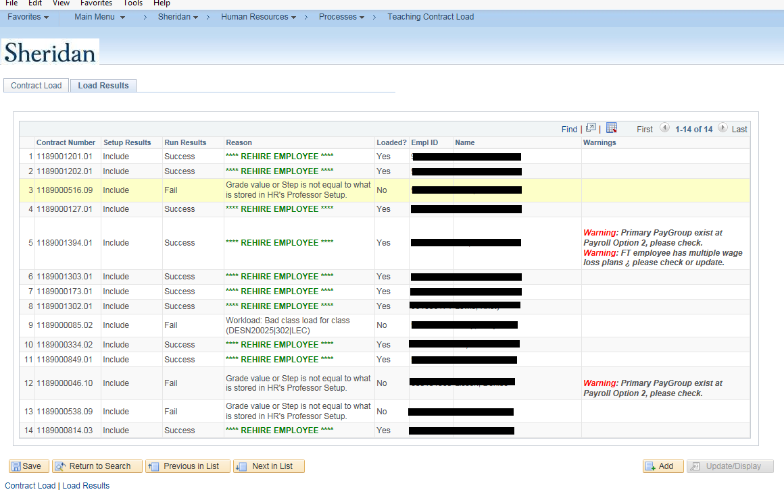
Contract load results
Notes:
Once loaded – the load status and any other important messaging will be displayed.
If the contract fails, it can be rerun if the data issue has been corrected.
Contract updates job data, time and labour, schedules, tax data, general deduction data

Slide 43
Contract load simulator
Notes:
If the contract will not load through the interface, the contract load simulator will provide all of the contract data necessary..
This is very important since the weekly schedule, Salary plan info and earnings distribution percentages do not print on the hard copy of the contract.

Slide 44
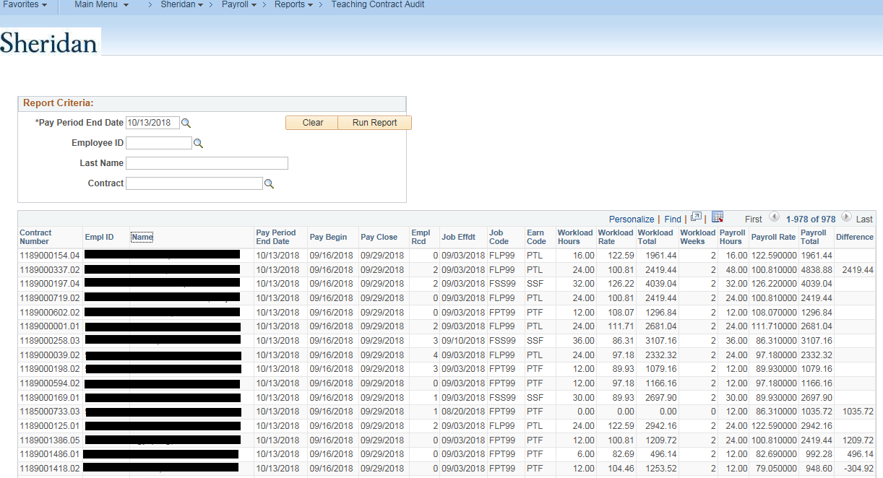
Teaching Contract payroll hours\earnings audit
Can pull information based on Empid, P\E, Last name or contract number
Notes:
Once a payroll calculation has been performed, can run this report and compare pay-line entries to the expected scheduled hours\earnings for the pay period being processed.
Payroll expected to review any items in the difference column
The information can be manipulated in excel

Slide 45
Questions
Notes:
Although we continue to implement system fixes and work through process improvements, the system(s) are now completing the workload for professors teaching in Winter 2019.
We have skirted around many details for brevity.
Are there any questions?

Slide 46
presenters
Phil Robitaille
Toni Umerez
Sr. Business Analyst
Sheridan College Institute of Technology and Advanced Learning
philippe.robitaille@sheridancollege.ca
Manager, Compensation and HRIS
Sheridan College Institute of Technology and Advanced Learning
toni.umerez1@sheridancollege.ca
all Alliance presentations will be available for download from the Conference Site

Slide 47
THANK YOU!

