Slide 1
Outsourcing benefits administration
SESSION 6028
Tue, Nov 13, 2018
Notes:
Treaty Six Territory Land Acknowledgement Statement

Slide 2
presenters
Celine Villavieja
Noelle MacLachlan
Manager, HR Systems & Reporting
MacEwan University
villaviejac@macewan.ca
Functional Analyst, Payroll
MacEwan University
maclachlann@macewan.ca

Slide 3
19,101 Part- & Full-Time Students
12,038 FT Students in credit programs
1,326 Full-Time employees
1,378 Part-Time employees
Founded 1971
Notes:
Established in 1971 as Grant MacEwan Community College, in honour of Dr. JW (Grant) MacEwan, lecturer, former Calgary mayor & AB Lt Governor
2009 – Became Grant MacEwan University
2013 – Rebranded to MacEwan University
Among FT employees:
37% - faculty
48% - staff
16% - OOS

Slide 4
agenda
Background
Timeline
In-House vs Outsourced Administration
Integration Design with GWL
Implementation Highlights
What Worked Well
Lessons Learned

Slide 5
background
2011
Administration was performed in-house using PeopleSoft Base Benefits
2015
Survey revealed that employees wanted flexibility in their benefits
2016
Joint Benefits Committee (JBC) decision to implement a Flexible Benefit Plan
2017
RFP issued for new Benefit plan & administration
Great-West Life (GWL) was selected
Notes:
Since 1999 – MacEwan has 1 benefit plan and provider
One standard benefit offering
Joint Benefits Committee – comprised of representatives from diff employee groups (MSA, FAC, OOS) ; chaired by HR
- decision-making committee for benefit plan design (monthly meetings)

Slide 6
flexible benefits plan
New plan structure: Move from “one size fits all” to flexible coverage options for various needs of each employee
New coverage types: Single, Employee + 1, and Family
New options
Critical illness insurance for employees and dependents
Optional life and AD&D insurance for dependents
Health Spending Account vs Wellness Spending Account
Opportunity to update coverage annually
Review and update your coverage online each year during annual enrollment

Slide 7
Introduce Flexibility
More Optional Benefits
Spending Accounts
Life Insurance
Accident Insurance
Short Term Disability
Long Term Disability
Other Benefits
Critical Illness
Health
Dental
Basic
Basic
Basic
Basic
Basic
EFAP
Level 1
Level 1
Basic
Health
Level 2
Level 2
Wellness
Emp
Emp
Emp
Level 3
Level 3
Spouse
Spouse
Spouse
Level 4
Level 4
Child
Child
Child
1999 – 2017 Benefit Plan
Introduced in 2018
Notes:
One benefit coverage for employees until 2017
Optional coverage only for employees on life insurance
Currently,
4 levels of coverage (previous basic is now level 3); 2 less expensive coverages are available
Option to have different coverage levels in Health & Dental
Option to use remaining flex credits to a Wellness Spending Account for fitness memberships, weight loss, smoking cessation & nutritional counselling
Optional coverage is available to other family members on Life, AD&D and Critical Illness

Slide 8
timeline
2015
Consultation & Benefit Program Design
2015-2016
2016
2017
1
Vendor Selection
Jan to Apr
2
3
4
5
6
Review of Eligibility Rules
System Interface Development
Change Management
Jun to Dec
7
8
9
10
11
Benefit Enrollment
Nov
12
2018
Go Live
Jan 2018
Notes:
Project timeline:
7 months for
reviewing eligibility rules based on new benefit program design
Building system interface
Planning and executing Change Management plans
Nov – first ever employee enrollment into an external benefit provider
Jan 2018 – Go-Live

Slide 9
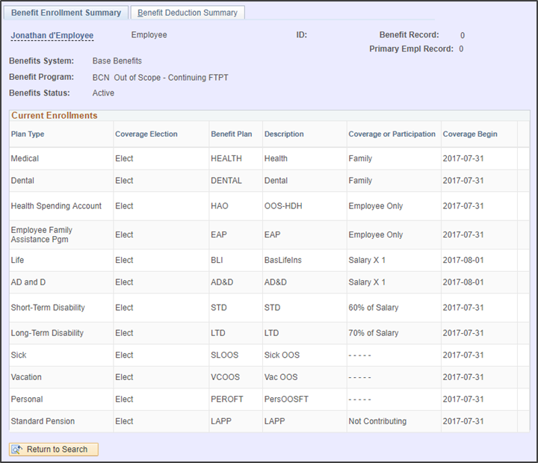
In-House administration
Notes:
Comparison of In-House and Outsourced Administration
In House – PeopleSoft Base Benefits
- information available on employee benefits is PS Benefits Summary page (static page)

Slide 10
In-House administration
EE & ER
Premium Amounts
HR Rep enters EE Personal & Job Info
PS
Person
Job Data
Biweekly
Pre Calculation
Final Pay Calculation
HR Rep enters EE Benefit Enrollment
PS
Employee
Benefits
PS
Benefit Premium Rates
Benefits Provider Database
HR Rep enters EE Info
Notes:
In-House Administration process : Workforce Admin, Base Benefits and Payroll for NA
Requires
HR Rep to enter employee enrollment into the Base Benefits pages
HR Rep to enter the same employee benefit information in the Benefit Provider’s website
HR to maintain Benefit Premium Rates in PS Base Benefits tables
Rates feed into the Biweekly Pre-Calc to calculate the amounts of EE and ER premiums for final pay

Slide 11
OUTSOURCED administration
EE & ER
Premium Amounts
HR Rep enters EE Personal & Job Info
PS
Person
Job Data
Biweekly
Pre Calculation
Final Pay Calculation
HR Rep enters EE Benefit Enrollment
PS
Employee
Benefits
PS
Benefit Premium Rates
Benefits Provider Database
Employee does Self Enrollment
EE & ER
Premium Amounts
HR Rep enters EE Info
Canada Alliance 5-7 November 2017
Notes:
Outsourced Administration simplifies
HR rep no longer enters Employee Benefit information
Employee data from PS tables are electronically transferred to Provider’s database
Employee (and not HR Rep) enters Employee information on Provider’s website – preserves confidential information
Base Benefits no longer has Dependent information
Benefit Rates are no longer needed in PS
Premium amounts are no longer calculated in PS – loaded from the Benefit Provider into the Paylines for final calculation

Slide 12
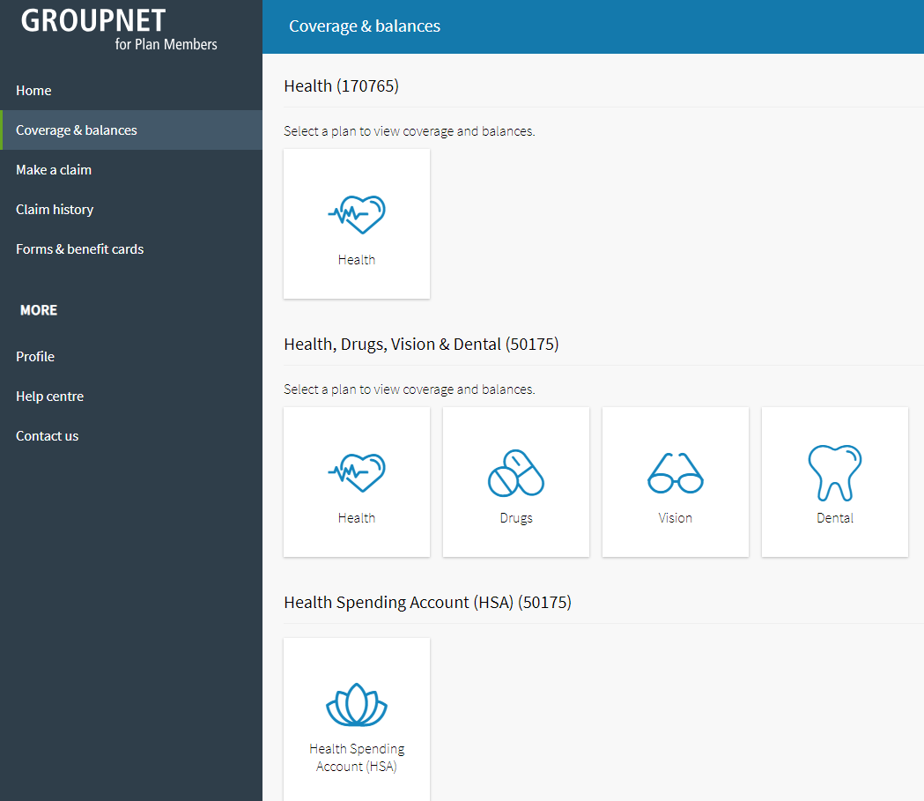
OUTSOURCED administration
Notes:
Outsourced Administration allows a richer employee experience on the provider’s website

Slide 13
System integration
MacEwan University (GMU)
Great-West Life
EE Master
GMU
Employee & Enrollment
JOB
HRIS
Extraction
weekly
biweekly
Paylines
Deduction Staging
Payroll Deductions
Notes:
Copy of the entire active employee Master
Upcoming hires for employee enrollment (benefit eligible on day 1)
Leave status, disability, termination

Slide 14
System integration
Business Process
HRIS Extraction (2 hours weekly)
Run extraction report (complete EE master)
Compare with previous submission
Transmit extraction file
Payroll (4 hours biweekly)
Upload premiums into Payroll staging table
Reconcile amounts vs Payroll register
Identify exceptions: employees on inactive status, disability
Benefit audit report: current vs previous deductions (new hires, terminations, changes in premiums)

Slide 15
Implementation highlights
Change Management
Employee Communications
Business Process
Data Cleanup
Member Enrollment
Benefit member cards
Transitioning from previous provider
Notes:
EMPLOYEE COMMUNICATION
Email campaign
Postcards mailed to employees
Benefits booklet mailed to employees
Information sessions (10pm for night-shift)
Campaign buttons on enrollment period
BUSINESS PROCESS
Change deadline schedule
More audit controls on data
DATA CLEANUP
Personal Information: Name, gender, address, email

Slide 16
What worked well
Employee Communication
91% enrollment rate
72% Self Selection – choosing different options
Collaboration of all business units (HR, Payroll, IT, Finance, JBC)
Evolving business processes to support data integrity
Partnership with GWL on managing data exceptions
HR-managed project
Notes:
67% - typical enrollment rate

Slide 17
Lessons learned
Employee Eligibility Rules
System Limitations
Compatible SDLC Models
Collective Agreement provisions
Notes:
ELIGIBILITY
MacEwan employees – eligible on day 1 (upcoming hire information for employee enrollment)
Sessional Faculty– covered for the academic year
– anticipated workload – (260 IH for sessional instructors)
Employee premiums for level 3 & 4 on periods of inactive status
SYSTEM LIMITATIONS
Different platforms
Values mapped differently
GMU size
SDLC Models
Traditional to revolutionary
Requirements gathering, testing
CA – another round of bargaining

Slide 18
Celine Villavieja
Manager, HR Systems & Reporting
villaviejac@macewan.ca
Noelle MacLachlan
Payroll Functional Analyst
maclachlann@macewan.ca
Rangon Bhattarai
HR Functional Analyst
bhattarair@macewan.ca

Slide 19
THANK YOU!
Outsourcing Benefits Administration
Session 6028

Slide 20
Employee stats
EMPLOYEE GROUP | HEAD COUNT | BENEFIT ELIGIBLE
Full-Time Faculty | 499 | 100%
Sessional Faculty | 497 | 32%
Staff | 1,229 | 51%
Out of Scope | 429 | 49%
Term | 50 | 68%
 | 2,704 | 57%

