Slide 1
Overview of Graduate Research Management at the University of Ottawa
SESSION 5010
Tue, Nov 07, 2017
(12:45 PM - 1:45 PM)

Slide 2
presenters
Louis Payette
France Proulx
Senior Business Expert
University of Ottawa
lpayett@uOttawa.ca
Information Technology Manager
University of Ottawa
fproulx@uOttawa.ca

Slide 3
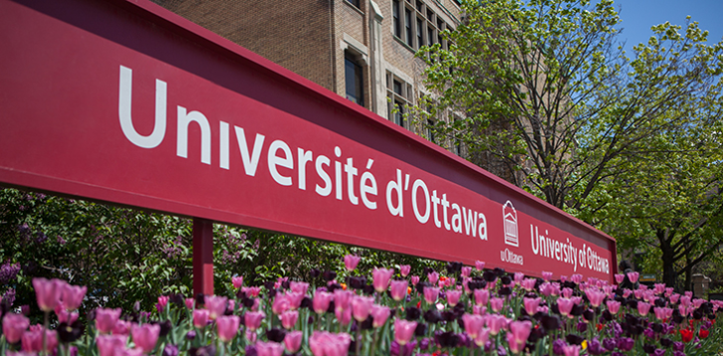
Quick facts

Slide 4
Quick facts about The University of Ottawa
Was founded in 1848
Is the largest bilingual (English-French) university in the world
Is world’s first French immersion undergraduate program
Is among Canada’s top 10 universities and ranked in the top 2% in the world
Has a co-operative education program amongst the top five in the country

Slide 5
Quick facts about The University of Ottawa
Programs and courses
5 careers, 9 faculties and 73 grad fields of study
More than 500 programs and 5000 courses offered
Enrollment numbers in 2016-2017
35,490 undergraduate students
6,390 graduate students

Slide 6
ORGANIZATION & ORACLE
Campus Solutions 9.0
Bundle 39
PeopleTools 8.54

Slide 7
criteria for success
Using the “vanilla” strategy as a best practice;
Changing some regulations and processes;
Decision committee directed by Graduate and Postdoctoral Studies;
Consultation with staff members, vice-deans and professors;
Optimizing the student experience;
Empowering students, professors and staff through bilingual Self-Service capabilities.

Slide 8
Highlights
Project kick-off in December 2014
Go Live on November 7th, 2016
Implementation done in partnership with Deloitte
We are thrilled to spend our one-year Campus Solutions anniversary with you here today at Alliance!

Slide 9
Graduate research management
Context: Decentralization of most grad operations to faculties
1
3
Candidate Management
What worked and what didn’t
Service Requests Everything starts here!
2
4
Thesis Management
Time savers
and challenges
Milestones
Tracking student progress

Slide 10
Context Decentralization of most graduate operations to faculties
Required us to:
design and configure modules to allow faculties to be independent as much as possible;
standardize processes;
implement new service agreement for dealing with exceptions and questions.

Slide 11
Service requests
Service Requests Everything starts here!
1
All of our graduate processes start with the student submitting a Service Request.
Approval process and automated 3C Communications
How can staff search for incoming Service Requests and follow up on them?
Queries and Related Content
Service Request Dashboard for supervisors

Slide 12
Service requests Approval process and automated 3C Communications
Service Requests Everything starts here!
1
A 3C communication is sent to the next person in charge of reviewing the Service Request.
Examples of SR: Progress report, Plan of study, Leave, Extension, etc.
Revisions required by student
Student submits SR
Supervisor review
Faculty review
Additionnal review

Slide 13
Service requests Queries for faculties
Service Requests Everything starts here!
1
Faculties can search for Service Requests using queries instead of the delivered page.
Search for Service Requests:
Allows faculties to search using prompts like Faculty, Request type, Status, EmplID, Assigned to.
Query results display information that allows a quick decision without having to open the Service Request: Most recent comment, Degree checkout status, Expected grad term, Sequence ID.
Drilling URL opens the Service Request quickly.
Watch list:
Allows to view all Service Requests that I worked on even if it’s assigned to someone else.
Service Request Dashboard:
For Professors only. Academic staff must use the queries. Professors participated in the development of this dashboard.
Added a watch list for professors and information about thesis evaluations they are involved in.

Slide 14
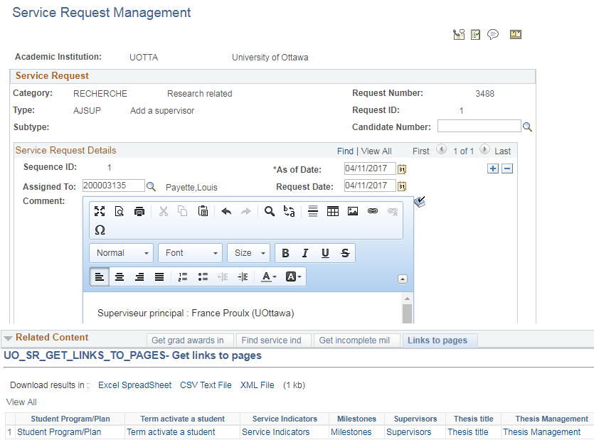
Service requests Related Content for Service requests
Service Requests Everything starts here!
1
A related content section allows staff to quickly make a decision without having to navigate to other pages.
Links to pages tab means easy access to important pages in the system.

Slide 15
Milestones Allows us to easily monitor A student’s progress throughout his/her career.
2
Milestones
Tracking student progress
Mass assignment of milestones per faculty every term with due dates.
Automated 3C reminders for students that did not complete their milestones.
Next step: automate the completion of milestones upon approval of Service Request.

Slide 16
Candidate Management The Candidate Center
3
Candidate Management
What worked and what didn’t
Service Items: making the student do the work
Submission of Service Requests through the Candidate Center
What we use it for in the end.

Slide 17
Candidate Center What we designed AND IMPLEMENTED, and why it did not work for us
3
Candidate Management
What worked and what didn’t
Service items: Allow students to manage their own student file.
Approval process for the supervisor’s nomination and thesis title was much more complex when students made the updates themselves.
This generated a lot of questions from students, because once the Service Item is submitted, there is no confirmation message.
Students would submit many supervisors and many thesis titles, making everybody deal with duplicates.

Slide 18
Candidate center What we designed AND IMPLEMENTED, and why it did not work for us
3
Candidate Management
What worked and what didn’t
Service Requests: the Candidate Center does not display all submitted service requests.
After a Service Request is submitted, there is no confirmation message displayed in the Candidate Center. Students would therefore submit it again and again, and then call faculties to make sure it was received.
Students on leave of absence do not have access to the Candidate Center to submit Service Requests.
Decisions:
Stop using Service Items
Stop using the Candidate Center to submit Service Requests. Use the Service Request page instead.

Slide 19
Candidate center What we designed AND IMPLEMENTED, and why it did not work for us
3
Candidate Management
What worked and what didn’t
Our Candidate Center is used for viewing information about Research topics, Supervisors and Thesis evaluations only.

Slide 20
Thesis Management
Thesis Management
Time savers
and challenges
4
Using evaluation management for thesis evaluations made it possible for us to setup a standard process used by all faculties.
Time savers
Automated emails dependent on evaluation status
Electronic form for thesis evaluations
Data analysis
System adapted to match our regulations
Thesis submitted electronically
Challenges
All thesis evaluators must be entered into the system, including externals.
Big learning curve for staff in the context of decentralization.
Tools
Query that finds all errors within the evaluation process.
Related Content.

Slide 21
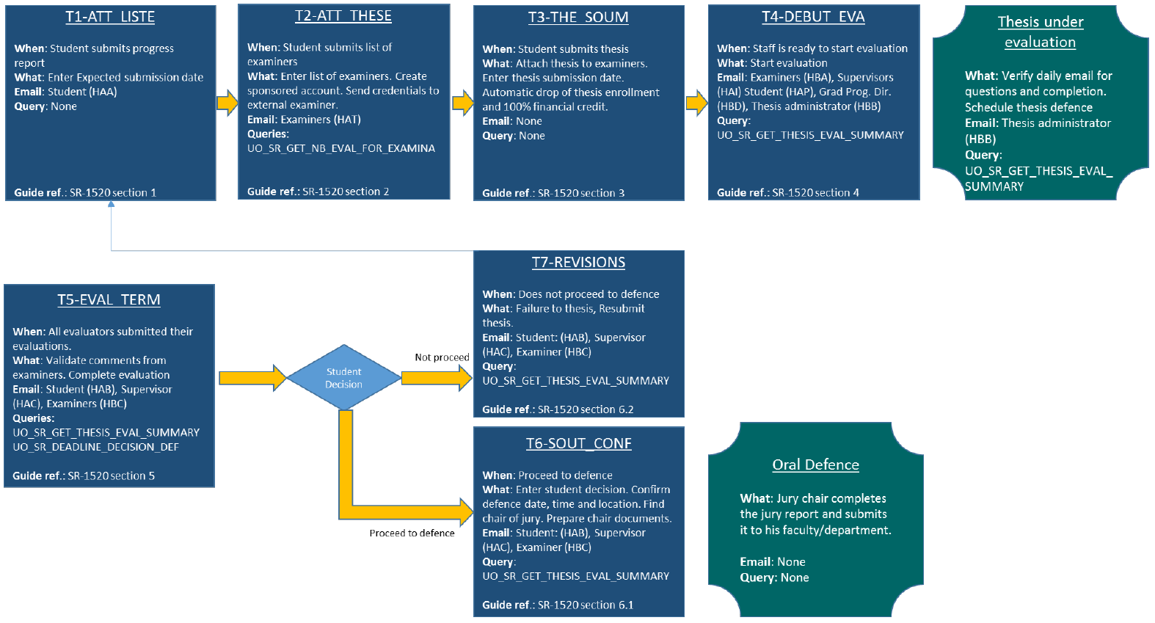
Thesis Management High level workflow

Slide 22
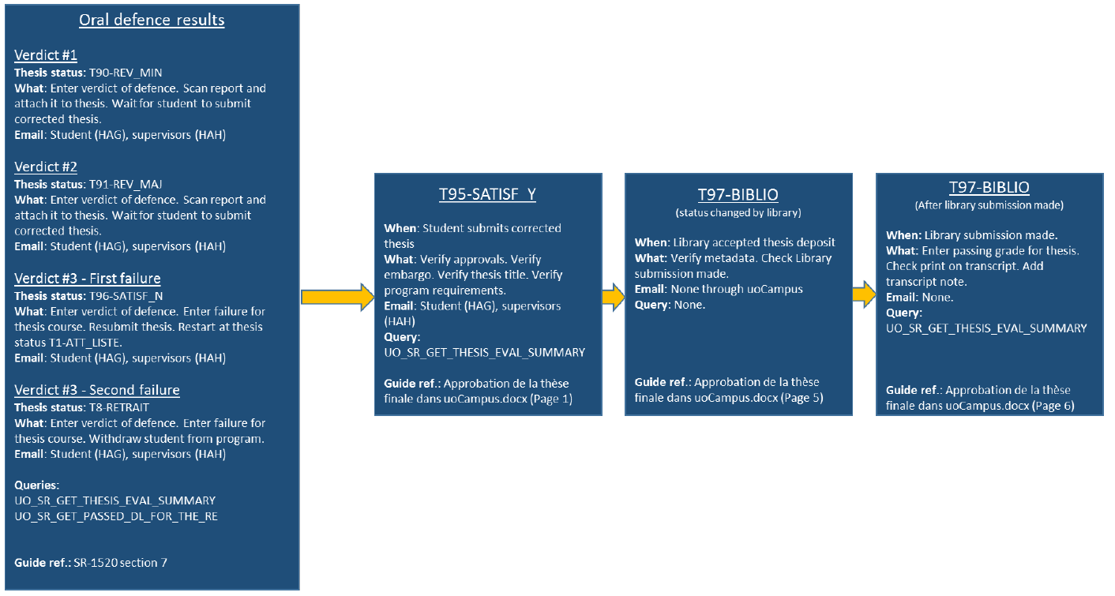
Thesis Management High level workflow

Slide 23
Thesis Management Challenges
Thesis Management
Time savers
and challenges
4
All thesis evaluators must be entered into the system, including externals.
Entire process is a big learning curve for staff in the context of decentralization.
Helpful tools:
Query that finds all errors within the evaluation process.
Related Content.

Slide 24
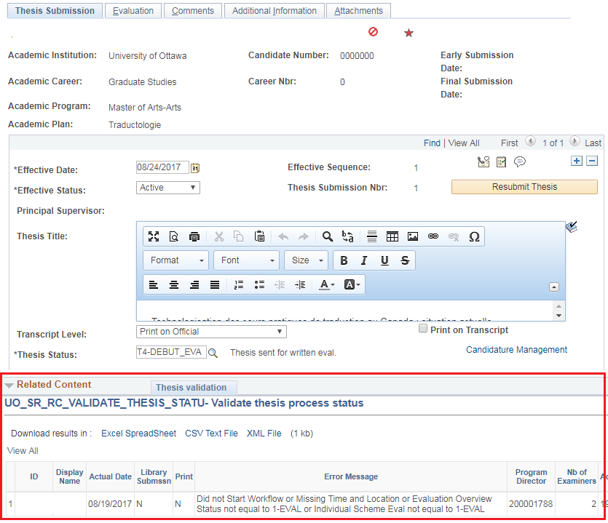
Thesis Management Process Validation query
Thesis Management
Time savers
and challenges
4

Slide 25
Conclusion
Time savers, standards and control
Over 1,500 automatic emails sent every week.
Standard processes for submission and approval of Service Requests.
Standard processes for thesis evaluation.
Professors, students and staff can access the system from anywhere 24/7.
Faculties have control of their data anytime.
Lessons learned
No matter how good a design is and how much it was tested, it will most likely change when challenged by the reality of the business! Design your systems to be flexible and easily adaptable.

Slide 26
THANK YOU!

Slide 27
Questions?

