Slide 1
PRAC Teacher automated payments
SESSION #36006
9 November, 2016

Slide 2
presenters
Karen Dixon
Kellie McVey
HR Consultant (Remuneration & Systems)
University of the Sunshine Coast
kdixon@usc.edu.au
HR Officer
University of the Sunshine Coast
kmcvey@usc.edu.au

Slide 3
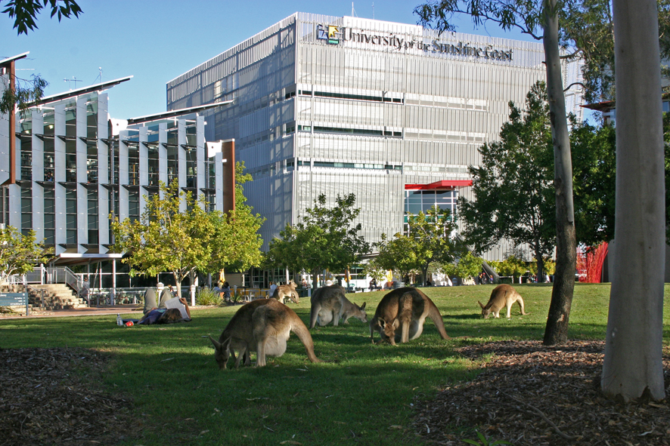
University of the sunshine coast
4 Campuses
Fraser Coast, Gympie, Sippy Downs & Southbank
2111 Staff

Slide 4
V9.0 (Ptools 8.54) currently upgrading to v9.2 (Ptools 8.55)

Slide 5
Manual Process
1238 payments made in 2015
Manual process –
Create Job Data, Add Tax, Banking, Address, Phone, Email, Emergency Contacts; Terminate appointment, Update shared School of Education/Payroll spreadsheet
Enter timesheet
Checking of data entry
Filing of Claim forms
Current Payment Timeline
4 week turn around from when the claim reaches Payroll Office
Paper based forms
Overpayments – duplicate claim forms, data entry errors
Incorrect Banking Details – Bank rejects, manual process for both Payroll and Financial Services to retransmit pay

Slide 6
Automated Process – SONIA to PeopleSoft HRIS
Peoplesoft modifications – 55 hours
Automated Process
Online claim form created in SONIA (Work Integrated Learning Software used to manage Student Placement)
Process creates Job Data after Search Match, Banking, Address, Phone, Email, Emergency Contacts; Terminates appointment,
Suspends employee if no Tax Data and removes Suspend row after Tax data is entered and the USC Import process is rerun.
Adds Positive Input with Batch Code
Payment
Within 2 weeks of upload

Slide 7
SONIA ONLINE CLAIM FORM

Slide 8
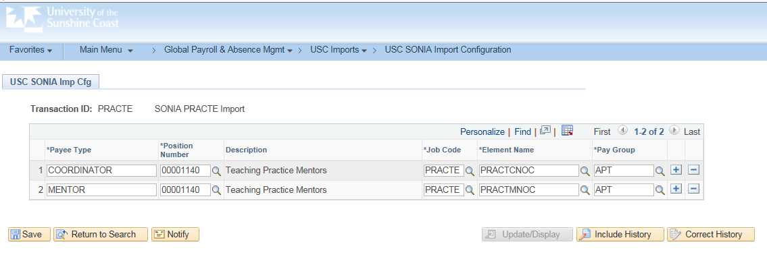
PeopleSoft Customisation
1. USC SONIA Import Configuration Page
This page has been created to allow the Functional team to make updates to the Position Number, Job Code, Earnings Code and PayGroup used in the upload e.g. if a new Payee Type other than Coordinator or Mentor is required.

Slide 9
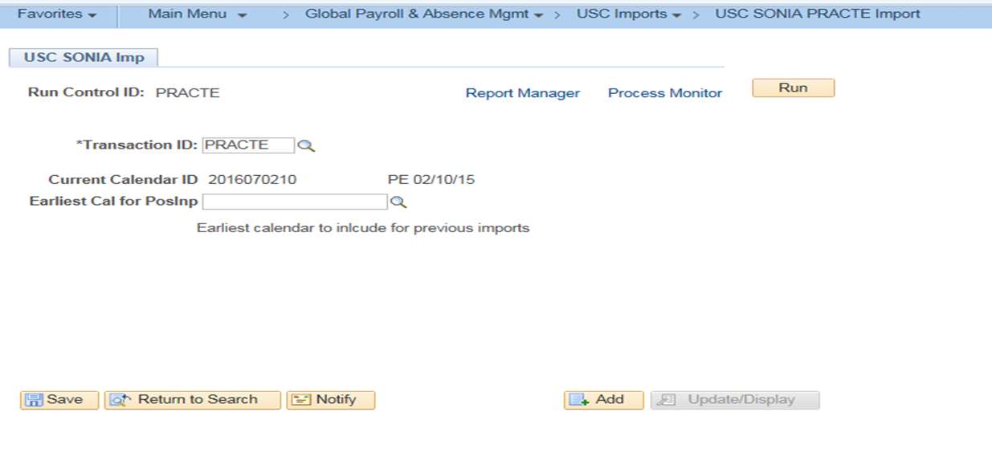
PeopleSoft Customisation
2. USC SONIA Imp
Import SONIA file into PeopleSoft

Slide 10
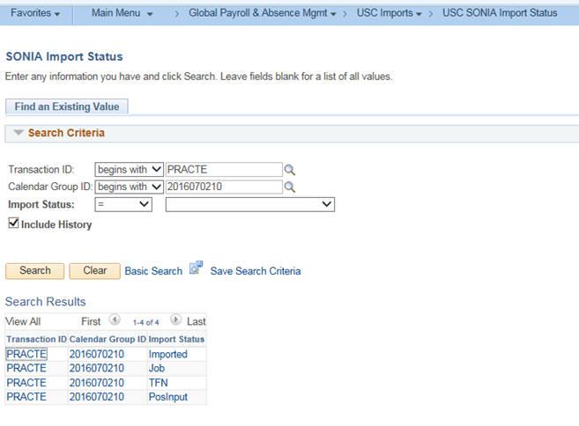
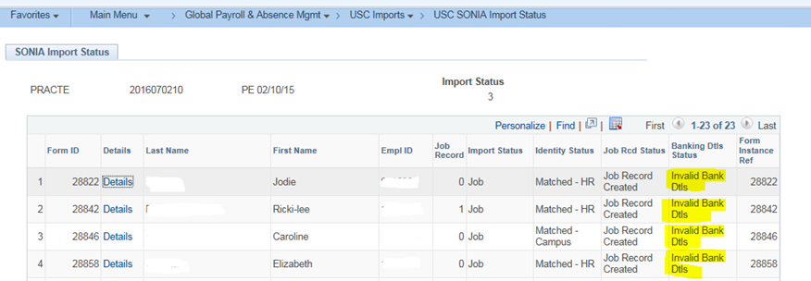
PeopleSoft Customisation
3. USC SONIA Import Status
Payroll can see which claims did not load due to issues around - Search/Match Employee ID, Banking and TFN.
Payroll review and correct the issues and then reimport. If the issue cannot be resolved for the current pay cycle, the USC SONIA Imp process will allow Payroll to reimport this claim for payment in a future pay cycle. Payroll can nominate the earliest calendar to reimport from.

Slide 11
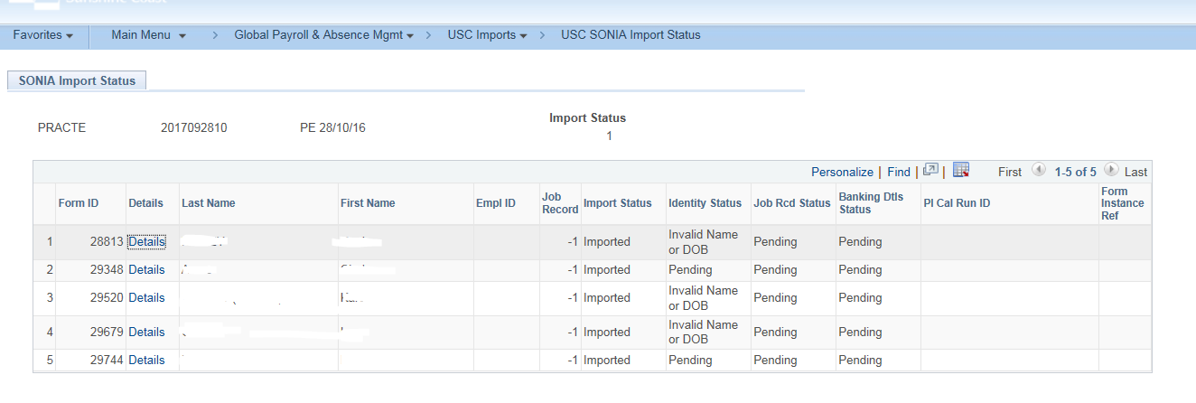
PeopleSoft Customisation
Import Status type = Pending
These forms have failed the Search/Match process and need to be manually added.
Reasons for failure – Known by another name (captured on Sonia form); Invalid birth date, Invalid name.
Phase 2 - Pending to be reloaded – Payroll will investigate the reason for the load failure and will either reload or enter manually. Due to Code freeze for V9.2 upgrade, there was insufficient time to implement this step in the process.

Slide 12
PeopleSoft Customisation
Import Status type = Awaiting TFN
The process has identified that the claimant does not have an existing TFN record in Maintain Tax Data AUS.
These forms have loaded into Job Data, updated Banking but have not uploaded to Positive Input. A Suspend row is automatically entered into Job Data by the import process so the employee does not error the pay.
Payroll update Maintain Tax Data and then import again. The process removes the Suspend row, updates Maintain Tax Data AUS and loads a row into Positive Input.
Phase 2 – Custom Online Tax form will be available with V9.2 upgrade

Slide 13
PeopleSoft Customisation
Import Status type = PosInput
The process has completed.
Job Data - Hire/Rehire row with Effective date = Period Begin Date
- Termination row with Effective date = Period End Date
Maintain Bank Accounts & Specify Net Pay Elections – row added with Effective Date = Hire Date or Period Begin Date if record already exists
Maintain Tax Data AUS - row added with Effective Date = Hire Date or Period Begin Date if record already exists
One Time (Positive Input) – row added for Mentor hours, row added for Co-ordinator hours. Hours are summed(by Earnings type) if multiple claims are loaded in the same calendar

Slide 14
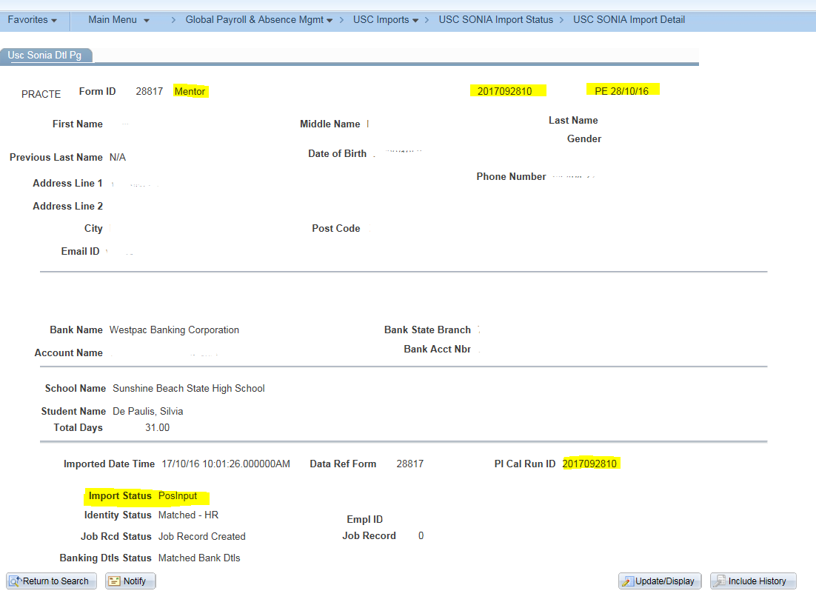
PeopleSoft Customisation
4. Sonia Detail Page in PeopleSoft
Used for phone enquires.
ID can be verified as ID details on this page eg DOB, address, student name
Identify Period when form uploaded
Identify Import Status
Identify when payment was processed

Slide 15
SUMMARY
No Overpayments due to data entry errors or submission of duplicate claim forms
Reduced bank rejects as claimant chooses BSB details from Drop down list, Bank Name derived from BSB
Reduction in Data entry, filing, checking and phone enquiries
Estimated time saving based on 2015 claims – 20 minutes per claim, 24760 minutes or 412.6 hours or 56.9 work days or 11.3 work weeks
Happy Payroll staff and Happy customers

Slide 16
ANY QUESTIONS

Slide 17
presenters
Karen Dixon
Kellie McVey
HR Consultant (Remuneration & Systems)
University of the Sunshine Coast
kdixon@usc.edu.au
HR Officer
University of the Sunshine Coast
kmcvey@usc.edu.au
all Alliance presentations will be available for download from the Conference Site

Slide 18
THANK YOU!

