Slide 1
DESIGNING FLEXIBLE CUSTOM PROCESSES USING POPULATION SELECTION
SESSION 6017
NOVEMBER 13, 2018

Slide 2
PRESENTERS
Alexandra Dosser
Vibhoo Singh
Kristy Sterling
Senior Business Systems Analyst
MacEwan University
dossera@macewan.ca
Senior Business
Systems Analyst
MacEwan University
singhv28@macewan.ca
Senior Business
Systems Analyst
MacEwan University
sterlingk@macewan.ca

Slide 3
MacEwan University
PeopleSoft Campus Solutions
Release 9.2
PUM 9.2.000
PeopleTools 8.56

Slide 4
MacEwan University
We offer nine four-year bachelor degrees, two applied degrees, and fourty-three diploma and certificate programs.
Hundreds of noncredit professional and personal development courses are offered on a part-time basis as well as programming for university and college preparation and English as an Additional Language courses.
Population Selection Queries
Custom Processes Using Population Selection

Slide 5
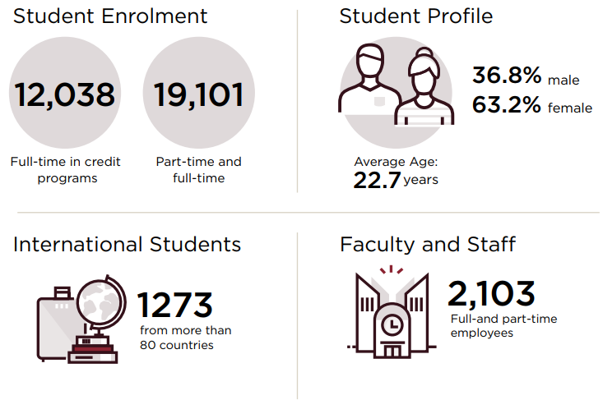
MacEwan University
Population Selection Queries
Custom Processes Using Population Selection

Slide 6
MacEwan University
Population Selection Queries
Custom Processes Using Population Selection

Slide 7
MacEwan University
Students’ Association of MacEwan University building (completion Fall 2019)
Population Selection Queries
Custom Processes Using Population Selection

Slide 8
OVERVIEW
1
3
Population Selection Fundamentals
Population Selection Queries
2
4
How Does Population Selection Work?
Custom Processes Using Population Selection

Slide 9
Population Selection Fundamentals

Slide 10
What is Population Selection?
A selection tool to identify the population that will be used in a process.
Population selection (a.k.a. “pop select”) is often used interchangeably to refer to the process OR the query that is used in the process.
May go by other names (e.g. trigger queries).

Slide 11
What is Population Selection?
PeopleSoft delivers 3 selection tools:
PS Query.
External File.
Equation Engine.
PS Query is MacEwan University’s most commonly used pop select tool due to the flexibility it provides.

Slide 12
Delivered Pop Select Processes
There is a lot of delivered functionality that uses population selection.
For example:
3C Engine.
Service Indicators.
Student Groups.
Activity Guides.
Create/Maintain EMS Evaluations.
Update Program Action/Reason.
Transcript Generation.
Oracle delivers sample pop select queries that start with QA_CS.
Notes:
Complete list of processes using Pop Select
https://docs.oracle.com/cd/F11339_01/cs92pbr11/eng/cs/lscc/concept_UnderstandingthePopulationSelectionGroupBox-ec7ff5.html?pli=ul_d49e718_lscc

Slide 13
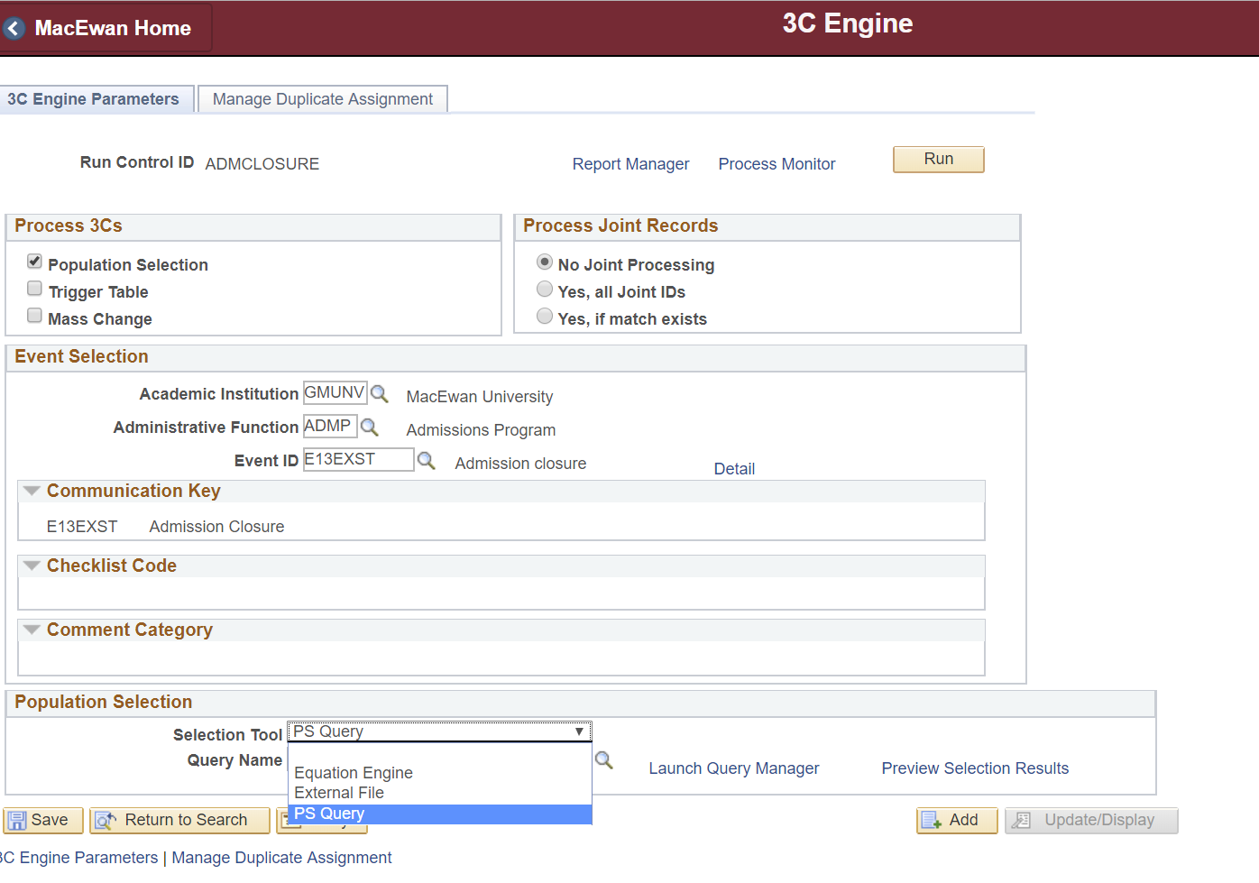
What Does Population Selection Do?
Selects values based on a defined PS query, external file or equation, and populates the selected values into a defined target table.
The values are then available for use in a process.

Slide 14
Benefits of Pop Select
Using Pop Select for batch processes provides:
Flexibility.
User-controlled selection parameters.
Adaptability to changing policies and practices.
Ease of maintenance.
Functional, Process, or Business Analysts can maintain the queries/business logic, without requiring developer intervention.

Slide 15
How Does Population Selection Work?

Slide 16
Context Definition
Context Definition configuration defines:
Valid Selection Tools.
Selection Mapping.
Bind Record.
Target Table.
Field Mapping.

Slide 17
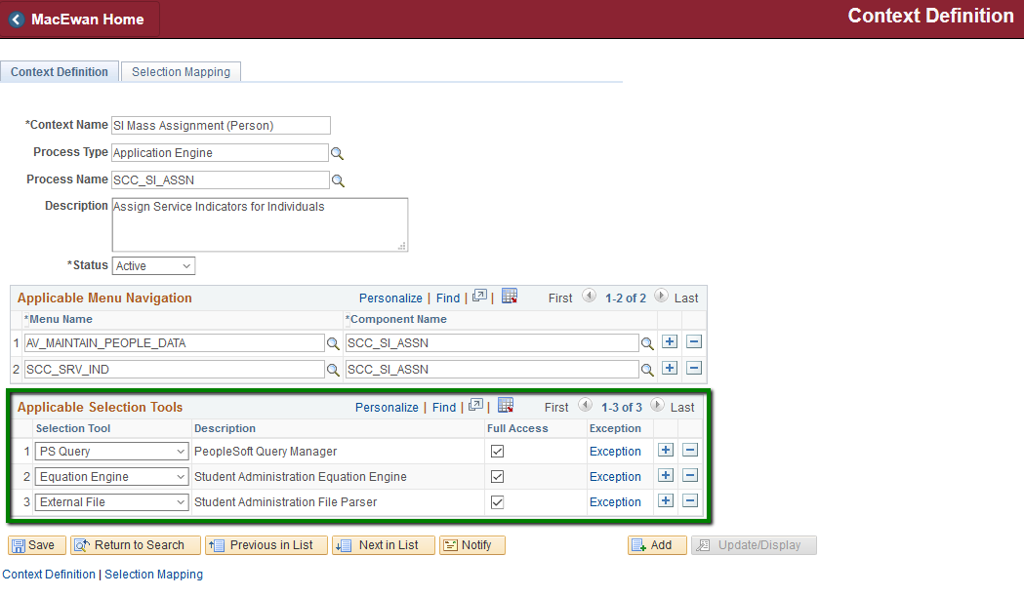
Valid Selection Tools
Example: Service indicator Assignment
Navigation: Set Up SACR > System Administration > Utilities > Population Selection > Context Definition

Slide 18
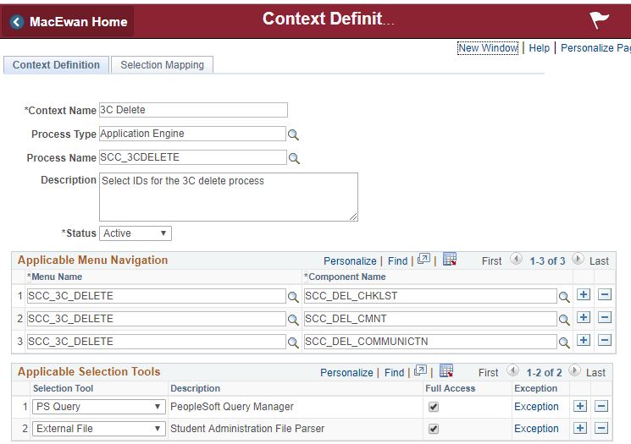
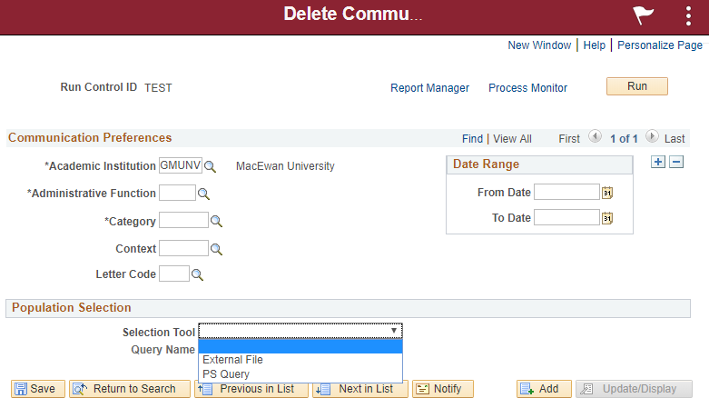
Valid Selection Tools
In-house built processes that leverage pop select only have PS Query as a Selection Tool

Slide 19
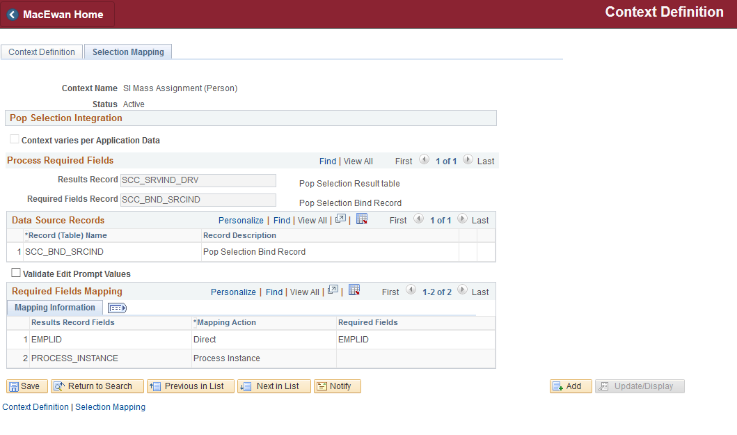
Selection Mapping - Bind Record
Ensures required parent records exist.
Restricts lookup of PS queries.

Slide 20
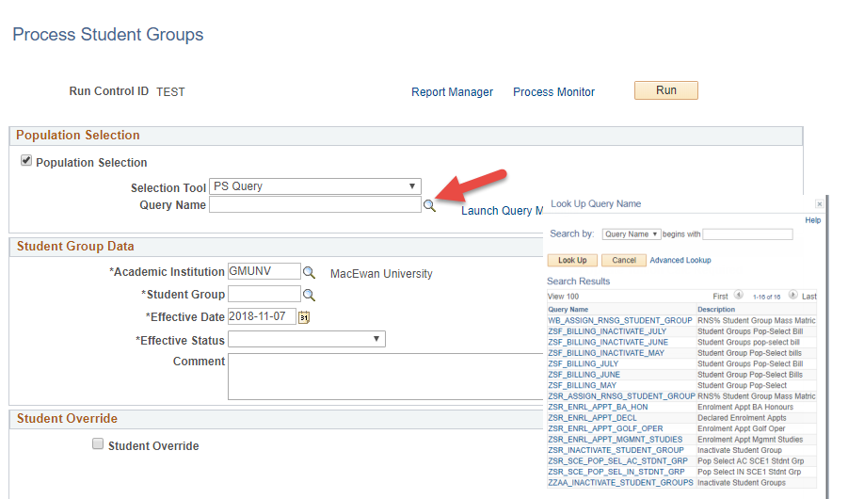
Selection Mapping - Bind Record
Bind Record

Slide 21
Selection Mapping
Target Table:
Temporary table.
Stores the records to be processed.
Field Mapping:
Maps query fields to target table fields.
Can also define default values for process fields.

Slide 22
Batch Processes with Population Selection
Batch processes generally have three phases:
Select Records
Process Records
Report Results
Population Selection is used to select records.
Process uses target table to perform desired updates.
Target table is used to generate required reports.

Slide 23
Population Selection Queries

Slide 24
Tips for Pop Select Queries
Bind record
Use the bind record to ensure the required parent record(s) exist for your process.
Return all fields from the bind record.
Views
It may be helpful to create custom views to support the query.
Test new views thoroughly.

Slide 25
Tips For Pop Select Queries
Development
Look to delivered pop select queries as examples.
Develop team and/or institutional standards and naming conventions.
E.g. ZFA_POP_SEL_% for custom Financial Aid pop select queries).
Review duplicate rows carefully; these may be a sign of imperfect joins.
Prompts
Plan prompt order carefully.

Slide 26
Tips For Pop Select Queries
Use a Query Type of Process (as opposed to User) for queries used in a process.
Document any changes to the query in Query Properties under Query Definition.
Performance: A large number of rows returned may negatively impact performance.

Slide 27
Tips For Pop Select Queries
To improve performance and reduce manual maintenance, consider the benefits of using criteria instead of prompts.
For example Terms: Add criteria to return rows for only the current term forward, as opposed to building a prompt where staff need to maintain and update prompt values manually.
Using extra fields in the selection can be useful when previewing query results or maintaining the query.

Slide 28
Remember
Left outer joins are tricky!
Test, test, and test again!

Slide 29
Good to Know
Target table
Can have additional fields to support batch processing, i.e. to indicate records that have been processed or had an error.
Pop Select has a performance issue after applying PUM 8. This is resolved in PUM 11 (released this month).

Slide 30
Custom Processes Using Pop Select

Slide 31
Pop Select at
MacEwan University
Calculate Student Special GPA
Process to create and update Special GPAs for students based on grade points and units returned by PS query.
Assess Academic Standing
Process to assess academic standing based on a configuration page that has a defined PS query for each Academic Standing Action.
Automate Entrance and Continuing Scholarship Assignment
Process to assign and modify scholarship offers based on a configuration page that has a defined PS query and grade range for each scholarship.

Slide 32
Design
At a high level, each process required a custom:
Context Definition.
Configuration component.
Population selection queries.
Run control component.
Application Engine program.

Slide 33
Why This Method?
Simplicity and transparency.
Most likely alternative is a more complex configuration component and application engine program.
Alternate methods lacked clarity for users.
Flexibility in meeting requirements.
The process can easily be adapted as policies and practices change.
Most requirements are met by pop select queries; less developer intervention is required.
Ease of maintenance.

Slide 34
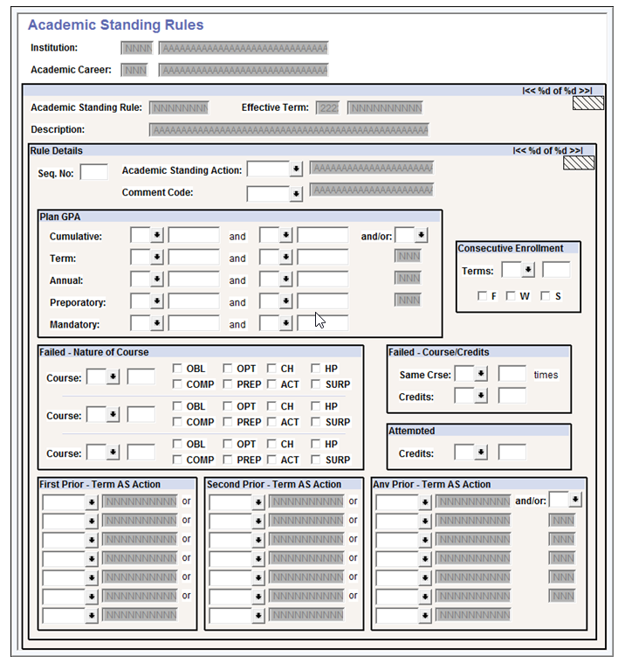
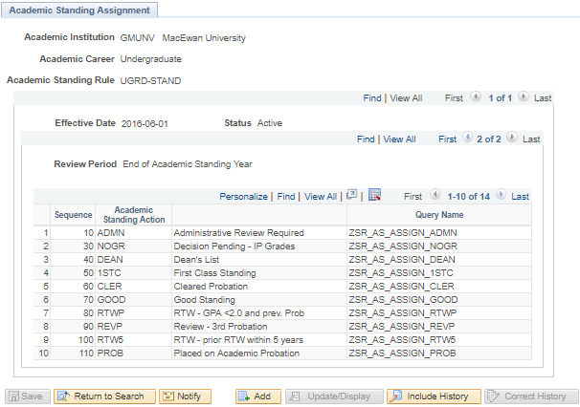
Simpler?

Slide 35
Custom Process 1:
Calculate Student Special GPA

Slide 36
Calculate Student Special GPA
Calculate Student Special GPA is a custom process to calculate and record Special GPAs for students. The process is run twice each term to calculate both Merit and Academic Standing GPAs for students.
The population to update is selected with a PS Query.
Calculation is based on grade points divided by units taken.
Uses a shared Application Package, which is controlled by configuration.

Slide 37
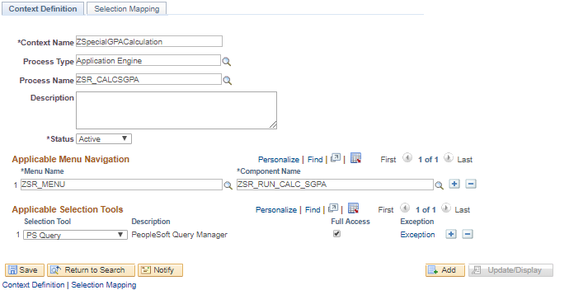
Calculate Student Special GPA
On the Context Definition configuration page, we’ve selected a Process Type of Application Engine, provided a name for the Context and the Process, defined the Menu and Component Names, and specified PS Query as the Selection Tool.

Slide 38
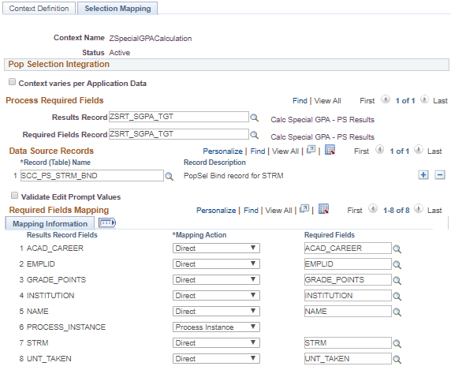
Calculate Student Special GPA
On the Selection Mapping page, we have:
Defined the Results Record and Required Fields Record.
Specified the STRM PopSel Bind record as the record to be used in the Data Source.
Mapped the Results Record Fields to the Required Fields.

Slide 39
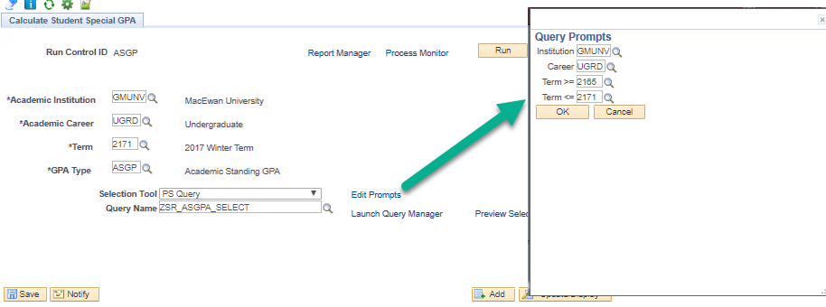
Calculate Student Special GPA
The process itself is run for an Institution, Academic Career, Term, GPA Type, and uses a pop select query to select valid enrollments to be included in the GPA.
The entire process is run twice, once for GPA Type ‘MER’ (Merit GPA) and once for GPA Type ‘ASGP’ (Academic Standing GPA).

Slide 40
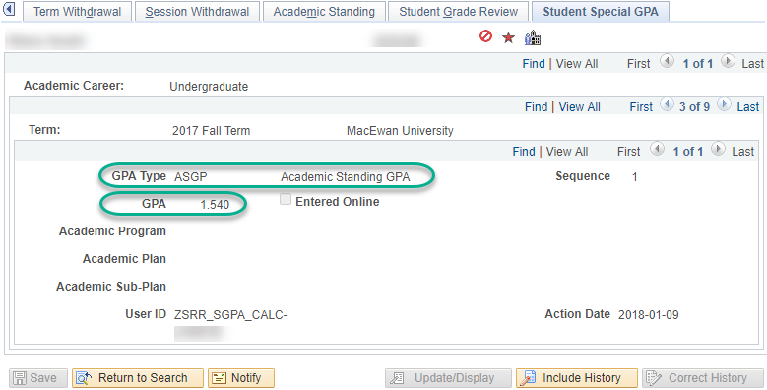
Calculate Student Special GPA
The GPA values are stored on the Student Special GPA tab on the student’s Term History.

Slide 41
Custom Process 2:
Assess Academic Standing

Slide 42
Assess Academic Standing
Process to assess academic standing.
The students that will be assigned each academic standing are identified with PS queries.
Queries are assigned to Academic Standing Actions on a configuration page.
Students who meet multiple queries will be assigned to the academic standing with the lowest sequence number.
Custom process calls the pop select Application Package once for each query, appends each query’s results into the target table, and then evaluates the results.

Slide 43
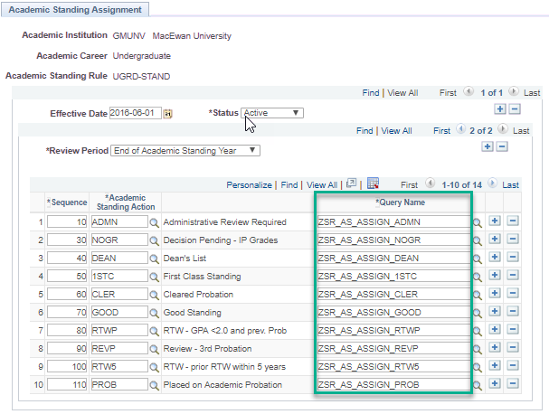
Assess Academic Standing
This custom component defines the following for an Academic Standing rule:
Effective date: To allow for tracking of changes over time.
Review Period: To associate one or more review periods to the Academic Standing Rule. Current values are Mid-Year (Spring/Summer and Fall Terms) and End of Academic Standing Year (Winter term).
Rule Details: To associate one or more detail rows for each review period. These define the Sequence Nbr, Academic Standing Action, and the associated pop select query to select students who meet the conditions for that particular standing rule.
Notes:
Mid -Year: Run at the end of the Spring / Summer and Fall Terms to assess the students eligible for the Dean’s List and First Class Standing and to place a ‘Continuing on Probation’ notation on the term for those students who are on probation for that Academic Standing year.
End of Academic Standing Year: Run at the end of the Winter term to assess the performance of all students for the Academic Standing year including students eligible for the Dean’s List and First Class Standing at the end of the Winter term.

Slide 44
Assess Academic Standing
Using a pop select query to select the student population enables the institution to accommodate new rules should they change in the future.
The SCC_PS_STRM_BND bind record is used to ensure that only students with a Student Term (STDNT_CAR_TERM) record are selected to be evaluated and assigned an Academic Standing.
The sequence number is used to determine in which order the rule details are evaluated, to ensure that students who meet multiple conditions are assessed the correct Academic Standing.

Slide 45
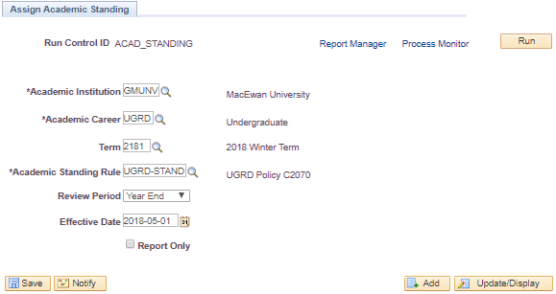
Assess Academic Standing
The custom process assesses and records a student's Academic Standing.
The process utilizes the custom Academic Standing rules associated to the student's primary program for the term to evaluate student performance.
The process is run once each term, based on the rules to be assessed during the review period.

Slide 46
Custom Process 3:
Automate Scholarship
Assignment

Slide 47
Automate Scholarship Assignment
Process to automatically assign and modify Entrance and Continuing scholarship offers.
Each scholarship tier has a defined item type, grade range, and population selection query.
Has edits to ensure students are not awarded multiple scholarships of the same type.
The pop select queries identify students in the program configured for each rule, who have the defined grade range (high school average or GPA).

Slide 48
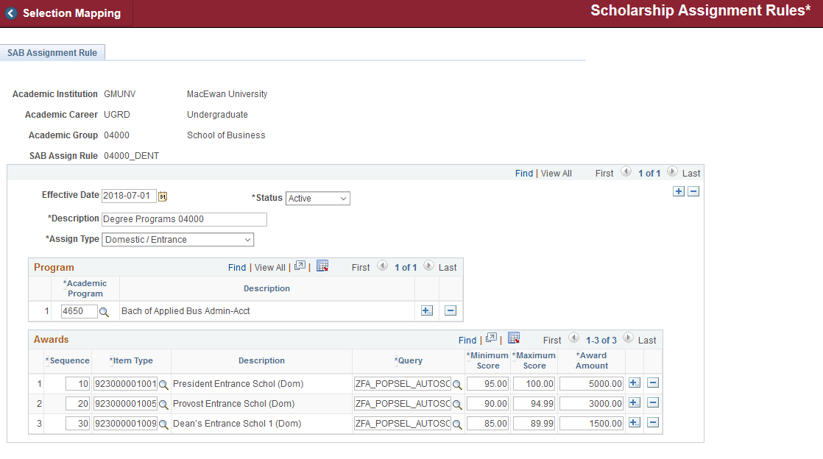
Automate Scholarship Assignment
Notes:
Custom configuration page for Scholarship Assignment Rules.

Slide 49
Automate Scholarship Assignment
The process passes in configured variables instead of a user entering a value for each prompt.

Slide 50
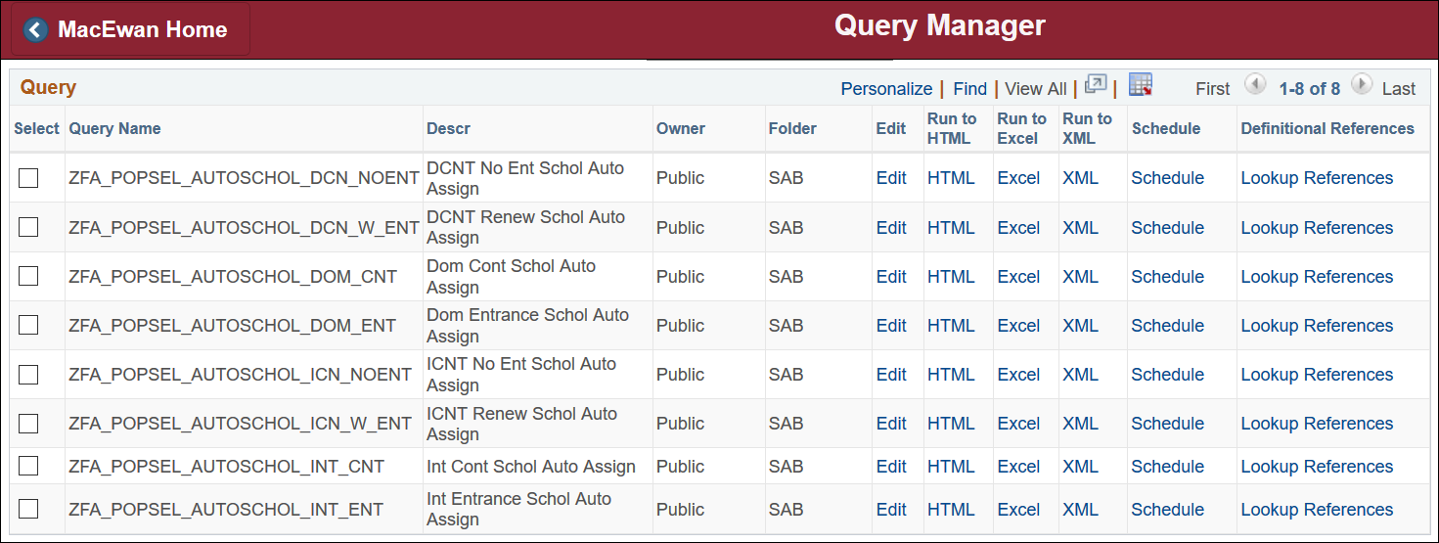
Automate Scholarship Assignment
All other elements are managed in the query criteria.

Slide 51
Automate Scholarship Assignment
Some business practices addressed using queries:
Entrance and Continuing scholarships have different rules.
There are different rules for Domestic and International scholarships.
Even within categories (e.g. Domestic Entrance, Domestic Continuing) there are multiple scholarships available.
These may have different rules, e.g. Continuing students with a previous Entrance scholarship vs. those without are eligible for different item types.

Slide 52
Automate Scholarship Assignment
Some business practices addressed using queries:
Grade ranges and award amounts vary and can change yearly.
Faculties and Schools can have different rules for eligibility.
Scholarship rules can change over time.
A wide range of records are used to determine eligibility.
Examples include Citizenship, Enrollment, Service Indicators, Education, Evaluation Management System, Awards.

Slide 53
Summary

Slide 54
Summary
Benefits of using Population Selection include:
Ease of maintenance (business users making logic changes as opposed to developers).
User-controlled selection parameters.
Adaptability to changing policies and practices.
Simplicity and transparency.
Flexibility in meeting requirements.

Slide 55
Questions?

Slide 56
PRESENTERS
Alexandra Dosser
Vibhoo Singh
Kristy Sterling
Senior Business Systems Analyst
MacEwan University
dossera@macewan.ca
Senior Business
Systems Analyst
MacEwan University
singhv28@macewan.ca
Senior Business
Systems Analyst
MacEwan University
sterlingk@macewan.ca
All Alliance presentations will be available for download from the conference site.

Slide 57
THANK YOU!

