Slide 1
Travel & Expense Fluid – McMaster’s Experience With Implementation and Adoption
SESSION 7018
November 5th, 2019

Slide 2
presenters
Derek Konieczny
Sue Graci
Business Systems Analyst – University Technology Services
McMaster University
konieczd@mcmaster.ca
Relationship Associate – Accounts Payable
McMaster University
gracis@mcmaster.ca
5 years with McMaster University as a Business Systems Analyst primarily focused on Travel & Expense, Grants, and Accounts Payable. Received the Certified Business Analyst Professional (CBAP) designation in 2012.
12 years with McMaster University, first as a Finance Assistant in Faculty of Health Sciences. Over five years as Accounts Payable Trainer for Non-PO Vouchers, Pcard Reconciliation and Travel & Expense Reports.

Slide 3
Agenda
Introduction
Review Customizations
Travel & Expense Fluid Walkthrough
User Feedback
Travel & Expense Fluid Bugs and Issues
Questions / Wrap Up

Slide 4
McMaster University
Ranked 72 in the internationally recognized 2020 Times Higher Education rankings

Slide 5
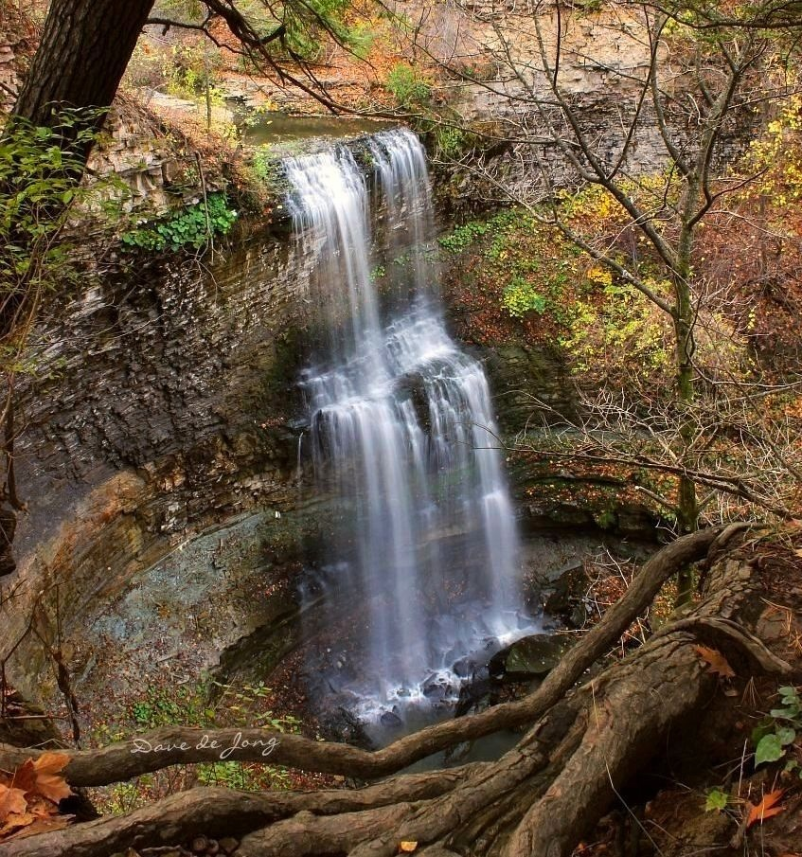
Hamilton – City of Waterfalls
Tew’s Falls
Felker’s Falls
Over 100 waterfalls can be seen in and around Hamilton
Webster’s Falls

Slide 6
Mcmaster University
Rolled out T&E Fluid in December 2018 on image 9.2.025 and PeopleTools 8.55.22.

Slide 7
Travel & Expense Fluid Customizations and Walkthrough
Review of Travel & Expense Report customizations, screens, My Wallet, My Reports, and History.

Slide 8
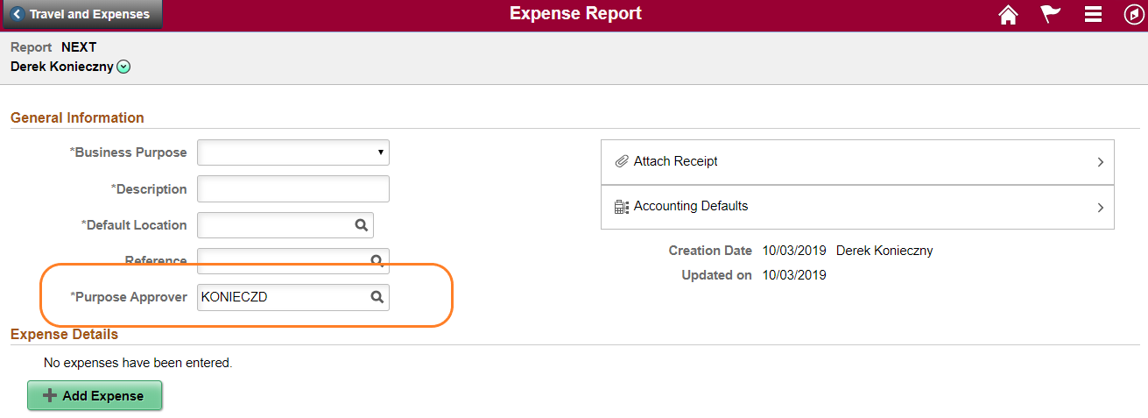
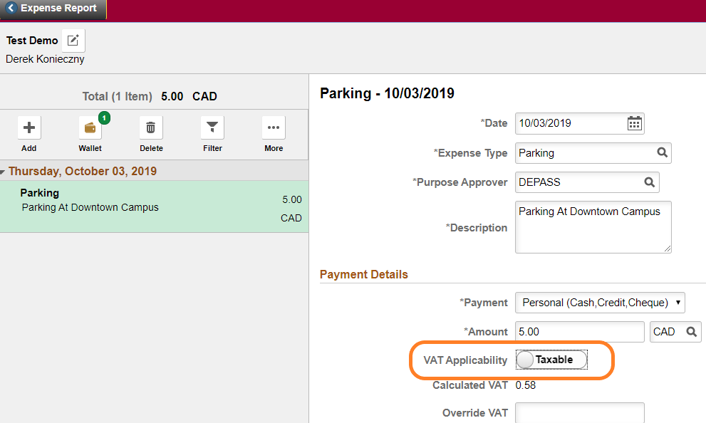
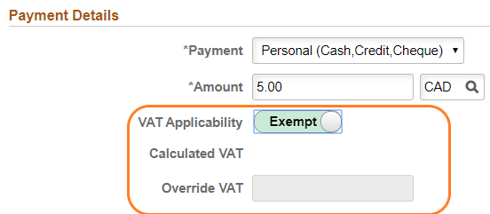
Customizations
1. Addition of a Purpose Approver in the expense report header.
2. Add a VAT exemption option.
Re-ordered the chart field.

Slide 9
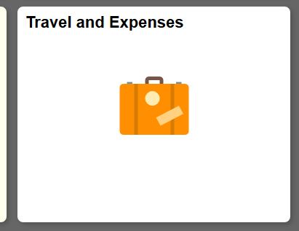
Creating t&e reports in fluid

Slide 10
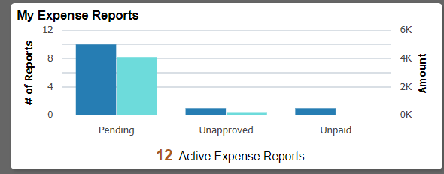
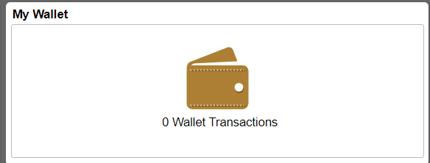
t&e reports in fluid
OR edit an existing report that has not yet been submitted
OR specify the expense type in My Wallet for Diners transactions

Slide 11
Creating t&e reports in fluid
Fields to complete on the expense report Header Information: Business Purpose, Description, Default Location (important!), Purpose Approver, Attach Receipts, Accounting Defaults
Business Purpose might be renamed Business Type or Category so user doesn’t feel they have satisfied McMaster policy on explaining business purpose as how it relates to user’s position

Slide 12
Creating t&e reports in fluid
The Purpose Approver has to auto fill so that will always mean a change – it is auto filled with Claimant’s name and must be replaced with Supervisor’s name
Attaching receipts at Header is not intuitive at this stage in a report’s preparation
Entering the chart field string at the Header is a huge efficiency – only the account (which corresponds to the expense type) is not completed as it changes at the line level

Slide 13
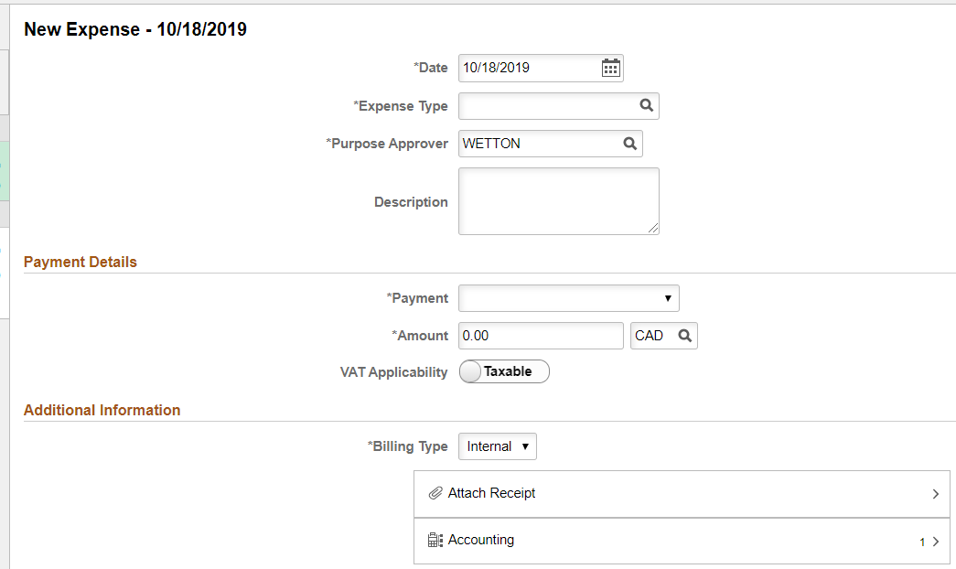
Creating t&e reports in fluid
Enter expense information – the date is always current date – this is annoying as it will virtually never be the current date in a reimbursement scenario
Complete all expense information. Description is important and cannot be blank. Tab to Payment type or user must double click.
Add receipts at Header, NOT here, at the line, for ease of review for approvers.

Slide 14
Creating t&e reports in fluid
PeopleSoft inserts account based on expense type chosen on each line – this is a huge efficiency over Classic – the entire distribution line (chart field string) had to be entered as each line was entered – now it can be completed at the Header and as each line’s expense type is selected, the program inserts the corresponding account number. Use the “+” button to split the charge between multiple chart field strings.
It would be nice to have the percentage split option available.

Slide 15
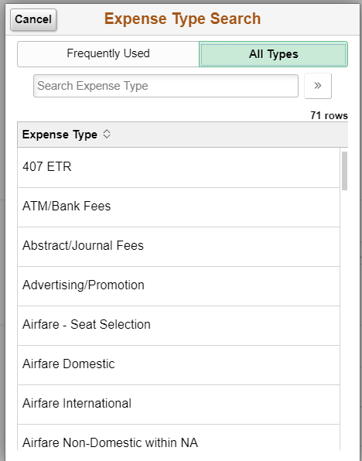
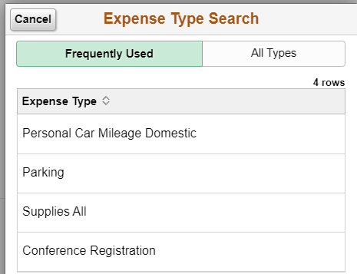
Creating t&e reports in fluid
Expense types that are used frequently are presented in a readily available list that increases as the user creates more reports – this is a great efficiency

Slide 16
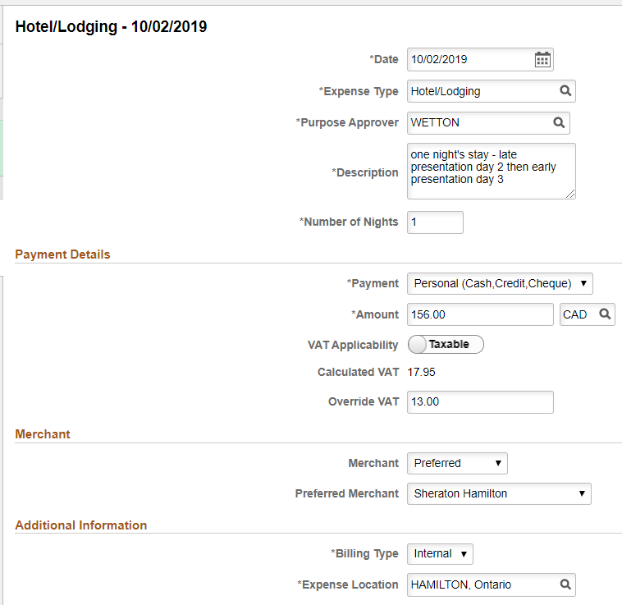
Creating t&e reports in fluid
Selecting certain expense types prompts the program to ask for more details such as number of nights stayed and hotel name, although the Preferred and Non Preferred options create confusion for first time users, thinking it is a list of McMaster approved hotels.

Slide 17
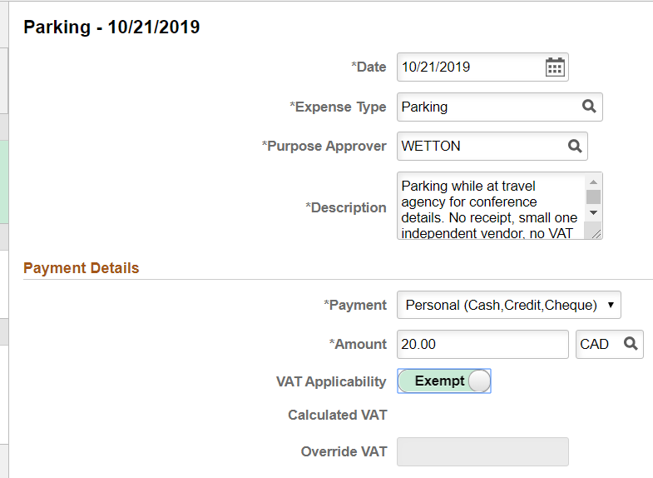
Creating t&e reports in fluid
VAT Applicability toggle switch is a great efficiency over Classic. This is a McMaster customization that is probably the most popular new feature with users. No one likes VAT!

Slide 18
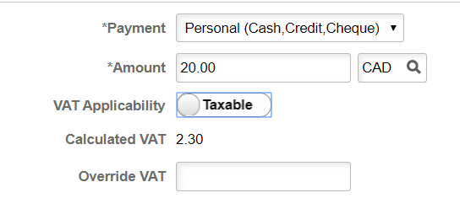
Creating t&e reports in fluid
If VAT has been paid the system automatically calculates it. Overriding it is a clearly marked field directly below. Toggle switch for Exempt is user friendly. Classic has to go to new screen and is very complicated. There were an additional 5 clicks minimum for what is now a simple click on the toggle.

Slide 19
Creating t&e reports in fluid
The Personal Expense button confuses users – they mistakenly think it’s asking if they paid for the expense being reimbursed rather than wanting to exclude from reimbursement.
The Missing Receipt Comment field does not immediately appear when No Receipt toggle switch is selected. It shows up once report has been saved by user.

Slide 20
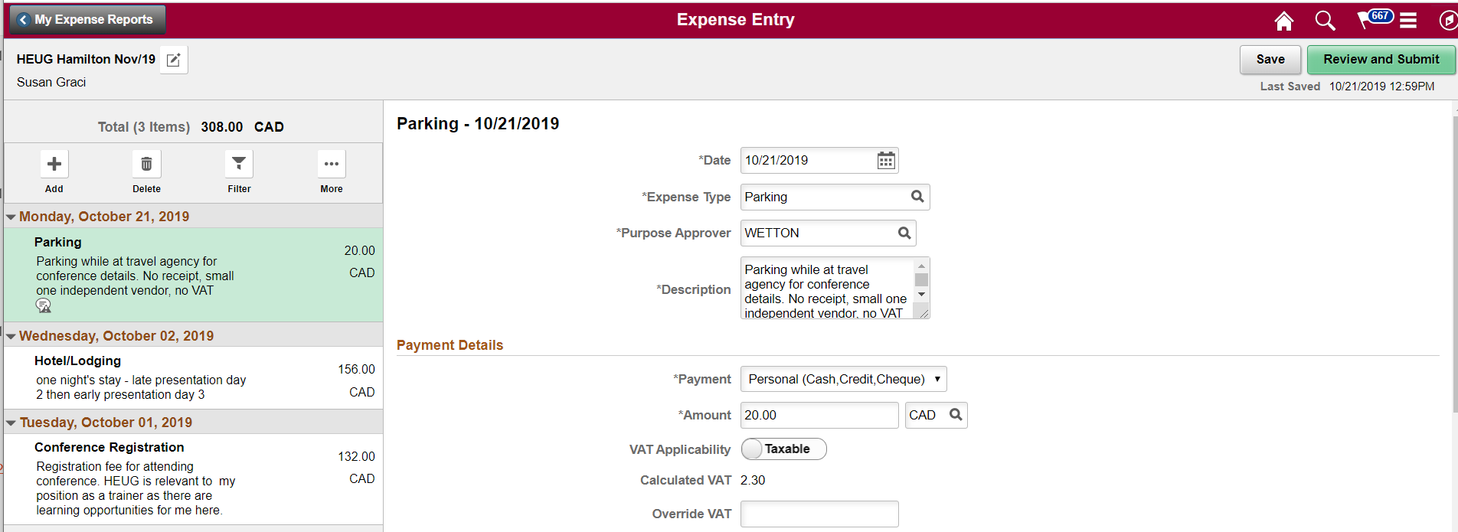
Creating t&e reports in fluid
There are times when the report ID# is not available to view. Users find this frustrating.
To return to the report’s Header, it is the small box with the pencil in it – very hard to see, not a meaningful graphic, and confusing with My Expense Reports button directly above it.

Slide 21
Creating t&e reports in fluid
Submitting is easier with Fluid. The screen nicely summarizes the report and the authorization blurb makes sense.
Getting back to fixing errors is not intuitive with Update Details button.

Slide 22
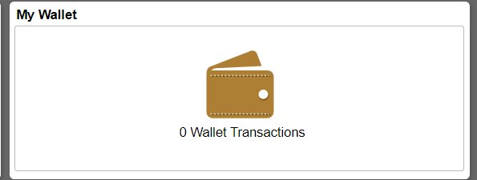
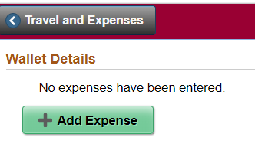
PAYING DINERS in fluid
If the claimant does not have a Diners it is confusing because no details appear. Changing user name is not on the screen until the Add Expense button is selected.

Slide 23
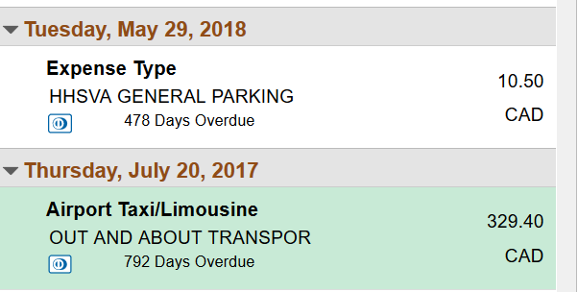
PAYING DINERS in fluid
1st expense – not specified
2nd expense – specified Airport Taxi/Limousine
My Wallet must be accessed separately, the expenses specified, THEN an expense report created and the transactions from My Wallet imported into the report – this changes from Classic where it was all done from within an existing expense report – several more clicks but users dislike this

Slide 24
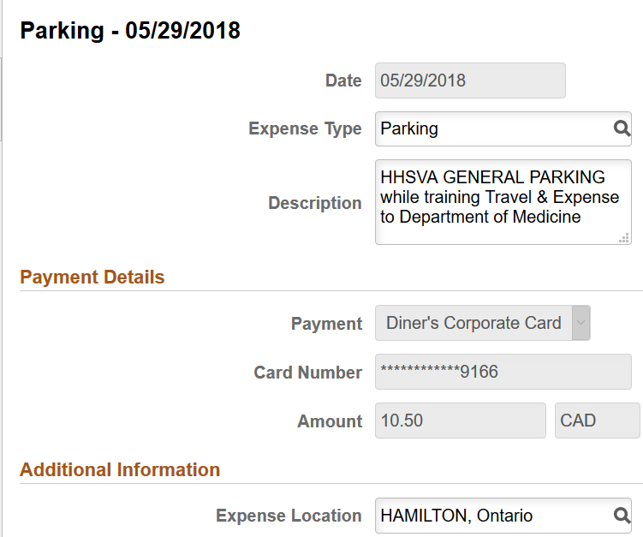
PAYING DINERS in fluid
Enter the expense type (mandatory) and description (optional). This will import to the expense report when it is processed.
Exit My Wallet once transactions to be processed are prepared.

Slide 25
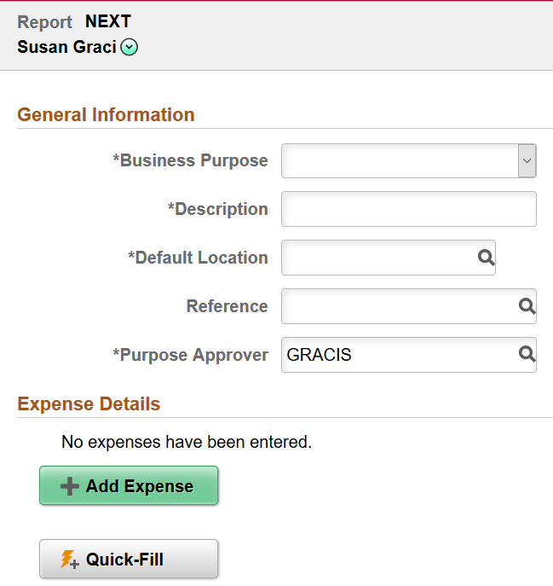
PAYING DINERS in fluid
Create a new expense report. If the Claimant is different from the Preparer, remember to change the name before the report is created. It cannot be changed after the report has been assigned a number.
If there are no Diners transactions waiting in My Wallet to be paid, the option to Add from My Wallet does not appear.
If the claimant does not have a Diners, the Add from My Wallet does not appear.

Slide 26
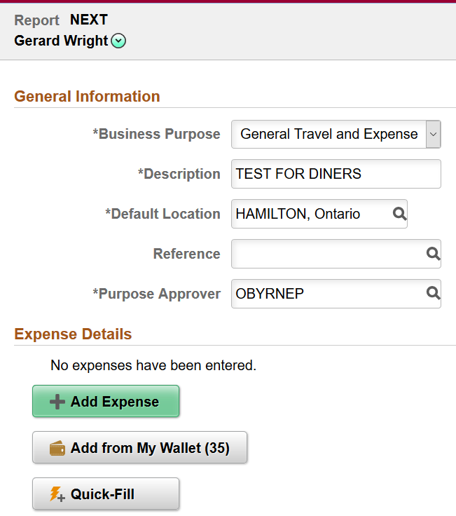
PAYING DINERS in fluid
When there are transactions in My Wallet, the Add from My Wallet button appears, showing how many outstanding transactions are present.
This claimant has 35 outstanding transactions. Any transactions to be processed have had the expense type specified in the My Wallet tile.
The Header is completed first, then select the Add from My Wallet button to choose transactions to be processed.

Slide 27
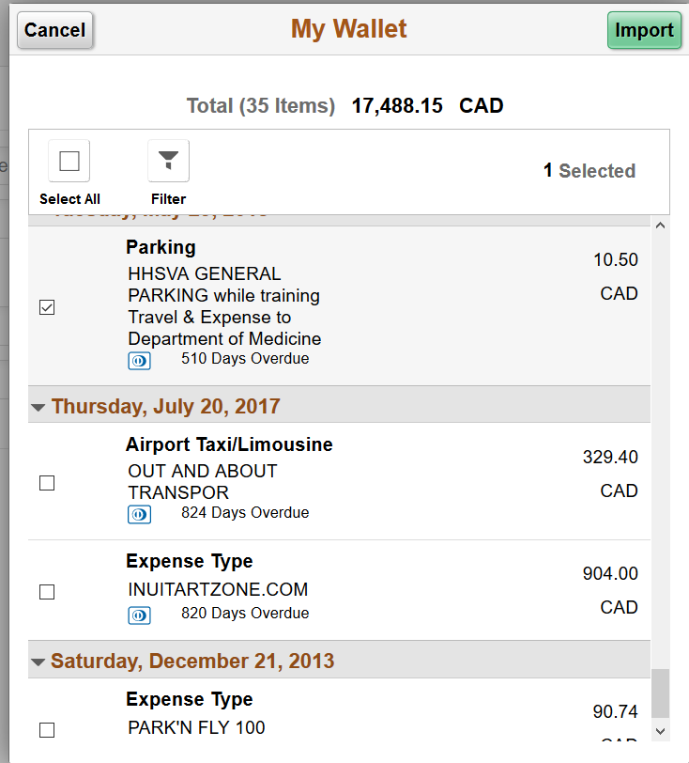
PAYING DINERS in fluid
Select the item(s) already with expense type specified, that can be processed.
Tick the box.
Import.

Slide 28
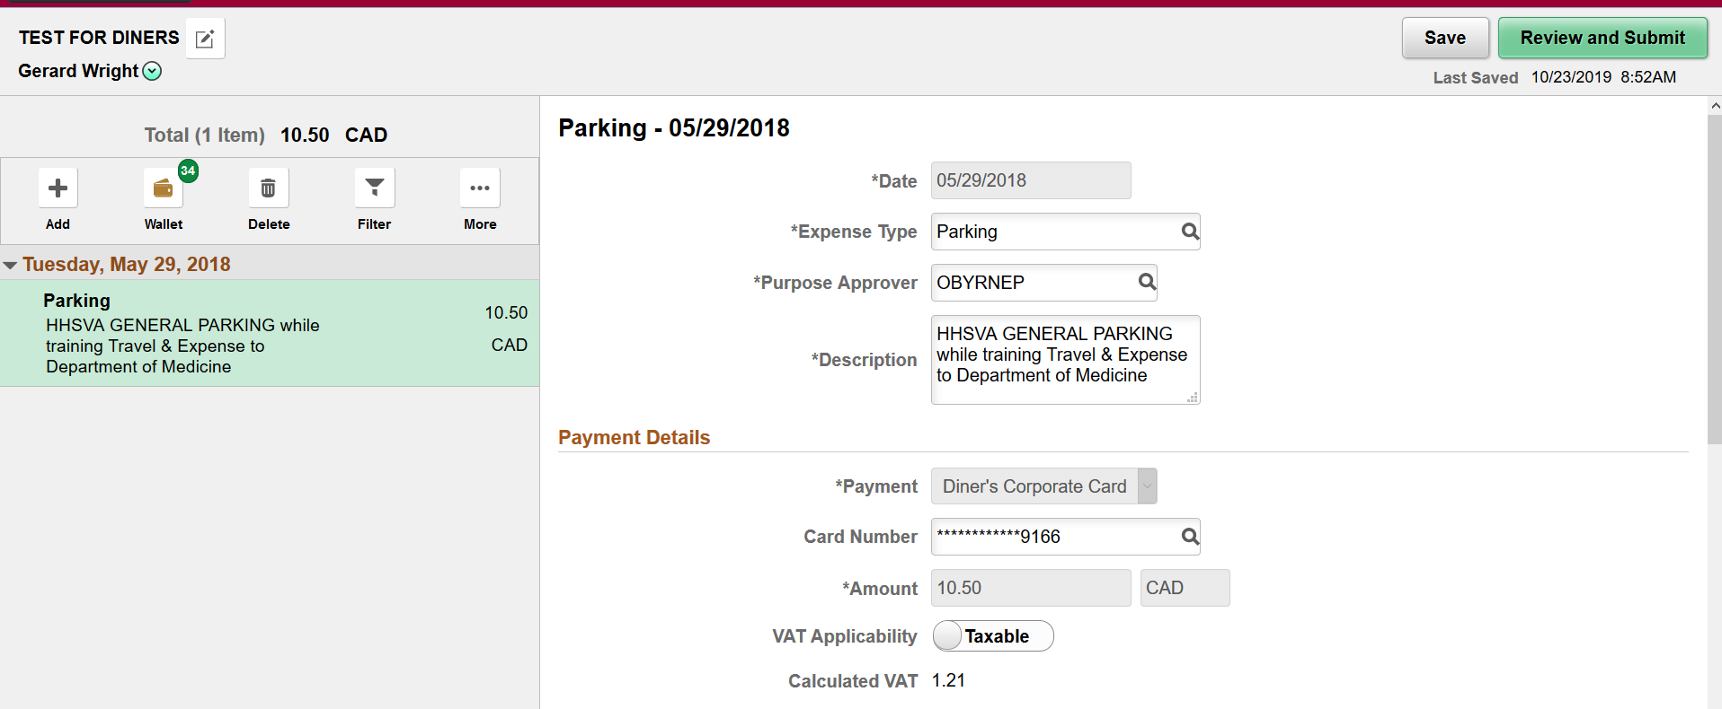
PAYING DINERS in fluid
The transaction appears in the report, payable to Diners, and this cannot be changed. Most fields are greyed out and cannot be changed. All information entered in My Wallet shows up in the report. Note that there are still 34 transactions in My Wallet to be processed. Confirm VAT, Review & Submit.

Slide 29
PAYING DINERS in fluid
When the report is submitted, notice it is payable to the Supplier and NOT to the employee.
Reports can pay both Diners and the claimant, reducing the number of reports that have to be created and, more importantly, approved.
Before the Submit button is selected, the user can click the Update Details and continue with the report or fix any errors if the system is showing an error message.

Slide 30
User Feedback
Most like it, some….not so much!
For rejected reports, users cannot see the denial message if they click the link in the rejection email.
The auto fill date should follow previous date.

Slide 31
FEEDBACK ON t&e REPORTS in fluid
User feedback has been varied. Change is always difficult and initial response to Fluid was negative.
However, as people used it more, they grew to like some of the new features.
But some features of Classic that were lost, are sorely missed!
Positive:
Cleaner look with expenses having most of the screen, rather than crowded line by line. Listing the expenses already entered on the left side of screen also good.
Entering a default chart field string in the Header is the most popular change. It populates the account (expense type) according to Expense Type chosen from existing list. Classic forced the user to enter the full chart field string on each line.
The Description field is large enough to put supporting information in without additional Comments section.
VAT Exempt toggle. That is the second most popular feature. Classic required opening another screen and an additional 5 clicks in the screen, just to exempt.

Slide 32
FEEDBACK ON t&e reports in fluid
Negative:
The date defaults to the current date – that is almost NEVER the case – the expenses are in the past and usually all around the same time, on a trip, for example, so this is time consuming and easy to miss updating
Paying Diners is more work since user must go into My Wallet to specify the expense type, save, then create an expense report and import the transactions.
Chart field strings are not easily visible on multiple lines so double checking when using more than one is difficult.
The Summary screen when submitting a report does not show the chart field string.
The name of the claimant is very small and can’t be changed once a report ID# has been assigned – but that is done without user saving it.
It seems to take longer to change names for preparing a report for someone else.
Attachments at the Header are not intuitive; they should be on the Summary screen.
The report ID# is not available on every screen.
Purpose Approver (customization) has to be auto filled with claimant’s name, which has to be changed on each report.
LOTS of clicking!

Slide 33
Travel & Expense Fluid Bugs, Issues, And What Is coming up
Review of Oracle bug fixes and future enhancements.

Slide 34
Incorrect Department Reference
The Issue: PeopleSoft displays the department associated with the maximum data record in Operational Data, not the primary record.
The fix can be found in PeopleSoft Enterprise FSCM 9.2 image #030. Details in document ID 1641843.2.

Slide 35
Users Unable To Import From My Wallet
The Issue: Users attempt to import a My Wallet transaction without a defined Expense Type. Upon seeing the error message users try to exit the page. They are then prompted to save. If they choose to save the Receipt_Verified field in EX_TRANS is flipped to “Y” and further attempts to re-import the transaction will not work.
Note: Users are also unable to delete the My Wallet transaction in fluid after this flag has been flipped.
No fix provided by Oracle.
Customization required.
You may wish to track service request 3-21371532331 for future updates from Oracle.

Slide 36
Mass EXPENSE Report Budget Status RESET
The Issue: User deletes an expense report within Fluid employee self-service while another user has started or is running an expense report budget check (FS_BP_PROC).
The code is selecting all expense reports for budget checking and changing the BUDGET_HDR_STATUS to “I” (In Process).
All expense reports had to be re-budget checked.
The issue occurs intermittently and cannot be reproduced in non-production on demand.
The Fix: No implicit instructions provided by Oracle.
Suggestion to turn off EX_BD_DEL.
Check Oracle bug fix 27581139 which is in image #028.

Slide 37
What’s Coming
As per Oracle:
Enhanced the global search results feature so that the system accesses the Fluid Expense Report page when using Fluid technology. - Image 030
Enhanced the expense report feature by allowing users to edit the expense type to entries populated from My Wallet. - Image 032
Added the GPS mileage calculator, which is a map-based solution that automatically calculates distance by capturing points on a map. - Image 032

Slide 38
Concluding thoughts
ANY QUESTIONS?

Slide 39
presenters
Derek Konieczny
Sue Graci
Business Systems Analyst
McMaster University
konieczd@mcmaster.ca
Accounts Payable Associate
McMaster University
gracis@mcmaster.ca
all Alliance presentations will be available for download from the Conference Site

Slide 40
Thank you!

